Slide 1
String Theory meets Field Theory in Heavy Ion Collisions
W. A. Horowitz
The Ohio State University
October 23, 2009
With many thanks to Brian Cole, Miklos Gyulassy, Ulrich Heinz, and Yuri Kovchegov

Slide 2
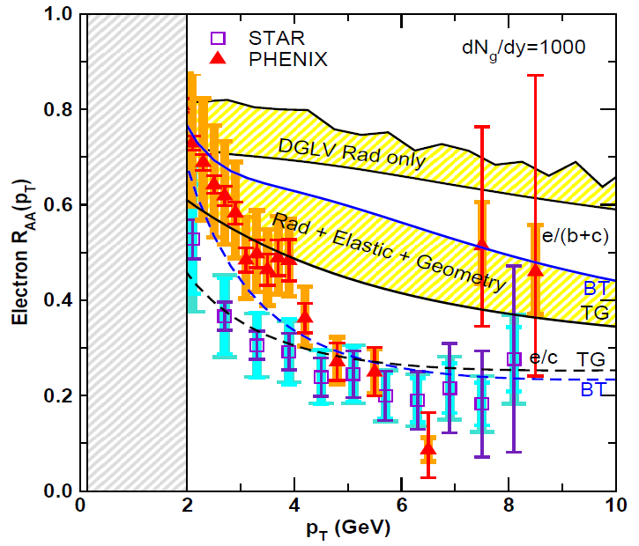
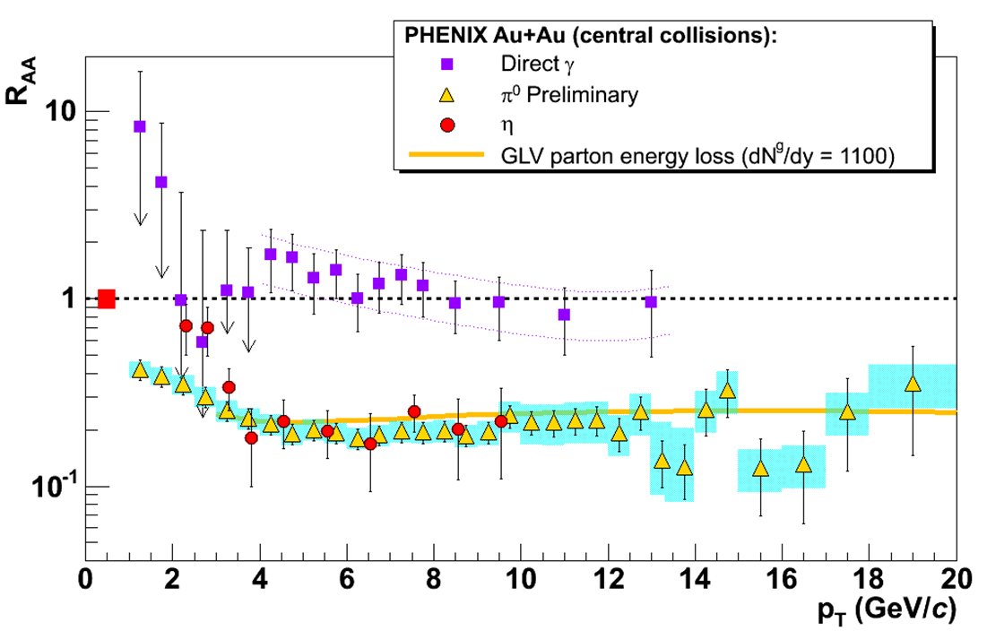
Confronting High-p_{T} Data
NPE
π⁰
Y. Akiba for the PHENIX collaboration, hep-ex/0510008
Wicks, WAH, Gyulassy, Djordjevic, NPA784 (2007)
WHDG
C. Vale, QM09 Plenary
(analysis by R. Wei)
PHENIX, Phys. Rev. Lett. 98, 172301 (2007)

Slide 3
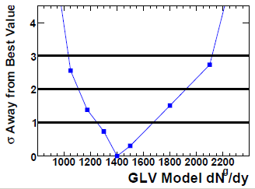
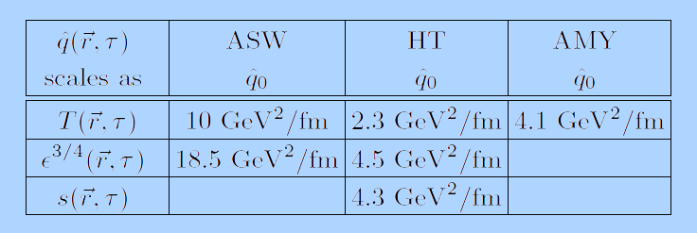
pQCD Quantification?
PHENIX, PRC77:064907,2008
Bass et al., Phys.Rev.C79:024901,2009

Slide 4
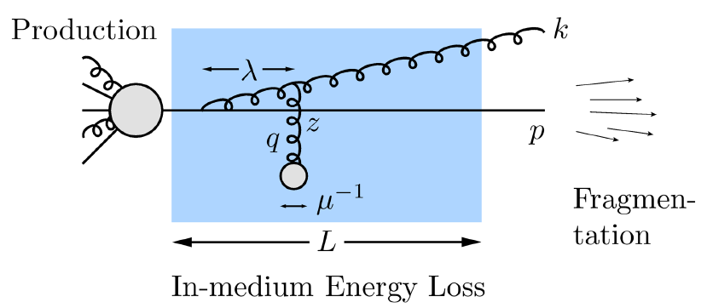
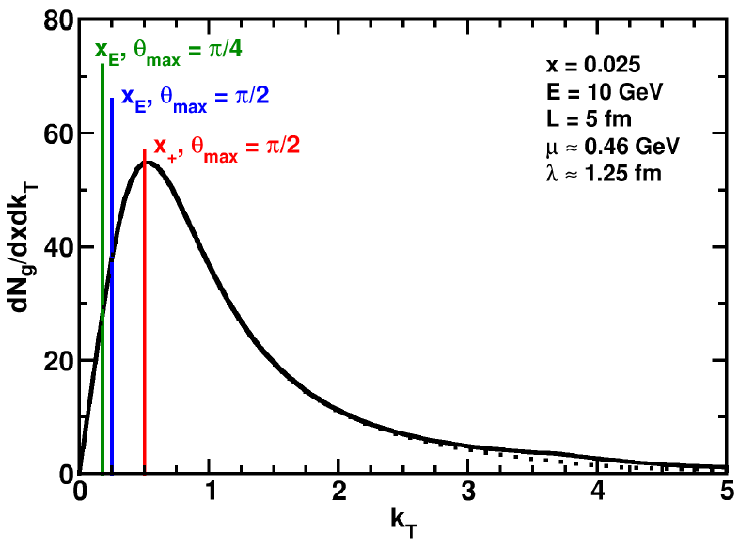
Collinear Approximation
Assume small angle emission
k_{T} << ω
2 defs. of x:
Affects ALL current pQCD models
Enforce via kinematic cutoffs
k_{T}
ω = k⁰
WAH and B Cole, 0910.1823

Slide 5
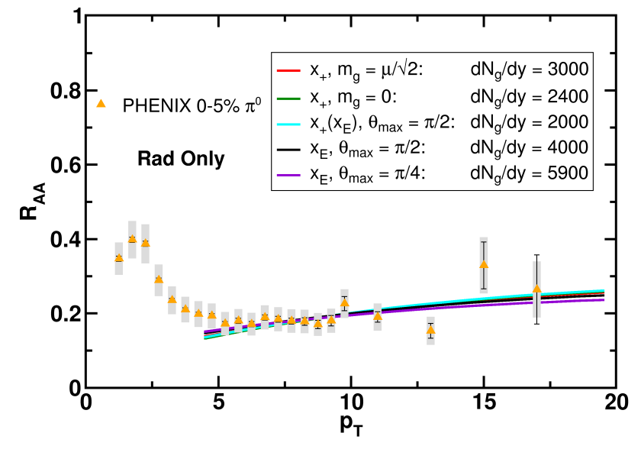
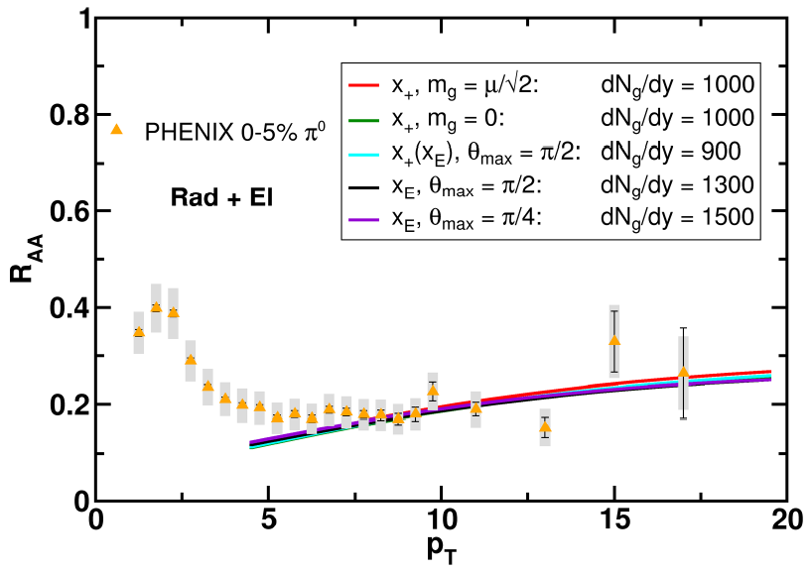
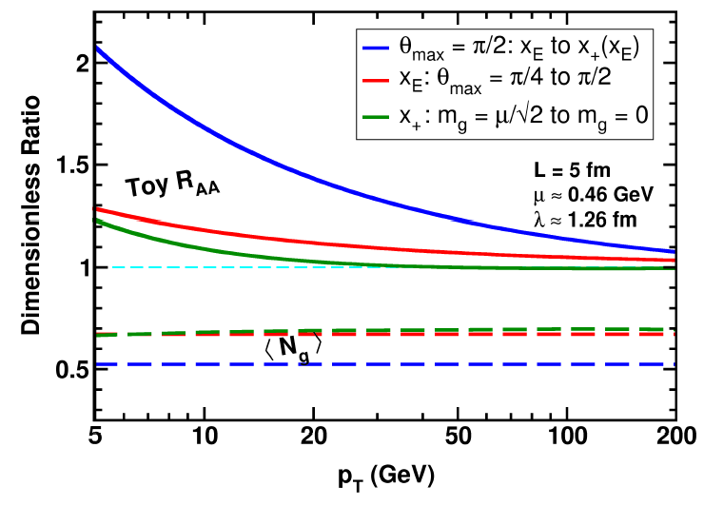
Huge Sensitivity
WAH and B Cole, 0910.1823

Slide 6
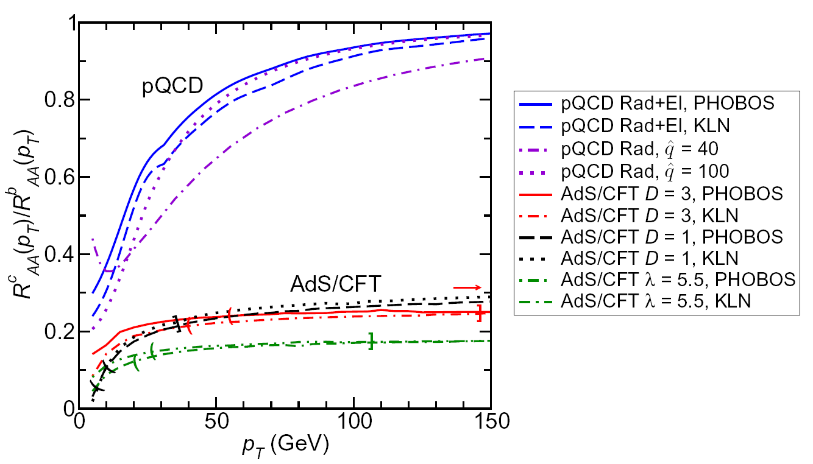
AdS/CFT and Heavy Quarks
J Friess, et al., PRD75:106003, 2007
WAH, PhD Thesis
WAH, M. Gyulassy, PLB666 (2008)

Slide 7
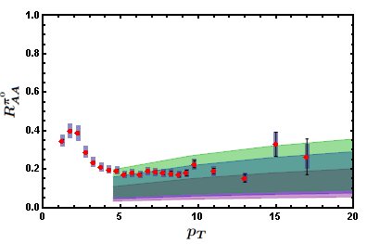
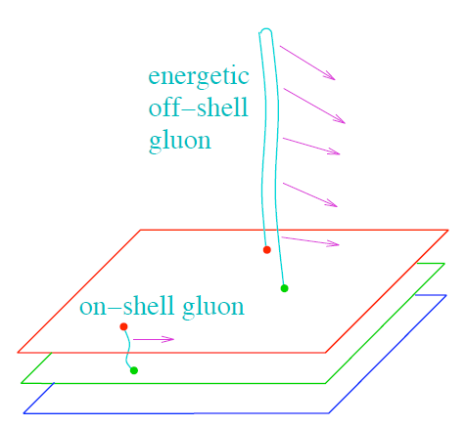
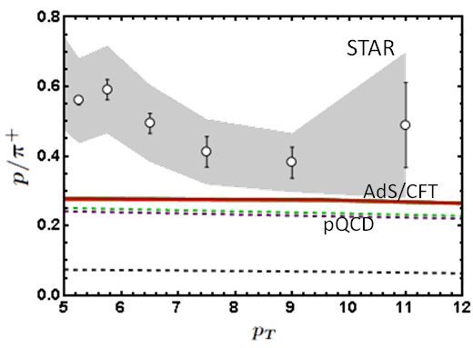
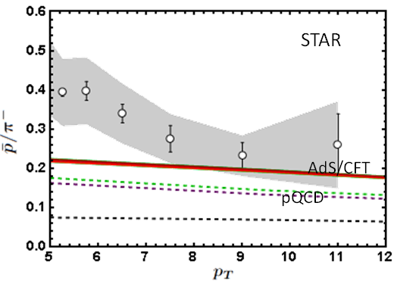
AdS/CFT
PHENIX 0-5% π⁰
S S Gubser, QM09
WAH, in preparation

