Slide 1
Heavy Ion Collisions with pQCD and AdS/CFT
W. A. Horowitz
The Ohio State University
November 24, 2009
With many thanks to Brian Cole, Miklos Gyulassy, Ulrich Heinz, and Yuri Kovchegov

Slide 2


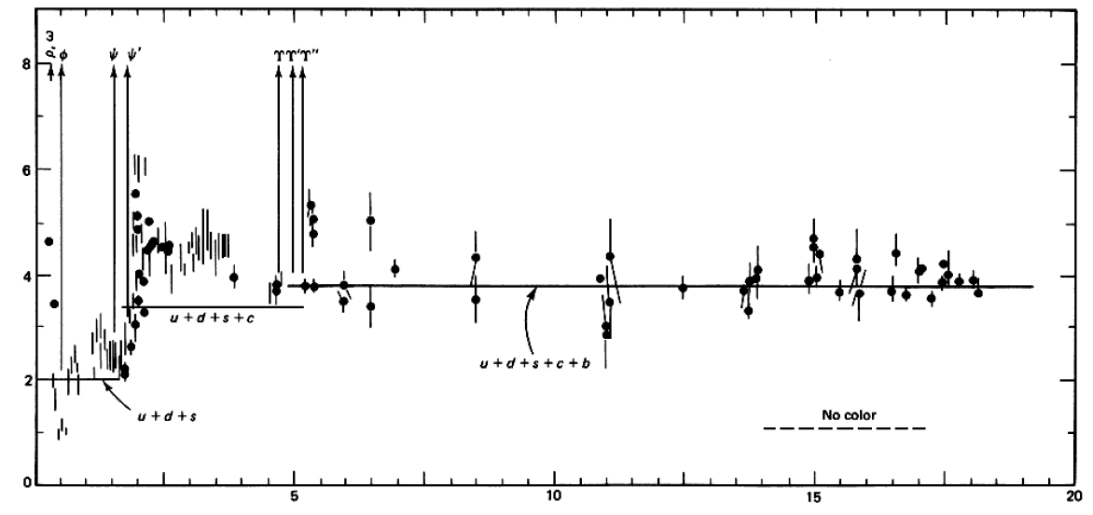

QCD: Theory of the Strong Force
    Running α_{s}
      -β-fcn
    SU(N_{c} = 3)
    N_{f}(E)
      N_{f}(RHIC) ≈ 2.5
PDG
ALEPH, PLB284, (1992)
Griffiths Particle Physics

Slide 3

Bulk QCD and Phase Diagram
Long Range Plan, 2008

Slide 4
Past, Present, and Future Questions
Bulk properties
  Deconfinement
  Thermalization, density
  EOS, η/s
  QGP DOF
Weakly vs. Strongly coupled plasma
  Γ = U/T: <<1 or >>1?
Weakly vs. Strongly coupled theories
  α_{s} ~ 0.3 << 1? λ = √(g_{YM}² N_{c}) ~ 3.5 >> 1?
New computational techniques
  AdS?
Notes:
Theoretical techniques up next!

Slide 5


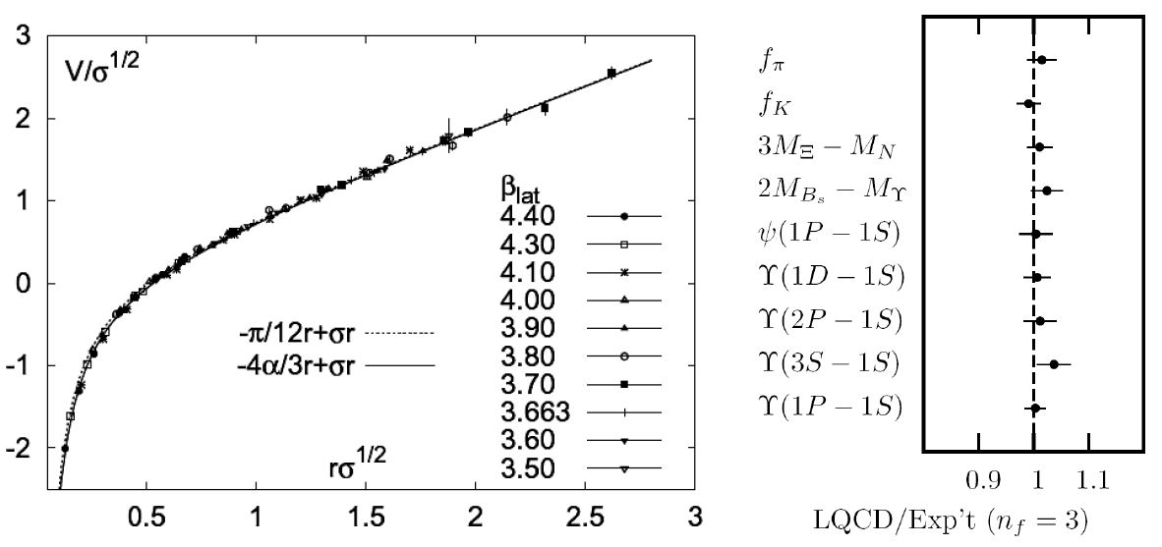
Methods of QCD Calculation I: Lattice
Long Range Plan, 2008
    All momenta
    Euclidean correlators
Kaczmarek and Zantow, PRD71 (2005)
Davies et al. (HPQCD), PRL92 (2004)

Slide 6


Methods of QCD Calculation II: pQCD
d’Enterria, 0902.2011
Jäger et al., PRD67 (2003)
    Any quantity
    Small coupling (large momenta only)

Slide 7




Methods of QCD Calculation III: AdS(?)
Maldacena conjecture: SYM in d ⬄ IIB in d+1
Gubser, QM09
    All quantities
    N_{c} → ∞
    SYM, not QCD: β = 0
      Probably not good approx. for p+p; maybe A+A?
Notes:
Next up, experiments!

Slide 8
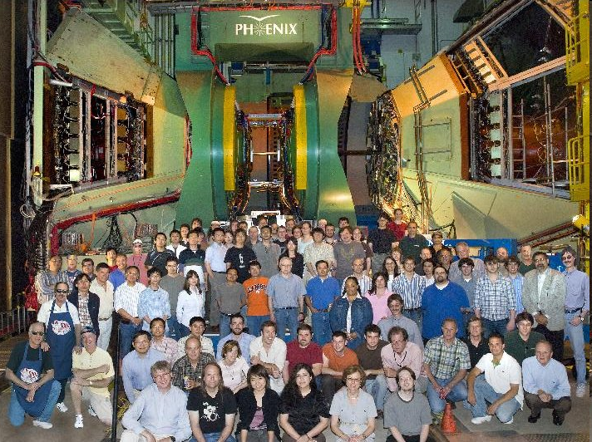
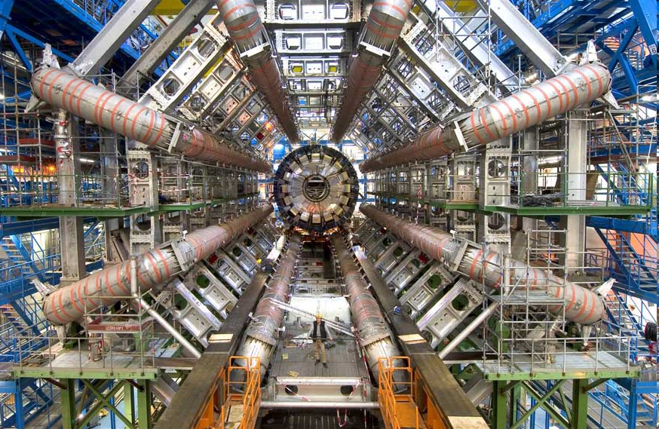
Present and Future QGP Experiments
RHIC
  BRAHMS
  PHENIX
  PHOBOS
  STAR
LHC
  ALICE
  ATLAS
  CMS
  LHCb
PHENIX
ATLAS

Slide 9
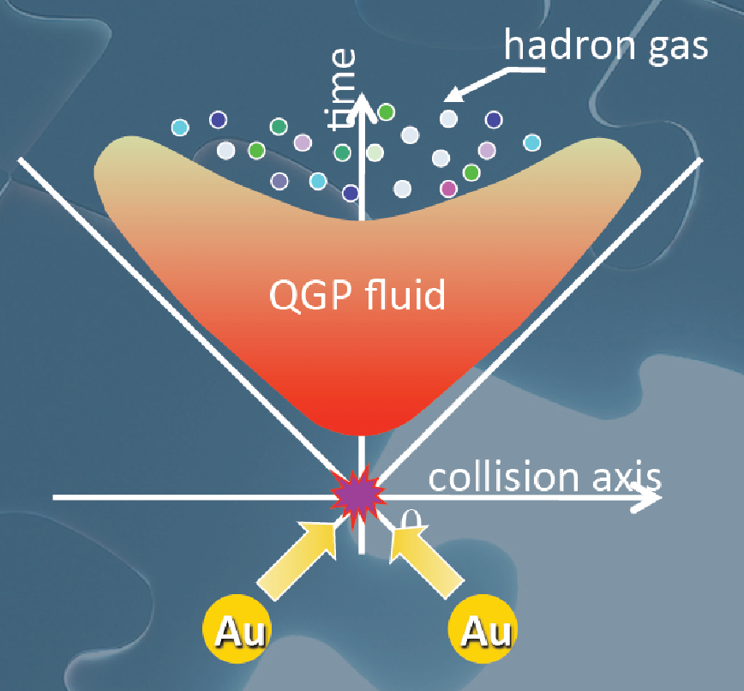
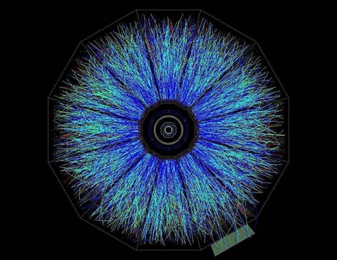
Evolution of a HI Collision
T Hirano, Colliding Nuclei from AMeV to ATeV
STAR

Slide 10

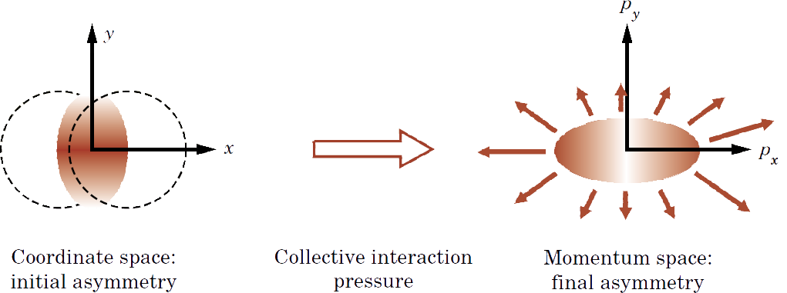
Geometry of a HI Collision
M Kaneta, Results from the
Relativistic Heavy Ion Collider (Part II)
T Ludlum and L McLerran, Phys. Today 56N10 (2003)
    Hydro propagates IC
      Results depend strongly on initial conditions
    Viscosity reduces momentum anisotropy

Slide 11
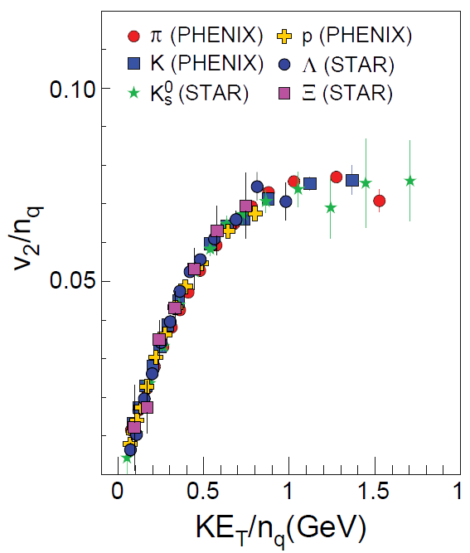
Low-p_{T} Measurements (I)
  Partonic DOF at hadronization!
LRP 2008

Slide 12
Low-p_{T} Measurements (II)
Viscosity: why the fuss?
  Naive pQCD => η/s ~ 1
  Naive AdS/CFT => η/s ~ 1/4π
Luzum and Romatschke, PRC78 (2008)
U Heinz, Quark Matter 2009

Slide 13

Why High-p_{T} Jets?
Tomography in medicine
One can learn a lot from a single probe…
and even more with multiple probes
SPECT-CT Scan uses internal γ photons and external X-rays
PET Scan
http://www.fas.org/irp/imint/docs/rst/Intro/Part2_26d.html

Slide 14

Tomography in QGP
Requires well-controlled theory of:
  production of rare, high-p_{T} probes
    g, u, d, s, c, b
  in-medium E-loss
  hadronization
Requires precision measurements of decay fragments
p_{T}
, γ, e⁻
φ
Invert attenuation pattern => measure medium properties

Slide 15


QGP Energy Loss
Learn about E-loss mechanism
  Most direct probe of DOF
pQCD Picture
AdS/CFT Picture

Slide 16
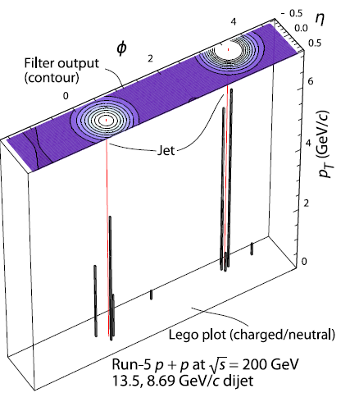
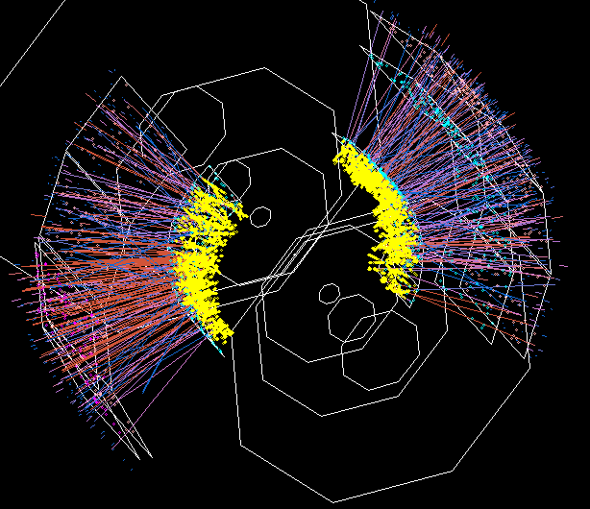
Jets in Heavy Ion Collisions
p+p
Au+Au
Y-S Lai, RHIC & AGS Users’ Meeting, 2009
PHENIX

Slide 17
High-p_{T} Observables
    Naively: if medium has no effect, then R_{AA} = 1
    Common variables used are transverse momentum, p_{T}, and angle with respect to the reaction plane, φ
p_{T}
, γ, e⁻
    Fourier expand R_{AA}:
φ

Slide 18
pQCD Rad Picture
Bremsstrahlung Radiation
  Weakly-coupled plasma
    Medium organizes into Debye-screened centers
  T ~ 250 MeV, g ~ 2
    μ ~ gT ~ 0.5 GeV
    λ_{mfp} ~ 1/g²T ~ 1 fm
    R_{Au} ~ 6 fm
  1/μ << λ_{mfp} << L
    mult. coh. em.
  LPM
    dp_{T}/dt ~ -LT³ log(p_{T}/M_{q})
  Bethe-Heitler
    dp_{T}/dt ~ -(T³/M_{q}²) p_{T}

Slide 19

pQCD Success at RHIC:
(circa 2005)
Y. Akiba for the PHENIX collaboration, hep-ex/0510008
  Consistency: R_{AA}(η)~R_{AA}(π)
  Null Control: R_{AA}(γ)~1
  GLV Prediction: Theory~Data for reasonable fixed L~5 fm and dN_{g}/dy~dN_{π}/dy

Slide 20

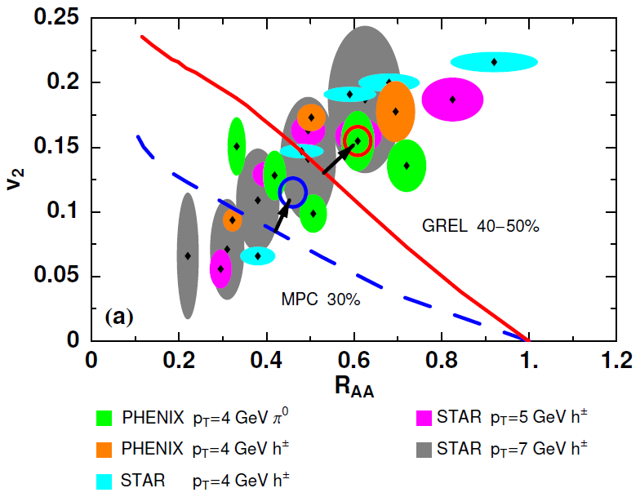
Trouble for Rad E-Loss Picture
v₂
e⁻
e⁻
WAH, Acta Phys.Hung.A27 (2006)
Djordjevic, Gyulassy, Vogt, and Wicks, PLB632 (2006)
Notes:
Anticorrelated; have e- come in later

Slide 21


What About Elastic Loss?
Appreciable!
Finite time effects small
Mustafa, PRC72 (2005)
Adil, Gyulassy, WAH, Wicks, PRC75 (2007)

Slide 22

Quantitative Disagreement Remains
  v₂ too small
  NPE supp. too large
π⁰ v₂
WHDG
NPE v₂
C. Vale, QM09 Plenary (analysis by R. Wei)
Wicks, WAH, Gyulassy, Djordjevic, NPA784 (2007)
Pert. at LHC energies?
PHENIX, Phys. Rev. Lett. 98, 172301 (2007)

Slide 23
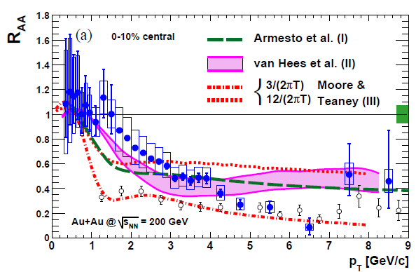
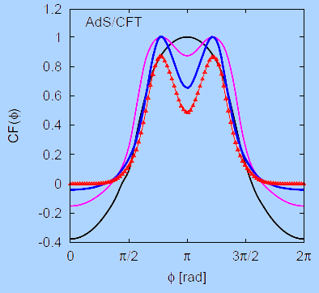
Strongly Coupled Qualitative Successes
AdS/CFT
Blaizot et al., JHEP0706
T. Hirano and M. Gyulassy, Nucl. Phys. A69:71-94 (2006)
PHENIX, PRL98, 172301 (2007)
Betz, Gyulassy, Noronha, Torrieri, PLB675 (2009)

Slide 24
Jets in AdS/CFT
Model heavy quark jet energy loss by embedding string in AdS space
  dp_{T}/dt = - μ p_{T}
  μ = πλ^{1/2} T²/2M_{q}
  Similar to Bethe-Heitler
    dp_{T}/dt ~ -(T³/M_{q}²) p_{T}
  Very different from LPM
    dp_{T}/dt ~ -LT³ log(p_{T}/M_{q})
J Friess, S Gubser, G Michalogiorgakis, S Pufu, Phys Rev D75 (2007)

Slide 25
Compared to Data
String drag: reasonable agreement
  Distinguishing measurement?
WAH, PhD Thesis

Slide 26


pQCD vs. AdS/CFT at LHC
Plethora of Predictions:
WAH, M. Gyulassy, PLB666 (2008)
      Taking the ratio cancels most normalization differences
      pQCD ratio asymptotically approaches 1, and more slowly so for increased quenching (until quenching saturates)
      AdS/CFT ratio is flat and many times smaller than pQCD at only moderate p_{T}
WAH, M. Gyulassy, PLB666 (2008)

Slide 27

Not So Fast!
  Speed limit estimate for applicability of AdS drag
    γ < γ_{crit} = (1 + 2M_{q}/λ^{1/2} T)²
    ~ 4M_{q}²/(λ T²)
      Limited by M_{charm} ~ 1.2 GeV
    Similar to BH LPM
      γ_{crit} ~ M_{q}/(λT)
  No Single T for QGP
    smallest γ_{crit} for largest T
    T = T(τ₀, x=y=0): “(”
    largest γ_{crit} for smallest T
    T = T_{c}: “]”
D7 Probe Brane
Q
Worldsheet boundary Spacelike if γ > γ_{crit}
x₅
Trailing
String
“Brachistochrone”
“z”
D3 Black Brane

Slide 28

LHC R^{c}_{AA}(p_{T})/R^{b}_{AA}(p_{T}) Prediction
(with speed limits)
WAH, M. Gyulassy, PLB666 (2008)
      T(τ₀): “(”, corrections likely small for smaller momenta
      T_{c}: “]”, corrections likely large for higher momenta

Slide 29

RHIC R^{cb} Ratio
pQCD
pQCD
AdS/CFT
AdS/CFT
WAH, M. Gyulassy, JPhysG35 (2008)
    Wider distribution of AdS/CFT curves due to large n: increased sensitivity to input parameters
    Advantage of RHIC: lower T => higher AdS speed limits

Slide 30
Universality and Applicability
How universal are th. HQ drag results?
  Examine different theories
  Investigate alternate geometries
Other AdS geometries
  Bjorken expanding hydro
  Shock metric
    Warm-up to Bj. hydro
    Can represent both hot and cold nuclear matter

Slide 31
New Geometries
Constant T Thermal Black Brane
Shock Geometries
P Chesler,
Quark Matter 2009
Nucleus as Shock
DIS
Embedded String in Shock
Before
After
Albacete, Kovchegov, Taliotis,
JHEP 0807, 074 (2008)
v_{shock}
z
Q
v_{shock}
z
Q
x
x
Bjorken-Expanding Medium
WAH and Kovchegov, PLB680 (2009)

Slide 32
Asymptotic Shock Results
Three t-ind. solutions (static gauge):
  X^{μ} = (t, x(z), 0,0, z)
  x(z) = x₀, x₀ ± μ ^{½} z³/3
    Constant solution unstable
    Time-reversed negative x solution unphysical
    Sim. to x ~ z³/3, z << 1, for const. T BH geom.
Q
z = 0
v_{shock}
x₀ − μ ^{½} z³/3
x₀ + μ ^{½} z³/3
x₀
x
z = ∞

Slide 33
HQ Momentum Loss
x(z) = μ ^{½} z³/3 =>
Relate μ to nuclear properties
  Use AdS dictionary
    Metric in Fefferman-Graham form: μ ~ T₋₋/N_{c}²
  N_{c}² gluons per nucleon in shock
  Λ is typical mom. scale; Λ⁻¹ typical dist. scale
    E-M in shock rest frame: T’₀₀ ~ N_{c}² Λ⁴

Slide 34

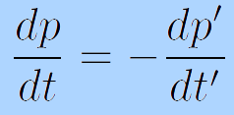
Frame Dragging
HQ Rest Frame
Shock Rest Frame
v_{sh}
M_{q}
Λ
v_{q} = -v_{sh}
M_{q}
1/Λ
i
v_{q} = 0
i
v_{sh} = 0
  Change coords, boost T_{μν} into HQ rest frame:
    T₋₋ ~ N_{c}² Λ⁴ γ² = N_{c}² Λ⁴ (p’/M)²
    p’ ~ γM: HQ mom. in rest frame of shock
  Boost mom. loss into shock rest frame (“lab” frame)
  π⁰_{t} = 0:

Slide 35
Putting It All Together
This leads to
We’ve generalized the BH solution to both cold and hot nuclear matter E-loss
  Recall for BH:
  Shock gives exactly the same drag as BH for Λ = π T

Slide 36
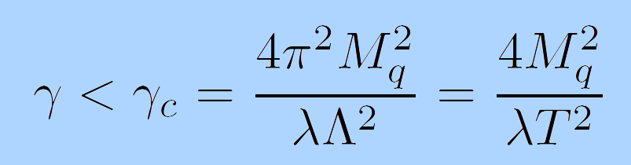
Shock Metric Speed Limit
Local speed of light (in HQ rest frame)
  Demand reality of point-particle action
Solve for v = 0 for finite mass HQ
  z = z_{M} = λ^{½}/2πM_{q}
  Same speed limit as for BH metric when Λ = πT

Slide 37

Quantitative, Falsifiable pQCD
Requires rigorous pQCD estimates, limits

Slide 38
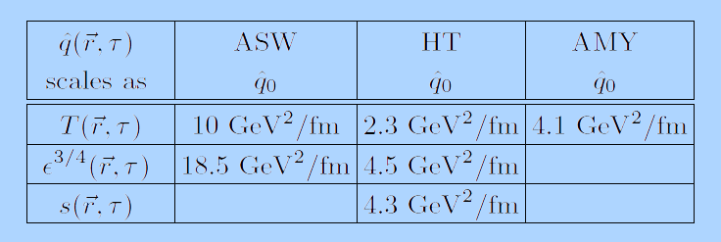
Multiple Models
WHDG, Nucl.Phys.A784:426-442,2007
Bass et al., Phys.Rev.C79:024901,2009
  Inconsistent medium properties
  Distinguish between models?
Bass et al.

Slide 39
Quantitative Parameter Extraction
Vary input param.
Find “best” value
Need for theoretical uncertainty
PHENIX, PRC77:064907,2008

Slide 40
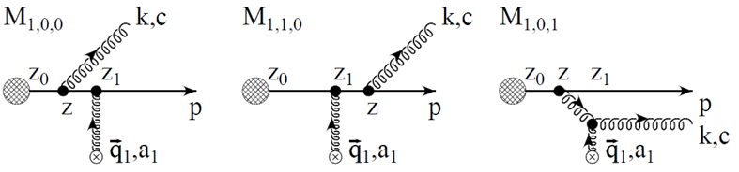
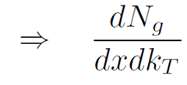
Mechanics of pQCD Rad Calculation
Derive single inclusive gluon emission
  Ambiguity in literature: x from light cone vs. Minkowski coords
    dN_{g}/dx₊dk_{T} related to dN_{g}/dx_{E}dk_{T} by Jacobian
Poisson convolution
  Approximate multiple gluon emission
  Single inclusive used as kernel
Gyulassy, Levai, and Vitev NPB594 (2001)

Slide 41
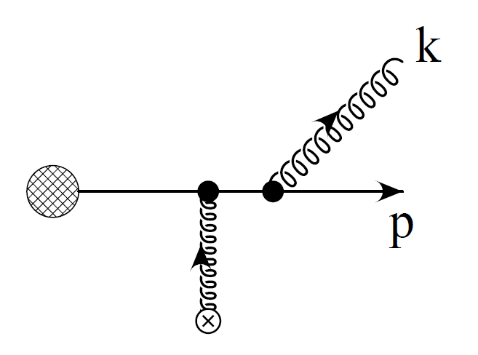
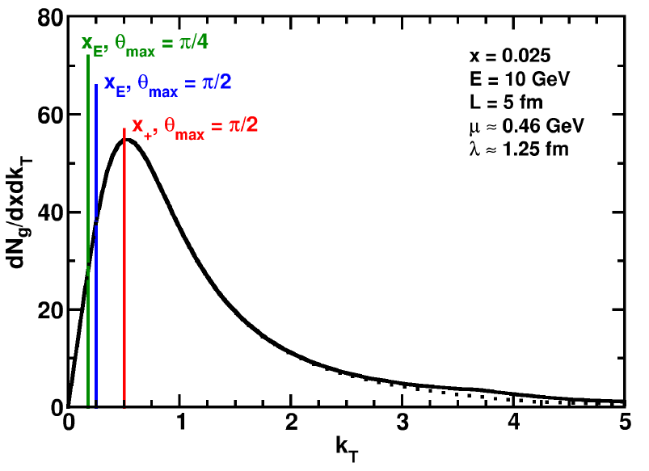
Collinear Approximation
Assume small angle emission
  k_{T} << ω = x_{E}E
    x₊ = x_{E} for k_{T} = 0
Affects ALL current pQCD models
Enforce via kinematic cutoffs
k_{T}
ω
WAH and B Cole, arXiv:0910.1823

Slide 42

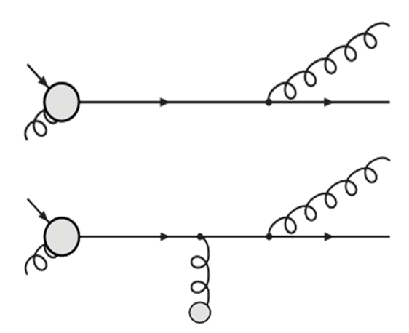
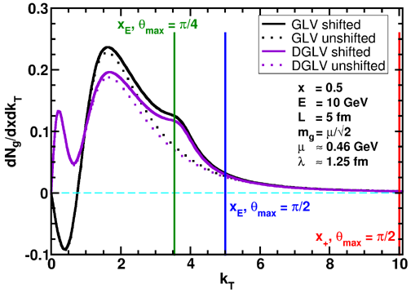
Collinearity and Gluon Mass
Larger x, smaller collinear effects
Thermal gluon mass alters coherence
m²
WAH and B Cole, arXiv:0910.1823

Slide 43
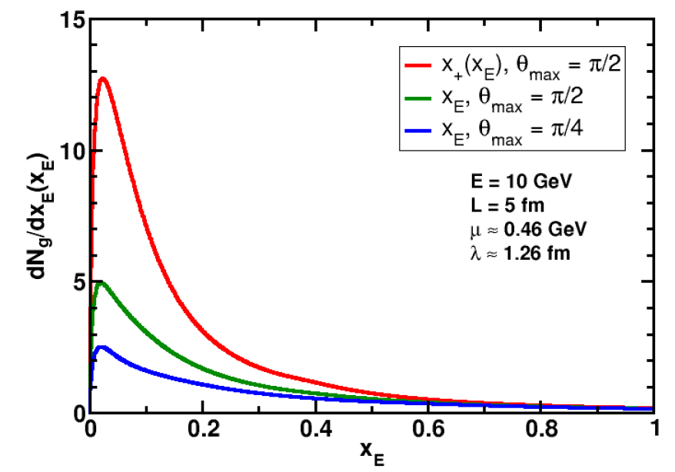
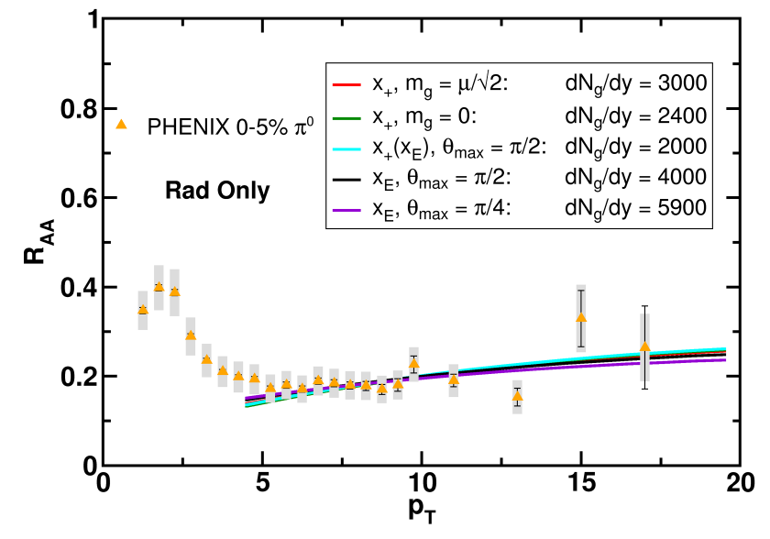
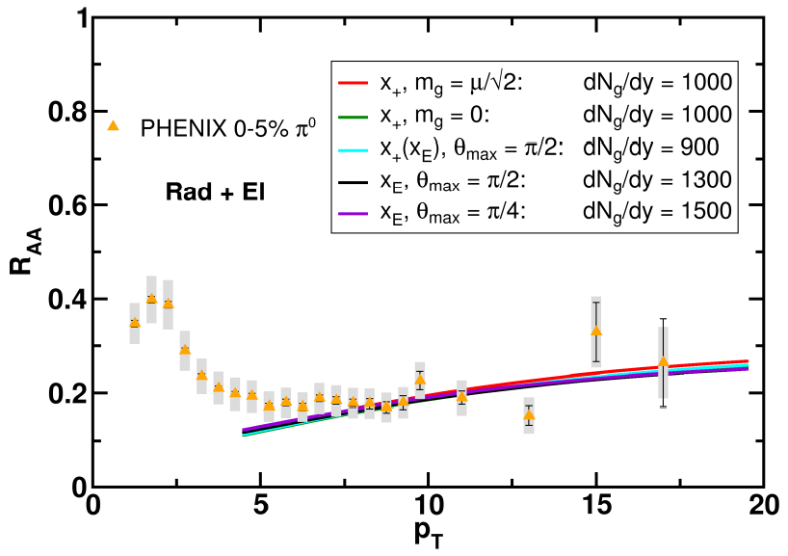
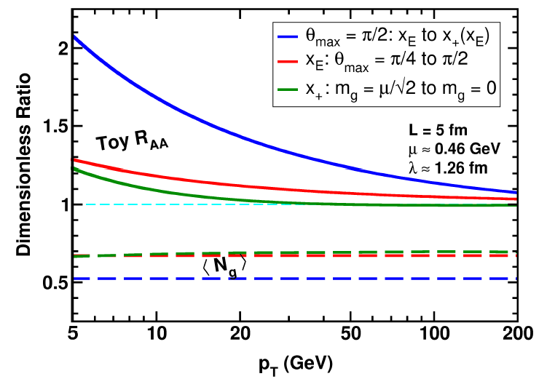
Huge Sensitivity
WAH and B Cole, arXiv:0910.1823

Slide 44
Conclusions I
QCD is a theory with rich structure
  Traditional techniques (Lattice, pQCD)
    Qualitatively successeful
  AdS/CFT exciting new tool
    Also qualitatively successful
Jet observables to disambiguate
  Examine mass, momentum dependence
    Charm and bottom R_{AA}
    Double ratio: R^{c}_{AA}/R^{b}_{AA}(p_{T})

Slide 45
Conclusions II
Generalize AdS/CFT HQ Drag
  Hot and cold nuclear matter
  Gain confidence in universality
Systematic theoretical uncertainty for pQCD
  Collinear approximation badly violated
    Some effects persist to LHC energies
      Single particle more interesting than full jet reconstruction?
    Extracted medium properties likely consistent w/i unc.
  Effects of running coupling not yet rigorously investigated

