Slide 1
Energy Loss in the Hot QCD Brick I
W. A. Horowitz
The Ohio State University
December 16, 2009
With many thanks to Brian Cole, Miklos Gyulassy, Yuri Kovchegov, and TECHQM Collab.

Slide 2
Outline
High-p_{T} motivation
Differences seen in parameters OK
Collinear approximation leads to large systematic theoretical uncertainty
Thermal gluon mass effects (surprisingly!) small
Conclusions

Slide 3
Why Study High-p_{T} Particles?
Tomography in Medicine
Learn about QGP medium
Measure suppression, use theory to invert
density profile and evolution
transport coefficients
SPECT-CT Scan uses internal γ photons and external X-rays

Slide 4
Acronyms, Acronyms
Four major pQCD formalisms for Rad E-loss
Opacity expansion: GLV (DGLV), ASW-SH
Multiple soft scattering: BDMPS (ASW-MS)
Higher Twist: HT
Thermal field theory: AMY

Slide 5
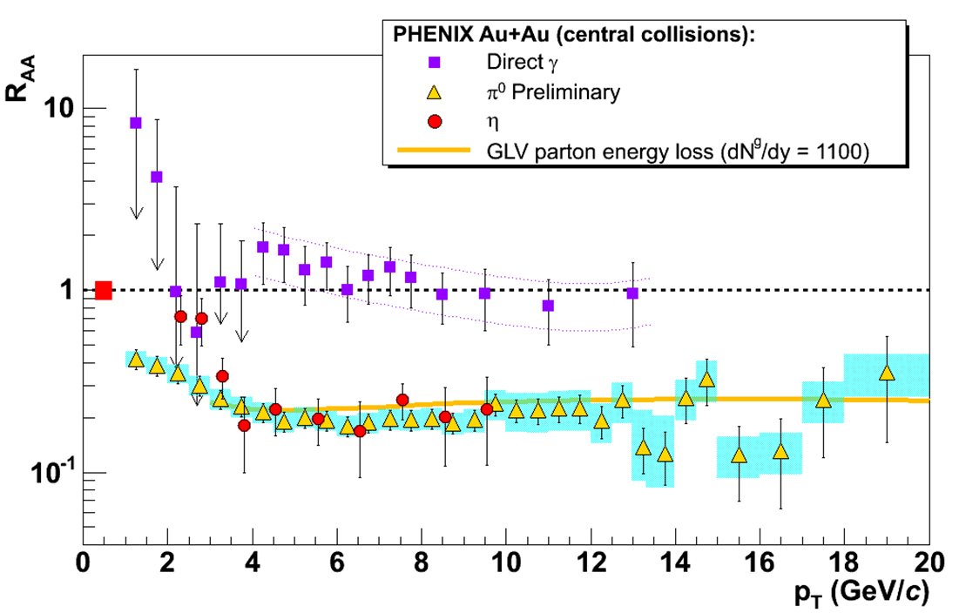
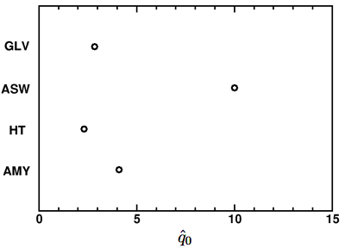
Different Formalisms, Different Results
Y. Akiba for the PHENIX collaboration, hep-ex/0510008
Bass et al., Phys.Rev.C79:
024901,2009

Slide 6
What to Do, What to Do?
Expectation of theorists: settle on single value of extracted parameter
Within pQCD: very diff. assumptions about the relevant physics
Shouldn’t expect a single density, qhat, etc. from different physics
Treat all theories as equal?
Ex: AdS/CFT
Need experimental observables to determine the relevant physics
Use suppression to learn about QCD, QGP
Brick problem: see Marta’s talk

Slide 7
Need for Theoretical Uncertainty
Want to rigorously:
falsify theories
quantify medium
Therefore need:
Precise observables
Precise theory
Distinguish between systematic uncertainties:
between formalisms
Due to diff. physics assumptions
within formalisms
Due to simplifying approximations
Focus specifically on opacity expansion
GLV; ASW-SH (never been compared with data)

Slide 8
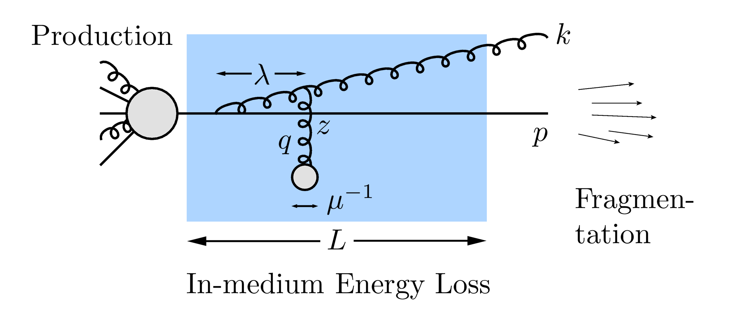
Energy Loss
R_{AA} ~ ∫(1-ϵ)^{n} P(ϵ) dϵ
E_{f} = (1-ϵ)E_{i}
Opacity expansions finds single inclusive gluon emission spectrum
dN_{g}/dxdk_{T}dq_{T}

Slide 9
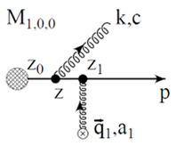
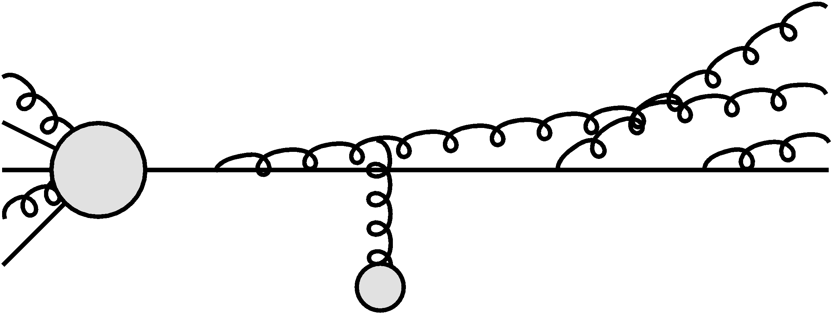
Poisson Convolution
Find P(ϵ) by convolving dN_{g}/dx
Approximates probabilistic multiple gluon emission
assume independent emissions
Gyulassy, Levai, and Vitev NPB594 (2001)

Slide 10
Opacity Expansion Calculation
Want to find dN_{g}/dx
Make approximations to simplify derivation
Small angle emission: k_{T} << xE
Note: ALL current formalisms use collinear approximation
Derived dN_{g}/dxdk_{T} violates collinear approx
Both IR and UV safe
Enforce small angle emission through UV cutoff in k_{T}

Slide 11
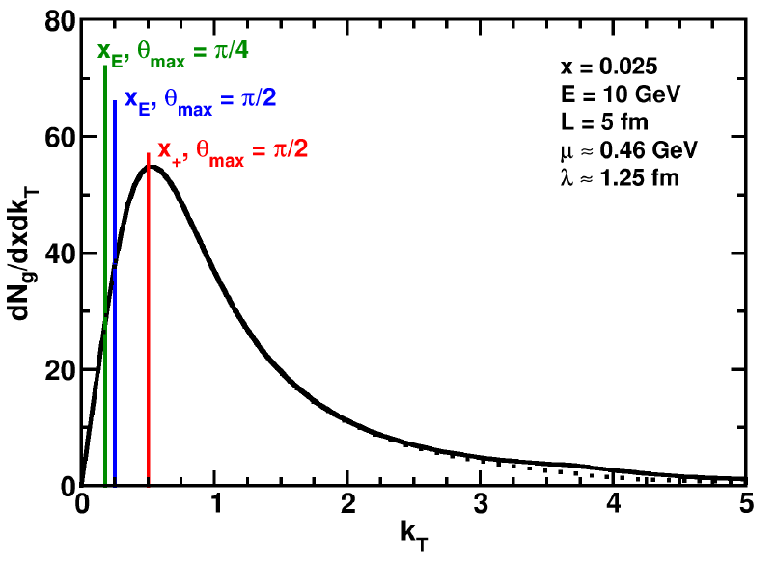
Uncertainty from Collinear Approx
Derived dN_{g}/dxdk_{T} maximally violates collinear approximation
dN_{g}/dx depends sensitively on k_{T} cutoff
Despite UV safety
For effect on extracted prop., must understand x
Discovered through TECHQM Brick Problem
WAH and B Cole, arXiv:0910.1823

Slide 12
ASW-SH Definition of x
ASW-SH: x_{E}
Minkowski coords
Always on-shell
P

Slide 13
GLV Definition of x
GLV: x₊
Light-cone coords
Always on-shell
P

Slide 14
Coordinate Transformations
Same in the limit k_{T}/xE → 0!
UV cutoff given by restricting maximum angle of emission
Previous comparisons with data took θ_{max}=π/2
Vary θ_{max} to estimate systematic theoretical uncertainty
θ
P

Slide 15
Jacobians
ϵ is fraction of longitudinal momentum
Need dN_{g}/dx_{E} to find P(ϵ)
A Jacobian is required for x = x₊ interpretation

Slide 16
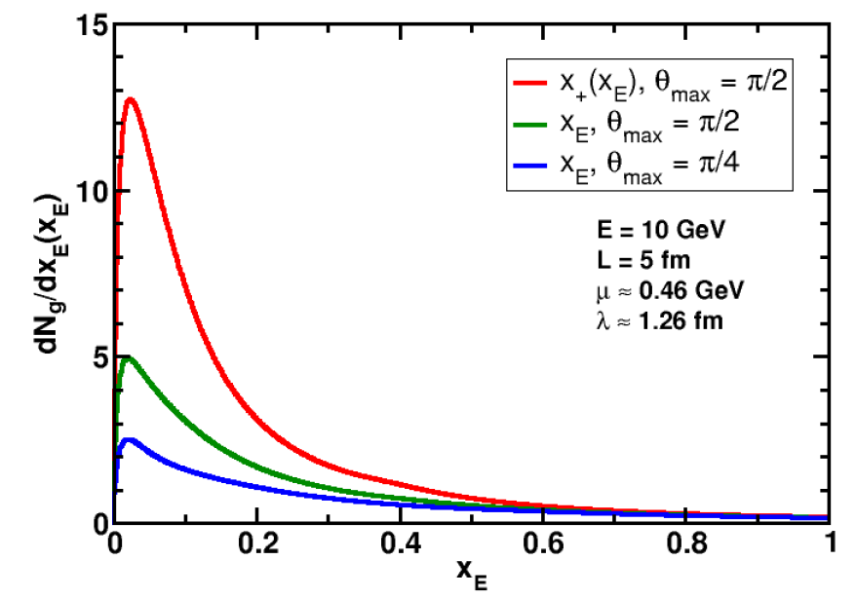
Rad. Gluon Kin. Sensitivities
UV
What about IR?
WAH and B Cole, arXiv:0910.1823

Slide 17
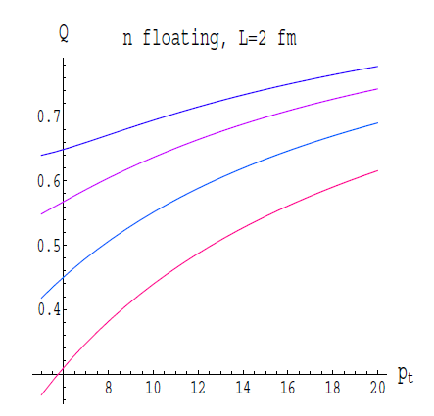
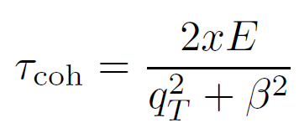
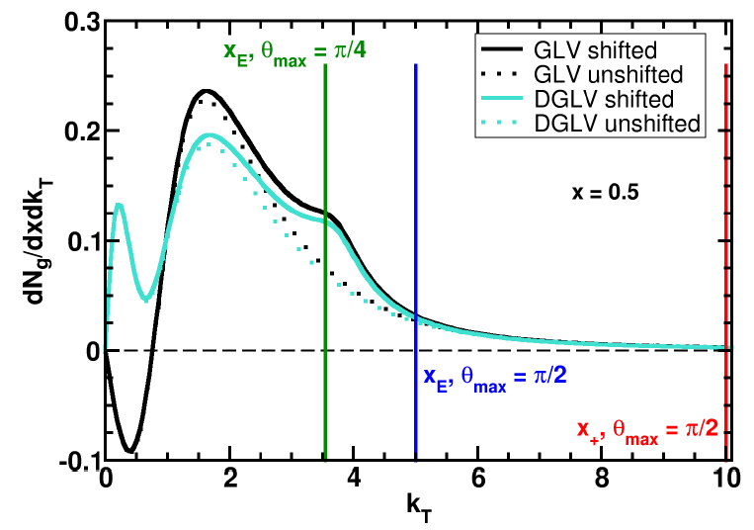
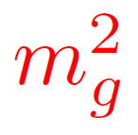
Collinearity and Gluon Mass
Massless gluons:
Large IR cutoff sensitivity
Gluons with thermal mass
BDMS, JHEP 0109 (2001)
Larger x better respects k_{T} << xE
WAH and B Cole, arXiv:0910.1823

Slide 18
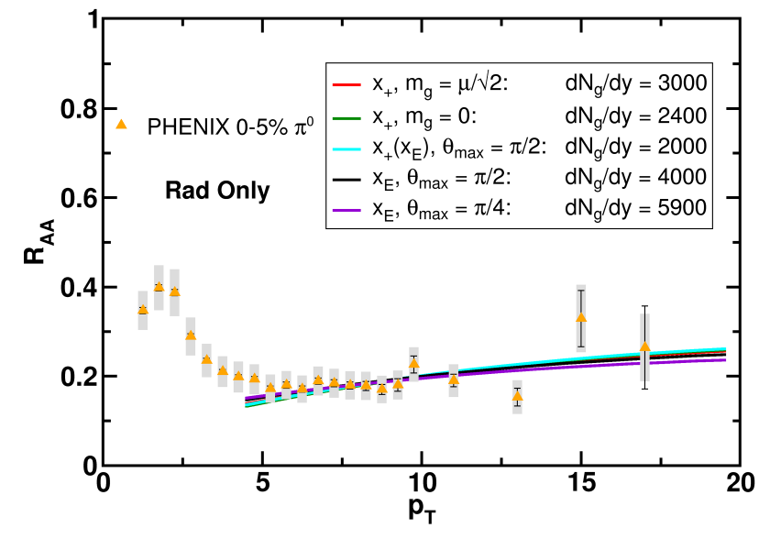
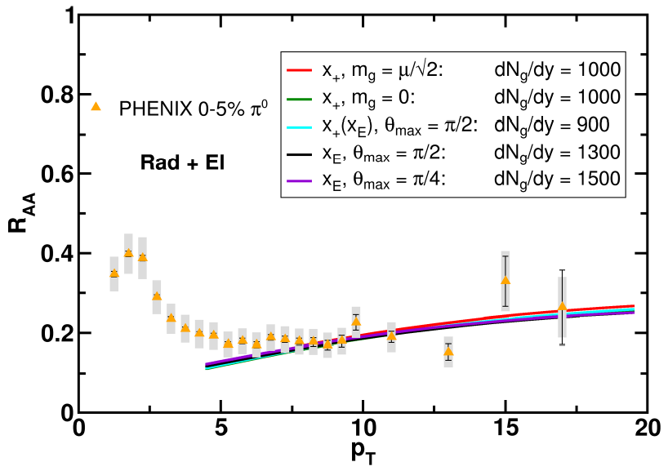
Results
Quantitatively compare to PHENIX data
Assumed infinite Elastic precision
WAH and B Cole, arXiv:0910.1823

Slide 19
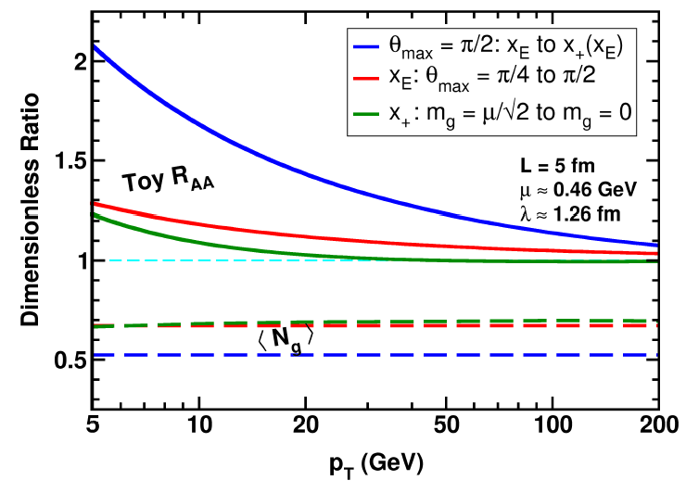
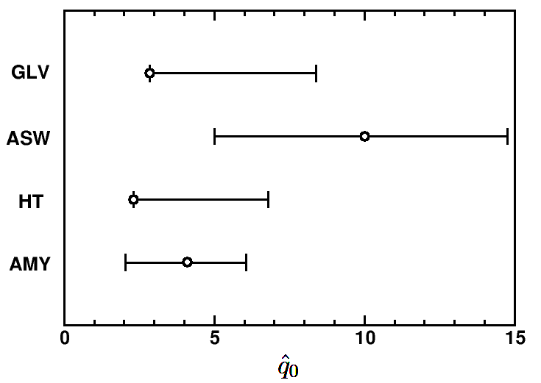
Parton Energy Dependence
Dependence on parton energy
Uncertainty on qhat
Assume all formalisms equally affected
WAH and B Cole, arXiv:0910.1823

Slide 20
Conclusions
Use different physics, expect different parameters
dN_{g}/dxdk_{T} drastically violates collinear approx.
Large angle radiation is important
Not under theoretical control
Leads to ~200% systematic theoretical uncertainty in extracted medium density at RHIC
Extracted parameters from pQCD formalisms likely consistent within uncertainty
Thermal gluon mass effects small
LHC
R_{AA} insensitive to collinear approx. at ultra-high-p_{T}
<N_{g}> uncertainty E-independent
Large cone jets not under theoretical control

