Slide 1
Uncertainties and Consistency (?) in pQCD and AdS/CFT Jet Physics
W. A. Horowitz
The Ohio State University
March 17, 2010
With many thanks to Brian Cole, Miklos Gyulassy, Ulrich Heinz, and Yuri Kovchegov

Slide 2
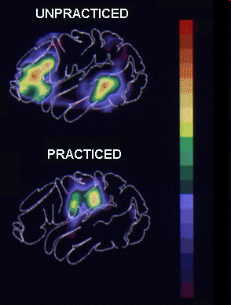
Why High-p_{T} Particles?
Tomography in medicine
One can learn a lot from a single probe…
and even more with multiple probes
SPECT-CT Scan uses internal γ photons and external X-rays
PET Scan
http://www.fas.org/irp/imint/docs/rst/Intro/Part2_26d.html

Slide 3
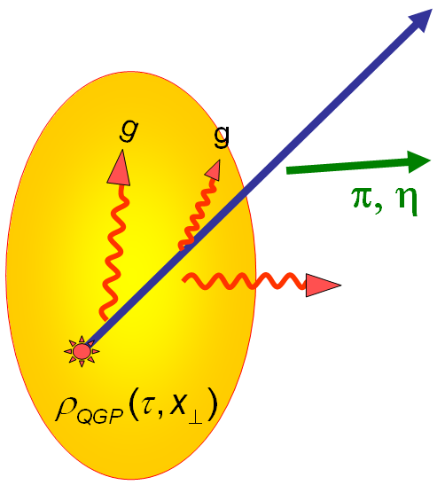
Tomography in QGP
Requires well-controlled theory of:
production of rare, high-p_{T} probes
g, u, d, s, c, b
in-medium E-loss
hadronization
Requires precision measurements of decay fragments
p_{T}
, γ, e⁻
φ
Invert attenuation pattern => measure medium properties

Slide 4
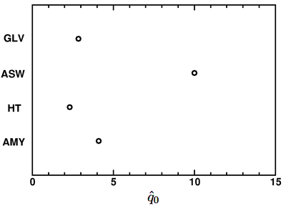
Different Formalisms, Different Results
Very diff. ideas about relevant physics
pQCD
AMY, BDMPS, GLV, HT
Is this a systematic th. unc.?
Bass et al., Phys.Rev.C79:
024901,2009
What about AdS/CFT?

Slide 5
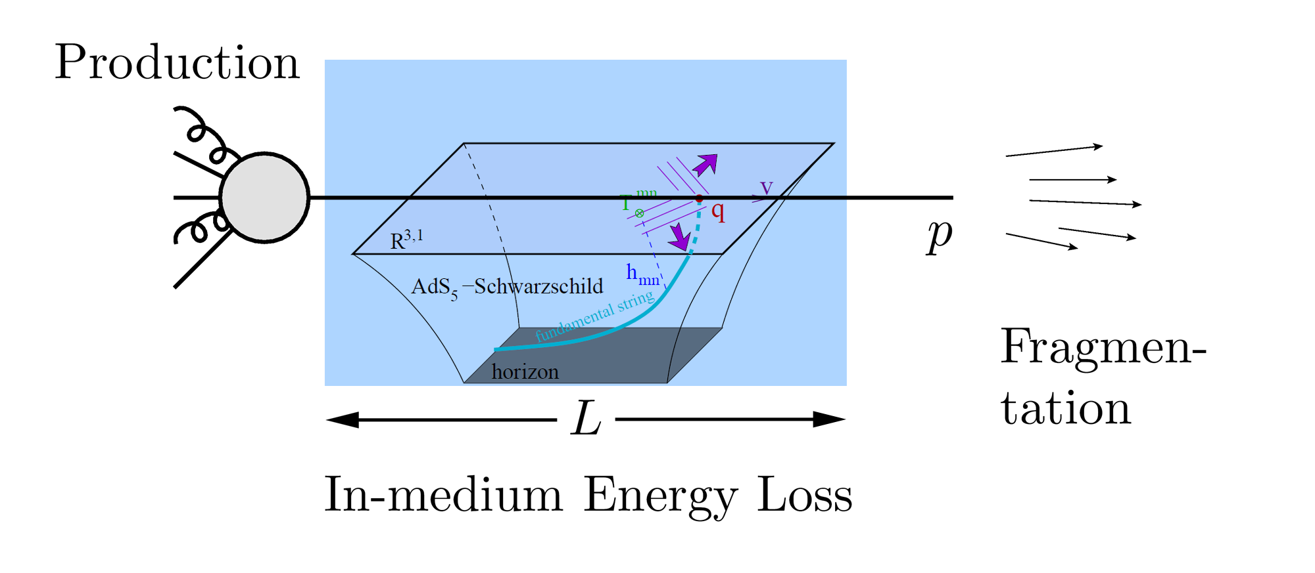
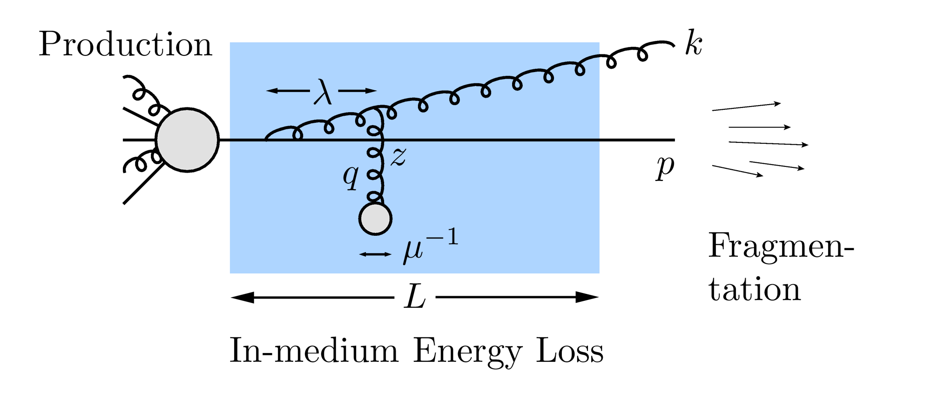
QGP Energy Loss
Learn about E-loss mechanism
Most direct probe of DOF
pQCD Picture
AdS/CFT Picture

Slide 6
Need for Theoretical Uncertainty
Want to rigorously:
falsify theories
quantify medium
Therefore need:
Precise observables
Precise theory
Distinguish between systematic uncertainties:
between formalisms
Due to diff. physics assumptions (AdS, pQCD: ASW, etc.)
within formalisms
Due to simplifying approximations
Focus specifically on opacity expansion
GLV; ASW-SH

Slide 7
Mechanics of Energy Loss
R_{AA} ~ ∫(1-ϵ)^{n} P(ϵ) dϵ
p_{f} = (1-ϵ)p_{i}
Opacity expansions finds single inclusive gluon emission spectrum
dN_{g}/dxdk_{T}dq_{T}

Slide 8
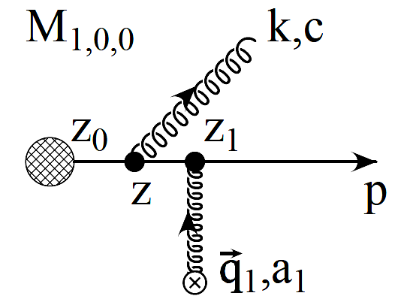
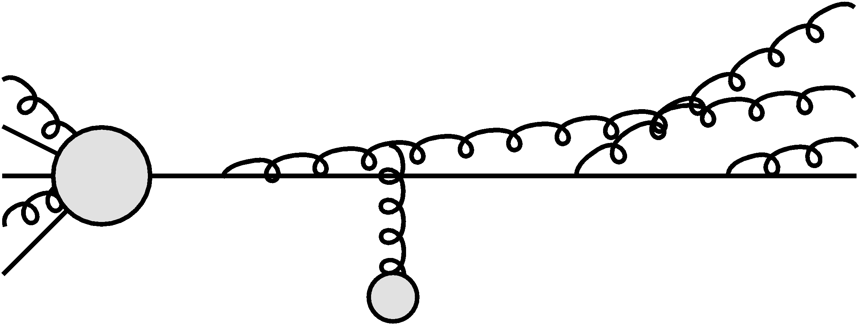
Poisson Convolution
Find P(ϵ) by convolving dN_{g}/dx
Approximates probabilistic multiple gluon emission, Sudakov
assume independent emissions
NB: ϵ is a momentum fraction
Gyulassy, Levai, and Vitev NPB594 (2001)

Slide 9
Opacity Expansion Calculation
Want to find dN_{g}/dx
Make approximations to simplify derivation
Small angle emission: k_{T} << xE
Note: ALL current formalisms use collinear approximation
Derived dN_{g}/dxdk_{T} violates collinear approx
Both IR and UV safe
Enforce small angle emission through UV cutoff in k_{T}

Slide 10
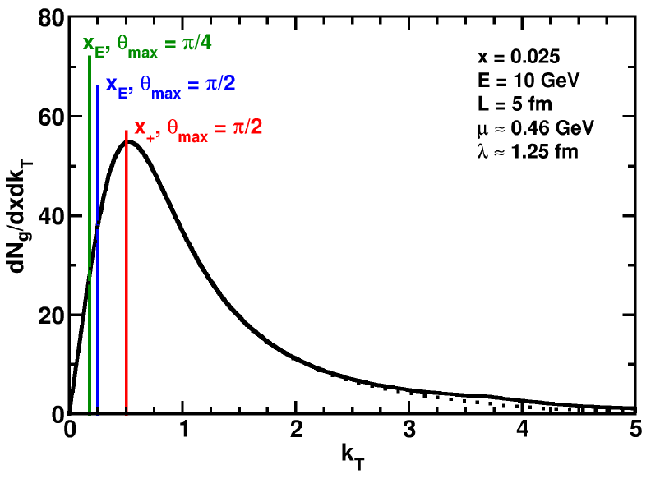
Uncertainty from Collinear Approx
Derived dN_{g}/dxdk_{T} maximally violates collinear approximation
dN_{g}/dx depends sensitively on k_{T} cutoff
Despite UV safety
For effect on extracted prop., must understand x
WAH and B Cole, PRC81, 2010

Slide 11
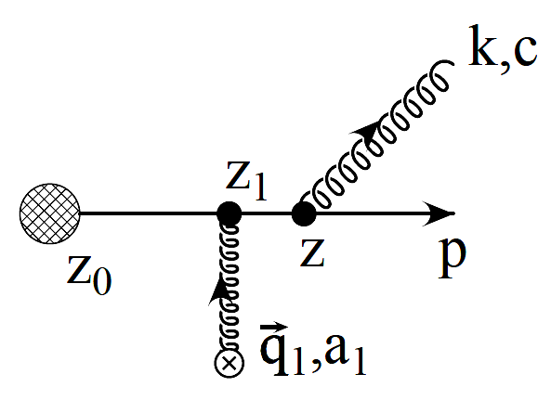
Two Standard x Definitions
ASW-SH: x_{E}
Energy fraction
GLV: x₊
Plus momentum fraction
P
NB: gluon always on-shell

Slide 12
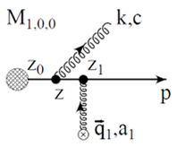
Coordinate Transformations
Same in the limit k_{T}/xE → 0!
UV cutoff given by restricting maximum angle of emission
Previous comparisons with data took θ_{max}=π/2
Vary θ_{max} to estimate systematic theoretical uncertainty
θ
P

Slide 13
Jacobians
ϵ is fraction of longitudinal momentum
Need dN_{g}/dx_{E} to find P(ϵ)
A Jacobian is required for x = x₊ interpretation

Slide 14
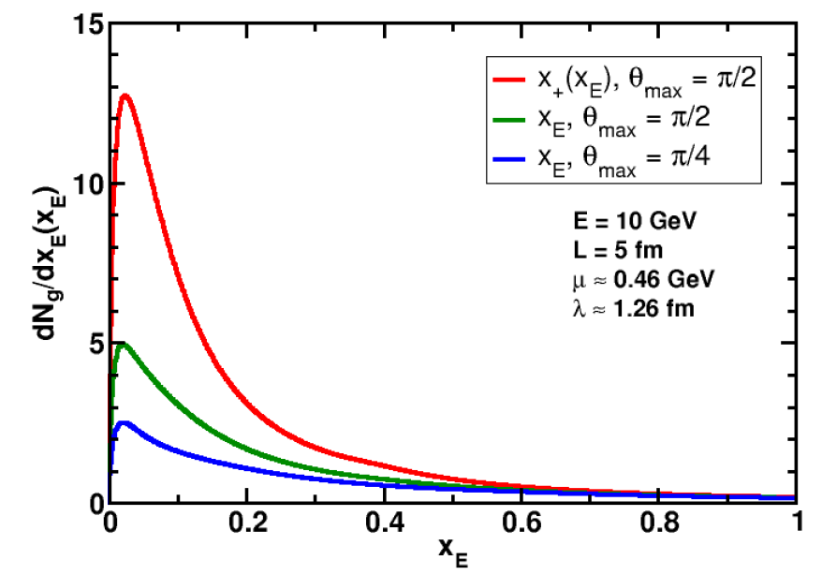
Rad. Gluon Kin. Sensitivities
UV
What about IR?
WAH and B Cole, PRC81, 2010

Slide 15
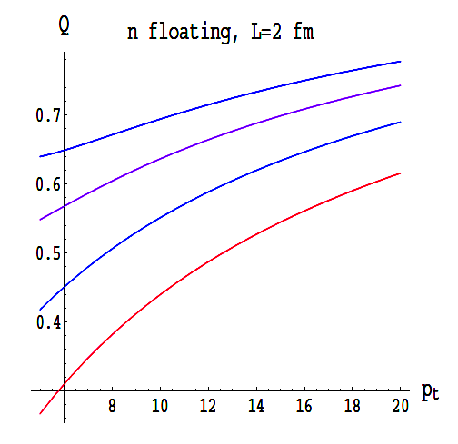
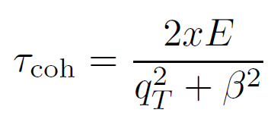
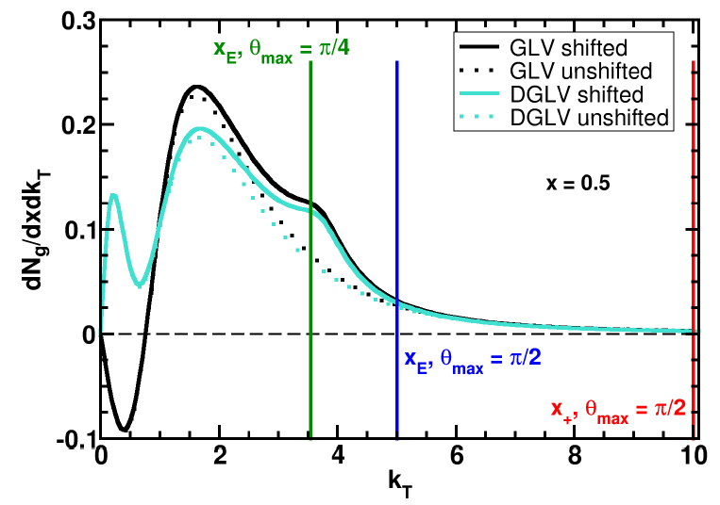
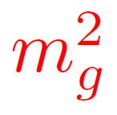
Collinearity and Gluon Mass
Massless gluons:
Large IR cutoff sensitivity
Gluons with thermal mass
BDMS, JHEP 0109 (2001)
~
Larger x better respects k_{T} << xE
WAH and B Cole, PRC81, 2010

Slide 16
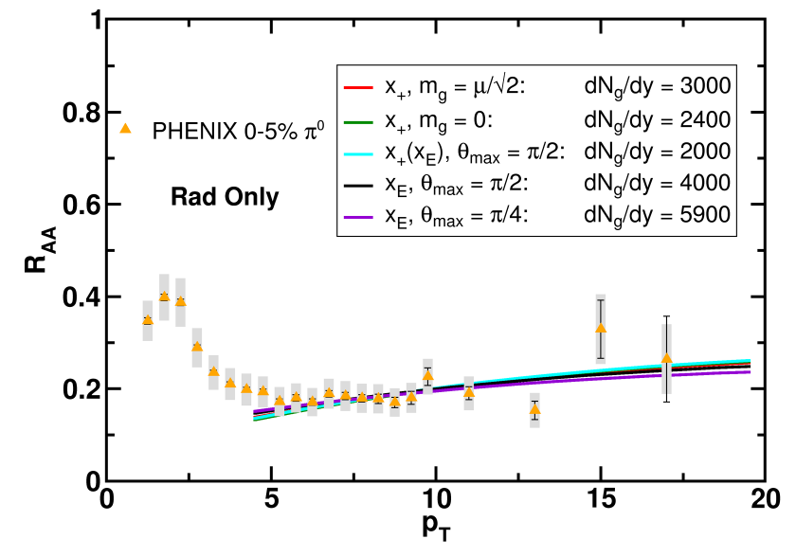
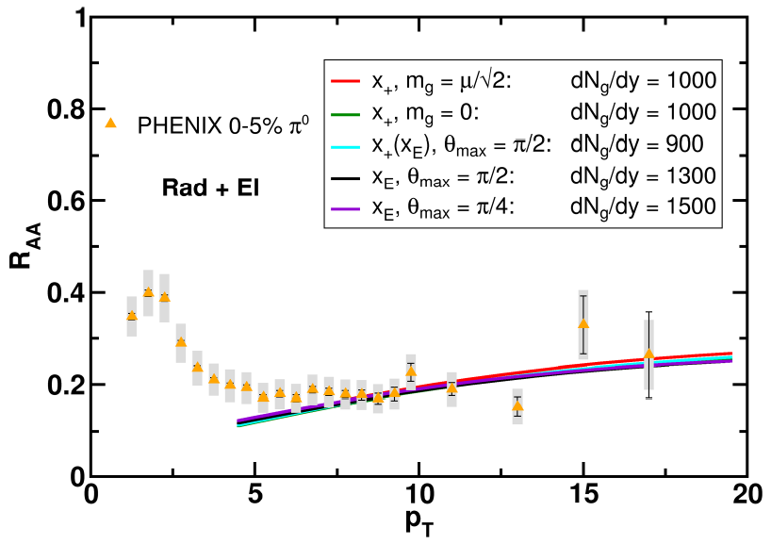
Results
Quantitatively compare to PHENIX data
Assumed infinite Elastic precision
WAH and B Cole, PRC81, 2010

Slide 17
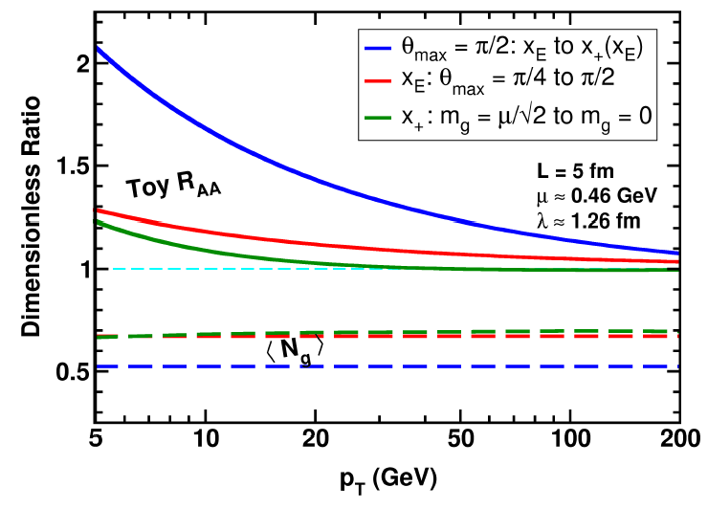
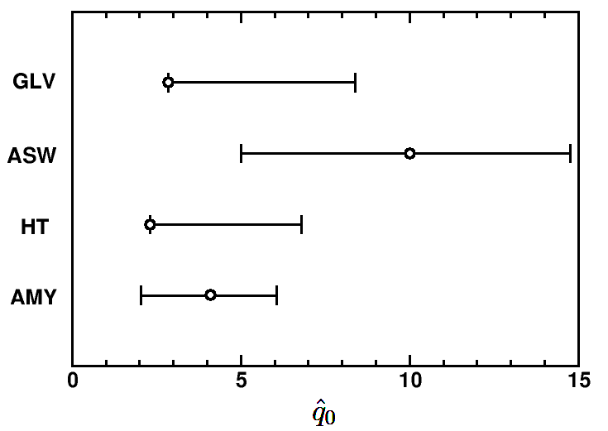
Parton Energy Dependence
Dependence on parton energy
Uncertainty on qhat
Assume all formalisms equally affected
WAH and B Cole, PRC81, 2010

Slide 18
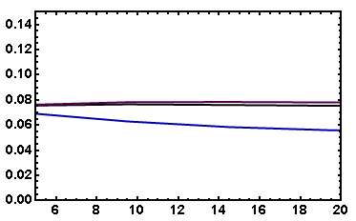
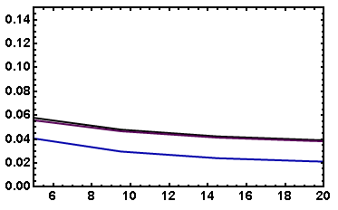
v₂ Variation
Fix dN_{g}/dy from R_{AA}, calculate v₂
Expect larger v₂ for smaller opening angle
Rad Only
Rad + El
20-30% π⁰
20-30% π⁰
v₂
v₂
p_{T}
p_{T}
WAH, in preparation

Slide 19
Heavy Quark Probes in AdS/CFT
Model heavy quark energy loss by embedding string in AdS space
dp_{T}/dt = - μ p_{T}
μ = πλ^{1/2} T²/2M_{q}
Similar to Bethe-Heitler
dp_{T}/dt ~ -(T³/M_{q}²) p_{T}
Very different from LPM
dp_{T}/dt ~ -LT³ log(p_{T}/M_{q})
J Friess, S Gubser, G Michalogiorgakis, S Pufu, Phys Rev D75 (2007)

Slide 20
Compared to Data
String drag: qualitative agreement
WAH, PhD Thesis

Slide 21
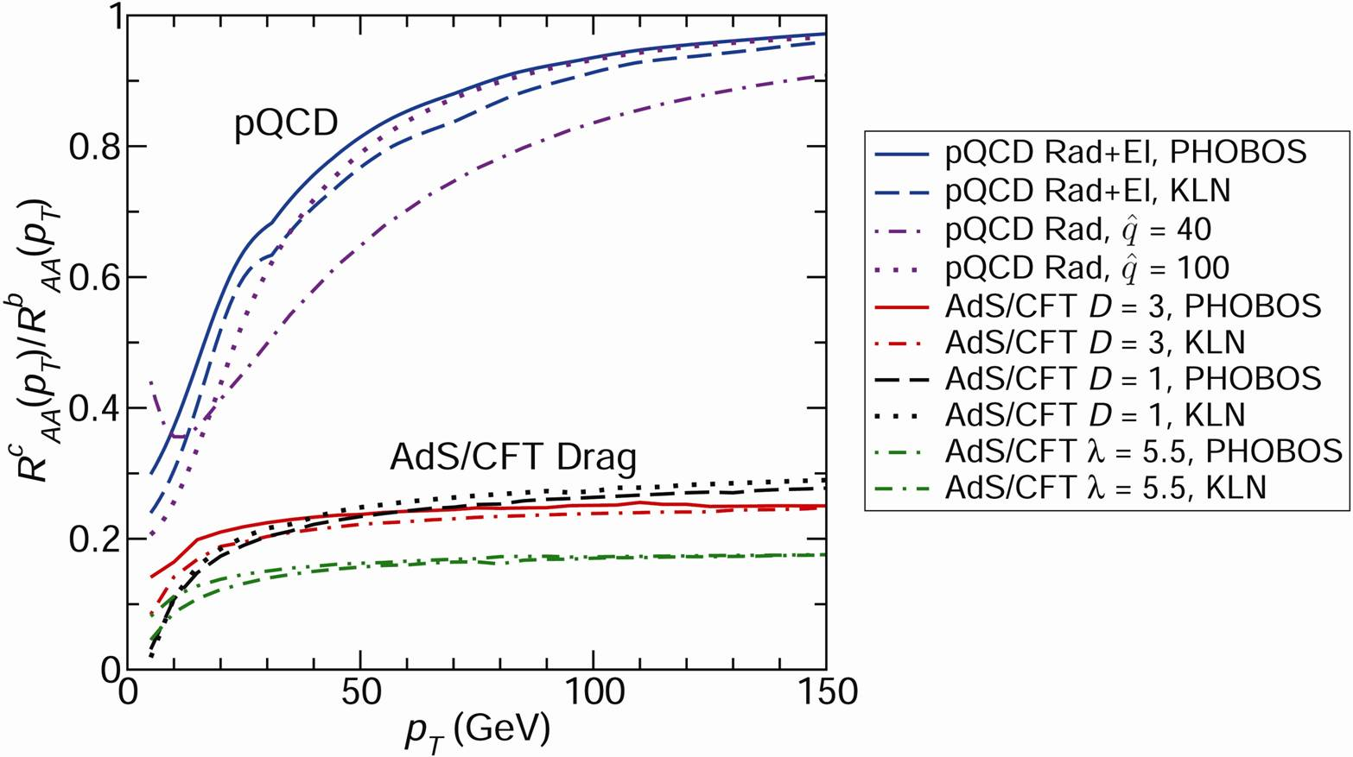
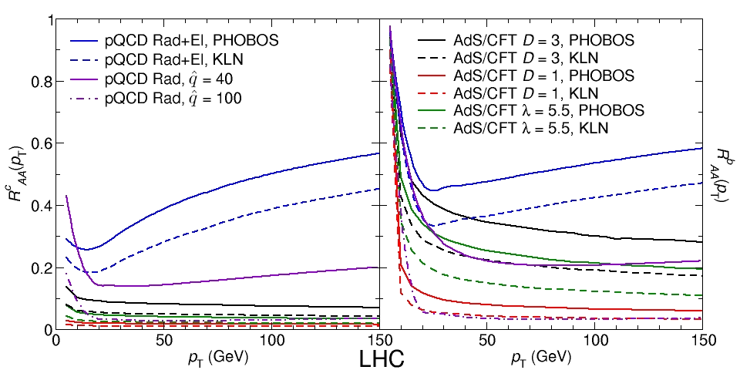
pQCD vs. AdS/CFT at LHC
Plethora of Predictions:
WAH, M. Gyulassy, PLB666 (2008)
Taking the ratio cancels most normalization differences
pQCD ratio asymptotically approaches 1, and more slowly so for increased quenching (until quenching saturates)
AdS/CFT ratio is flat and many times smaller than pQCD at only moderate p_{T}
WAH, M. Gyulassy, PLB666 (2008)

Slide 22
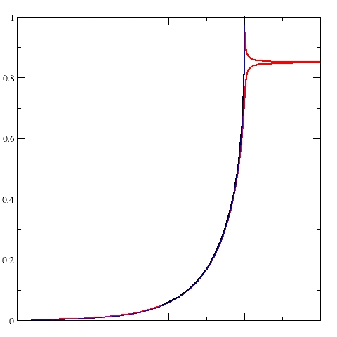
Not So Fast!
Speed limit estimate for applicability of AdS drag
γ < γ_{crit} = (1 + 2M_{q}/λ^{1/2} T)²
~ 4M_{q}²/(λ T²)
Limited by M_{charm} ~ 1.2 GeV
Similar to BH LPM
γ_{crit} ~ M_{q}/(λT)
No Single T for QGP
smallest γ_{crit} for largest T
T = T(τ₀, x=y=0): “(”
largest γ_{crit} for smallest T
T = T_{c}: “]”
D7 Probe Brane
Q
Worldsheet boundary Spacelike if γ > γ_{crit}
x₅
Trailing
String
“Brachistochrone”
“z”
D3 Black Brane

Slide 23
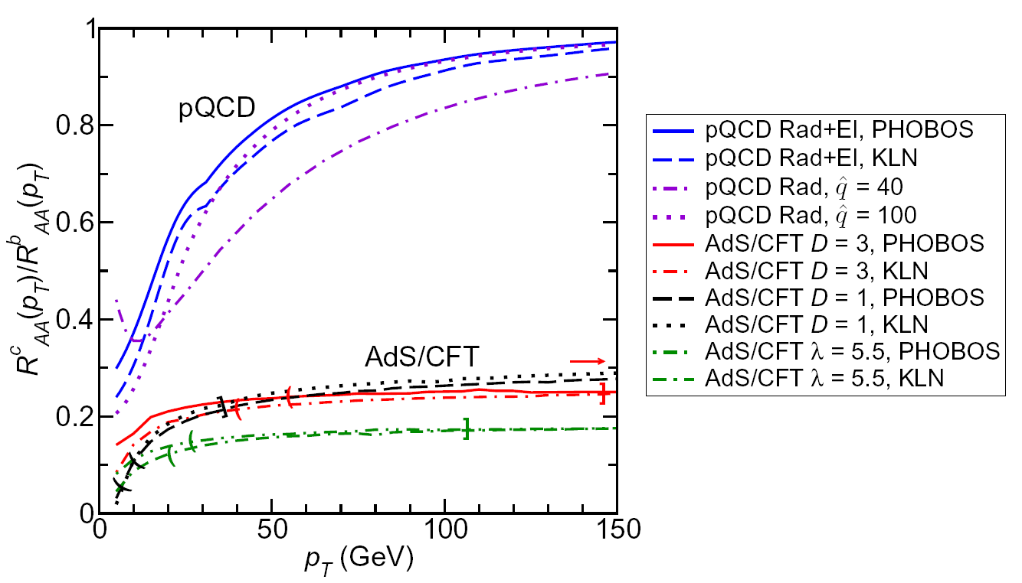
LHC R^{c}_{AA}(p_{T})/R^{b}_{AA}(p_{T}) Prediction (with speed limits)
WAH, M. Gyulassy, PLB666 (2008)
T(τ₀): “(”, corrections likely small for smaller momenta
T_{c}: “]”, corrections likely large for higher momenta

Slide 24
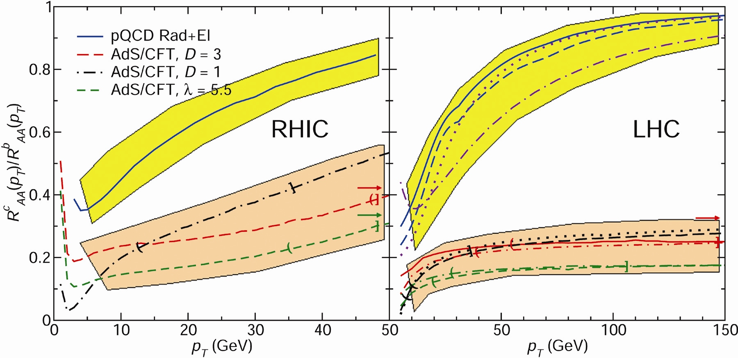
RHIC R^{cb} Ratio
pQCD
pQCD
AdS/CFT
AdS/CFT
WAH, M. Gyulassy, JPhysG35 (2008)
Wider distribution of AdS/CFT curves due to large n: increased sensitivity to input parameters
Advantage of RHIC: lower T => higher AdS speed limits

Slide 25
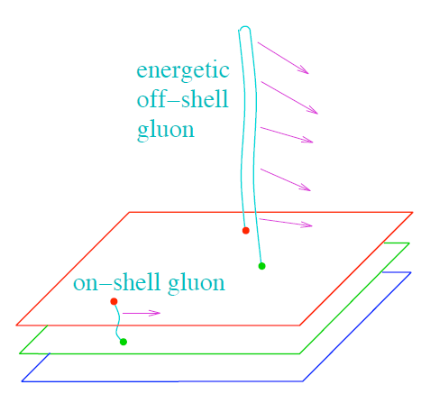
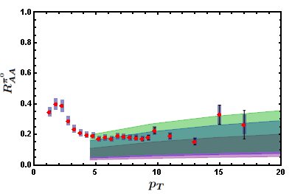
Light Quark and Gluon E-Loss
WAH, in preparation
ΔL^{q}_{therm} ~ E^{1/3}
ΔL^{q}_{therm} ~ (2E)^{1/3}

Slide 26
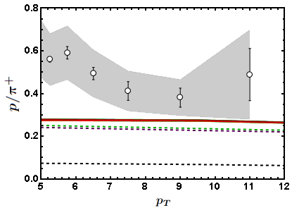
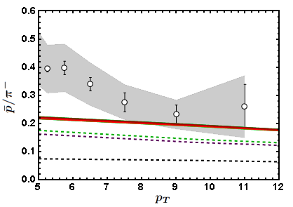
Baryon to Meson Ratios
AdS/CFT
AdS/CFT
pQCD
pQCD
WAH, in preparation

Slide 27
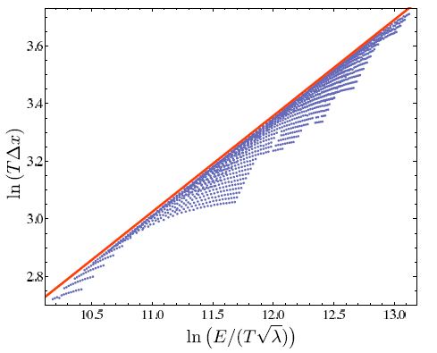
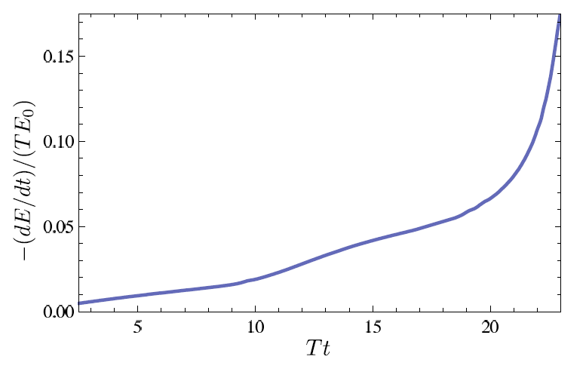
Quantitative g, q from AdS?
Highly sensitive to IC
Chesler et al., Phys.Rev.D79:125015,2009

Slide 28
Conclusions
Quantitative comparisons with rigorous theoretical uncertainty estimates needed for falsification/verification
Consistency within current uncertainty estimates
Theoretical work needed in both in pQCD and AdS
In AdS, control of jet IC, large p_{T} required
In pQCD, wide angle radiation very important, not under theoretical control
Better estimation of phase space
Running α_{s}

