Slide 1
Heavy Ion Physics at RHIC and LHC
W. A. Horowitz
The Ohio State University
July 16, 2010
With many thanks to Brian Cole, Miklos Gyulassy,
Ulrich Heinz, Jiangyong Jia, and Yuri Kovchegov

Slide 2


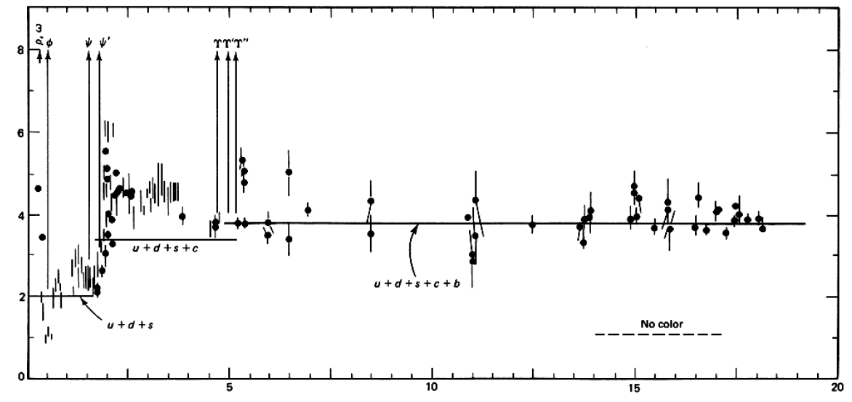

QCD: Theory of the Strong Force
    Running α_{s}
      -β-fcn
    SU(N_{c} = 3)
    N_{f}(E)
      N_{f}(RHIC) ≈ 2.5
PDG
ALEPH, PLB284, (1992)
Griffiths Particle Physics

Slide 3

What are We Interested In?
Measure many-body physics of strong force
Test & understand theory of many-body non-Abelian fields
Long Range Plan, 2008
Notes:
Unique as compared to strongly coupled Abelian problems

Slide 4
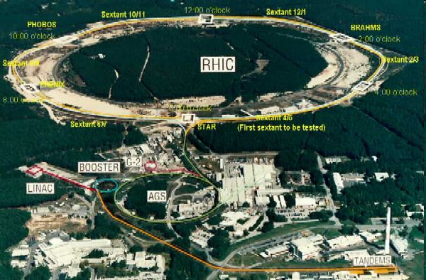
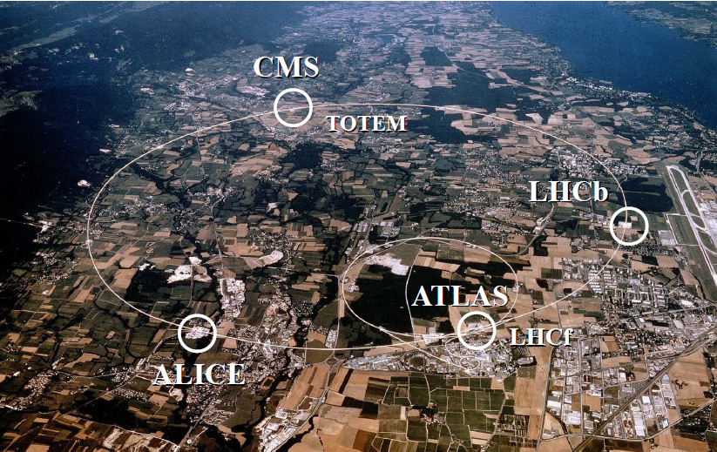
HI Collisions Tool for Strong Force Physics Study
Want a consistent picture of matter produced in HI collisions
  Then, want to quantify the properties of the produced matter

Slide 5
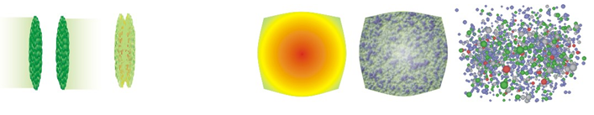
Spacetime Evolution of a HI Collision
At RHIC
  Nontrivial to learn about QGP through HIC
t = - ∞
t = 0
t = 1 fm/c
t = 3 fm/c
t = 4 fm/c
t = + ∞
Initial State
Initial Overlap
Thermalization
QGP
Hadronization
Hadron Gas

Slide 6


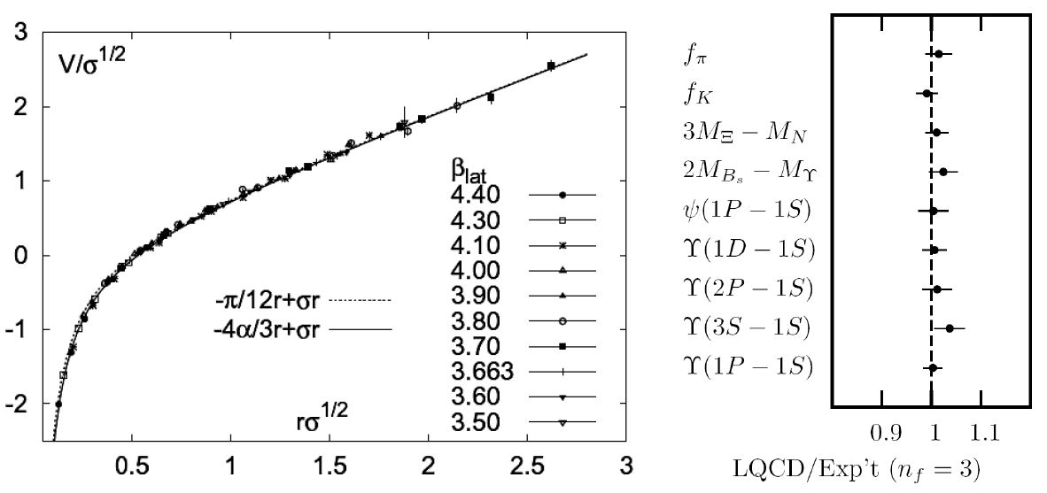
Methods of QCD Calculation I: Lattice
Long Range Plan, 2008
    All momenta
    Euclidean correlators
Kaczmarek and Zantow, PRD71 (2005)
Davies et al. (HPQCD), PRL92 (2004)

Slide 7


Methods of QCD Calculation II: pQCD
(perturbative QCD)
d’Enterria, 0902.2011
Jäger et al., PRD67 (2003)
    Any quantity
    Small coupling (large momenta only)

Slide 8




Methods III: AdS/CFT
Maldacena conjecture: SYM in d ⬄ IIB in d+1
Gubser, QM09
    All quantities
    N_{c} → ∞ SYM, not QCD
      Probably not good approx. for p+p; maybe A+A?
    Applicable to condensed matter systems?
Notes:
Next up, experiments!

Slide 9

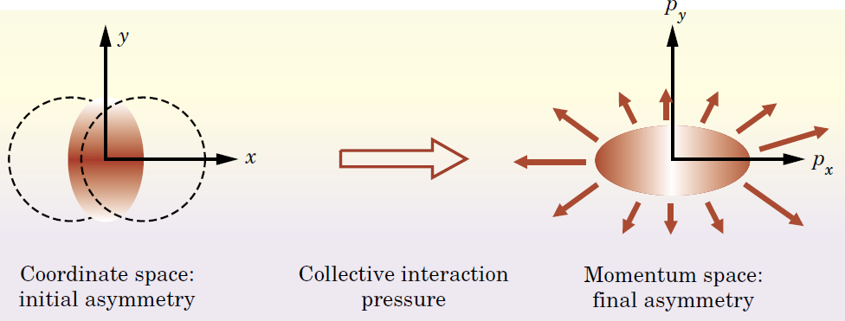
Some Probes of the Evolution
Low-p_{T}
leading
particle suppressed
hadrons
q
q
hadrons
leading particle suppressed
High-p_{T}

Slide 10
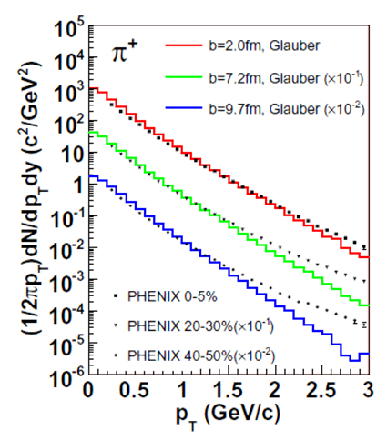
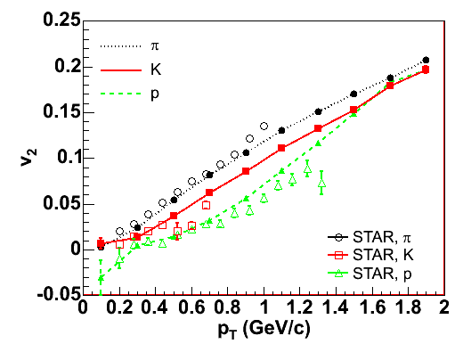
A Lil’ Bit of Low-p_{T}
Hydro
  Early therm.
  Evolution: ∂_{μ}T^{μν} = 0
    “Ideal”
  Hadronization
    Cooper-Frye freeze-out
  Hadronic rescattering
T Hirano, et al., Phys.Rev.C77:044909,2008

Slide 11
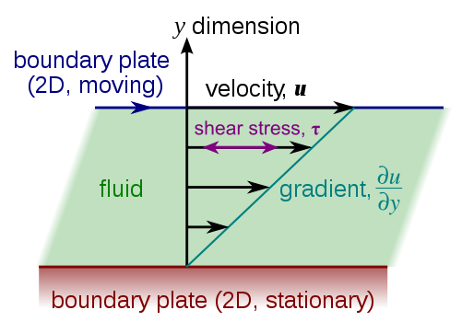
Viscous Hydrodynamics
Viscosity reduces elliptic flow
  Naive pQCD => η/s ~ 1
  Naive AdS/CFT => η/s ~ 1/4π
    => Strongly coupled medium?
Luzum and Romatschke,
Phys.Rev.C78:034915,2008

Slide 12
Geometry Matters
Poorly constrained initial geom => 100% uncertainty in viscosity
  Fluctuations in IC additional uncon. effect
T Hirano, et al., Phys.Lett.B636:299-304,2006

Slide 13

Why High-p_{T} Particles?
Tomography in medicine
One can learn a lot from a single probe…
and even more with multiple probes
SPECT-CT Scan uses internal γ photons and external X-rays
PET Scan
http://www.fas.org/irp/imint/docs/rst/Intro/Part2_26d.html

Slide 14

Tomography in QGP
Requires well-controlled theory of:
  production of rare, high-p_{T} probes
    g, u, d, s, c, b
  in-medium E-loss
  hadronization
Requires precision measurements of decay fragments
p_{T}
, γ, e⁻
φ
Invert attenuation pattern => measure medium properties

Slide 15


QGP Energy Loss
Learn about E-loss mechanism
  Most direct probe of DOF
pQCD Picture
AdS/CFT Picture

Slide 16

pQCD Rad Picture
Bremsstrahlung Radiation
  Weakly-coupled plasma
    Medium organizes into Debye-screened centers
  T ~ 250 MeV, g ~ 2
    μ ~ gT ~ 0.5 GeV
    λ_{mfp} ~ 1/g²T ~ 1 fm
    R_{Au} ~ 6 fm
  1/μ << λ_{mfp} << L
    mult. coh. em.
Gyulassy, Levai, and Vitev, NPB571 (200)
  LPM
    dp_{T}/dt ~ -LT³ log(p_{T}/M_{q})
  Bethe-Heitler
    dp_{T}/dt ~ -(T³/M_{q}²) p_{T}

Slide 17

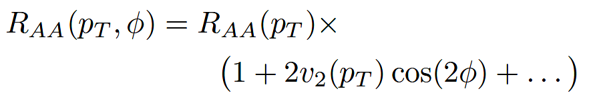
High-p_{T} Observables
    Naively: if medium has no effect, then R_{AA} = 1
    Common variables used are transverse momentum, p_{T}, and angle with respect to the reaction plane, φ
p_{T}
, γ, e⁻
    Fourier expand R_{AA}:
φ

Slide 18

pQCD Success at RHIC:
(circa 2005)
Y. Akiba for the PHENIX collaboration, hep-ex/0510008
  Consistency: R_{AA}(η)~R_{AA}(π)
  Null Control: R_{AA}(γ)~1
  GLV Prediction: Theory~Data for reasonable fixed L~5 fm and dN_{g}/dy~dN_{π}/dy

Slide 19

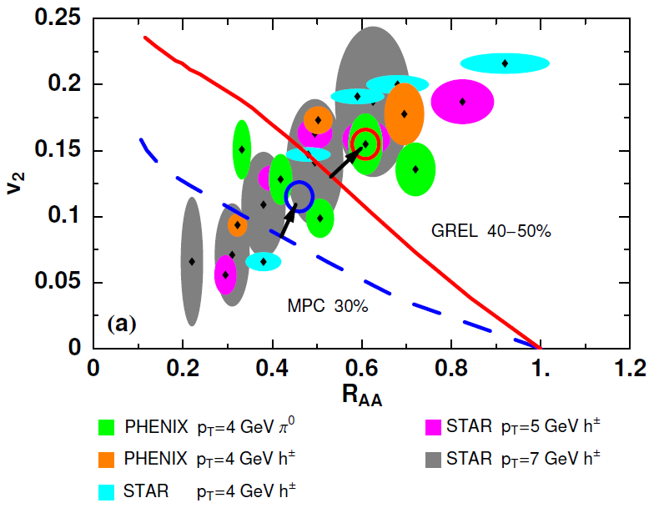
Trouble for Rad E-Loss Picture
v₂
e⁻
e⁻
WAH, Acta Phys.Hung.A27 (2006)
Djordjevic, Gyulassy, Vogt, and Wicks, PLB632 (2006)
Notes:
Anticorrelated; have e- come in later

Slide 20


What About Elastic Loss?
Appreciable!
Finite time effects small
Mustafa, PRC72 (2005)
Adil, Gyulassy, WAH, Wicks, PRC75 (2007)

Slide 21
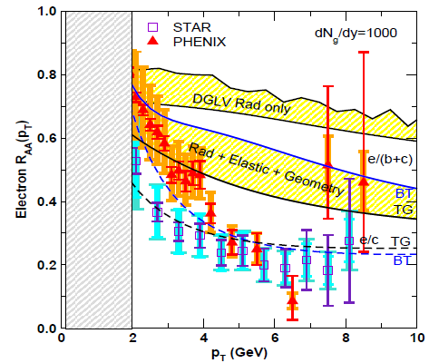
pQCD Still Inadequate
Lack of even qualitative understanding
  π⁰, η, γ R_{AA} well described, BUT
  e⁻ R_{AA}, v₂ is not, even with elastic loss
    NB: M_{Q}/E << 1 assumed, not well controlled for b
PHENIX, Phys. Rev. Lett. 98, 172301 (2007)
Wicks et al.

Slide 22
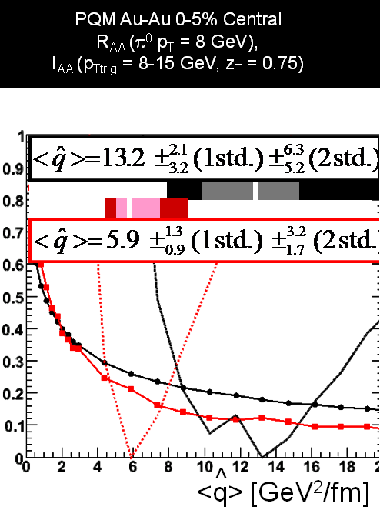
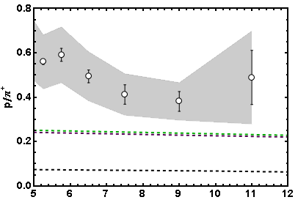
More Reasons for Concern
I_{AA}
  WHDG soon
Baryon/Meson Ratio
STAR
pQCD w/ DSS
pQCD w/ KKP
p_{T}
WAH, in preparation
Jamie Nagle, QM09
Pert. at LHC energies?

Slide 23
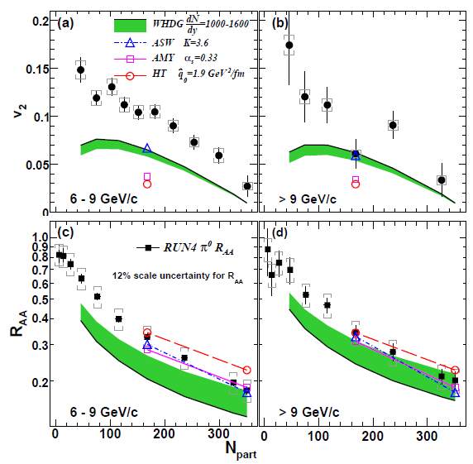
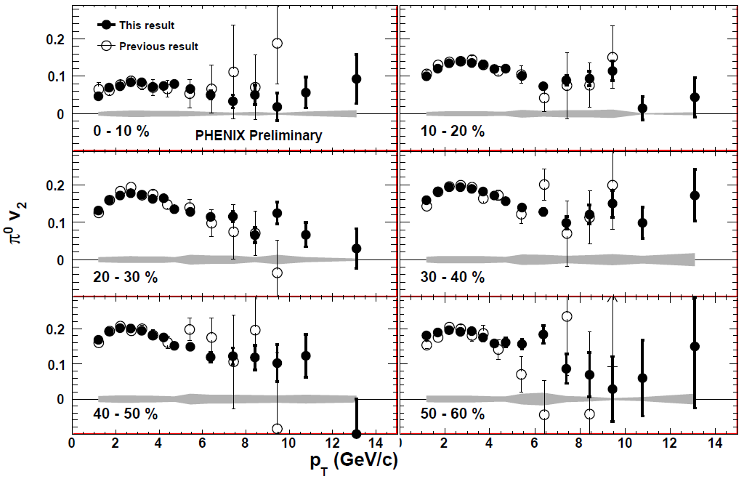
Death of pQCD at RHIC?
Failure at > 9 GeV!
Rui Wei, for PHENIX, QM09
PHENIX, arXiv:1006.3740
Notes:
Important to get to >~ 10 GeV to avoid IS, hadronization effects

Slide 24
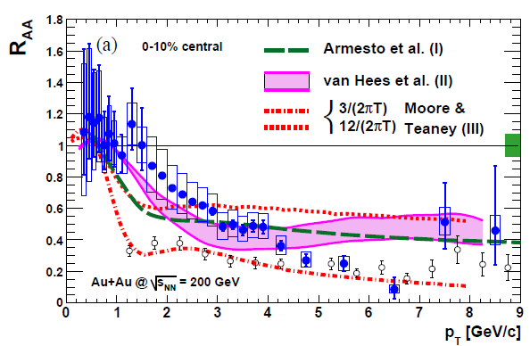
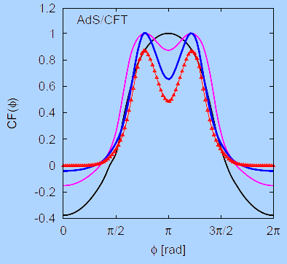
Strongly Coupled Qualitative Successes
AdS/CFT
Blaizot et al., JHEP0706
T. Hirano and M. Gyulassy, Nucl. Phys. A69:71-94 (2006)
PHENIX, PRL98, 172301 (2007)
Betz, Gyulassy, Noronha, Torrieri, PLB675 (2009)

Slide 25
Jets in AdS/CFT
Model heavy quark jet energy loss by embedding string in AdS space
  dp_{T}/dt = - μ p_{T}
  μ = πλ^{1/2} T²/2M_{q}
  Similar to Bethe-Heitler
    dp_{T}/dt ~ -(T³/M_{q}²) p_{T}
  Very different from LPM
    dp_{T}/dt ~ -LT³ log(p_{T}/M_{q})
J Friess, S Gubser, G Michalogiorgakis, S Pufu, Phys Rev D75 (2007)

Slide 26
Compared to Data
String drag: qualitative agreement
WAH, PhD Thesis

Slide 27


Light Quark and Gluon E-Loss
WAH, in preparation
ΔL^{q}_{therm} ~ E^{1/3}
ΔL^{q}_{therm} ~ (2E)^{1/3}

Slide 28


pQCD vs. AdS/CFT at LHC
Plethora of Predictions:
WAH, M. Gyulassy, PLB666 (2008)
      Taking the ratio cancels most normalization differences
      pQCD ratio asymptotically approaches 1, and more slowly so for increased quenching (until quenching saturates)
      AdS/CFT ratio is flat and many times smaller than pQCD at only moderate p_{T}
WAH, M. Gyulassy, PLB666 (2008)

Slide 29

Not So Fast!
  Speed limit estimate for applicability of AdS drag
    γ < γ_{crit} = (1 + 2M_{q}/λ^{1/2} T)²
    ~ 4M_{q}²/(λ T²)
      Limited by M_{charm} ~ 1.2 GeV
    Similar to BH LPM
      γ_{crit} ~ M_{q}/(λT)
  No Single T for QGP
    smallest γ_{crit} for largest T
    T = T(τ₀, x=y=0): “(”
    largest γ_{crit} for smallest T
    T = T_{c}: “]”
D7 Probe Brane
Q
Worldsheet boundary Spacelike if γ > γ_{crit}
x₅
Trailing
String
“Brachistochrone”
“z”
D3 Black Brane

Slide 30

LHC R^{c}_{AA}(p_{T})/R^{b}_{AA}(p_{T}) Prediction
(with speed limits)
WAH, M. Gyulassy, PLB666 (2008)
      T(τ₀): “(”, corrections likely small for smaller momenta
      T_{c}: “]”, corrections likely large for higher momenta

Slide 31

RHIC R^{cb} Ratio
pQCD
pQCD
AdS/CFT
AdS/CFT
WAH, M. Gyulassy, JPhysG35 (2008)
    Wider distribution of AdS/CFT curves due to large n: increased sensitivity to input parameters
    Advantage of RHIC: lower T => higher AdS speed limits

Slide 32
Conclusions
RHIC at 10 Years
  Fascinating discoveries
    Perfect (?) Fluidity
    “Jet” Suppression
Full Picture Lacking
  Little constrains many aspects of HIC
    Initial geometry
    Thermalization
    Energy loss mechanism
Exciting Days Ahead
  New Energy Regime at LHC
    Hydro confirmation?
    New tests for E-loss
  HF Separation at RHIC

