Slide 1
Qualitative and Quantitative Energy Loss?
W. A. Horowitz
University of Cape Town
December 9, 2010
With many thanks to Brian Cole, Miklos Gyulassy,
Ulrich Heinz, Jangyong Jia, and Yuri Kovchegov

Slide 2
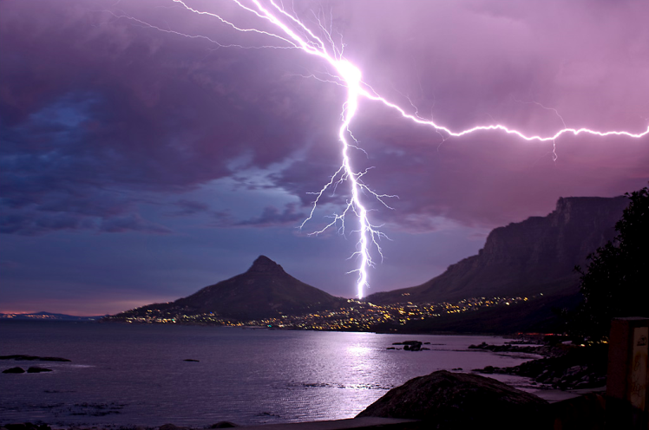
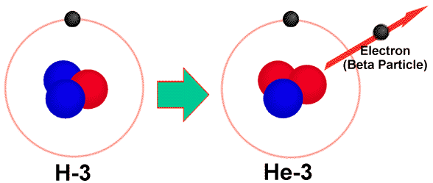
Four Fundamental Forces
Gravity
Electromagnetism
starchild.gsfc.nasa.gov
John Maarschalk, travelblog.portfoliocollection.com
Weak
Strong
lhs.lps.org/staff/sputnam/chem_notes/tritium_decay.gif

Slide 3
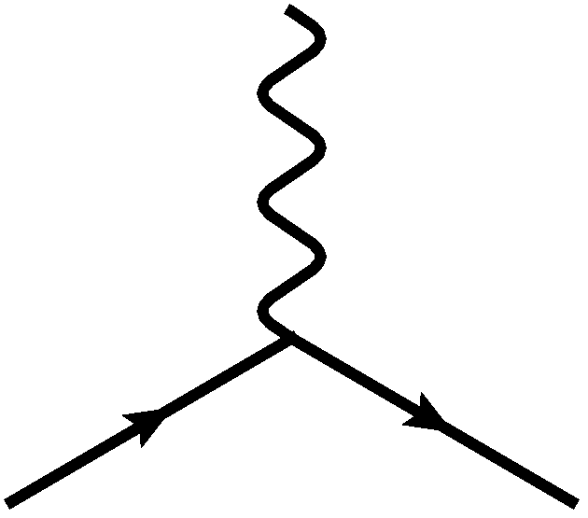
E&M Particle Physics Well Understood
Lagrangian known:
QED Vertex:
Ex. of Precision QED: g - 2
Gabrielse et al., PRL97 (2006)
Hanneke, Fogwell, and Gabrielse, PRL100 (2008)

Slide 4
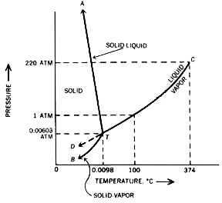
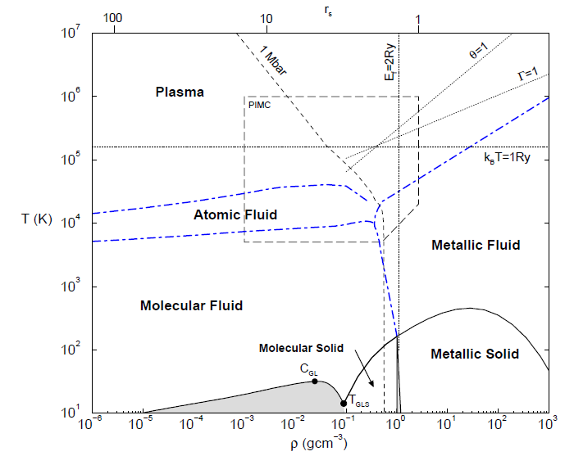
E&M and Phase Diagrams
Many body physics less well understood
Water
Hydrogen
www.sv.vt.edu/classes/MSE2094_NoteBook/96ClassProj/examples/triplpt.html
Calculated, Burkhard Militzer,
Diploma Thesis, Berlin, 2000

Slide 5
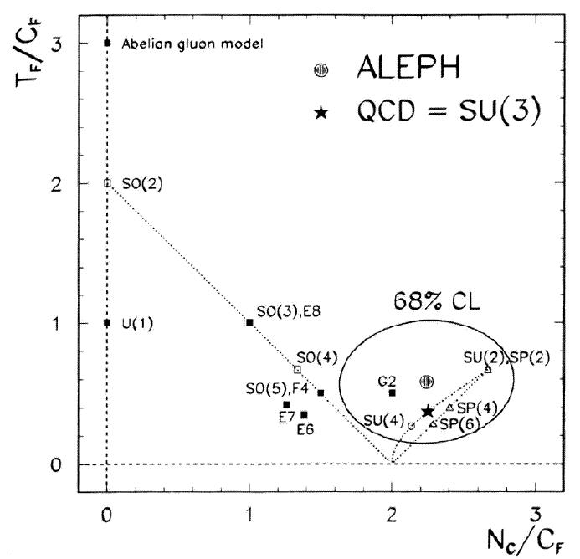
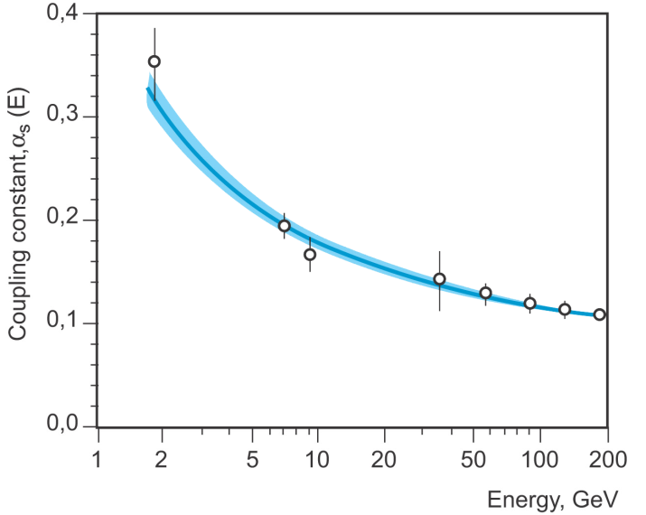
QCD Particle Physics Well Understood
Lagr. known:
QCD Vertices:
Qual. & Quant. agreement w/ data
ALEPH,
PLB284
(1992)
PDG

Slide 6
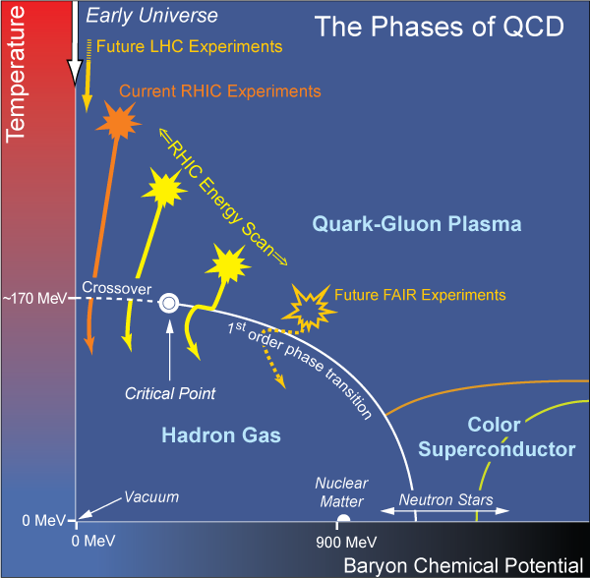
What Are We Interested In?
Measure many-body physics of strong force
Test & understand theory of many-body non-Abelian fields
Do this via Heavy Ion Collisions
Long Range Plan, 2008
Notes:
Unique as compared to strongly coupled Abelian problems

Slide 7
Big Bang vs. Little Bang
ALICE Collaboration
t = - ∞
t = 0
t = 1 fm/c
t = 3 fm/c
t = 4 fm/c
t = + ∞
JET
Initial State
Initial Overlap
Thermalization
QGP
Hadronization
Hadron Gas

Slide 8
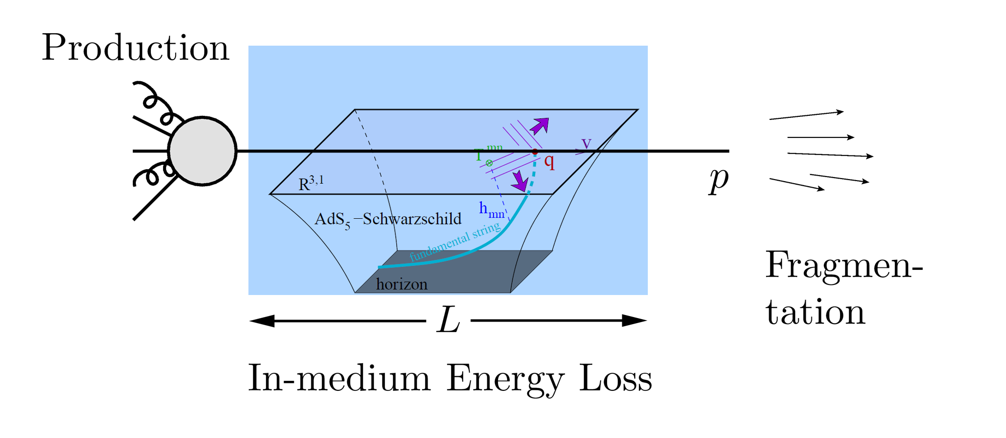
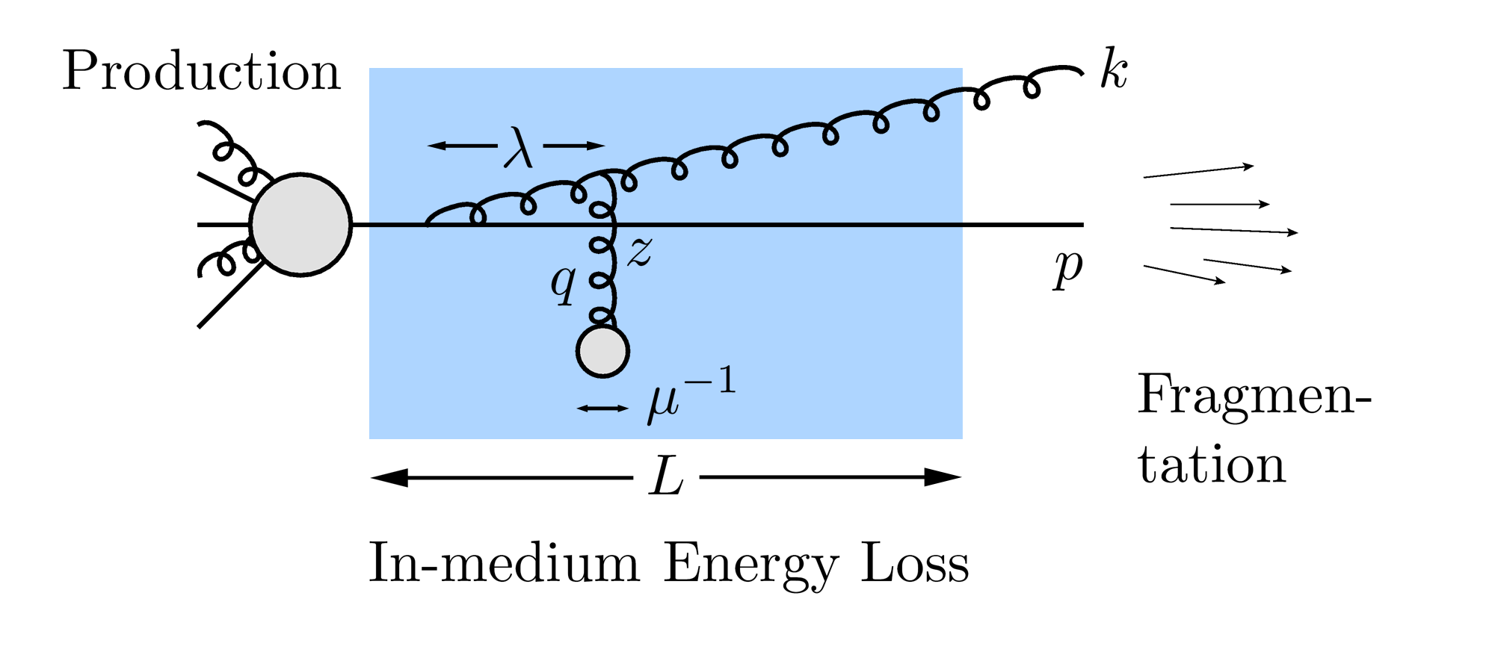
QGP Energy Loss
Learn about E-loss mechanism
Most direct probe of DOF
pQCD Picture
AdS/CFT Picture

Slide 9
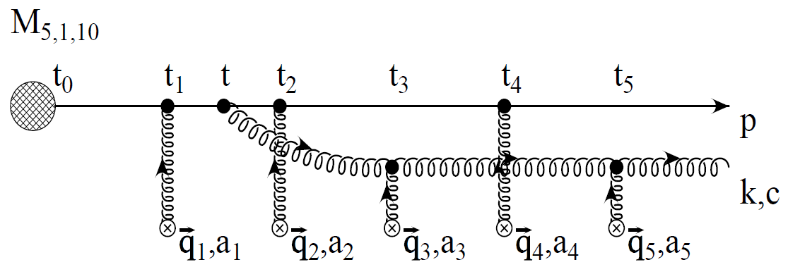
pQCD Rad Picture
Bremsstrahlung Radiation
Weakly-coupled plasma
Medium organizes into Debye-screened centers
T ~ 250 MeV, g ~ 2
μ ~ gT ~ 0.5 GeV
λ_{mfp} ~ 1/g²T ~ 1 fm
R_{Au} ~ 6 fm
1/μ << λ_{mfp} << L
mult. coh. em.
Gyulassy, Levai, and Vitev, NPB571 (2000)
LPM
dp_{T}/dt ~ -LT³ log(p_{T}/M_{q})
Bethe-Heitler
dp_{T}/dt ~ -(T³/M_{q}²) p_{T}

Slide 10
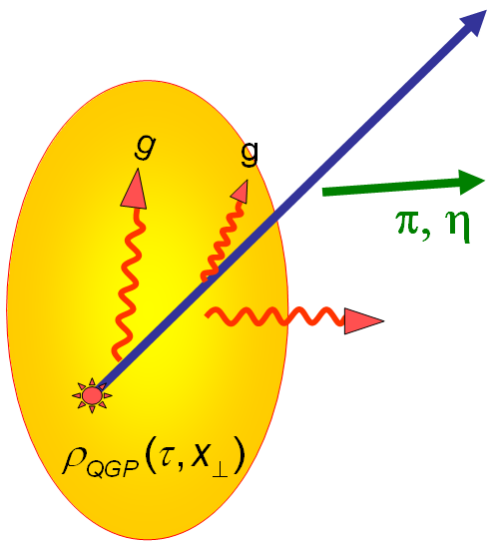
High-p_{T} Observables
Naively: if medium has no effect, then R_{AA} = 1
Common variables used are transverse momentum, p_{T}, and angle with respect to the reaction plane, φ
p_{T}
, γ, e⁻
Fourier expand R_{AA}:
φ

Slide 11
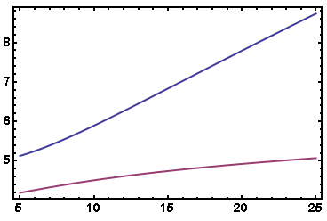
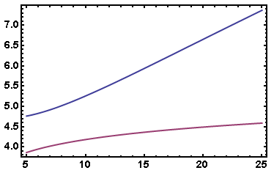
Expectations from pQCD
Power law p + p π + X spectrum
dσ/dp_{T} ~ A/(p_{T})^{n}
pQCD fractional energy loss ε ~ log(p_{T})/p_{T}
For n fixed, R_{AA} 1 at large p_{T}
=> R_{AA} ~ (1 – ε)^{n-1}
RHIC light quarks
RHIC glue
n
n
LHC glue
LHC light quarks
p_{T}
p_{T}
At RHIC, n increases with p_{T}; at LHC, n relatively constant

Slide 12
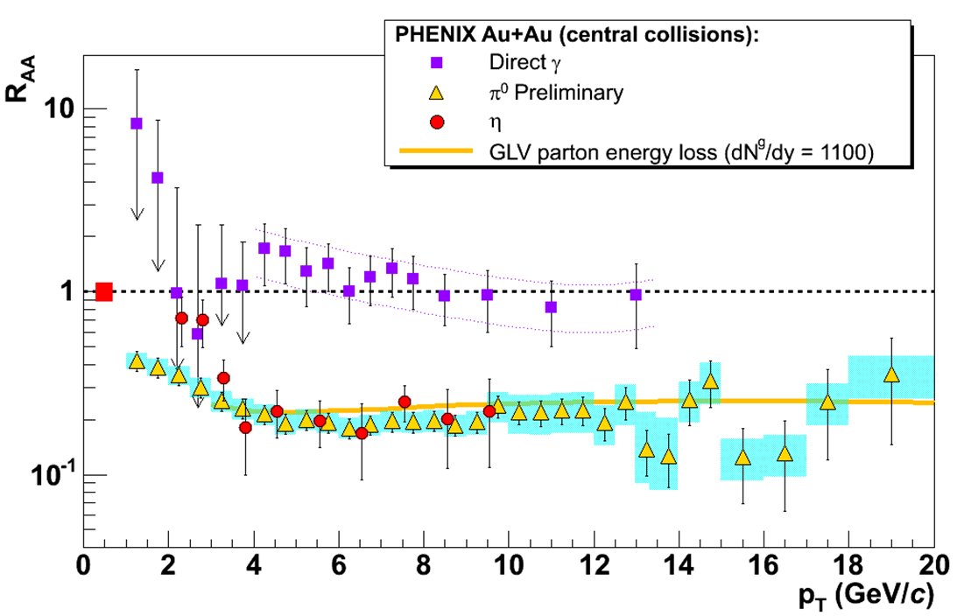
pQCD Success at RHIC:
(circa 2005)
Y. Akiba for the PHENIX collaboration, Nucl. Phys. A774 (2006)
Consistency: R_{AA}(η)~R_{AA}(π)
Null Control: R_{AA}(γ)~1
GLV Prediction: Theory~Data for reasonable fixed L~5 fm and dN_{g}/dy~dN_{π}/dy

Slide 13
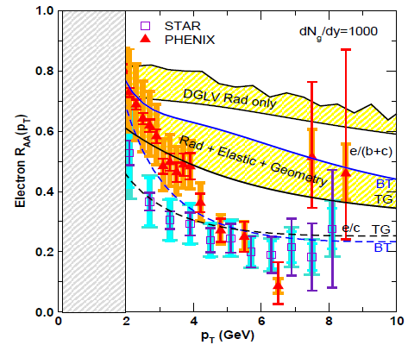
pQCD Suppression Picture Inadequate
Lack of even qualitative understanding
π⁰, η, γ R_{AA} well described, BUT
e⁻ R_{AA}, v₂ are not, even with elastic loss
PHENIX, Phys. Rev. Lett. 98, 172301 (2007)
Wicks, WAH, Djordjevic, Gyulassy, NPA784, 2007

Slide 14
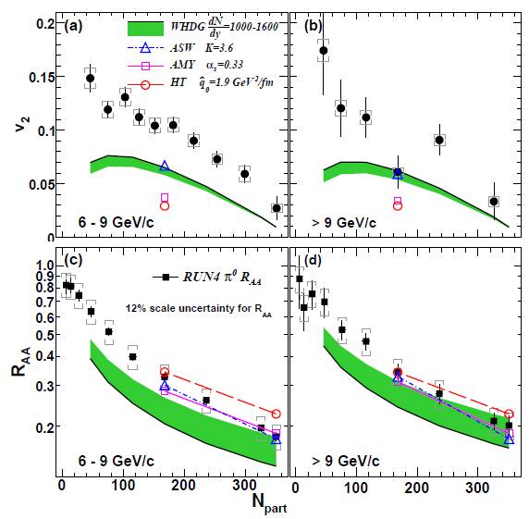
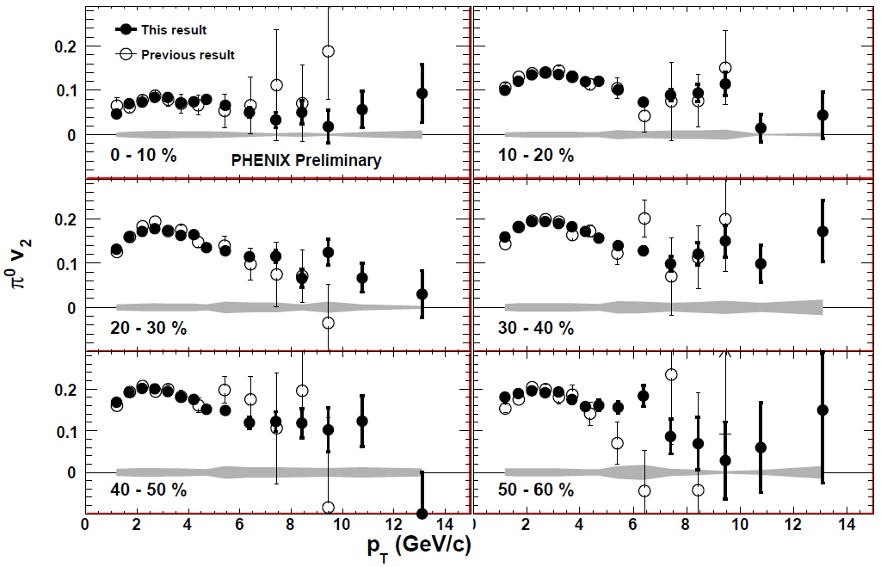
Death of pQCD at RHIC?
Failure at > 9 GeV!
Rui Wei, for PHENIX, QM09
PHENIX, arXiv:1006.3740
Pert. at LHC energies?
Notes:
Important to get to >~ 10 GeV to avoid IS, hadronization effects

Slide 15
Before We Make Any Conclusions...
While experiments are converging
Theoretically, what are the effects of
higher orders in
α_{s} (large)
k_{T}/xE (large)
M_{Q}/E (large?)
opacity (large?)
geometry
uncertainty in IC (small)
coupling to flow (large?)
better treatment of
elastic E-loss
E-loss in confined matter

Slide 16
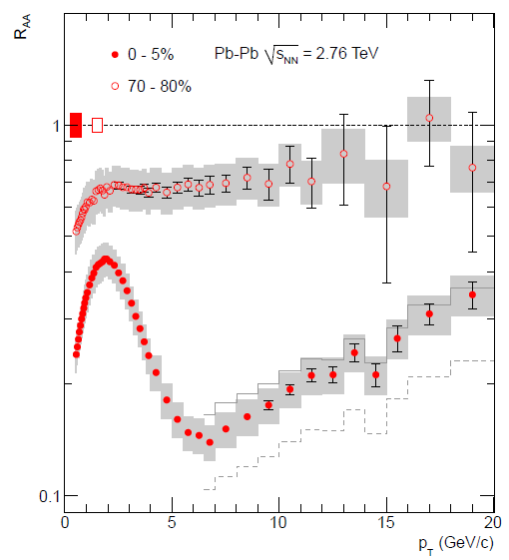
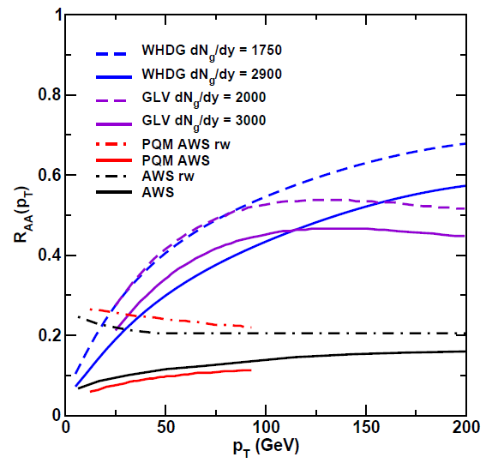
ALICE First Results!
Rise with p_{T} looks very pQCD-ish
5.5 TeV
ALICE, arXiv:1012.1004
WAH, Int.J.Mod.Phys. E16 (2007)

Slide 17
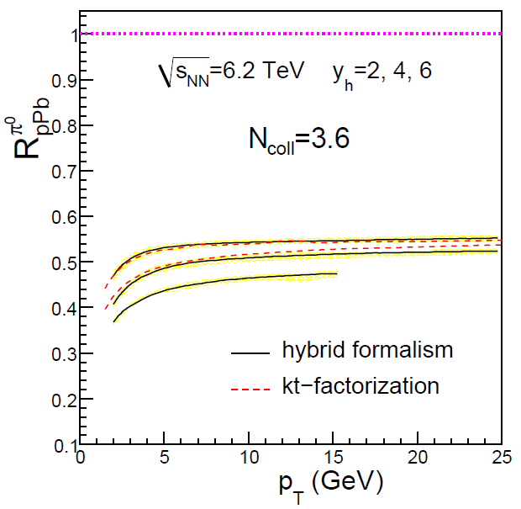
Caution about pQCD at LHC
Quenching due to IS or FS?
Initial or Final State physics?
Require exp. control over production
R_{pPb} ~ 0.5!
R_{PbPb} ~ 0.25
from IS alone!
p + p and p + Pb run at LHC
Albacete and Marquet, PLB687, 2010

Slide 18
Jets in AdS/CFT
Model heavy quark jet energy loss by embedding string in AdS space
dp_{T}/dt = - μ p_{T}
μ = πλ^{1/2} T²/2M_{q}
Similar to Bethe-Heitler
dp_{T}/dt ~ -(T³/M_{q}²) p_{T}
Very different from usual pQCD and LPM
dp_{T}/dt ~ -LT³ log(p_{T}/M_{q})
J Friess, S Gubser, G Michalogiorgakis, S Pufu, Phys Rev D75 (2007)

Slide 19
Compared to Data
String drag: qualitative agreement
WAH, PhD Thesis

Slide 20
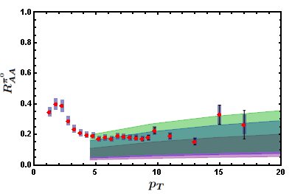
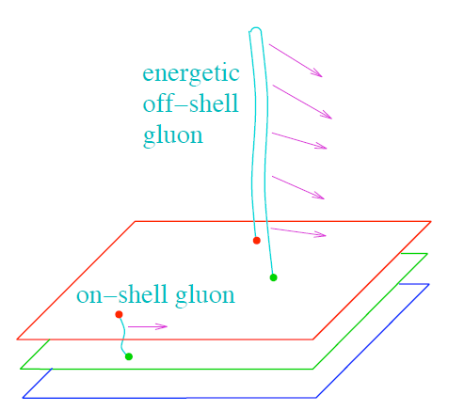
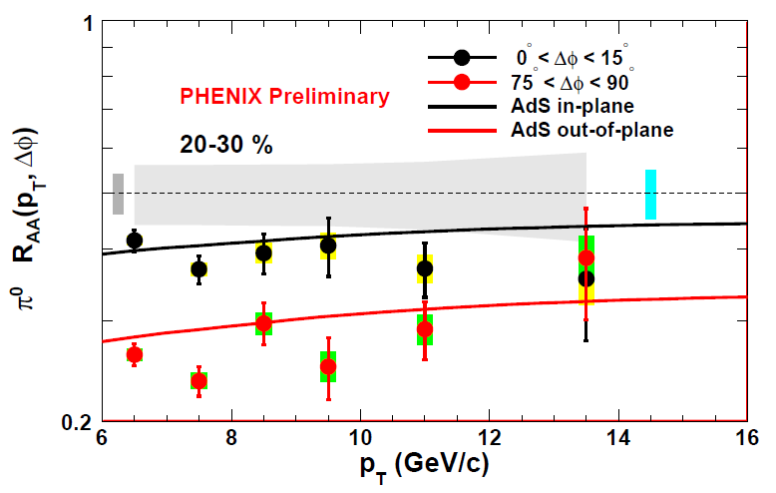
Light Quark and Gluon E-Loss
WAH, in preparation
SS Gubser, QM08
ΔL^{g}_{therm} ~ E^{1/3}
ΔL^{q}_{therm} ~ (2E)^{1/3}
Gubser et al., JHEP0810 (2008)
Chesler et al., PRD79 (2009)
Marquet and Renk, PLB685 (2010)

Slide 21
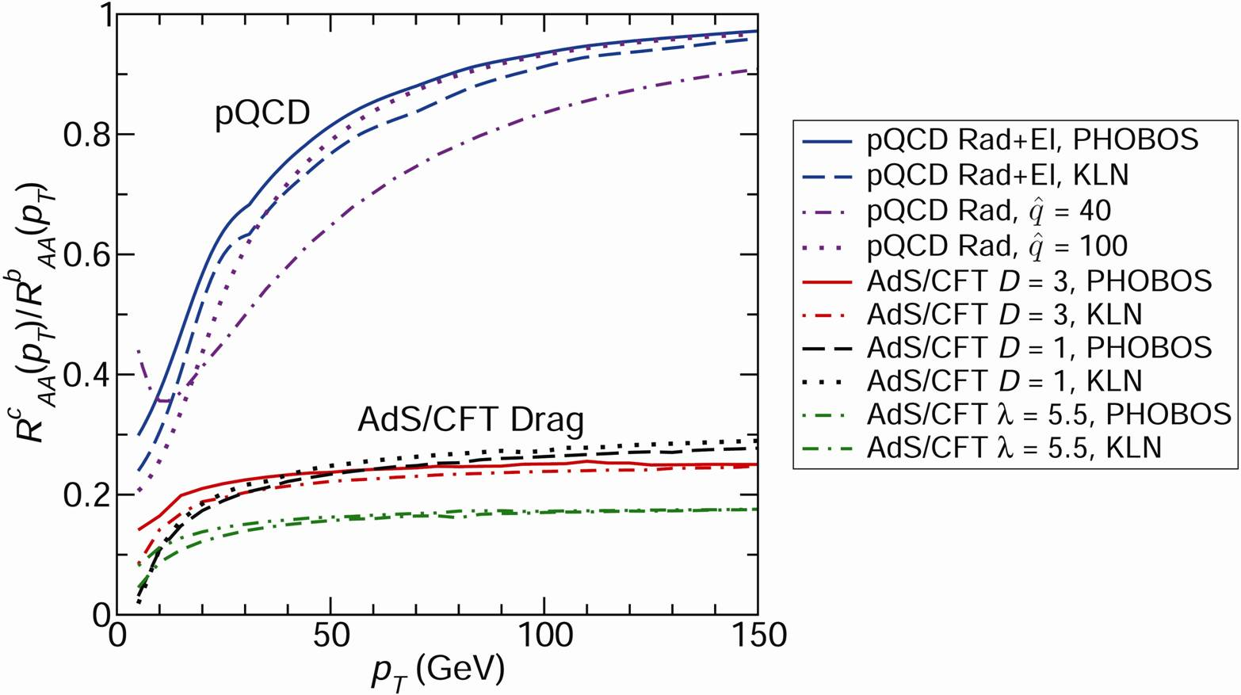
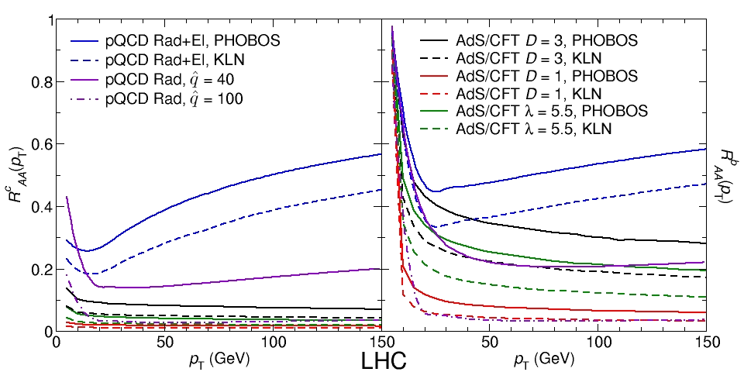
pQCD vs. AdS/CFT at LHC
Plethora of Predictions:
WAH, M. Gyulassy, PLB666 (2008)
Taking the ratio cancels most normalization differences
pQCD ratio asymptotically approaches 1, and more slowly so for increased quenching (until quenching saturates)
AdS/CFT ratio is flat and many times smaller than pQCD at only moderate p_{T}
WAH, M. Gyulassy, PLB666 (2008)

Slide 22
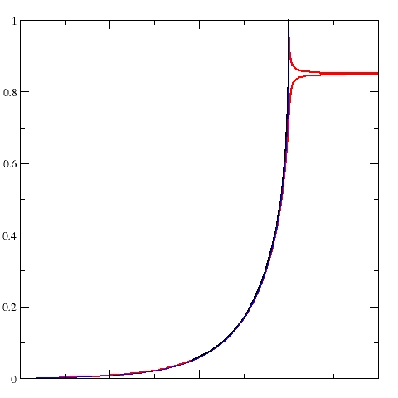
Not So Fast!
Speed limit estimate for applicability of AdS drag
γ < γ_{crit} = (1 + 2M_{q}/λ^{1/2} T)²
~ 4M_{q}²/(λ T²)
Limited by M_{charm} ~ 1.2 GeV
Similar to BH LPM
γ_{crit} ~ M_{q}/(λT)
No Single T for QGP
smallest γ_{crit} for largest T
T = T(τ₀, x=y=0): “(”
largest γ_{crit} for smallest T
T = T_{c}: “]”
D7 Probe Brane
Q
Worldsheet boundary Spacelike if γ > γ_{crit}
x₅
Trailing
String
“Brachistochrone”
“z”
D3 Black Brane

Slide 23
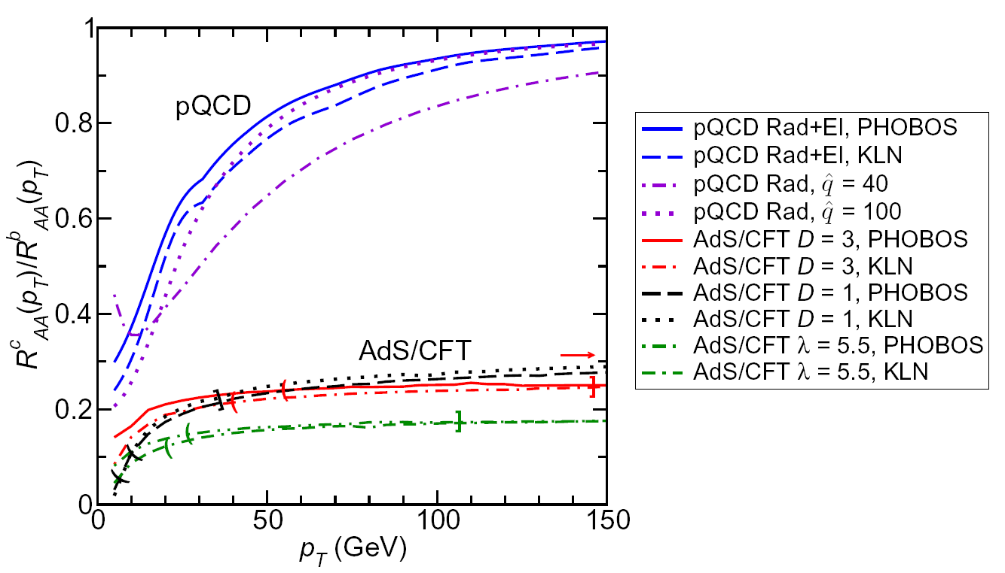
LHC R^{c}_{AA}(p_{T})/R^{b}_{AA}(p_{T}) Prediction (with speed limits)
WAH, M. Gyulassy, PLB666 (2008)
T(τ₀): “(”, corrections likely small for smaller momenta
T_{c}: “]”, corrections likely large for higher momenta
Qualitatively, corrections to AdS/CFT result will drive double ratio to unity

Slide 24
Conclusions
Energy loss is a unique tool for probing QGP
pQCD fails to simultaneously describe R_{AA}, v₂, ... for π, e at RHIC
Importance of HO effects, approx.,...?
Exciting new ALICE results
Appears tantalizingly perturbative
Due to final state energy loss or initial state?
2.76 TeV p + p and p + Pb run required for interp.
Heavy Quarks provide clean observable for investigating QGP physics

