Slide 1
Calculation of Energy Loss in AA Collisions
W. A. Horowitz
University of Cape Town
May 31, 2011
With many thanks to Alessandro Buzzatti, Brian Cole, Miklos Gyulassy, Jiangyong Jia, and Yuri Kovchegov

Slide 2
Motivation

Slide 3
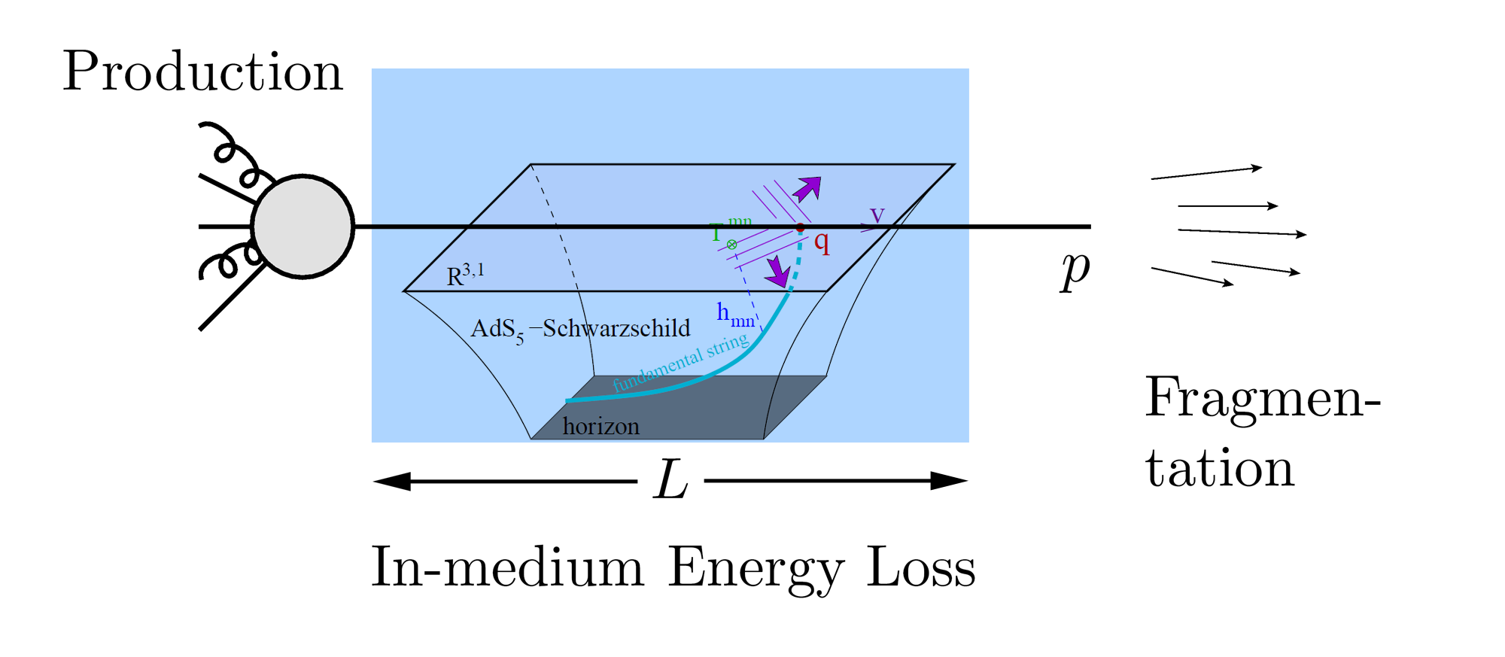
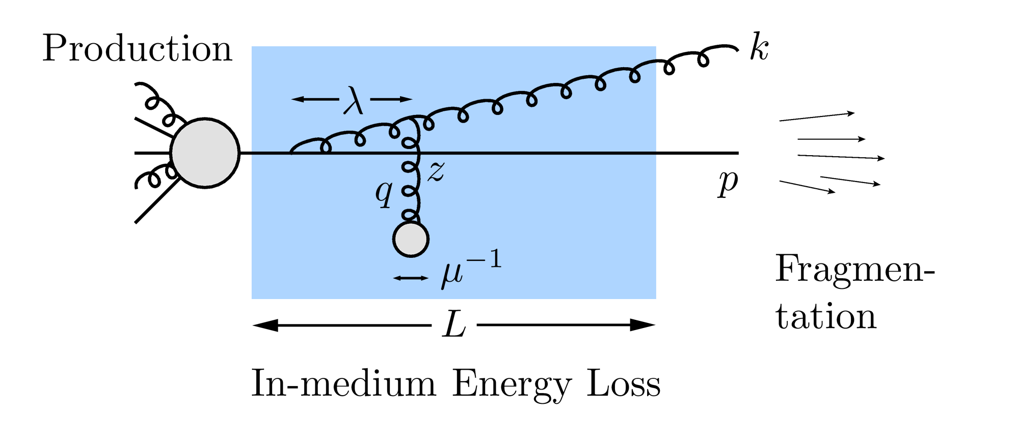
QGP Energy Loss
Learn about E-loss mechanism
Most direct probe of DOF
pQCD Picture
AdS/CFT Picture

Slide 4
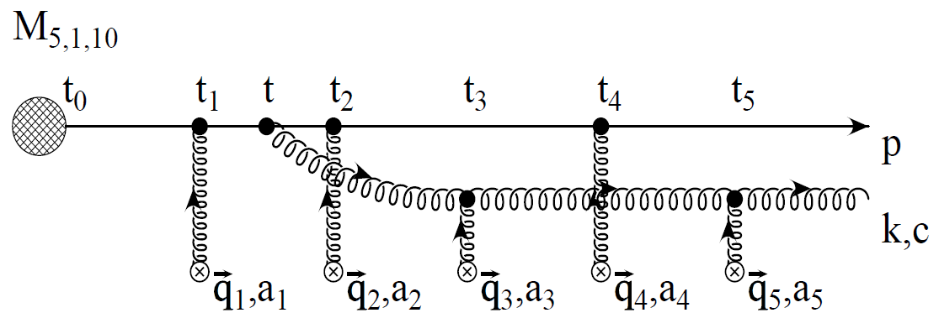
pQCD E-Loss Picture
Bremsstrahlung Radiation
Weakly-coupled plasma
Medium organizes into Debye-screened centers
T ~ 250 MeV, g ~ 2
μ ~ gT ~ 0.5 GeV
λ_{mfp} ~ 1/g²T ~ 1 fm
R_{Au} ~ 6 fm
1/μ << λ_{mfp} << L
mult. coh. em.
Gyulassy, Levai, and Vitev, NPB571 (2002)
LPM
dp_{T}/dt ~ -LT³ log(p_{T}/M_{q})
c.f. Elastic Loss
dp_{T}/dt ~ -T² log(p_{T}/M_{q})
Bethe-Heitler
dp_{T}/dt ~ -(T³/M_{q}²) p_{T}

Slide 5
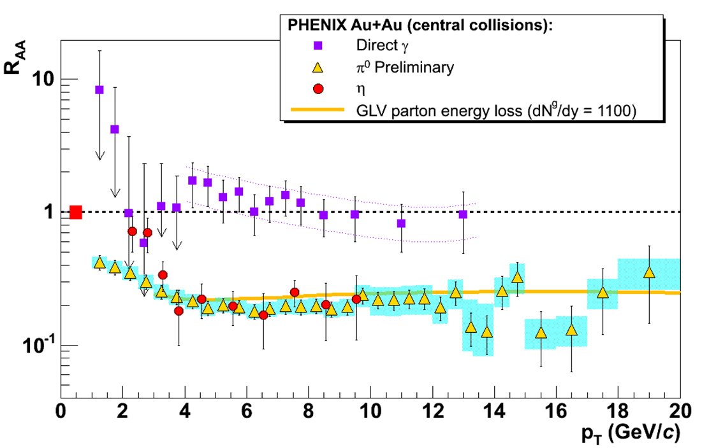
pQCD Success at RHIC:
(circa 2005)
Y. Akiba for the PHENIX collaboration, hep-ex/0510008
Consistency: R_{AA}(η)~R_{AA}(π)
Null Control: R_{AA}(γ)~1
GLV Prediction: Theory~Data for reasonable fixed L~5 fm and dN_{g}/dy~dN_{π}/dy

Slide 6
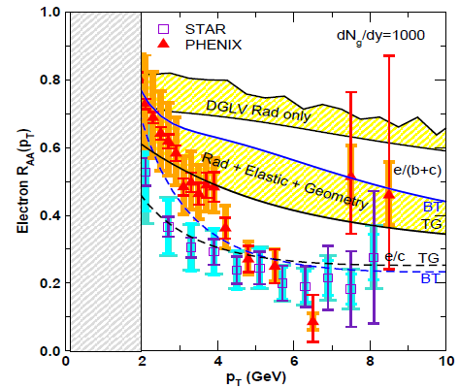
pQCD Suppression Picture Inadequate
Lack of even qualitative understanding
π⁰, η, γ R_{AA} well described, BUT
e⁻ R_{AA}, v₂ are not, even with elastic loss
PHENIX, Phys. Rev. Lett. 98, 172301 (2007)
Wicks et al., NPA784, 2007

Slide 7
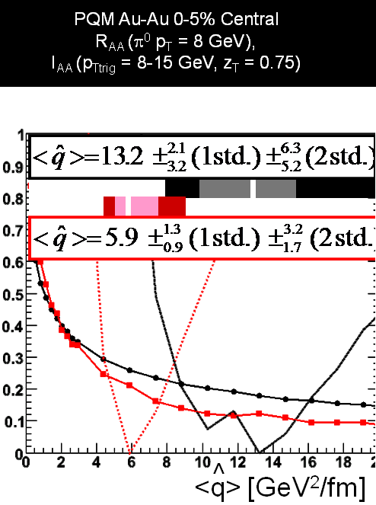
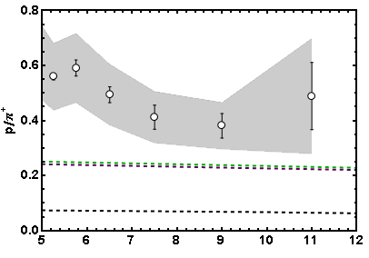
More Reasons for Concern
I_{AA}
Baryon/Meson Ratio
STAR
pQCD w/ DSS
pQCD w/ KKP
p_{T}
WAH, in preparation
Jamie Nagle, QM09

Slide 8
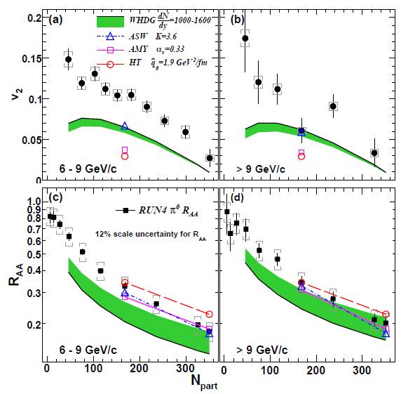
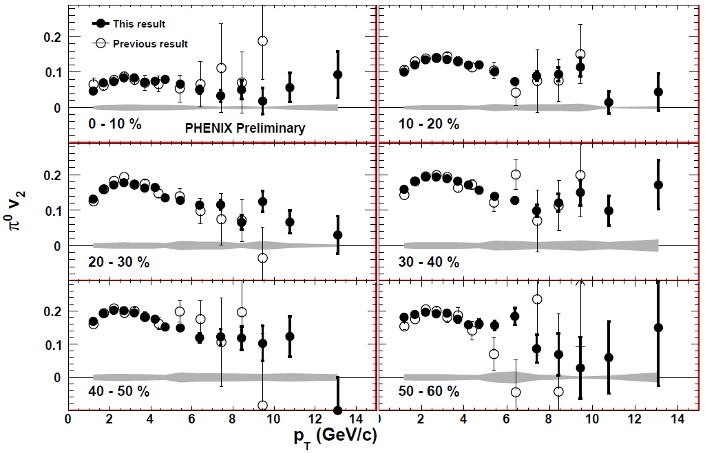
Death of pQCD at RHIC?
Failure at > 9 GeV!
Rui Wei, for PHENIX, QM09
PHENIX, arXiv:1006.3740
Pert. at LHC energies?
Notes:
Important to get to >~ 10 GeV to avoid IS, hadronization effects

Slide 9
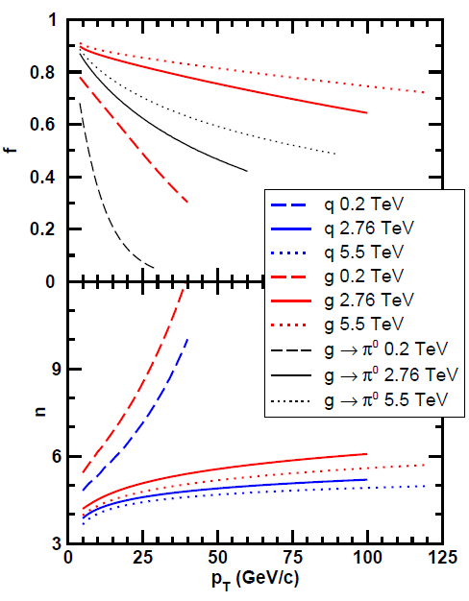
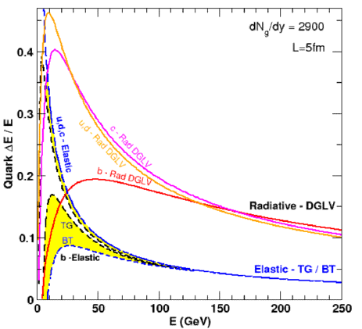
LHC Context
LHC is gluon machine
Flatter spectra
Elastic ~ Radiative
WAH, PhD Thesis
WAH and M Gyulassy, arXiv:1104.4958

Slide 10
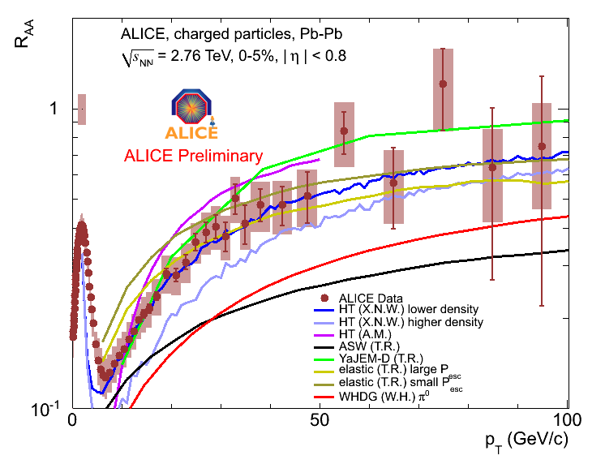
pQCD at LHC?
R_{AA} ~ (1-ε)^{n-1}
ε = (E_{i}-E_{f})/E_{i}
<ε>_{pQCD} ~ log(p_{T})/p_{T}
=> R_{AA} inc. with p_{T}
Appelshauser, ALICE, QM11
p_{T} rise in data readily understood from generic perturbative physics!

Slide 11
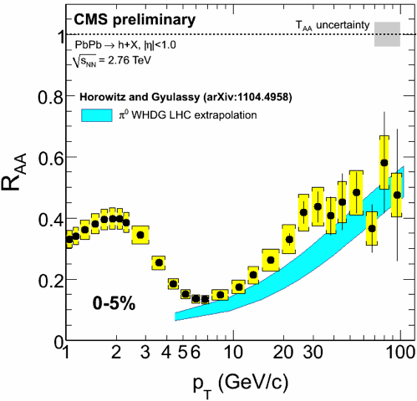
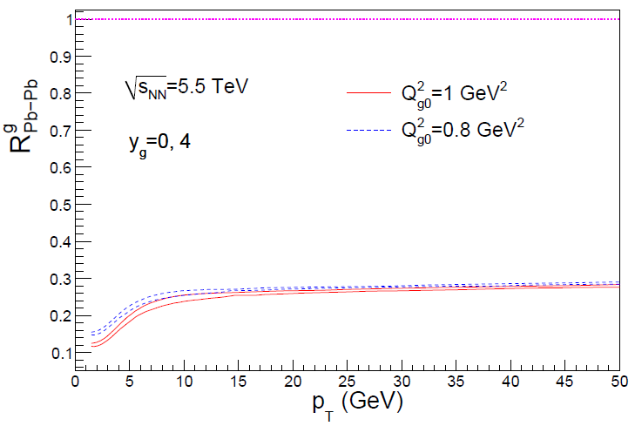
Rise in R_{AA} a Final State Effect?
Is rise really due to pQCD?
Or other quench (flat?)
+ initial state CNM effects a la CGC?
Wenger,
private communication
WHDG vs. ALICE vs. CMS?
Albacete and Marquet, PLB687 (2010)

Slide 12
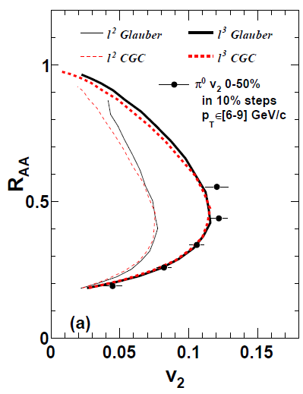
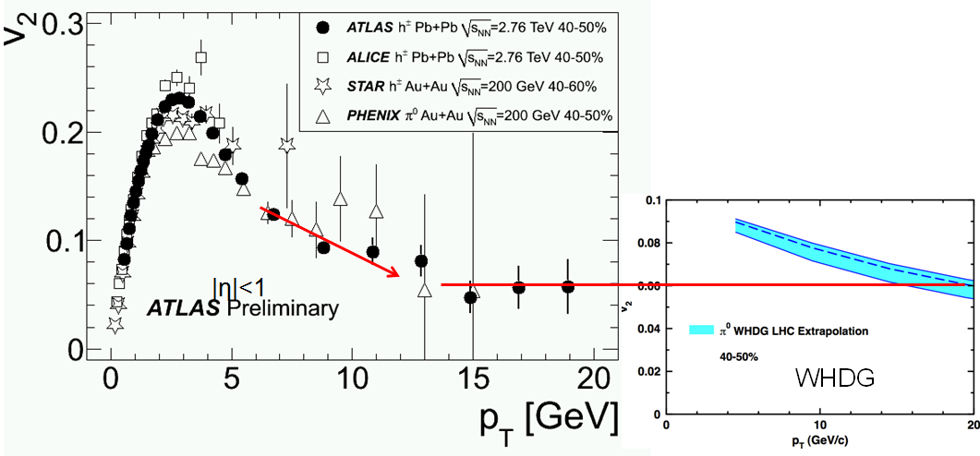
Mult. Obs. at LHC?
RHIC
J Jia, WAH, J Liao,
arXiv:1101.0290
Are pQCD predictions of both R_{AA} & v₂ consistent with data? At 100 GeV/c?
Jia, ATLAS, QM11
Wenger, private communication

Slide 13
Quant. (Qual?) Conclusions Require...
Further experimental results
Theoretically, investigation of the effects of
higher orders in
α_{s} (large)
k_{T}/xE (large)
M_{Q}/E (large?)
opacity (large?)
geometry
uncertainty in IC (small)
coupling to flow (large?)
Eloss geom. approx. (?)
τ < τ₀ (large: see Buzzatti poster)
dyn. vs. static centers (see Buzzatti poster)
hydro background (see Renk)
better treatment of
Coh. vs. decoh. multigluons (see Mehtar-Tani)
elastic E-loss
E-loss in confined matter

Slide 14
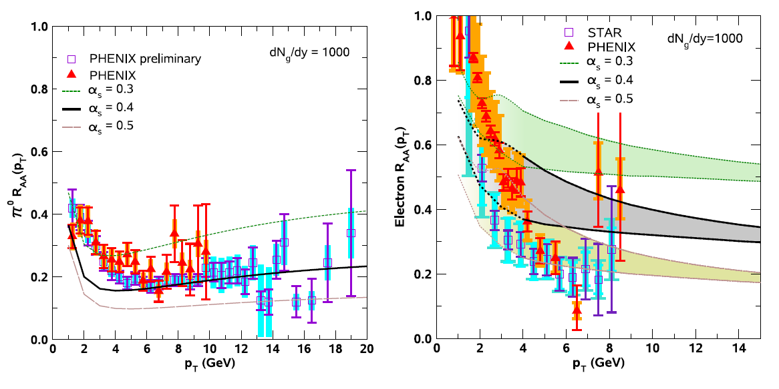
Varying α_{s} has huge effect
<ε>_{rad,pQCD} ~ α_{s}³; <ε>_{el,pQCD} ~ α_{s}²
Role of running coupling, irreducible uncertainty from non-pert. physics?
Nontrivial changes from better elastic treatment
S Wicks, PhD Thesis

Slide 15
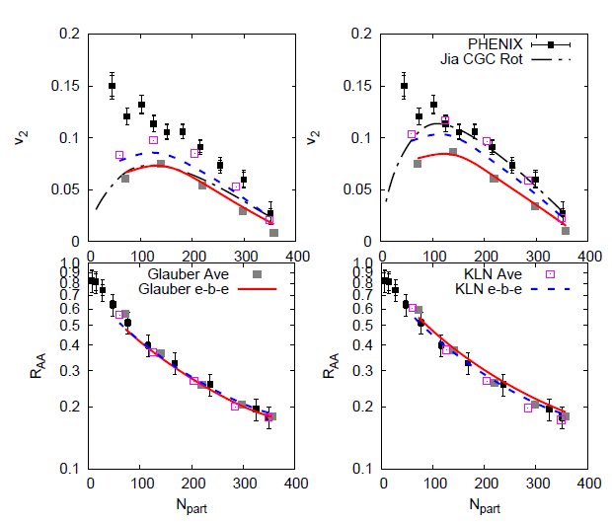
Quantifying Sensitivity to Geometry IC
Effects of geom. on, e.g. v₂, might be quite large
KLN CGC vs. WS Glaub. and rotating RP
Effect not large enough for pQCD
Possibly truly extreme
initial geometry?
See also Renk et al., PRC83 (2011)
Betz, Gyulassy, and Torrieri, arXiv:1102.5416 [nucl-th]

Slide 16
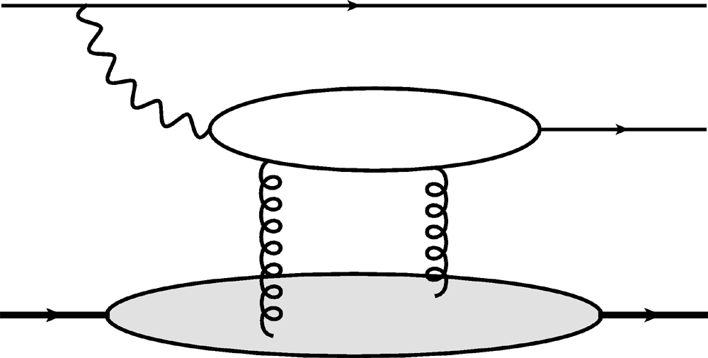
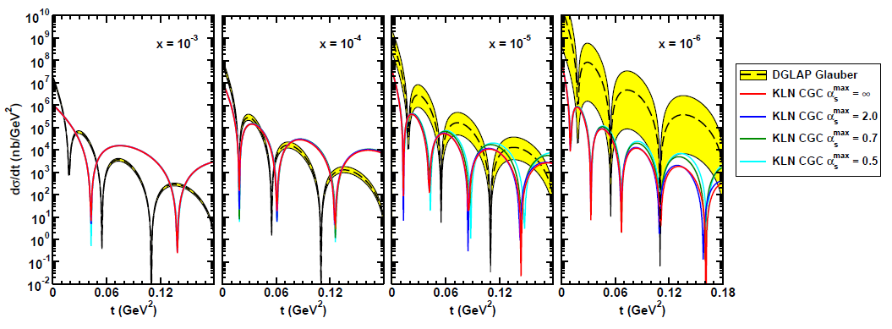
Gluon Distribution of A at x ~ 10⁻³
e
e
Coherent vector meson production in e + A
2 gluon exchange => mean & fluc.
γ*
J/ψ
A
A
Must reject incoherent
collisions at ~100%
WAH, arXiv:1102.5058
Also DVCS and Incoherent production; see talk by A Stasto

Slide 17
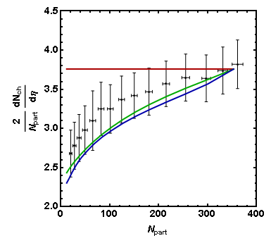
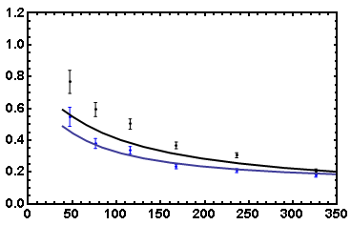
Coupling of Flow to Eloss
Is high-p_{T} v₂ huge due to medium push?
R_{AA}(φ = 0, N_{part}) vs. R_{AA}(φ = π/2, N_{part})
WS Glauber
HN Mixed
KLN CGC
PHENIX Preliminary
7-8 GeV π⁰
R_{AA} in
R_{AA} out
R_{AA}
PHOBOS 2008 Data
N_{part}
Care taken with dN_{g}/dy(N_{part})
Horowitz and Jia, in preparation
Smaller influence of fluc.?

Slide 18
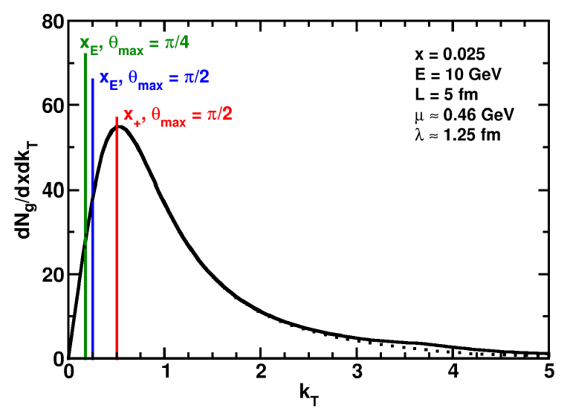
Uncertainty from Wide Angle Radiation
Single inclusive dN_{g}/dx leads to energy loss
All current Eloss calculations assume small angle emission (k_{T} << xE)
This is a bad assumption for RHIC kinematics
WAH and B Cole, PRC81, 2010

Slide 19
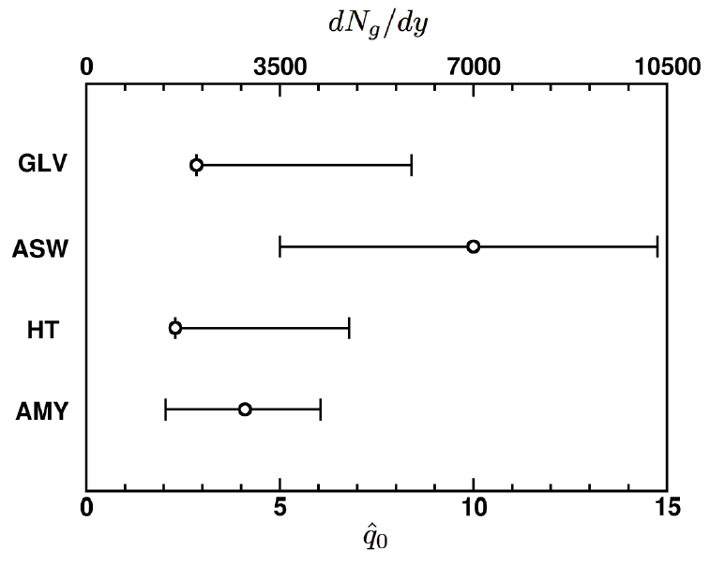
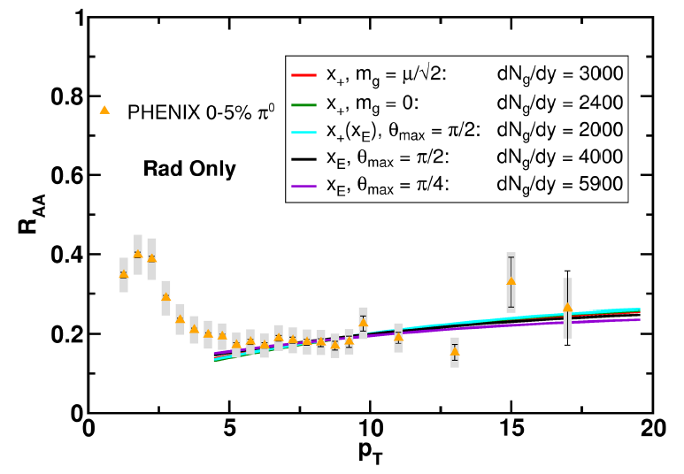
Quantification of Collinear Uncertainty
Factor ~ 3 uncertainty in extracted medium density!
“qhat” values from different formalisms consistent w/i unc.
WAH and B Cole, PRC81, 2010

Slide 20
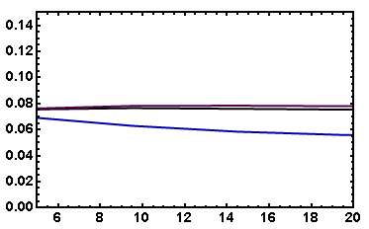
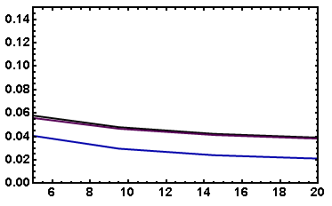
v₂: “Collinearly Safe”
Fix dN_{g}/dy from R_{AA}, calculate v₂
Expect larger v₂ for smaller opening angle
( τ_{coh} ~ 1/k_{T}² )
I_{AA}: coming soon
Rad Only
Rad + El
20-30% π⁰
20-30% π⁰
v₂
v₂
p_{T}
p_{T}
WAH, in preparation

Slide 21
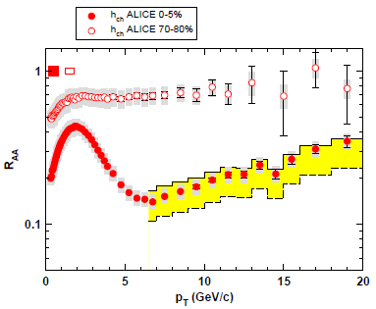
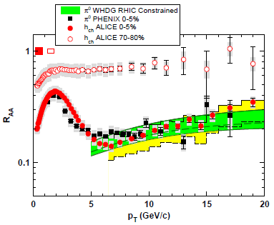
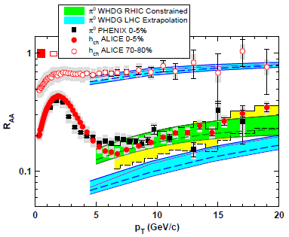
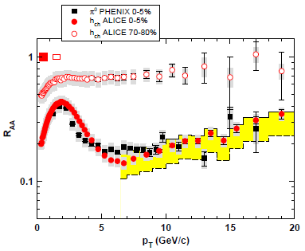
WHDG π⁰ R_{AA} at LHC: First Results
WHDG band from 1-σ RHIC dN_{g}/dy extraction
Note that constrained predictions have small uncertainty from collinear approx
Constrain WHDG at RHIC
Make LHC predictions assuming dN_{g}/dy ~ dN_{ch}/dη
=> dN_{g}^{LHC}/dy = 2.4 dN_{g}^{RHIC}/dy
Data shown at Kruger2010
WAH and M Gyulassy, arXiv:1104.4958

Slide 22
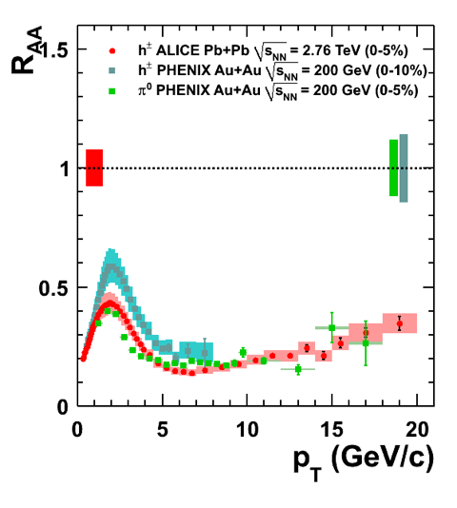
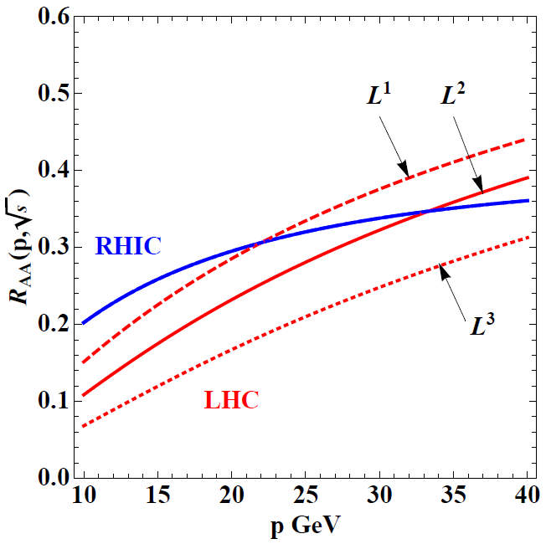
Suppression From RHIC to LHC
Purschke, PHENIX, QM11
WAH and M Gyulassy, arXiv:1104.4958
Non-suppression RHIC to LHC generically hard to understand from dE/dx ~ ρ^{m} Eloss
Eloss insensitive to temperature?

Slide 23
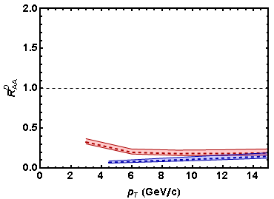
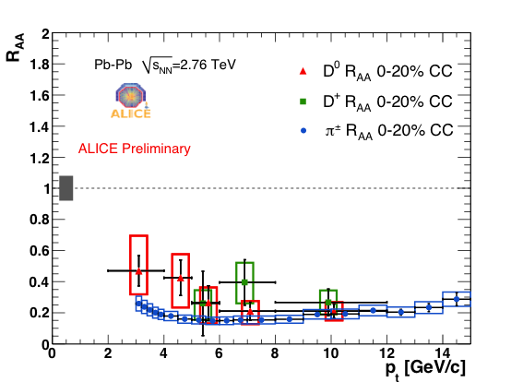
WHDG D R_{AA} at LHC: First Results
D Meson Predictions
R_{AA} requires: production, E-loss, FF
Does not immediately follow that R^{π}_{AA} << R^{D}_{AA} << R^{B}_{AA}
See also A Dainese, ALICE, QM11; CMS B -> J/Ψ
WHDG
π⁰ (Blue)
D (red)
0-20%
J Schukraft, ALICE, QM11

Slide 24
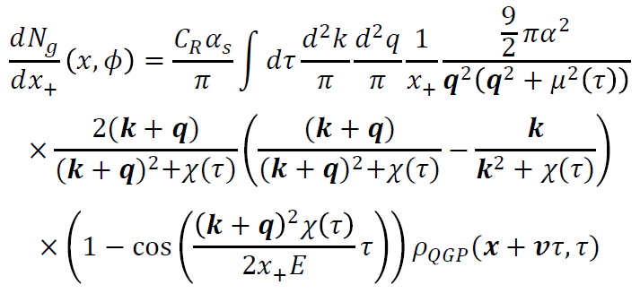
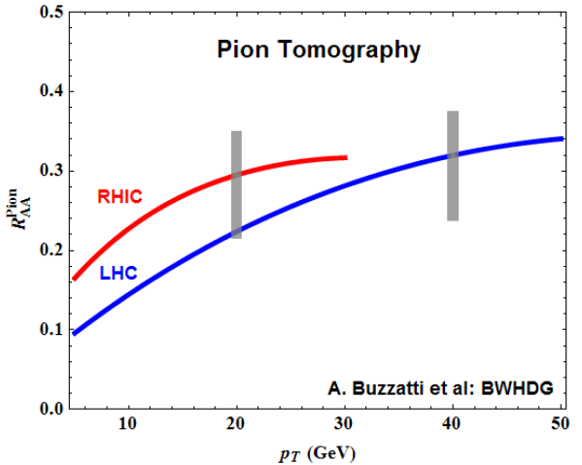
Geometry, Early Time Investigation
Significant progress made
Full geometry integration, dynamical scattering centers
RHIC suppression with dN_{g}/dy = 1000
Large uncertainty due to unconstrained, non-equilibrium τ < τ₀ physics
Future work: higher orders in opacity

Slide 25
Jets in AdS/CFT
Model heavy quark jet energy loss by embedding string in AdS space
dp_{T}/dt = - μ p_{T}
μ = πλ^{1/2} T²/2M_{q}
Similar to Bethe-Heitler
dp_{T}/dt ~ -(T³/M_{q}²) p_{T}
Very different from usual pQCD and LPM
dp_{T}/dt ~ -LT³ log(p_{T}/M_{q})
J Friess, S Gubser, G Michalogiorgakis, S Pufu, Phys Rev D75 (2007)

Slide 26
Compared to Data
String drag: qualitative agreement
WAH, PhD Thesis

Slide 27
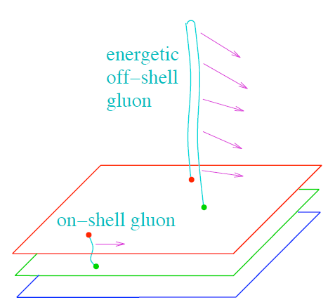
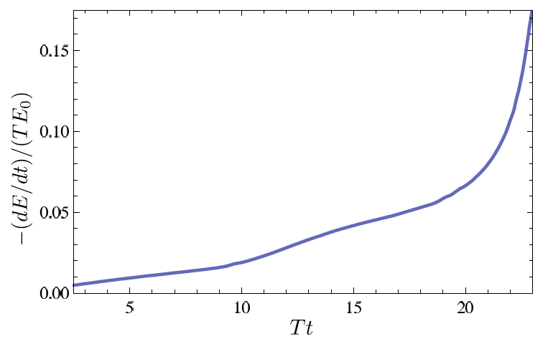
Light Quark and Gluon E-Loss
Chesler et al., PRD79 (2009)
SS Gubser, QM08
Light quarks and gluons: generic Bragg peak
Leads to lack of T dependence?
ΔL^{q}_{therm} ~ E^{1/3}
ΔL^{q}_{therm} ~ (2E)^{1/3}
Gubser et al., JHEP0810 (2008)
Chesler et al., PRD79 (2009)
See also Marquet and Renk,
PLB685 (2010), and
Jia, WAH, and Liao,
arXiv:1101.0290, for v₂

Slide 28
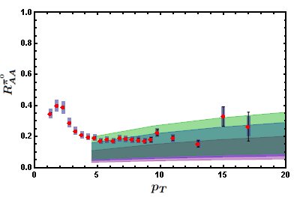
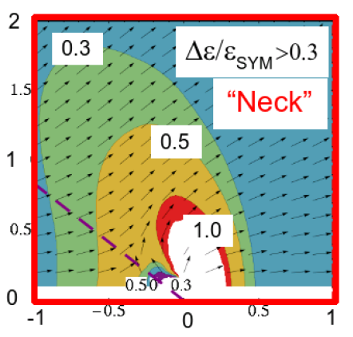
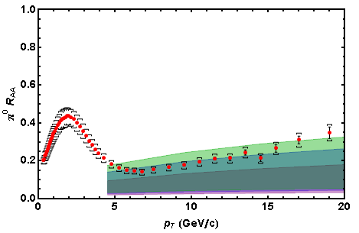
AdS/CFT Energy Loss and Distribution
0.2 TeV
2.76 TeV
Jo Noronha, M Gyulassy, and G Torrieri, PRL102 (2009)
In AdS/CFT, heavy quarks: wide angle energy loss
WAH, in preparation
Simple Bragg peak model

Slide 29
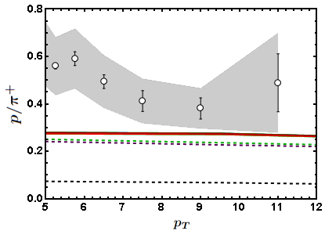
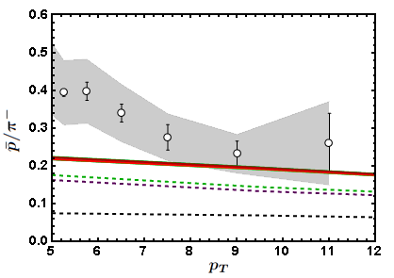
Baryon to Meson Ratios
Distinguishing measurement?
STAR
STAR
AdS/CFT
AdS/CFT
pQCD
pQCD
WAH, in preparation

Slide 30
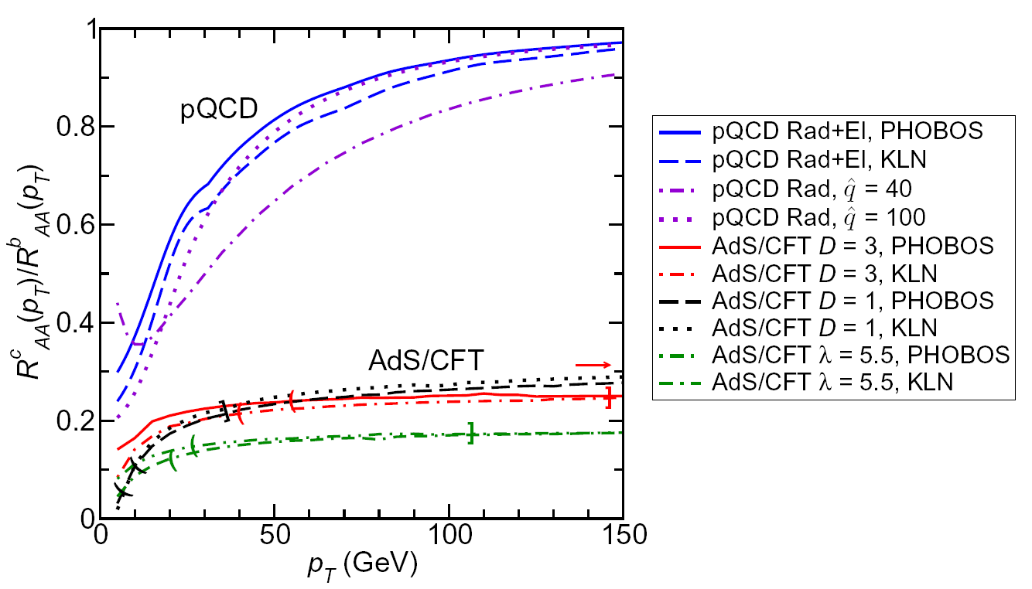
LHC R^{c}_{AA}(p_{T})/R^{b}_{AA}(p_{T}) Prediction (with speed limits)
WAH, M. Gyulassy, PLB666 (2008)
T(τ₀): “(”, corrections likely small for smaller momenta
T_{c}: “]”, corrections likely large for higher momenta
Qualitatively, corrections to AdS/CFT result will drive double ratio to unity

Slide 31
Conclusions: Questions
Does rise in R_{AA}(p_{T}) imply perturbative E-loss dominant at LHC?
To make a qualitative statement need:
Experimental control over production effects
Reduced exp. uncertainties at large (~100 GeV/c) p_{T}
Consistency check btwn pQCD and mult. observables at large (~100 GeV/c) p_{T}, esp. v₂
Data suggests:
surprisingly little T, strong L dependencies
Generically difficult to understand in typical dE/dx picture (both pQCD and AdS/CFT)
E-loss in (currently) uncontrolled pre-thermalization dynamics?
Possibly signal of AdS/CFT Bragg peak physics
Soft particle energy loss at very wide angles
Not inconsistent with pQCD or AdS/CFT pictures
WHDG zero parameter LHC predictions constrained by RHIC appear to:
(Possibly) systematically oversuppress light hadron R_{AA}
Describe light hadron v₂ at “intermediate” p_{T} ~ 20 GeV/c
Describe D meson suppression
CAUTION: many important effects not currently under th. control
AdS Eloss: consistent with RHIC and LHC within large th. uncertainties
Looking forward to exciting future distinguishing measurements, esp. heavy quark suppression separation

Slide 33
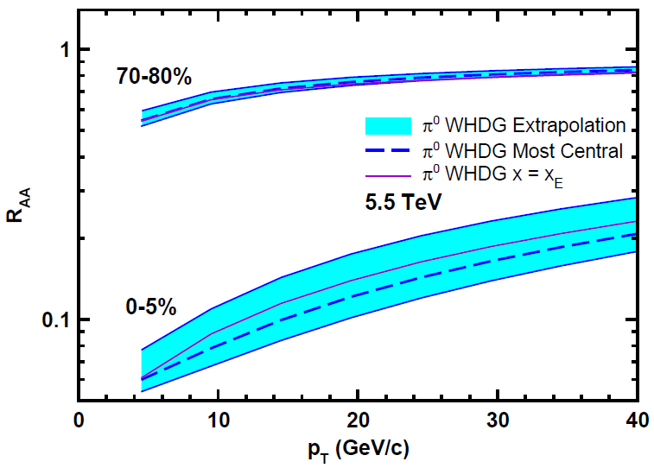
Top Energy Predictions
For posterity:
WAH and M Gyulassy, in preparation

Slide 34
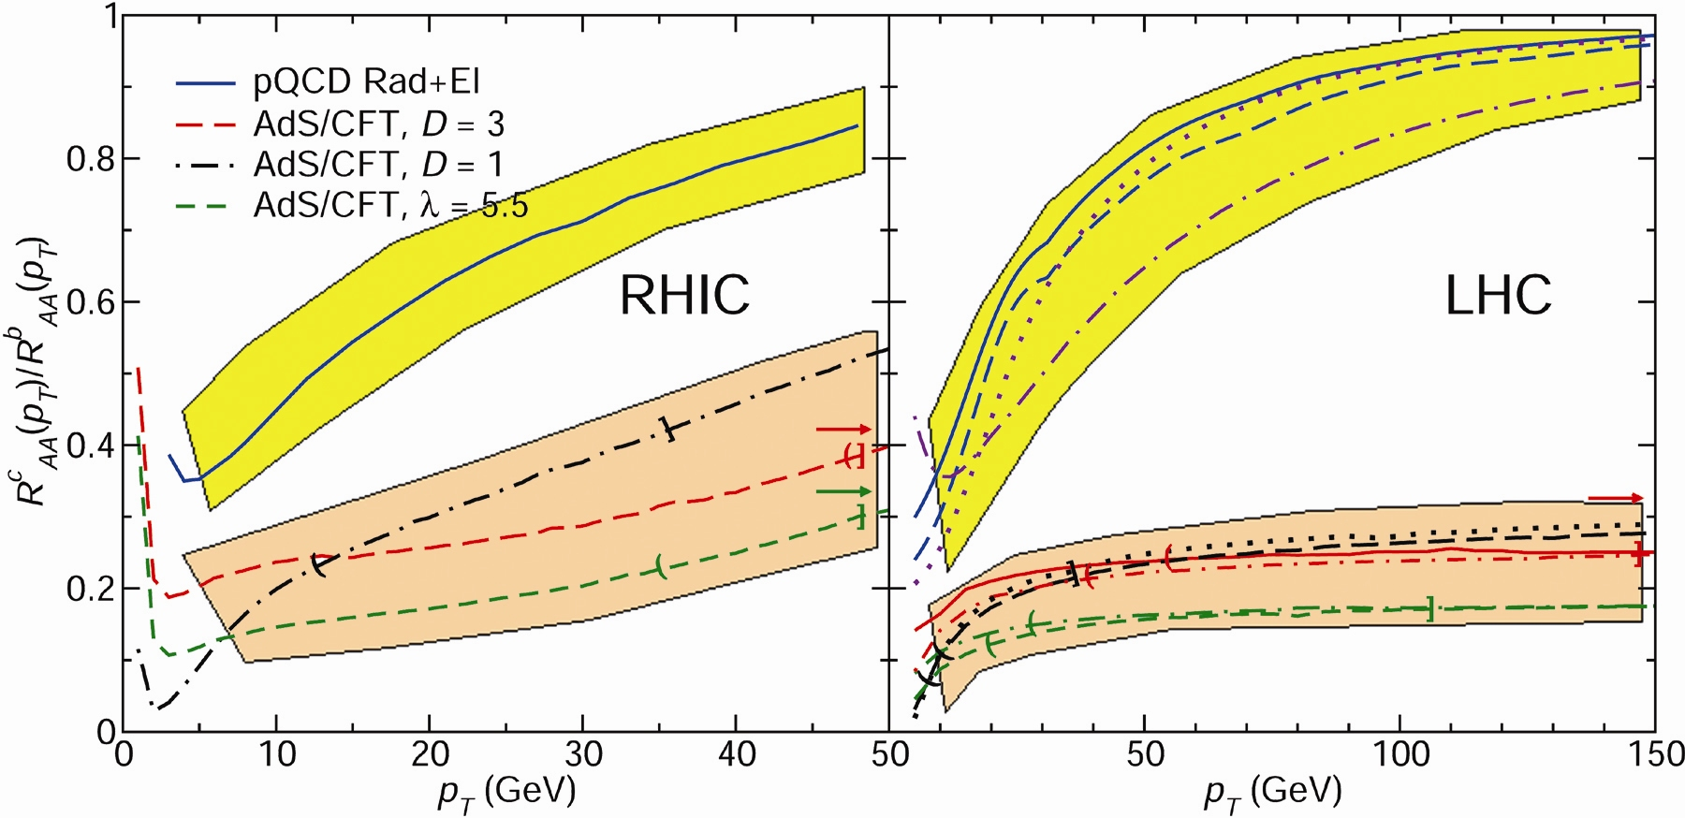
RHIC R^{cb} Ratio
pQCD
pQCD
AdS/CFT
AdS/CFT
WAH, M. Gyulassy, JPhysG35 (2008)
Wider distribution of AdS/CFT curves due to large n: increased sensitivity to input parameters
Advantage of RHIC: lower T => higher AdS speed limits

Slide 35
pQCD Rad Picture
Bremsstrahlung Radiation
Weakly-coupled plasma
Medium organizes into Debye-screened centers
T ~ 250 MeV, g ~ 2
μ ~ gT ~ 0.5 GeV
λ_{mfp} ~ 1/g²T ~ 1 fm
R_{Au} ~ 6 fm
1/μ << λ_{mfp} << L
mult. coh. em.
Gyulassy, Levai, and Vitev, NPB571 (200)
LPM
dp_{T}/dt ~ -LT³ log(p_{T}/M_{q})
Bethe-Heitler
dp_{T}/dt ~ -(T³/M_{q}²) p_{T}

Slide 36
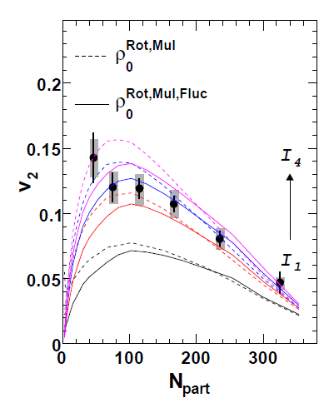
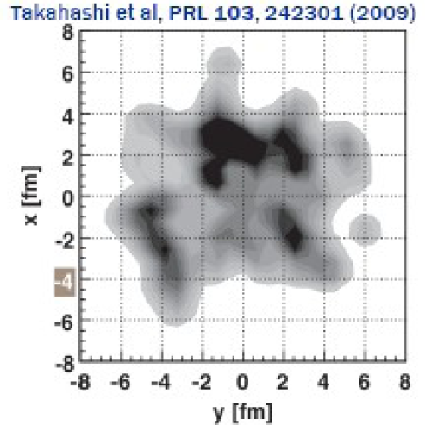
What About Fluctuations?
Hot spots can be huge
NEXUS calculation for 10% most central top RHIC energy event
For simple E-loss not a large effect
Important for fluc., opacity exp.?
Jia and Wei, arXiv:1005.0645

Slide 37
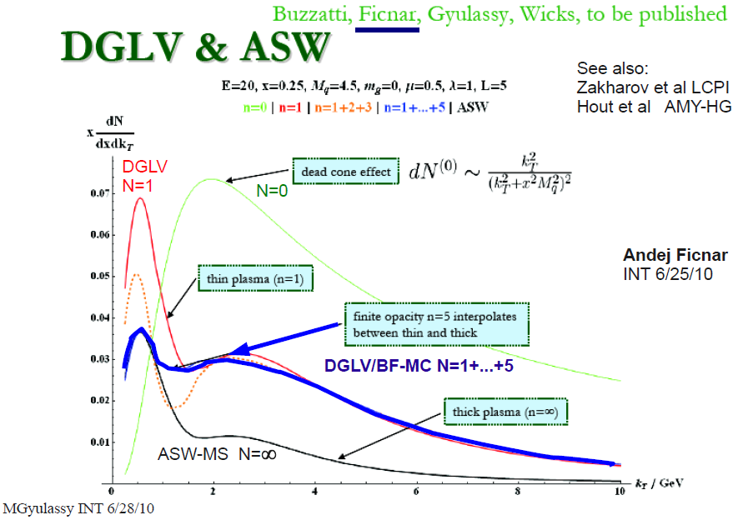
Opacity Corrections
Likely important, but integration over many variables required for comparison to data

Slide 38
Chesler et al., PRD79 (2009)

Slide 39
Appelshauser, ALICE, QM11

Slide 40
pQCD vs. AdS/CFT at LHC
Plethora of Predictions:
WAH, M. Gyulassy, PLB666 (2008)
Taking the ratio cancels most normalization differences
pQCD ratio asymptotically approaches 1, and more slowly so for increased quenching (until quenching saturates)
AdS/CFT ratio is flat and many times smaller than pQCD at only moderate p_{T}
WAH, M. Gyulassy, PLB666 (2008)

Slide 41
Not So Fast!
Speed limit estimate for applicability of AdS drag
γ < γ_{crit} = (1 + 2M_{q}/λ^{1/2} T)²
~ 4M_{q}²/(λ T²)
Limited by M_{charm} ~ 1.2 GeV
Similar to BH LPM
γ_{crit} ~ M_{q}/(λT)
No Single T for QGP
smallest γ_{crit} for largest T
T = T(τ₀, x=y=0): “(”
largest γ_{crit} for smallest T
T = T_{c}: “]”
D7 Probe Brane
Q
Worldsheet boundary Spacelike if γ > γ_{crit}
x₅
Trailing
String
“Brachistochrone”
“z”
D3 Black Brane

Slide 42
RHIC R^{cb} Ratio
pQCD
pQCD
AdS/CFT
AdS/CFT
WAH, M. Gyulassy, JPhysG35 (2008)
Wider distribution of AdS/CFT curves due to large n: increased sensitivity to input parameters
Advantage of RHIC: lower T => higher AdS speed limits

Slide 43
An Enhanced Signal: LHC
But what about the interplay between mass and momentum?
Take ratio of c to b R_{AA}(p_{T})
pQCD: Mass effects die out with increasing p_{T}
Ratio starts below 1, asymptotically approaches 1. Approach is slower for higher quenching
ST: drag independent of p_{T}, inversely proportional to mass. Simple analytic approx. of uniform medium gives
R^{cb}_{pQCD}(p_{T}) ~ n_{b}M_{c}/n_{c}M_{b} ~ M_{c}/M_{b} ~ .27
Ratio starts below 1; independent of p_{T}
R^{cb}_{pQCD}(p_{T}) ∼ 1 - α_{s} n(p_{T}) L² log(M_{b}/M_{c}) ( /p_{T})

Slide 44
pQCD Rad Picture
Bremsstrahlung Radiation
Weakly-coupled plasma
Medium organizes into Debye-screened centers
T ~ 250 MeV, g ~ 2
μ ~ gT ~ 0.5 GeV
λ_{mfp} ~ 1/g²T ~ 1 fm
R_{Au} ~ 6 fm
1/μ << λ_{mfp} << L
mult. coh. em.
Gyulassy, Levai, and Vitev, NPB571 (200)
LPM
dp_{T}/dt ~ -LT³ log(p_{T}/M_{q})
Bethe-Heitler
dp_{T}/dt ~ -(T³/M_{q}²) p_{T}

Slide 45
pQCD E-loss Picture
Bremsstrahlung Radiation
Weakly-coupled plasma
Medium organizes into Debye-screened centers
T ~ 250 MeV, g ~ 2
μ ~ gT ~ 0.5 GeV
λ_{mfp} ~ 1/g²T ~ 1 fm
R_{Au} ~ 6 fm
1/μ << λ_{mfp} << L
mult. coh. em.
LPM
dp_{T}/dt ~ -LT³ log(p_{T}/M_{q})
Bethe-Heitler
dp_{T}/dt ~ -(T³/M_{q}²) p_{T}
c.f. Elastic Loss
dp_{T}/dt ~ -T² log(p_{T}/M_{q})
Gyulassy, Levai, and Vitev, NPB571 (2002)

