Slide 1
Energy Loss Calculations, RHIC, and First Results from LHC
W. A. Horowitz
University of Cape Town
July 21, 2011
With many thanks to Alessandro Buzzatti, Brian Cole, Miklos Gyulassy, Jiangyong Jia, and Yuri Kovchegov

Slide 2




Four Fundamental Forces
Gravity
Electromagnetism
starchild.gsfc.nasa.gov
John Maarschalk, travelblog.portfoliocollection.com
Weak
Strong
lhs.lps.org/staff/sputnam/chem_notes/tritium_decay.gif

Slide 3

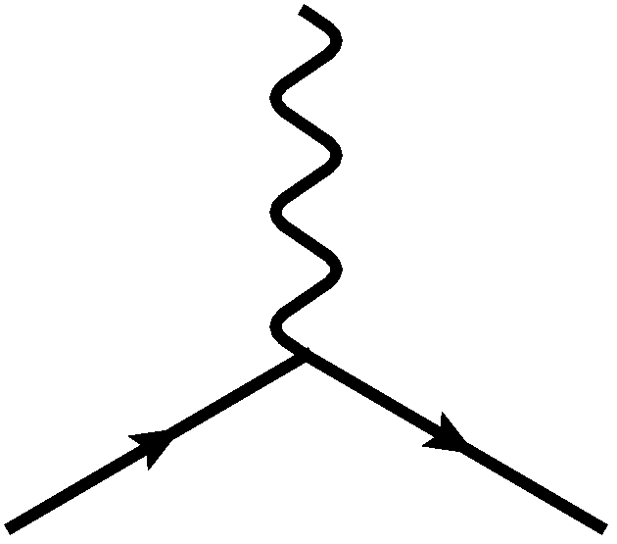
E&M Particle Physics Well Understood
Lagrangian known:
QED Vertex:
Ex. of Precision QED: g - 2
Gabrielse et al., PRL97 (2006)
Hanneke, Fogwell, and Gabrielse, PRL100 (2008)

Slide 4
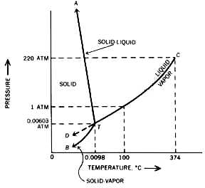

E&M and Phase Diagrams
Many body physics less well understood
Water
Hydrogen
www.sv.vt.edu/classes/MSE2094_NoteBook/96ClassProj/examples/triplpt.html
Calculated, Burkhard Militzer,
Diploma Thesis, Berlin, 2000

Slide 5




QCD Particle Physics Well Understood
Lagr. known:
QCD Vertices:
Qual. & Quant. agreement w/ data
ALEPH,
PLB284
(1992)
PDG

Slide 6

What Are We Interested In?
Measure many-body physics of strong force
Test & understand theory of many-body non-Abelian fields
Long Range Plan, 2008
Notes:
Unique as compared to strongly coupled Abelian problems

Slide 7
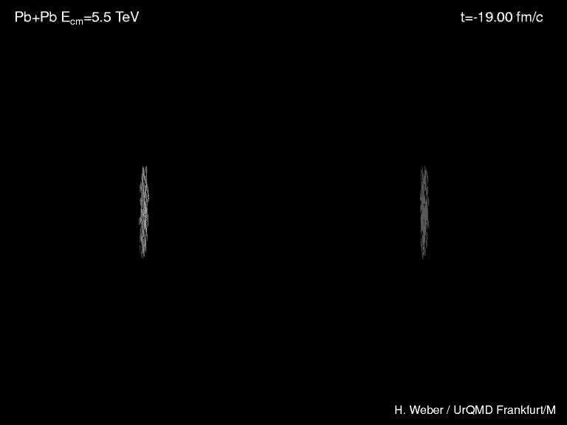
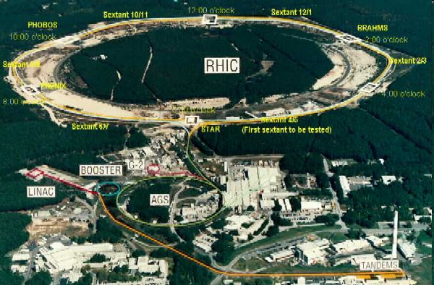
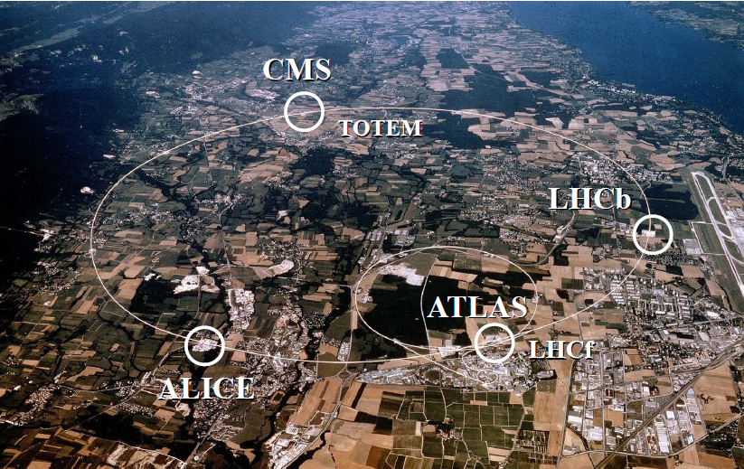
Heavy Ion Collisions
Collider machines: RHIC, LHC
Relativistic Heavy Ion Collider
Large Hadron Collider

Slide 8
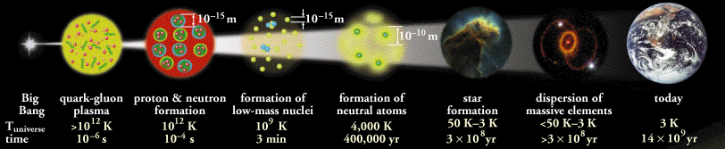
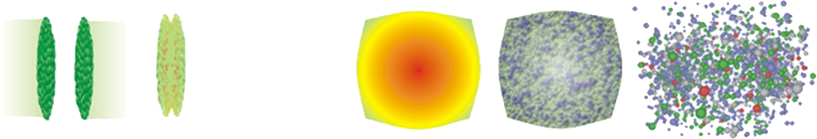
Big Bang vs. Little Bang
ALICE Collaboration
High Momentum Particle
t = - ∞
t = 0
t ~ 1 fm/c
t = + ∞
Initial State
Initial Overlap
Thermalization
QGP
Hadronization
Hadron Gas

Slide 9


QGP Energy Loss
Learn about E-loss mechanism
  Most direct probe of DOF
pQCD Picture
AdS/CFT Picture

Slide 10

pQCD Rad Picture
Bremsstrahlung Radiation
  Weakly-coupled plasma
    Medium organizes into Debye-screened centers
  T ~ 250 MeV, g ~ 2
    μ ~ gT ~ 0.5 GeV
    λ_{mfp} ~ 1/g²T ~ 1 fm
    R_{Au} ~ 6 fm
  1/μ << λ_{mfp} << L
    mult. coh. em.
Gyulassy, Levai, and Vitev, NPB571 (2000)
  LPM
    dp_{T}/dt ~ -LT³ log(p_{T}/M_{q})
  Bethe-Heitler
    dp_{T}/dt ~ -(T³/M_{q}²) p_{T}

Slide 11
High Momentum Particles in AdS/CFT
Model heavy quark jet energy loss by embedding string in AdS space
  dp_{T}/dt = - μ p_{T}
  μ = πλ^{1/2} T²/2M_{q}
  Similar to Bethe-Heitler
    dp_{T}/dt ~ -(T³/M_{q}²) p_{T}
  Very different from usual pQCD and LPM
    dp_{T}/dt ~ -LT³ log(p_{T}/M_{q})
J Friess, S Gubser, G Michalogiorgakis, S Pufu, Phys Rev D75 (2007)

Slide 12

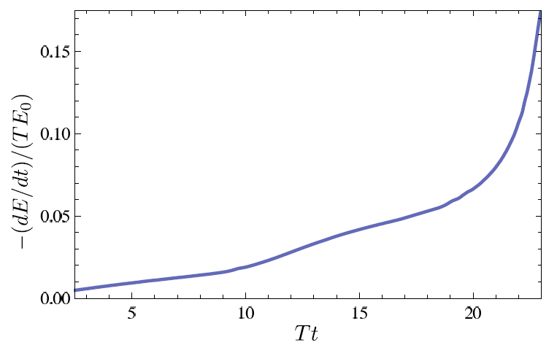
Light Quark and Gluon E-Loss
Chesler et al., PRD79 (2009)
SS Gubser, QM08
Light quarks and gluons: generic Bragg peak
  Leads to lack of T dependence?
ΔL^{q}_{therm} ~ E^{1/3}
ΔL^{q}_{therm} ~ (2E)^{1/3}
Gubser et al., JHEP0810 (2008)
Chesler et al., PRD79 (2009)
Arnold and Vaman, JHEP 1104 (2011)
See also Marquet and Renk,
PLB685 (2010), and
Jia, WAH, and Liao,
arXiv:1101.0290, for v₂

Slide 13


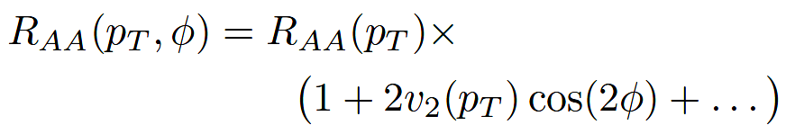
High-p_{T} Observables
    Naively: if medium has no effect, then R_{AA} = 1
    Common variables used are transverse momentum, p_{T}, and angle with respect to the reaction plane, φ
p_{T}
, γ, e⁻
    Fourier expand R_{AA}:
φ

Slide 14

pQCD Success at RHIC:
(circa 2005)
Y. Akiba for the PHENIX collaboration, hep-ex/0510008
  Consistency: R_{AA}(η)~R_{AA}(π)
  Null Control: R_{AA}(γ)~1
  GLV Prediction: Theory~Data for reasonable fixed L~5 fm and dN_{g}/dy~dN_{π}/dy

Slide 15
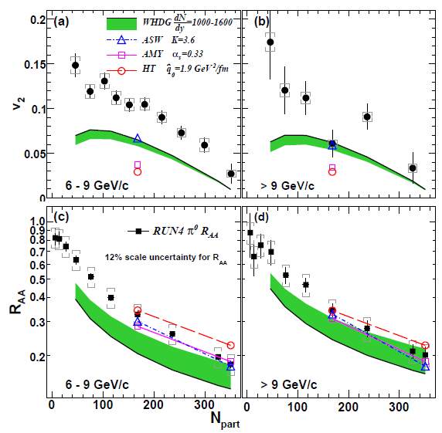
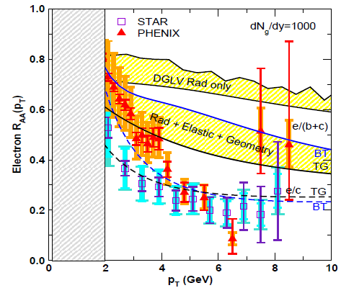
pQCD Picture Inadequate at RHIC
Lack of simultaneous description of multiple observables
  even with inclusion of elastic loss
PHENIX, PRL 105 (2010)
Wicks et al., NPA784, 2007
See also J Jia from QM09,
J Nagle QM09
Pert. at LHC energies?

Slide 16
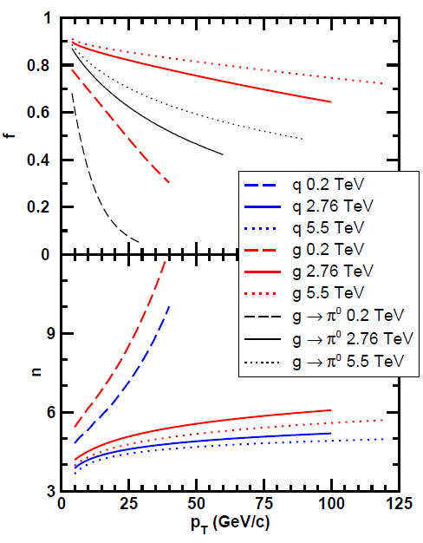
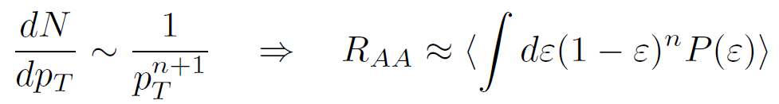
Qualitative Expectations for LHC
  For approx. power law production and energy loss probability P(ε), ε = (E_{i} - E_{f})/E_{i}
  Asymptotically, pQCD => ΔE/E ~ log(E/μ)/E
    ~ flat R_{AA}(p_{T}) at RHIC
    Rising R_{AA}(p_{T}) at LHC
  NB: LHC is a glue machine

Slide 17
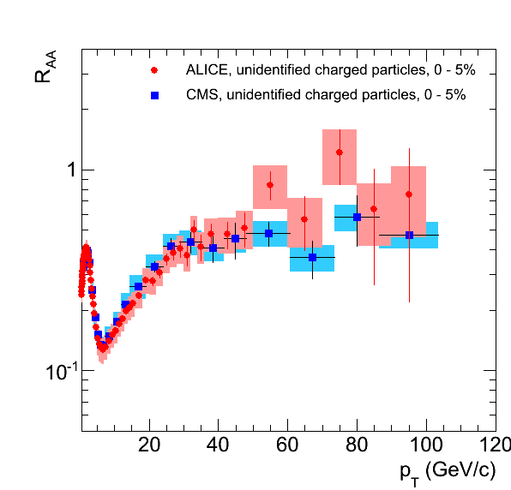
pQCD at LHC?
Appelshauser, ALICE, QM11
p_{T} rise in data readily understood from generic perturbative physics!

Slide 18
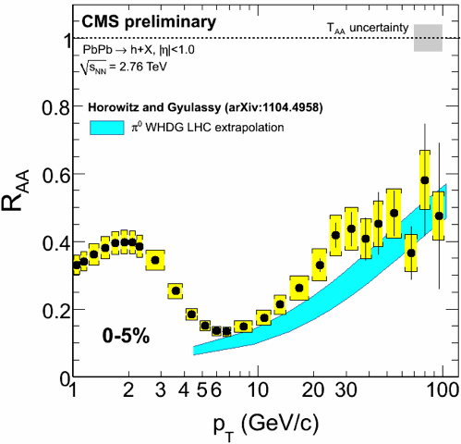
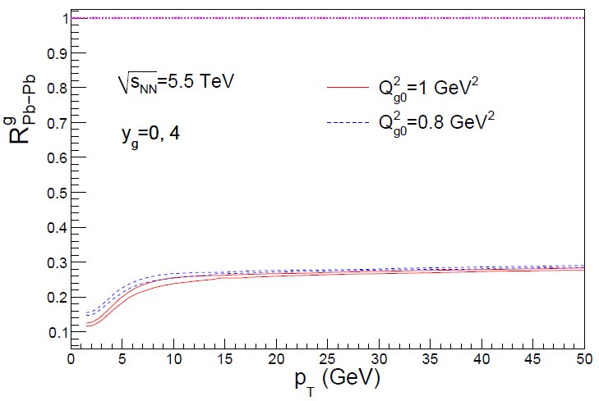
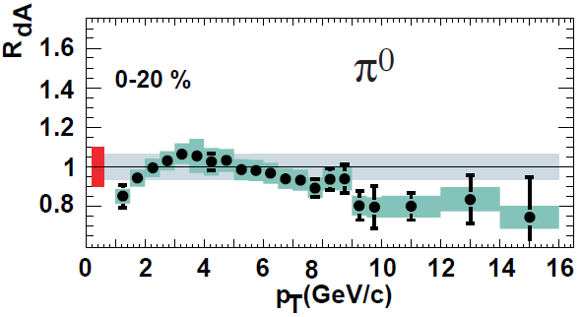
Rise in R_{AA} a Final State Effect?
  Is rise really due to pQCD?
  Or other quench (flat?)
+ initial state CNM effects a la CGC?
Y-J Lee, QM11
Albacete and Marquet, PLB687 (2010)
Require p + A and/or direct γ
PHENIX PRL98, 2007

Slide 19
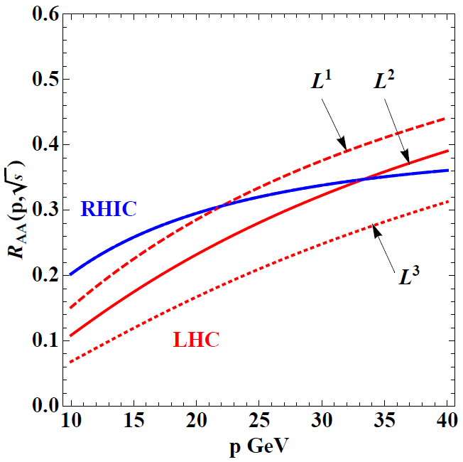
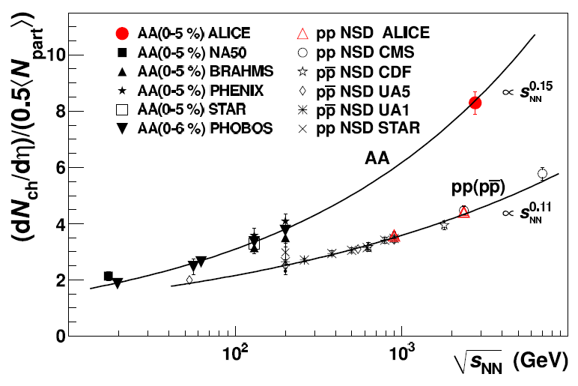
Qual Norm of R_{AA} From RHIC to LHC
Assume QGP density scales with observed particle multiplicity: ~2.5x more dense than RHIC
ALICE, PRL105, 2010
WAH and M Gyulassy, arXiv:1104.4958
  Suppression from RHIC to LHC generically increases

Slide 20
Quant. (Qual?) Conclusions Require...
Further experimental results
Theoretically, investigation of the effects of
  higher orders in
    α_{s} (large)
    k_{T}/xE (large)
    M_{Q}/E (large?)
    opacity (large?)
  geometry
    uncertainty in IC (small)
    coupling to flow (large?)
    Eloss geom. approx. (?)
    τ < τ₀ (large: see Buzzatti and Gyulassy)
    dyn. vs. static centers (see Buzzatti and Gyulassy)
    hydro background (see Renk, Majumder)
  better treatment of
    Coh. vs. decoh. multigluons (see Mehtar-Tani)
    elastic E-loss
    E-loss in confined matter

Slide 21
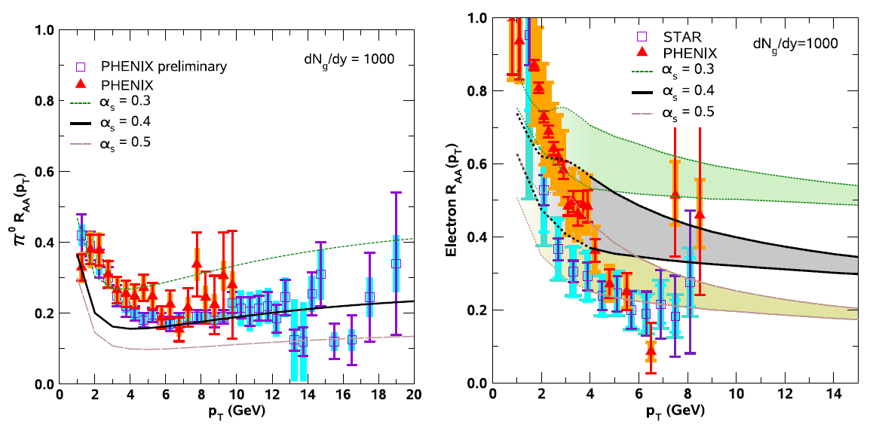
Varying α_{s} has huge effect
<ε>_{rad,pQCD} ~ α_{s}³; <ε>_{el,pQCD} ~ α_{s}²
  Role of running coupling, irreducible uncertainty from non-pert. physics?
  Nontrivial changes from better elastic treatment
S Wicks, PhD Thesis

Slide 22
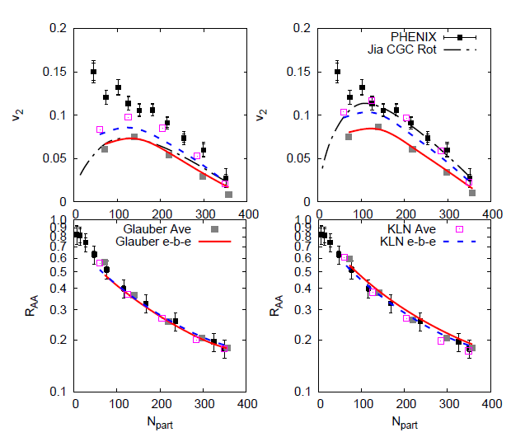
Quantifying Sensitivity to Geometry IC
Effects of geom. on, e.g. v₂, might be quite large
  KLN CGC vs. WS Glaub. and rotating RP
  Effect not large enough for pQCD
Possibly truly extreme
initial geometry?
      See also Renk et al., PRC83 (2011), Jia, WH, Liao, 1101.0290
Betz, Gyulassy, and Torrieri, arXiv:1102.5416 [nucl-th]

Slide 23
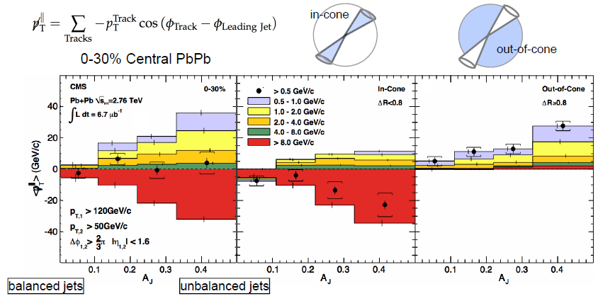
Aside: pQCD and Jet Measurements
  CMS sees redistribution of lost energy at large angles
    Naive pQCD expectation: collinear radiation
Wyslouch, CMS, QM11

Slide 24
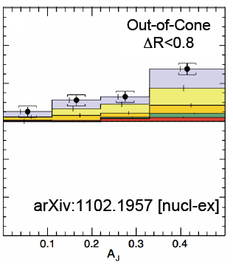
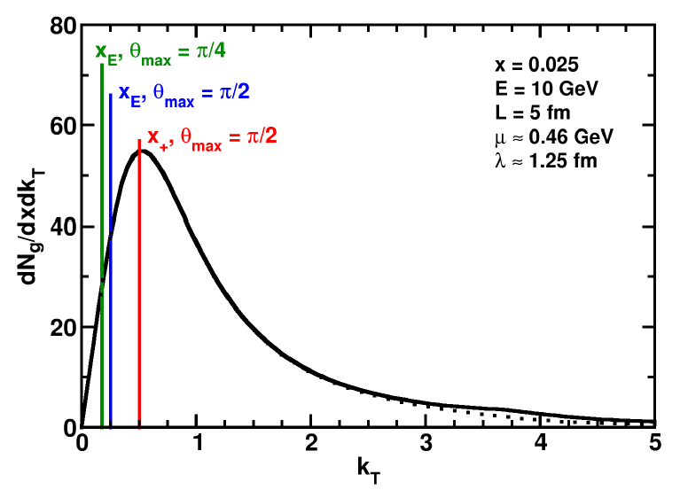
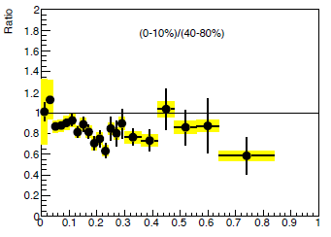
pQCD and Wide Angle Radiation
  Naively, pQCD =>
  x_{typical}, θ_{typical} ~ μ/E; μ ~ 0.5 GeV
  All current Eloss calculations assume small angle emission
  (k_{T} << xE)
  Collinear approximation is (maximally) violated; x_{typ} ~ μ/E
  pQCD not obviously inconsistent
C Roland, CMS, QM11
z
WAH and B Cole, PRC81, 2010
B Cole, ATLAS, QM11

Slide 25
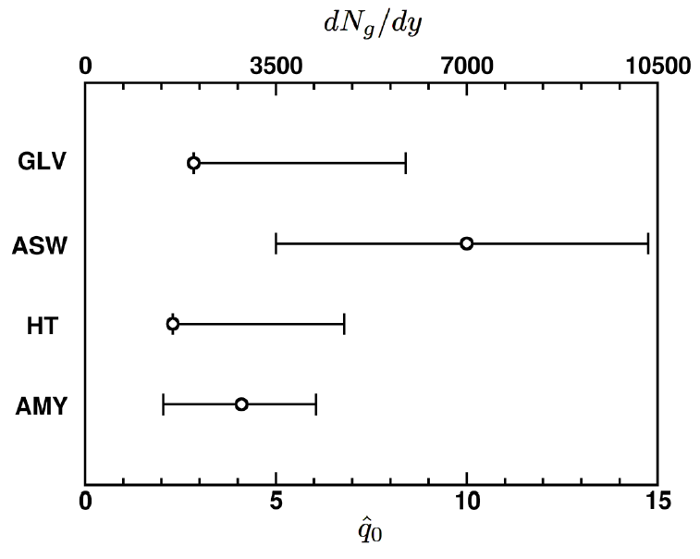
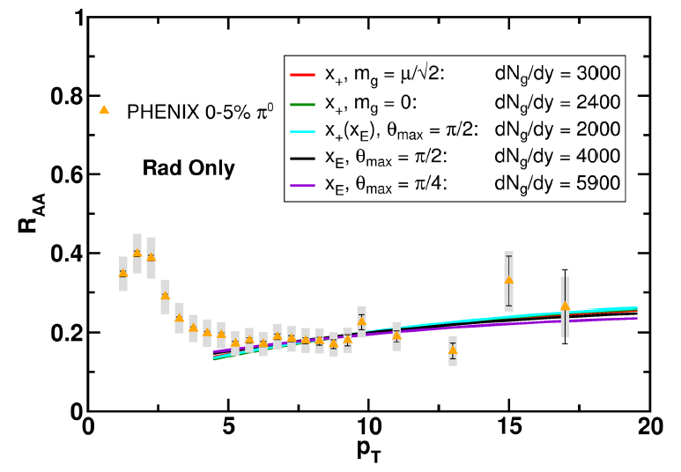
Quantification of Collinear Uncertainty
Factor ~ 3 uncertainty in extracted medium density!
“qhat” values from different formalisms consistent w/i unc.
WAH and B Cole, PRC81, 2010

Slide 26
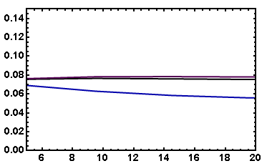
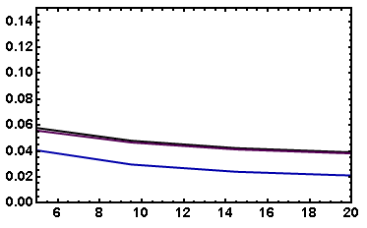
Coll. Approx. and Constrained v₂
Fix dN_{g}/dy from R_{AA}, calculate v₂
  Expect: larger v₂ for smaller opening angle
    τ_{coh} = xE/k_{T}² larger for smaller θ_{max}
      more paths in deep LPM (ΔE ~ L²) region
  Not large sensitivity
    Rad Only
    Rad + El
20-30% π⁰
20-30% π⁰
v₂
v₂
p_{T}
WAH, in preparation
p_{T}

Slide 27
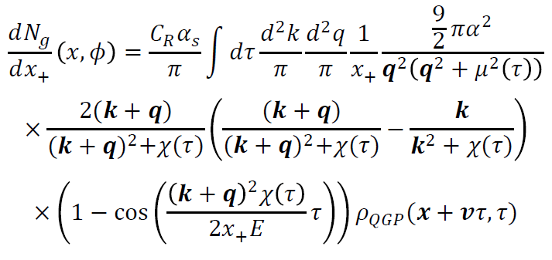
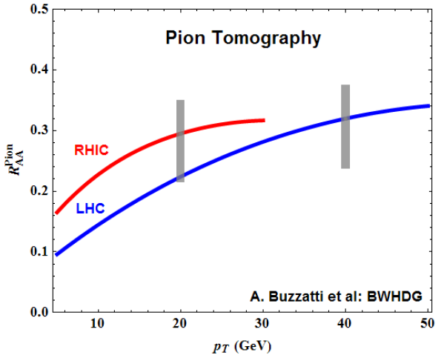
Geometry, Early Time Investigation
    Significant progress made
      Full geometry integration, dynamical scattering centers
      RHIC suppression with dN_{g}/dy = 1000
      Large uncertainty due to unconstrained, non-equilibrium τ < τ₀ physics
      Future work: higher orders in opacity
Buzzatti and Gyulassy, 1106.3061

Slide 28
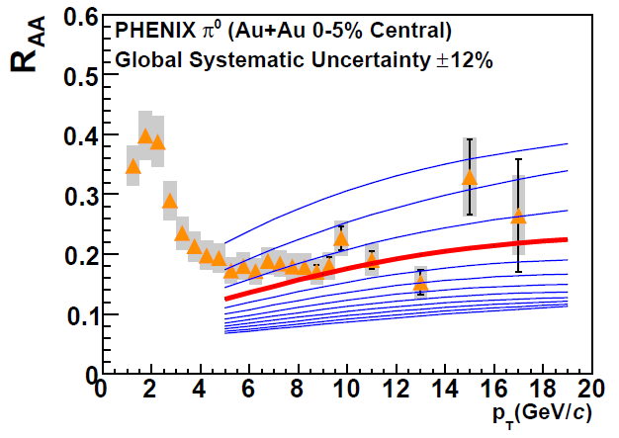
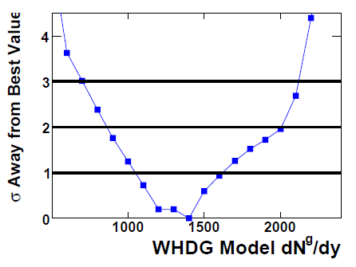
With Caveats in Mind...
Quantitatively compare a parameter free “prediction” from WHDG for LHC, rigorously constrained by RHIC
  Increase density at LHC by observed increase in particle multiplicity
PHENIX PRC77, 2008

Slide 29
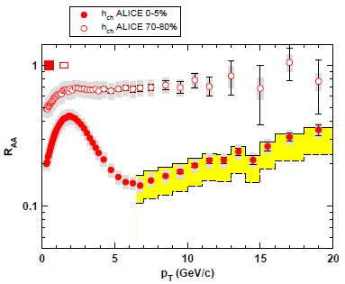
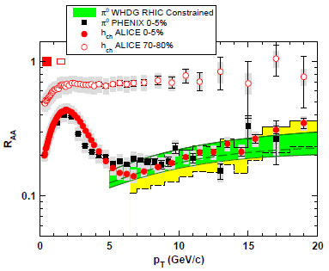
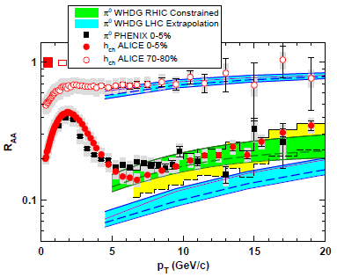
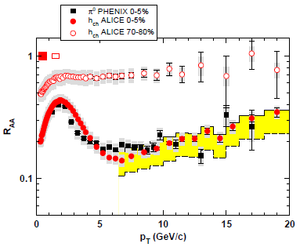
WHDG π⁰ R_{AA} at LHC: First Results
  WHDG band from 1-σ RHIC dN_{g}/dy extraction
  Note that constrained predictions have small uncertainty from collinear approx
  Constrain WHDG at RHIC
  Make LHC predictions assuming dN_{g}/dy ~ dN_{ch}/dη
  => dN_{g}^{LHC}/dy = 2.4 dN_{g}^{RHIC}/dy
Data shown at Kruger2010
WAH and M Gyulassy, arXiv:1104.4958

Slide 30
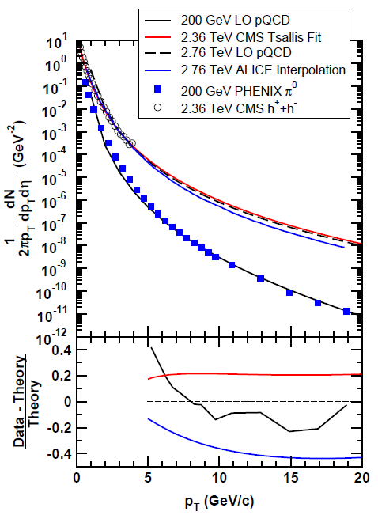
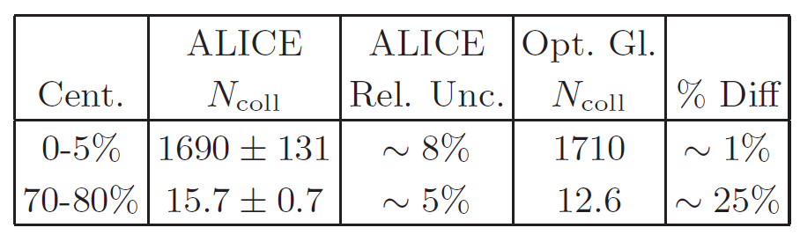
ALICE Published Results
  NB: ALICE unmeasured p + p interpolation > LO pQCD
  Also, small reported unc. in N_{bin}
    Fluctuations important at large centralities
WAH and M Gyulassy,
arXiv:1104.4958

Slide 31
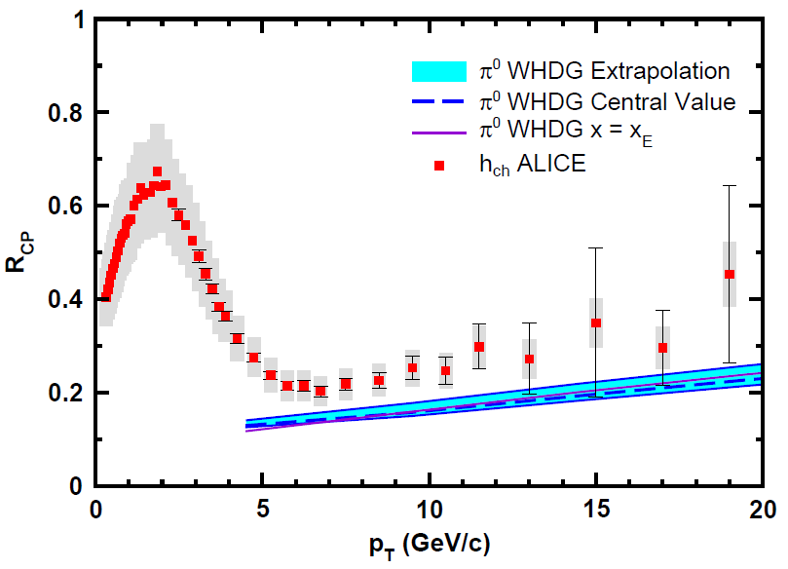
WHDG Compared to R_{CP}
Examine R_{CP}, ratio of central to peripheral R_{AA}
  p + p uncertainty cancels
  0-5% R_{AA} to
  70-80% R_{AA}
  Validity of E-loss in very peripheral collisions?
WAH and M Gyulassy, arXiv:1104.4958

Slide 32
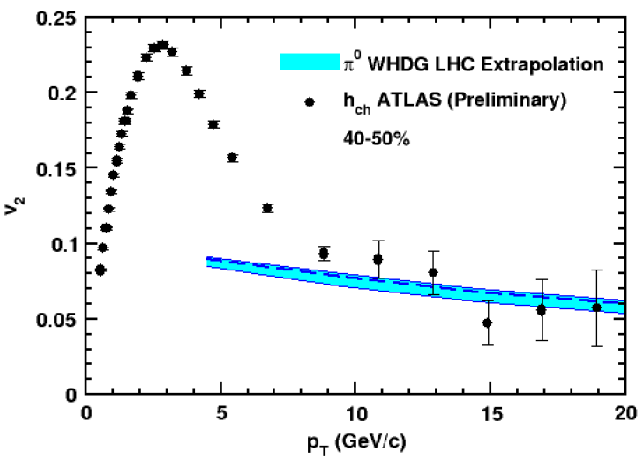
WHDG Describes R_{AA} and v₂?
  Fixed by RHIC data, parameter-free WHDG describes preliminary R_{AA} and v₂ quite well
    v₂ at very high p_{T}?
Y-J Lee, QM11 and
cdsweb.cern.ch/record/1352777
WAH and M Gyulassy,
arXiv:1107.2136

Slide 33
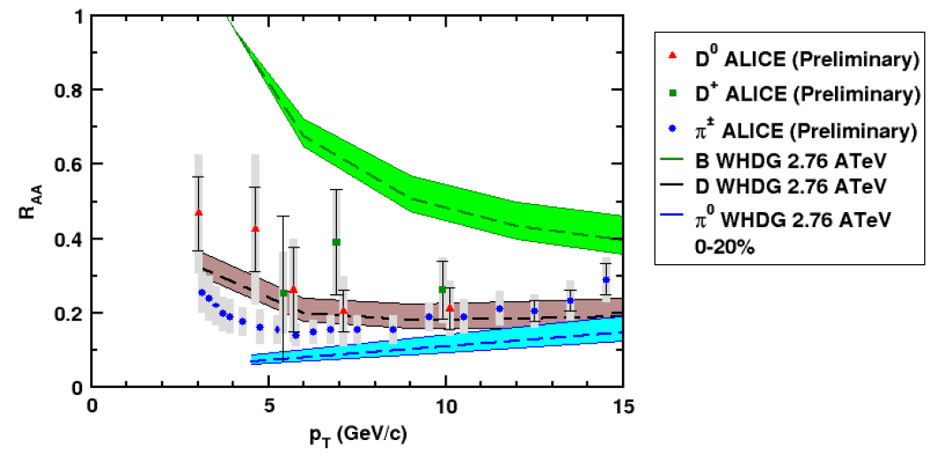
And D R_{AA} at LHC?
  NB: R_{AA} requires production, E-loss, FF
    Does not immediately follow that R^{π}_{AA} << R^{D}_{AA} << R^{B}_{AA}
WAH and M Gyulassy, arXiv:1107.2136

Slide 34
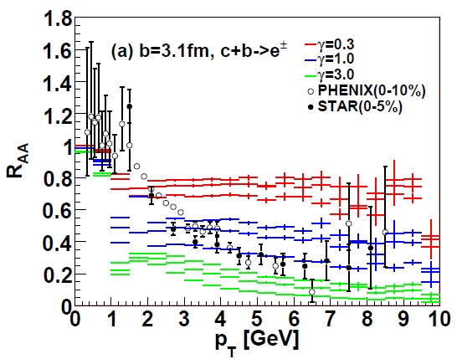
AdS/CFT at RHIC
String drag: qualitative agreement in heavy flavor sector
WAH, PhD Thesis
Akamatsu, Hatsuda, and Hirano, PRC79, 2009

Slide 35

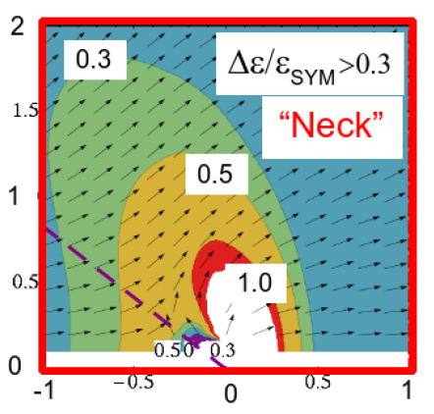
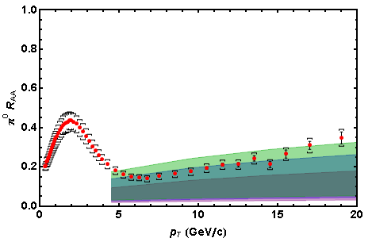
AdS/CFT Energy Loss and Distribution
0.2 TeV
2.76 TeV
Jo Noronha, M Gyulassy, and G Torrieri, PRL102 (2009)
In AdS/CFT, heavy quarks: wide angle energy loss
WAH, in preparation
Simple Bragg peak model

Slide 36

LHC R^{c}_{AA}(p_{T})/R^{b}_{AA}(p_{T}) Prediction
(with speed limits)
WAH, M. Gyulassy, PLB666 (2008)
      T(τ₀): “(”, corrections likely small for smaller momenta
      T_{c}: “]”, corrections likely large for higher momenta
Qualitatively, corrections to AdS/CFT result will drive double ratio to unity

Slide 37
Measuring the Initial Gluon State
What is the spatial distribution of gluons in a highly boosted nucleus?
What are the initial conditions fed into hydro in HIC?
T Hirano, et al.,
Phys.Lett.B636, 2006

Slide 38
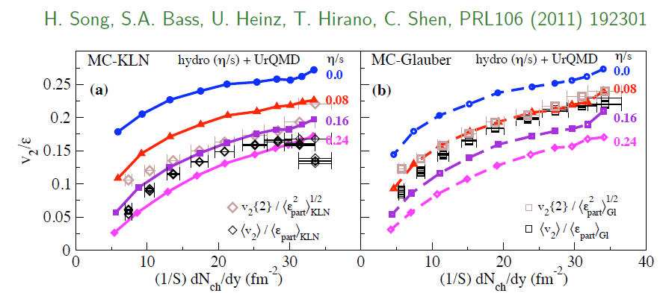
η/s Extraction
Factor at least 2 uncertainty in η/s from IC
  Naive pQCD => η/s ~ 1
  Naive AdS/CFT => η/s ~ 1/4π
Teaney, Users’ Meeting 2011

Slide 39
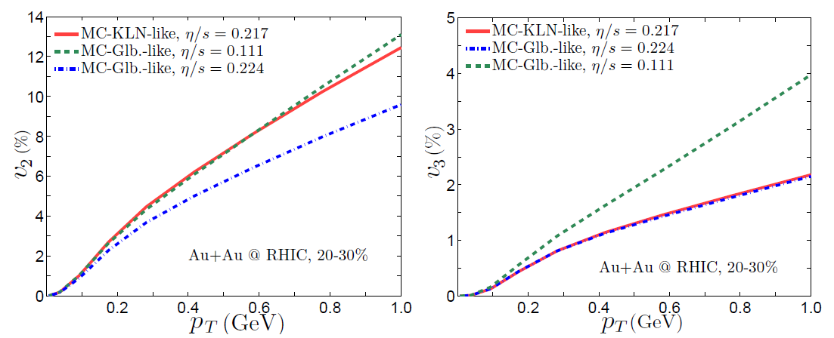
IC from Higher Harmonics
Chen et al., arXiv:1106.6350

Slide 40
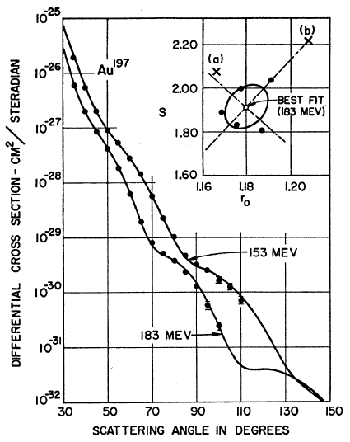
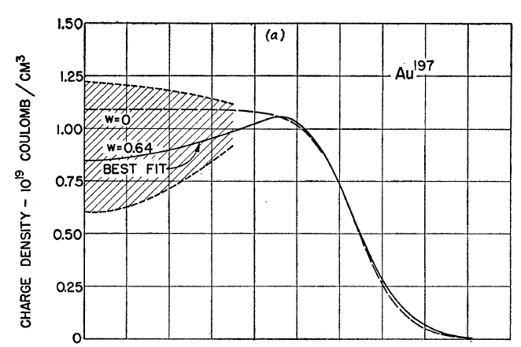
Measuring the IC
eRHIC could give experimental handle on initial geometry
  Recall e + A diffraction exps. on A at rest
Hahn, Ravenhall, and Hofstadter, Phys Rev 101 (1956)

Slide 41
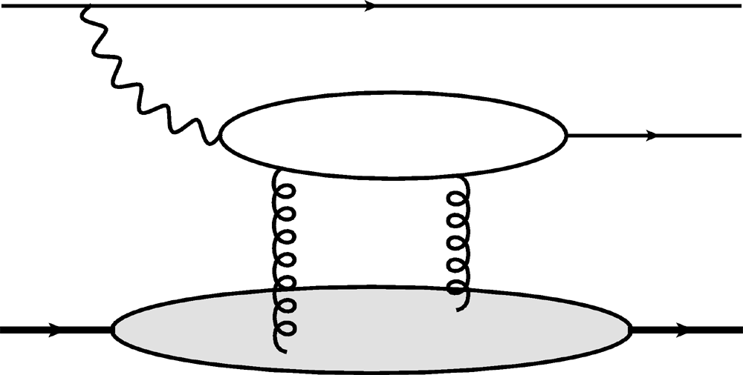

Gluon Distribution of A at x ~ 10⁻³
e
e
γ*
J/ψ
Coherent vector meson production in e + A
A
A
Must reject incoherent
collisions at ~100%
WAH, arXiv:1102.5058

Slide 42
Conclusions (1 of 2)
Does rise in R_{AA}(p_{T}) imply perturbative E-loss dominant at LHC?
  To make a qualitative statement need:
    Experimental control over production effects
    Reduced exp. uncertainties at large (~100 GeV/c) p_{T}
    Consistency check btwn pQCD and multiple observables at large (~100 GeV/c) p_{T}, especially v₂
Recent LHC Results:
  Published ALICE R_{AA} suppression generically difficult to understand in typical dE/dx picture (both pQCD and AdS/CFT)
    E-loss in (currently) uncontrolled pre-thermalization dynamics?
    Possibly signal of AdS/CFT Bragg peak physics
  Soft particle energy loss at very wide angles
    Not inconsistent with pQCD or AdS/CFT pictures

Slide 43
Conclusions (2 of 2)
WHDG zero parameter LHC predictions constrained by RHIC appear to:
  (Possibly) systematically oversuppress light hadron R_{AA}
  Describe light hadron v₂ at “intermediate” p_{T} ~ 20 GeV/c
  Describe D meson suppression
    CAUTION: many important effects not currently under theoretical control
    HOWEVER: qualitative agreement suggests continued effort interesting and worthwhile
AdS Eloss: consistent with RHIC and LHC within large theoretical uncertainties
  Looking forward to exciting future distinguishing measurements, esp. heavy quark suppression separation
Exciting prospects for measuring initial spatial distribution of gluons in a highly relativistic nucleus at an EIC

