Slide 1
EVMP: Nucleons vs. Nuclei An Update
W. A. Horowitz
University of Cape Town
February 2, 2012

Slide 2
Motivation
Many-body QCD:
Quantitative extraction of properties (η/s, E-loss,...) requires quantitative knowledge of the geometry
Physics of “the edge” very important, not under good theoretical control (non-perturbative)
EVMP provides an independent, direct measurement of the small-x nuclear profile
Very sensitive to edge physics

Slide 3
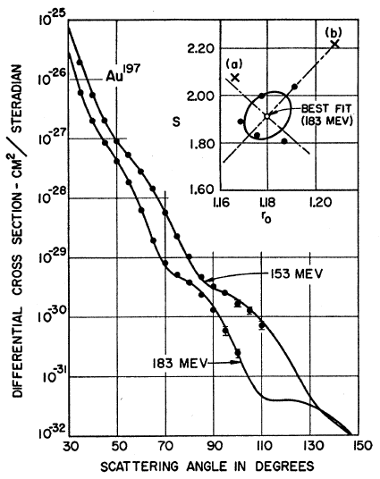
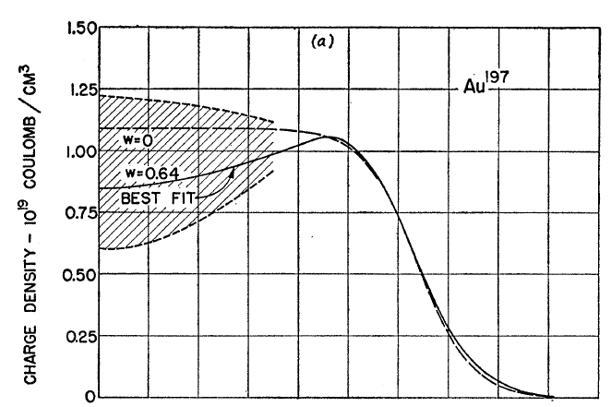
Motivating EVMP
Recall e + A exps. on A at rest
Invert Dirac => Woods-Saxon distribution!
Hahn, Ravenhall, and Hofstadter, Phys Rev 101 (1956)

Slide 4
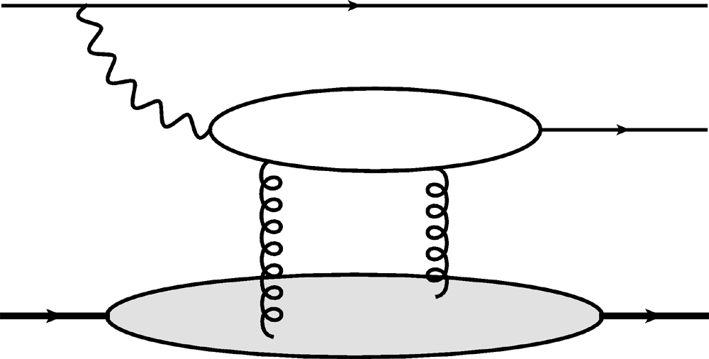
Gluon Distribution of A
e
e
J/ψ
Coherent vector meson production in e + A
γ*
A
A
Invert dσ/dt to measure gluon distribution
See diff. in dσ/dt from diff. gluon evolution?

Slide 5
dσ/d²b: DGLAP
First Work: Compare DGLAP and KLN 2-gluon exchange straw men
1) Assume incoherent interaction with nucleons (a la Caldwell & Kowalksi) & DGLAP
T: glue distribution in nucleon:
Integrate over WS distribution of nucleons in nucleus

Slide 6
dσ/d²b: KLN
2) small-x evo. approx. by KLN
xg_{A} is integrated KLN UGD: coherent nuclear effect
Simple KLN form for UGD
Back of the envelope calc. of Q_{s}

Slide 7
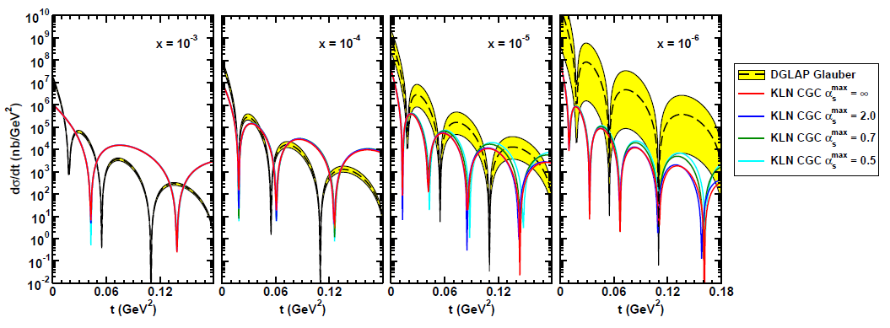
EVMP dσ/dt Result
Must reject incoherent
collisions at ~100%
WAH, arXiv:1102.5058
Huge growth in DGLAP Glauber x-scn
Nuclear shape changes for KLN, not for DGLAP Glauber

Slide 8
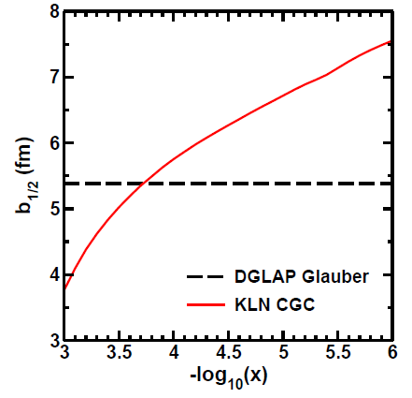
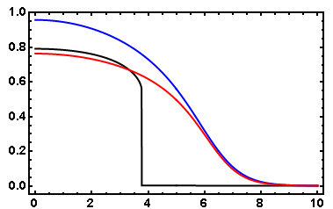
Two Issues
1) Only 2 gluon exchange
Expect mult. int. at saturation
Both straw men can violate black-disc limit
2) Pathology in nuclear size for KLN
DGLAP Glauber (Blue)
KLN CGC (Black)
IPSat (Red)
dσ/d²b
r = 1 GeV⁻¹
x = 10⁻³
b (fm)

Slide 9
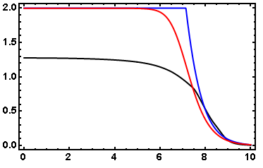
First, Unitarize
Cut off DGLAP dipole at 1
Exponentiate KLN
r = 1 GeV⁻¹
x = 10⁻⁶
dσ/d²b
DGLAP Glauber (Blue)
KLN CGC (Black)
IPSat (Red)
b (fm)

Slide 10
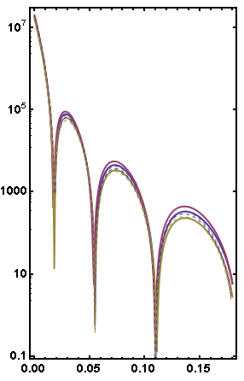
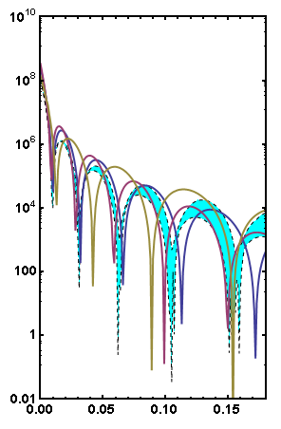
Unitarized Results
DGLAPU (B, P, G; solid)
DGLAP (B, P, G; dashed)
DGLAPU (B, P, G)
KLNU (Teal Band)
x = 10⁻³
x = 10⁻⁶
dσ/dt
dσ/dt
t (GeV²)
t (GeV²)
Sig. shape diff. from unitarization. NB esp. changes due to MSTW uncertainties, KLN’s slower dropoff
Little Change at “large” x

Slide 11
Conclusions & Future Work
Conclusions:
10⁻⁶ Results tantalizing proof of principle
See effect of coherence, saturation
Large effects from unconstrained PDF
Future Work
dσ/dt directly from dσ/d²b = 2N from rcBK
Comparison over range in x, including “large” x
Smaller PDF uncertainties
Explicitly see evolution of nuclear size with x

Slide 13
dσ/d²b
Simple 2-gluon exchange
Assume DGLAP evo. of glue & incoherent interaction with nucleons
Assume small-x evo. approx. by KLN
xg_{A} is integrated KLN UGD, coherent nuclear effect

Slide 14
KLN Gluon Distribution
Obtain GD from UGD
Simple KLN form for UGD
Back of the envelope Q_{s} formula

Slide 15
Gluon Distribution of A at x ~ 10⁻³
e
e
J/ψ
Coherent vector meson production in e + A
γ*
A
A
Must reject incoherent
collisions at ~100%
WAH, arXiv:1102.5058

Slide 16
X-scn:

Slide 17
dσ/d²b
Simple 2-gluon exchange
Assume DGLAP evo. of glue & incoherent interaction with nucleons
Assume small-x evo. approx. by KLN
xg_{A} is integrated KLN UGD, coherent nuclear effect

