Slide 1
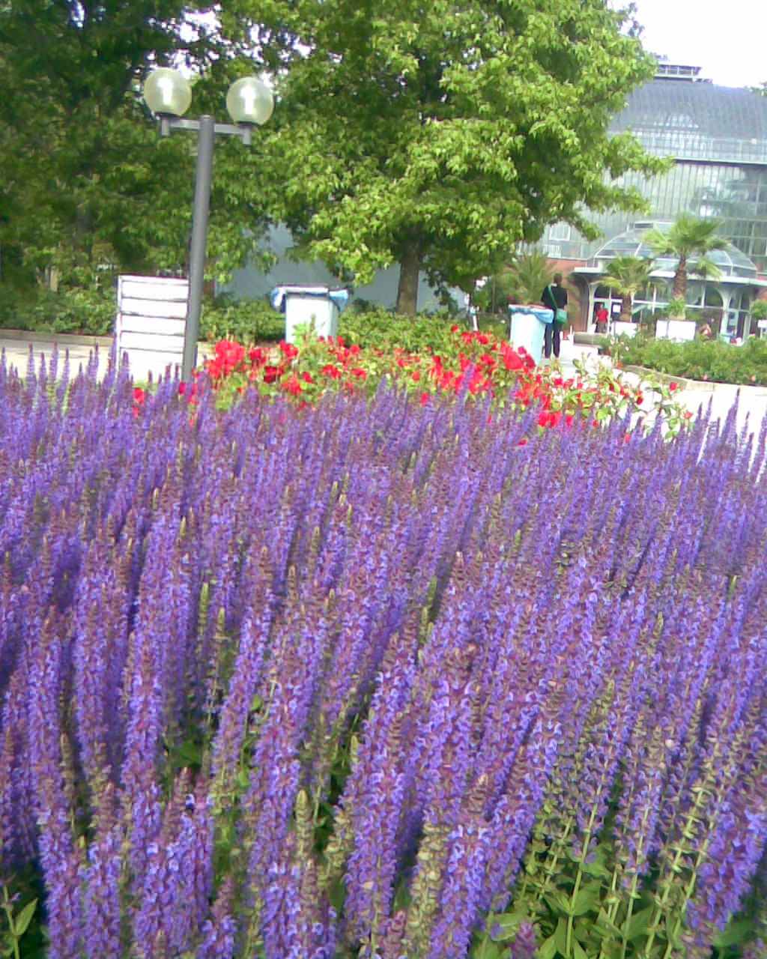
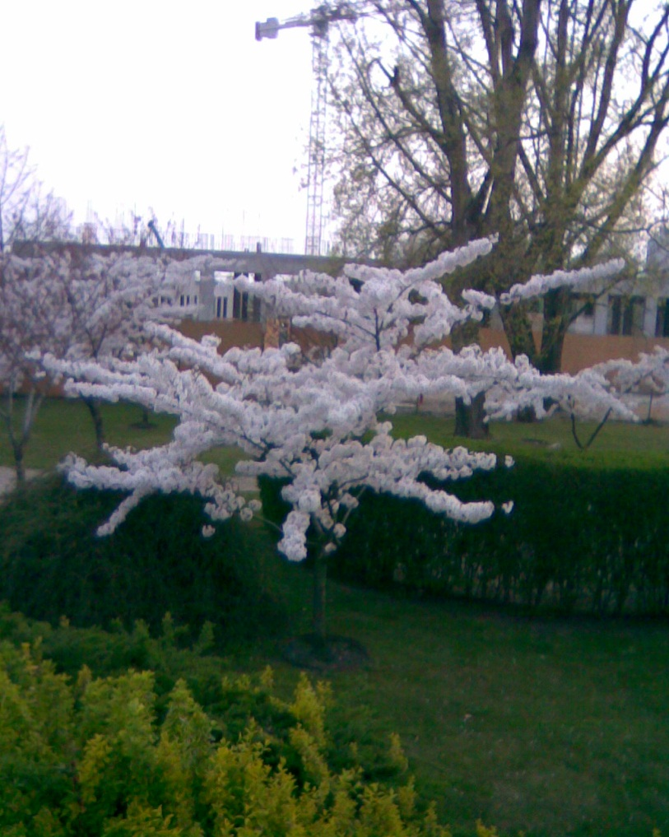
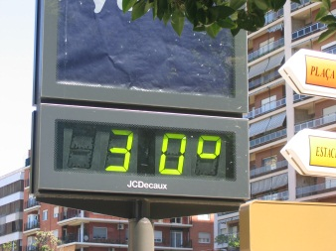
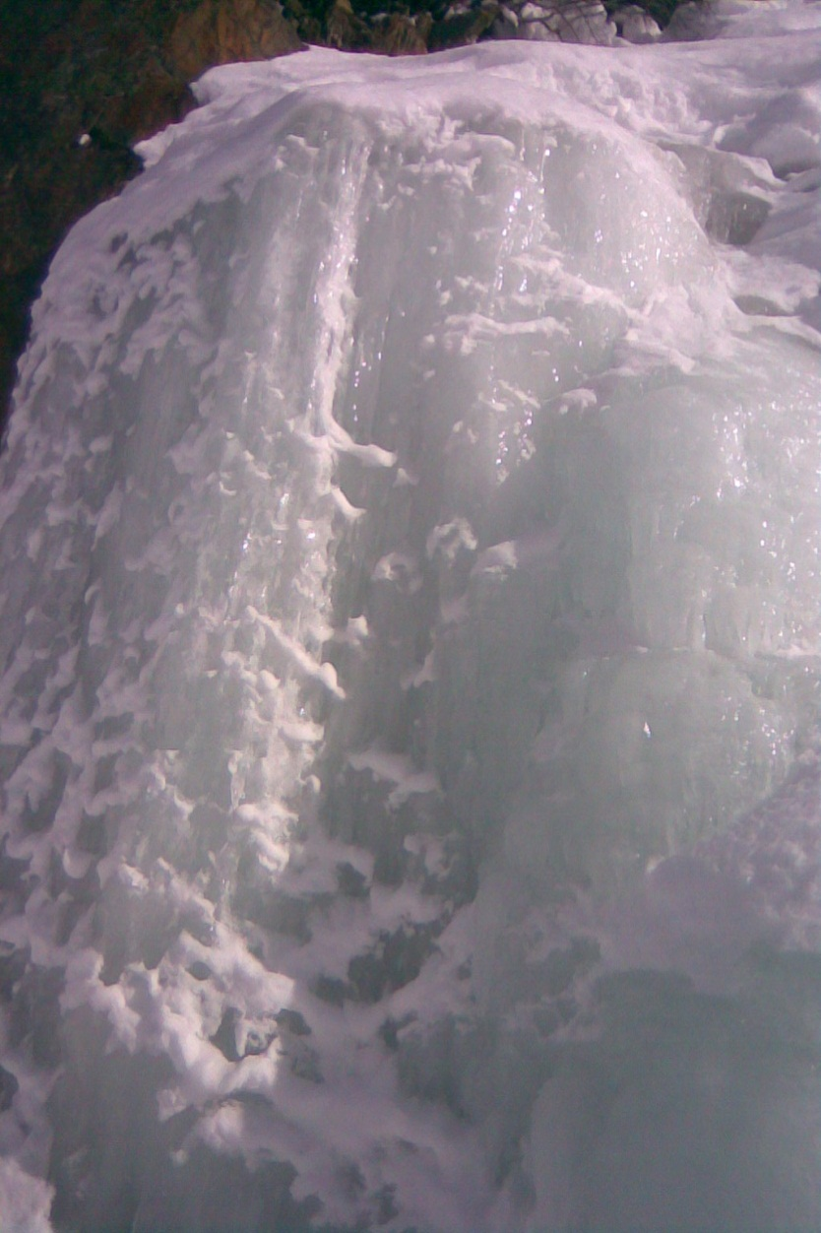
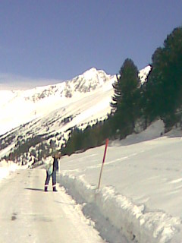
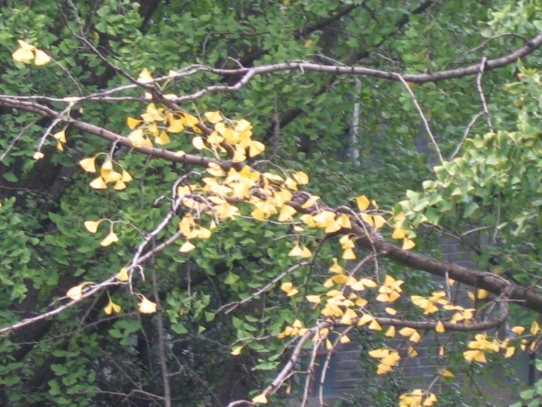
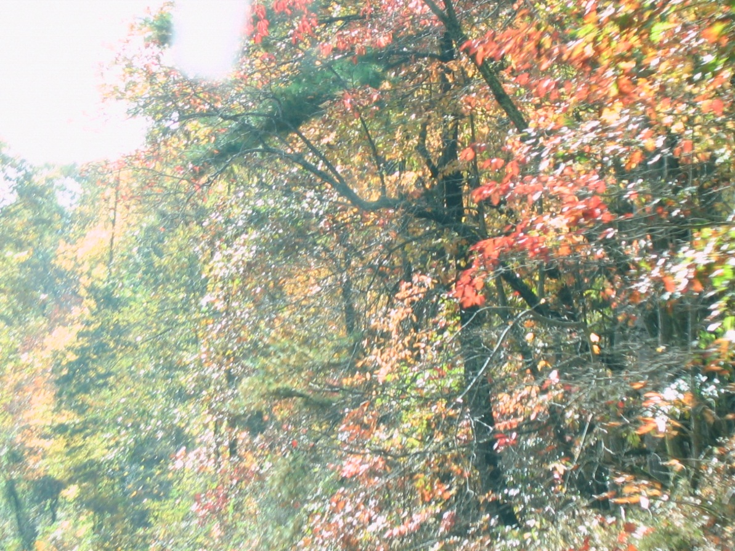
Notes:
Exploring QCD Frontiers: 2012 (ITP), Jan. 30. – Feb.03. 2012, Stellenbosch, South Africa

Slide 2
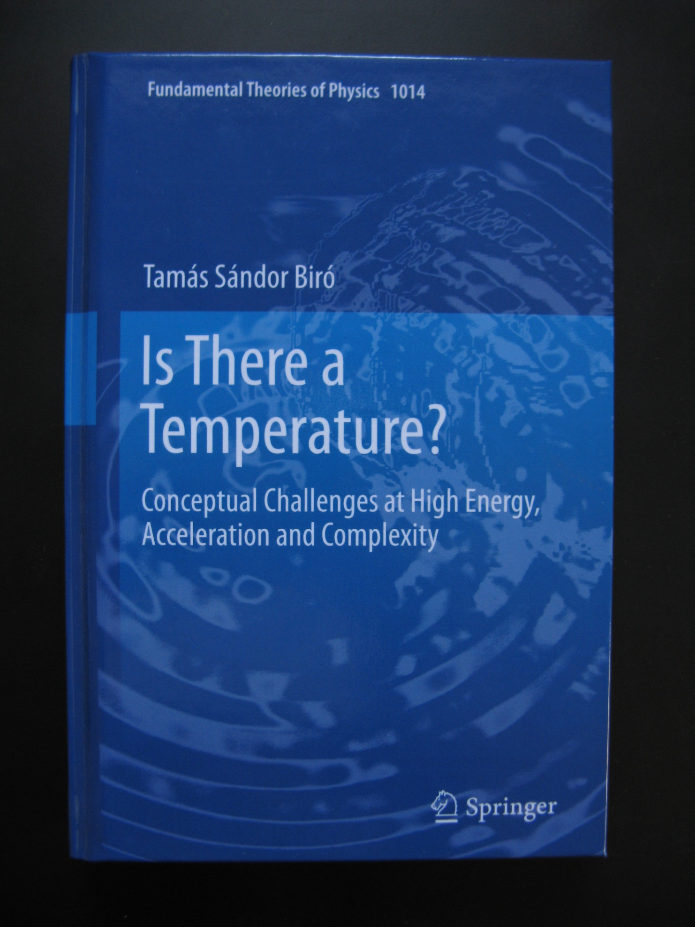

Slide 3
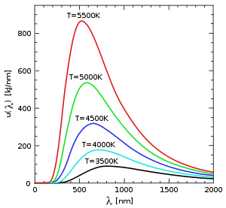
Measuring the temperature
Thermometer (direct contact)
dilatation
air pressure
mechanical or electric stress
Chemistry (mixture)
color
mass ratios
hadronic composition
Spectra (telemetrics)
astronomy (photons)
pT spectra of light and heavy particles
multiplicity fluctuations

Slide 4
Measuring the temperature
Thermometer (direct contact)
dilatation
air pressure
mechanical or electric stress
Chemistry (mixture)
color
mass ratios
hadronic composition
Spectra (telemetrics)
astronomy (photons)
pT spectra of light and heavy particles
multiplicity fluctuations

Slide 5
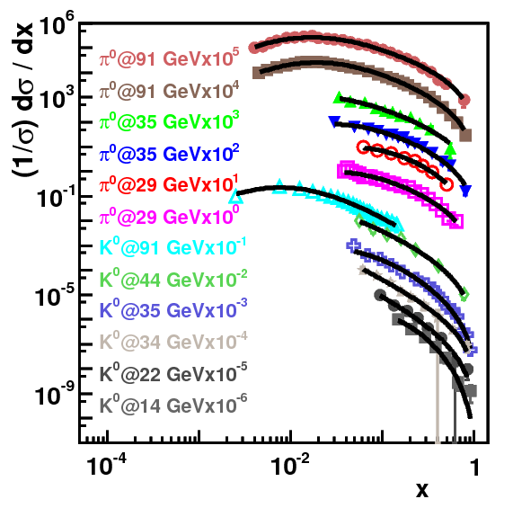
Interpreting the temperature
Thermodynamics (universality of equilibrium)
zeroth theorem (Biro+Van PRE 2011)
derivative of entropy
Boyle-Mariotte type equation of state
Kinetic theory (equipartition)
energy / degree of freedom
fluctuation - dissipation
other average values
Spectral statistics (abstract)
logarithmic slope parameter
observed energy scale
dispersion / power -law effects

Slide 6
Tsallis quark matter + transverse flow + quark coalescence fits to hadron spectra
with Károly Ürmössy
RHIC data
JPG: SQM 2008, Beijing

Slide 7
Tsallis quark matter + transverse flow + quark coalescence fits to hadron spectra
with Károly Ürmössy
RHIC data
JPG: SQM 2008, Beijing

Slide 8
Blast wave fits and quark coalescence
with Károly Ürmössy
arXiV: 1011.3442
SQM 2008, Beijing

Slide 9
All particle types follow power-law
with Károly Ürmössy
B E T T E R !
E
G O O D
L(E)

Slide 10
arXiV: 1111.4817 -> PLB: Unruh gamma radiation at RHIC ?
with Miklós Gyulassy and Zsolt Schram
Mimicking thermal sources
by Unruh radiation
T.S.Biró¹, M.Gyulassy² and Z.Schram³
¹ MTA KFKI RMKI → MTA Wigner Research Centre RMI
²University of Columbia, ³University of Debrecen
Constant acceleration* is alike temperature…
Soft bremsstrahlung: high k_T exp, low k_T 1 / square;
long acceleration: Bjorken
short acceleration: Landau hydro
* What about non-constant, non time-symmetric acceleration?
Exploring QCD Frontiers: from RHIC and LHC to EIC, Jan. 30. – Feb. 03. 2012, Stellenbosch, Republic of South-Africa
Notes:
Frankfurt University (ITP), Colloquium talk, 2011. Dec. 8, Frankfurt am Main, D

Slide 11
Why do statistics work ?
Independent observation over 100M events
Universal laws for large numbers
Steady noise in environment: ‚reservoir’
Phase space dominance
By chance the dynamics mimics thermal behavior

Slide 12
Canonical distribution with Rényi entropy
This cut power-law distribution is
an excellent fit to particle spectra
in high-energy experiments!

Slide 13
Fit and physics with Rényi entropy
The cut power-law distribution is an excellent fit, but it gives smaller values for the parameter hat(T) at the same T than the Boltzmann form!

Slide 14
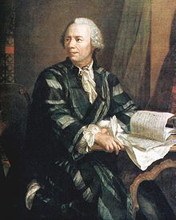
NBD = Euler ○ Poisson Power Law = Euler ○ Gibbs
S u p e r s t a t i s t i c s

Slide 15
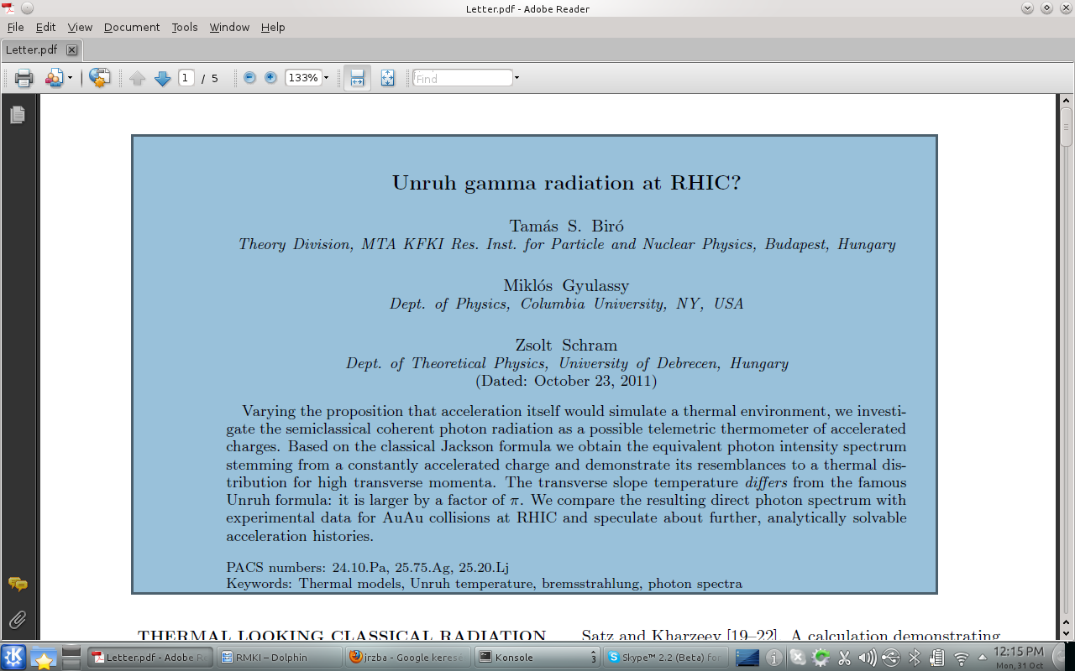
Our view
Arxiv: 1111.4817
Phys.Lett. B, 2012

Slide 16
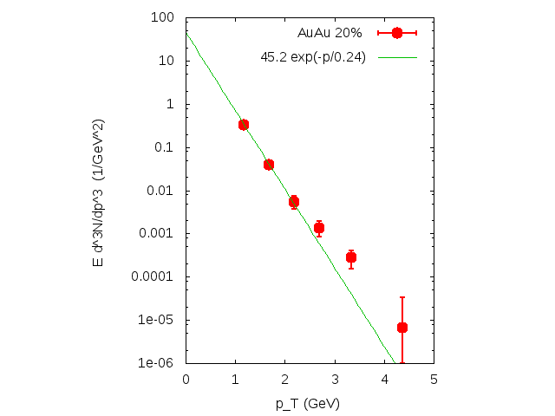
Experimental motivation: apparently thermal photons
RHIC: PHENIX
$$Au+Au → γ + X$$

Slide 17
Theoretical motivation
Deceleration due to stopping
Schwinger formula + Newton + Unruh = Boltzmann
Satz, Kharzeev, …

Slide 18
Why Photons (gammas) ?
Zero mass: flow – Doppler, easy kinematics
Color neutral: escapes strong interaction
Couples to charge: Z / A sensitive
Classical field theory also predicts spectra

Slide 19
Soft bremsstrahlung
Jackson formula for the amplitude:
$$\vec{A} =K\int{e^{iφ} \frac{d}{dt}\left(\frac{\vec{n}×\left(\vec{n}×\vec{β}\right)}{1−\vec{n} ∙ \vec{β}}\right) dt}$$
With $K^{2}=\frac{e^{2}}{8πc^{2}}$, $\vec{β}=\frac{\vec{v}}{c}=\frac{1}{c}\frac{d\vec{r}}{dt}$
and the retarded phase $φ=ω\left(t−\frac{\vec{n}∙\vec{r}}{c}\right)=k∙x$
$$\vec{u}$$

Slide 20
Soft bremsstrahlung
Covariant notation:
$$k=\left(ω,ω\vec{n}\right)=k_{⊥}\left(\cosh{η,\sinh{η,\cos{ψ,\sin{ψ} }}}\right)$$
$$u=\left(γ,γ\vec{v}\right)=\left(\cosh{ξ},\sinh{ξ},0,0\right)$$
$$ℵ = \int{e^{iφ} \frac{d}{dτ}\left(\frac{ε∙u}{k∙u}\right) dτ}$$
IR div, coherent effects
Feynman graphs
The Unruh effect cannot be calculated by any finite number of Feynman graphs!

Slide 21
Kinematics, source trajectory
Rapidity: $β=\frac{v}{c}=\tanh{(ξ+ξ_{0})}$
$ξ=\frac{g}{c} τ$
Trajectory:
$t=t_{0}+\frac{c}{g}\left(\sinh{({ξ+ξ}_{0})}−\sinh{ξ_{0}}\right)$
$z=z_{0}+\frac{c^{2}}{g}\left(\cosh{({ξ+ξ}_{0})}−\cosh{ξ_{0}}\right)$
Let us denote $ξ+ξ_{0}$ by $ξ$ in the followings!

Slide 22
Kinematics, photon rapidity
Angle and rapidity:
$cos θ= \tanh{η}$
$\sin{θ=\frac{1}{\cosh{η}} }$
$\cot{θ=\sinh{η}}$
$η=\ln{\cot{\frac{θ}{2}}}$

Slide 23
Kinematics, photon rapidity
Doppler factor:
$k∙u=ωγ\left(1−β\cos{θ}\right)=ω\frac{\cosh{(ξ−η)}}{\cosh{η}}$ $=\frac{dφ}{dτ}$
Phase:
$φ=\frac{ωc}{g}\frac{\sinh{(ξ−η)}}{\cosh{η}}= ℓk_{⊥}\sinh{(ξ−η)}$
Magnitude of projected velocity:
$u=\frac{\sinh{ξ}}{\cosh{(ξ−η)}}, \frac{du}{dξ}=\frac{\cosh{η}}{{\cosh^{2}{(ξ−η)}}}$

Slide 24
Intensity, photon number
Amplitude as an integral over rapidities on the trajectory:
$\vec{A}=K\vec{e} \int_{ξ_{1}}^{ξ_{2}}{e^{i{ℓk}_{⊥}\sinh{(ξ−η)}} \frac{\cosh{η}}{\cosh^{2}{(ξ−η)}}dξ}$
Here $ℓ=\frac{c^{2}}{g}$is a characteristic length.

Slide 25
Intensity, photon number
Amplitude as an integral over infinite rapidities on the trajectory (velocity goes from –c to +c):
$\vec{A}=2K\vec{e} ℓk_{⊥}\cosh{η} K_{1}(ℓk_{⊥})$
With K1 Bessel function!
$\frac{dN}{{k_{⊥}dk}_{⊥}dη dψ}=\frac{{4α}_{EM}}{π} ℓ^{2} K{}_{1}^{2}{(ℓk_{⊥})}$
Flat in rapidity !

Slide 26
Photon spectrum, limits
Amplitude as an integral over infinite rapidities on the trajectory (velocity goes from –c to +c):
$\frac{dN}{{k_{⊥}dk}_{⊥}dηdψ }=\frac{{4α}_{EM}}{π} \frac{1}{k_{⊥}^{2}}$ for $ℓk_{⊥}→0$
$\frac{dN}{{k_{⊥}dk}_{⊥}dη dψ}=2α_{EM} \frac{ℓ}{k_{⊥}^{}} e^{−2ℓk_{⊥}}$ for $ℓk_{⊥}→∞$

Slide 27
Photon spectrum from pp backgroound, PHENIX experiment

Slide 28
Apparent temperature
High - $k_{⊥}$infinite proper time acceleration:
$$k_{B} T=\frac{ℏc}{2ℓ}=\frac{ℏg}{2c}=π k_{B} T^{Unruh}$$
Connection to Unruh:
$\frac{du}{dτ} → e^{−iντ}$ proper time Fourier analysis of a monochromatic wave

Slide 29
Unruh temperature
Entirely classical effect
Special Relativity suffices
Unruh
Constant ‚g’ acceleration in a comoving system: dv/dτ = -g(1-v²)
Max Planck

Slide 30
Unruh temperature
Planck-interpretation:
The temperature in
Planck units:
The temperature
more commonly:

Slide 31
Unruh temperature
On Earth’ surface ist is 10^(-19) eV, while at room temperature about 10^(-3) eV.

Slide 32
Unruh temperature
Braking from +c to -c in a Compton wavelength:
kT ~ 150 MeV if mc² ~ 940 MeV (proton)

Slide 33
Connection to Unruh
$$\frac{dN}{k_{⊥}dk_{⊥}dη dψ}= \frac{α_{EM}}{2πk_{⊥}^{2} \cosh^{2}{η}} {\left|\int_{−∞}^{+∞}{e^{iφ(τ)} \frac{du}{dτ} dτ}\right|}^{2}$$
Fourier component for the retarded phase:
$$f_{k}=\int_{−∞}^{+∞}{e^{iφ(τ)} e^{iντ}dτ} = \frac{ℓ}{c}\int_{−∞}^{+∞}{e^{iℓk_{⊥}\sinh{ξ}} e^{ikξ}dξ}$$

Slide 34
Connection to Unruh
Fourier component for the projected acceleration:
$$a_{k}=\int_{−∞}^{+∞}{\frac{du}{dτ}e^{iντ}}dτ= \cosh{η}\int_{−∞}^{+∞}{\frac{1}{\cosh^{2}{ξ}} e^{ikξ}dξ}$$
Photon spectrum in the incoherent approximation:
$$\frac{dN}{k_{⊥}dk_{⊥}dη dψ}≈ \frac{α_{EM}}{2πk_{⊥}^{2} \cosh^{2}{η}}\int_{−∞}^{+∞}{{\left|f_{k}\right|}^{2}{\left|a_{k}\right|}^{2} \frac{c}{ℓ} \frac{dk}{2π}}$$

Slide 35
Connection to Unruh
Fourier component for the retarded phase at constant acceleration:
$f_{k}=\frac{ℓ}{c}\int_{−∞}^{+∞}{e^{iℓk_{⊥}\sinh{ξ}} e^{ikξ}dξ}=\frac{2ℓ}{c} K_{ik}\left(ℓk_{⊥}\right) e^{−πk/2}$
KMS relation and Planck distribution:
$$f_{−k}= e^{kπ} f_{k}^{∗}, {\left|f_{−k}\right|}^{2}= e^{2πk} {\left|f_{k}\right|}^{2}$$
$$−n\left(−ν\right)=e^{{2πℓν}/c} n\left(ν\right)=1+n\left(ν\right)$$
$$n\left(ν\right)= \frac{1}{e^{{2πℓν}/c}−1}$$

Slide 36
Connection to Unruh
KMS relation and Planck distribution:
$$2πk=\frac{2πc}{g} ν= \frac{ℏ}{k_{B}T_{U}} ν ;$$
$$T_{U}= \frac{ℏ}{2πk_{B}c} g$$

Slide 37
Connection to Unruh
Note:
$$a_{k}= \cosh{η \frac{kπ}{\sinh{{kπ}/2}}}$$
It is peaked around k = 0, but relatively wide! (an unparticle…)

Slide 38
Transverse flow interpretation
Mathematica knows: ( I derived it using Feynman variables)
$$\int_{0}^{π}{\frac{dθ}{\sin{θ}} K_{2}\left(\frac{z}{\sin{θ}}\right) = K_{1}^{2}\left(\frac{z}{2}\right)}$$
$$\frac{1}{\sin{θ}}= \cosh{η}$$
$\frac{dN}{k_{⊥}dk_{⊥}dη dψ}= \frac{4α_{EM} ℏc}{π{\left(2πk_{B}T_{U}\right)}^{2} } \int_{−∞}^{+∞}{K_{2}\left(\frac{ℏc k_{⊥}}{πk_{B}T_{U}} \cosh{(ζ−η)}\right) dζ}$
$\frac{dN}{k_{⊥}dk_{⊥}dη dψ}= \frac{4α_{EM} }{π g } \int_{−∞}^{+∞}{K_{2}\left(\frac{ k⋅u}{πT_{U}} \right) dτ}$
Alike Jüttner distributions integrated over the flow rapidity…

Slide 39
Finite time (rapidity) effects
$\frac{dN}{k_{⊥}dk_{⊥}dη dψ}$ = $\frac{4K^{2}}{ℏ{{ k}_{⊥}}_{}^{2}}{\left|\int_{w_{1}}^{w_{2}}{\frac{e^{iℓk_{⊥}w}}{{(1+w^{2})}^{3/2}}}\right|}^{2}$
with $w=\sinh{(ξ−η)}$
Short-time deceleration → Non-uniform rapidity distribution; → Landau hydrodynamics
Long-time deceleration → uniform rapidity distribution; → Bjorken hydrodynamics

Slide 40
Short time constant acceleration
$\frac{dN}{k_{⊥}dk_{⊥}dη dψ}= \frac{4α_{EM}}{π} \frac{1}{k_{⊥}^{2}} \frac{{(w_{2}−w_{1})}^{2}}{{(1+w_{0}^{2})}^{3}}$
$$\frac{dN}{k_{⊥}dk_{⊥}dη dψ}= \frac{4α_{EM}}{π} \frac{4}{ω_{}^{2}} \frac{1}{\cosh^{2}{η}}$$
Non-uniform rapidity distribution;
→ Landau hydrodynamics

Slide 41
Analytic results
x(t), v(t), g(t), τ(t), 𝒜, dN/kdkdη limit
$\sqrt{1+t^{2} }, \frac{t}{\sqrt{1+t^{2} }}, 1, \text{Arc} \text{sh}{t}, bK_{1}\left(b\right), \frac{ℓ}{k}e^{−2ℓk}$
$1+ln⁡(1+t^{2}), \frac{2t}{1+t^{2}}, \frac{2\left(1+t^{2}\right)}{{\left(1−t^{2}\right)}^{2}}, 2\text{atn}{t −t, be^{−b}, ℓ^{2}e^{−2ℓk}}$
$1+\frac{2t}{π}\text{atn}\left(\frac{t}{π}\right)−\ln\left(1+\frac{t^{2}}{π^{2}}\right),\frac{2}{π}\text{atn}\left(\frac{t}{π}\right), \frac{2γ^{3}}{π^{2}+t^{2}}, \frac{π^{2}}{2}\int{\frac{\sqrt{1−v^{2}} dv}{\cos^{2}\left(\frac{πv}{2}\right){}}}, e^{−b}, \frac{1}{k^{2}}e^{−2ℓk}$

Slide 48
Large pT:
NLO QCD
Smaller pT:
plus direct gammas

Slide 49
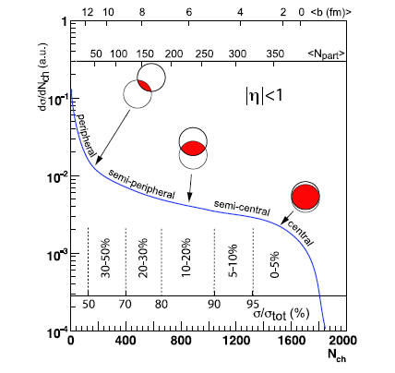
$$Au+Au → γ + X$$
Glauber model

Slide 50
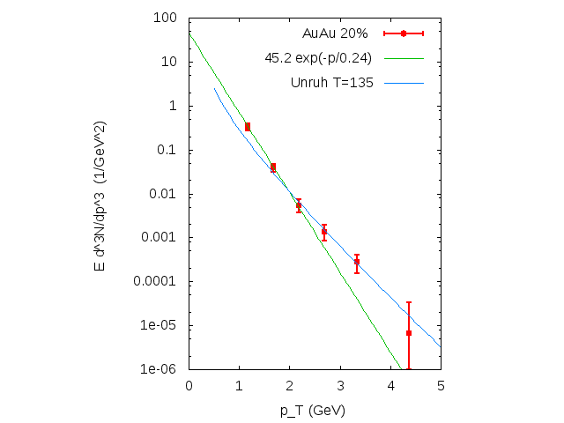
$$Au+Au → γ + X$$
Glauber model

Slide 52
Summary
Semiclassical radiation from constant accelerating point charge occurs rapidity-flat and thermal
The thermal tail develops at high enough k_perp
At low k_perp the conformal NLO result emerges
Finite time/rapidity acceleration leads to peaked rapidity distribution, alike Landau - hydro
Exponential fits to surplus over NLO pQCD results reveal a ’’pi-times Unruh-’’ temperature

Slide 53
Is acceleration a heat container?

