Slide 1
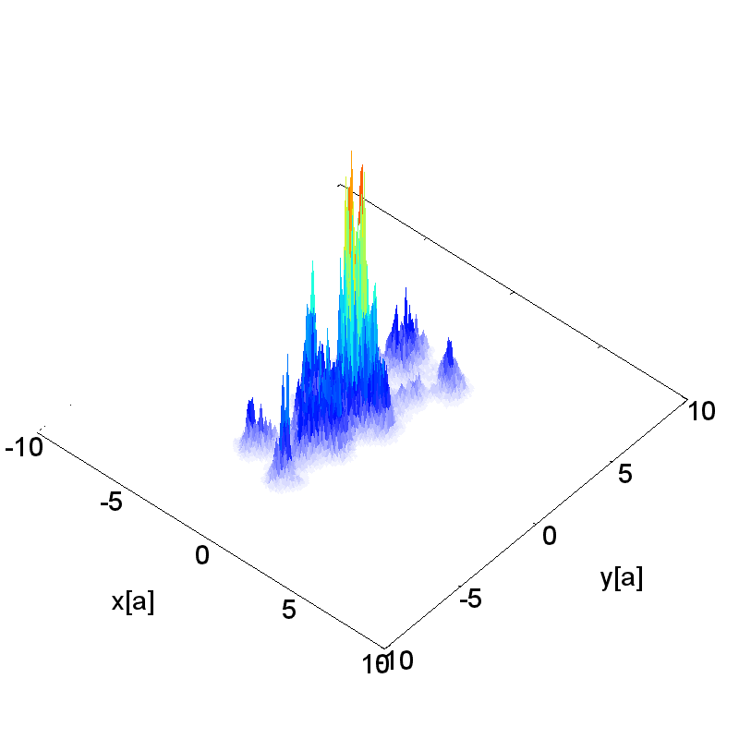
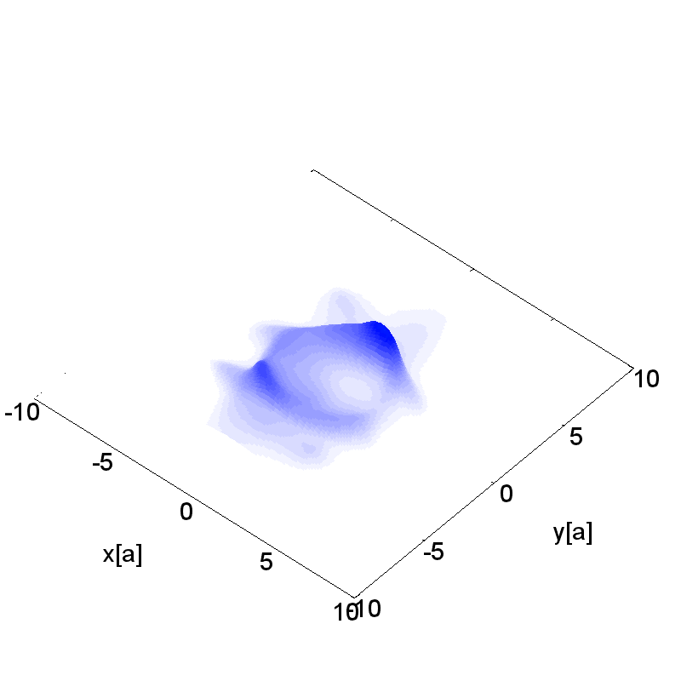
The Glasma: coherence, evolution,
correlations
Raju Venugopalan
Lecture III, UCT, February 2012

Slide 2
Outline of lectures
Lecture I: QCD and the Quark-Gluon Plasma
Lecture II: Gluon Saturation and the Color Glass Condensate
Lecture III: Quantum field theory in strong fields. Factorization. the Glasma and long range correlations
Lecture IV: Quantum field theory in strong fields.
Instabilities and the spectrum of initial quantum fluctuations
Lecture V: Quantum field theory in strong fields. Decoherence, hydrodynamics, Bose-Einstein Condensation and thermalization
Lecture VI: Future prospects: RHIC, LHC and the EIC

Slide 3
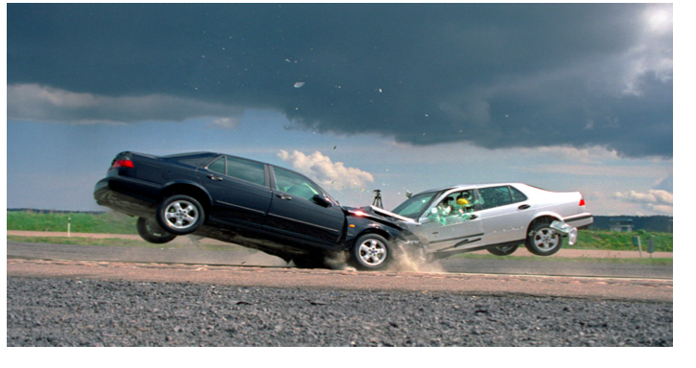
Traditional picture of heavy ion collisions
*@$#! on *@$#!
Well known physicist (circa early 1980s)

Slide 4
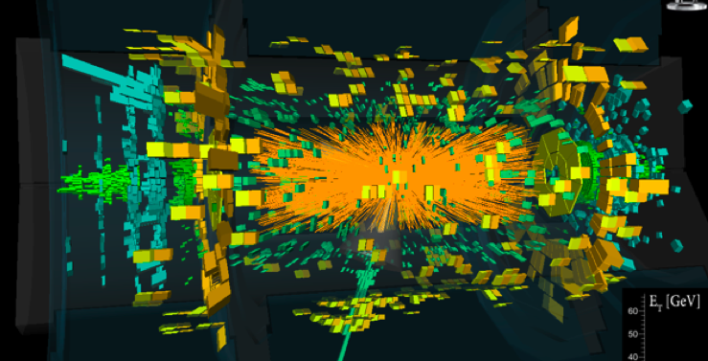
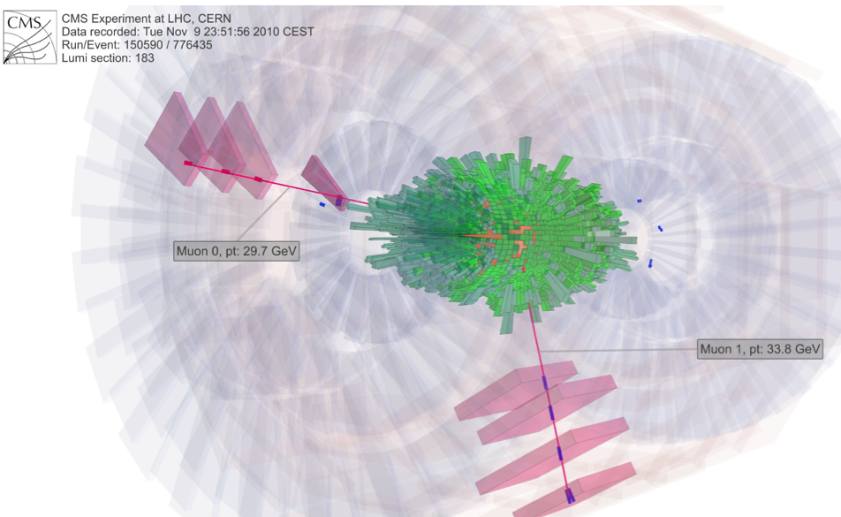
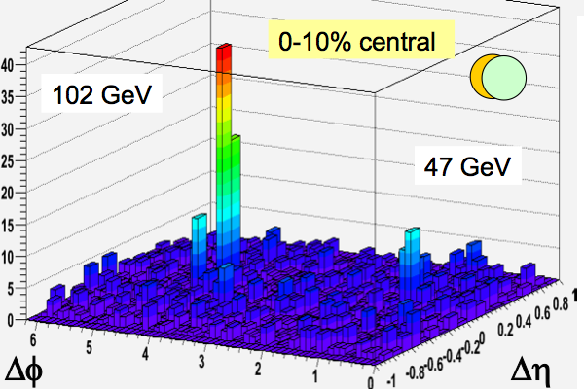
A contemporary view
CERN seminar, Dec. 2nd, 2010
First Z⁰ HI event

Slide 5
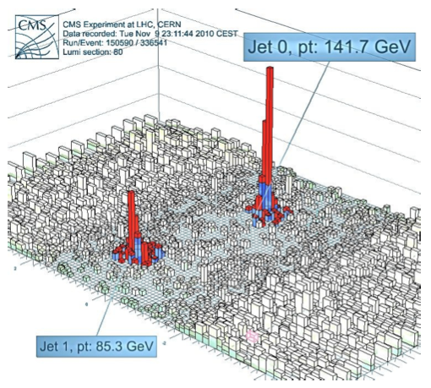
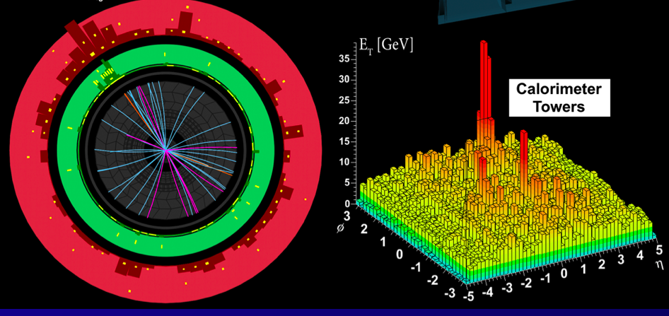
LHC jets!

Slide 6
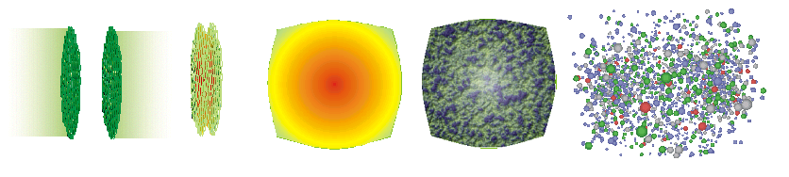
Standard model of HI Collisions
Color Glass
Condensates
Initial
Singularity
Glasma
sQGP -
perfect fluid
Hadron
Gas
t
Glasma (\Glahs-maa\): Noun: non-equilibrium matter between Color Glass Condensate (CGC)& Quark Gluon Plasma (QGP)

Slide 7
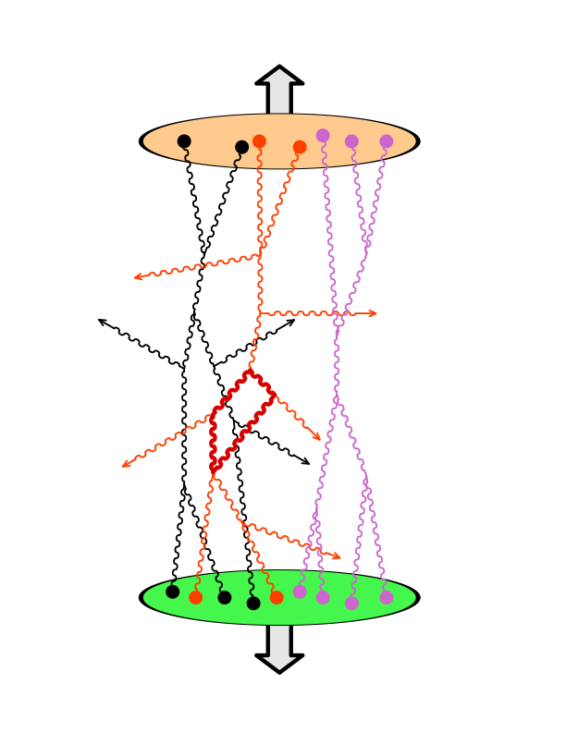
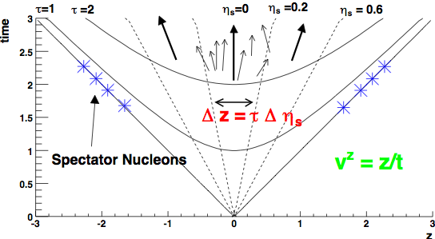
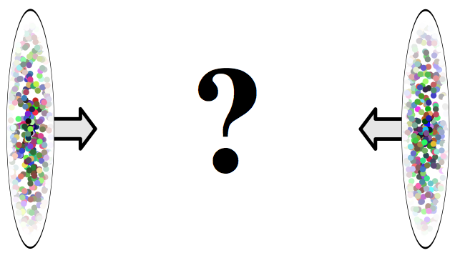
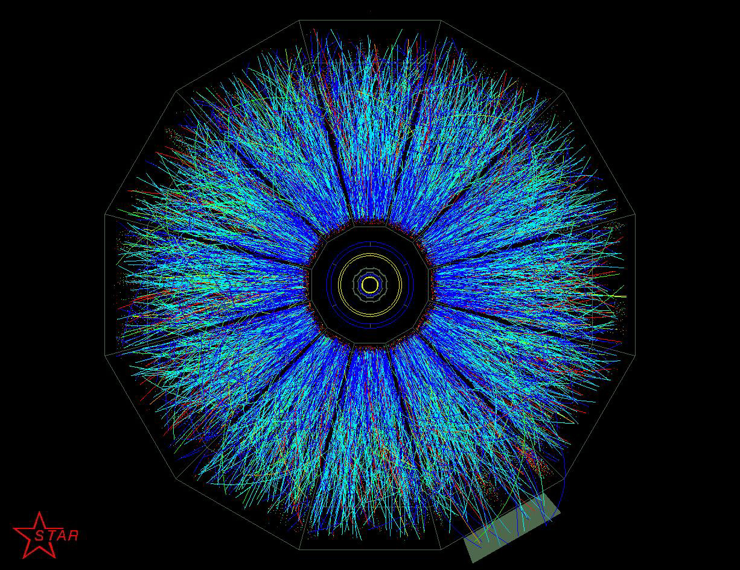
Forming a Glasma in the little Bang
Problem: Compute particle production in QCD with
strong time dependent sources
Solution: for early times (t ≤ 1/Q_{S}) -- n-gluon production computed
in A+A to all orders in pert. theory to leading log accuracy
Gelis, Lappi, RV; arXiv : 0804.2630, 0807.1306, 0810.4829

Slide 8
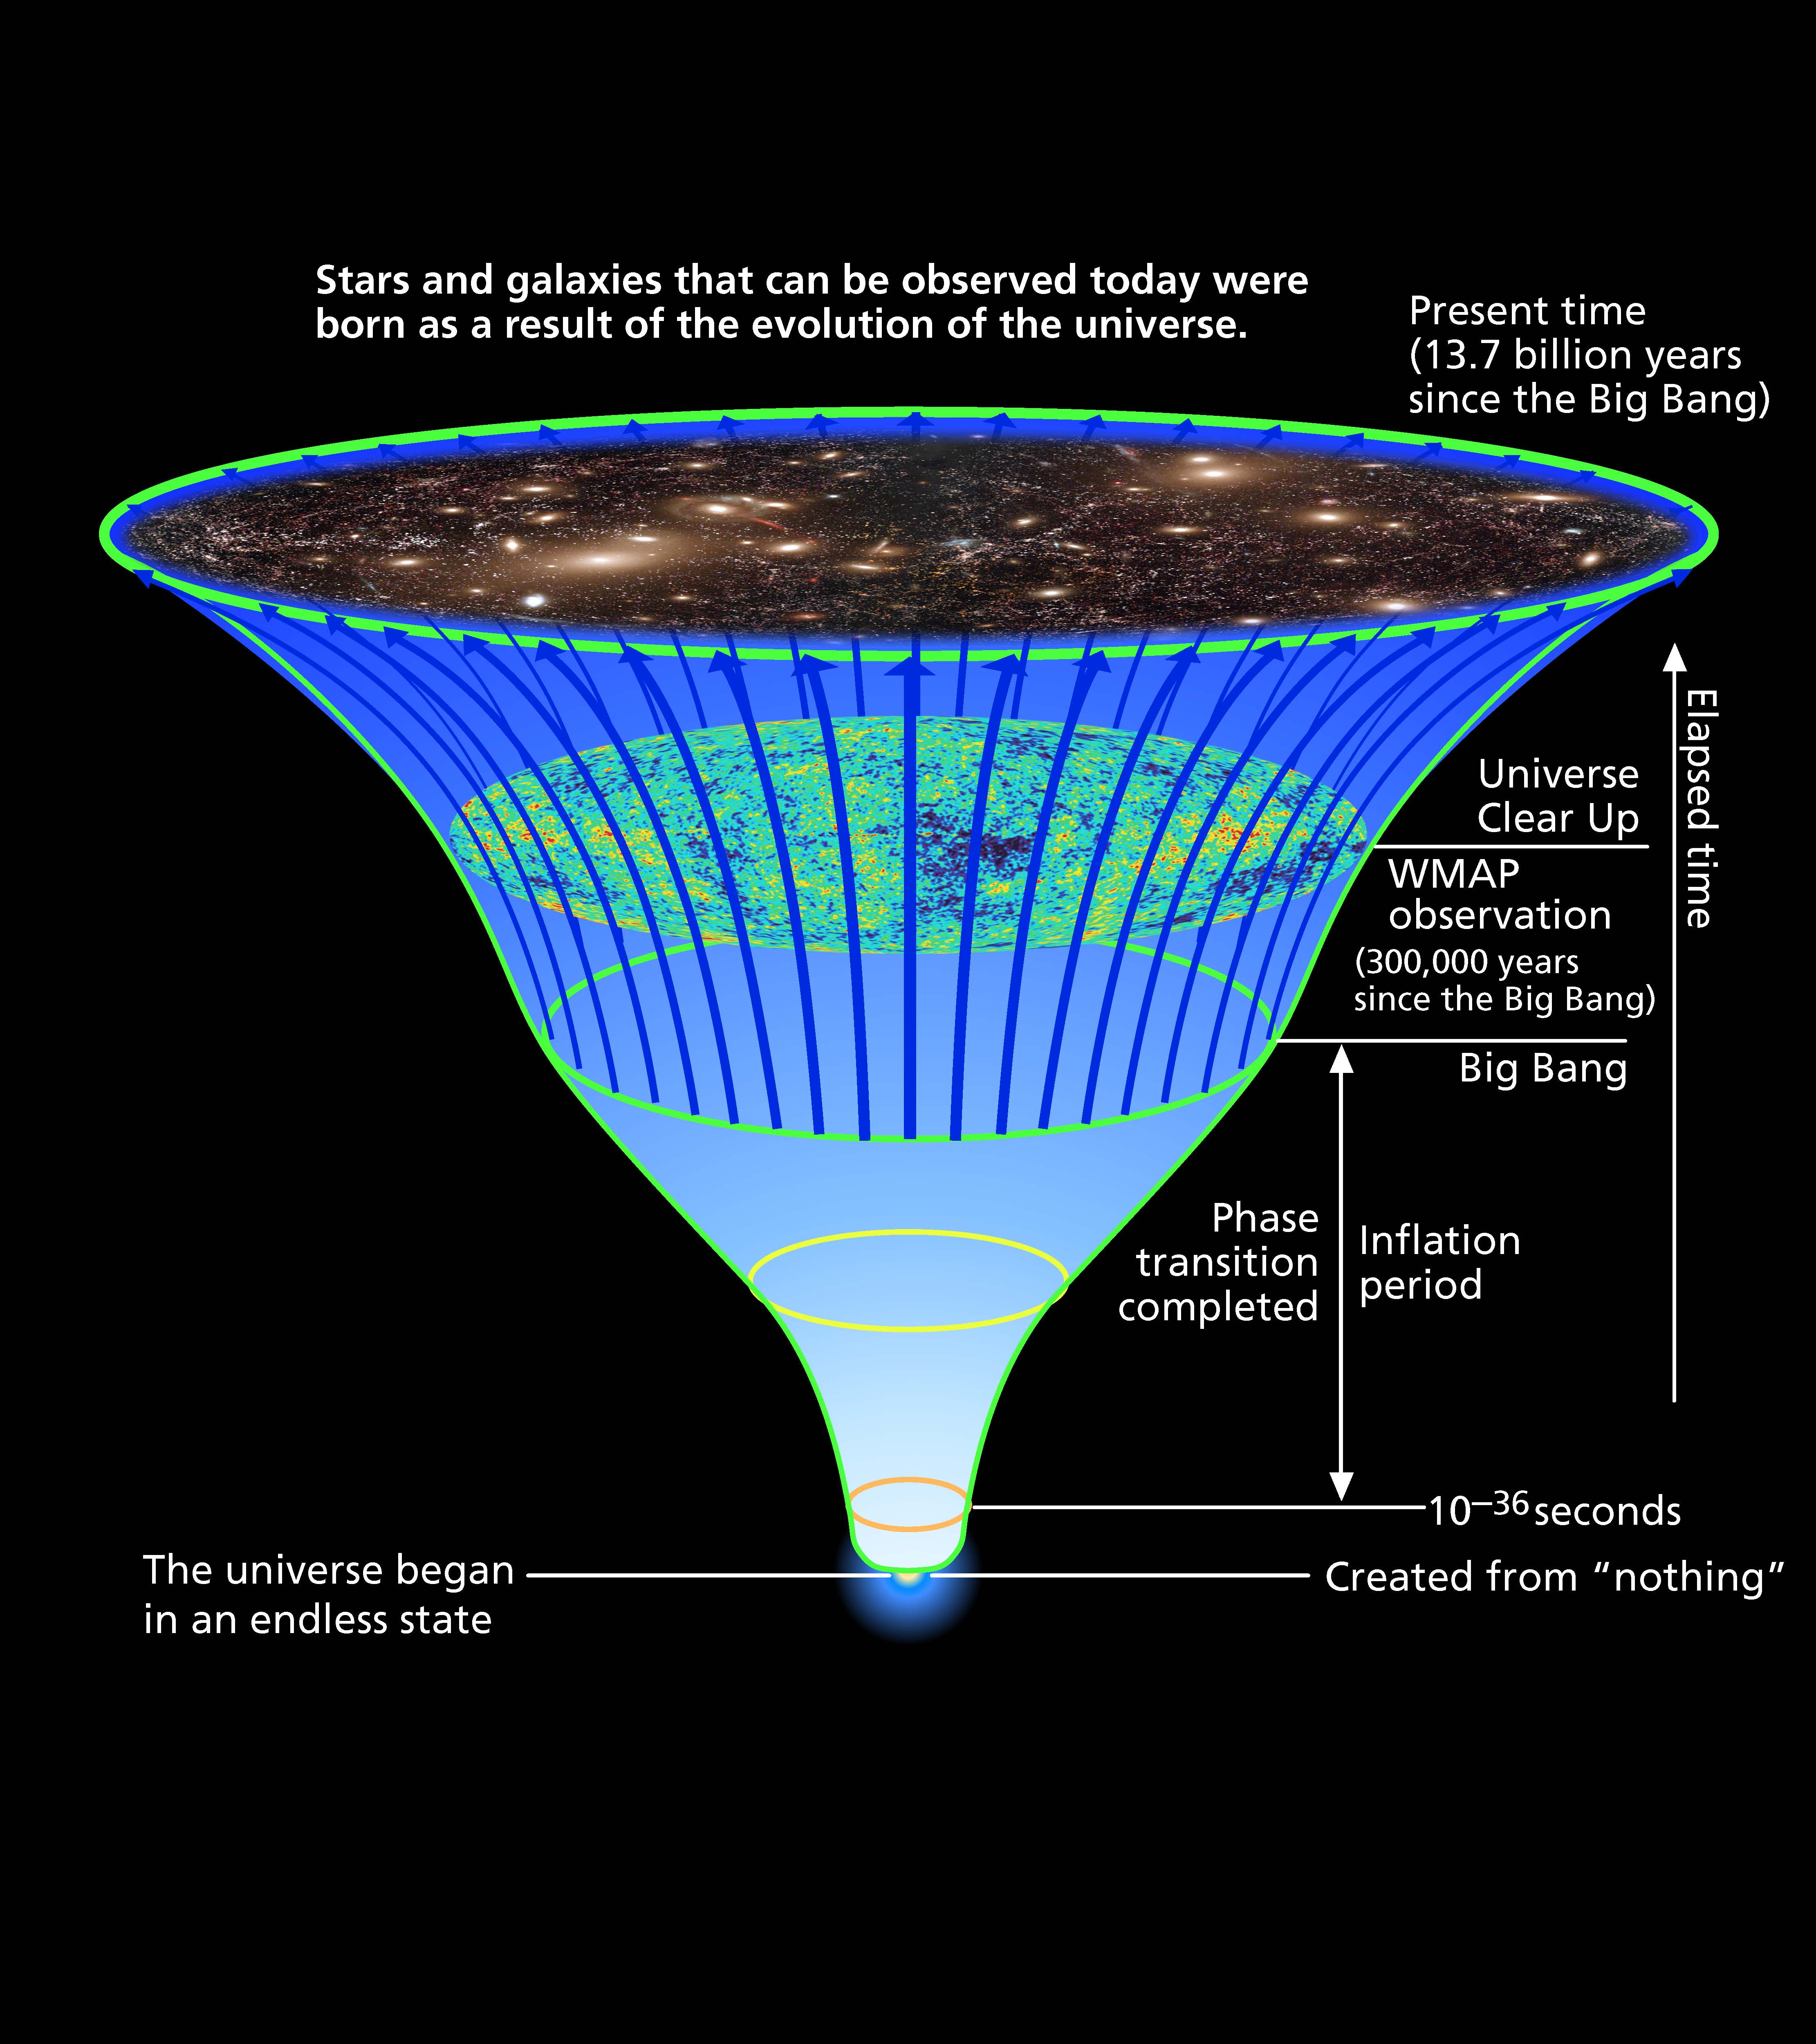
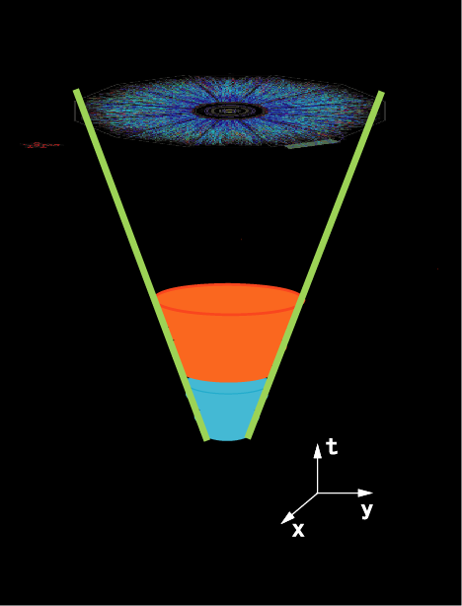
Big Bang
Little Bang
Present
(13.7 x 10⁹ years)
RHIC data
WMAP data
(3x10⁵ years)
Hot Era
QGP
Inflation
CGC/
Glasma
Plot by Tetsuo Hatsuda

Slide 9
Big Bang vs. Little Bang
Decaying Inflaton
with occupation # 1/g²
Decaying Glasma
with occupation # 1/g²
Explosive amplification
of low mom. small
fluctuations (preheating)
Explosive amplification
of low mom. small fluct.
(Weibel instabilities)
Int. of fluctutations/inflaton
-> thermalization ?
Int. of fluctutations/Glasma
-> thermalization ?
Other common features: topological defects, turbulence ?

Slide 10
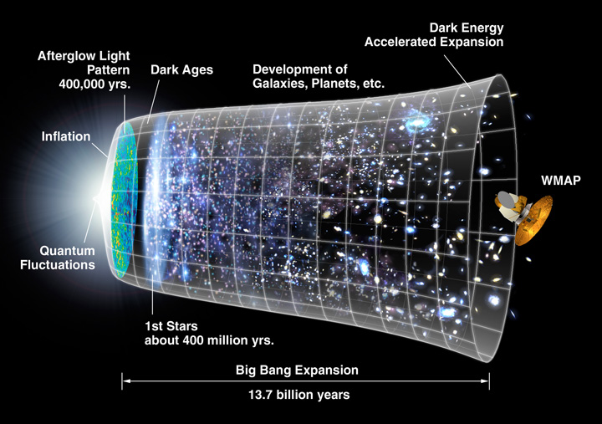
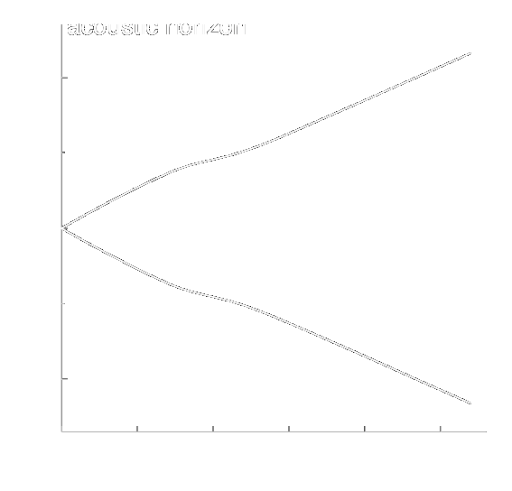

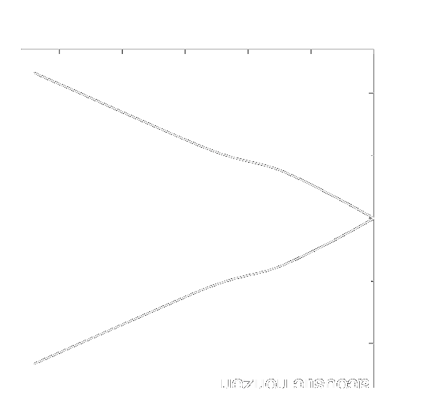
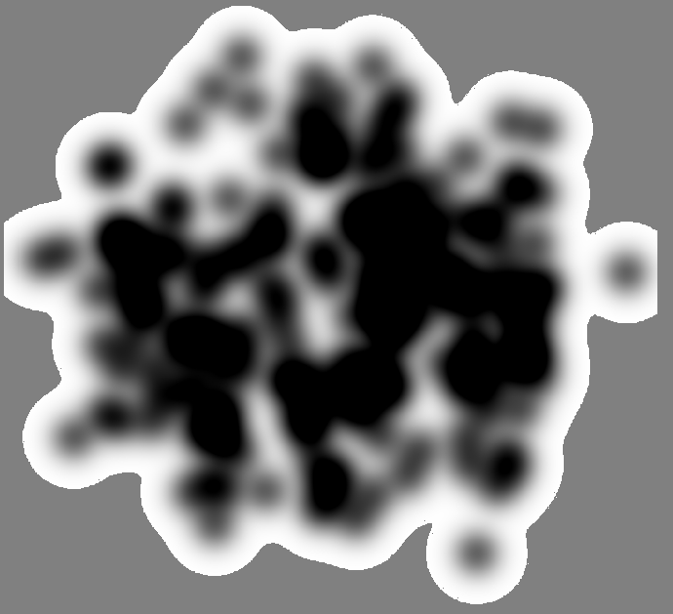
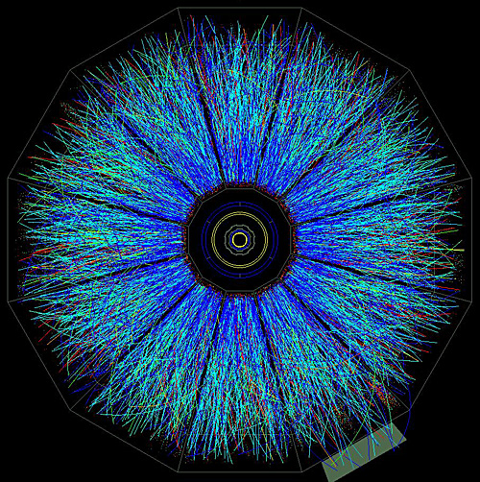
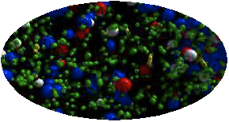
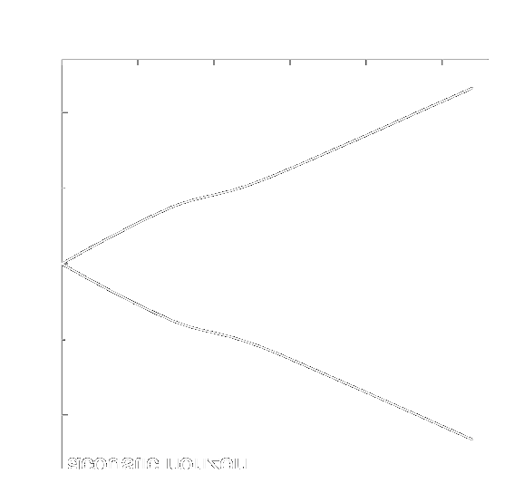
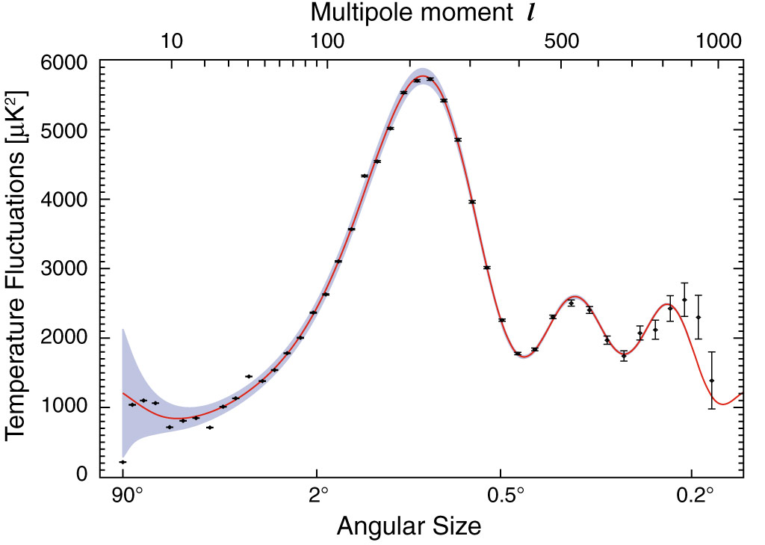
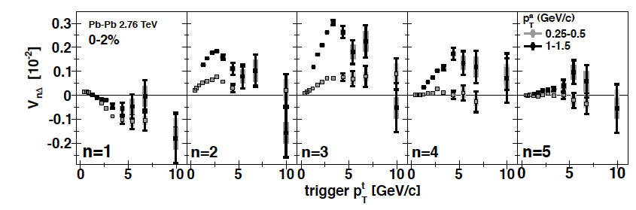
P
Another Analogy with the Early Universe
Mishra et al; Mocsy- Sorensen
The Universe
HIC
distributions and correlations of produced particles
kinetic
freeze-out
lumpy initial energy density
hadronization
QGP phase
quark and gluon degrees of freedom
Credit: NASA
Δρ/√ρ_{ref}
Δφ
WMAP
HIC-ALICE

Slide 11
THE LITTLE BANG
How can we compute multiparticle production ab initio in HI collisions ?
Always non-perturbative
for questions of
interest in this talk!
perturbative VS non-perturbative,
strong coupling VS weak coupling
AdS/CFT ? Interesting set of issues… not discussed here

Slide 12
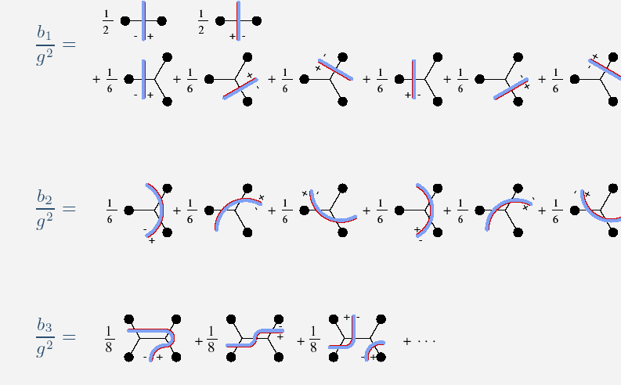
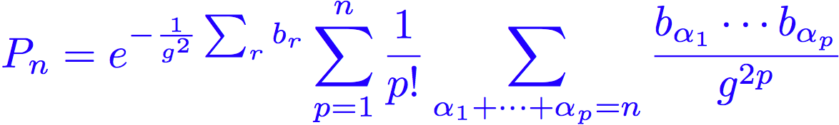

Multiparticle production for strong time dependent sources:
Gelis, RV ; NPA776 (2006)
probability of vacuum-vacuum diagrams with r cuts
“combinants”

Slide 13
Observations:
P_{n} is non-perturbative for any n
and for coupling g << 1 - no simple power counting in g
Even at tree level, P_{n} is not a Poisson dist.
III) However, vacuum-vacuum contributions cancel for inclusive quantitites
( <n^{p}> = Σ n^{p} P_{n} / Σ P_{n} )
and one has systematic power counting for these…
Power counting
LO: 1/g², all orders in sources (gρ_{1,2})^{n}
NLO: O(1), all orders in (gρ_{1,2})^{n}
At NLO, large logs : g² ln(1/x_{1,2}) – can be resummed to all orders and factorized
into evolution of wave functions

Slide 14
Quantum decoherence from classical coherence
Color Glass
Condensates
Initial
Singularity
sQGP -
perfect fluid
Hadron
Gas
Glasma
t
Computational framework
Schwinger-Keldysh: for strong time dependent sources (ρ ~ 1/g) ,
initial value problem for inclusive quantities
For eg., Schwinger mechanism for pair production, Hawking radiation, …

Slide 15
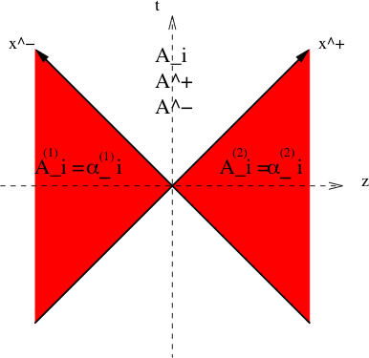
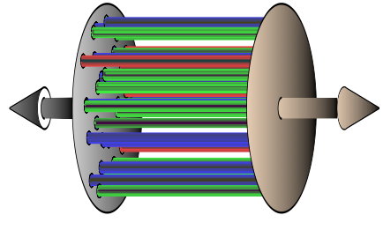
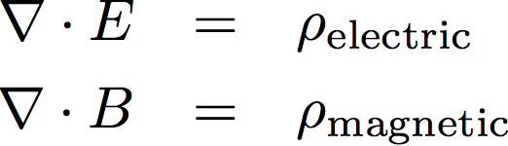
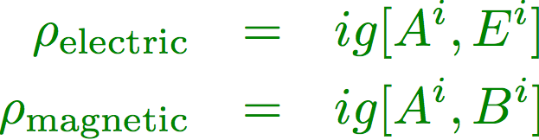
The Glasma at LO:Yang-Mills eqns. for two nuclei
O(1/g²) and all orders in (gρ)^{n}
Glasma initial conditions from
matching classical CGC
wave-fns on light cone
Kovner,McLerran,Weigert; Krasnitz, RV; Lappi
Lappi,Srednyak,RV (2010)
Boost invariant flux tubes of size with || color E & B fields- generate Chern-Simons charge
However, this results in very anisotropic (P_{T} >> P_{L}) pressure for τ ~ 1/Q_{S}

Slide 16
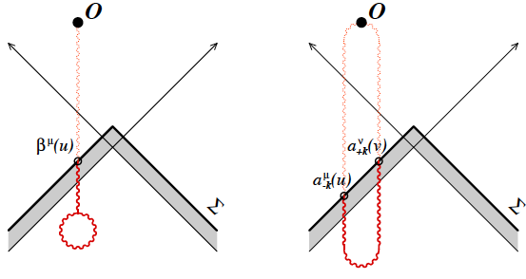
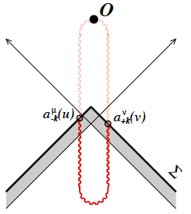

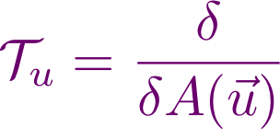
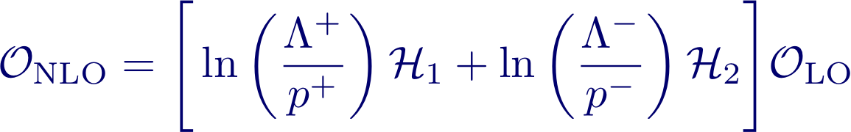


RG evolution for 2 nuclei
Gelis,Lappi,RV (2008)
Log divergent contributions
crossing nucleus 1 or 2:
and
can be computed on the initial Cauchy surface
linear operator on initial surface
Contributions across both nuclei are finite-no log
divergences => factorization

Slide 17
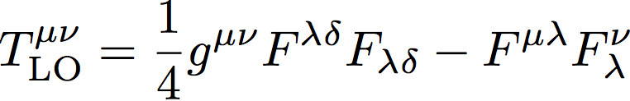
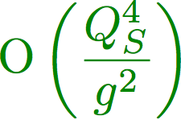


Factorization + temporal evolution in the Glasma
ε=20-40 GeV/fm³ for τ=0.3 fm @ RHIC
NLO terms are as large as LO for α_{S} ln(1/x):
small x (leading logs) and strong field (gρ) resummation
Gelis,Lappi,RV (2008)
Glasma factorization => universal “density matrices W” ⊗ “matrix element”

Slide 18
Long range rapidity correlations
Some notation: Δη-ΔΦ
Rapidity: a measure of
velocity (denoted by y or η)
additive under Lorentz boost
Δη – measure of
angular separation
along beam direction
Large Δη means particles
are flying off in opposite
directions along beam axis
Di-hadron
correlations
associated
Δϕ
trigger

Slide 19
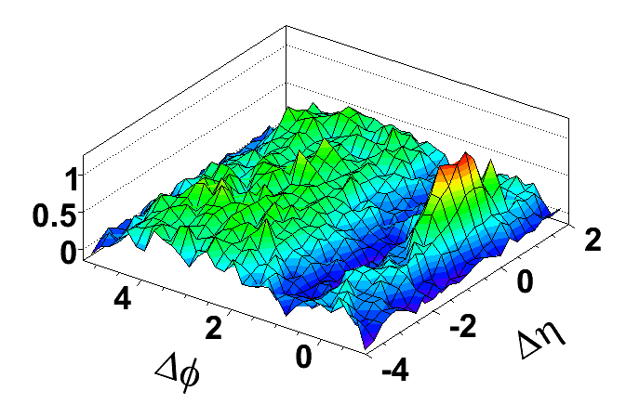
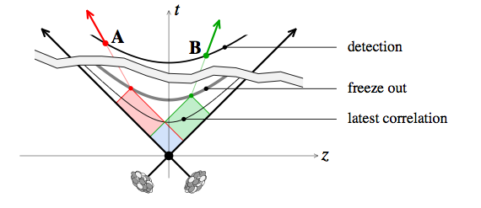
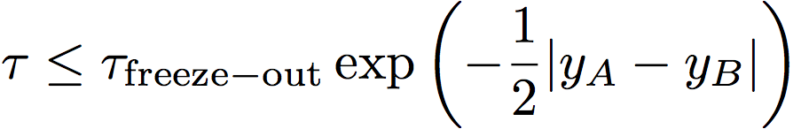
Long range rapidity correlations as chronometer
Au+Au 200 GeV, 0 - 30%
PHOBOS preliminary
Long range rapidity correlations are sensitive to Glasma dynamics at early times
Dumitru, Gelis, McLerran, RV, arXiv 0804.3858

Slide 20
Really long range correlations
Au+Au 200 GeV, 0 - 30%
PHOBOS preliminary
Au+Au 200 GeV, 0 - 30%
PHOBOS
These structures reflect dynamics of strong gluon fields at times < 3•10⁻²⁴ seconds

Slide 21
An example of a small fluctuation spectrum…

Slide 22
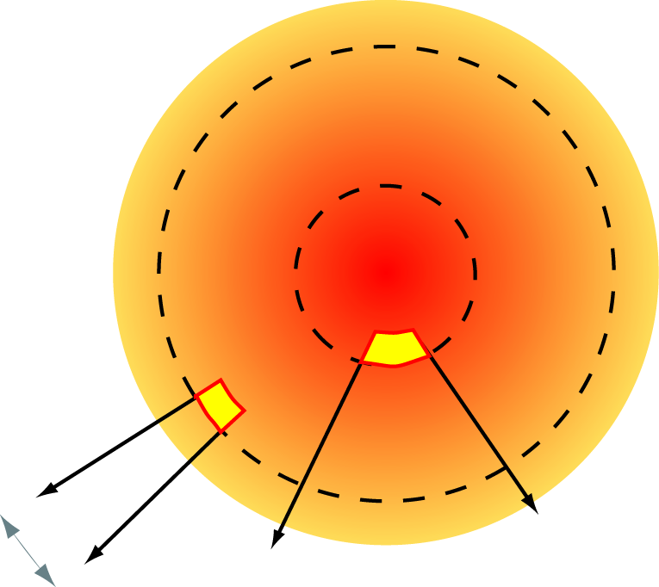
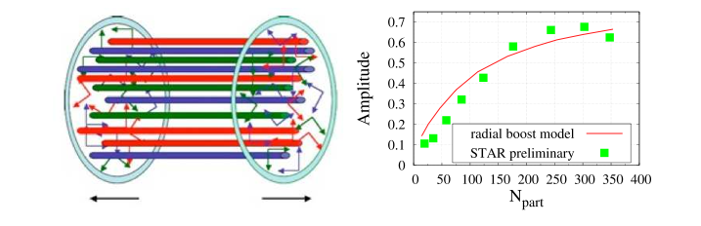
The Ridge: Glasma flux tubes+ Radial flow
Au+Au 200 GeV, 0 - 30%
PHOBOS preliminary
Glasma flux tubes provide the long range rapidity correlation
Dumitru, Gelis, McLerran, RV; Gavin, McLerran, Moschelli
Lappi, Srednyak, RV (2010)
Radial (“Hubble”) flow of the tubes provides the azimuthal collimation
Voloshin; Shuryak

Slide 23
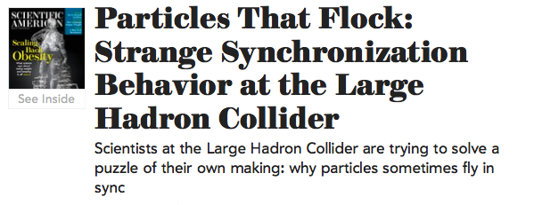
Scientific American, February (2011)
The high-energy collisions of protons in the LHC may be uncovering “a new deep internal structure of the initial protons,” says Frank Wilczek of the Massachusetts Institute of Technology, winner of a Nobel Prize
“At these higher energies [of the LHC], one is taking a snapshot of the proton with higher spatial and time resolution than ever before”

Slide 24
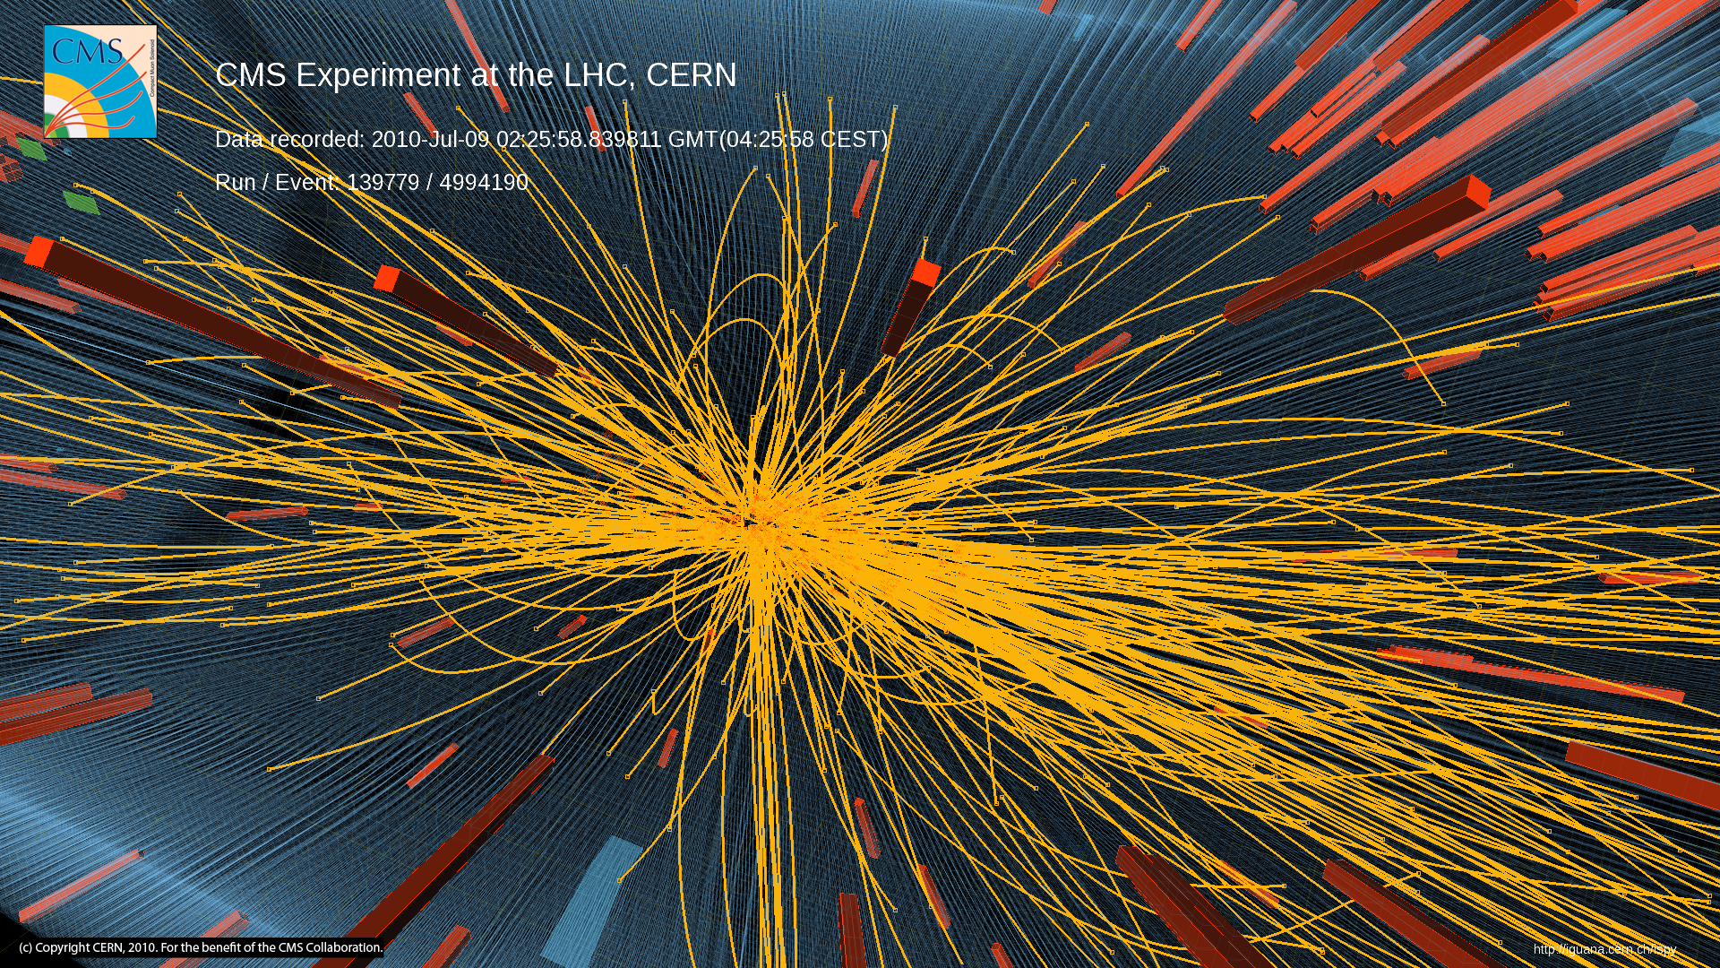
A ridge in high multiplicity pp collisions
Notes:
24

Slide 25
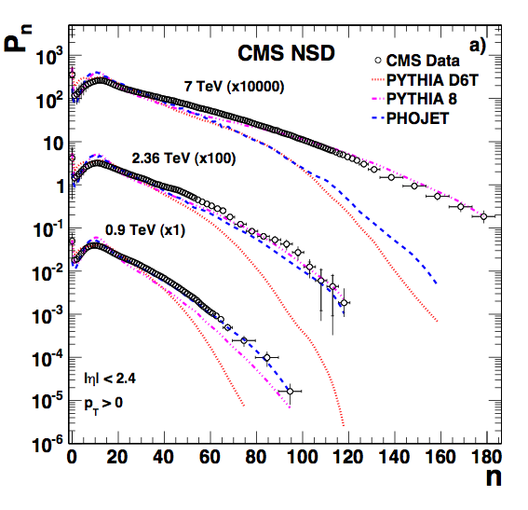
High Multiplicity pp collisions
High Multiplicity events are rare in nature
Very high particle density regime
Is there anything peculiar happening there?
Notes:
25

Slide 26
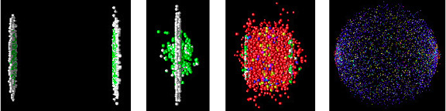
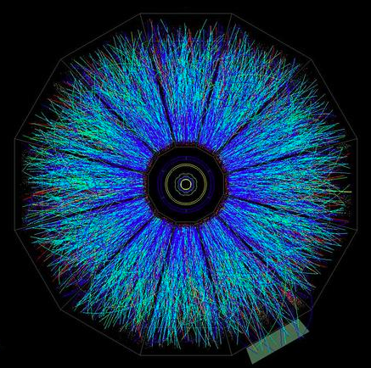
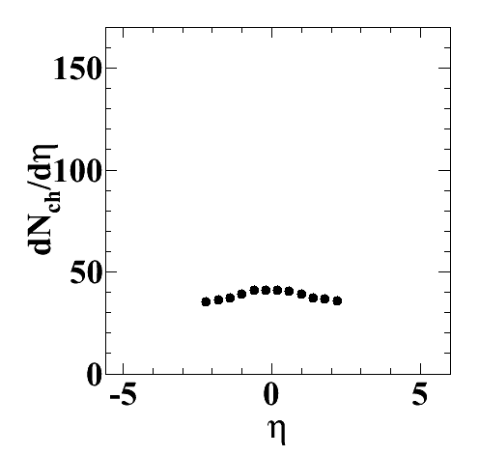
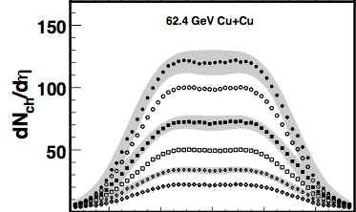



Relativistic Heavy Ion Collisions
Pre-collision
Initial
state
Quark Gluon Plasma
Hadron Gas
Detector
?
CMS pp 7TeV, N>110
PHOBOS CuCu 62.4GeV
Notes:
26

Slide 27
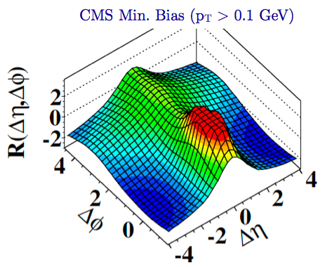
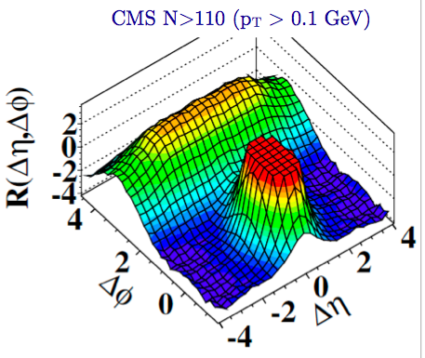
Two particle correlations: CMS results

Slide 28



Two particle correlations: CMS results
“Discovery”
Ridge: Distinct long range correlation in η collimated around ΔΦ≈ 0
for two hadrons in the intermediate 1 < p_{T}, q_{T} < 3 GeV

Slide 29

Comparing to MC models
PYTHIA8, v8.135
No ridge in MC!
Notes:
29

Slide 30

Two particle correlations: p_{T} systematics
Signal not present for p_{T}, q_{T} > 3 GeV

Slide 31
What’s the underlying dynamics?
Large number of models with a range of speculations
A similar ridge was seen in heavy ion collisions @ RHIC (and now in
HI collisions @ LHC) -is it hydrodynamic flow ?
I will argue that the p+p ridge is an intrinsic QCD effect - providing a
snapshot of frozen wee (small x) multi-parton correlations in the
proton wave function
In contrast, the A+A ridge is entirely due to hydrodynamic flow…

Slide 32



High multiplicity events in p+p
High multiplicity events likely correspond to
high occupation numbers (1/α_{S}) in the
proton wave functions for p_{T} ≤ Q_{S}
I will emphasize this point further shortly

Slide 33


The saturated proton: two particle correlations
Correlations are induced by color fluctuations that vary event to event - these are local transversely and have color screening radius ~ 1/Q_{S}
These graphs (called “Glasma graphs”), which generate long range rapidity correlations, are highly suppressed for Q_{S} << p_{T}
However, effective coupling of sources to fields with k_{T} ≤ Q_{S} = 1/g (“saturation”)
Power counting changes for high multiplicity events by α_{S}⁸ !
These graphs become competitive with usual pQCD graphs

Slide 34


2-particle
n-particle correlations
Dumitru,Gelis,McLerran,RV
Dusling,Fernandez-Fraile,RV
Glasma flux tube picture: two particle correlations
proportional to ratio 1/Q_{S}² / S_{T}
Only certain color combinations of “dimers” give leading contributions
…iterating combinatorics for 2, 3, n…gives

Slide 35


2-particle
n-particle correlations
Gelis, Lappi,McLerran
Multiplicity distribution: Leading combinatorics of dimers gives the
negative binomial distribution
k = 1 : Bose-Einstein
k = ∞ : Poisson
Yang-Mills computation shows picture is robust for 2 part. Corr.
and gives ζ ~ 1/3 – 3/2 … O(1)
Lappi,Srednyak,RV

Slide 36



Long range di-hadron correlations
Gelis,Lappi,RV (2009)
Dusling,Gelis,Lappi,RV, arXiv:0911.2720
LRC of Δy~10 can be studied at the LHC

Slide 37


Long range di-hadron correlations
RG evolution of two particle correlations (in mean field approx) expressed
in terms of “unintegrated gluon distributions”
Caveat: Contribution of higher 4-pt. Wilson line correlators not included
Dumitru, Jalilian-Marian; Kovner, Lublinsky (2011)

Slide 38

The p+p ridge: azimuthal corr. from Glasma graphs
Dumitru; Dumitru,Dusling,Gelis,Jalilian-Marian,Lappi,RV
For p_{T} = q_{T}, the largest contribution to two particle correlation is from ΔΦ≈0,π

Slide 39

Systematics of the correlation
Near-side correlation sensitive to diffuseness of wavefunction

Slide 40



Quantitative description of pp ridge
Dusling,RV, 1201.2658
Try soft and hard
fragmentation functions:
D₁ = 3(1-x)² / x
D₂ = 2(1-x) / x
Only parameter fit to yield
data is K =2.3
Dependence on transverse
area cancels in ratio…
Subtracts any pedestal “phi-independent” correlation

Slide 41


Quantitative description of pp ridge
Dusling,RV, 1201.2658
CMS preliminary data
Assoc. yield with centrality
Assoc. yield with p_{T}^{Trig}

Slide 42

Quantitative description of pp ridge
Dusling,RV, 1201.2658
Predictions:
Yields for higher p_{T}^{Assoc.} are
sensitive to fragmentation functions –
not known at forward rapidities

Slide 43


What about flow in p+p ?
Au+Au 200 GeV, 0 - 30%
PHOBOS preliminary
In heavy ion collisions
Au+Au 200 GeV, 0 - 30%
PHOBOS
Δφ
p+p
0-5%
STAR Preliminary
A+A
Glasma flux tubes provide the long range rapidity correlation
Dumitru, Gelis, McLerran, RV; Gavin, McLerran, Moschelli
Radial (“Hubble”) flow of the tubes provides the azimuthal collimation
Voloshin; Shuryak

Slide 44

What about flow in p+p ?
Au+Au 200 GeV, 0 - 30%
PHOBOS preliminary
Simple radial flow model result:
Boosts, bottom to top,
β=0,0.1,0.2,0.25,0.3
With increasing flow, the pedestal gets collimated
Associated yield reflects the p_{T} dependence of the Glasma pedestal
Can accommodate only very small re-scattering / flow contribution

Slide 45

A+A ridge is all flow
Au+Au 200 GeV, 0 - 30%
PHOBOS preliminary
Preliminary CMS data

Slide 46
Theory issues
Collimation in Glasma graphs is from N_{c}² suppressed graphs.
Intrinsic leading N_{c} four point correlators give no collimation (Dumitru,Jalilian-Marian,Petreska) ?? – pomeron loop effects ? (Kovner-Lublinsky)
Multiple-scattering and evolution of two-gluon correlations can be computed for dense-dense sources systematically
(Gelis,Lappi,RV; Lappi,Schenke,RV, in progress)
More systematic “global” analysis of single (and double ?) inclusive
distributions can constrain even simpler models

