Slide 1
JABBA-Select: Addressing the Panels Requests Henning Winker* MARAM International Stock Assessment Workshop 2017
*Henning.winker@gmail.com

Slide 2
Democratising Linefish Assessments with limited resources
JABBA-Select: Open access github
Data pipeline for Catch & CPUE: 5 days preparation
Rapid assessments: 5 days Workshop for 8 species
Scenarios and robustness runs pre-agreed by LSWG
Refinements are feasible during short workshop
All assessments can be conducted by all members
Reduced risk of version corruptions
Standardized Mark-Down Assessment reports for documentation
Long-term: less reliance on individual experts

Slide 3
Linefish Assessment Vision Potential Annual Cycle (6-8 stocks)
CPUE Standardization
NMLS update
Catch & Effort
Long-term rights
Global TAE
Catch
Stock parameters:
Growth
Longevity
Maturity
Fecundity
Selectivity
Annual stock status:
Continuity runs: TRACK
Updates
Robustness runs (Grid?)
Projections
JABBA-Select
Responses
Fishery
Stocks
Adoptive management
Size limits
Spatial-temporal closure
Effort restriction (sea days)
Moratorium (Cul de sac!)
LMP
MBR-OMs
Biological
Studies
Size Data
Observer Programme

Slide 4
Homework part I
Provide scatter plots to show correlations of variables input deviates of M’ and m’ and JABBA-Select priors from ASEM Monte-Carlo simulation approach

Slide 5
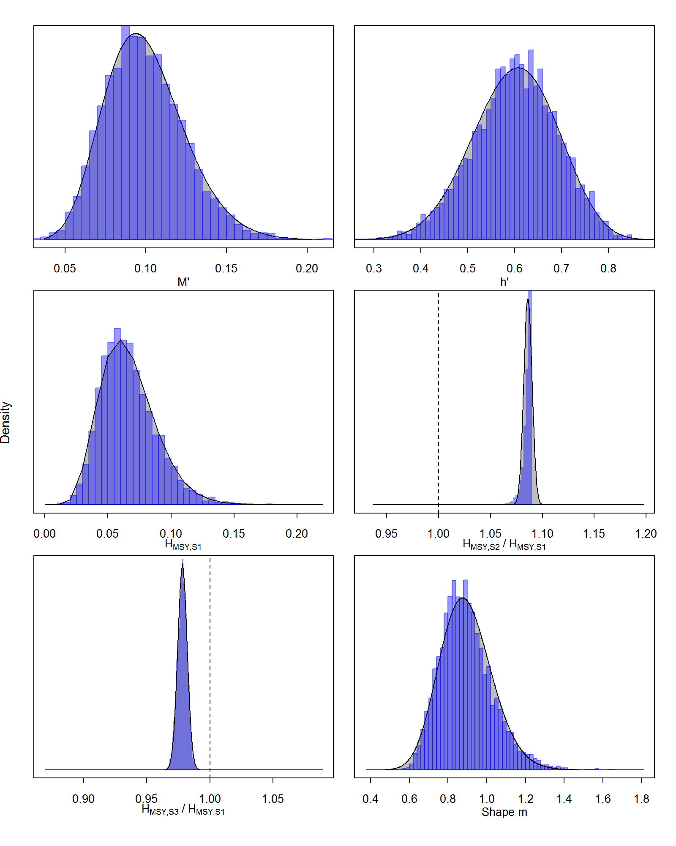
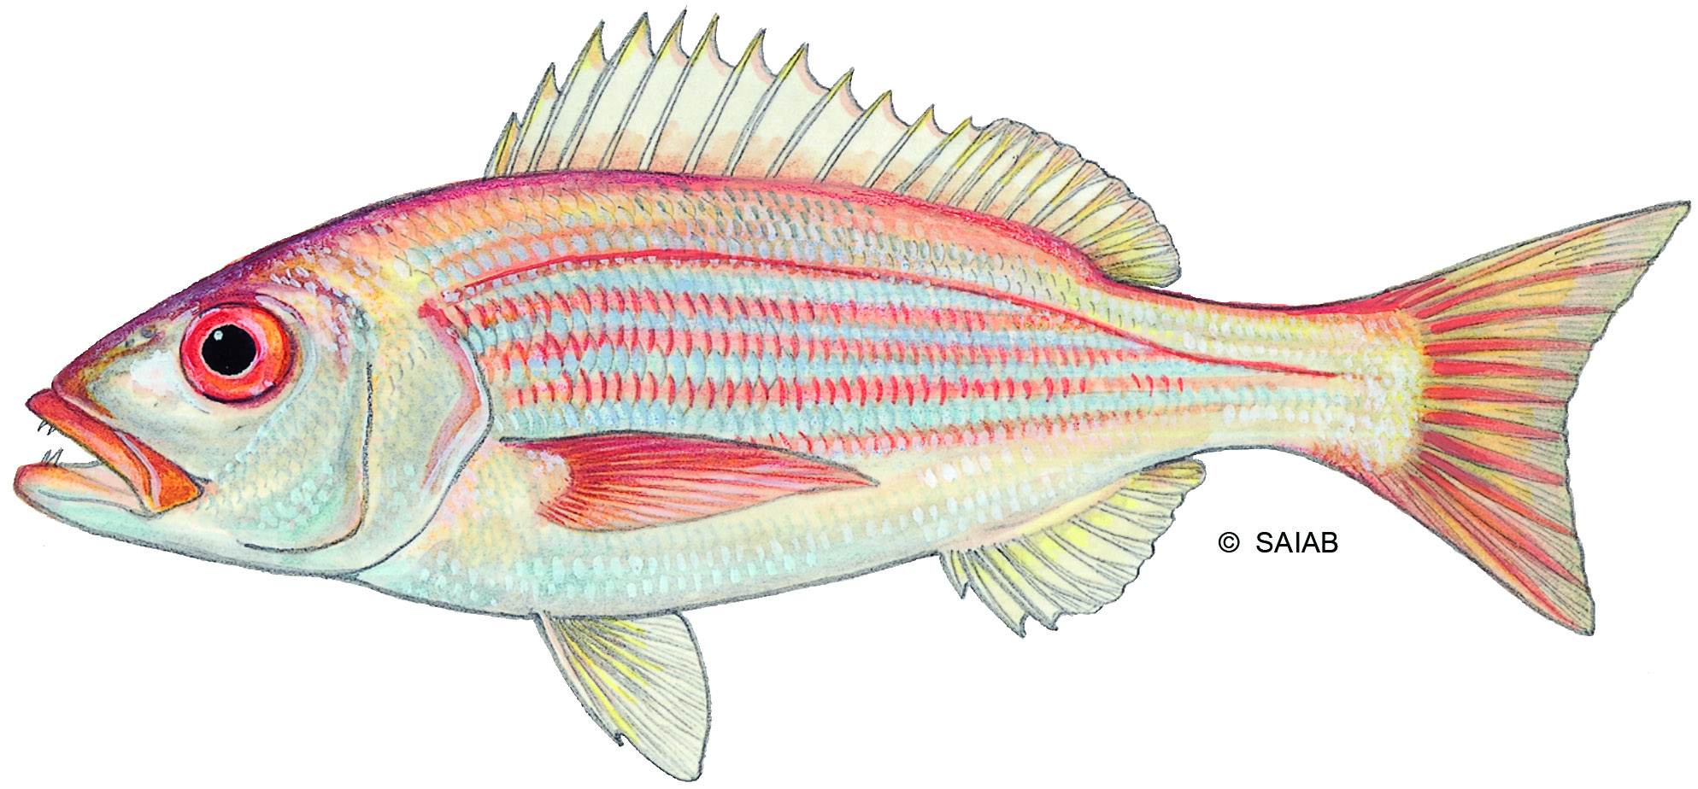
Carpenter
Gamma in fact

Slide 6
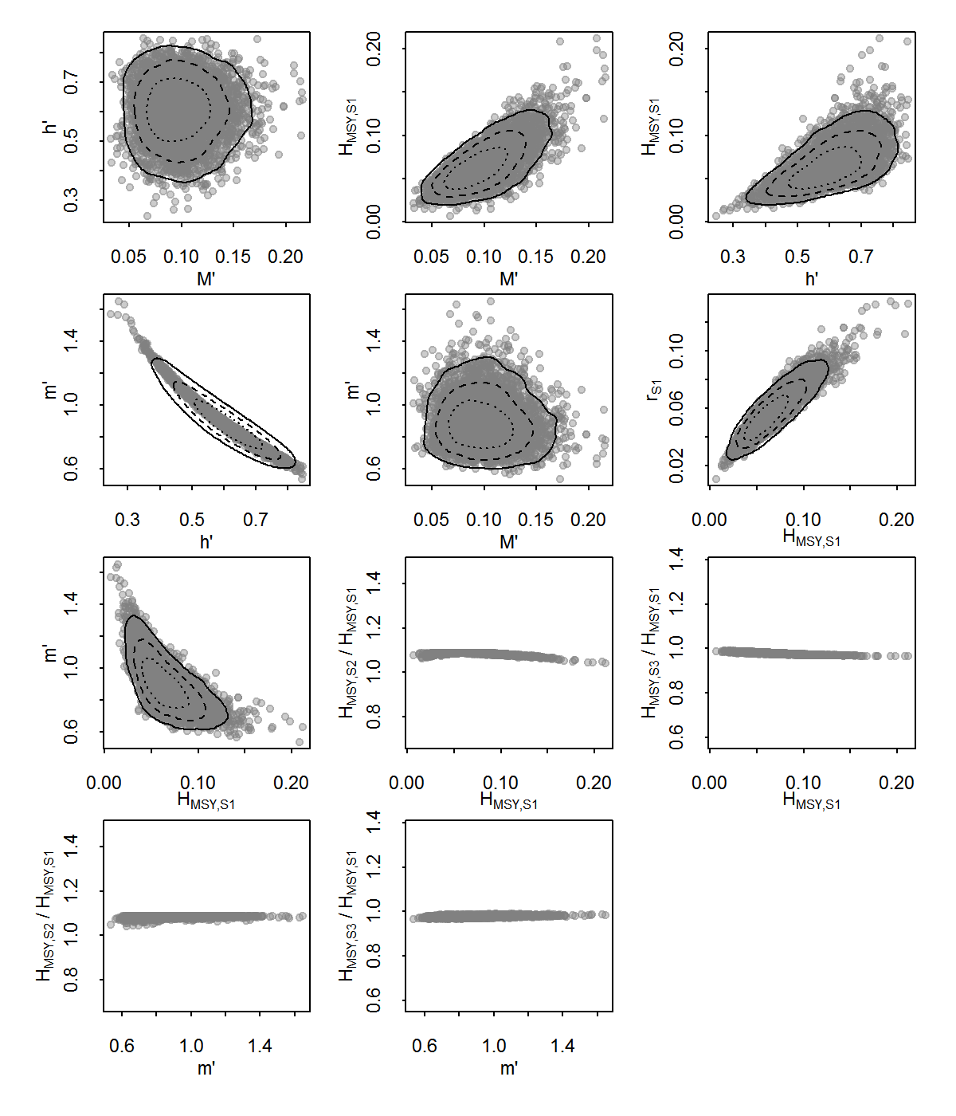
Carpenter

Slide 7
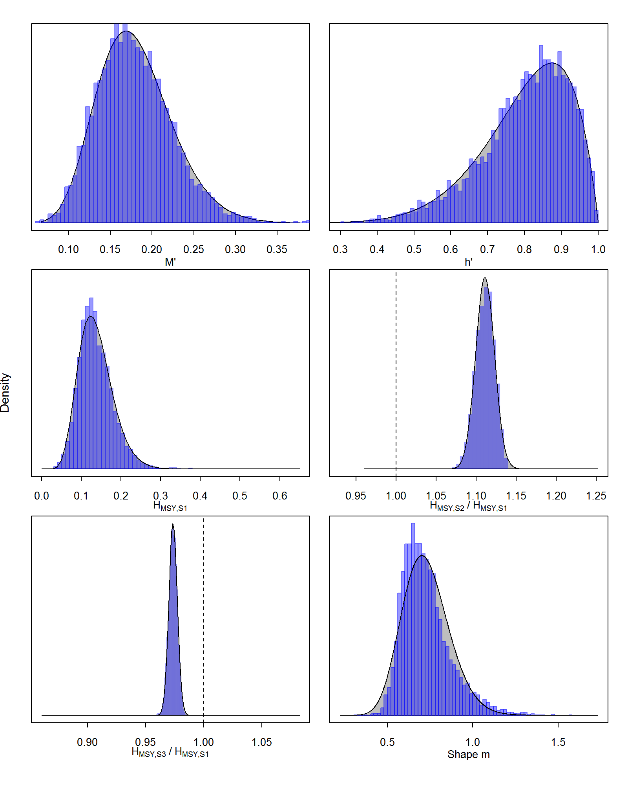
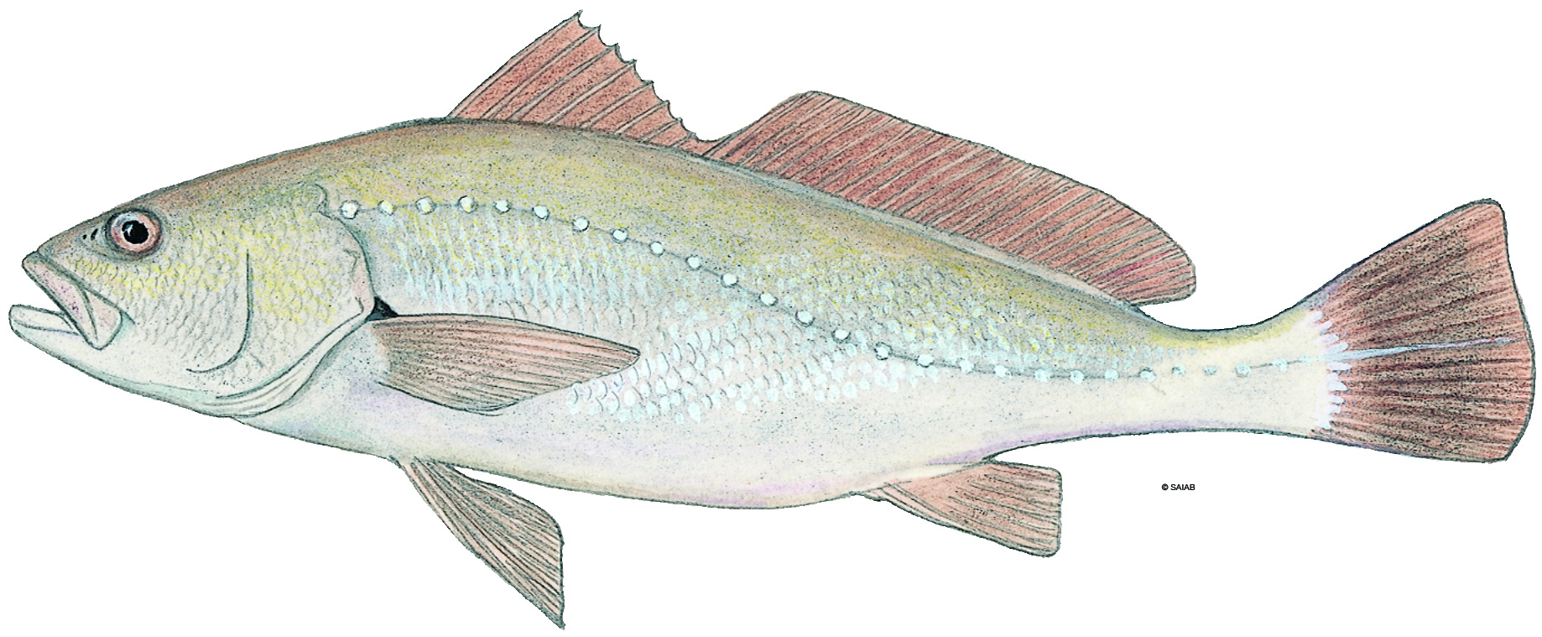
Silver kob
Gamma in fact

Slide 8
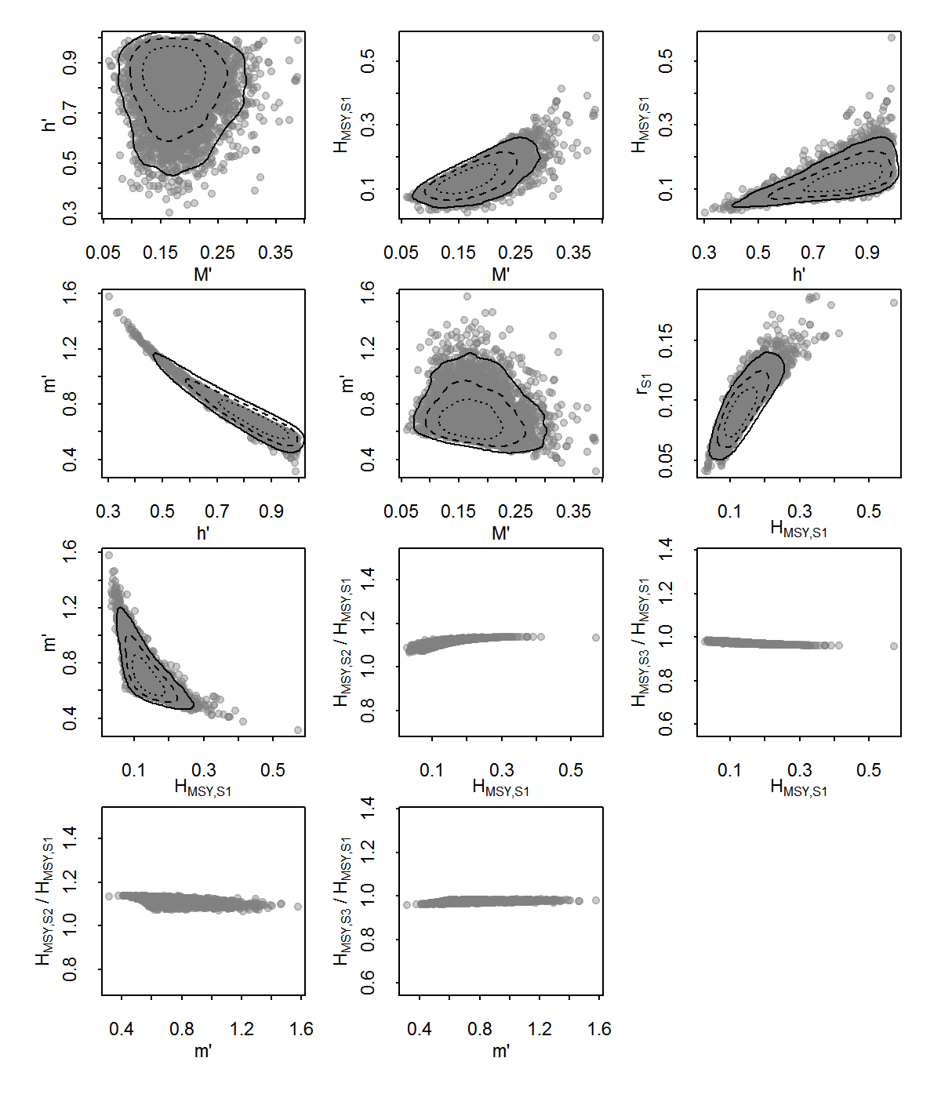
Silver kob

Slide 9
Homework part II
Some considerations regarding ‘narrow’ beta PDF for ‘steepness’ h

Slide 10
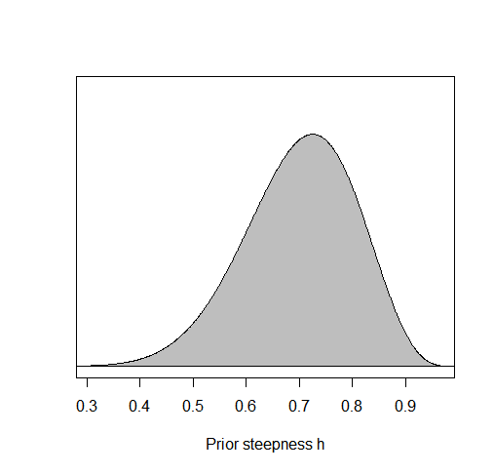
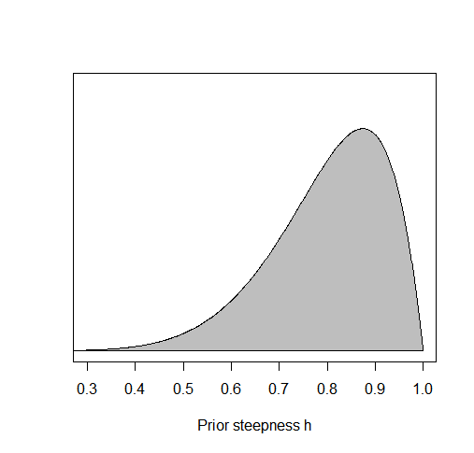
h = 0.8; CV =15%
h = 0.6; CV =15%
CHECKED by sd/mean of vectors 5000 random draws h’ – Correct
Coverage appears reasonable, no?

Slide 11
Homework part III
Some considerations regarding narrow beta PDF for initial biomass depletion (psi)

Slide 12
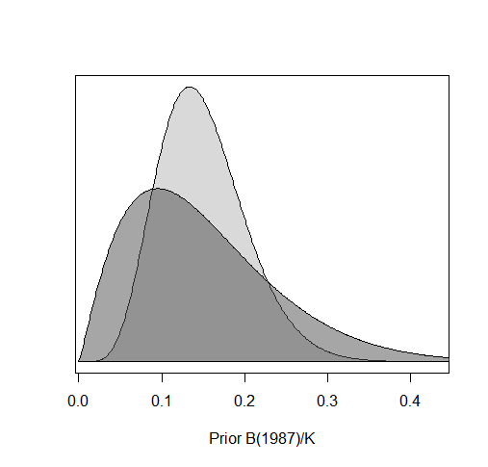
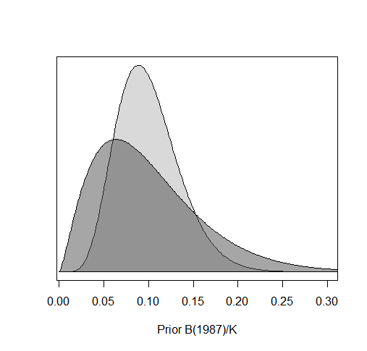
CV = 35%
CV = 35%
CV = 60%
CV = 60%

Slide 13
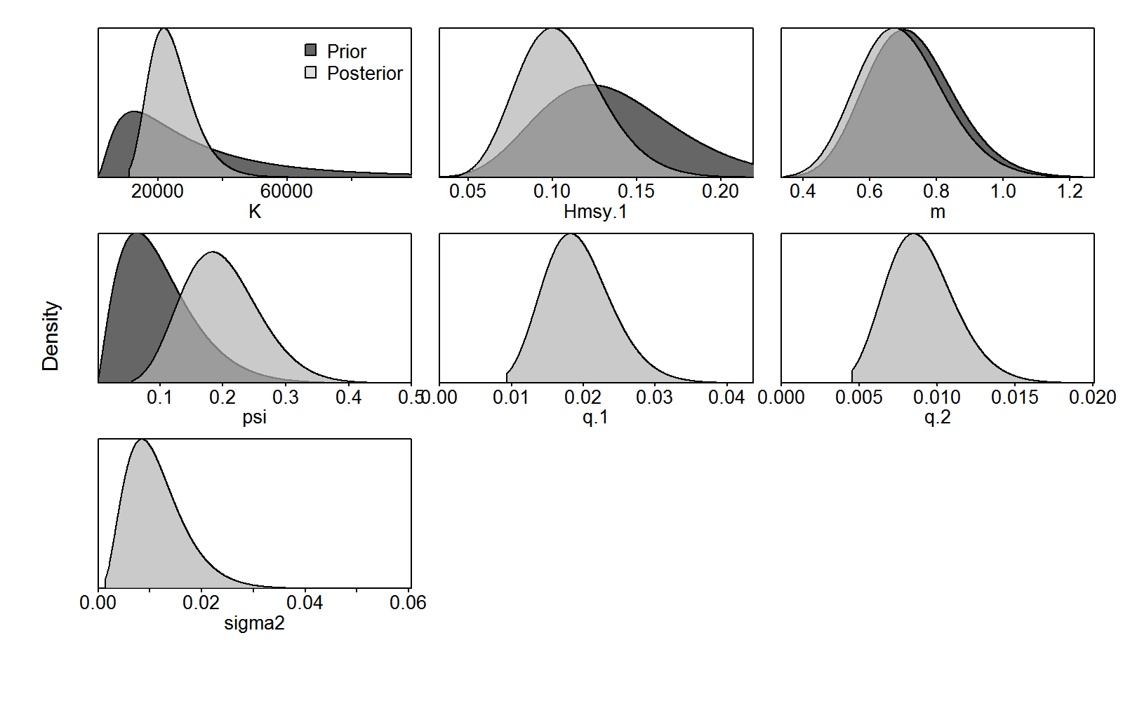
CV = 60%

Slide 14
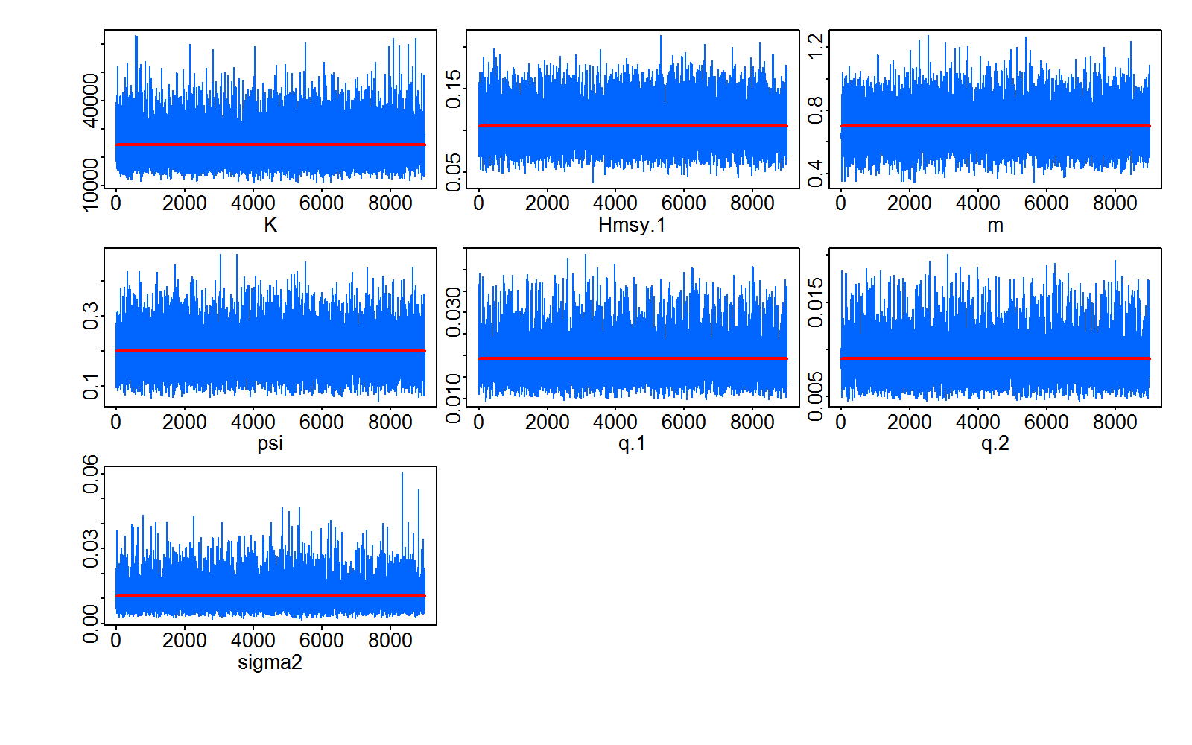
CV = 60%

Slide 15
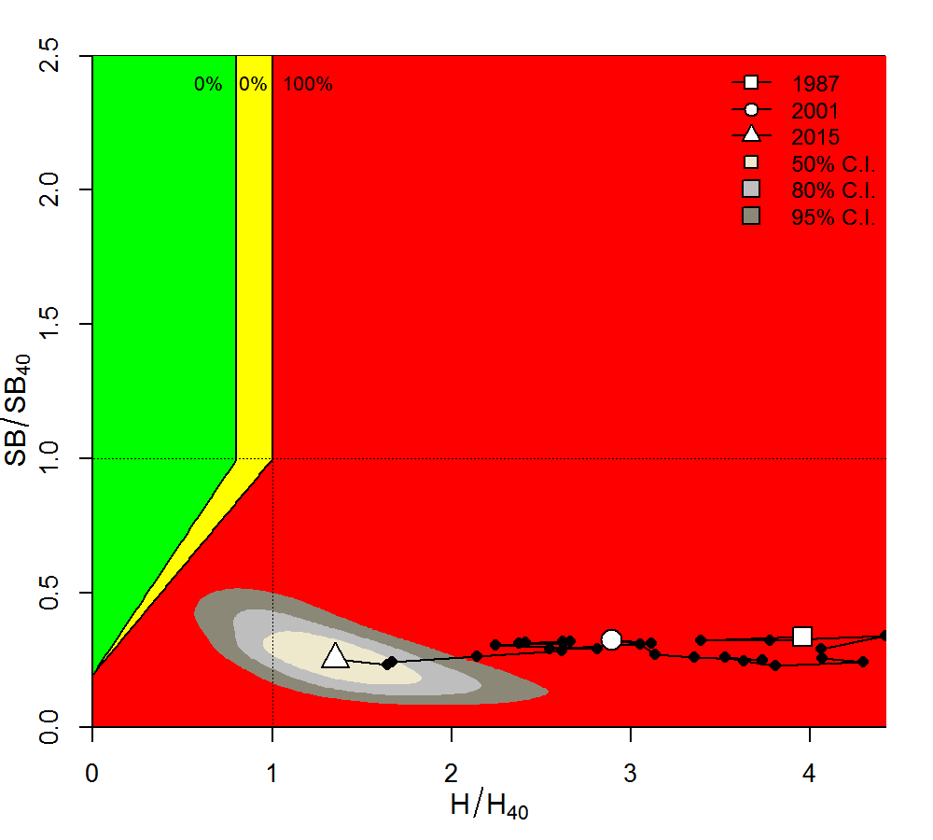
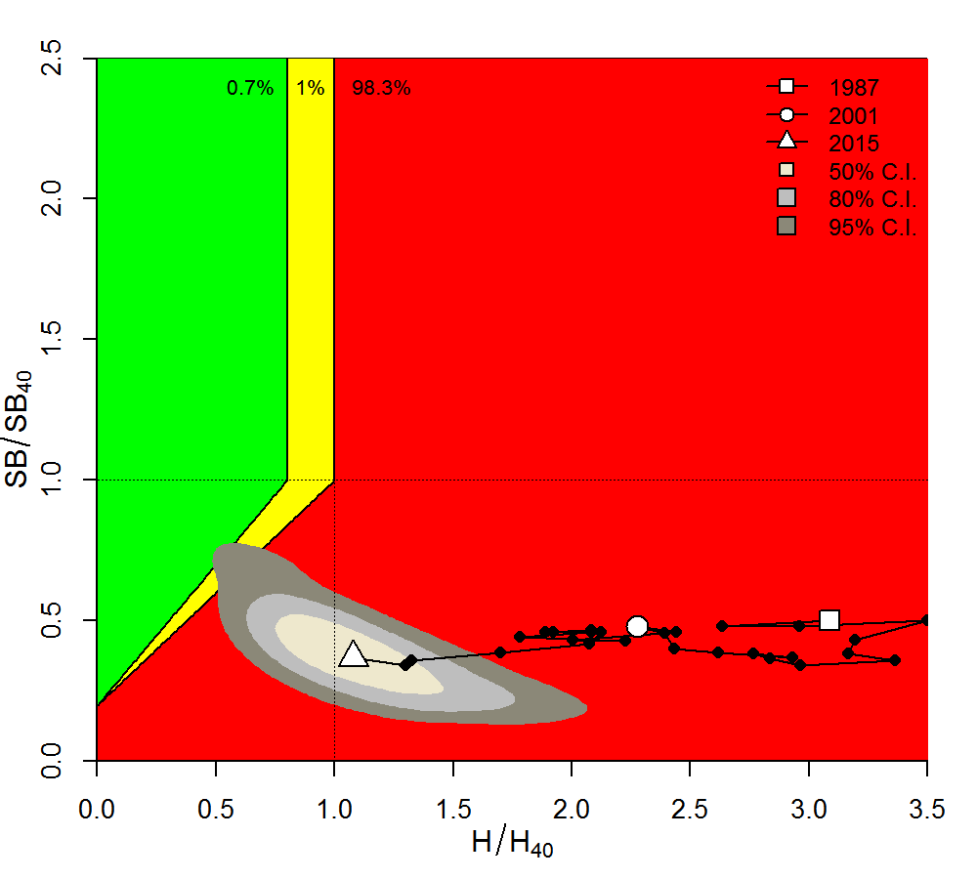
CV = 35%
CV = 60%

Slide 16
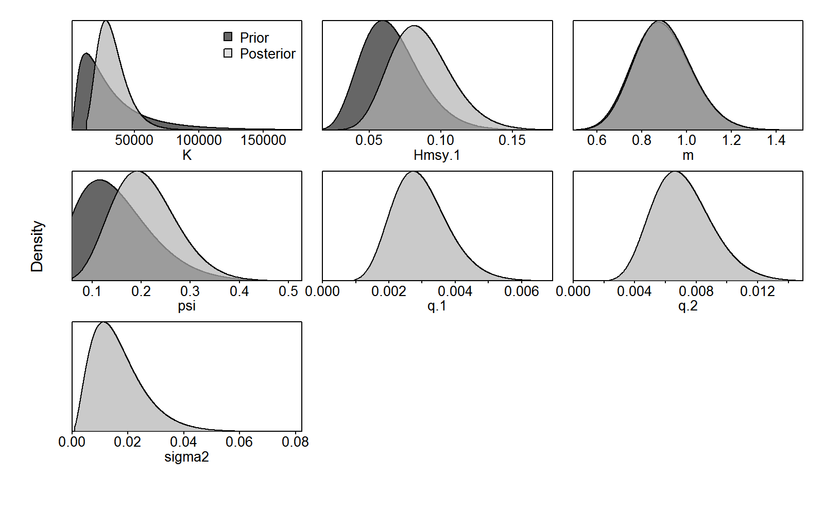
CV = 60%

Slide 17
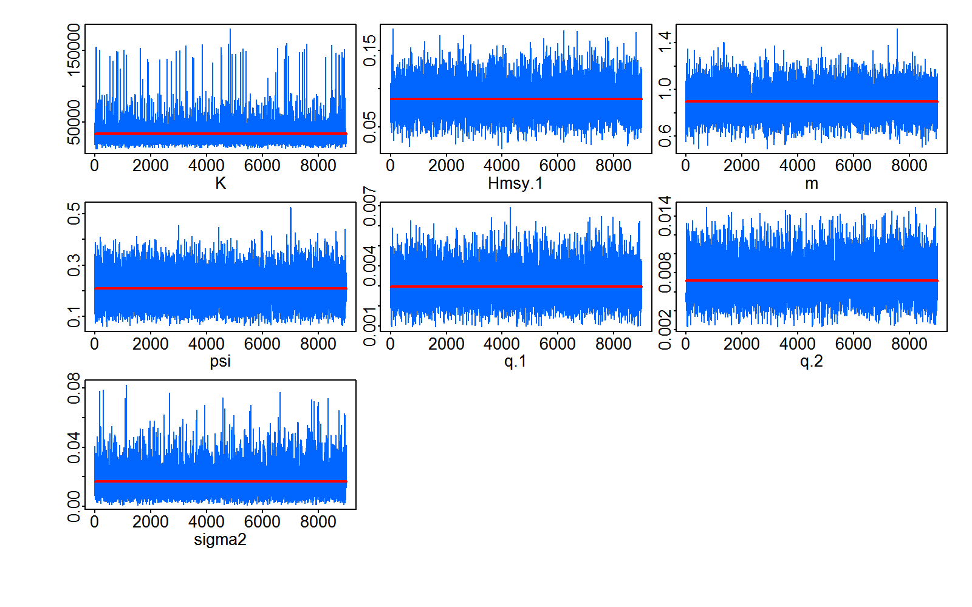
CV = 60%

Slide 18
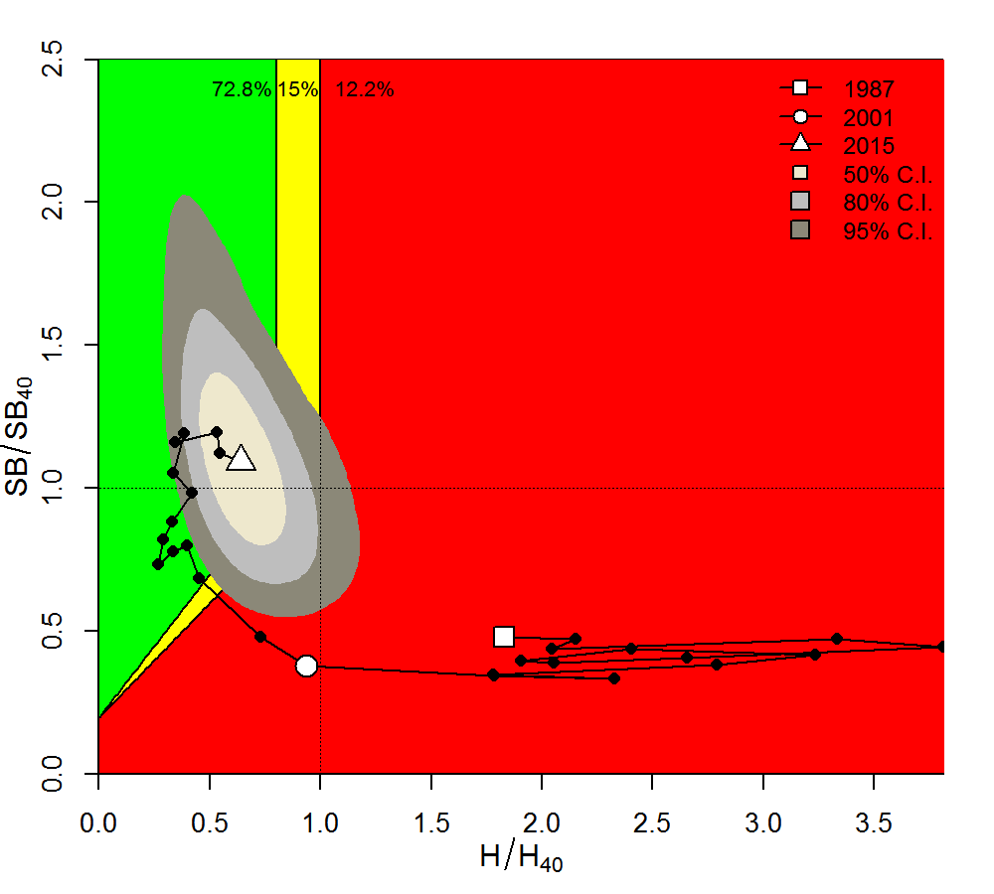
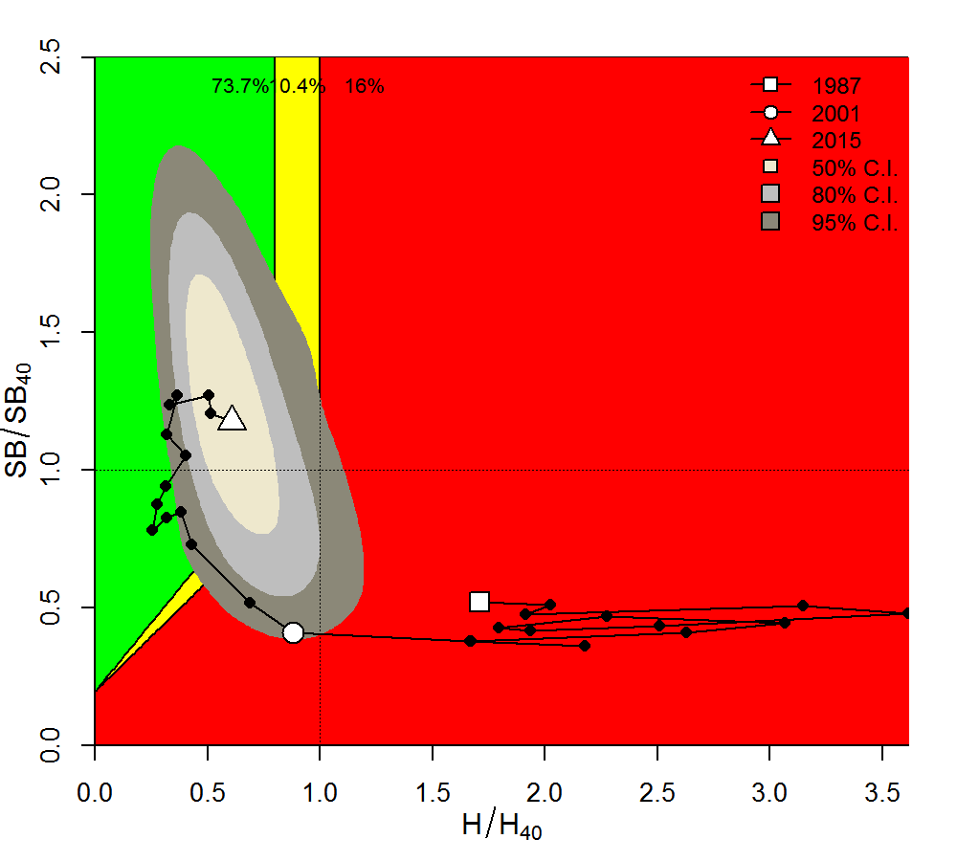
CV = 35%
CV = 60%

Slide 19
Homework part IV
Plot the process error deviates from JABBA-Select fits against those generated from the OM under no fishing, i.e log(SB_{y})-log(SB_{y})

Slide 20
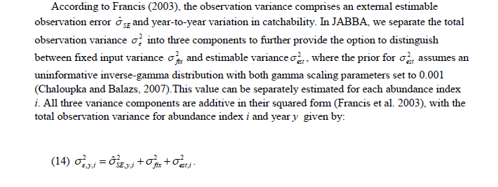
…some observation variance considerations

Slide 21
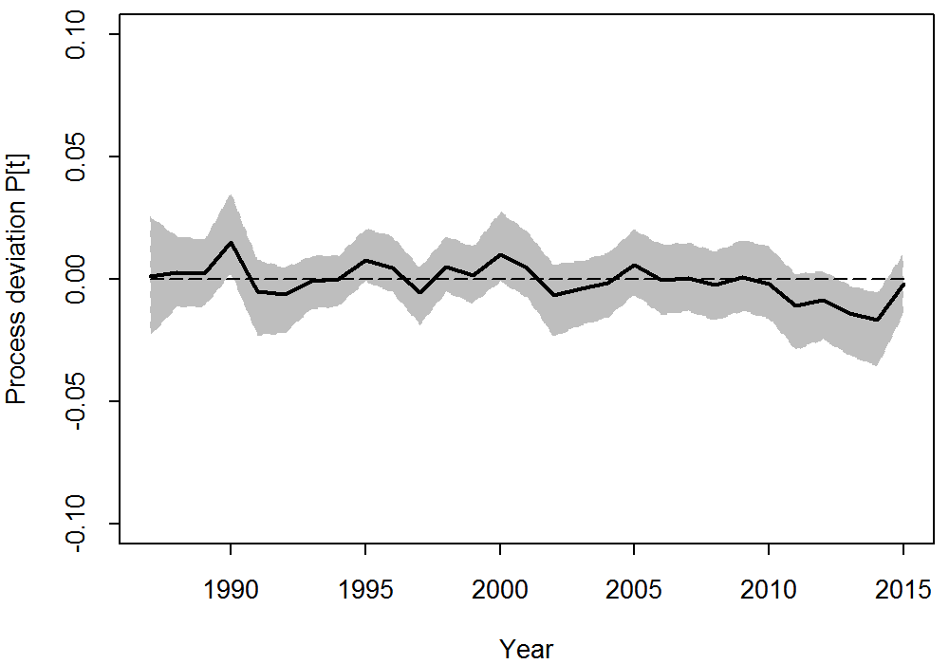
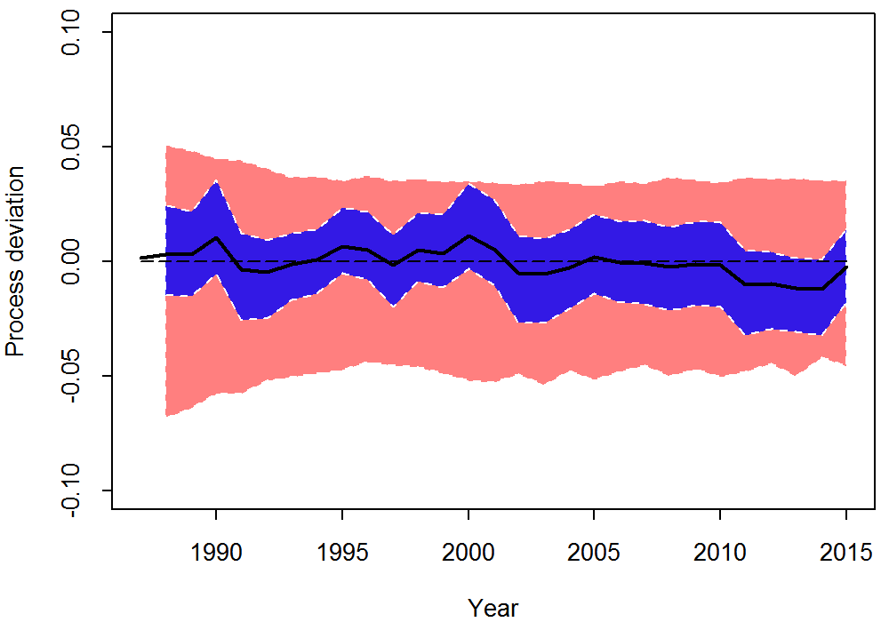

Slide 22
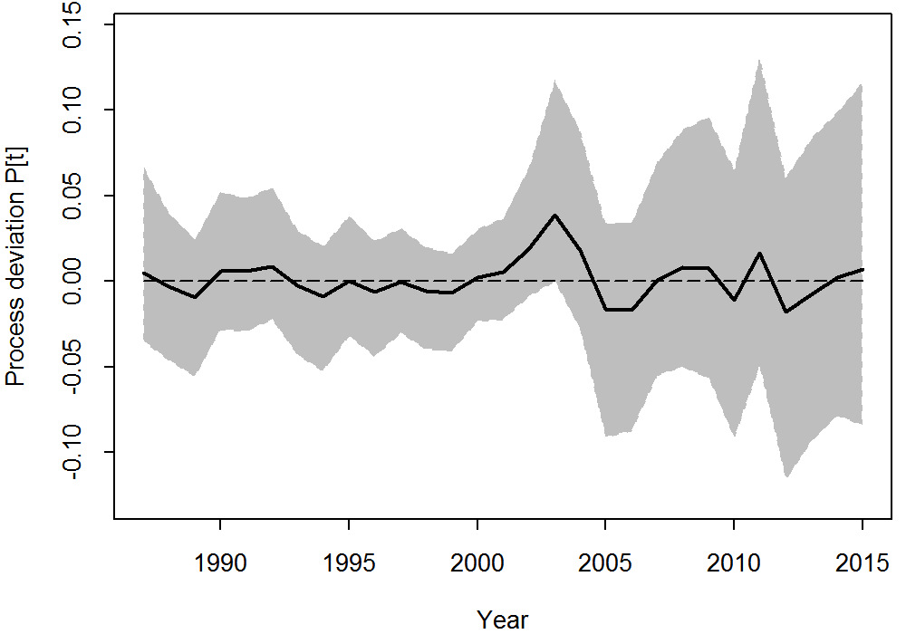
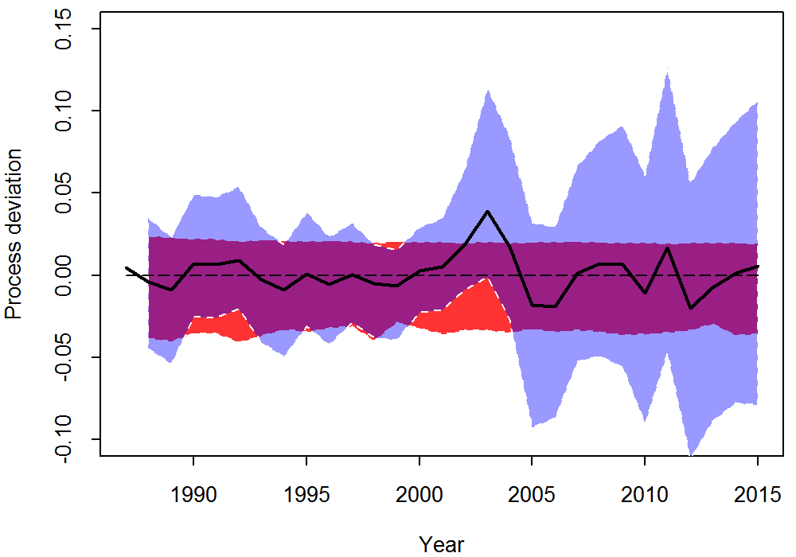

Slide 23
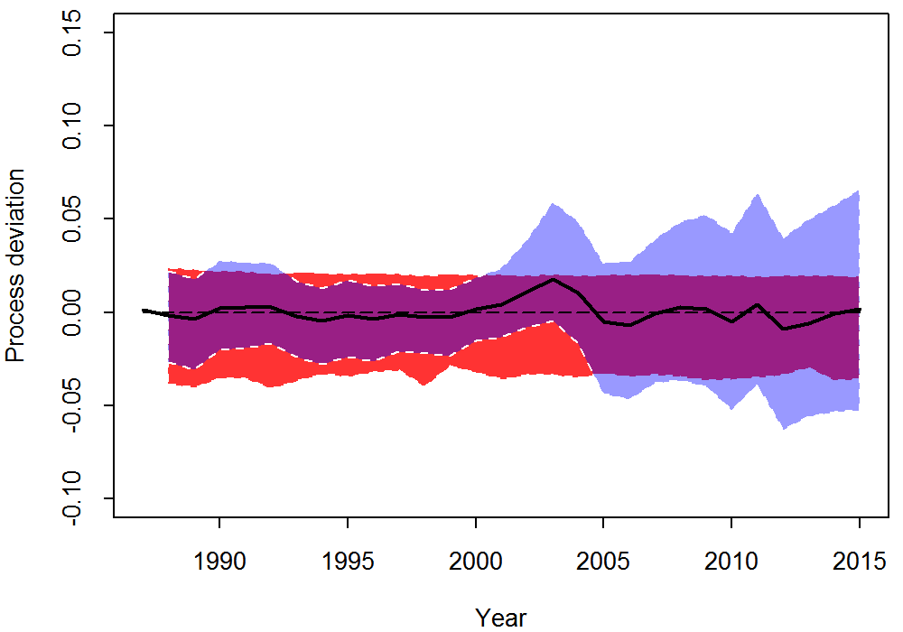
= 0.2
Plus informative process variance prior,
Here: 1/gamma(4,0.01)
mu = 0.07, CV ~ 50%

Slide 24
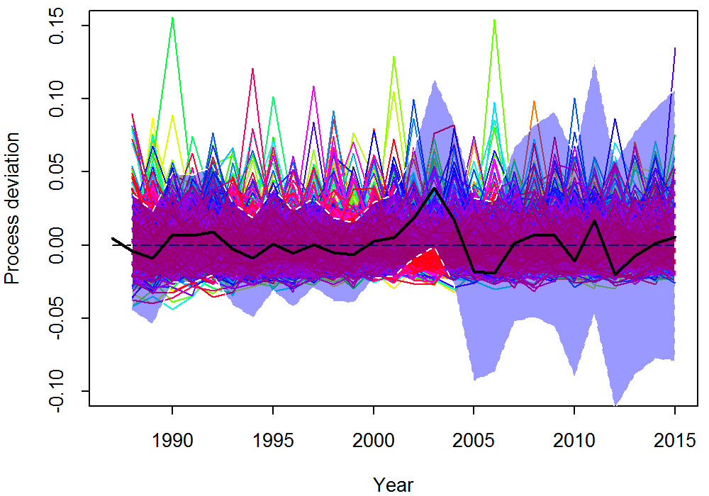
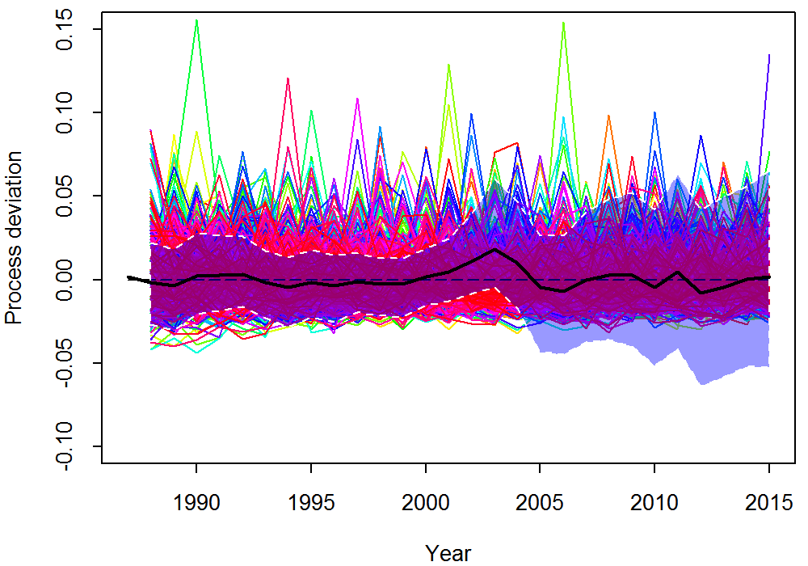
However, if one changes perspective…..
Plus informative process variance prior,
Here: 1/gamma(4,0.01)
mu = 0.07, CV ~ 50%

