Slide 1



JABBA-Select: An alternative surplus production model to account for changes in selectivity and relative mortality from multiple fisheries
Henning Winker*
MARAM International Stock Assessment Workshop
2017
*Henning.winker@gmail.com

Slide 2
Surplus Production Models
Minimal demands of data and parameters
Age-aggregated!
Catch
r
Growth: Linf, K, to
Longevity: tmax
LW: a, b
Maturity: Lm50, dL
Mortality: M
Recruitment: h, SB₀
SPM
m
CPUE

Slide 3
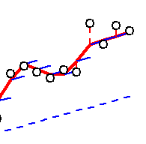
State-space Schaefer model example
Unobservable (latent) states of the system
Imperfect observations
Deterministic trend
Process, State or Evolutionary equation
Process error
Process variance
State variable
Production Function
Observation equation
Observation
Observation
error
Observation variance

Slide 4

Bayesian Framework
“Standing on the Shoulders of Giants“
(Hilborn and Liermann 1998)
Permits the integration of existent information from literature or expert knowledge by formulating informative prior distributions:
Estimated reference points: Depletion levels
Demographic information: Growth, Maturation, Mortality, Longivity
Knowledge from similar stocks: e.g. K, r
BUT, care must be taken not to overstate the precision of priors for uncertain model parameters!

Slide 5
Pella-Tomlison Surplus Production Model
Surplus production function of the generalized three parameter SPM by Pella and Tomlinson (1969)
(1)
where r is the intrinsic rate of population increase at time t, K is the unfished biomass and m is a shape parameter that determines at which B/K ratio maximum surplus production is attained.
If m = 2, the model reduces to a Schaefer form, with the surplus production SP attaining MSY at exactly K/2
If 0 < m < 2, SP attains MSY at depletion levels smaller than K/2 and vice versa
The Pella-Tomlinson model reduces to a Fox model if m approaches one (m=1) resulting in maximum surplus production at ~ 0.37K

Slide 6
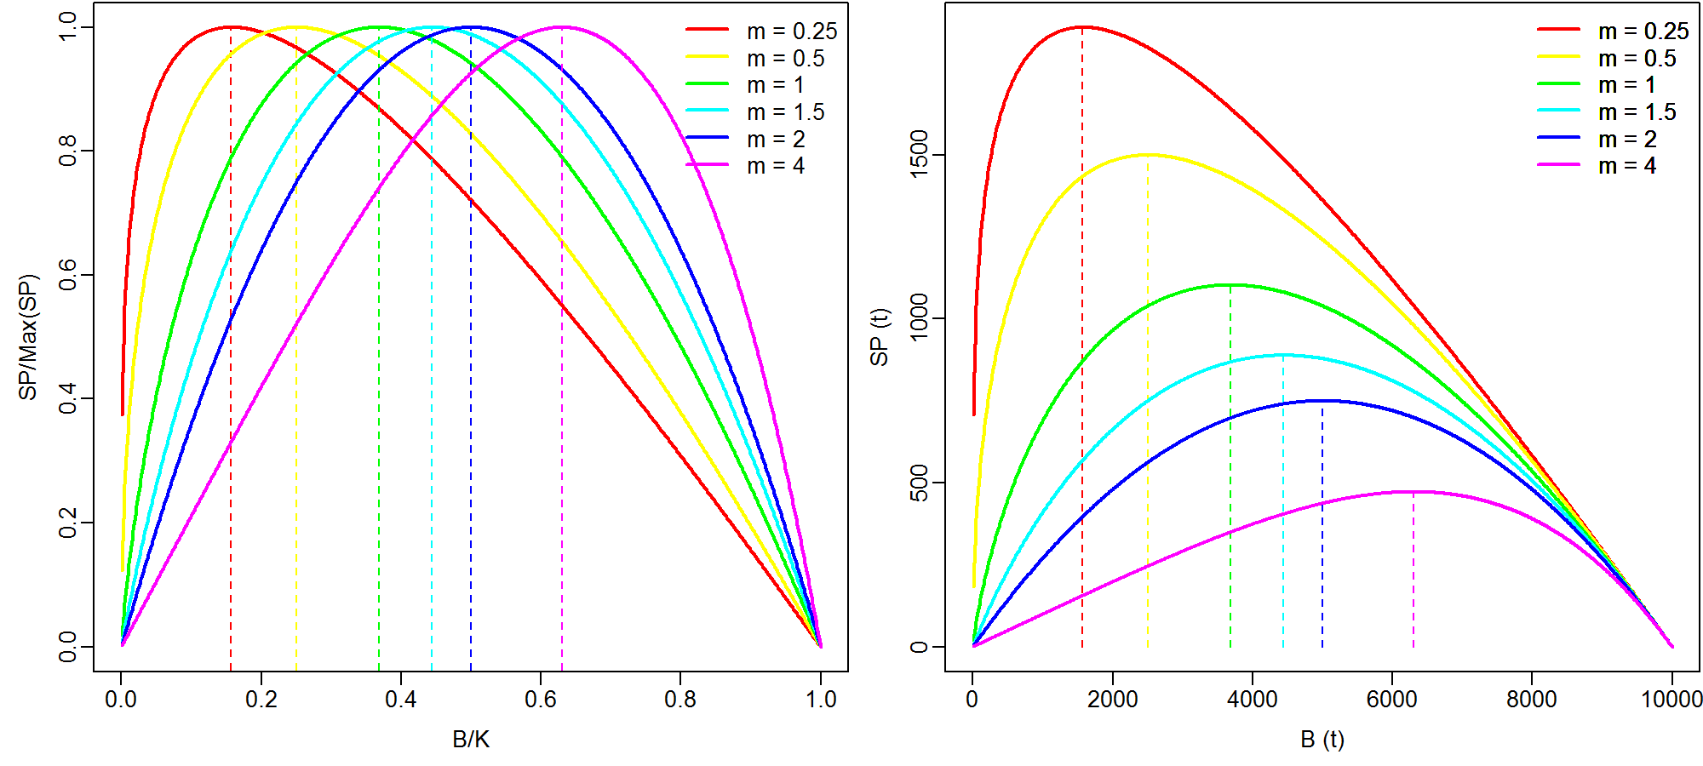
Shape parameter defines B_{MSY}/K
(2)
K = 1000 t, r = 0.3

Slide 7
Some relationships
B_{MSY} can be obtained from re-arranging Eq. 2
(3)
Inputting B_{MSY} into Eq. 1 give MSY (i.e. maximized Surplus Production)
(4)
The Pella-Tomlinson solution for H_{MSY} is:
(5)
But given that harvest is simply defined as: , it follows that:
(6)

Slide 8
Some relationships...
Combing and re-arranging equation (5) and (6), it follows that r in equation (1) can be expressed as:
or
This allows re-formulating the production function of the Pella-Tomlinson equation as a function of H_{MSY}, such that:
(7)

Slide 9
JABBA-SELECT

Slide 10
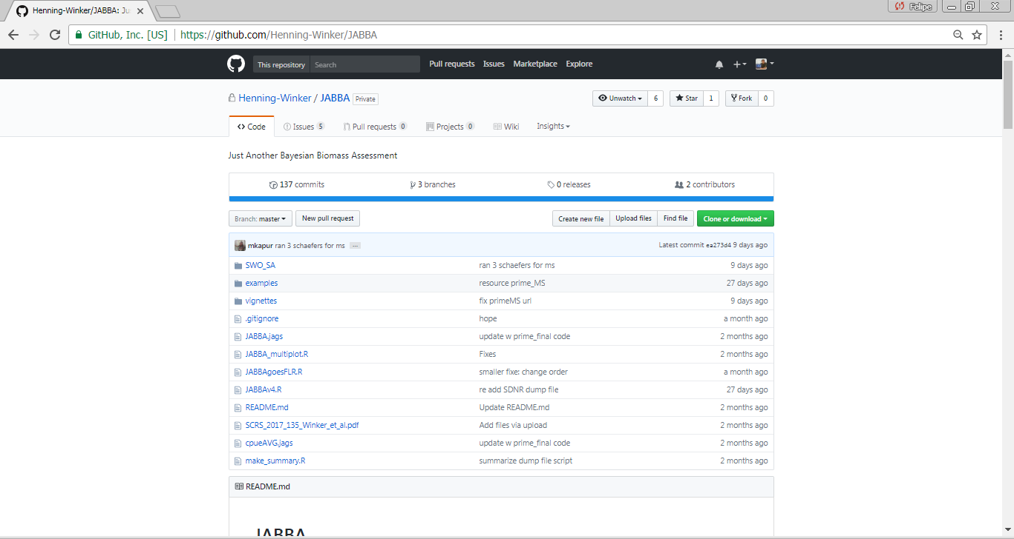


JABBA (Just Another Bayesian Biomass Assessment):
A generalized Bayesian State-Space Surplus Production Model
To ensure reproducibility, JABBA is distributed through the global open-source platform GitHub

Slide 11
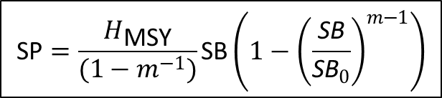
Linking age-structure and surplus production models:
JABBA-Select
$$\text{SP}=\frac{H_{\text{MSY}}}{(1−m^{−1})}\text{SB}\left(1−{\left(\frac{\text{S}\text{B}}{{\text{S}\text{B}}_{0}}\right)}^{m−1}\right)$$
Fig. 1. Schematic of functional relationships between the productivity parameter r and the shape parameter of the surplus production function and the Age-Structured Equilibrium Model (ASEM; i.e. yield- and spawning biomass-per-recruit models with integrated spawner recruitment relationship). Numbers in boxes denote the sequence of deriving deviates of r and m from life history and selectivity parameter inputs into the ASEM.

Slide 12
South African line fish examples
Parameter | Silver kob | Carpenter |  | Sources
L∞ | 1372 | 619 | mm | Griffiths (1997); Brouwer & Griffiths (2005)
κ | 0.115 | 0.06 | year⁻¹ | Griffiths (1997); Brouwer & Griffiths (2005)
t₀ | -0.815 | -4.5 | years | Griffiths (1997); Brouwer & Griffiths (2005)
a | 0.000006 | 0.00004 | g | Griffiths (1997); Brouwer & Griffiths (2005)
b | 3.07 | 2.855 | g mm⁻¹ | Griffiths (1997); Brouwer & Griffiths (2005)
A_{mat} | 3 | 4 | years | Griffiths (1997); Brouwer & Griffiths (2005)
d_{t} | 0.1 | 0.01 | year⁻¹ | assumed ~ knife-edge
t_{max} | 25 | 30 | years | Griffiths (1997); Brouwer & Griffiths (2005)
M | 0.18 | 0.1 | year⁻¹ | Winker et al. (2014b)
h (Steepness) | 0.8 | 0.6 |  | Winker et al. (2014b)
a_{min} | 1 | 1 | years | minimum assessment age
a_{max} | 15 | 30 | years | assumed plus group
S_{L,S1} | 400 | 270 | mm | Winker et al. (2014b)
d_{S1} | 5 | 12 | mm⁻¹ | Winker et al. (2014b)
S_{L,S2} | 500 | 330 | mm | Winker et al. (2014b)
d_{S2} | 5 | 10 | mm⁻¹ | Winker et al. (2014b)
S_{L,S3} | 334 | 280 | mm | Winker et al. (2014b)
d_{S3} | 11 | 22 | mm⁻¹ | Winker et al. (2014b)

Slide 13
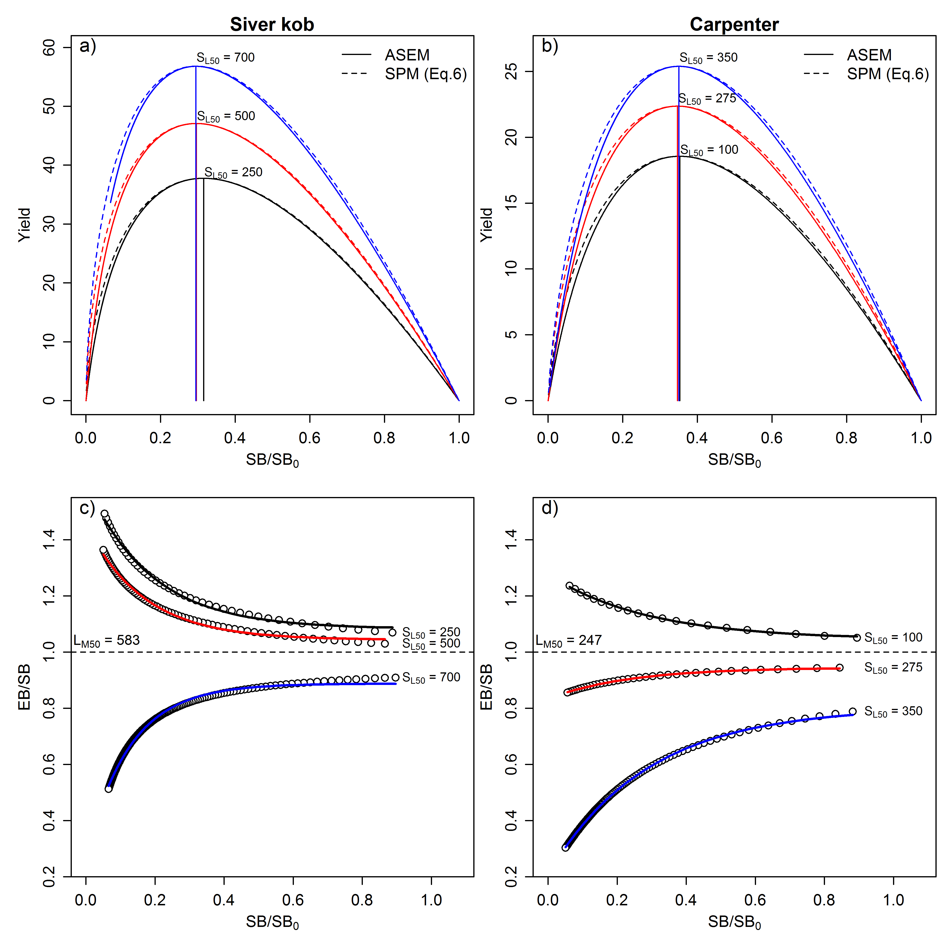
Production functions
SPM: Surplus production model
ASEM: Age-structured equilibrium model (i.e. per-recruit with B&H SSR)
SL50 = Length-at-50-selectivity
Note that because SB_{MSY} / SB₀ and MSY/SB_{MSY} are relative, absolute estimates and therefore fitting a model not even required!!! A simple Age-structured equilibrium model for determination Fisheries Reference Points (FRPs) would do ☺

Slide 14
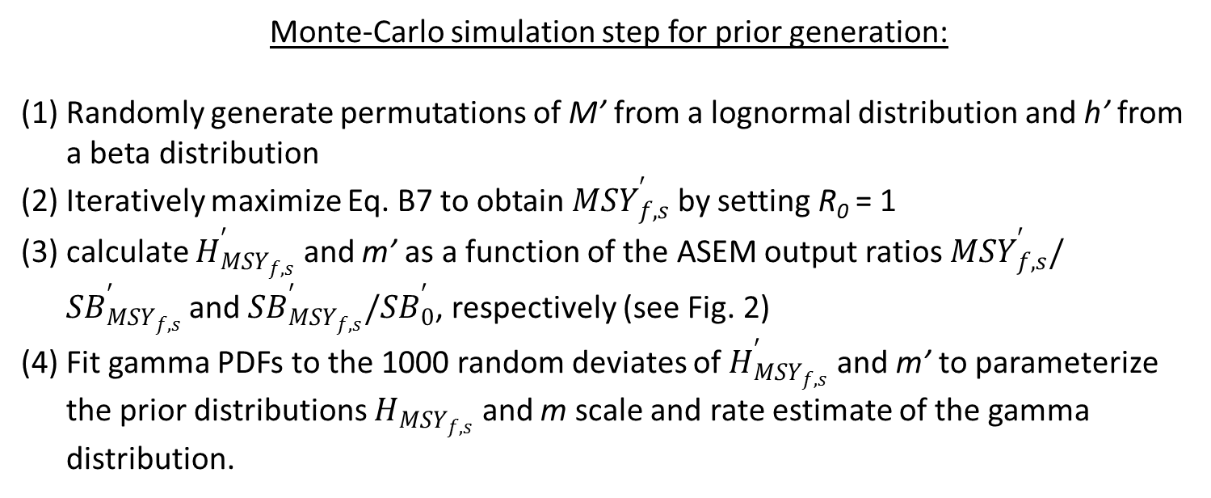
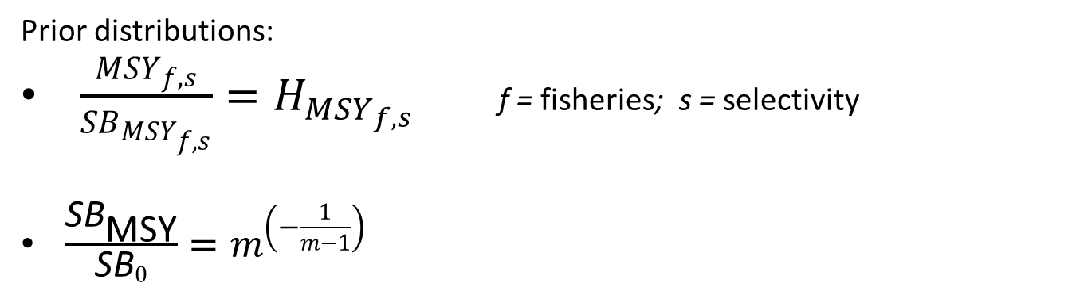
JABBA-SELECT ASEM Priors
Prior distributions:
$\frac{{MSY}_{f,s}}{{SB}_{{MSY}_{f,s}}}=H_{{MSY}_{f,s}}$ f = fisheries; s = selectivity
$\frac{{\text{SB}}_{\text{MSY}}}{{\text{SB}}_{0}}=m^{\left(−\frac{1}{m−1}\right)}$
Monte-Carlo simulation step for prior generation:
Randomly generate permutations of M’ from a lognormal distribution and h’ from a beta distribution
Iteratively maximize Eq. B7 to obtain ${MSY}_{f,s}^{′}$ by setting R₀ = 1
calculate $H_{{MSY}_{f,s}}^{′}$ and m’ as a function of the ASEM output ratios ${MSY}_{f,s}^{′}/{SB}_{{MSY}_{f,s}}^{′}$and ${SB}_{{MSY}_{f,s}}^{′}/{SB}_{0}^{′}$, respectively (see Fig. 2)
Fit gamma PDFs to the 1000 random deviates of $H_{{MSY}_{f,s}}^{′}$ and m’ to parameterize the prior distributions $H_{{MSY}_{f,s}}$ and m scale and rate estimate of the gamma distribution.

Slide 15
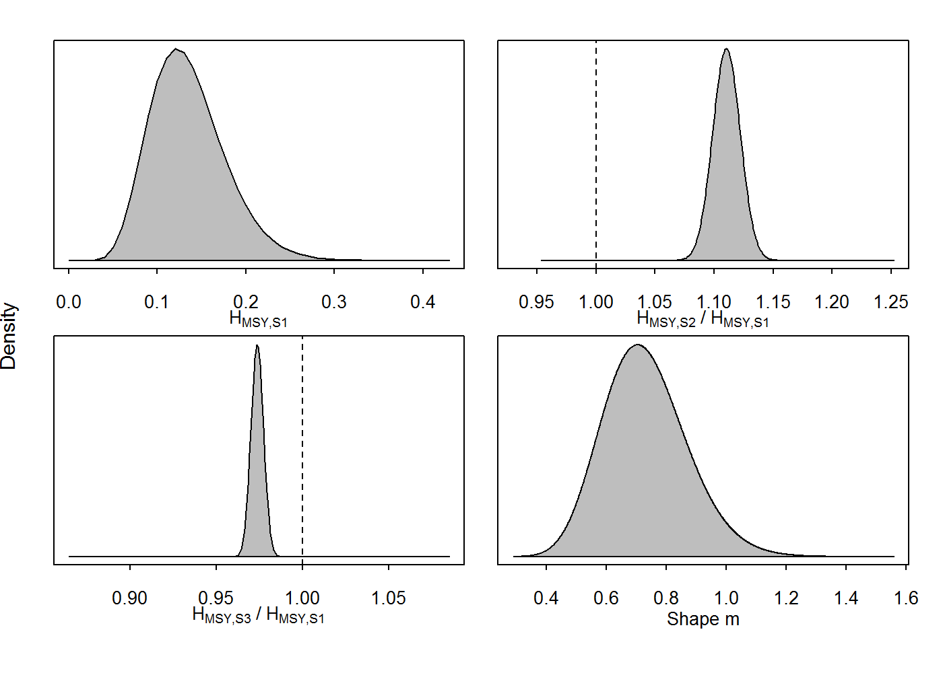
Fig. B1. Probability density function of gamma priors for H_{MS𝑌,f,s} for three logistic selectivity curves (S1-S3) and m using the input parameters for silver kob (Table 2), which were generated from the Age-Structured Equilibrium Model (ASEM) through Monte-Carlo simulation.

Slide 16
Selectivity distortion

Slide 17
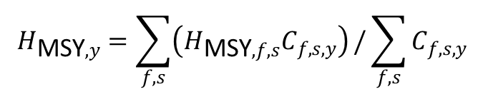
JABBA-Select Formulation
Process equation
$$H_{\text{MSY},y}=\sum_{f,s}{\left(H_{\text{MSY},f,s}C_{f,s,y}\right)}/\sum_{f,s}{C_{f,s,y}}$$
Time-varying resilience
Separating SB and EB
Observation Equation

Slide 18
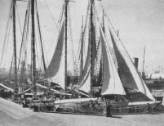
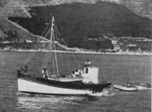

Linefishery application
Mid-1800‘s: Establishment of a thriving linefishery sector in the cape region
1986 – 1906: First records landings of catch and CPUE
1926 – 1931: Second set of catch records
1985: National Marine Linefish System (NMLS)
& first management regulations (e.g. gag- and size limits)
1990s: Once-off per-recruit assessments
1999: Linefish management protocol (LMP)
  - Biological reference points incl. SB/R & Decline in CPUE
2000: Declaration of the state of emergency in the linefishery
2003: Drastic effort cut (~ 70%) and several new size andbag limits
2010 Shore-based observer programme for size data ceased
2011-13: Standarization of linefish CPUE by accouning for targeting
2012-13: First round of age-structured assessments for 4 species
      Fitted to CPUE + size comps (1987-2010)
2014-16: Difficulties to update age-structured assessments
2017 Preliminary follow-up stock assessments using JABBA-Selectict for now 8 species (Snoek, Yellowtail, Santer, Red Roman, Red stumpnose, Silver kob, Carpenter, Slinger, Hottentot)

Slide 19
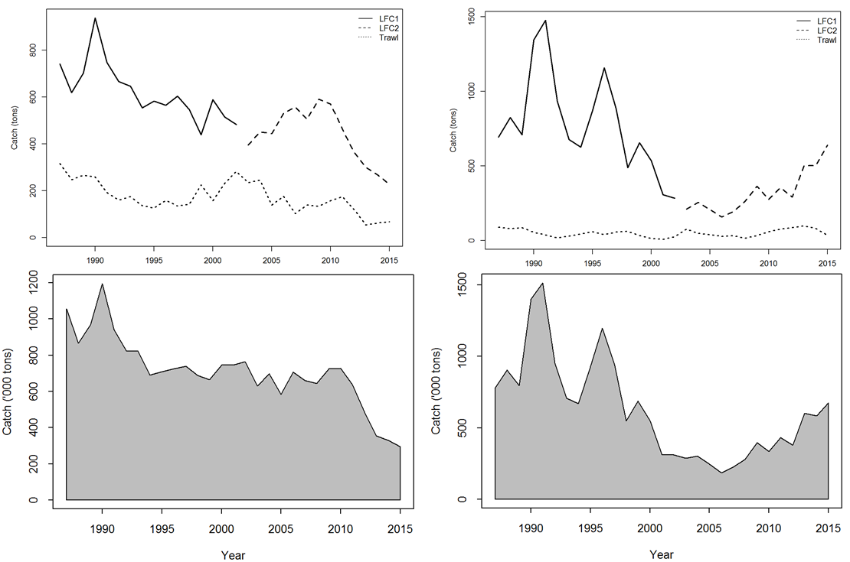
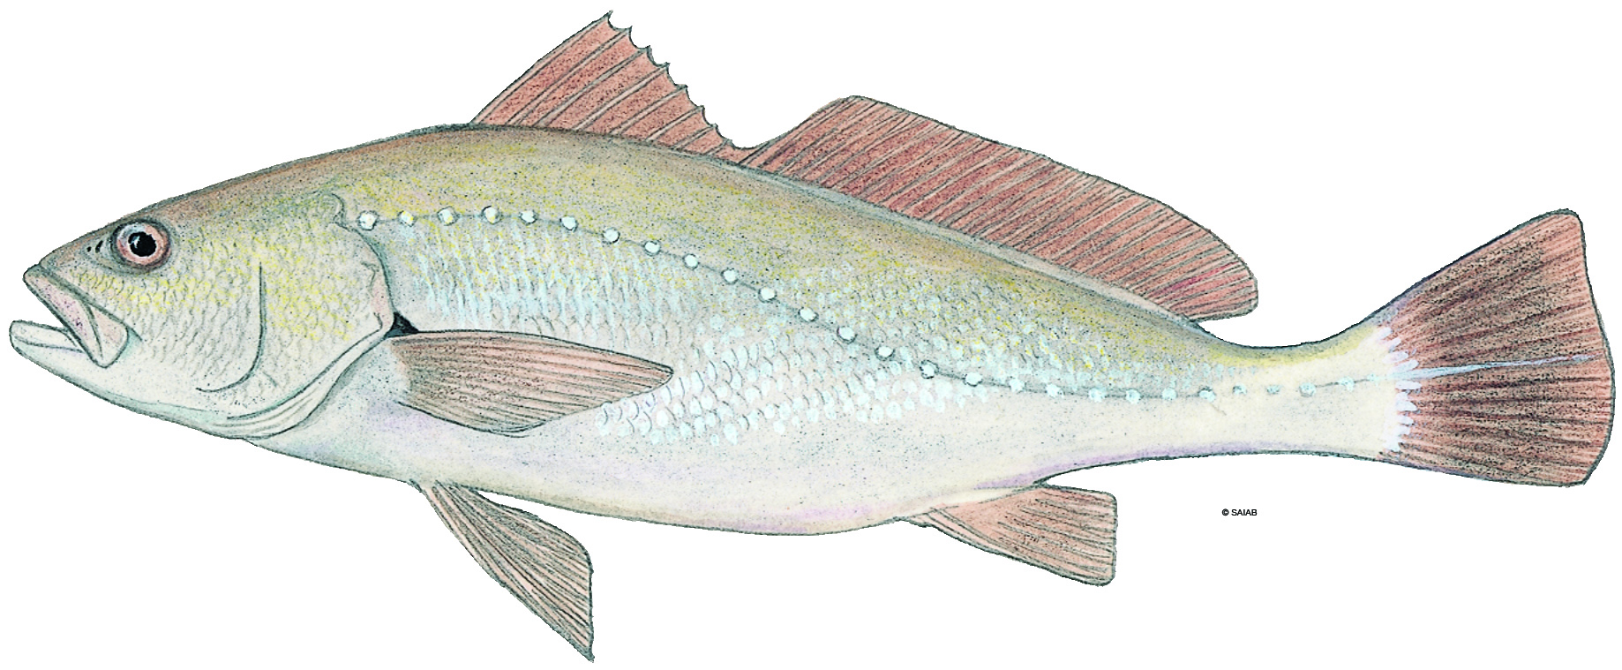
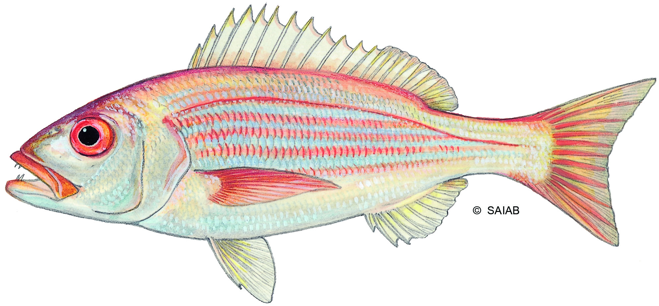
Available Catch History
Size limit increase
Size limit increase

Slide 20
Key prior inputs
Parameter | Species | Distribution | μ | CV | Input
SB₀ | Silver kob | log-normal | 35000 | 100% | Prior
 | Carpenter |  | 35000 | 100% | Prior
q catchability | Both | Uniform |  |  | Prior
φ = SB₁₉₈₇/SB₀ | Silver kob | Beta | 0.1 | 30% | Prior
 | Carpenter | Beta | 0.15 | 30% | Prior
Process variance | All | inverse-gamma | 1/gamma(0.001,0.001) |  | Prior
Observation variance | All | inverse-gamma | 1/gamma(0.001,0.001) |  | Prior
H ‘steepness’ | Silver kob | Beta | 0.8 | 15% | ASEM input
 | Carpenter | Beta | 0.6 | 15% | ASEM input
M Natural Mortality | Silver kob | log-normal | 0.18 | 25% | ASEM input
 | Carpenter | log-normal | 0.1 | 25% | ASEM input

Slide 21
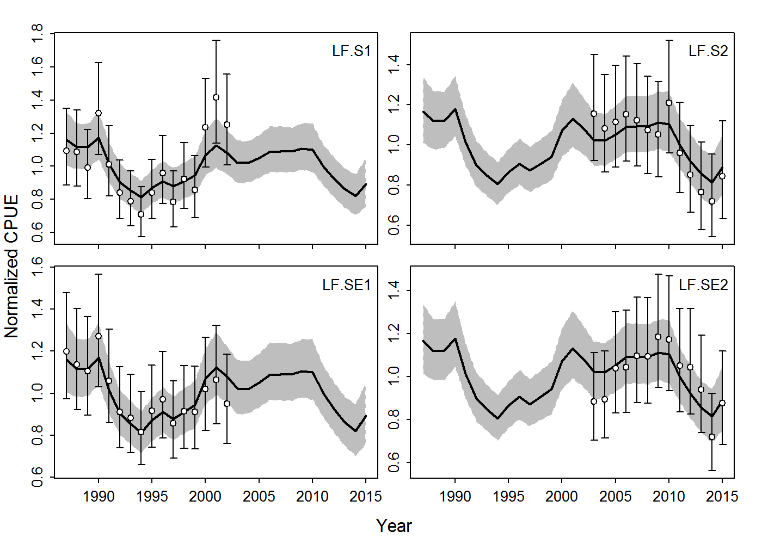
JABBA-Select Fits to Standardized CPUE

Slide 22
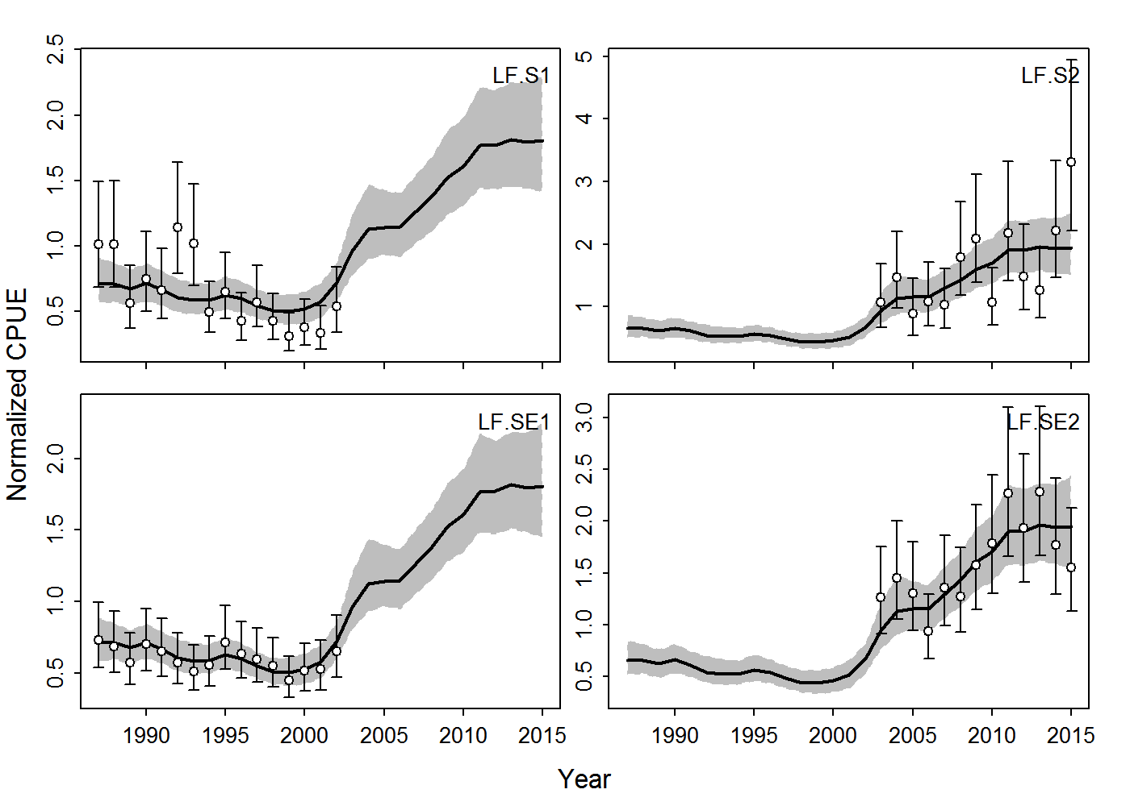
JABBA-Select Fits to Standardized CPUE

Slide 23
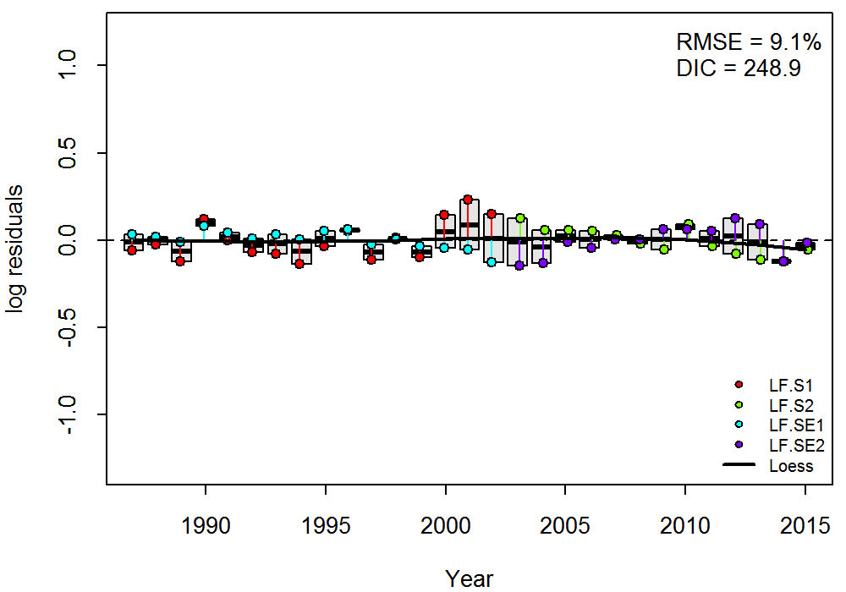
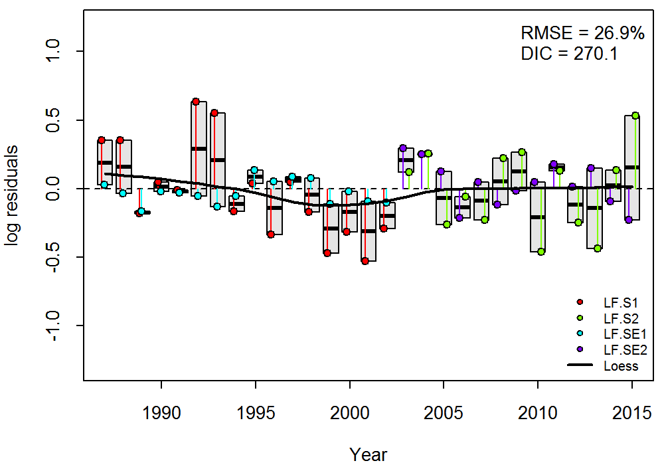
Goodness-of-Fit
Figure 6. Residual diagnostic plots of CPUE fits for silver kob (left) and carpenter (right) Boxplots indicating the median and quantiles of all residuals available for any given year, and solid black line indicates a loess smoother through all residuals.

Slide 24
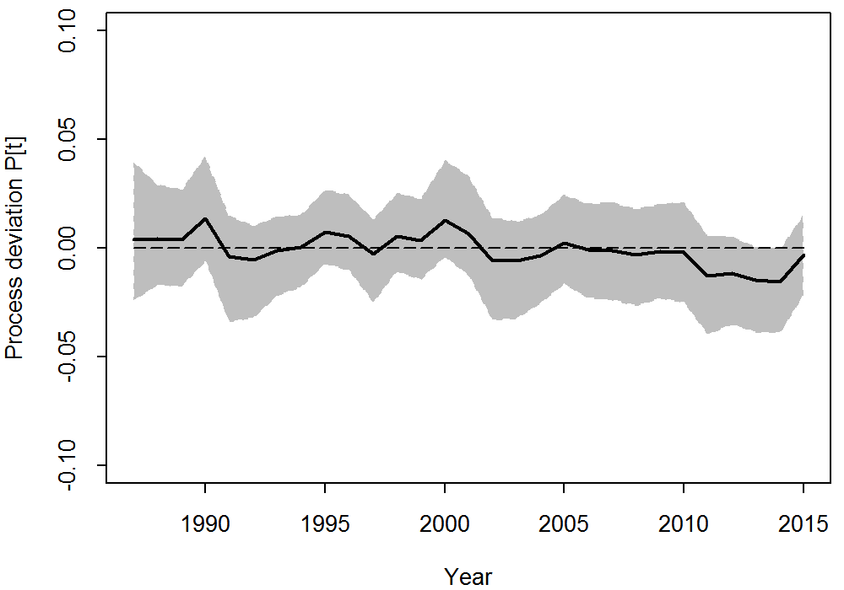
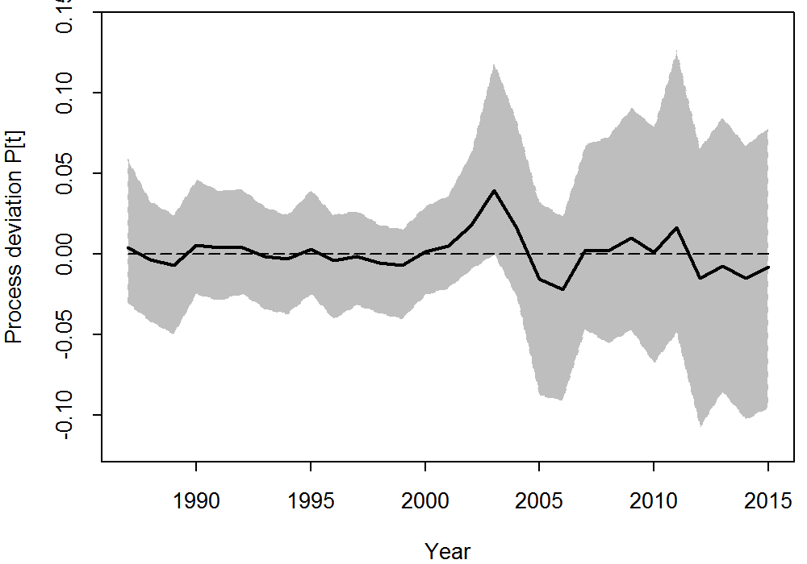
Process error deviation

Slide 25
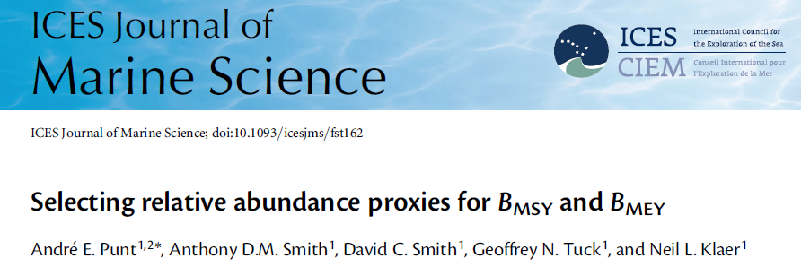

Fisheries Reference Points
SB_{MSY} ~ SB₄₀ = 0.4 × SB₀

Slide 26
Fisheries Reference Points
Rev_ Table 4. Summary of posterior estimates (medians) and 95% Bayesian Credibility Intervals of Fisheries Reference Points (FRPs) from the JABBA-Select for silver kob and carpenter, including selectivity specific reference point quantities for: S1 = linefishery (1987-2002) and S2 = linfishery (2003 -2015) and S3 = inshore trawl fishery (1987-2015)

Slide 27
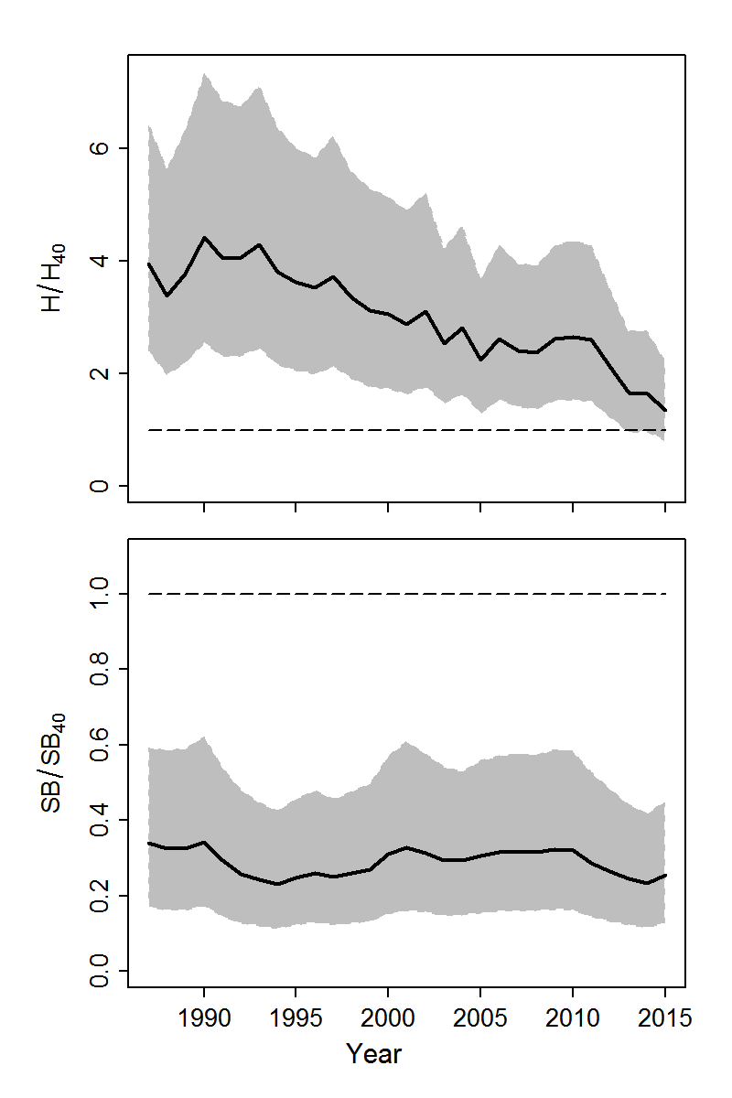
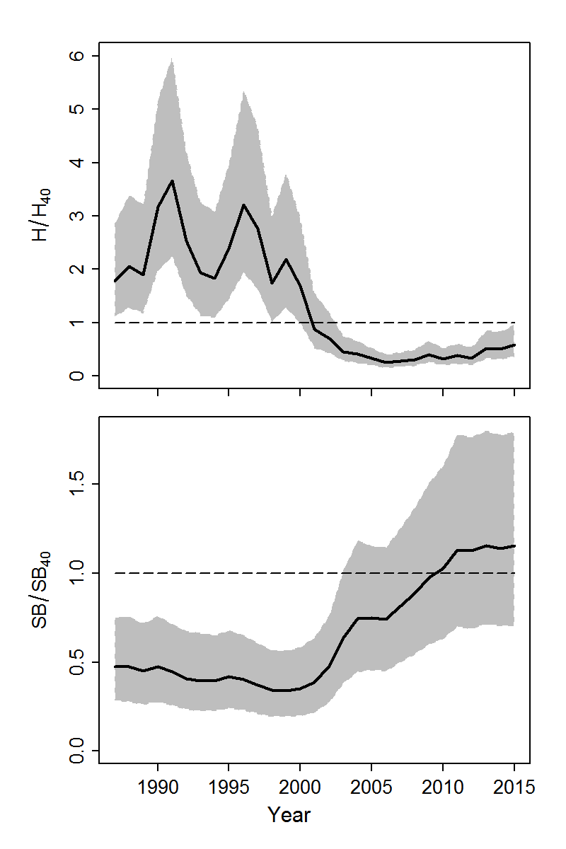
Stock Status Trajectories

Slide 28
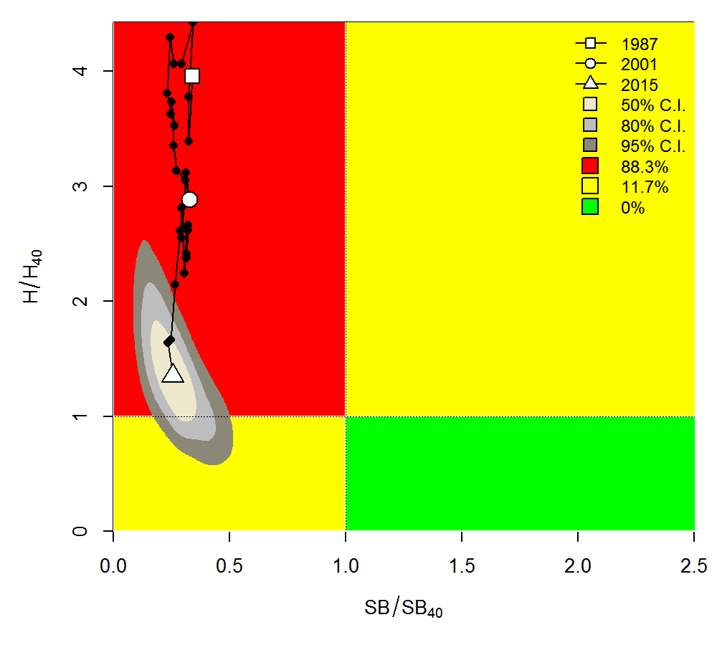
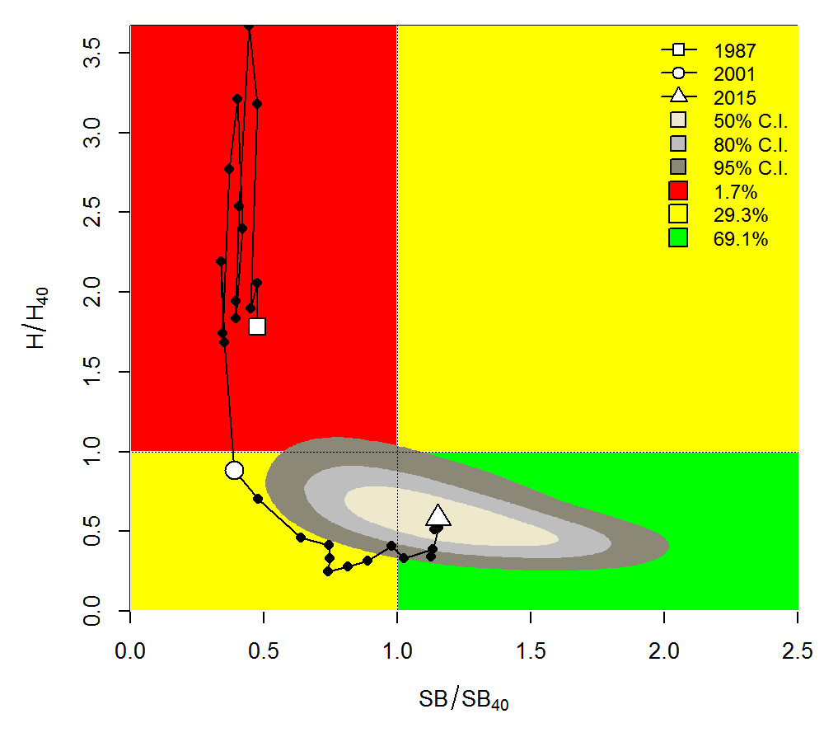
Stock Status – Kobe phase Plots

Slide 29
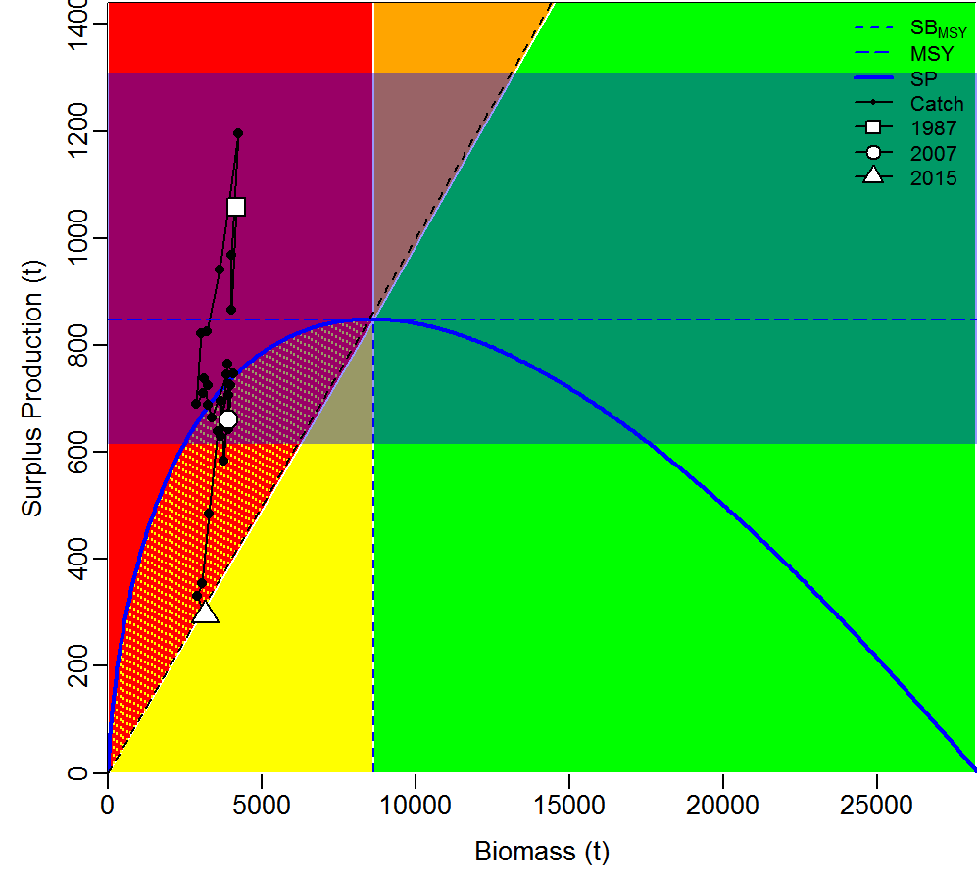
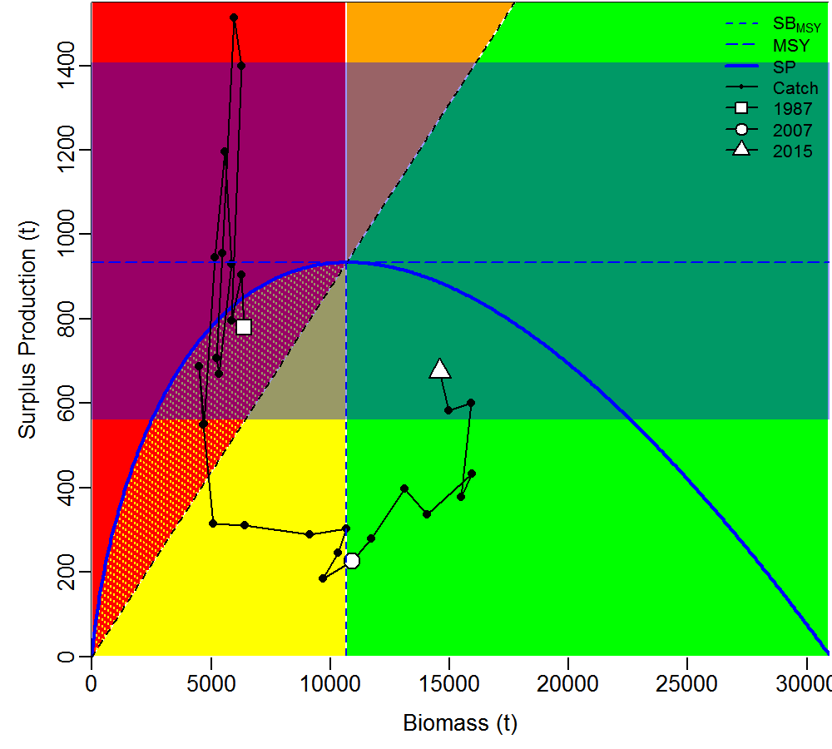
Surplus-Production Phase Plots

Slide 30
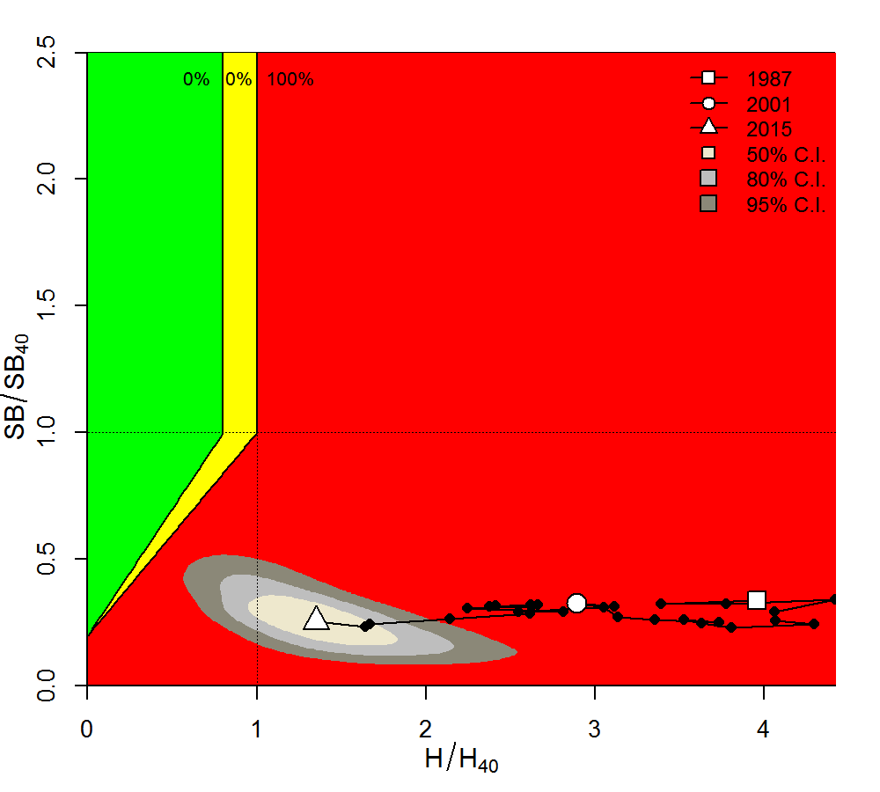
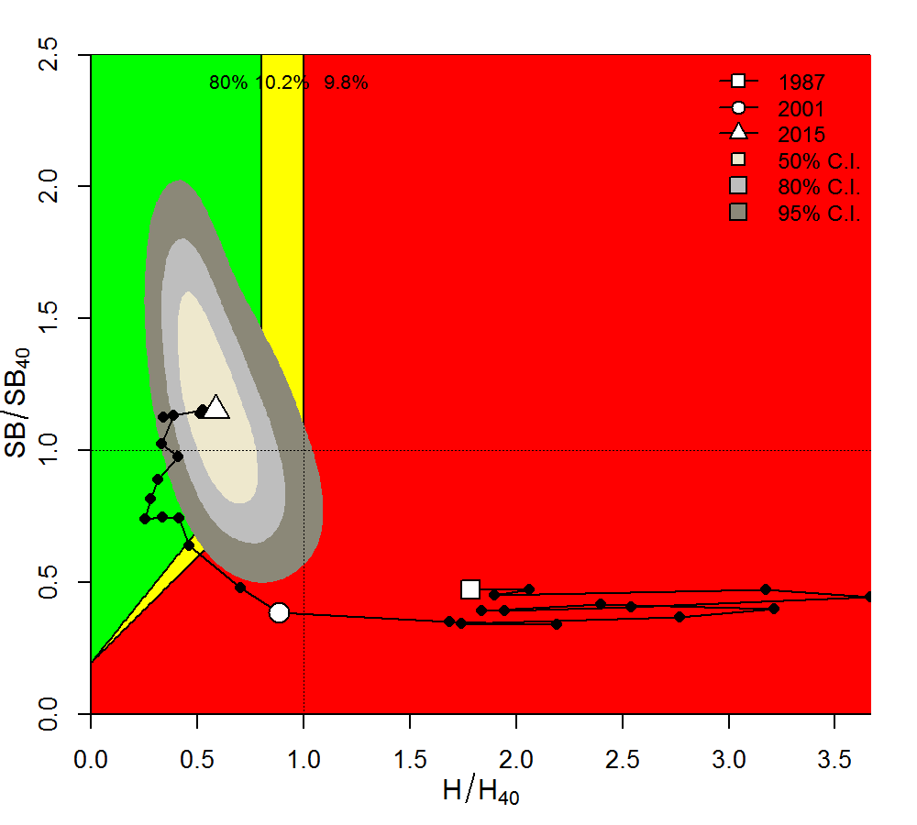
Stock Status – ‘post-modern’ Biplots

Slide 31
JABBA-Select Demo

Slide 32

The End Part I

Slide 33
Pella-Tomlinson Properties

Slide 34
Merging Pella-Tomlinson with the Hockey-Stick
After Froese et al. (2016; CMSY)
P_{lim} = B_{lim} / K ~ 0.2 – 0.25
R*=1
alpha = 1/ P_{lim}

Slide 35
Merging Pella-Tomlinson with the Hockey-Stick
After Froese et al. (2016; CMSY)
(11)
If Plim = 0.2
If Plim = 0
Compare to Fletch-Schaefer composite model in BSP2

