Slide 1
MARAM/IWS/2017/Sardine/P8
Sardine assessment results compared to a run which excludes the directed sardine catch, 1984 - 2015

Slide 2
What is the impact of the fishery on the resource?
What would the resource look like today if, since 1984, there had been no directed sardine fishery?
The assessment provides a basis to estimate this.

Slide 3
‘Catch’ run of the model since 1984: The assessment as is, at the MLE mode, run from 1984 – 2015.
‘No directed catch’: A run of the assessment model, using the MLE parameter values, but setting directed sardine catches to zero.

Slide 4
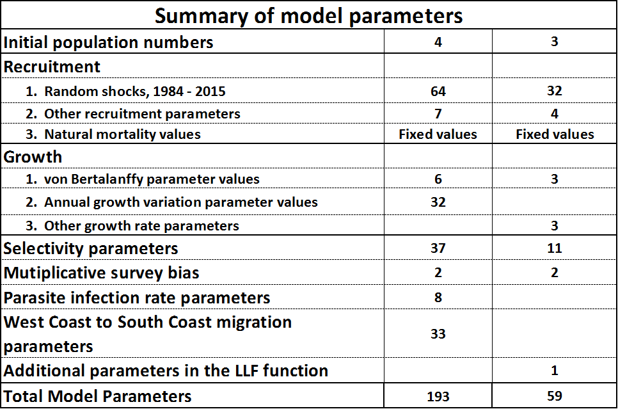
Clarification of “no directed catch”, and “the same set of parameter values”.
‘No directed catch’: The only catches that are retained are those related to anchovy catches.
“The same set of parameter values”.

Slide 5
Recruitment and spawning biomass: Recruitment is a function of spawning biomass and “random shocks”.
Spawning biomass will differ between “Catch” and “No directed catch”.
The random shocks are estimates of other impacts on recruitment (environmental), these are included in the set of model parameters that are held the same between the two runs “Catch” and “No directed catch”.

Slide 6
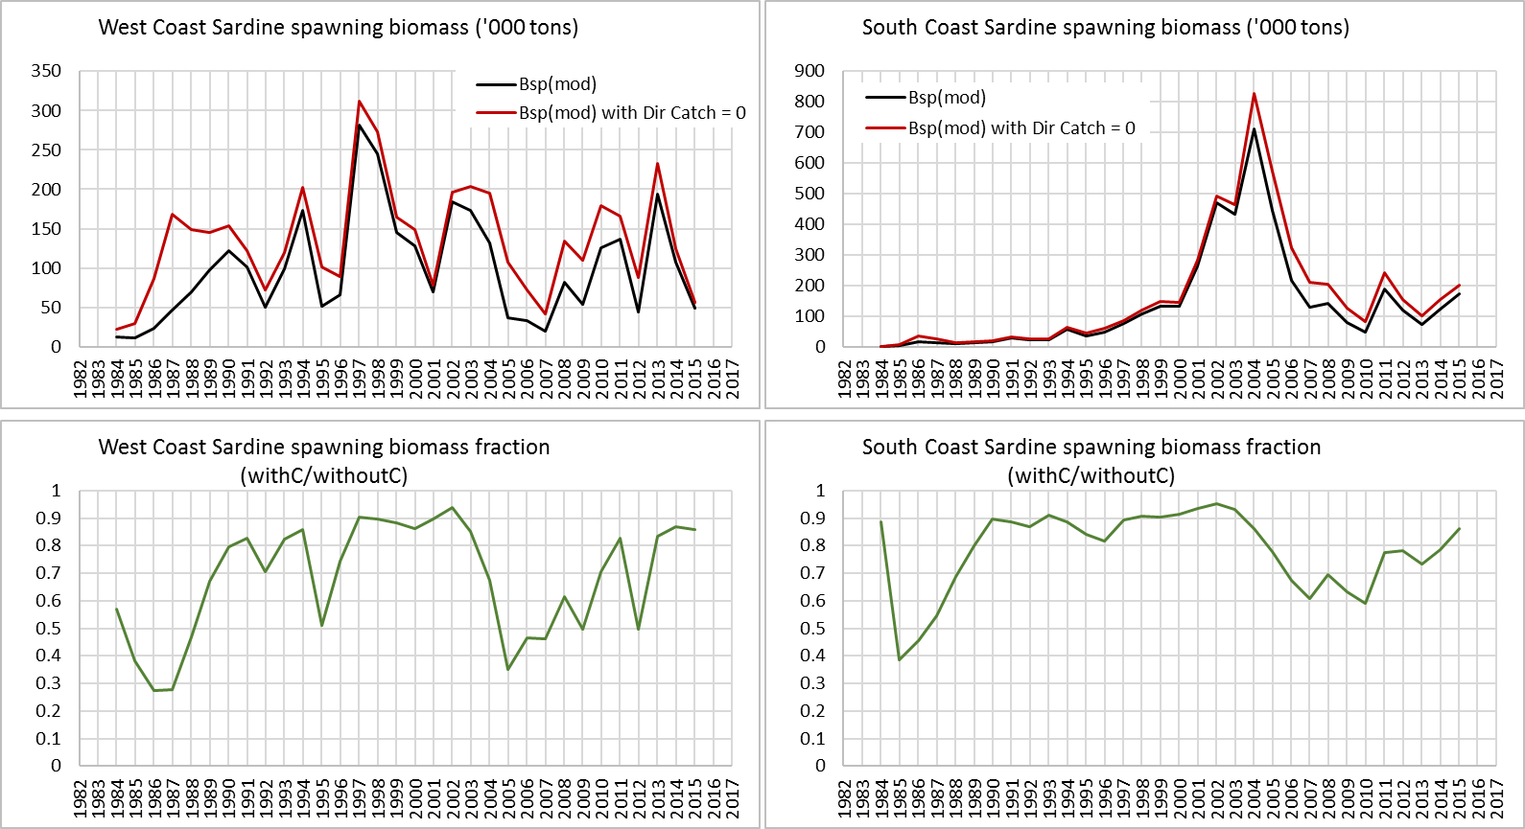
Spawning biomass, West Coast and South Coast

Slide 7
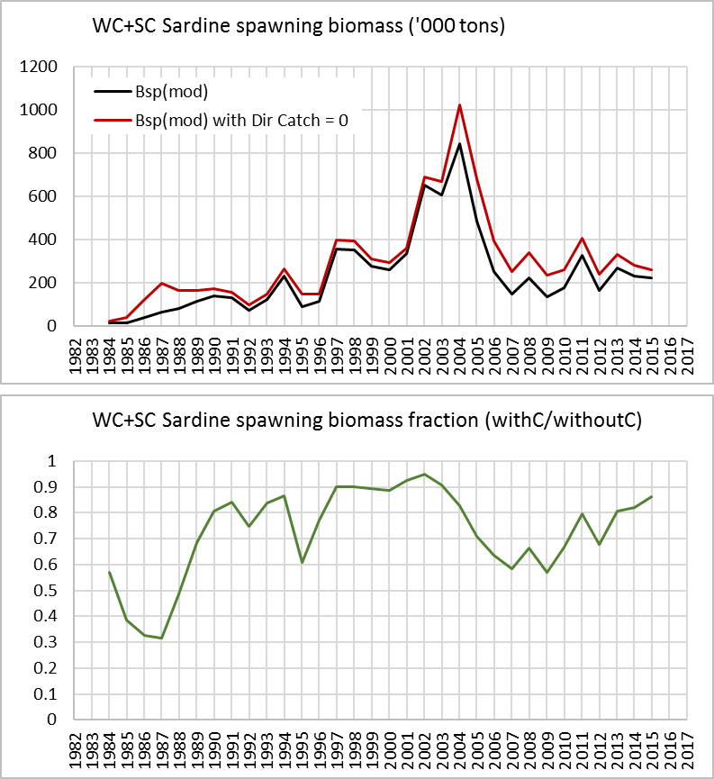
Spawning biomass: Total

Slide 8
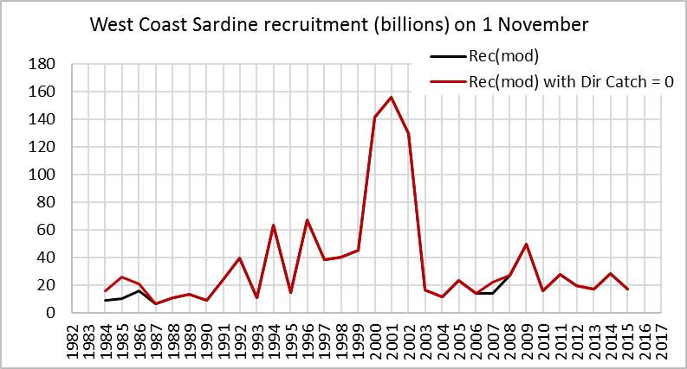
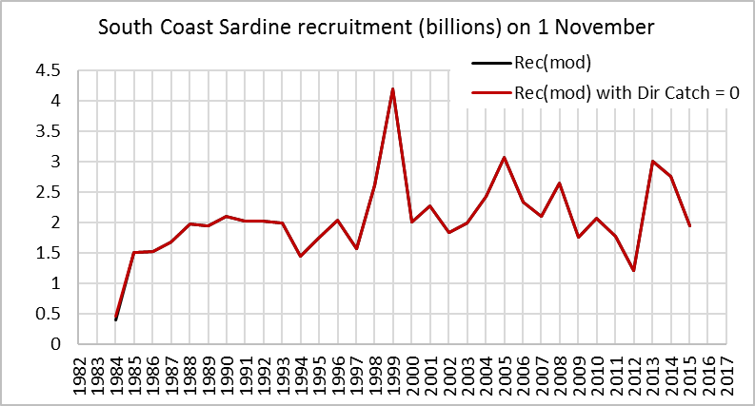
Recruitment, West Coast and South Coast

Slide 9
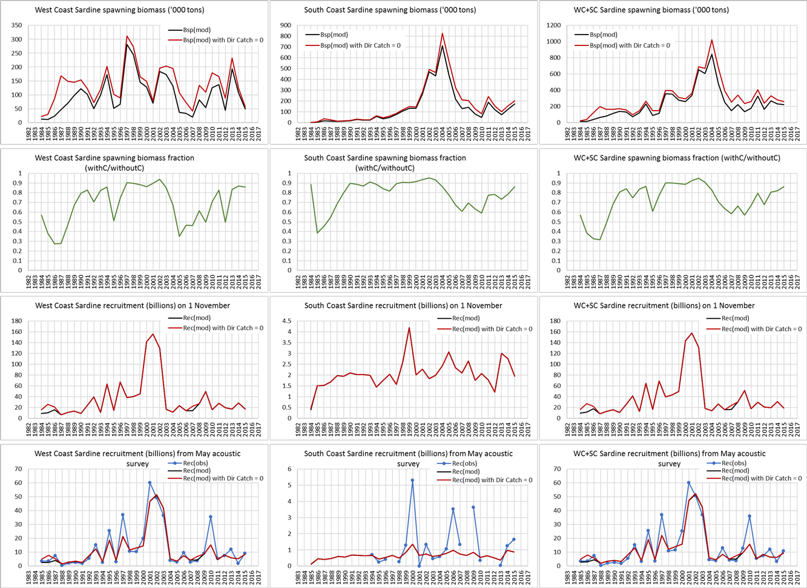
Spawning Biomass and Recruitment

Slide 10
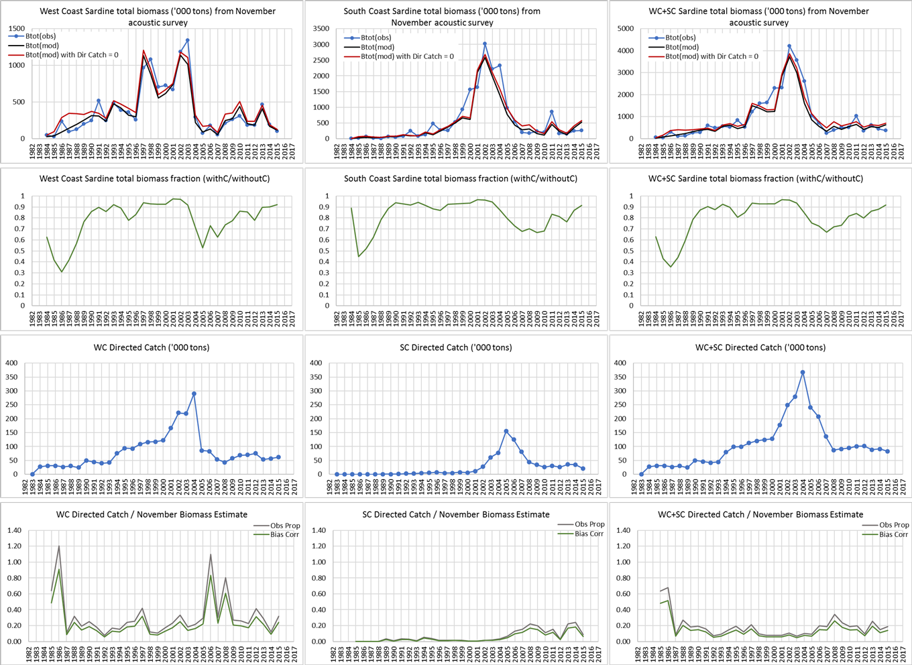
Total Biomass and Catches

