Slide 1

VESSEL REPLACEMENT APPRAISAL
International Stock Assessment Workshop (UCT)
3rd December 2025
Sobahle Somhlaba

Slide 2

CONTENTS
Mega projects in Government
2025 Medium Term Budget Policy Statement (2026 to 2029)
Focus on future revenue (catch) and cost (surveys)
Evaluation of decision criteria considered by National Treasury

Slide 3
Mega projects
R 400 million per year for a minimum of three years
Projects costing at least R1 billion
These require prefeasibility study
Conduct comprehensive study for scrutiny by National Treasury
The department is data rich for a very comprehensive quantitative study (Highly developed knowhow in sustainable management)

Slide 4
2025 Medium Term Expenditure Statement
2025 MTBPS, Table 4.2 (p. 34)
The main budget item to focus on in the next four years

Slide 5
2025 Medium Term Expenditure Statement
2025 MTBPS, Table 4.2 (p. 34)

Slide 6
Focus on future revenue (catch)
Cash flows to MLRF
Species as per levy Table 1 | Future catches (tonnes) | Source of future catch | Period to the future
Anchovy | ~U (100 000, 120 000) | Historical TAC constraint landings (OMP should be used) | 49 years
Sardine | ~U (20 000, 120 000) | Historical TAC constraint landings (OMP should be used) | 49 years
Round herring | ~U (70 000, 120 000) | Historical landings (Assessment models could be used) | 49 years
Chub mackerel | ~U (20, 650) | From historical landings | 49 years
Meso pelagic | ~ U(5, 100) | Historical landings | 49 years
Hake | OMP | OMP (future catches are averaged over a range of outputs) | 49 years
Horse mackerel | ~( 5000, 15 000) | Historical landings (previous TACs are from models) | 49 years
Squid | ~U(2000, 12 000) | Historical landings (previous TAEs are from models) | 49 years
Kingklip | ~U( 2000, 4500) | Historical landings (previous TACs are from models) | 49 years
Monk | ~U(3000, 11 000) | Historical landings (previous TACs are from models) | 49 years
Ribbon fish | ~U (100, 200) | Historical landings | 49 years
Sole | ~U (0, 800) | Historical landings (previous TACs are from models) | 49 years
Snoek | ~ U(100, 2000) | Historical landings | 49 years

Slide 7
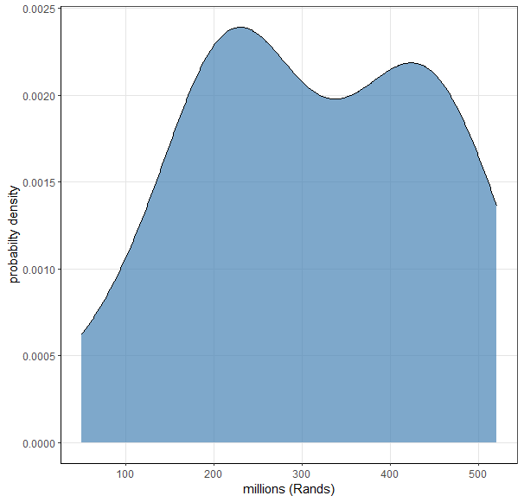
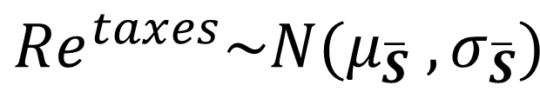
Focus on future revenue (catch)
Cash flows to National Treasury, tax collection
${Re}^{taxes}\sim N(μ_{\overline{S}} ,σ_{\overline{S}})$

Slide 8
Focus on future cost (surveys)
Survey and other costs
$${Co}_{surv, y} \sim U(180 000, 200 000)$$

Slide 9

Decision criteria
$NPV=I_{initial_investment}+\frac{{CF}_{1}}{{\left(1+R\right)}^{1}}+\frac{{CF}_{2}}{{\left(1+R\right)}^{2}}+….+\frac{{CF}_{n}}{{\left(1+R\right)}^{n}}$
Invest if $NPV>0$
Do not invest if $NPV<0$

Slide 10
Discounts rates
Interest rates as the cost of capital

Slide 11
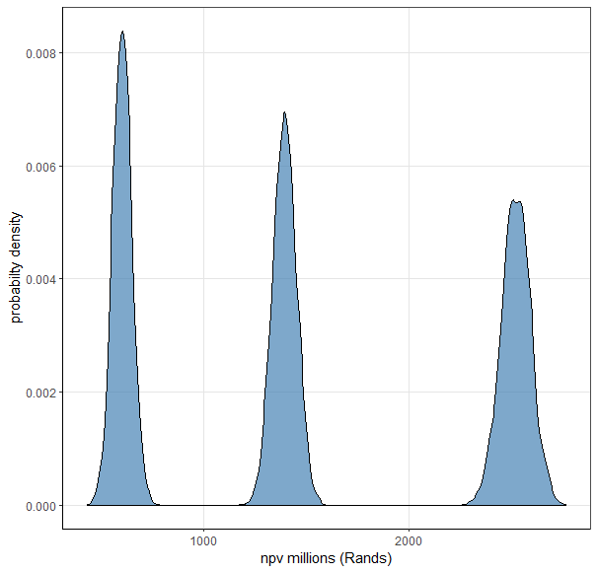
Decision criteria (NPV)
Interest rate of 18%
Interest rate of 12%
Interest rate of 8%

Slide 12
Questions?
Generation of future TACs requires further examination of specific aspects such as:
Use OMP for all species managed under OMPs
How far into the future should OMPs be used for purposes of this analysis?
How are TACs from other models to be produced?
Producing future revenue using assumed distributions; are there better alternatives?
Three options are being evaluated within the larger feasibility study:
Acquisition of a new vessel (the focus of this analysis)
Chartering of the vessel to conduct surveys
Continuing operations with RV Africana into the future

Slide 13

THANK YOU!

