Slide 1
APPROPRIATE HARVEST LEVELS FOR LTL SPECIES THAT TAKE ACCOUNT OF THE NEED OF DEPENDENT PREDATORS AND THE WIDER ECOSYSTEM
INITIAL THOUGHTS ON THE POTENTIAL USE OF MICE
Kevern Cochrane and Janet Coetzee

Slide 2
Models of Intermediate Complexity for Ecosystem assessments(MICE)
Value of MICE, enabling greater statistical rigour and testing, is well understood.
Three examples of their use for management advice:
  Punt and Butterworth (1995): South Africa, two hake species, Cape fur seal and hake fishery;
  Punt et al. (2016): Southern California Bight, impacts of fishery for Pacific sardine on brown pelicans and California sea lions; and
  Chagaris et al. (2020): Northwest Atlantic Coastal Shelf, impacts of fishery for Atlantic menhaden on four predators, particularly striped bass.

Slide 3
Key Questions
From the information presented in EBFM/P3 and BG2, should redeye be included in a MICE as a key LTL species?
Should preference be given to any particular type of MICE, e.g. a population dynamics model, EwE form, or some other? Would there be value in developing more than one kind?
Any comments on an approach to determining an optimal spatial structure and the trade-offs involved?
Is there an optimal number or range of predator species that should be included? Any guidance on criteria for deciding on how many and which species should be included?

Slide 4
Contributions of anchovy, sardine and redeye round herring to the diets of predators. Blank = 0.05 – 0.09 of diet; yellow = > 0.10 to 0.29 of the diet, and red = 0.30 or higher (from Shannon et al., 2020).

Slide 5
Annual contribution of anchovy, sardine and fish larvae (mostly anchovy and sardine) to the diet of adult African penguins returning to Dassen and Robben Islands

Slide 6
Estimated annual consumption of anchovy and sardine by selected predators

Slide 7
Status of predator species with a relatively high dependence on small pelagics
Species | Status | Reference
Snoek | Abundant, light fishing pressure. | DFFE, 2025
Tuna&Swordfish | Varies | DFFE, 2025
Sciaenids - geelbek | Depleted | Parker et al., 2020
Sciaenids – silver kob | Depleted, optimal fishing pressure | DFFE, 2025
Yellowtail | Optimal abundance and fishing pressure | DFFE, 2025
M. capensis | Abundant, light fishing pressure. | DFFE, 2025
M. paradoxus | Optimal abundance and fishing pressure | DFFE, 2025
African Penguin | Critically endangered | IUCN Red List
Cape Gannet | Endangered | IUCN Red List
Cape Cormorant | Endangered | IUCN Red List
Seals | Least concern | IUCN Red List
Cetaceans | Varies

Slide 8
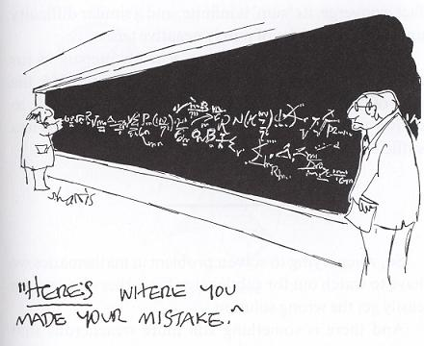
What Next?

