Slide 1
APPROPRIATE HARVEST LEVELS FOR LTL SPECIES THAT TAKE ACCOUNT OF THE NEED OF DEPENDENT PREDATORS AND THE WIDER ECOSYSTEM
Chair’s Summary of the Discussions and Recommendations of the DFFE Ecosystem Inputs to Management Task Group
Kevern Cochrane

Slide 2
Legal Background
Marine Living Resources Act
Objectives and Principles
The need to achieve optimum utilisation and ecologically sustainable development of marine living resources;
the need to conserve marine living resources for both present and future generations;
(f) the need to preserve marine biodiversity, amongst other related principles; etc
National Environmental Management Act 107 (as amended up to 2009)
National Environmental Management Principles
(2) Environmental management must place people and their needs at the forefront of its concern, and serve their physical, psychological, developmental, cultural and social interests equitably.
(3) Development must be socially, environmentally and economically sustainable.
(4) (a) …
(i) That the disturbance of ecosystems and loss of biological
diversity are avoided, or, where they cannot be altogether
avoided, are minimised and remedied;

Slide 3
Aspects and Approaches Considered by EIMTG
Comparisons with harvest rates of other small pelagic species included in the RAM legacy database;
The MSC default standard for key low trophic level species (LTL) of 75% of B0 target biomass and the basis underpinning that standard (Smith et al. 2011; Pikitch et al., 2012 (the Lenfest Report));
Ecosystem models and modelling;
Information from other seabird-fisheries interaction studies;
Examples of management approaches used in fisheries on LTL species from other regions that have been certified by MSC.

Slide 4
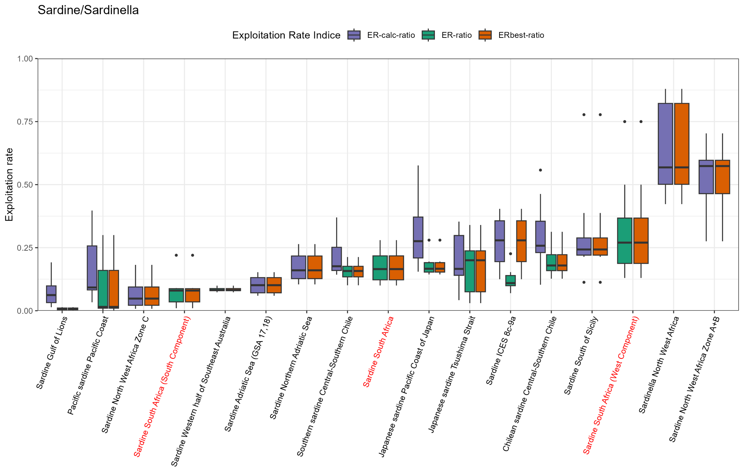
Comparison of harvest rates from RAM Legacy Database

Slide 5
MSC Standard
SA2.2.14
a. The default biomass target level consistent with ecosystem needs shall be 75% of the B0 or SSB0 that would be expected in the absence of fishing.
b. However, a higher or lower target level, down to a minimum 40% of the B0 or SSB0 that would be expected in the absence of fishing, may still achieve an 80-level score if it can be demonstrated, using a credible ecosystem model or robust empirical data for the UoA/ecosystem being assessed, that the level adopted [ meets specified ecosystem-based criteria].
GSA2.2.16
In the absence of robust estimates for B0, target F values that would achieve the appropriate target biomass levels can be adopted ….
At least SG60 is justified if F is “likely” to have been somewhat below F_{MSY} but not as low as 50%F_{MSY} for at least one generation time of the species, or for at least 2 years, if greater. etc

Slide 6
Basis of MSC 75% Default: Smith et al. 2011
A suggestion raised that ‘conventional’ single-species models are not compatible with Smith et al. C/Cmsy curve and that adjustments may be required to the former if 75%B0 RP is used..
Pikitch et al. make recommendations similarly based on ecosystem modelling (F < 0.5Fmsy).
Hilborn et al. and Free et al. caution that ecosystem models can lead to over-estimation of impacts on prey abundance on predators if specified factors not taken into account.

Slide 7
Ecosystem Models and Modelling
Currently available models
Ortega-Cisneros et al. (2018), “Evaluating the effects of climate change in the southern Benguela upwelling system using the Atlantis modelling framework”;
Shannon et al. (2020) “Exploring Temporal Variability in the Southern Benguela Ecosystem Over the Past Four Decades Using a Time-Dynamic Ecosystem Model”
Ongoing work
A more detailed inspection of predator-prey dynamics in the Southern Benguela by improving model fitting; and
Spatially dynamic Ecospace modelling has been undertaken to improve the fit of the Southern Benguela Ecosim model to historical catch and abundance time series.

Slide 8
Information from other seabird-fisheries interaction studies

Slide 9
Management approaches used in fisheries on LTL species from other regions that have been certified by MSC.
Seven examples presented:
In four cases MSC defaults applied (75% B0 or 0.5Fmsy);
Two cases, both N. Sea fisheries, took predator needs into account (but some reservations about estimates of needs);
One case, US Atlantic menhaden fishery, uses ecological reference points derived from EwE-based MICE.

Slide 10
Way Forward
The continued importance of taking dependent predators into account in management was stressed, with initial emphasis on seabirds.
In the short-term, the Smith et al. 0.75B₀ approach was considered to provide the best option for consideration of appropriate harvest levels, with possible adjustments to M to achieve comparability;
The EIMTG agreed that the use of ecosystem modelling to help to inform selection of reference points for small pelagics should be considered in the longer-term. Suggested this work should start next year and be conducted within dedicated TG.

Slide 11
Modifying Current Single Species Models for Consistency with Smith et al. 2011 Curve Key Questions Related to P2 and P4
Should local anchovy/sardine stock models be adjusted in the manner proposed in IWS/2025/EBFM/P2 in order to achieve consistency with Smith et al.’s (2011) 75%/20% trade-off suggestion?
The stock assessment and operating models for anchovy and sardine used at present assume constant natural mortality rates, while the approach proposed by Bergh … requires natural mortality M to increase at high biomasses B. Is this possibility falsified if the single-species assessment provides an estimated M vs B relationship which is not statistically compatible with such an increase?
An alternative to the above could be to re-evaluate the trade-off between impacts on yield and on depletion of predators suggested by Smith et al (2011) under local conditions? Would that be a reasonable option and, if so, what is the recommended approach …

