Slide 1
Improving Scientific Communication and Media Reporting on Marine Resource Management Issues
Kevern Cochrane
Dept. of Ichthylogy and Fisheries Science, Rhodes University, South Africa.

Slide 2
Influences on the Policy Process
Other political consider-ations
Public Opinion
Policies and Management Choices
Decision-makers
Media
Science

Slide 3
The Media as a Source of Information*
The main source of scientific information for many people is the media: mainstream, internet and the social media.
Social media and user-generated content (UGC) have drastically altered the nature of news.
They have created additional layer of information and outlet for diverse opinions that increasingly being used, especially when recommended by friends or some other trusted source.
Most people (in 2009) reported as still relying on mainstream news organisations “to sort fact from fiction and serve up a filtered view”
* Newman, 2009

Slide 4
The Media: Biased or Misguided on Environment and Fisheries
HEADLINE | PUBLISHER | SOURCE
“Bottom trawling releases as much carbon as air travel, landmark study finds” | The Guardian, March 2021 | Sala et al. 2021
“Fish stocks eaten to extinction by 2050” | The Times, November 2006 | Worm et al., 2006
“Industrial fishing exploits more than half of the surface of the oceans” | Le Monde, February, 2018. | Kroodsma et al., 2018
“Fishing exclusion zones are the right solution to save our critically endangered African penguins” (). | The Daily Maverick, December, 2022 | Sydeman et al., 2021 and other references
“Ocean damage unspeakably awful, Attenborough tells prince” | BBC News, June, 2025 | Report of interview of David Attenborough by Prince of Wales on film ‘Ocean’

Slide 5
The Media: Reporting on Fisheries Perspectives, or Both
HEADLINE | PUBLISHER | SOURCE
“Scaling up: the app that’s transforming lives in South African fishing communities” | The Guardian, May 2024 | Abalobi and members
“How small-scale fisheries are big contributor to jobs, diets” | Times of India, April 2023 (but almost no other mainstream coverage) | Extensive study by FAO, Duke University & WorldFish, 2023: Illuminating Hidden Harvests
“Joint Fishing Industry Statement Condemns Stage 3 MPA Ban Plans” | The Fishing Daily, June 2025 (but could only find in trade journals) | Statement by fishing sector representatives from 4 European countries.
Inside the African penguin litigation — how fishing industry, conservation groups found common ground | The Daily Maverick, March 2025 | Interview with ‘both sides’ by Kristin Engel

Slide 6
Ensuring the Truth, Popular or Not
Scientists
Should strive for objectivity and accuracy, whatever their personal biases, and distinguish clearly in their communications between scientific statements and advocacy;
Wide, easily understood communication of important scientific findings and facts is essential, using e.g. press releases, social media, etc.
Create ‘hooks’ to attract attention (but not always possible to create hooks without distorting overall results?)
Consider enrolling (serious and objective) celebrities to utilise celebrity culture and help counter widespread use of celebrities to promote narrow agendas.
Media
Adhere to the established charters of ethics for journalists, including*:
Respect for the facts and for the right of the public to truth [the full truth]….; and
….at all times defend the principles of freedom in the honest collection and publication of news, and of the right of fair comment and criticism. He/she will make sure to clearly distinguish factual information from commentary and criticism.
*From IFJ Global Charter of Ethics for Journalists,
https://www.ifj.org/who/rules-and-policy/global-charter-of-ethics-for-journalists
! Square brackets my addition but assumed to be implied in statement

Slide 7
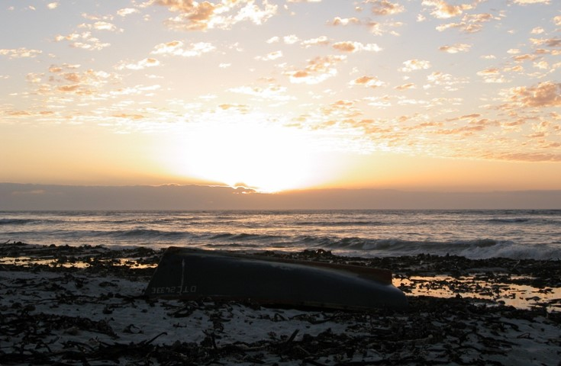
Thank You

Slide 8
References
D.A. Kroodsma, J. Mayorga, T. Hochberg, N.A. Miller, K. Boerder, F. Ferretti, A. Wilson, B. Bergman, T.D. White, B.A. Block, Tracking the global footprint of fisheries, Science 359(6378) (2018) 904-908. https://doi.org/10.1126/science.aao5646.
FAO, Duke University & WorldFish. 2023. Illuminating Hidden Harvests – The contributions of small-scale fisheries to sustainable development. Rome. https://doi.org/10.4060/cc4576en
Newman. 2009. The rise of social media and its impact on mainstream journalism. Working paper, Reuters Inst. for the Study of Journalism, Oxford University.
E. Sala, J. Mayorga, D. Bradley, R.B. Cabral, T.B. Atwood, A. Auber, W. Cheung, C. Costello, F. Ferretti, A.M. Friedlander, Protecting the global ocean for biodiversity, food and climate, Nature 592(7854) (2021) 397-402. https://doi.org/10.1038/s41586-021-03371-z.
W.J. Sydeman, G.L. Hunt, E.K. Pikitch, J.K. Parrish, J.F. Piatt, P.D. Boersma, L. Kaufman, D.W. Anderson, S.A. Thompson, R.B. Sherley, South Africa's experimental fisheries closures and recovery of the endangered African penguin, Ices Journal of Marine Science 78(10) (2021) 3538-3543. https://doi.org/10.1093/icesjms/fsab231.
B. Worm, E.B. Barbier, N. Beaumont, J.E. Duffy, C. Folke, B.S. Halpern, J.B. Jackson, H.K. Lotze, F. Micheli, S.R. Palumbi, E. Sala, K.A. Selkoe, J.J. Stachowicz, R. Watson, Impacts of biodiversity loss on ocean ecosystem services, Science 314(5800) (2006) 787-90.

