Slide 1
WHDG Brick and Comparing WHDG to ASW-SH
William Horowitz
The Ohio State University
July 7, 2009
With many thanks to Brian Cole, Ulrich Heinz, and Yuri Kovchegov

Slide 2
Outline
Context
Pedagogy
(Some) brick results
Comparing WHDG to ASW-SH
Pedagogy
Surprise!
Conclusions

Slide 3
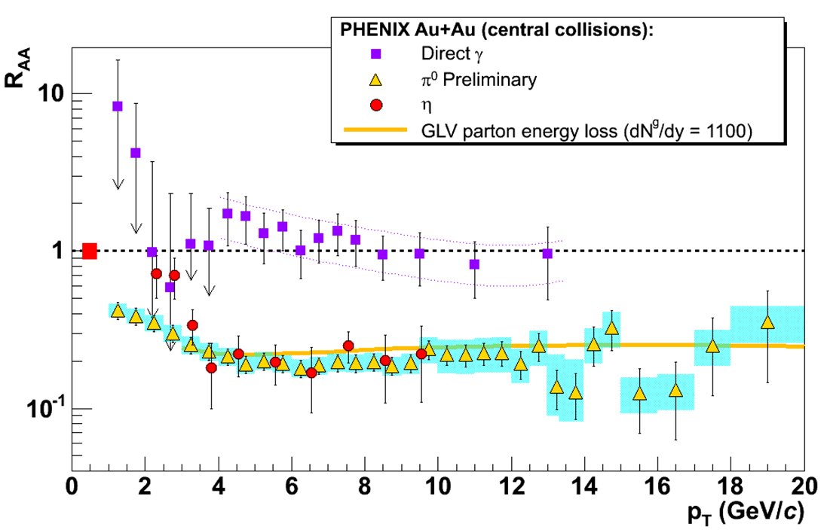
pQCD Success at RHIC:
(circa 2005)
Y. Akiba for the PHENIX collaboration, hep-ex/0510008
Consistency: R_{AA}(η)~R_{AA}(π)
Null Control: R_{AA}(γ)~1
GLV Prediction: Theory~Data for reasonable fixed L~5 fm and dN_{g}/dy~dN_{π}/dy

Slide 4
Trouble for High-p_{T} wQGP Picture
v₂ too small
NPE supp. too large
π⁰ v₂
WHDG
C. Vale, QM09 Plenary (analysis by R. Wei)
NPE v₂
STAR, Phys. Rev. Lett. 98, 192301 (2007)
Pert. at LHC energies?
PHENIX, Phys. Rev. Lett. 98, 172301 (2007)

Slide 5
Multiple Models
WHDG, Nucl.Phys.A784:426-442,2007
Bass et al., Phys.Rev.C79:024901,2009
Inconsistent medium properties
Distinguish between models
Bass et al.

Slide 6
Quantitative Parameter Extraction
Vary input param.
Find “best” value
Need for theoretical error
PHENIX, PRC77:064907,2008

Slide 7
pQCD Rad. Opacity Exp. (I)
All orders in L/λ expression for dN_{g}/dx
N_{g}: number of emitted gluons
x: “momentum fraction carried by gluon”
Small x regime, x << 1
Assumed length scales: μ ⁻¹ << λ << L
Debye screening mass μ
Mean free path λ
Medium length L
Localized scattering centers; partons see many centers and radiate coherently (crucial!)

Slide 8
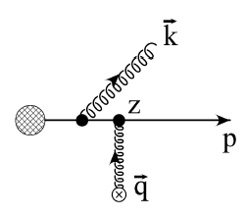
pQCD Rad. Opacity Exp. (II)
m_{g}
Eikonality assumed
p⁺ >> p⁻
k⁺ >> k⁻
Radiation emitted forward
Parent parton continues moving forward
Partons move on straight-line paths
First order in opacity
Interference w/ vacuum rad. crucial
M
TECHQM @ CERN

Slide 9
FOO dN_{g}/dx
WHDG Rad: μ, M, m_{g} depend on T

Slide 10
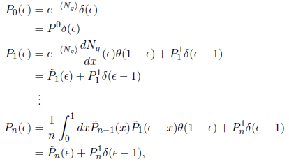
dN_{g}/dx to P(ε)
Opacity expansion => dN_{g}/dx
Single gluon emission spectrum
Approx. multi-gluon fluct. w/ Poisson conv.
Prob. to lose mom. frac. ε: p_{f} = (1- ε)p_{i}
Assumes incoherent emission of non-Abelian gluons

Slide 11
WHDG Collisional Loss
Gaussian distribution
Mean loss for light quarks:
Braaten-Thoma, PRD44, 2625 (1991)
Width given by Fluctuation-Dissipation theorem
Poisson conv. not well approx
by Gaussian for realistic,
small num of scatterings
See Simon Wicks’ thesis

Slide 12
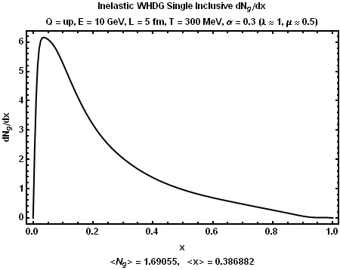
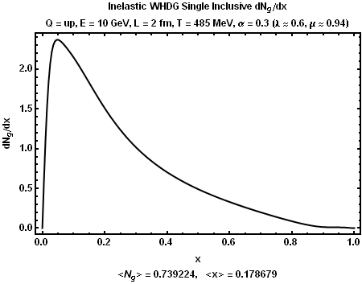
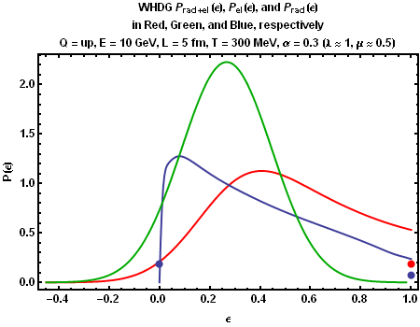
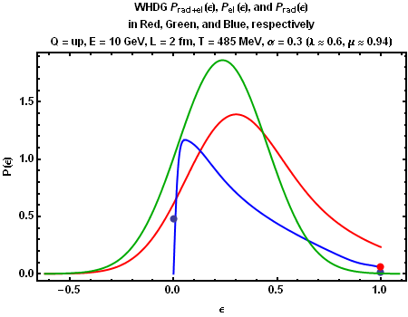
Typical Results
Original Brick
Wiedemann Brick <ε> = .4

Slide 13
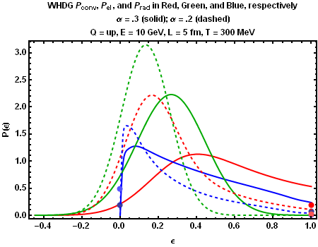
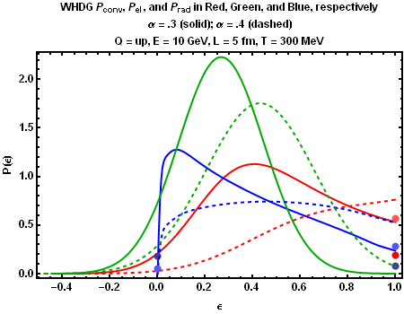
Running α_{s}?
α_{s} = .2, .3
Not surprisingly, changes in α_{s} make huge difference to P(ε)
α_{s} = .3, .4

Slide 14
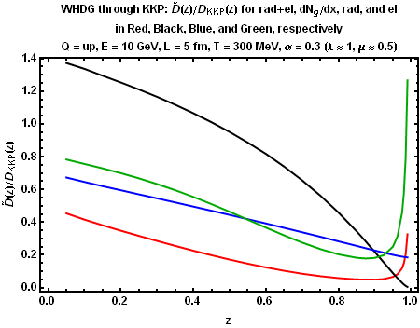
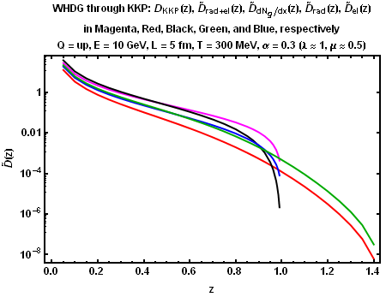
WHDG thru KKP
Facilitate comparison between WHDG and HT
Elastic gain => D(z > 1) > 0

Slide 15
FOO dN_{g}/dx
WHDG Rad: μ, M, m_{g} depend on T

Slide 16
Differences
WHDG Rad
m_{g} = μ/√2
M = μ/2
k_{max} = 2 x (1-x) E
ρ_{exp}(z)
L/λ(T)
q_{max} = √(3 μ E)
α_{s} = .3
ASW-SH
m_{g} = 0
M = 0
k_{max} = x E
ρ_{theta}(z)
L/λ = 1
q_{max} = ∞
α_{s} = 1/3

Slide 17
Where Did k_{max}’s Come From? (I)
DGLV
Light cone momenta
Note x₊ def.!
Always on-shell
ASW-SH
4-momenta
Note x_{E} def.!
Always on-shell
The same in the eikonal limit!

Slide 18
Where Did k_{max}’s Come From? (II)
DGLV
Light cone momenta
Note x₊ def.!
Always on-shell
k_{T} < x₊ E⁺ = 2 x₊ E
Forward travel
ASW-SH
4-momenta
Note x_{E} def.!
Always on-shell
k_{T} < x_{E} E
Forward travel
Same physics: cutoff when gluons radiated at 90º

Slide 19
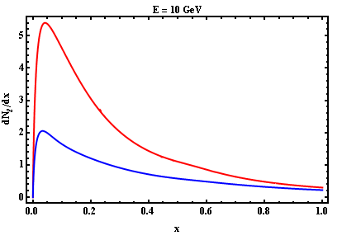
Compare Apples to Apples
Differences must be due to non-eikonality
GLV(x_{E}) in red; ASW-SH(x_{E}) in blue

Slide 20
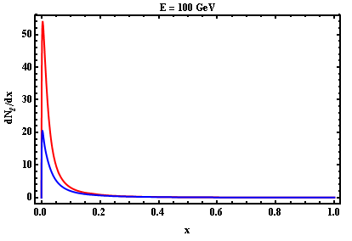
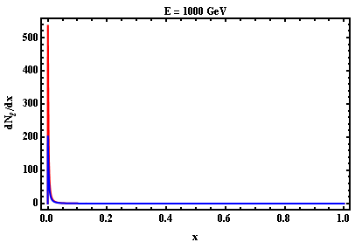
Large E Limit
GLV(x_{E}) in red; ASW-SH(x_{E}) in blue
For most values of x, naïve interpretation holds
What’s going on at small x?

Slide 21
Interpretation
Physically:
Typical k_{T} ~ μ => typ. ω ~ μ
System wants to radiate lots of glue at x ~ μ /E
BUT, this is right at our k_{T} cutoff:
k_{T} ~ μ < μ ~ k_{T, max}: the system will always take advantage of all the “phase space” we give it
Analytically:
More natural way to write dN_{g}/dx

Slide 22
Consequences
At large energies, <N_{g}> is E ind.
Large irreducible systematic uncertainty for some observables
For T = 485 GeV, L = 2 fm, α_{s} = 0.3:
<N_{g}> ≈ 1, k_{max} = x E
<N_{g}> ≈ 2, k_{max} = 2 x E
Note that R_{AA} becomes insensitive to details of k_{max} (goes to 1)

Slide 23
Conclusions
Current phen. comparisons of pQCD to data unsatisfactory
WHDG not oversuppressed
Opacity expansion suffers from large systematic errors
Strong dependence on k_{max} = # x E
# is not specified by framework
Similar dependence on IR cutoff, m_{g}
Irreducible?
Consequences for other models, parameter extractions?

Slide 24
Supplement

Slide 25
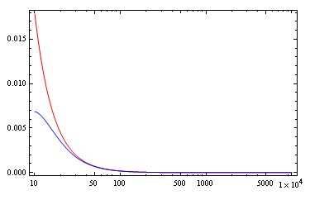
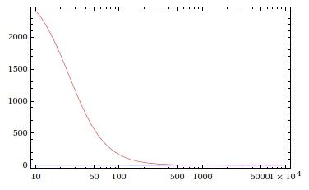
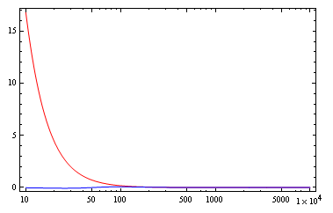
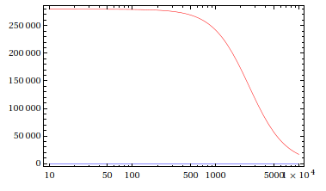
Eikonality Sets in for all x
X = .1
X = .001
E
E
X = .01
X = .00001
E
E

