Slide 1
pQCD and AdS/CFT in Heavy Ion Collisions
W. A. Horowitz
The Ohio State University
September 22, 2009
With many thanks to Yuri Kovchegov, Miklos Gyulassy, and Ulrich Heinz

Slide 2


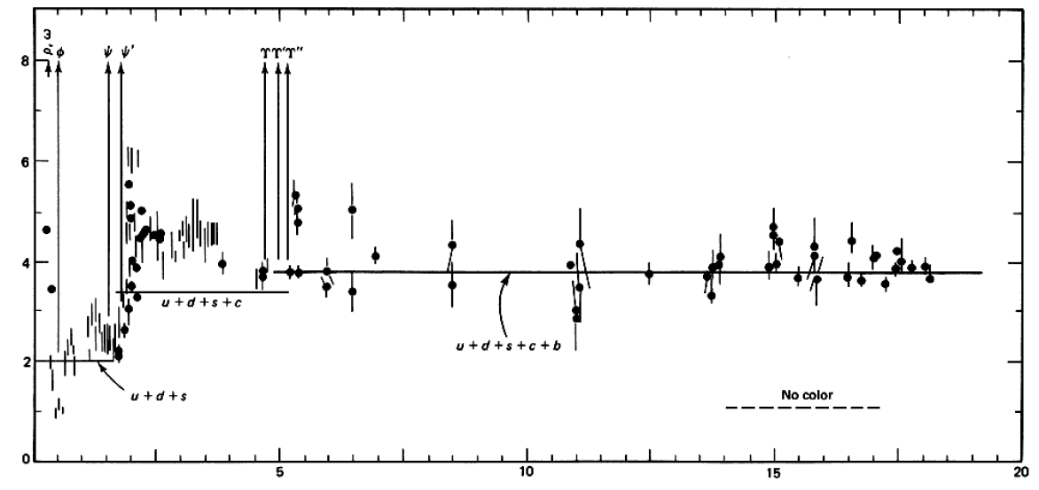

QCD: Theory of the Strong Force
    Running α_{s}
      -β-fcn
    SU(N_{c} = 3)
    N_{f}(E)
      N_{f}(RHIC) ≈ 2.5
PDG
ALEPH, PLB284, (1992)
Griffiths Particle Physics

Slide 3

Bulk QCD and Phase Diagram
Long Range Plan, 2008

Slide 4
Past, Present, and Future Questions
Bulk properties
  Deconfinement
  Thermalization, density
  EOS, η/s
  QGP DOF
Weakly vs. Strongly coupled plasma
  Γ = U/T: <<1 or >>1?
Weakly vs. Strongly coupled theories
  α_{s} ~ .3 << 1? λ = √(g_{YM}² N_{c}) ~ 5.5 >> 1?
New strong coupling techniques
  AdS?
Notes:
Theoretical techniques up next!

Slide 5


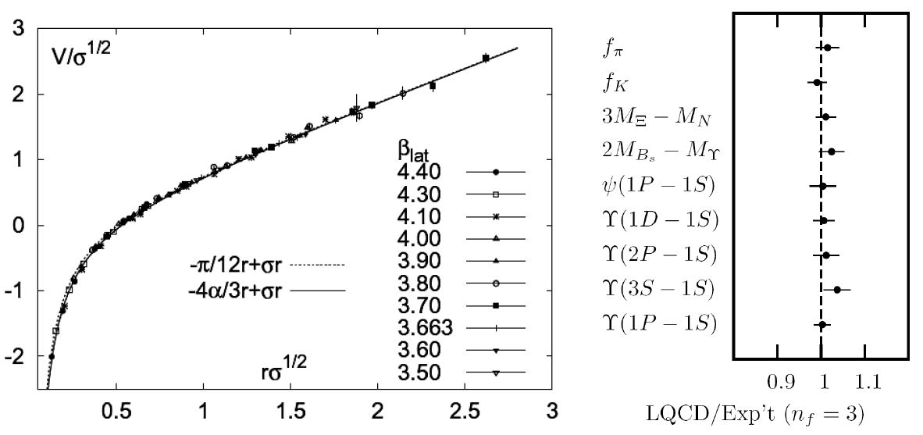
Methods of QCD Calculation I: Lattice
Long Range Plan, 2008
    All momenta
    Euclidean correlators
Kaczmarek and Zantow, PRD71 (2005)
Davies et al. (HPQCD), PRL92 (2004)

Slide 6


Methods of QCD Calculation II: pQCD
d’Enterria, 0902.2011
Jäger et al., PRD67 (2003)
    Any quantity
    Small coupling (large momenta only)

Slide 7




Methods of QCD Calculation III: AdS(?)
Maldacena conjecture: SYM in d ⬄ IIB in d+1
Gubser, QM09
    All quantities
    N_{c} → ∞
    SYM, not QCD: β = 0
      Probably not good for p+p; maybe A+A?
Notes:
Next up, experiments!

Slide 8
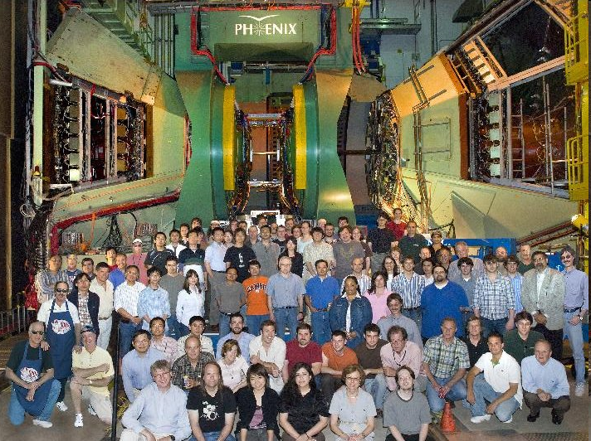
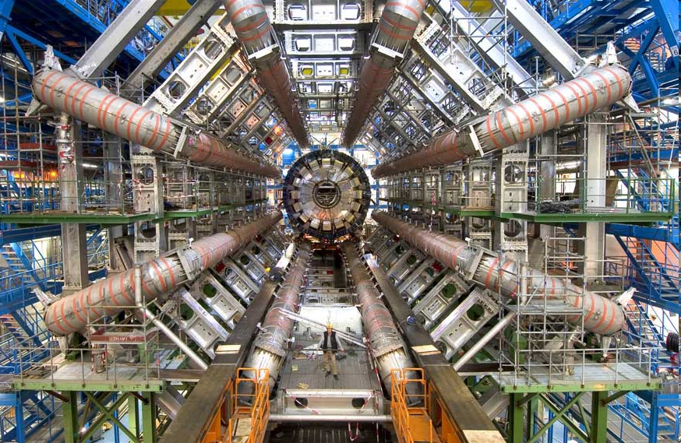
Present and Future QGP Experiments
RHIC
  BRAHMS
  PHENIX
  PHOBOS
  STAR
LHC
  ALICE
  ATLAS
  CMS
  LHCb
PHENIX
ATLAS

Slide 9
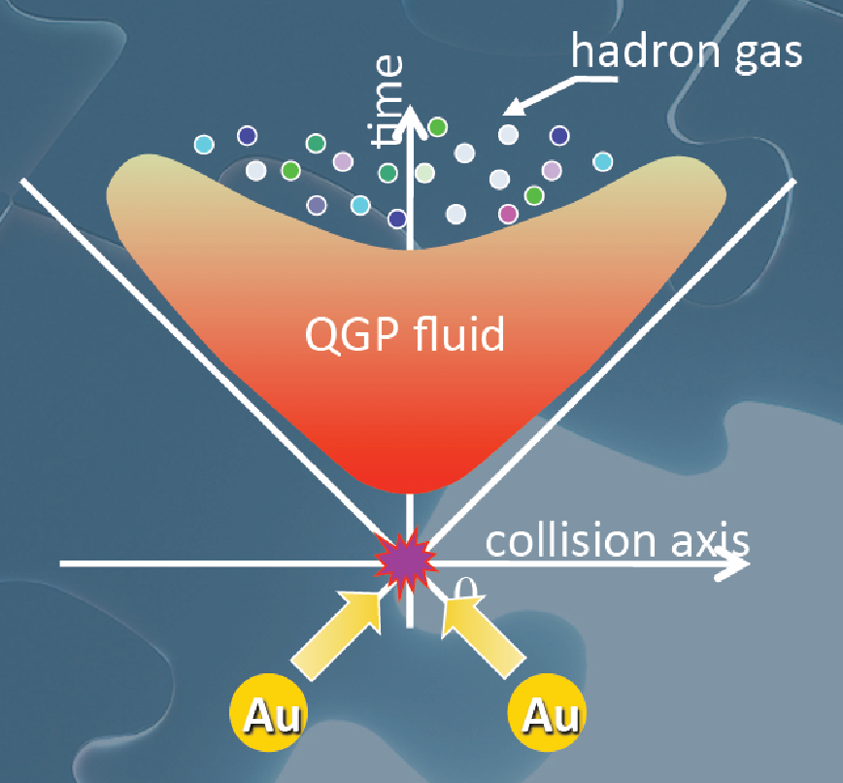
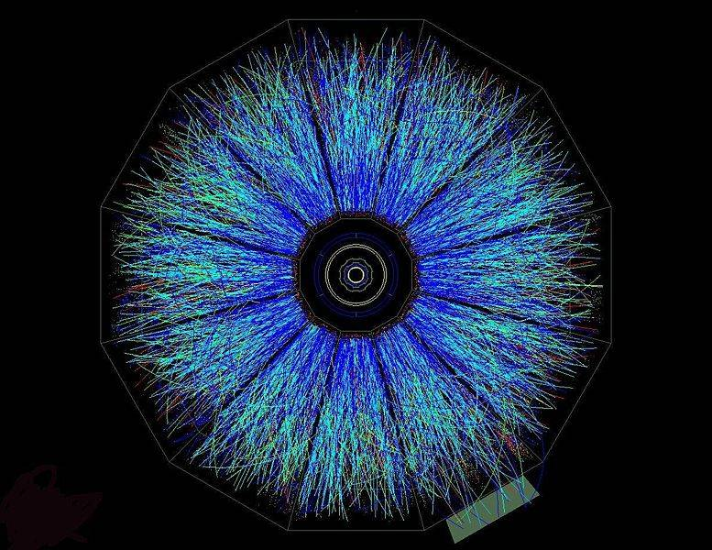
Evolution of a HI Collision
T Hirano, Colliding Nuclei from AMeV to ATeV
STAR

Slide 10

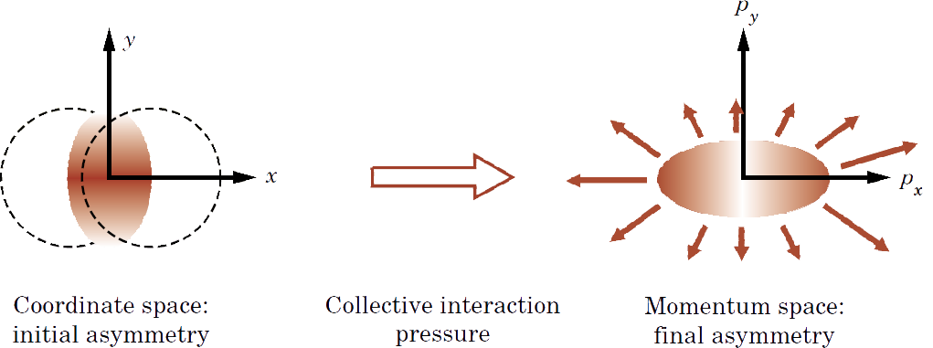
Geometry of a HI Collision
M Kaneta, Results from the
Relativistic Heavy Ion Collider (Part II)
T Ludlum and L McLerran, Phys. Today 56N10 (2003)
    Hydro propagates IC
      Results depend strongly on initial conditions
    Viscosity reduces momentum anisotropy

Slide 11
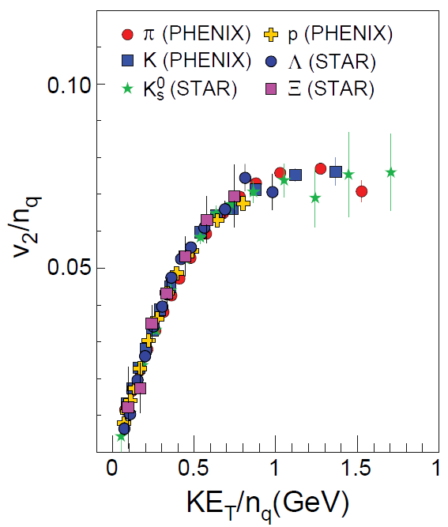
Low-p_{T} Measurements (I)
  Partonic DOF at hadronization!
LRP 2008

Slide 12
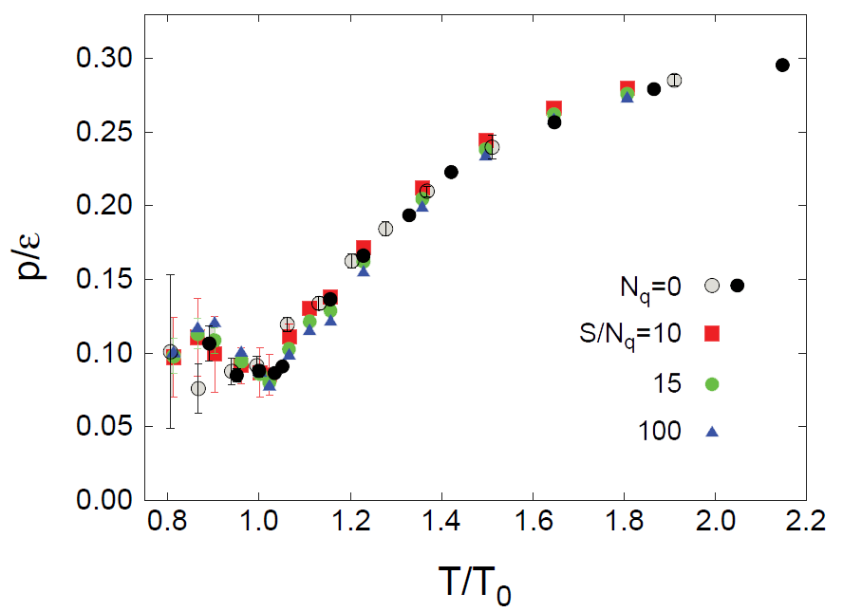
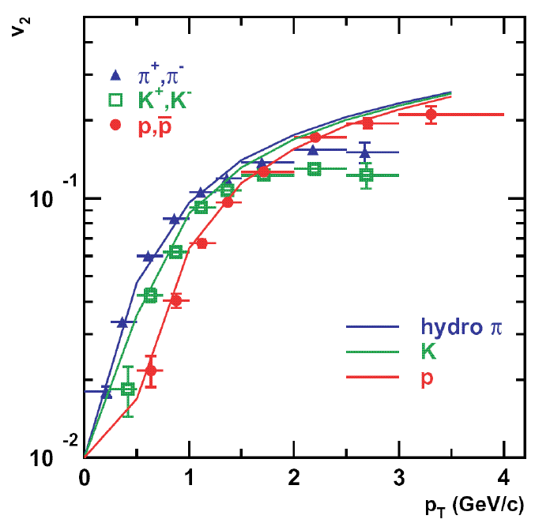
Low-p_{T} Measurements (II)
EOS from lattice
Anisotropy from (ideal) Hydro + IC
LRP 2008
PHENIX White Paper

Slide 13
Low-p_{T} Measurements (III)
Viscosity: why the fuss?
  Naive pQCD => η/s ~ 1
  Naive AdS/CFT => η/s ~ 1/4π
Luzum and Romatschke, PRC78 (2008)
U Heinz, Quark Matter 2009

Slide 14

Why High-p_{T} Jets?
Tomography
One can learn a lot from a single probe…
and even more with multiple probes
SPECT-CT Scan uses internal γ photons and external X-rays
PET Scan
http://www.fas.org/irp/imint/docs/rst/Intro/Part2_26d.html

Slide 15

Why High-p_{T} Jets?
Learn about medium
  Strongly coupled SYM soup
Gyulassy, Levai, and Vitev, NPB571 (200)
  Weakly coupled, Debye-screened gas-like plasma
J Friess, et al., PRD75:106003, 2007

Slide 16

High-p_{T} Observables
    Naively: if medium has no effect, then R_{AA} = 1
    Common variables used are transverse momentum, p_{T}, and angle with respect to the reaction plane, φ
p_{T}
, γ, e⁻
    Fourier expand R_{AA}:
φ

Slide 17
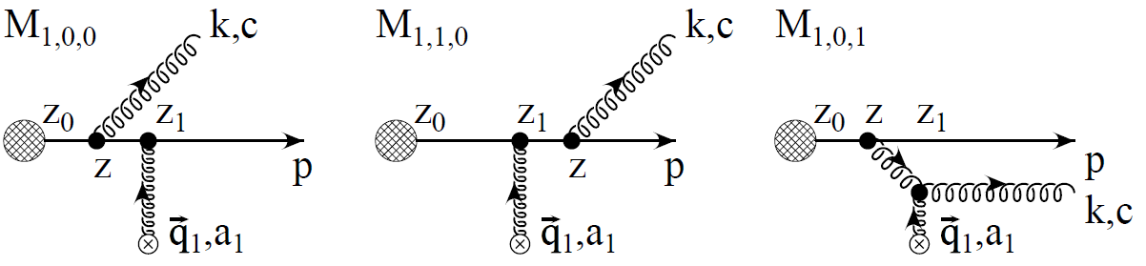
pQCD Rad E-loss Calculation
HE Bremsstrahlung
  μ ~ 0.5 GeV, λ_{mfp} ~ 1 fm, R_{Au} ~ 6 fm
  1/ μ << λ_{mfp} << L
Gyulassy, Levai, and Vitev NPB594 (2001)
  Bethe-Heitler
    dp_{T}/dt ~ -(T³/M_{q}²) p_{T}
  LPM
    dp_{T}/dt ~ -LT³ log(p_{T}/M_{q})
Notes:
High energy bremsstrahlung

Slide 18

pQCD Success at RHIC:
(circa 2005)
Y. Akiba for the PHENIX collaboration, hep-ex/0510008
  Consistency: R_{AA}(η)~R_{AA}(π)
  Null Control: R_{AA}(γ)~1
  GLV Prediction: Theory~Data for reasonable fixed L~5 fm and dN_{g}/dy~dN_{π}/dy

Slide 19

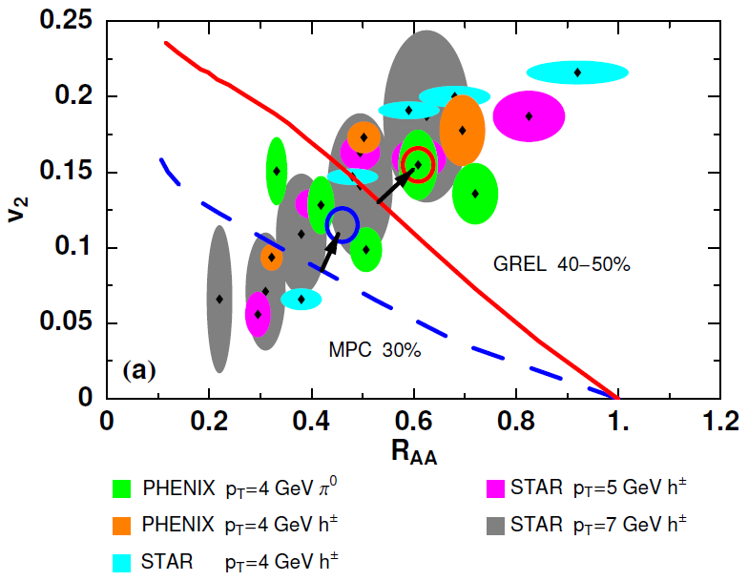
Trouble for Rad E-Loss Picture
v₂
e⁻
e⁻
WAH, Acta Phys.Hung.A27 (2006)
Djordjevic, Gyulassy, Vogt, and Wicks, PLB632 (2006)
Notes:
Anticorrelated; have e- come in later

Slide 20


What About Elastic Loss?
Appreciable!
Finite time effects small
Mustafa, PRC72 (2005)
Adil, Gyulassy, WAH, Wicks, PRC75 (2007)

Slide 21

Quantitative Disagreement Remains
  v₂ too small
  NPE supp. too large
π⁰ v₂
WHDG
NPE v₂
C. Vale, QM09 Plenary (analysis by R. Wei)
Wicks, WAH, Gyulassy, Djordjevic, NPA784 (2007)
Pert. at LHC energies?
PHENIX, Phys. Rev. Lett. 98, 172301 (2007)

Slide 22
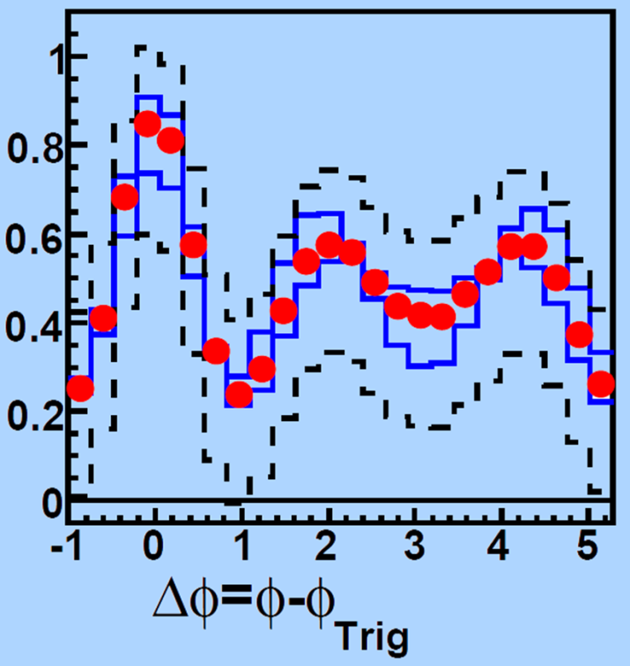
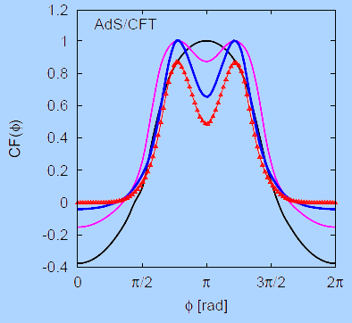
Strongly Coupled Qualitative Successes
AdS/CFT
Blaizot et al., JHEP0706
T. Hirano and M. Gyulassy, Nucl. Phys. A69:71-94 (2006)
STAR, PRL102 (2009)
Betz, Gyulassy, Noronha, Torrieri, 0807.4526

Slide 23
AdS/CFT Drag
Model heavy quark jet energy loss by embedding string in AdS space
  dp_{T}/dt = - μ p_{T}
  μ = πλ^{1/2} T²/2M_{q}
  Similar to Bethe-Heitler
    dp_{T}/dt ~ -(T³/M_{q}²) p_{T}
  Very different from LPM
    dp_{T}/dt ~ -LT³ log(p_{T}/M_{q})
J Friess, S Gubser, G Michalogiorgakis, S Pufu, Phys Rev D75 (2007)

Slide 24
Compared to Data
String drag: reasonable agreement
WAH, PhD Thesis

Slide 25


Light Quark and Gluon E-Loss
PHENIX 0-5% π⁰
WAH, in preparation
dp^{q}/dt ~ E^{1/3}
dp^{g}/dt ~ (2E)^{1/3}

Slide 26
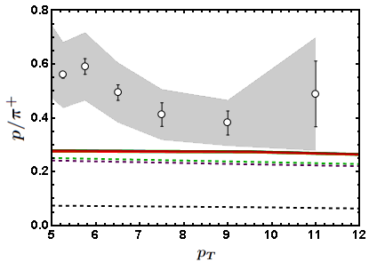
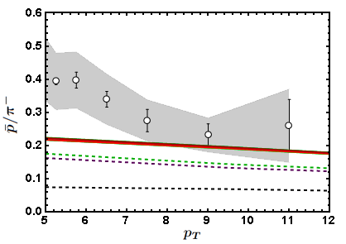
Baryon to Meson Ratios
STAR
STAR
AdS/CFT
AdS/CFT
pQCD
pQCD
WAH, in preparation

Slide 27
Looking for a Qualitative, Distinguishing Signal
  Use LHC’s large p_{T} reach and identification of c and b to distinguish between pQCD, AdS/CFT
    Asymptotic pQCD momentum loss:
    String theory drag momentum loss:
      Independent of p_{T} and strongly dependent on M_{q}!
      T² dependence in exponent makes for a very sensitive probe
  Expect: ε_{pQCD} 0 vs. ε_{AdS} indep of p_{T}!!
    dR_{AA}(p_{T})/dp_{T} > 0 => pQCD; dR_{AA}(p_{T})/dp_{T} < 0 => ST
ε_{rad} ∼ α_{s} L² log(p_{T}/M_{q})/p_{T}
ε_{ST} ∼ 1 - Exp(-μ L), μ = πλ^{1/2} T²/2M_{q}
S. Gubser, Phys.Rev.D74:126005 (2006); C. Herzog et al. JHEP 0607:013,2006

Slide 28
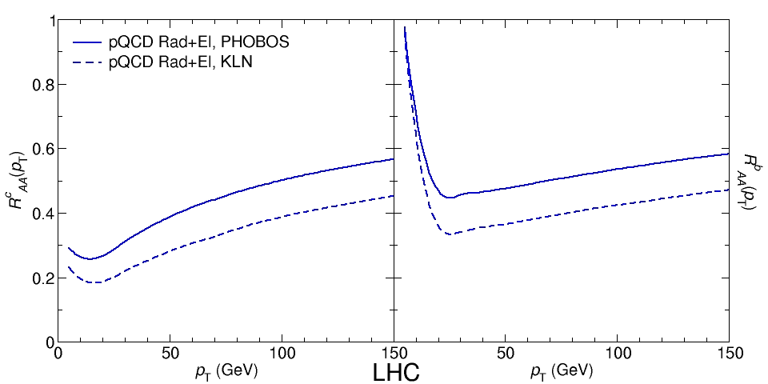

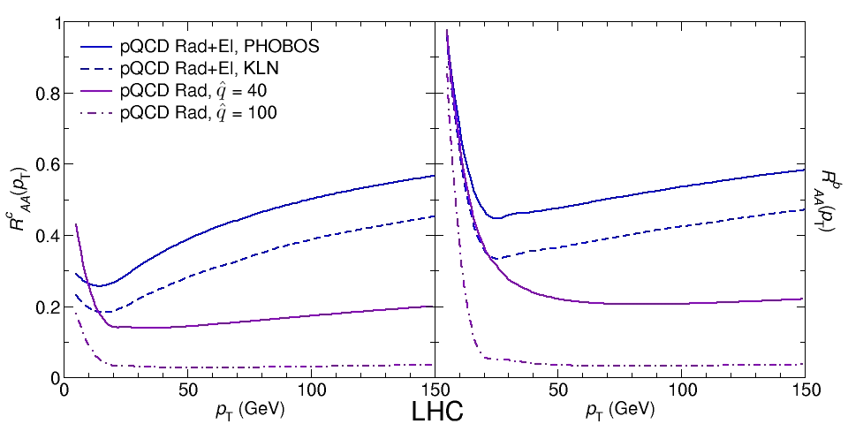
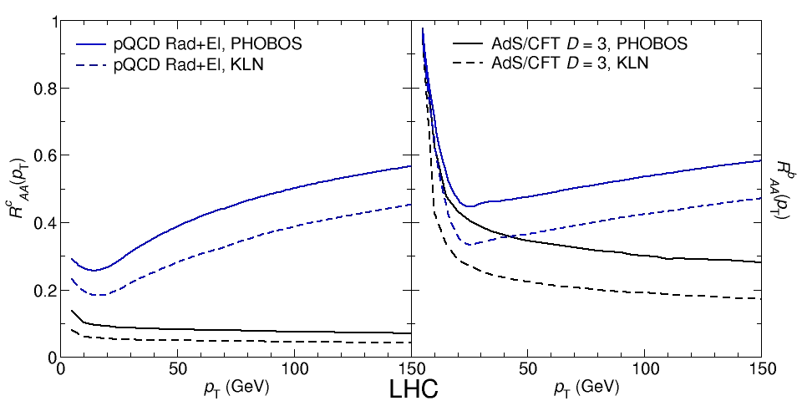
LHC c, b R_{AA} p_{T} Dependence
WAH, M. Gyulassy, PLB666 (2008)
      LHC Prediction Zoo: What a Mess!
      Let’s go through step by step
      Unfortunately, large suppression pQCD similar to AdS/CFT
      Large suppression leads to flattening
      Use of realistic geometry and Bjorken expansion allows saturation below .2
      Significant rise in R_{AA}(p_{T}) for pQCD Rad+El
      Naïve expectations met in full numerical calculation:
      dR_{AA}(p_{T})/dp_{T} > 0 => pQCD; dR_{AA}(p_{T})/dp_{T} < 0 => ST

Slide 29

An Enhanced Signal
But what about the interplay between mass and momentum?
  Take ratio of c to b R_{AA}(p_{T})
    pQCD: Mass effects die out with increasing p_{T}
      Ratio starts below 1, asymptotically approaches 1. Approach is slower for higher quenching
    ST: drag independent of p_{T}, inversely proportional to mass. Simple analytic approx. of uniform medium gives
    R^{cb}_{pQCD}(p_{T}) ~ n_{b}M_{c}/n_{c}M_{b} ~ M_{c}/M_{b} ~ .27
      Ratio starts below 1; independent of p_{T}
R^{cb}_{pQCD}(p_{T}) ∼ 1 - α_{s} n(p_{T}) L² log(M_{b}/M_{c}) ( /p_{T})

Slide 30

LHC R^{c}_{AA}(p_{T})/R^{b}_{AA}(p_{T}) Prediction
Recall the Zoo:
WAH, M. Gyulassy, PLB666 (2008)
      Taking the ratio cancels most normalization differences seen previously
      pQCD ratio asymptotically approaches 1, and more slowly so for increased quenching (until quenching saturates)
      AdS/CFT ratio is flat and many times smaller than pQCD at only moderate p_{T}
WAH, M. Gyulassy, PLB666 (2008)

Slide 31

Not So Fast!
  Speed limit estimate for applicability of AdS drag
    γ < γ_{crit} = (1 + 2M_{q}/λ^{1/2} T)²
    ~ 4M_{q}²/(λ T²)
      Limited by M_{charm} ~ 1.2 GeV
    Similar to BH LPM
      γ_{crit} ~ M_{q}/(λT)
  No Single T for QGP
    smallest γ_{crit} for largest T
    T = T(τ₀, x=y=0): “(”
    largest γ_{crit} for smallest T
    T = T_{c}: “]”
D7 Probe Brane
Q
Worldsheet boundary Spacelike if γ > γ_{crit}
x₅
Trailing
String
“Brachistochrone”
“z”
D3 Black Brane

Slide 32

LHC R^{c}_{AA}(p_{T})/R^{b}_{AA}(p_{T}) Prediction
(with speed limits)
WAH, M. Gyulassy, PLB666 (2008)
      T(τ₀): (O), corrections unlikely for smaller momenta
      T_{c}: (|), corrections likely for higher momenta

Slide 33
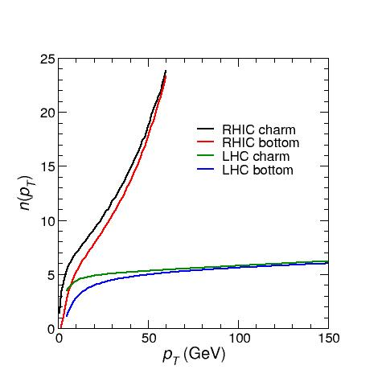
Measurement at RHIC
  Future detector upgrades will allow for identified c and b quark measurements
  RHIC production spectrum significantly harder than LHC
y=0
    NOT slowly varying
      No longer expect
      pQCD dR_{AA}/dp_{T} > 0
    Large n requires corrections to naïve
    R^{cb} ~ M_{c}/M_{b}
RHIC
LHC

Slide 34
RHIC c, b R_{AA} p_{T} Dependence
WAH, M. Gyulassy, JPhysG35 (2008)
    Large increase in n(p_{T}) overcomes reduction in E-loss and makes pQCD dR_{AA}/dp_{T} < 0, as well

Slide 35

RHIC R^{cb} Ratio
pQCD
pQCD
AdS/CFT
AdS/CFT
WAH, M. Gyulassy, JPhysG35 (2008)
    Wider distribution of AdS/CFT curves due to large n: increased sensitivity to input parameters
    Advantage of RHIC: lower T => higher AdS speed limits

Slide 36
Universality and Applicability
How universal are th. HQ drag results?
  Examine different theories
  Investigate alternate geometries
Other AdS geometries
  Bjorken expanding hydro
  Shock metric
    Warm-up to Bj. hydro
    Can represent both hot and cold nuclear matter

Slide 37
New Geometries
Constant T Thermal Black Brane
Shock Geometries
P Chesler,
Quark Matter 2009
Nucleus as Shock
DIS
Embedded String in Shock
Before
After
Albacete, Kovchegov, Taliotis,
JHEP 0807, 074 (2008)
v_{shock}
z
Q
v_{shock}
z
Q
x
x
Bjorken-Expanding Medium
WAH and Kovchegov, PLB680 (2009)

Slide 38
New in the Shock
Find string solutions in HQ rest frame
  v_{HQ} = 0
Assume static case (not new)
  Shock wave exists for all time
  String dragged for all time
    X^{μ} = (t, x(z), 0,0, z)
Simple analytic solutions:
  x(z) = x₀, x₀ ± μ ^{½} z³/3

Slide 39
Shock Geometry Results
Three t-ind. solutions (static gauge):
  X^{μ} = (t, x(z), 0,0, z)
  x(z) = x₀, x₀ ± μ ^{½} z³/3
    Constant solution unstable
    Time-reversed negative x solution unphysical
    Sim. to x ~ z³/3, z << 1, for const. T BH geom.
Q
z = 0
v_{shock}
x₀ − μ ^{½} z³/3
x₀ + μ ^{½} z³/3
x₀
x
z = ∞

Slide 40
HQ Momentum Loss
x(z) = μ ^{½} z³/3 =>
Relate μ to nuclear properties
  Use AdS dictionary
    Metric in Fefferman-Graham form: μ ~ T₋₋/N_{c}²
  T’₀₀ ~ N_{c}² Λ⁴
    N_{c}² gluons per nucleon in shock
    Λ is typical mom. scale; Λ⁻¹ typical dist. scale

Slide 41

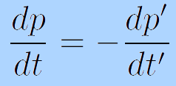
Frame Dragging
HQ Rest Frame
Shock Rest Frame
v_{sh}
M_{q}
Λ
v_{q} = -v_{sh}
M_{q}
1/Λ
i
v_{q} = 0
i
v_{sh} = 0
  Change coords, boost T_{μν} into HQ rest frame:
    T₋₋ ~ N_{c}² Λ⁴ γ² ∼ N_{c}² Λ⁴ (p’/M)²
    p’ ~ γM: HQ mom. in rest frame of shock
  Boost mom. loss into shock rest frame
  π⁰_{t} = 0:

Slide 42
Putting It All Together
This leads to
We’ve generalized the BH solution to both cold and hot nuclear matter E-loss
  Recall for BH:
  Shock gives exactly the same drag as BH for Λ = π T

Slide 43
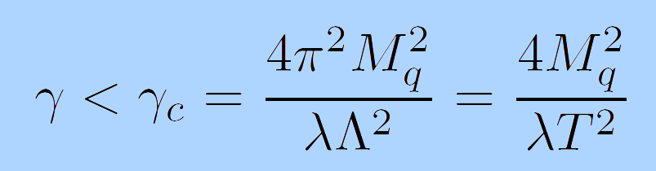
Shock Metric Speed Limit
Local speed of light (in HQ rest frame)
  Demand reality of point-particle action
Solve for v = 0 for finite mass HQ
  z = z_{M} = λ^{½}/2πM_{q}
  Same speed limit as for BH metric when Λ = πT

Slide 44

Quantitative, Falsifiable pQCD
Requires rigorous pQCD estimates, limits

Slide 45
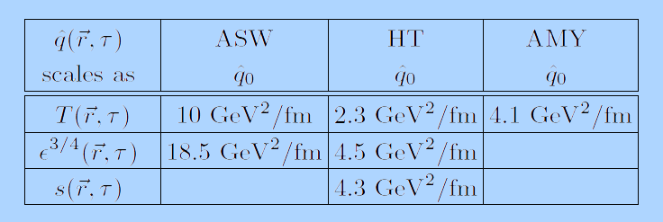
Multiple Models
WHDG, Nucl.Phys.A784:426-442,2007
Bass et al., Phys.Rev.C79:024901,2009
  Inconsistent medium properties
  Distinguish between models
Bass et al.

Slide 46
Quantitative Parameter Extraction
Vary input param.
Find “best” value
Need for theoretical error
PHENIX, PRC77:064907,2008

Slide 47
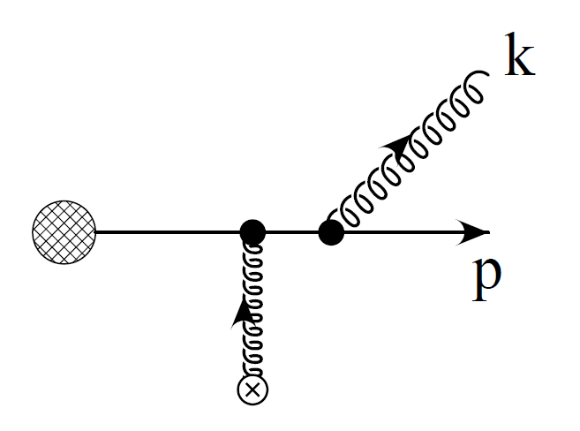
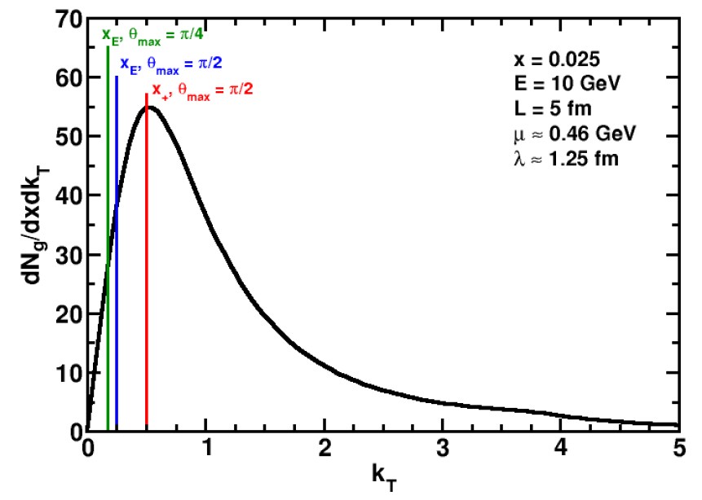
Effect of Collinear Approximation
Assume small angle emission
  k_{T} << ω
Affects ALL current pQCD models
Enforce via kinematic cutoffs
k_{T}
ω
WAH and B Cole, in preparation

Slide 48
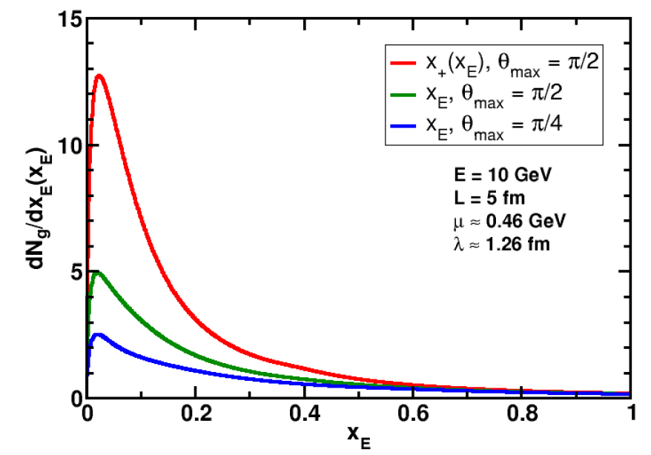
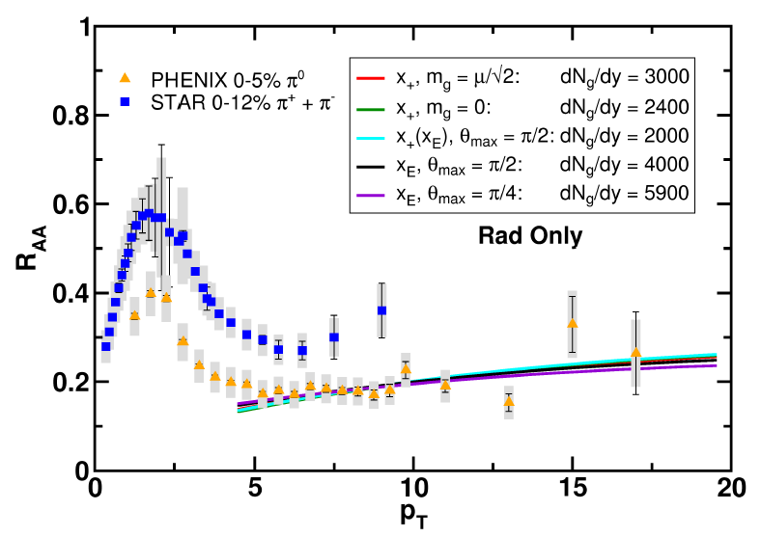
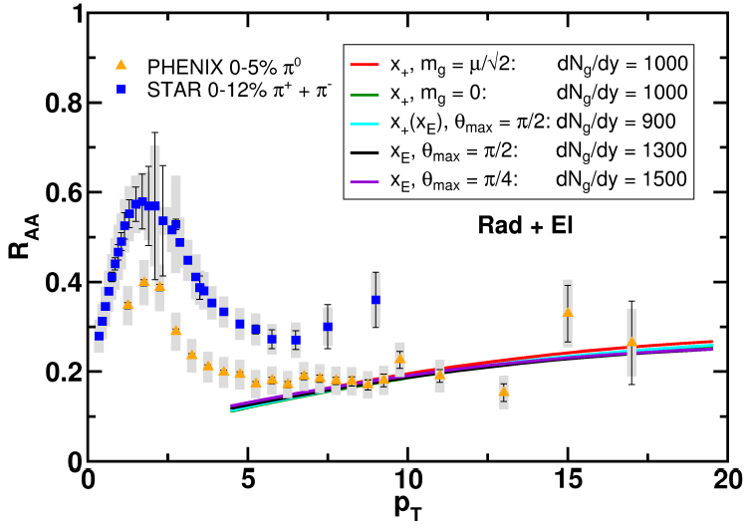
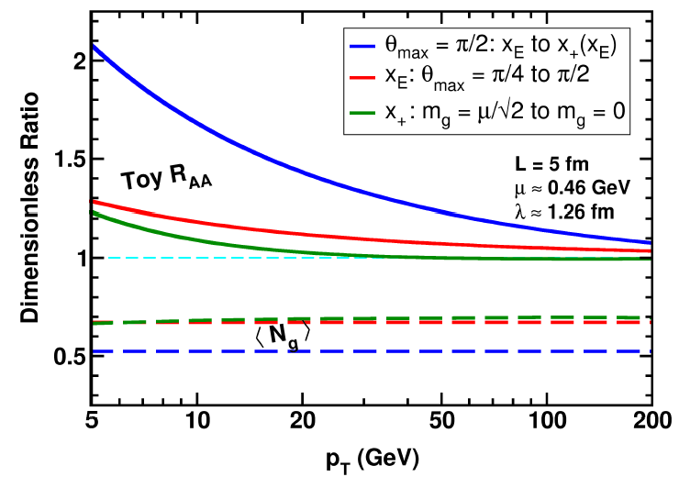
Huge Sensitivity
WAH and B Cole, in preparation

Slide 49
Conclusions I
QCD is a theory with rich structure
  Traditional techniques (Lattice, pQCD)
    Qualitatively successeful
  AdS/CFT exciting new tool
    Also qualitatively successful
Jet observables to disambiguate
  Examine mass, momentum dependence
    Charm and bottom R_{AA}
    Double ratio: R^{c}_{AA}/R^{b}_{AA}(p_{T})

Slide 50
Conclusions II
Generalize AdS/CFT HQ Drag
  Hot and cold nuclear matter
  Gain confidence in universality
Systematic theoretical error for pQCD
  Collinear approximation badly violated
    Some effects persist to LHC energies
      Single particle more interesting than full jet reconstruction?
  Effects of running coupling not yet rigorously investigated

