Slide 1
Heavy Ion Collisions with pQCD and AdS/CFT
W. A. Horowitz
The Ohio State University
November 24, 2009
With many thanks to Brian Cole, Miklos Gyulassy, Ulrich Heinz, and Yuri Kovchegov

Slide 2


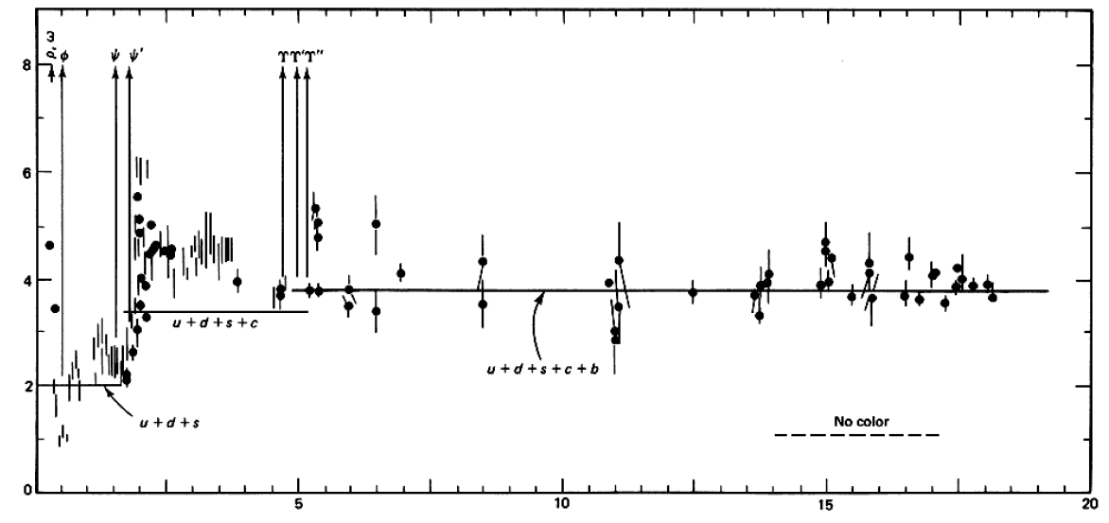

QCD: Theory of the Strong Force
    Running α_{s}
      -β-fcn
    SU(N_{c} = 3)
    N_{f}(E)
      N_{f}(RHIC) ≈ 2.5
PDG
ALEPH, PLB284, (1992)
Griffiths Particle Physics

Slide 3

Bulk QCD and Phase Diagram
Long Range Plan, 2008

Slide 4
Past, Present, and Future Questions
Bulk properties
  Deconfinement
  Thermalization, density
  EOS, η/s
  QGP DOF
Weakly vs. Strongly coupled plasma
  Γ = U/T: <<1 or >>1?
Weakly vs. Strongly coupled theories
  α_{s} ~ 0.3 << 1? λ = √(g_{YM}² N_{c}) ~ 3.5 >> 1?
New computational techniques
  AdS?
Notes:
Theoretical techniques up next!

Slide 5


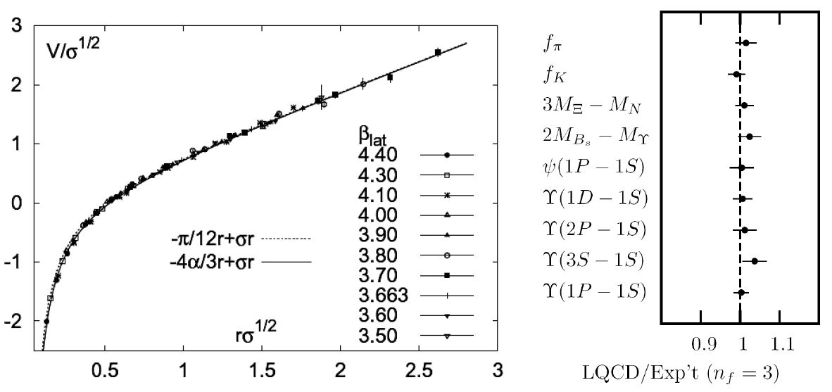
Methods of QCD Calculation I: Lattice
Long Range Plan, 2008
    All momenta
    Euclidean correlators
Kaczmarek and Zantow, PRD71 (2005)
Davies et al. (HPQCD), PRL92 (2004)

Slide 6


Methods of QCD Calculation II: pQCD
d’Enterria, 0902.2011
Jäger et al., PRD67 (2003)
    Any quantity
    Small coupling (large momenta only)

Slide 7




Methods of QCD Calculation III: AdS(?)
Maldacena conjecture: SYM in d ⬄ IIB in d+1
Gubser, QM09
    All quantities
    N_{c} → ∞
    SYM, not QCD: β = 0
      Probably not good approx. for p+p; maybe A+A?
Notes:
Next up, experiments!

Slide 8
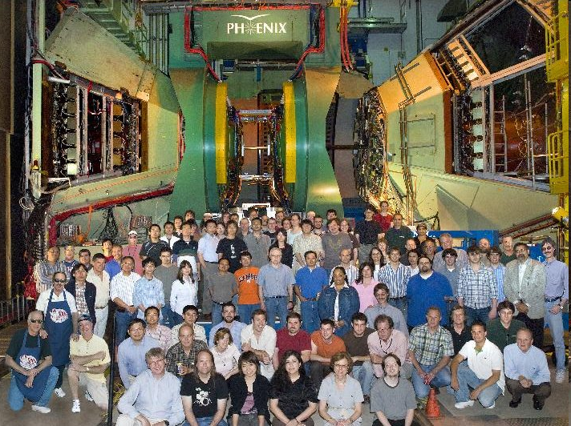
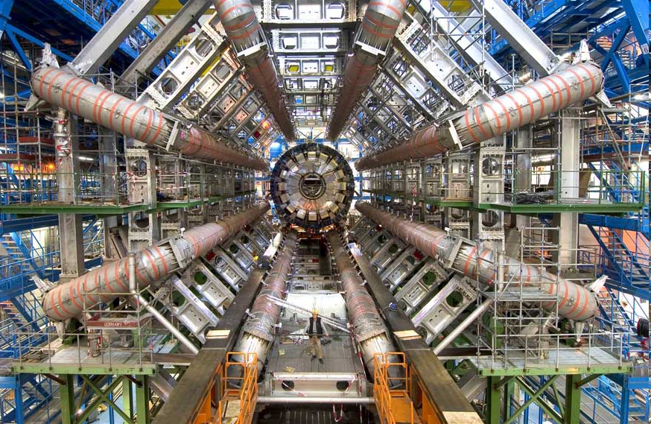
Present and Future QGP Experiments
RHIC
  BRAHMS
  PHENIX
  PHOBOS
  STAR
LHC
  ALICE
  ATLAS
  CMS
  LHCb
PHENIX
ATLAS

Slide 9
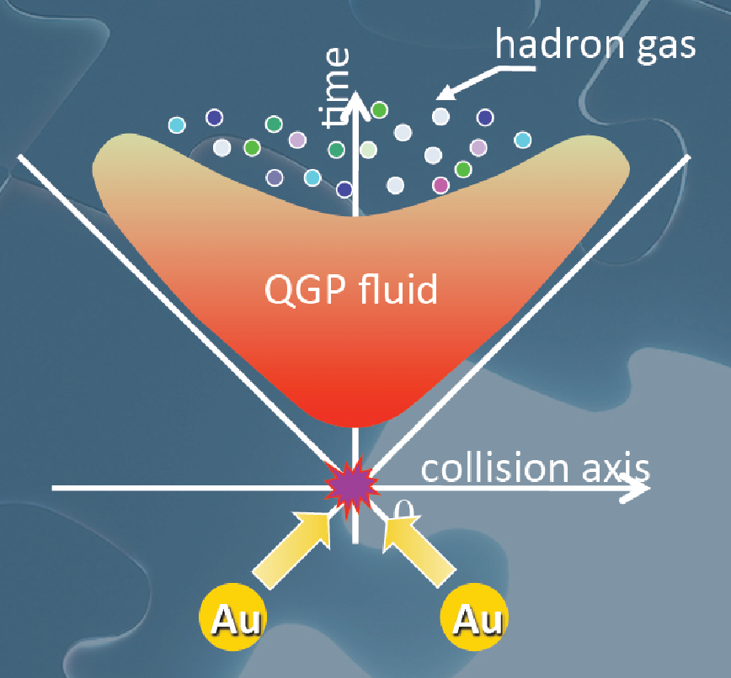
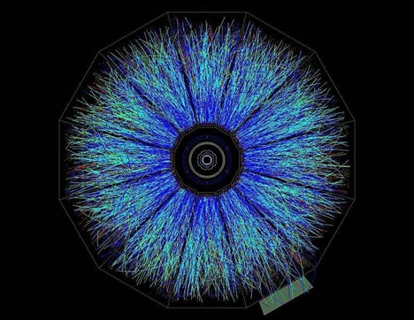
Evolution of a HI Collision
T Hirano, Colliding Nuclei from AMeV to ATeV
STAR

Slide 10

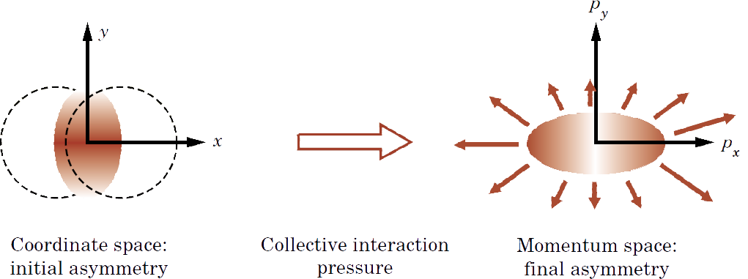
Geometry of a HI Collision
M Kaneta, Results from the
Relativistic Heavy Ion Collider (Part II)
T Ludlum and L McLerran, Phys. Today 56N10 (2003)
    Hydro propagates IC
      Results depend strongly on initial conditions
    Viscosity reduces momentum anisotropy

Slide 11
Low-p_{T} Measurements
Viscosity: why the fuss?
  Naive pQCD => η/s ~ 1
  Naive AdS/CFT => η/s ~ 1/4π
Luzum and Romatschke, PRC78 (2008)
U Heinz, Quark Matter 2009

Slide 12

Why High-p_{T} Jets?
Tomography in medicine
One can learn a lot from a single probe…
and even more with multiple probes
SPECT-CT Scan uses internal γ photons and external X-rays
PET Scan
http://www.fas.org/irp/imint/docs/rst/Intro/Part2_26d.html

Slide 13

Tomography in QGP
Requires well-controlled theory of:
  production of rare, high-p_{T} probes
    g, u, d, s, c, b
  in-medium E-loss
  hadronization
Requires precision measurements of decay fragments
p_{T}
, γ, e⁻
φ
Invert attenuation pattern => measure medium properties

Slide 14


QGP Energy Loss
Learn about E-loss mechanism
  Most direct probe of DOF
pQCD Picture
AdS/CFT Picture

Slide 15
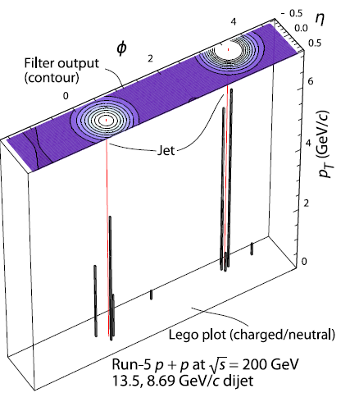
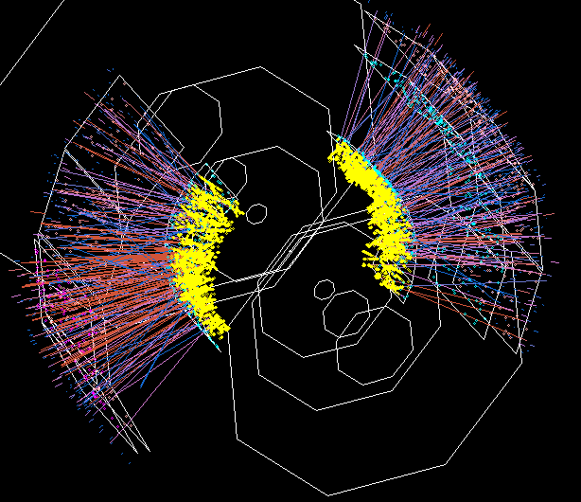
Jets in Heavy Ion Collisions
p+p
Au+Au
Y-S Lai, RHIC & AGS Users’ Meeting, 2009
PHENIX

Slide 16
High-p_{T} Observables
    Naively: if medium has no effect, then R_{AA} = 1
    Common variables used are transverse momentum, p_{T}, and angle with respect to the reaction plane, φ
p_{T}
, γ, e⁻
    Fourier expand R_{AA}:
φ

Slide 17
pQCD Rad Picture
Bremsstrahlung Radiation
  Weakly-coupled plasma
    Medium organizes into Debye-screened centers
  T ~ 250 MeV, g ~ 2
    μ ~ gT ~ 0.5 GeV
    λ_{mfp} ~ 1/g²T ~ 1 fm
    R_{Au} ~ 6 fm
  1/μ << λ_{mfp} << L
    mult. coh. em.
  LPM
    dp_{T}/dt ~ -LT³ log(p_{T}/M_{q})
  Bethe-Heitler
    dp_{T}/dt ~ -(T³/M_{q}²) p_{T}

Slide 18

pQCD Success at RHIC:
(circa 2005)
Y. Akiba for the PHENIX collaboration, hep-ex/0510008
  Consistency: R_{AA}(η)~R_{AA}(π)
  Null Control: R_{AA}(γ)~1
  GLV Prediction: Theory~Data for reasonable fixed L~5 fm and dN_{g}/dy~dN_{π}/dy

Slide 19

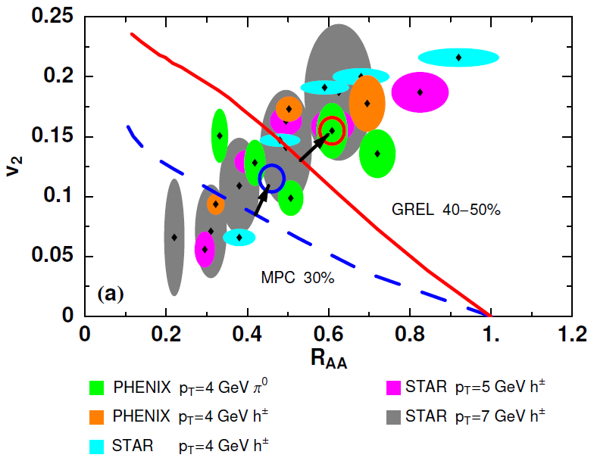
Trouble for Rad E-Loss Picture
v₂
e⁻
e⁻
WAH, Acta Phys.Hung.A27 (2006)
Djordjevic, Gyulassy, Vogt, and Wicks, PLB632 (2006)
Notes:
Anticorrelated; have e- come in later

Slide 20


What About Elastic Loss?
Appreciable!
Finite time effects small
Mustafa, PRC72 (2005)
Adil, Gyulassy, WAH, Wicks, PRC75 (2007)

Slide 21

Quantitative Disagreement Remains
  v₂ too small
  NPE supp. too large
π⁰ v₂
WHDG
NPE v₂
C. Vale, QM09 Plenary (analysis by R. Wei)
Wicks, WAH, Gyulassy, Djordjevic, NPA784 (2007)
Pert. at LHC energies?
PHENIX, Phys. Rev. Lett. 98, 172301 (2007)

Slide 22
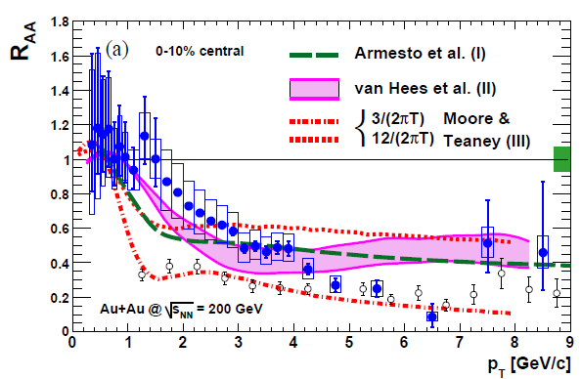
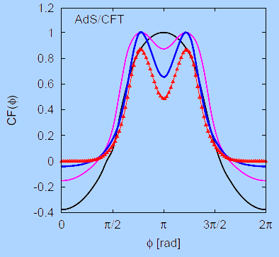
Strongly Coupled Qualitative Successes
AdS/CFT
Blaizot et al., JHEP0706
T. Hirano and M. Gyulassy, Nucl. Phys. A69:71-94 (2006)
PHENIX, PRL98, 172301 (2007)
Betz, Gyulassy, Noronha, Torrieri, PLB675 (2009)

Slide 23
Jets in AdS/CFT
Model heavy quark jet energy loss by embedding string in AdS space
  dp_{T}/dt = - μ p_{T}
  μ = πλ^{1/2} T²/2M_{q}
  Similar to Bethe-Heitler
    dp_{T}/dt ~ -(T³/M_{q}²) p_{T}
  Very different from LPM
    dp_{T}/dt ~ -LT³ log(p_{T}/M_{q})
J Friess, S Gubser, G Michalogiorgakis, S Pufu, Phys Rev D75 (2007)

Slide 24
Compared to Data
String drag: reasonable agreement
  Distinguishing measurement?
WAH, PhD Thesis

Slide 25


pQCD vs. AdS/CFT at LHC
Plethora of Predictions:
WAH, M. Gyulassy, PLB666 (2008)
      Taking the ratio cancels most normalization differences
      pQCD ratio asymptotically approaches 1, and more slowly so for increased quenching (until quenching saturates)
      AdS/CFT ratio is flat and many times smaller than pQCD at only moderate p_{T}
WAH, M. Gyulassy, PLB666 (2008)

Slide 26

Not So Fast!
  Speed limit estimate for applicability of AdS drag
    γ < γ_{crit} = (1 + 2M_{q}/λ^{1/2} T)²
    ~ 4M_{q}²/(λ T²)
      Limited by M_{charm} ~ 1.2 GeV
    Similar to BH LPM
      γ_{crit} ~ M_{q}/(λT)
  No Single T for QGP
    smallest γ_{crit} for largest T
    T = T(τ₀, x=y=0): “(”
    largest γ_{crit} for smallest T
    T = T_{c}: “]”
D7 Probe Brane
Q
Worldsheet boundary Spacelike if γ > γ_{crit}
x₅
Trailing
String
“Brachistochrone”
“z”
D3 Black Brane

Slide 27

LHC R^{c}_{AA}(p_{T})/R^{b}_{AA}(p_{T}) Prediction
(with speed limits)
WAH, M. Gyulassy, PLB666 (2008)
      T(τ₀): “(”, corrections likely small for smaller momenta
      T_{c}: “]”, corrections likely large for higher momenta

Slide 28

RHIC R^{cb} Ratio
pQCD
pQCD
AdS/CFT
AdS/CFT
WAH, M. Gyulassy, JPhysG35 (2008)
    Wider distribution of AdS/CFT curves due to large n: increased sensitivity to input parameters
    Advantage of RHIC: lower T => higher AdS speed limits

Slide 29
Universality and Applicability
How universal are th. HQ drag results?
  Examine different theories
  Investigate alternate geometries
Other AdS geometries
  Bjorken expanding hydro
  Shock metric
    Warm-up to Bj. hydro
    Can represent both hot and cold nuclear matter

Slide 30
New Geometries
Constant T Thermal Black Brane
Shock Geometries
P Chesler,
Quark Matter 2009
Nucleus as Shock
DIS
Embedded String in Shock
Before
After
Albacete, Kovchegov, Taliotis,
JHEP 0807, 074 (2008)
v_{shock}
z
Q
v_{shock}
z
Q
x
x
Bjorken-Expanding Medium
WAH and Kovchegov, PLB680 (2009)

Slide 31
Asymptotic Shock Results
Three t-ind. solutions (static gauge):
  X^{μ} = (t, x(z), 0,0, z)
  x(z) = x₀, x₀ ± μ ^{½} z³/3
    Constant solution unstable
    Time-reversed negative x solution unphysical
    Sim. to x ~ z³/3, z << 1, for const. T BH geom.
Q
z = 0
v_{shock}
x₀ − μ ^{½} z³/3
x₀ + μ ^{½} z³/3
x₀
x
z = ∞

Slide 32
HQ Momentum Loss
x(z) = μ ^{½} z³/3 =>
Relate μ to nuclear properties
  Use AdS dictionary
    Metric in Fefferman-Graham form: μ ~ T₋₋/N_{c}²
  N_{c}² gluons per nucleon in shock
  Λ is typical mom. scale; Λ⁻¹ typical dist. scale
    E-M in shock rest frame: T’₀₀ ~ N_{c}² Λ⁴

Slide 33

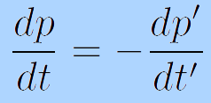
Frame Dragging
HQ Rest Frame
Shock Rest Frame
v_{sh}
M_{q}
Λ
v_{q} = -v_{sh}
M_{q}
1/Λ
i
v_{q} = 0
i
v_{sh} = 0
  Change coords, boost T_{μν} into HQ rest frame:
    T₋₋ ~ N_{c}² Λ⁴ γ² = N_{c}² Λ⁴ (p’/M)²
    p’ ~ γM: HQ mom. in rest frame of shock
  Boost mom. loss into shock rest frame (“lab” frame)
  π⁰_{t} = 0:

Slide 34
Putting It All Together
This leads to
We’ve generalized the BH solution to both cold and hot nuclear matter E-loss
  Recall for BH:
  Shock gives exactly the same drag as BH for Λ = π T

Slide 35
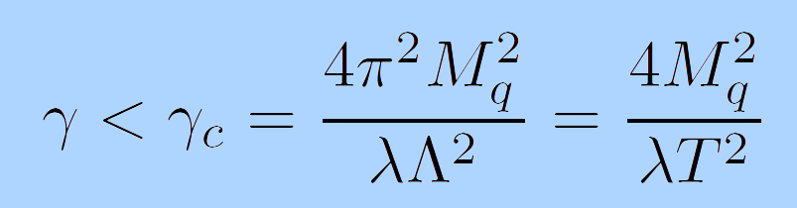
Shock Metric Speed Limit
Local speed of light (in HQ rest frame)
  Demand reality of point-particle action
Solve for v = 0 for finite mass HQ
  z = z_{M} = λ^{½}/2πM_{q}
  Same speed limit as for BH metric when Λ = πT

Slide 36

Quantitative, Falsifiable pQCD
Requires rigorous pQCD estimates, limits

Slide 37
Acronyms, Acronyms
Four major pQCD formalisms for Rad E-loss
  Opacity expansion: GLV (DGLV), ASW-SH
  Multiple soft scattering: BDMPS (ASW-MS)
  Higher Twist: HT
  Thermal field theory: AMY

Slide 38
Energy Loss
  R_{AA} ~ ∫(1-ϵ)^{n} P(ϵ) dϵ
    E_{f} = (1-ϵ)E_{i}
  Opacity expansions finds single inclusive gluon emission spectrum
    dN_{g}/dxdk_{T}dq_{T}

Slide 39
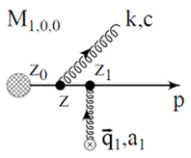
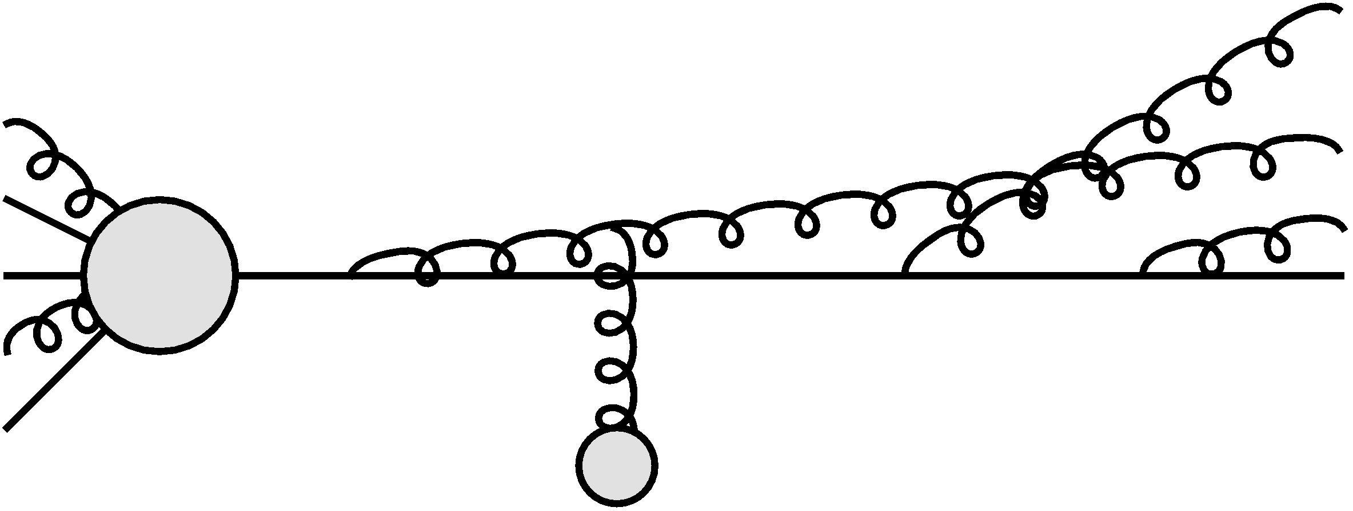
Poisson Convolution
Find P(ϵ) by convolving dN_{g}/dx
  Approximates probabilistic multiple gluon emission
    assume independent emissions
Gyulassy, Levai, and Vitev NPB594 (2001)

Slide 40
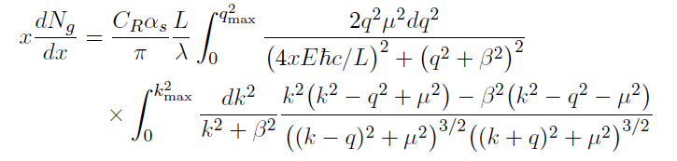

Opacity Expansion Calculation
Want to find dN_{g}/dx
  Make approximations to simplify derivation
    Small angle emission: k_{T} << xE
      Note: ALL current formalisms use collinear approximation
  Derived dN_{g}/dxdk_{T} violates collinear approx
    Both IR and UV safe
    Enforce small angle emission through UV cutoff in k_{T}

Slide 41
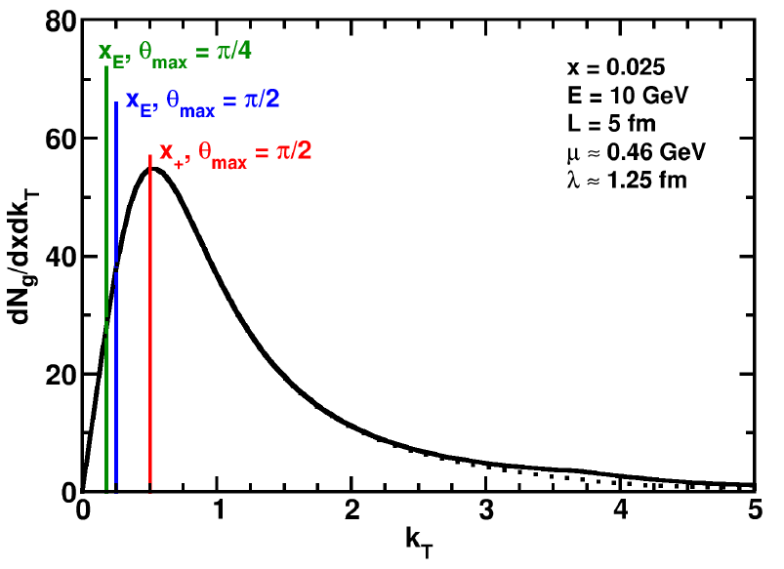
Uncertainty from Collinear Approx
Derived dN_{g}/dxdk_{T} maximally violates collinear approximation
  dN_{g}/dx depends sensitively on k_{T} cutoff
    Despite UV safety
  For effect on extracted prop., must understand x
    Discovered through TECHQM Brick Problem
WAH and B Cole, arXiv:0910.1823

Slide 42
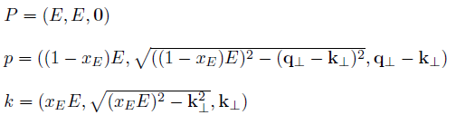
ASW-SH Definition of x
ASW-SH: x_{E}
  Minkowski coords
    Always on-shell
P

Slide 43


GLV Definition of x
GLV: x₊
  Light-cone coords
    Always on-shell
P

Slide 44
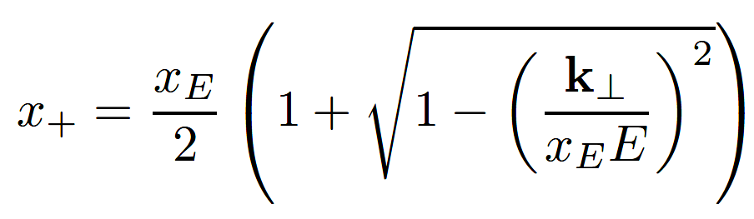
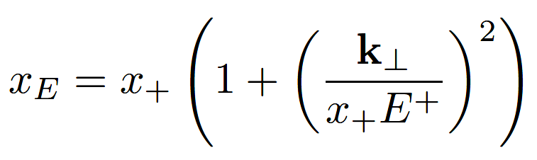

Coordinate Transformations
  Same in the limit k_{T}/xE → 0!
UV cutoff given by restricting maximum angle of emission
  Previous comparisons with data took θ_{max}=π/2
  Vary θ_{max} to estimate systematic theoretical uncertainty
θ
P

Slide 45
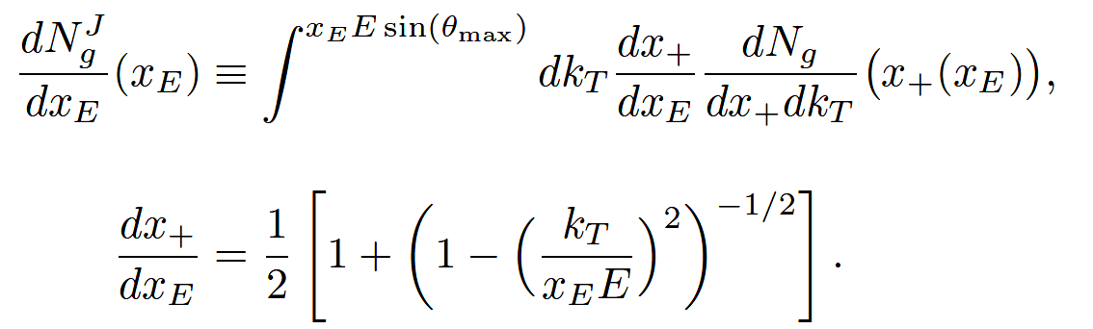
Jacobians
ϵ is fraction of longitudinal momentum
  Need dN_{g}/dx_{E} to find P(ϵ)
  A Jacobian is required for x = x₊ interpretation

Slide 46
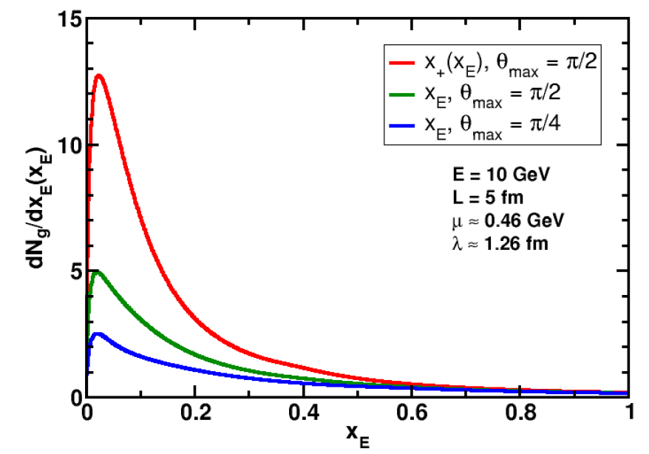
Rad. Gluon Kin. Sensitivities
UV
What about IR?
WAH and B Cole, arXiv:0910.1823

Slide 47
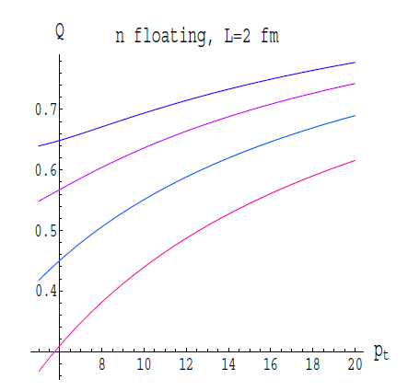
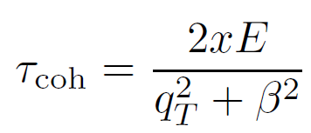
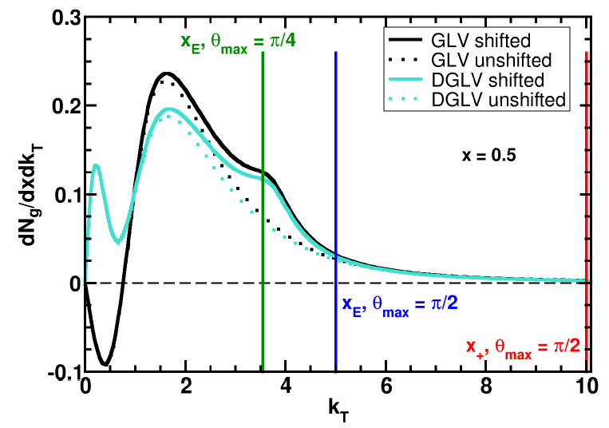
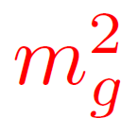
Collinearity and Gluon Mass
Massless gluons:
  Large IR cutoff sensitivity
Gluons with thermal mass
BDMS, JHEP 0109 (2001)
Larger x better respects k_{T} << xE
WAH and B Cole, arXiv:0910.1823

Slide 48
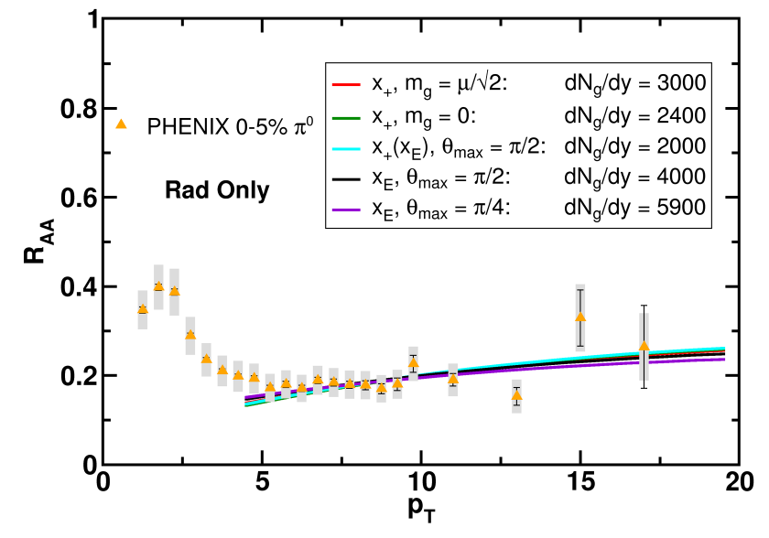
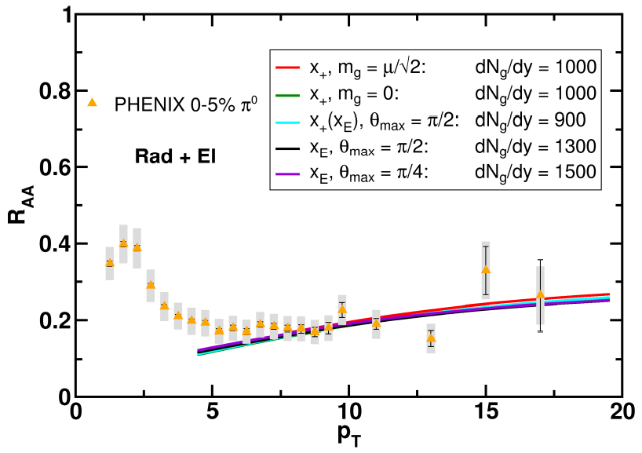
Results
Quantitatively compare to PHENIX data
  Assumed infinite Elastic precision
WAH and B Cole, arXiv:0910.1823

Slide 49
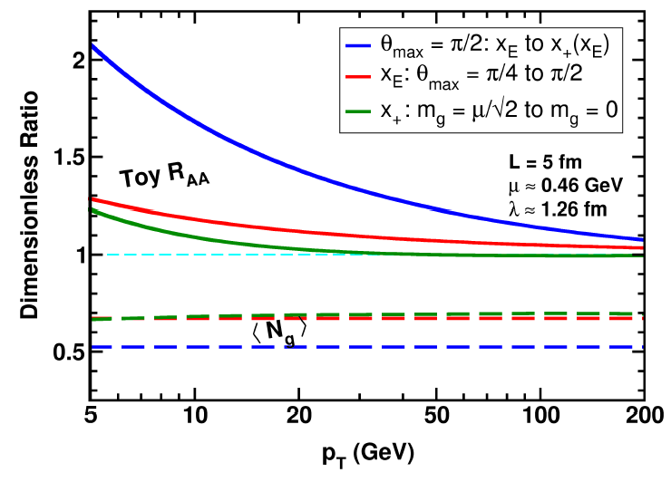
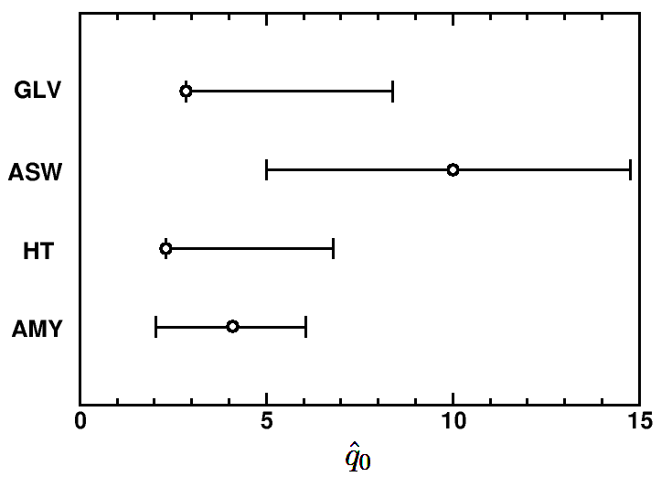
Parton Energy Dependence
Dependence on parton energy
Uncertainty on qhat
  Assume all formalisms equally affected
WAH and B Cole, arXiv:0910.1823

Slide 50
Conclusions I
QCD is a theory with rich structure
  Traditional techniques (Lattice, pQCD)
    Qualitatively successeful
  AdS/CFT exciting new tool
    Also qualitatively successful
Jet observables to disambiguate
  Examine mass, momentum dependence
    Charm and bottom R_{AA}
    Double ratio: R^{c}_{AA}/R^{b}_{AA}(p_{T})

Slide 51
Conclusions II
Generalize AdS/CFT HQ Drag
  Hot and cold nuclear matter
  Gain confidence in universality
Systematic theoretical uncertainty for pQCD
  Collinear approximation badly violated
    Some effects persist to LHC energies
      Single particle more interesting than full jet reconstruction?
    Extracted medium properties likely consistent w/i unc.
  Effects of running coupling not yet rigorously investigated

