Slide 1
Jet Energy Loss with pQCD and AdS/CFT in Heavy Ion Collisions
W. A. Horowitz
The Ohio State University
February 11, 2010
With many thanks to Brian Cole, Miklos Gyulassy, Ulrich Heinz, and Yuri Kovchegov

Slide 2


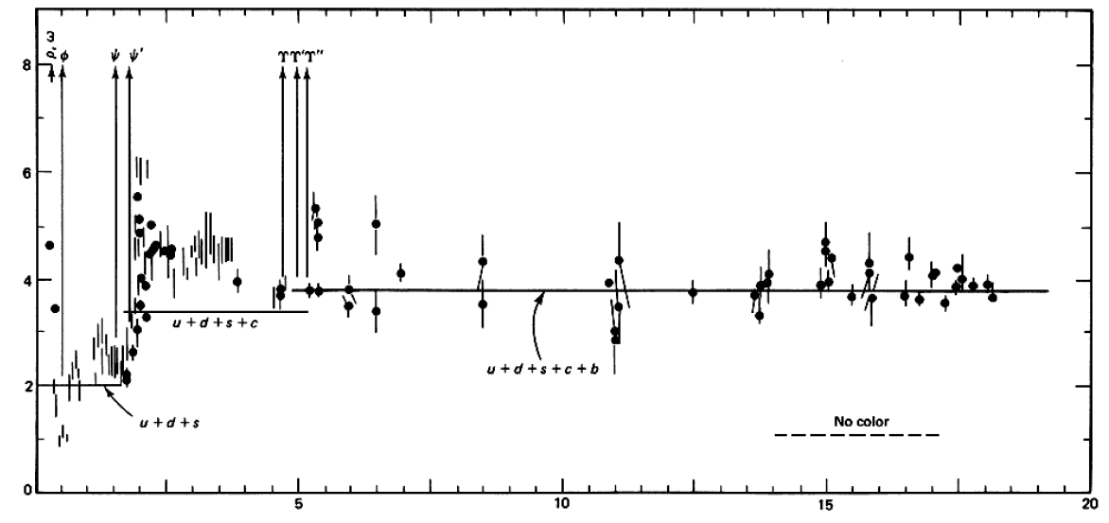

QCD: Theory of the Strong Force
    Running α_{s}
      -β-fcn
    SU(N_{c} = 3)
    N_{f}(E)
      N_{f}(RHIC) ≈ 2.5
PDG
ALEPH, PLB284, (1992)
Griffiths Particle Physics

Slide 3

Bulk QCD and Phase Diagram
Long Range Plan, 2008

Slide 4
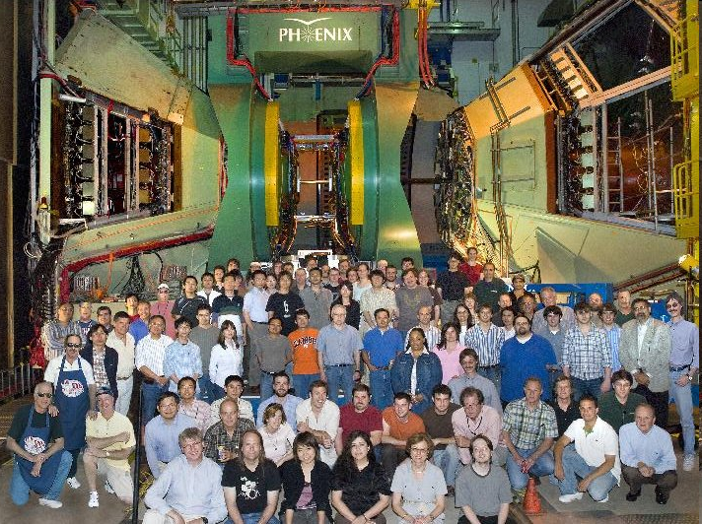
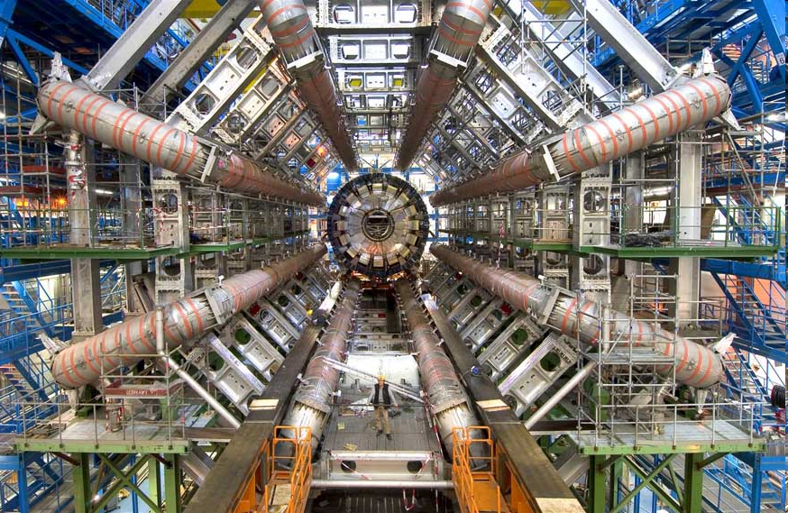
Present and Future QGP Experiments
RHIC
  BRAHMS
  PHENIX
  PHOBOS
  STAR
LHC
  ALICE
  ATLAS
  CMS
  LHCb
PHENIX
ATLAS

Slide 5
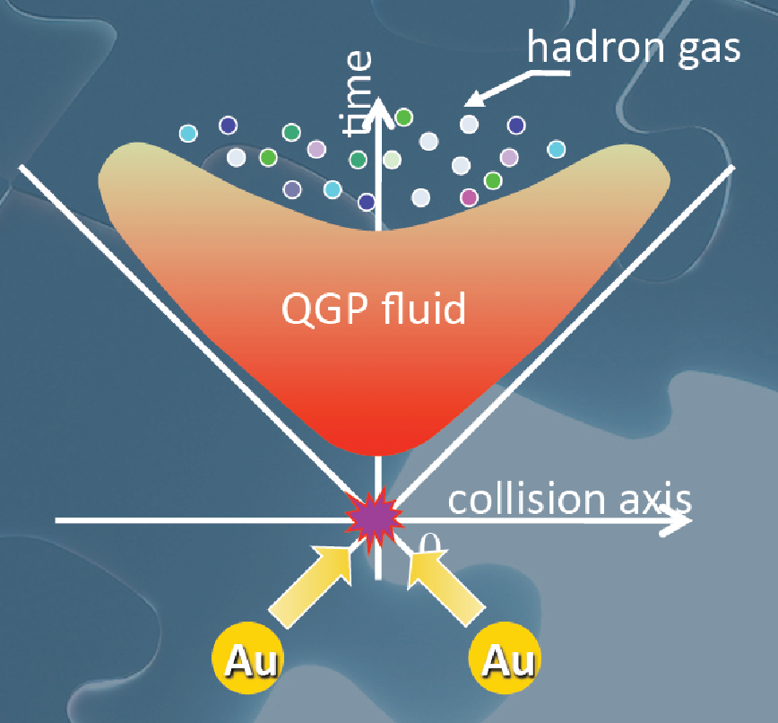
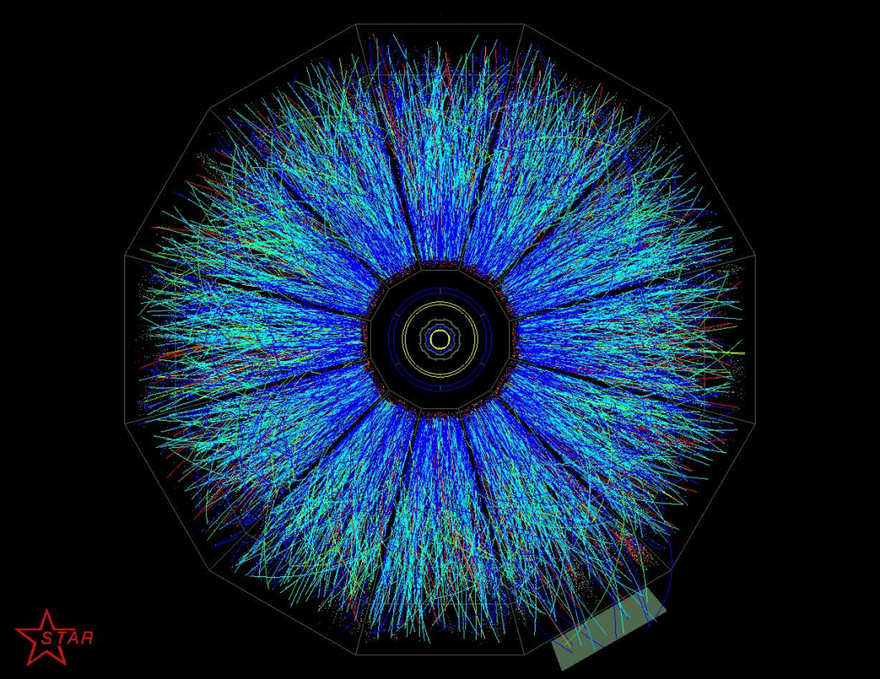
Evolution of a HI Collision
T Hirano, Colliding Nuclei from AMeV to ATeV
STAR

Slide 6
Past, Present, and Future Questions
Bulk properties
  Deconfinement
  Thermalization, density
  EOS, η/s
  QGP DOF
Weakly vs. Strongly coupled plasma
  Γ = U/T: <<1 or >>1?
Weakly vs. Strongly coupled theories
  α_{s} ~ 0.3 << 1? λ = √(g_{YM}² N_{c}) ~ 3.5 >> 1?
New computational techniques
  AdS?
Notes:
Theoretical techniques up next!

Slide 7


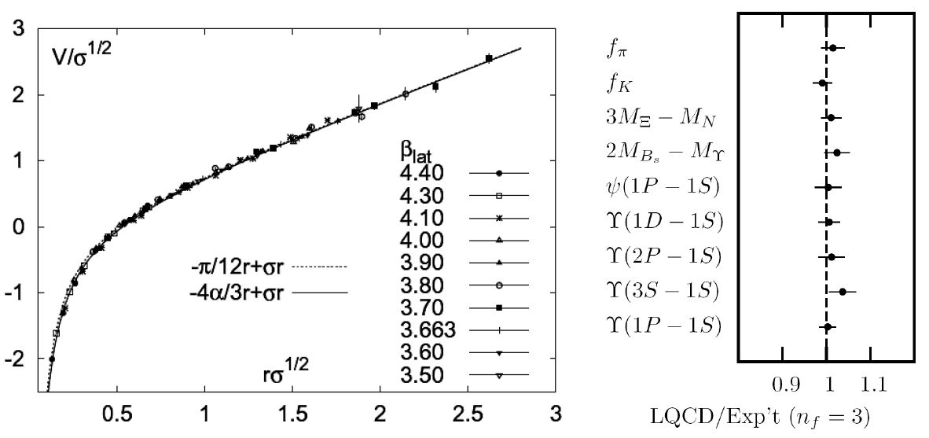
Methods of QCD Calculation I: Lattice
Long Range Plan, 2008
    All momenta
    Euclidean correlators
Kaczmarek and Zantow, PRD71 (2005)
Davies et al. (HPQCD), PRL92 (2004)

Slide 8


Methods of QCD Calculation II: pQCD
d’Enterria, 0902.2011
Jäger et al., PRD67 (2003)
    Any quantity
    Small coupling (large momenta only)

Slide 9




Methods of QCD Calculation III: AdS(?)
Maldacena conjecture: SYM in d ⬄ IIB in d+1
Gubser, QM09
    All quantities
    N_{c} → ∞
    SYM, not QCD: β = 0
      Probably not good approx. for p+p; maybe A+A?
Notes:
Next up, experiments!

Slide 10

Why High-p_{T} Jets?
Tomography in medicine
One can learn a lot from a single probe…
and even more with multiple probes
SPECT-CT Scan uses internal γ photons and external X-rays
PET Scan
http://www.fas.org/irp/imint/docs/rst/Intro/Part2_26d.html

Slide 11

Tomography in QGP
Requires well-controlled theory of:
  production of rare, high-p_{T} probes
    g, u, d, s, c, b
  in-medium E-loss
  hadronization
Requires precision measurements of decay fragments
p_{T}
, γ, e⁻
φ
Invert attenuation pattern => measure medium properties

Slide 12


QGP Energy Loss
Learn about E-loss mechanism
  Most direct probe of DOF
pQCD Picture
AdS/CFT Picture

Slide 13
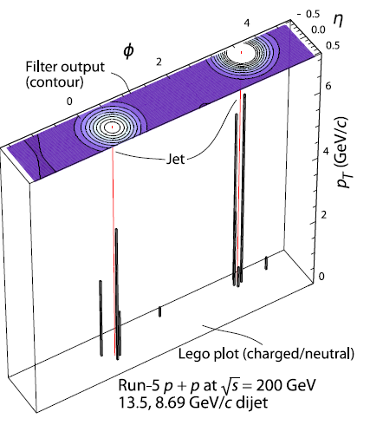
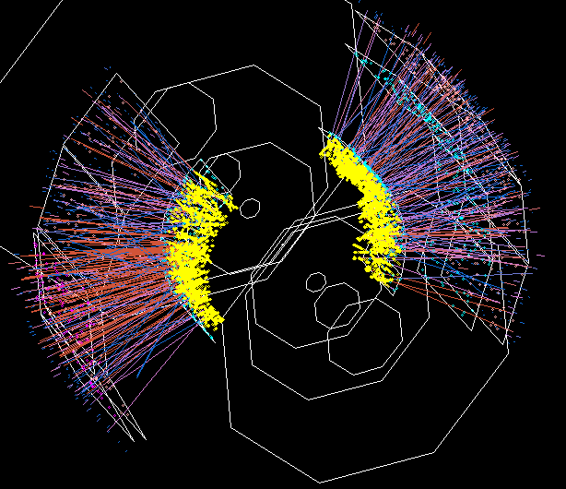

Jets in Heavy Ion Collisions
p+p
Au+Au
Y-S Lai, RHIC & AGS Users’ Meeting, 2009
PHENIX

Slide 14

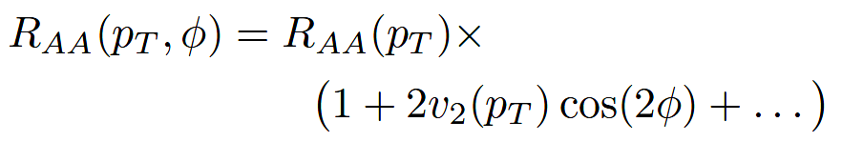
High-p_{T} Observables
    Naively: if medium has no effect, then R_{AA} = 1
    Common variables used are transverse momentum, p_{T}, and angle with respect to the reaction plane, φ
p_{T}
, γ, e⁻
    Fourier expand R_{AA}:
φ

Slide 15

pQCD Rad Picture
Bremsstrahlung Radiation
  Weakly-coupled plasma
    Medium organizes into Debye-screened centers
  T ~ 250 MeV, g ~ 2
    μ ~ gT ~ 0.5 GeV
    λ_{mfp} ~ 1/g²T ~ 1 fm
    R_{Au} ~ 6 fm
  1/μ << λ_{mfp} << L
    mult. coh. em.
Gyulassy, Levai, and Vitev, NPB571 (200)
  LPM
    dp_{T}/dt ~ -LT³ log(p_{T}/M_{q})
  Bethe-Heitler
    dp_{T}/dt ~ -(T³/M_{q}²) p_{T}

Slide 16

pQCD Success at RHIC:
(circa 2005)
Y. Akiba for the PHENIX collaboration, hep-ex/0510008
  Consistency: R_{AA}(η)~R_{AA}(π)
  Null Control: R_{AA}(γ)~1
  GLV Prediction: Theory~Data for reasonable fixed L~5 fm and dN_{g}/dy~dN_{π}/dy

Slide 17

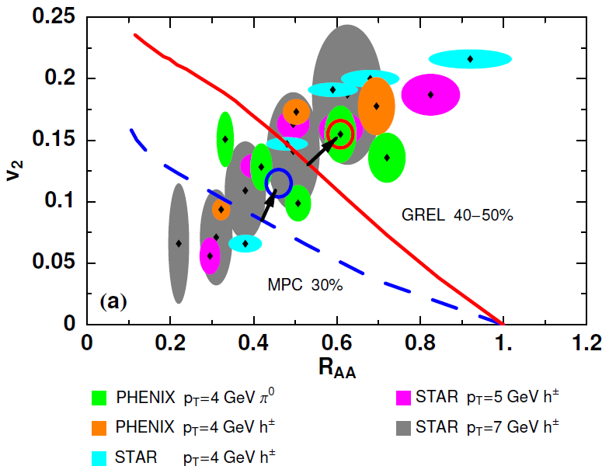
Trouble for Rad E-Loss Picture
v₂
e⁻
e⁻
WAH, Acta Phys.Hung.A27 (2006)
Djordjevic, Gyulassy, Vogt, and Wicks, PLB632 (2006)
Notes:
Anticorrelated; have e- come in later

Slide 18


What About Elastic Loss?
Appreciable!
Finite time effects small
Mustafa, PRC72 (2005)
Adil, Gyulassy, WAH, Wicks, PRC75 (2007)

Slide 19

Quantitative Disagreement Remains
  v₂ too small
  NPE supp. too large
π⁰ v₂
WHDG
NPE v₂
C. Vale, QM09 Plenary (analysis by R. Wei)
Wicks, WAH, Gyulassy, Djordjevic, NPA784 (2007)
Pert. at LHC energies?
PHENIX, Phys. Rev. Lett. 98, 172301 (2007)

Slide 20
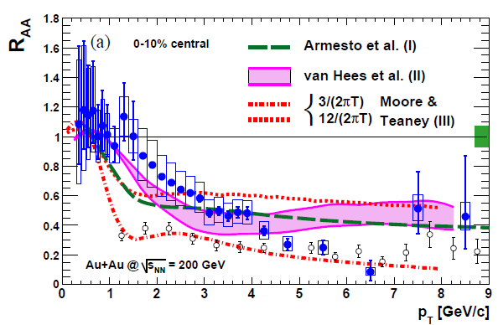
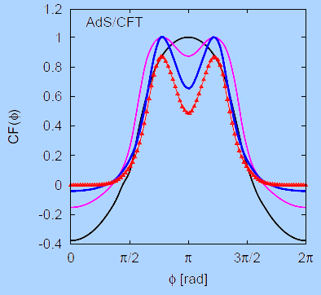
Strongly Coupled Qualitative Successes
AdS/CFT
Blaizot et al., JHEP0706
T. Hirano and M. Gyulassy, Nucl. Phys. A69:71-94 (2006)
PHENIX, PRL98, 172301 (2007)
Betz, Gyulassy, Noronha, Torrieri, PLB675 (2009)

Slide 21
Jets in AdS/CFT
Model heavy quark jet energy loss by embedding string in AdS space
  dp_{T}/dt = - μ p_{T}
  μ = πλ^{1/2} T²/2M_{q}
  Similar to Bethe-Heitler
    dp_{T}/dt ~ -(T³/M_{q}²) p_{T}
  Very different from LPM
    dp_{T}/dt ~ -LT³ log(p_{T}/M_{q})
J Friess, S Gubser, G Michalogiorgakis, S Pufu, Phys Rev D75 (2007)

Slide 22
Compared to Data
String drag: qualitative agreement
WAH, PhD Thesis

Slide 23


Light Quark and Gluon E-Loss
PHENIX 0-5% π⁰
Gubser, QM09
WAH, in preparation
ΔL^{q}_{therm} ~ E^{1/3}
ΔL^{g}_{therm} ~ (2E)^{1/3}

Slide 24
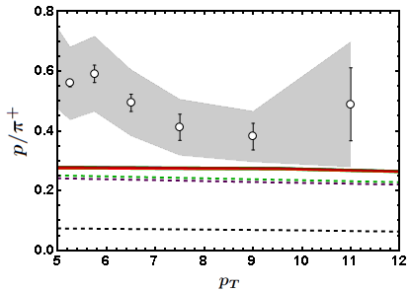
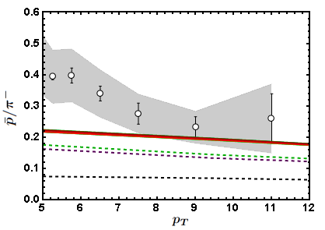
Baryon to Meson Ratios
STAR
STAR
AdS/CFT
AdS/CFT
pQCD
pQCD
WAH, in preparation

Slide 25
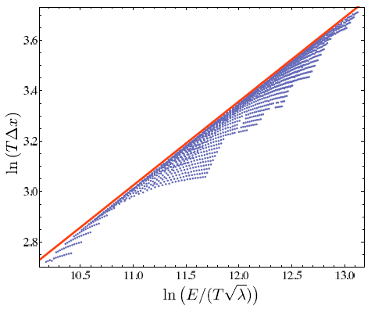
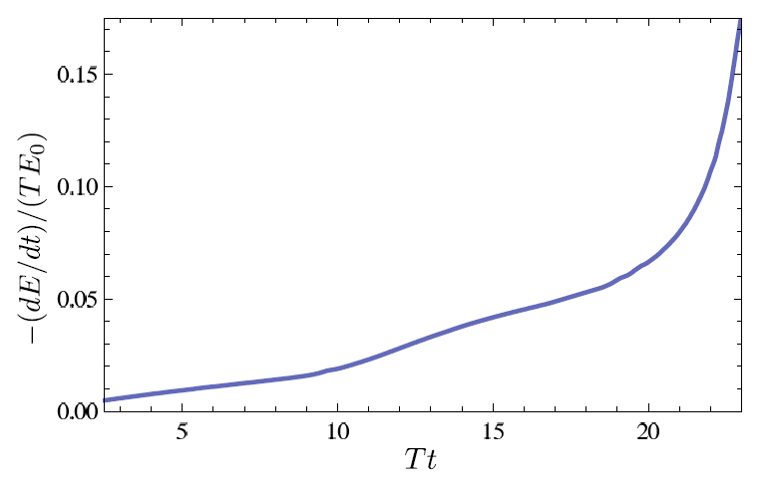
Quantitative g, q from AdS?
Highly sensitive to IC
  Distinguishing measurement?
Chesler et al., Phys.Rev.D79:125015,2009

Slide 26
Looking for a Qualitative, Distinguishing Signal
  Use LHC’s large p_{T} reach and identification of c and b to distinguish between pQCD, AdS/CFT
    Asymptotic pQCD momentum loss:
    String theory drag momentum loss:
      Independent of p_{T} and strongly dependent on M_{q}!
      T² dependence in exponent makes for a very sensitive probe
  Expect: ε_{pQCD} 0 vs. ε_{AdS} indep of p_{T}!!
    dR_{AA}(p_{T})/dp_{T} > 0 => pQCD; dR_{AA}(p_{T})/dp_{T} < 0 => ST
ε_{rad} ∼ α_{s} L² log(p_{T}/M_{q})/p_{T}
ε_{ST} ∼ 1 - Exp(-μ L), μ = πλ^{1/2} T²/2M_{q}
S. Gubser, Phys.Rev.D74:126005 (2006); C. Herzog et al. JHEP 0607:013,2006

Slide 27

LHC c, b R_{AA} p_{T} Dependence
WAH, M. Gyulassy, PLB666 (2008)
      Unfortunately, large suppression pQCD similar to AdS/CFT

Slide 28

An Enhanced Signal
But what about the interplay between mass and momentum?
  Take ratio of c to b R_{AA}(p_{T})
    pQCD: Mass effects die out with increasing p_{T}
      Ratio starts below 1, asymptotically approaches 1. Approach is slower for higher quenching
    ST: drag independent of p_{T}, inversely proportional to mass. Simple analytic approx. of uniform medium gives
    R^{cb}_{pQCD}(p_{T}) ~ n_{b}M_{c}/n_{c}M_{b} ~ M_{c}/M_{b} ~ .27
      Ratio starts below 1; independent of p_{T}
R^{cb}_{pQCD}(p_{T}) ∼ 1 - α_{s} n(p_{T}) L² log(M_{b}/M_{c}) ( /p_{T})

Slide 29

pQCD vs. AdS/CFT at LHC
Plethora of Predictions:
WAH, M. Gyulassy, PLB666 (2008)
      Taking the ratio cancels most normalization differences
      pQCD ratio asymptotically approaches 1, and more slowly so for increased quenching (until quenching saturates)
      AdS/CFT ratio is flat and many times smaller than pQCD at only moderate p_{T}
WAH, M. Gyulassy, PLB666 (2008)

Slide 30

Not So Fast!
  Speed limit estimate for applicability of AdS drag
    γ < γ_{crit} = (1 + 2M_{q}/λ^{1/2} T)²
    ~ 4M_{q}²/(λ T²)
      Limited by M_{charm} ~ 1.2 GeV
    Similar to BH LPM
      γ_{crit} ~ M_{q}/(λT)
  No Single T for QGP
    smallest γ_{crit} for largest T
    T = T(τ₀, x=y=0): “(”
    largest γ_{crit} for smallest T
    T = T_{c}: “]”
D7 Probe Brane
Q
Worldsheet boundary Spacelike if γ > γ_{crit}
x₅
Trailing
String
“Brachistochrone”
“z”
D3 Black Brane

Slide 31

LHC R^{c}_{AA}(p_{T})/R^{b}_{AA}(p_{T}) Prediction
(with speed limits)
WAH, M. Gyulassy, PLB666 (2008)
      T(τ₀): “(”, corrections likely small for smaller momenta
      T_{c}: “]”, corrections likely large for higher momenta

Slide 32

RHIC R^{cb} Ratio
pQCD
pQCD
AdS/CFT
AdS/CFT
WAH, M. Gyulassy, JPhysG35 (2008)
    Wider distribution of AdS/CFT curves due to large n: increased sensitivity to input parameters
    Advantage of RHIC: lower T => higher AdS speed limits

Slide 33
Universality and Applicability
How universal are th. HQ drag results?
  Examine different theories
  Investigate alternate geometries
Other AdS geometries
  Bjorken expanding hydro
  Shock metric
    Warm-up to Bj. hydro
    Can represent both hot and cold nuclear matter

Slide 34
New Geometries
Constant T Thermal Black Brane
Shock Geometries
P Chesler,
Quark Matter 2009
Nucleus as Shock
DIS
Embedded String in Shock
Albacete, Kovchegov, Taliotis,
JHEP 0807, 074 (2008)
Before
After
v_{shock}
z
Q
v_{shock}
z
Q
x
x
WAH and Kovchegov, PLB680 (2009)

Slide 35
Asymptotic Shock Results
Three t-ind. solutions (static gauge):
  X^{μ} = (t, x(z), 0,0, z)
  x(z) = x₀, x₀ ± μ ^{½} z³/3
    Constant solution unstable
    Time-reversed negative x solution unphysical
    Sim. to x ~ z³/3, z << 1, for const. T BH geom.
Q
z = 0
v_{shock}
x₀ − μ ^{½} z³/3
x₀ + μ ^{½} z³/3
x₀
x
z = ∞

Slide 36
HQ Momentum Loss
x(z) = μ ^{½} z³/3 =>
Relate μ to nuclear properties
  Use AdS dictionary
    Metric in Fefferman-Graham form: μ ~ T₋₋/N_{c}²
  T’₀₀ ~ N_{c}² Λ⁴
    N_{c}² gluons per nucleon in shock
    Λ is typical mom. scale; Λ⁻¹ typical dist. scale

Slide 37

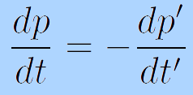
Frame Dragging
HQ Rest Frame
Shock Rest Frame
v_{sh}
M_{q}
Λ
v_{q} = -v_{sh}
M_{q}
1/Λ
i
v_{q} = 0
i
v_{sh} = 0
  Change coords, boost T_{μν} into HQ rest frame:
    T₋₋ ~ N_{c}² Λ⁴ γ² ∼ N_{c}² Λ⁴ (p’/M)²
    p’ ~ γM: HQ mom. in rest frame of shock
  Boost mom. loss into shock rest frame
  π⁰_{t} = 0:

Slide 38
Putting It All Together
For Λ typical momentum scale of the medium
We’ve generalized the BH solution to both cold and hot nuclear matter E-loss
  Recall for BH:
  Shock gives exactly the same drag as BH for Λ = π T

Slide 39
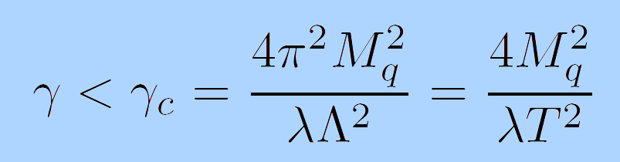
Shock Metric Speed Limit
Local speed of light (in HQ rest frame)
  Demand reality of point-particle action
Solve for v = 0 for finite mass HQ
  z = z_{M} = λ^{½}/2πM_{q}
  Same speed limit as for BH metric when Λ = πT

Slide 40
Conclusions
  pQCD and AdS/CFT enjoy qualitative successes, concerns in high-p_{T} HIC
    RHIC suppression of lights and heavies
    Future LHC measurements
  Quantitative comparisons with rigorous theoretical uncertainty estimates needed for falsification/verification
    Theoretical work needed in both in pQCD and AdS
      In AdS, control of jet IC, large p_{T} required
      In pQCD, wide angle radiation very important, not under theoretical control

