Slide 1
Successes, Failures, and Uncertainties in Jet Physics in Heavy Ion Collisions
W. A. Horowitz
The Ohio State University
February 18, 2010
With many thanks to Brian Cole, Miklos Gyulassy, Ulrich Heinz, and Yuri Kovchegov

Slide 2


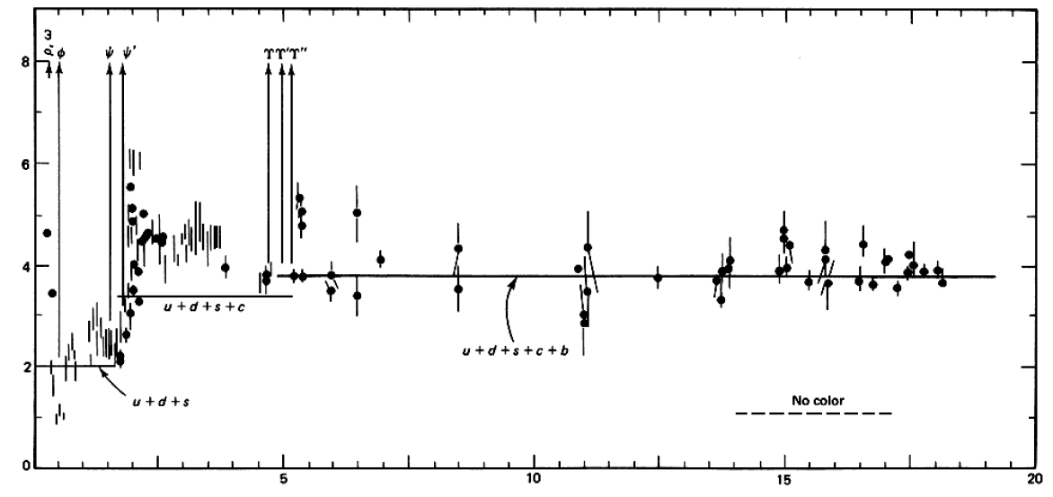

QCD: Theory of the Strong Force
    Running α_{s}
      -β-fcn
    SU(N_{c} = 3)
    N_{f}(E)
      N_{f}(RHIC) ≈ 2.5
PDG
ALEPH, PLB284, (1992)
Griffiths Particle Physics

Slide 3

Bulk QCD and Phase Diagram
Long Range Plan, 2008

Slide 4
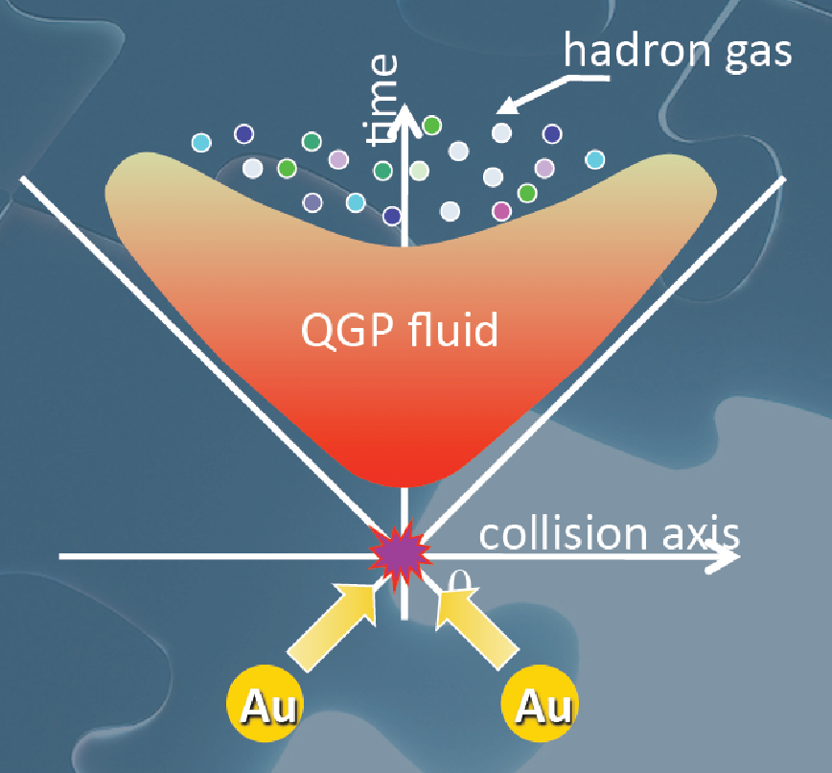
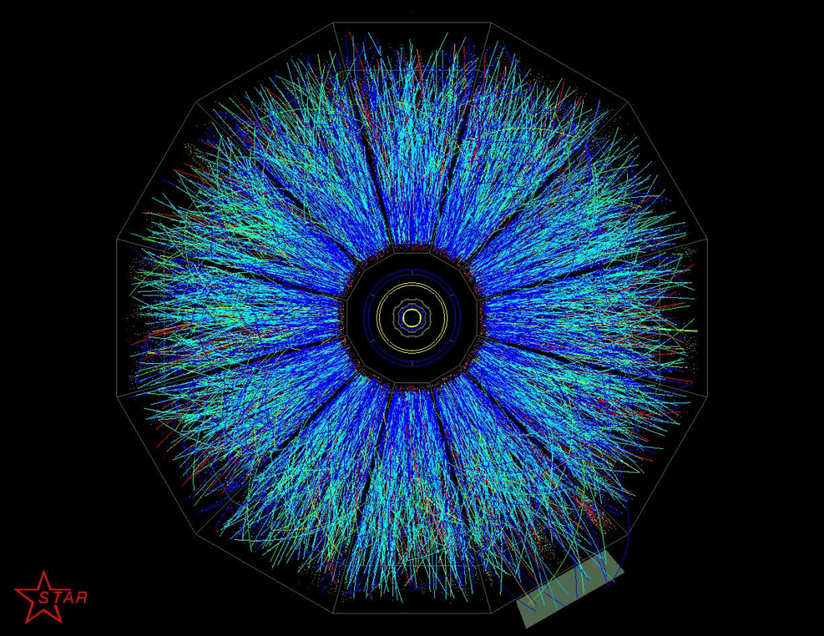
Evolution of a HI Collision
T Hirano, Colliding Nuclei from AMeV to ATeV
STAR

Slide 5
Past, Present, and Future Questions
Bulk properties
  Deconfinement
  Thermalization, density
  EOS, η/s
  QGP DOF
Weakly vs. Strongly coupled plasma
  Γ = U/T: <<1 or >>1?
Weakly vs. Strongly coupled theories
  α_{s} ~ 0.3 << 1? λ = √(g_{YM}² N_{c}) ~ 3.5 >> 1?
New computational techniques
  AdS?
Notes:
Theoretical techniques up next!

Slide 6


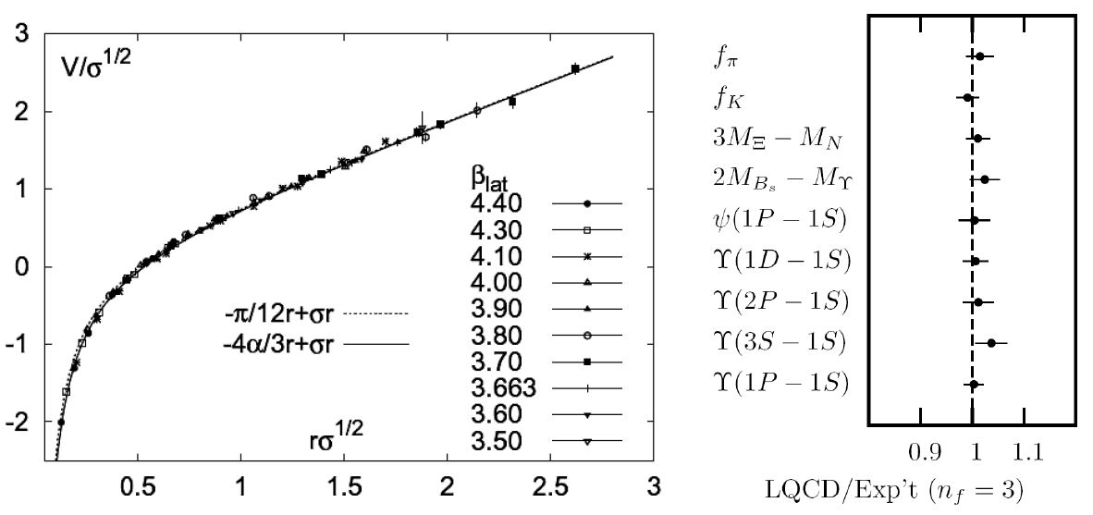
Methods of QCD Calculation I: Lattice
Long Range Plan, 2008
    All momenta
    Euclidean correlators
Kaczmarek and Zantow, PRD71 (2005)
Davies et al. (HPQCD), PRL92 (2004)

Slide 7


Methods of QCD Calculation II: pQCD
d’Enterria, 0902.2011
Jäger et al., PRD67 (2003)
    Any quantity
    Small coupling (large momenta only)

Slide 8




Methods of QCD Calculation III: AdS(?)
Maldacena conjecture: SYM in d ⬄ IIB in d+1
Gubser, QM09
    All quantities
    N_{c} → ∞
    SYM, not QCD: β = 0
      Probably not good approx. for p+p; maybe A+A?
Notes:
Next up, experiments!

Slide 9

Why High-p_{T} Jets?
Tomography in medicine
One can learn a lot from a single probe…
and even more with multiple probes
SPECT-CT Scan uses internal γ photons and external X-rays
PET Scan
http://www.fas.org/irp/imint/docs/rst/Intro/Part2_26d.html

Slide 10

Tomography in QGP
Requires well-controlled theory of:
  production of rare, high-p_{T} probes
    g, u, d, s, c, b
  in-medium E-loss
  hadronization
Requires precision measurements of decay fragments
p_{T}
, γ, e⁻
φ
Invert attenuation pattern => measure medium properties

Slide 11


QGP Energy Loss
Learn about E-loss mechanism
  Most direct probe of DOF
pQCD Picture
AdS/CFT Picture

Slide 12
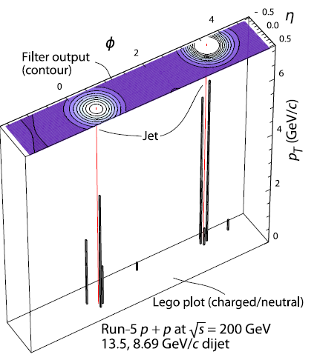
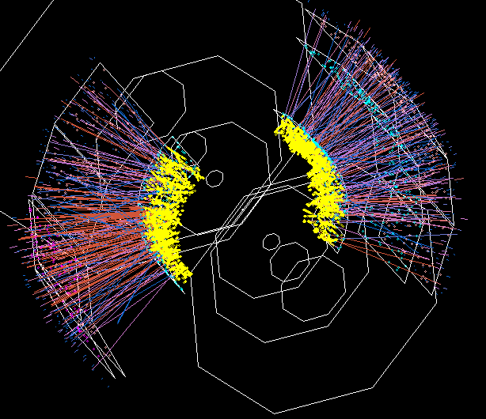

Jets in Heavy Ion Collisions
p+p
Au+Au
Y-S Lai, RHIC & AGS Users’ Meeting, 2009
PHENIX

Slide 13

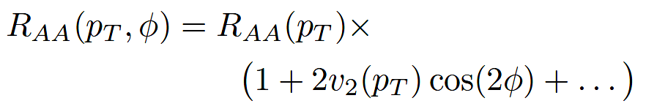
High-p_{T} Observables
    Naively: if medium has no effect, then R_{AA} = 1
    Common variables used are transverse momentum, p_{T}, and angle with respect to the reaction plane, φ
p_{T}
, γ, e⁻
    Fourier expand R_{AA}:
φ

Slide 14
pQCD Rad Picture
Bremsstrahlung Radiation
  Weakly-coupled plasma
    Medium organizes into Debye-screened centers
  T ~ 250 MeV, g ~ 2
    μ ~ gT ~ 0.5 GeV
    λ_{mfp} ~ 1/g²T ~ 1 fm
    R_{Au} ~ 6 fm
  1/μ << λ_{mfp} << L
    mult. coh. em.
  LPM
    dp_{T}/dt ~ -LT³ log(p_{T}/M_{q})
  Bethe-Heitler
    dp_{T}/dt ~ -(T³/M_{q}²) p_{T}

Slide 15

pQCD Success at RHIC:
(circa 2005)
Y. Akiba for the PHENIX collaboration, hep-ex/0510008
  Consistency: R_{AA}(η)~R_{AA}(π)
  Null Control: R_{AA}(γ)~1
  GLV Prediction: Theory~Data for reasonable fixed L~5 fm and dN_{g}/dy~dN_{π}/dy

Slide 16

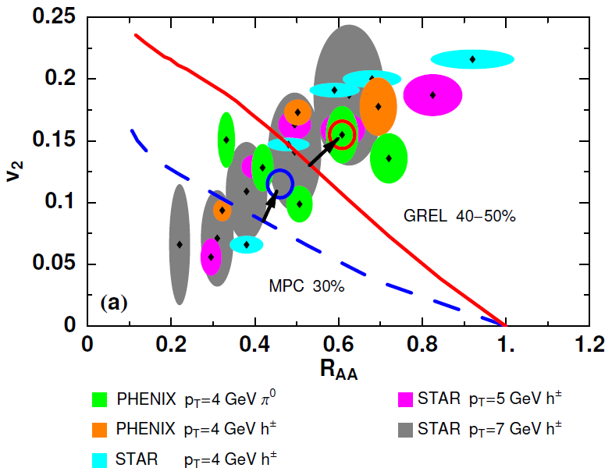
Trouble for Rad E-Loss Picture
v₂
e⁻
e⁻
WAH, Acta Phys.Hung.A27 (2006)
Djordjevic, Gyulassy, Vogt, and Wicks, PLB632 (2006)
Notes:
Anticorrelated; have e- come in later

Slide 17


What About Elastic Loss?
Appreciable!
Finite time effects small
Mustafa, PRC72 (2005)
Adil, Gyulassy, WAH, Wicks, PRC75 (2007)

Slide 18

Quantitative Disagreement Remains
  v₂ too small
  NPE supp. too large
π⁰ v₂
WHDG
NPE v₂
C. Vale, QM09 Plenary (analysis by R. Wei)
Wicks, WAH, Gyulassy, Djordjevic, NPA784 (2007)
Pert. at LHC energies?
PHENIX, Phys. Rev. Lett. 98, 172301 (2007)

Slide 19
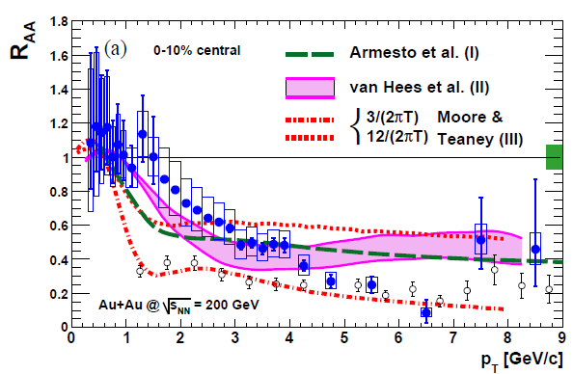
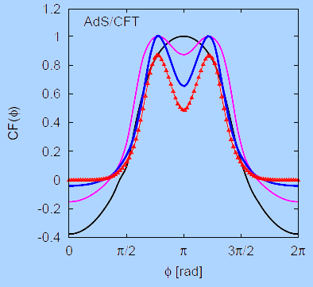
Strongly Coupled Qualitative Successes
AdS/CFT
Blaizot et al., JHEP0706
T. Hirano and M. Gyulassy, Nucl. Phys. A69:71-94 (2006)
PHENIX, PRL98, 172301 (2007)
Betz, Gyulassy, Noronha, Torrieri, PLB675 (2009)

Slide 20
Jets in AdS/CFT
Model heavy quark jet energy loss by embedding string in AdS space
  dp_{T}/dt = - μ p_{T}
  μ = πλ^{1/2} T²/2M_{q}
  Similar to Bethe-Heitler
    dp_{T}/dt ~ -(T³/M_{q}²) p_{T}
  Very different from LPM
    dp_{T}/dt ~ -LT³ log(p_{T}/M_{q})
J Friess, S Gubser, G Michalogiorgakis, S Pufu, Phys Rev D75 (2007)

Slide 21
Compared to Data
String drag: qualitative agreement
WAH, PhD Thesis

Slide 22


pQCD vs. AdS/CFT at LHC
Plethora of Predictions:
WAH, M. Gyulassy, PLB666 (2008)
      Taking the ratio cancels most normalization differences
      pQCD ratio asymptotically approaches 1, and more slowly so for increased quenching (until quenching saturates)
      AdS/CFT ratio is flat and many times smaller than pQCD at only moderate p_{T}
WAH, M. Gyulassy, PLB666 (2008)

Slide 23

Not So Fast!
  Speed limit estimate for applicability of AdS drag
    γ < γ_{crit} = (1 + 2M_{q}/λ^{1/2} T)²
    ~ 4M_{q}²/(λ T²)
      Limited by M_{charm} ~ 1.2 GeV
    Similar to BH LPM
      γ_{crit} ~ M_{q}/(λT)
  No Single T for QGP
    smallest γ_{crit} for largest T
    T = T(τ₀, x=y=0): “(”
    largest γ_{crit} for smallest T
    T = T_{c}: “]”
D7 Probe Brane
Q
Worldsheet boundary Spacelike if γ > γ_{crit}
x₅
Trailing
String
“Brachistochrone”
“z”
D3 Black Brane

Slide 24

LHC R^{c}_{AA}(p_{T})/R^{b}_{AA}(p_{T}) Prediction
(with speed limits)
WAH, M. Gyulassy, PLB666 (2008)
      T(τ₀): “(”, corrections likely small for smaller momenta
      T_{c}: “]”, corrections likely large for higher momenta

Slide 25

RHIC R^{cb} Ratio
pQCD
pQCD
AdS/CFT
AdS/CFT
WAH, M. Gyulassy, JPhysG35 (2008)
    Wider distribution of AdS/CFT curves due to large n: increased sensitivity to input parameters
    Advantage of RHIC: lower T => higher AdS speed limits

Slide 26
Universality and Applicability
How universal are th. HQ drag results?
  Examine different theories
  Investigate alternate geometries
Other AdS geometries
  Bjorken expanding hydro
  Shock metric
    Warm-up to Bj. hydro
    Can represent both hot and cold nuclear matter

Slide 27
New Geometries
Constant T Thermal Black Brane
Shock Geometries
P Chesler,
Quark Matter 2009
Nucleus as Shock
DIS
Embedded String in Shock
Albacete, Kovchegov, Taliotis,
JHEP 0807, 074 (2008)
Before
After
v_{shock}
z
Q
v_{shock}
z
Q
x
x
WAH and Kovchegov, PLB680 (2009)

Slide 28
Asymptotic Shock Results
Three t-ind. solutions (static gauge):
  X^{μ} = (t, x(z), 0,0, z)
  x(z) = x₀, x₀ ± μ ^{½} z³/3
    Constant solution unstable
    Time-reversed negative x solution unphysical
    Sim. to x ~ z³/3, z << 1, for const. T BH geom.
Q
z = 0
v_{shock}
x₀ − μ ^{½} z³/3
x₀ + μ ^{½} z³/3
x₀
x
z = ∞

Slide 29
Putting It All Together
For Λ typical momentum scale of the medium
We’ve generalized the BH solution to both cold and hot nuclear matter E-loss
  Recall for BH:
  Shock gives exactly the same drag as BH for Λ = π T

Slide 30
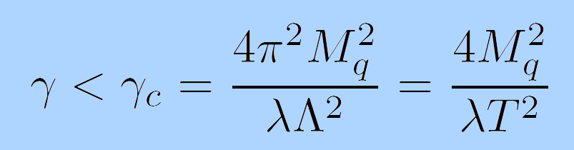
Shock Metric Speed Limit
Local speed of light (in HQ rest frame)
  Demand reality of point-particle action
Solve for v = 0 for finite mass HQ
  z = z_{M} = λ^{½}/2πM_{q}
  Same speed limit as for BH metric when Λ = πT

Slide 31

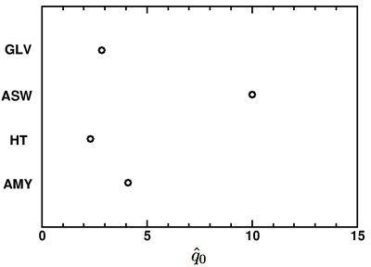
Back to pQCD: Quant. and Falsifiable
  Requires rigorous pQCD estimates, limits:
  Different pQCD formalisms, different results
Bass et al., Phys.Rev.C79:
024901,2009

Slide 32
Need for Theoretical Uncertainty
Want to rigorously:
  falsify theories
  quantify medium
Therefore need:
  Precise observables
  Precise theory
Distinguish between systematic uncertainties:
  between formalisms
    Due to diff. physics assumptions
  within formalisms
    Due to simplifying approximations
Focus specifically on opacity expansion
  GLV; ASW-SH

Slide 33
Mechanics of Energy Loss
  R_{AA} ~ ∫(1-ϵ)^{n} P(ϵ) dϵ
    E_{f} = (1-ϵ)E_{i}
  Opacity expansions finds single inclusive gluon emission spectrum
    dN_{g}/dxdk_{T}dq_{T}

Slide 34
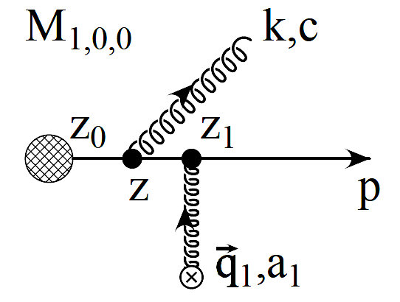
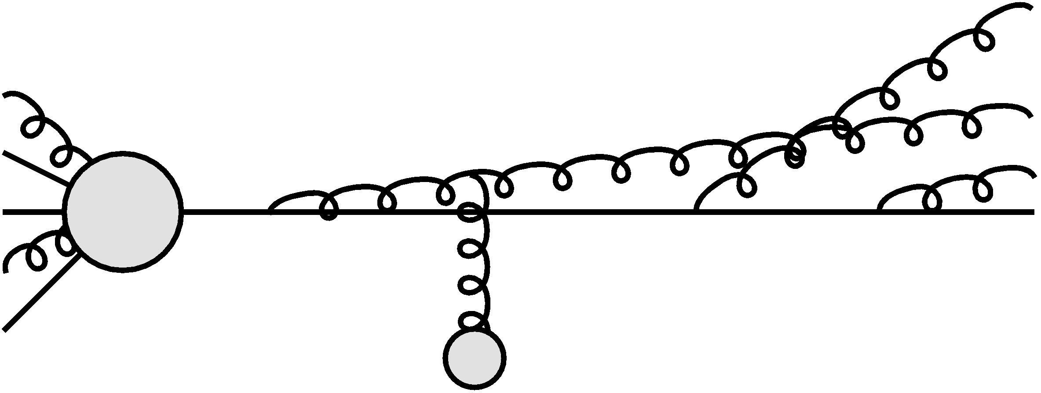
Poisson Convolution
Find P(ϵ) by convolving dN_{g}/dx
  Approximates probabilistic multiple gluon emission, Sudakov
    assume independent emissions
  NB: ϵ is a momentum fraction
Gyulassy, Levai, and Vitev NPB594 (2001)

Slide 35
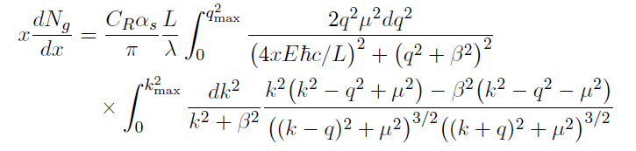

Opacity Expansion Calculation
Want to find dN_{g}/dx
  Make approximations to simplify derivation
    Small angle emission: k_{T} << xE
      Note: ALL current formalisms use collinear approximation
  Derived dN_{g}/dxdk_{T} violates collinear approx
    Both IR and UV safe
    Enforce small angle emission through UV cutoff in k_{T}

Slide 36
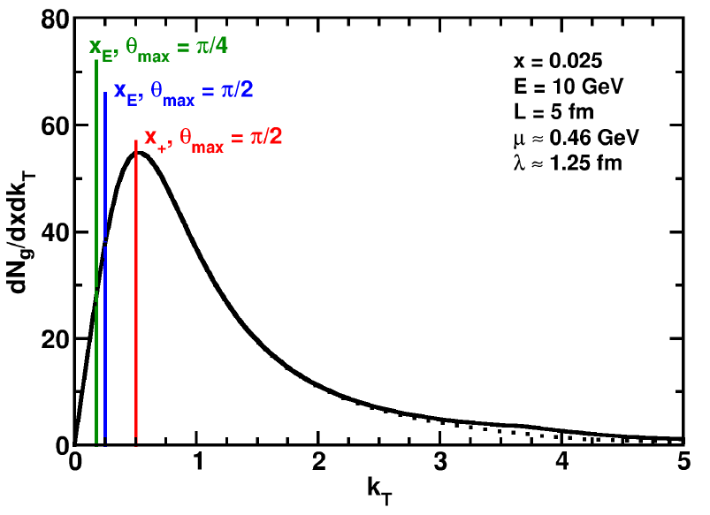
Uncertainty from Collinear Approx
Derived dN_{g}/dxdk_{T} maximally violates collinear approximation
  dN_{g}/dx depends sensitively on k_{T} cutoff
    Despite UV safety
  For effect on extracted prop., must understand x
    Discovered through TECHQM Brick Problem
WAH and B Cole, arXiv:0910.1823

Slide 37
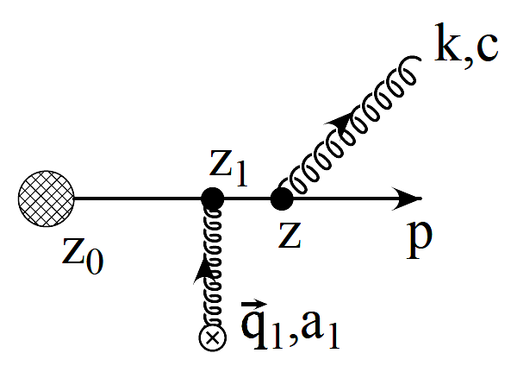



Two Standard x Definitions
ASW-SH: x_{E}
  Energy fraction
GLV: x₊
  Plus momentum fraction
P
  NB: gluon always on-shell

Slide 38
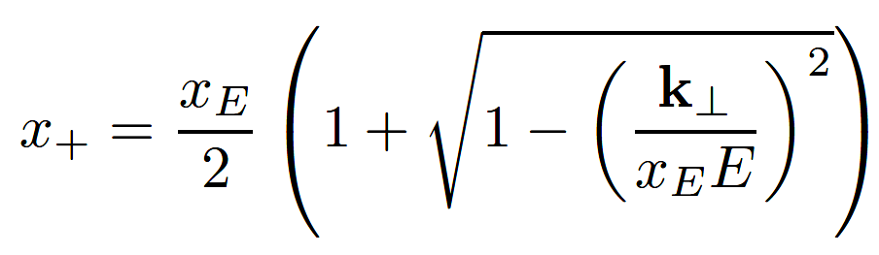
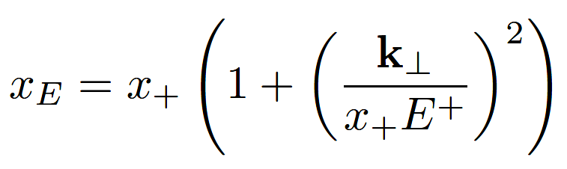
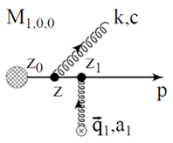

Coordinate Transformations
  Same in the limit k_{T}/xE → 0!
UV cutoff given by restricting maximum angle of emission
  Previous comparisons with data took θ_{max}=π/2
  Vary θ_{max} to estimate systematic theoretical uncertainty
θ
P

Slide 39
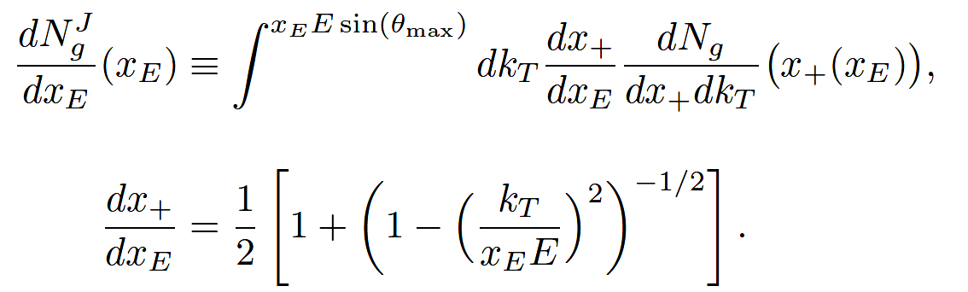
Jacobians
ϵ is fraction of longitudinal momentum
  Need dN_{g}/dx_{E} to find P(ϵ)
  A Jacobian is required for x = x₊ interpretation

Slide 40
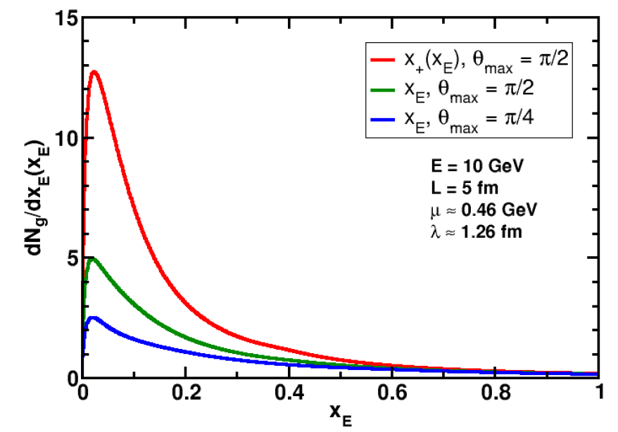
Rad. Gluon Kin. Sensitivities
UV
What about IR?
WAH and B Cole, arXiv:0910.1823

Slide 41
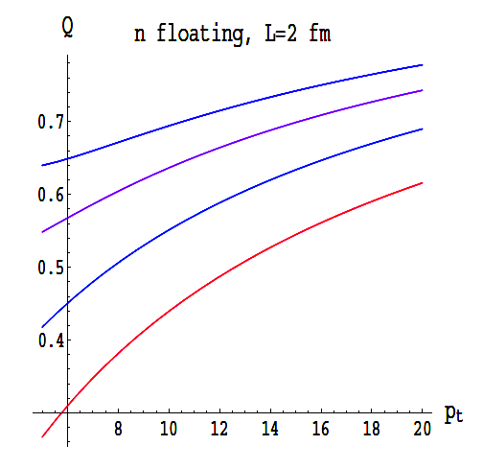
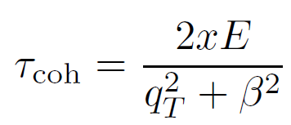
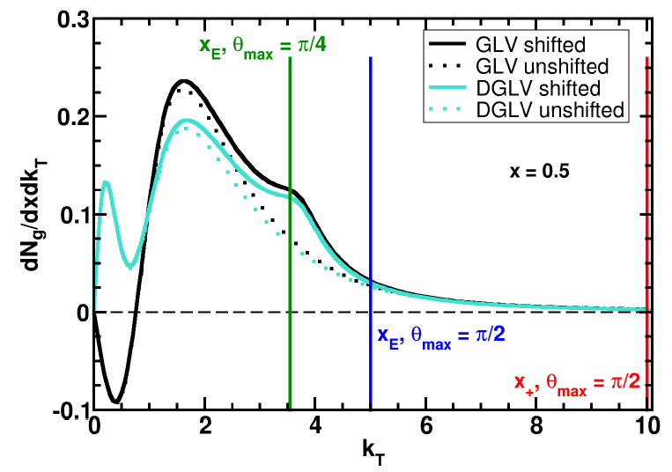
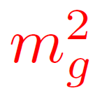
Collinearity and Gluon Mass
Massless gluons:
  Large IR cutoff sensitivity
Gluons with thermal mass
BDMS, JHEP 0109 (2001)
~
Larger x better respects k_{T} << xE
WAH and B Cole, arXiv:0910.1823

Slide 42
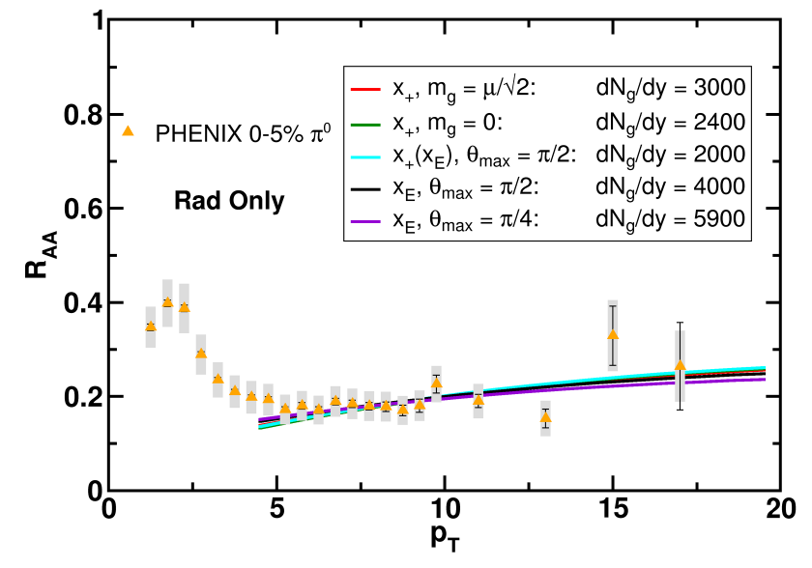
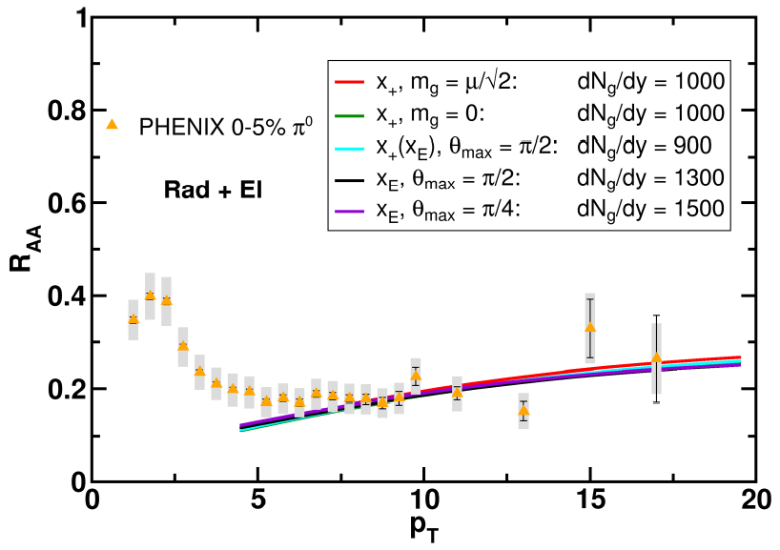
Results
Quantitatively compare to PHENIX data
  Assumed infinite Elastic precision
WAH and B Cole, arXiv:0910.1823

Slide 43
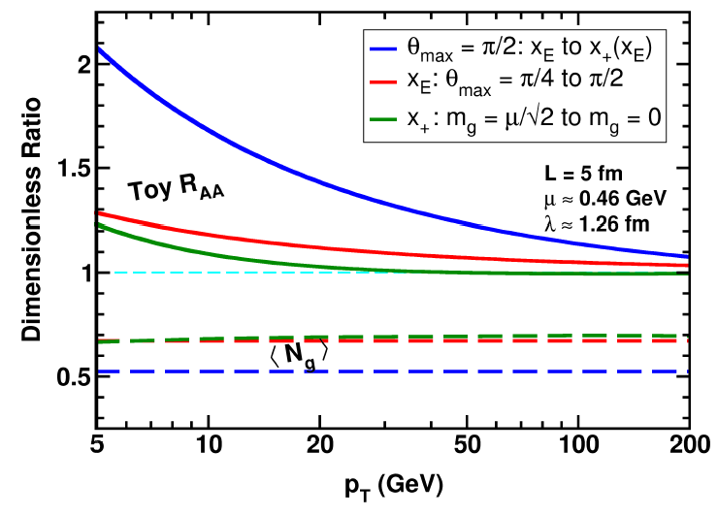
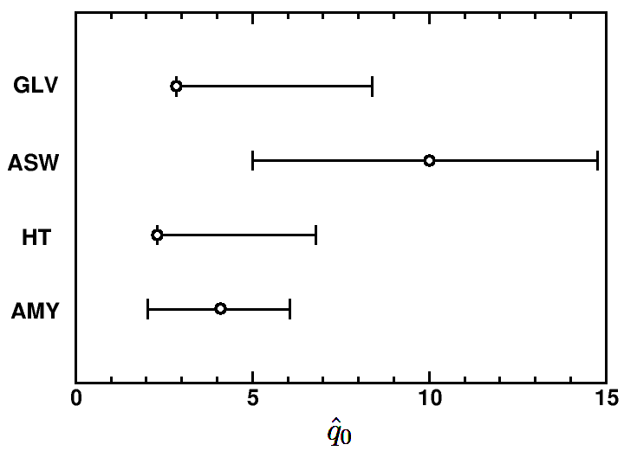
Parton Energy Dependence
Dependence on parton energy
Uncertainty on qhat
  Assume all formalisms equally affected
WAH and B Cole, arXiv:0910.1823

Slide 44
Conclusions
  pQCD and AdS/CFT enjoy qualitative successes, concerns in high-p_{T} HIC
    RHIC suppression of lights and heavies
    Future LHC measurements
  Quantitative comparisons with rigorous theoretical uncertainty estimates needed for falsification/verification
    Theoretical work needed in both in pQCD and AdS
      In AdS, control of jet IC, large p_{T} required
      In pQCD, wide angle radiation very important, not under theoretical control

Slide 45
Additional Treats

Slide 46
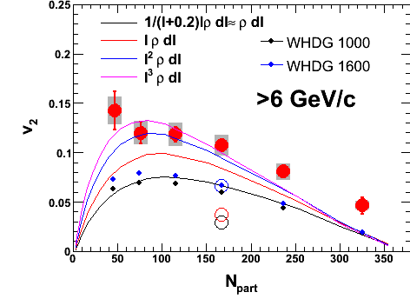
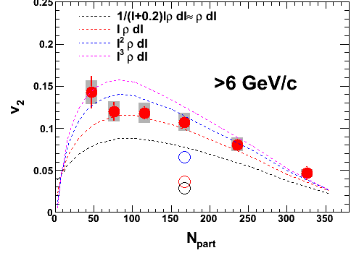
Jia, WWND 2010
Private comm. with W. Horowitz
Also 0910.1823
Increase jet quenching v2 by
  Using higher orders of L dependence.
  Take into account fluctuation in RP angle.
Fluctuation + L³ (ADS/CFT like) dependence seems able to match data
Imply coupling for intermediate pT jet is too strong for perturbative applicable?

Slide 47
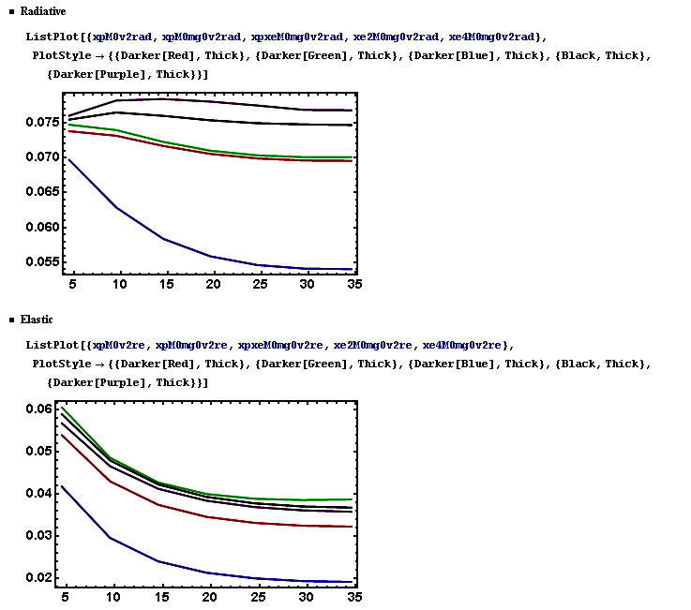

Slide 48

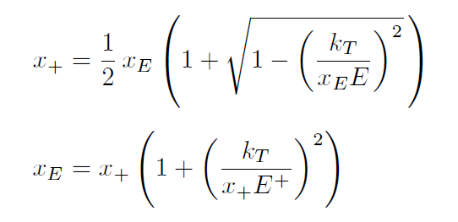
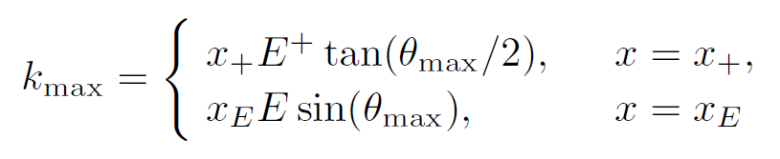
x₊ vs. x_{E}

Slide 49
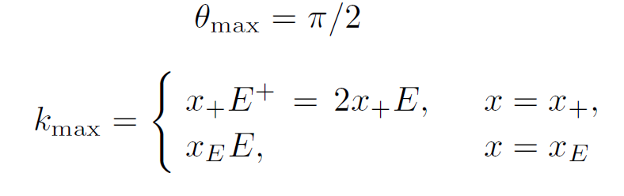
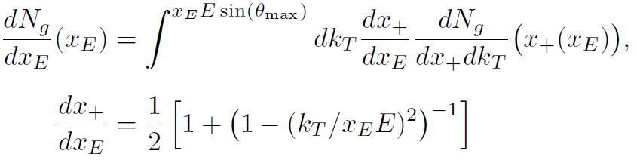
x₊ vs. x_{E}: k_{max}, Jacobian

