Slide 1
Successes, Failures, and Uncertainties in the Jet Physics of Heavy Ion Collisions
W. A. Horowitz
The Ohio State University
February 23, 2010
With many thanks to Brian Cole, Miklos Gyulassy, Ulrich Heinz, and Yuri Kovchegov

Slide 2
Introduction
What is a heavy ion collision?
Why do people care?
  Phase diagram of QCD
  Big Bang
  Strongly coupled systems
    AdS/CFT
What is jet physics and what can we learn from it?

Slide 3
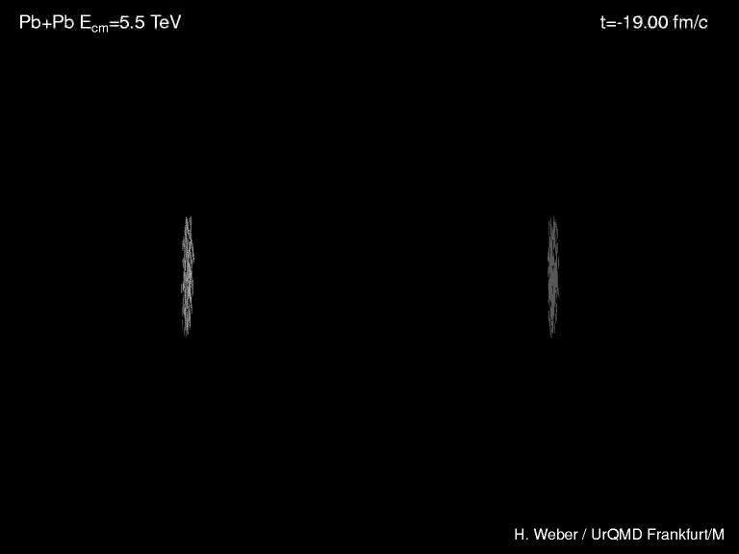
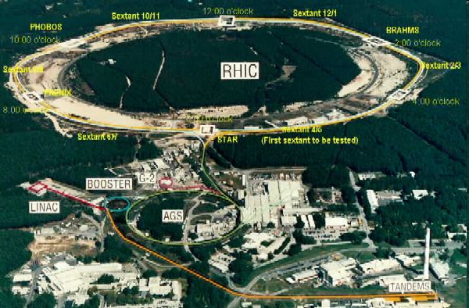
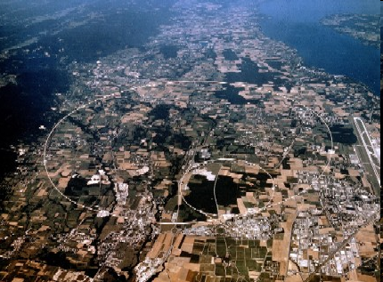
Heavy Ion Collisions
Collider machines: RHIC, LHC
Cartoon of a collision
Relativistic Heavy Ion Collider
Large Hadron Collider

Slide 4




Four Fundamental Forces
Gravity
Electromagnetism
starchild.gsfc.nasa.gov
John Maarschalk, travelblog.portfoliocollection.com
Weak
Strong
lhs.lps.org/staff/sputnam/chem_notes/tritium_decay.gif

Slide 5

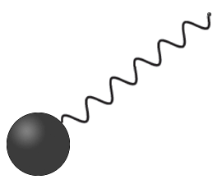
Strong compared to E&M
Electromagnetism
  Electric charge (+)
    electrons
  Carriers: photons
  Field theory:
    Quantum electro-dynamics (QED)
Strong
  Color charge (r, g, b)
    quarks
  Carriers: gluons
  Field theory:
    Quantum chromo-dynamics (QCD)
-
Hydrogen
Look Inside
+
Proton
nobelprize.org

Slide 6
Crucial QCD Facts
Yang-Mills Theory: non-Abelian
  Gluons carry color charge
  “Strong” over long distances, “weak” over short distances
    Rigorous analytic calculations only for large momentum processes
      Large compared to Λ_{QCD} ~ 200 MeV
Quarks and gluons are confined
    no bare quark or gluon has ever been detected
      1,000,000 USD Clay Millenium prize for proof of confinement in Yang-Mills theories

Slide 7
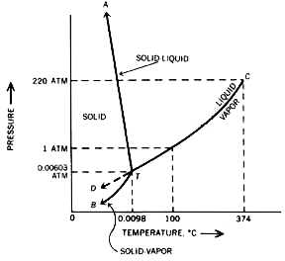

Standard Model and Phase Diagrams
E&M, Strong, and Weak particle physics well understood (few particles)
Many body physics less well understood
Water
Hydrogen
www.sv.vt.edu/classes/MSE2094_NoteBook/96ClassProj/examples/triplpt.html
Calculated, Burkhard Militzer,
Diploma Thesis, Berlin, 2000

Slide 8

Phase Diagram in QCD
Long Range Plan, 2008

Slide 9


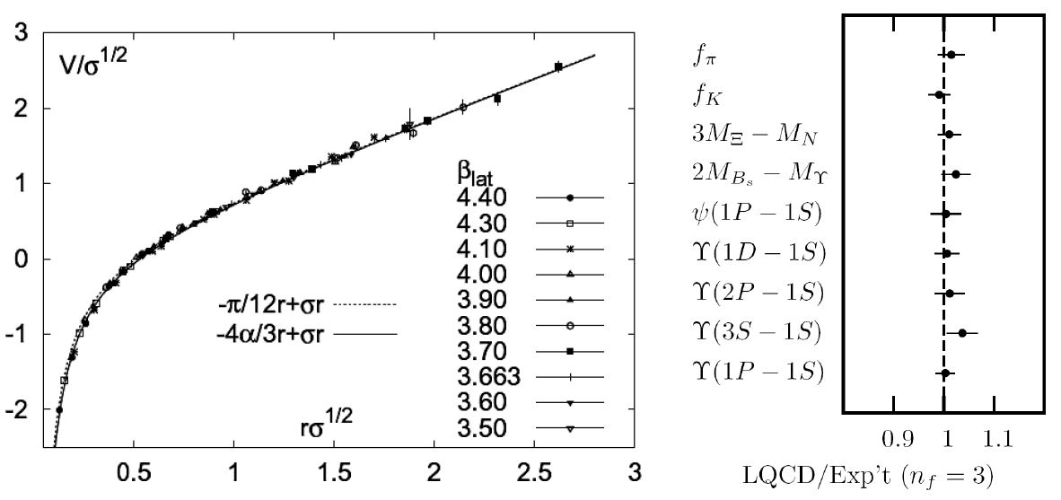
Methods of QCD Calculation I: Lattice
Long Range Plan, 2008
    All momenta
    Euclidean correlators
Kaczmarek and Zantow, PRD71 (2005)
Davies et al. (HPQCD), PRL92 (2004)

Slide 10


Methods of QCD Calculation II: pQCD
(perturbative QCD)
d’Enterria, 0902.2011
Jäger et al., PRD67 (2003)
    Any quantity
    Small coupling (large momenta only)

Slide 11




Methods III: AdS/CFT
Maldacena conjecture: SYM in d ⬄ IIB in d+1
Gubser, QM09
    All quantities
    N_{c} → ∞ SYM, not QCD
      Probably not good approx. for p+p; maybe A+A?
    Applicable to condensed matter systems?
Notes:
Next up, experiments!

Slide 12

Why High-p_{T} Jets?
Tomography in medicine
One can learn a lot from a single probe…
and even more with multiple probes
SPECT-CT Scan uses internal γ photons and external X-rays
PET Scan
http://www.fas.org/irp/imint/docs/rst/Intro/Part2_26d.html

Slide 13

Tomography in QGP
Requires well-controlled theory of:
  production of rare, high-p_{T} probes
    g, u, d, s, c, b
  in-medium E-loss
  hadronization
Requires precision measurements of decay fragments
p_{T}
, γ, e⁻
φ
Invert attenuation pattern => measure medium properties

Slide 14


QGP Energy Loss
Learn about E-loss mechanism
  Most direct probe of DOF
pQCD Picture
AdS/CFT Picture

Slide 15

pQCD Rad Picture
Bremsstrahlung Radiation
  Weakly-coupled plasma
    Medium organizes into Debye-screened centers
  T ~ 250 MeV, g ~ 2
    μ ~ gT ~ 0.5 GeV
    λ_{mfp} ~ 1/g²T ~ 1 fm
    R_{Au} ~ 6 fm
  1/μ << λ_{mfp} << L
    mult. coh. em.
Gyulassy, Levai, and Vitev, NPB571 (200)
  LPM
    dp_{T}/dt ~ -LT³ log(p_{T}/M_{q})
  Bethe-Heitler
    dp_{T}/dt ~ -(T³/M_{q}²) p_{T}

Slide 16
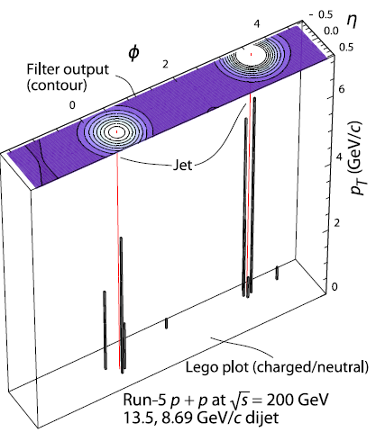
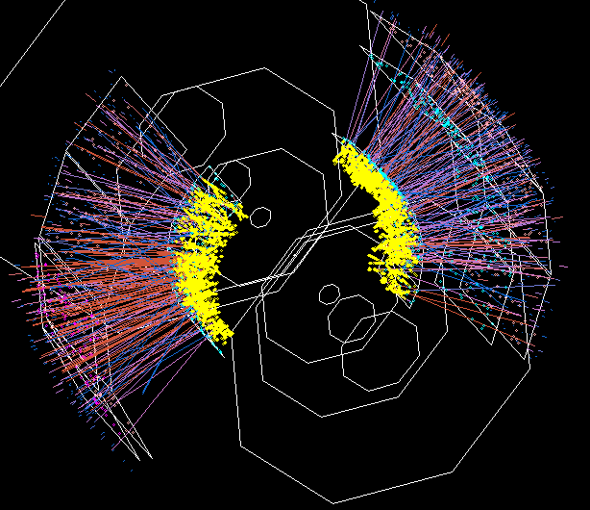

Jets in Heavy Ion Collisions
p+p
Au+Au
Y-S Lai, RHIC & AGS Users’ Meeting, 2009
PHENIX

Slide 17
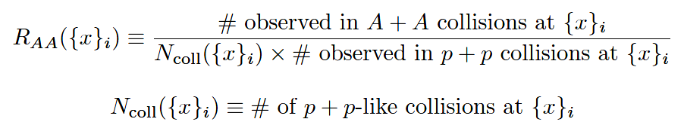
High-p_{T} Observable
    Naively: if medium has no effect, then R_{AA} = 1

Slide 18

pQCD Success at RHIC:
(circa 2005)
Y. Akiba for the PHENIX collaboration, hep-ex/0510008
  Consistency: R_{AA}(η)~R_{AA}(π)
  Null Control: R_{AA}(γ)~1
  GLV Prediction: Theory~Data for reasonable fixed L~5 fm and dN_{g}/dy~dN_{π}/dy

Slide 19

Qualitative Disagreement
e⁻
Djordjevic, Gyulassy, Vogt, and Wicks, PLB632 (2006)

Slide 20


What About Elastic Loss?
Appreciable!
Finite time effects small
Mustafa, PRC72 (2005)
Adil, Gyulassy, WAH, Wicks, PRC75 (2007)

Slide 21

Quantitative Disagreement Remains
Wicks, WAH, Gyulassy, Djordjevic, NPA784 (2007)
Pert. at LHC energies?

Slide 22
Jets in AdS/CFT
Model heavy quark jet energy loss by embedding string in AdS space
  dp_{T}/dt = - μ p_{T}
  μ = πλ^{1/2} T²/2M_{q}
  Similar to Bethe-Heitler
    dp_{T}/dt ~ -(T³/M_{q}²) p_{T}
  Very different from LPM
    dp_{T}/dt ~ -LT³ log(p_{T}/M_{q})
J Friess, S Gubser, G Michalogiorgakis, S Pufu, Phys Rev D75 (2007)

Slide 23
Compared to Data
String drag: qualitative agreement
WAH, PhD Thesis

Slide 24


pQCD vs. AdS/CFT at LHC
Plethora of Predictions:
WAH, M. Gyulassy, PLB666 (2008)
      Taking the ratio cancels most normalization differences
      pQCD ratio asymptotically approaches 1, and more slowly so for increased quenching (until quenching saturates)
      AdS/CFT ratio is flat and many times smaller than pQCD at only moderate p_{T}
WAH, M. Gyulassy, PLB666 (2008)

Slide 25

Not So Fast!
  Speed limit estimate for applicability of AdS drag
    γ < γ_{crit} = (1 + 2M_{q}/λ^{1/2} T)²
    ~ 4M_{q}²/(λ T²)
      Limited by M_{charm} ~ 1.2 GeV
    Similar to BH LPM
      γ_{crit} ~ M_{q}/(λT)
  No Single T for QGP
    smallest γ_{crit} for largest T
    T = T(τ₀, x=y=0): “(”
    largest γ_{crit} for smallest T
    T = T_{c}: “]”
D7 Probe Brane
Q
Worldsheet boundary Spacelike if γ > γ_{crit}
x₅
Trailing
String
“Brachistochrone”
“z”
D3 Black Brane

Slide 26

LHC R^{c}_{AA}(p_{T})/R^{b}_{AA}(p_{T}) Prediction
(with speed limits)
WAH, M. Gyulassy, PLB666 (2008)
      T(τ₀): “(”, corrections likely small for smaller momenta
      T_{c}: “]”, corrections likely large for higher momenta

Slide 27
Conclusions
Heavy Ion Physics is fascinating
  Jets provide a unique tool for study
Usual theory techniques in quantitative disagreement
  New, exciting tool with AdS/CFT, successes
Experimental signature: R^{c}_{AA}/R^{b}_{AA}
Recent and future work:
  Double ratio at RHIC
  Ultimately want to be able to rigorously falsify
    Universality of AdS result
    Uncertainties in pQCD
    Comparison to additional exp. observables
    Corrections to pQCD and AdS/CFT
WAH, J.Phys.G35:044025,2008
WAH and Y Kovchegov, PLB680:56-61,2009
WAH and B Cole, arXiv:0910.1823 [hep-ph]

