Slide 1
Qualitative Successes of AdS/CFT at RHIC
W. A. Horowitz
The Ohio State University
March 21, 2010
With many thanks to Miklos Gyulassy and Yuri Kovchegov

Slide 2
Introduction
Why do we care about HI?
Phase diagram of QCD
Big Bang
Non-Abelian many-body: perturbative vs. AdS
Qualitative Successes of AdS/CFT
Entropy density (compared to lattice)
η/s ~ 1/4π from low-p_{T} measurements
Consistent suppression of π and e⁻
Some important open problems

Slide 3
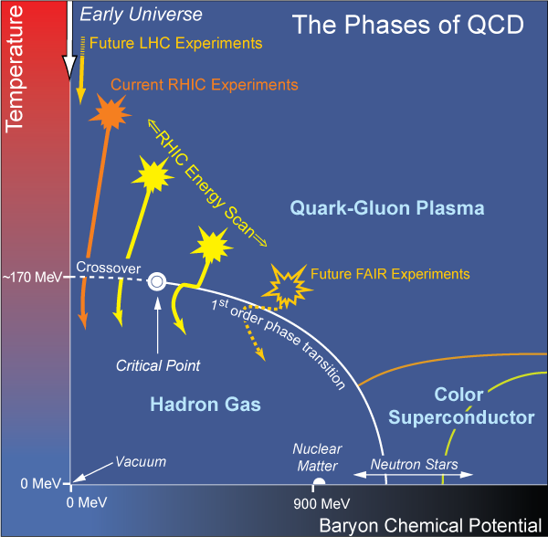
Bulk QCD and Phase Diagram
Long Range Plan, 2008

Slide 4
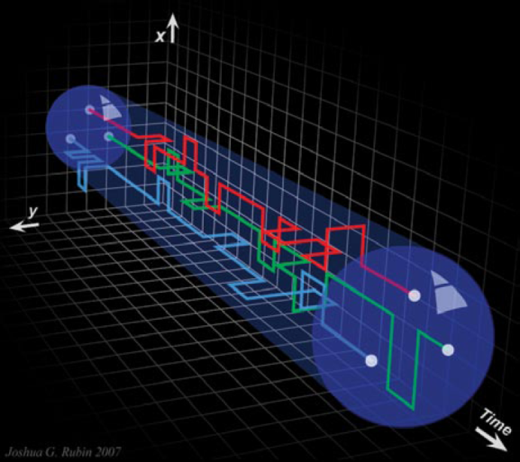
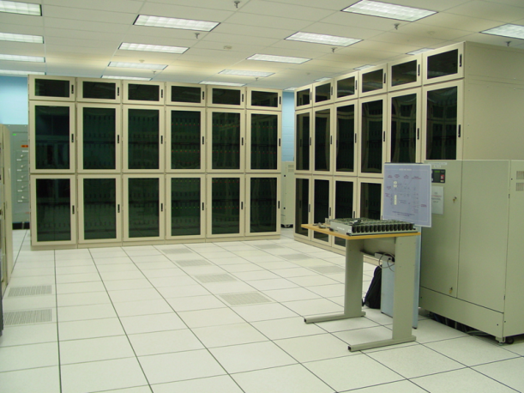
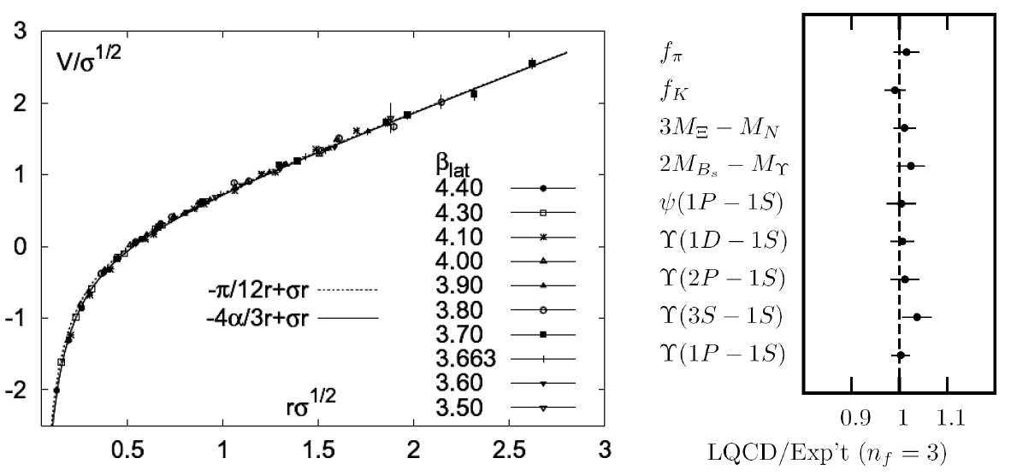
Methods of QCD Calculation I: Lattice
Long Range Plan, 2008
All momenta
Euclidean correlators
Kaczmarek and Zantow, PRD71 (2005)
Davies et al. (HPQCD), PRL92 (2004)

Slide 5
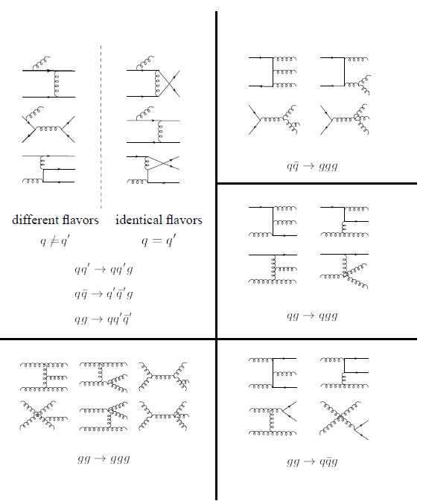
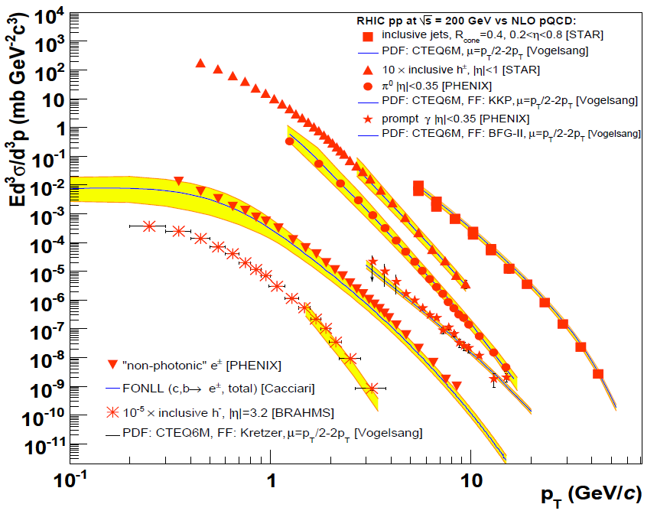
Methods of QCD Calculation II: pQCD
d’Enterria, 0902.2011
Jäger et al., PRD67 (2003)
Any quantity
Small coupling (large momenta only)

Slide 6
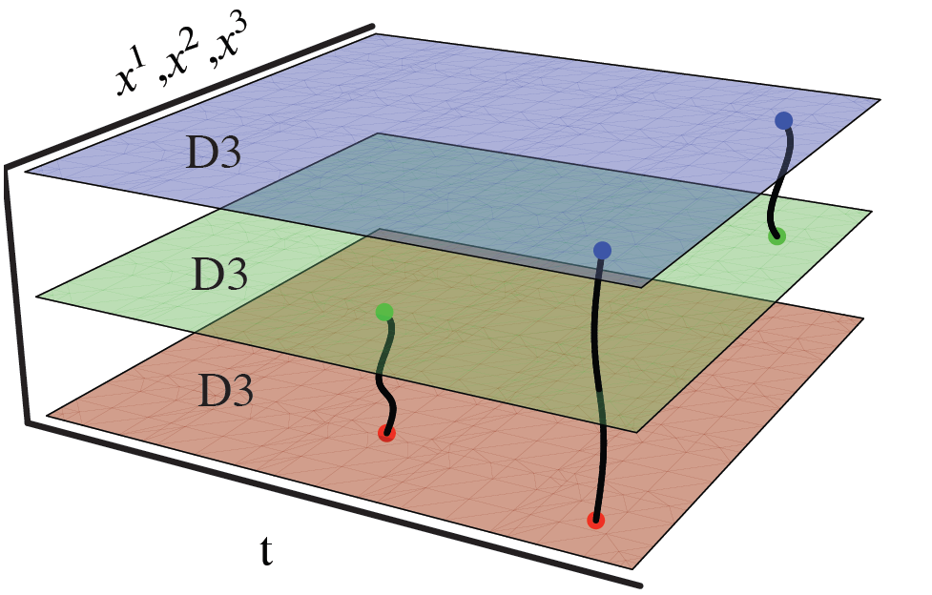
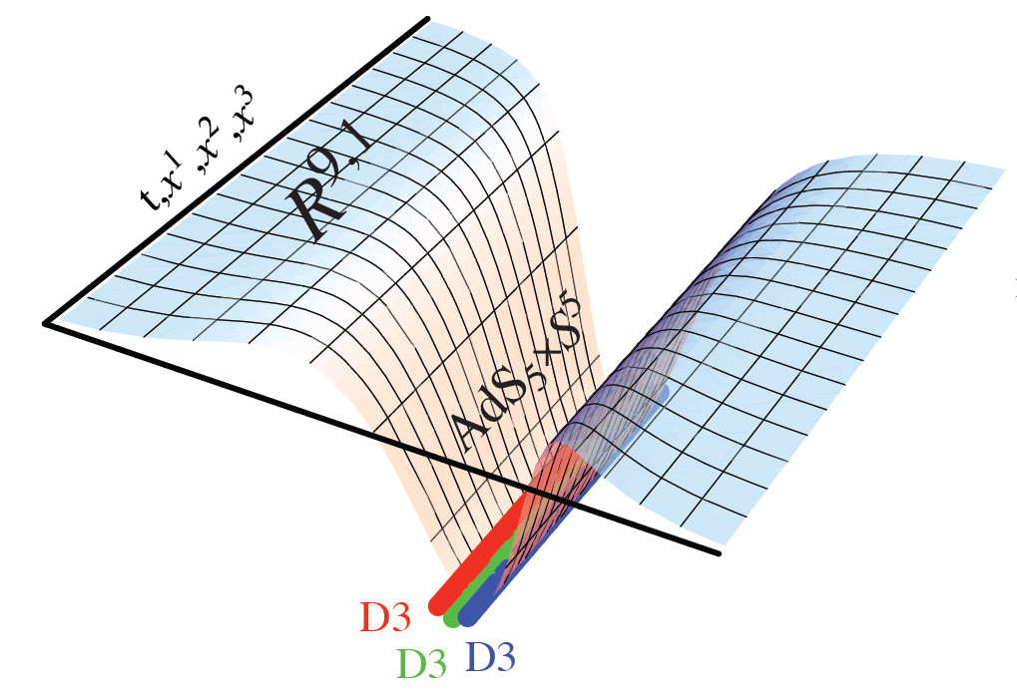
Methods of QCD Calculation III: AdS(?)
Maldacena conjecture: SYM in d ⬄ IIB in d+1
Gubser, QM09
All quantities
N_{c} → ∞
SYM, not QCD: β = 0
Probably not good approx. for p+p; maybe A+A?
Notes:
Next up, experiments!

Slide 7
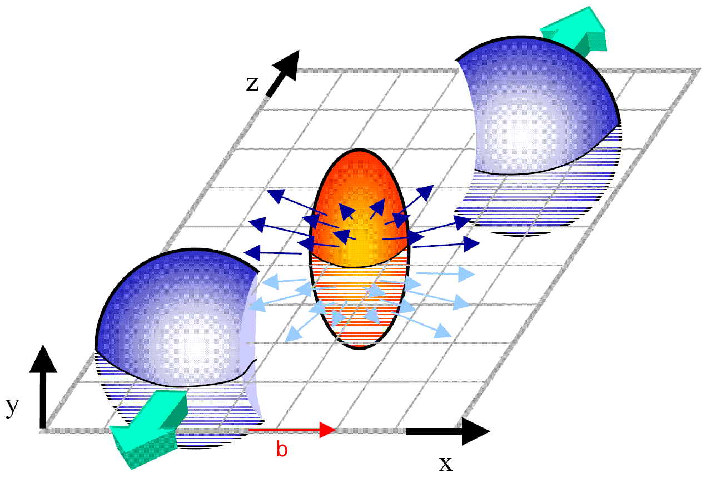
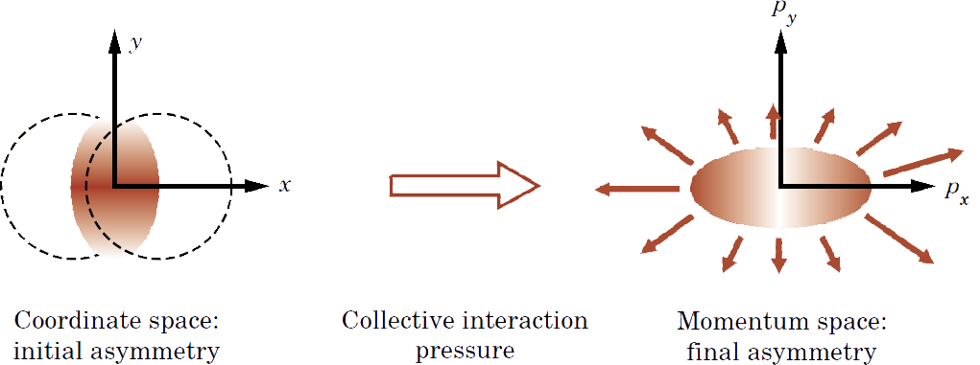
Geometry of a HI Collision
M Kaneta, Results from the
Relativistic Heavy Ion Collider (Part II)
T Ludlum and L McLerran, Phys. Today 56N10 (2003)
Hydro propagates IC
Results depend strongly on initial conditions
Viscosity reduces momentum anisotropy

Slide 8
Low-p_{T} Measurements
Viscosity: why the fuss?
Naive pQCD => η/s ~ 1
Naive AdS/CFT => η/s ~ 1/4π
Luzum and Romatschke, PRC78 (2008)
U Heinz, Quark Matter 2009

Slide 9
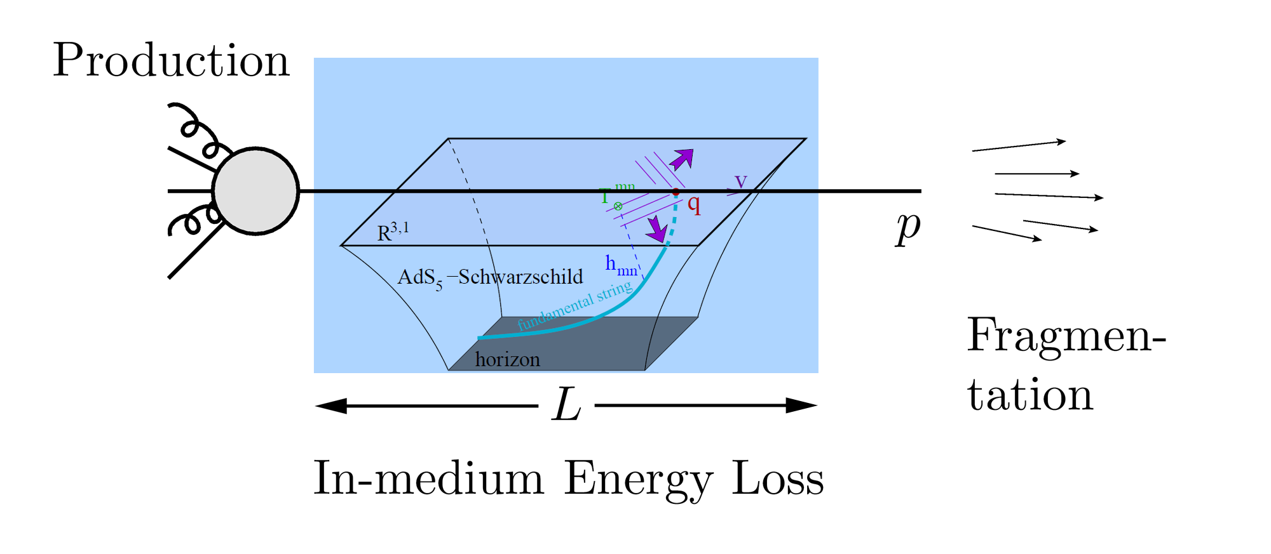
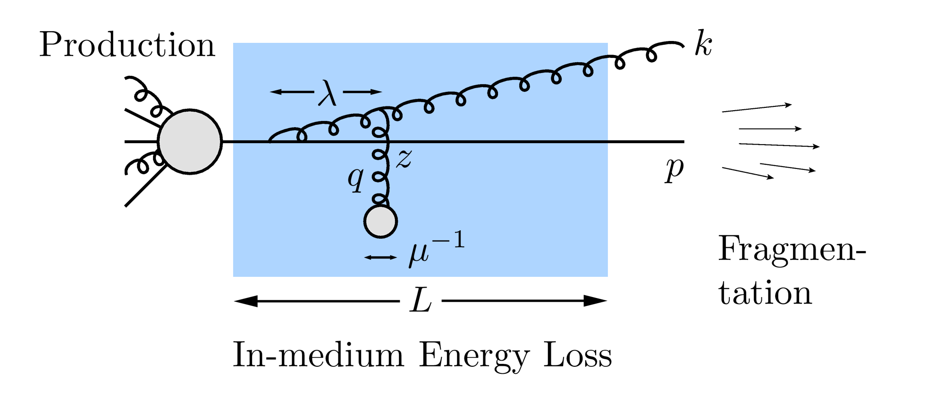
Why High-p_{T} Jets?
Learn about E-loss mechanism
Most direct probe of DOF
pQCD Picture
AdS/CFT Picture

Slide 10
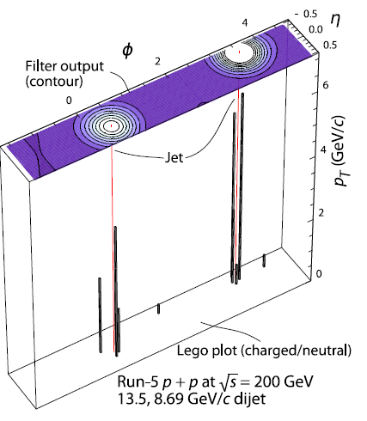
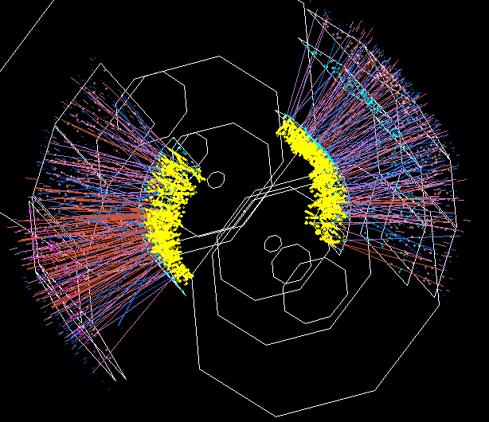
Jets in Heavy Ion Collisions
p+p
Au+Au
Y-S Lai, RHIC & AGS Users’ Meeting, 2009
PHENIX

Slide 11
High-p_{T} Observable
Naively: if medium has no effect, then R_{AA} = 1

Slide 12
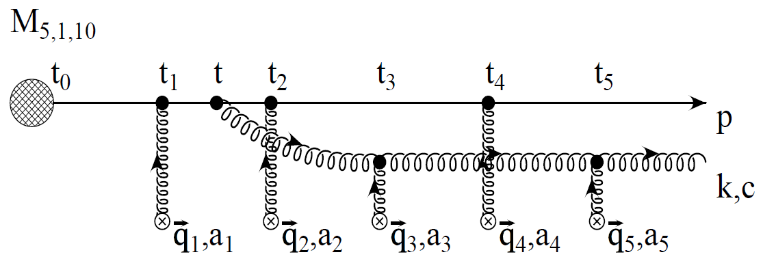
pQCD Rad Picture
Bremsstrahlung Radiation
Weakly-coupled plasma
Medium organizes into Debye-screened centers
T ~ 250 MeV, g ~ 2
μ ~ gT ~ 0.5 GeV
λ_{mfp} ~ 1/g²T ~ 1 fm
R_{Au} ~ 6 fm
1/μ << λ_{mfp} << L
mult. coh. em.
Gyulassy, Levai, and Vitev, NPB571 (200)
LPM
dp_{T}/dt ~ -LT³ log(p_{T}/M_{q})
Bethe-Heitler
dp_{T}/dt ~ -(T³/M_{q}²) p_{T}

Slide 13
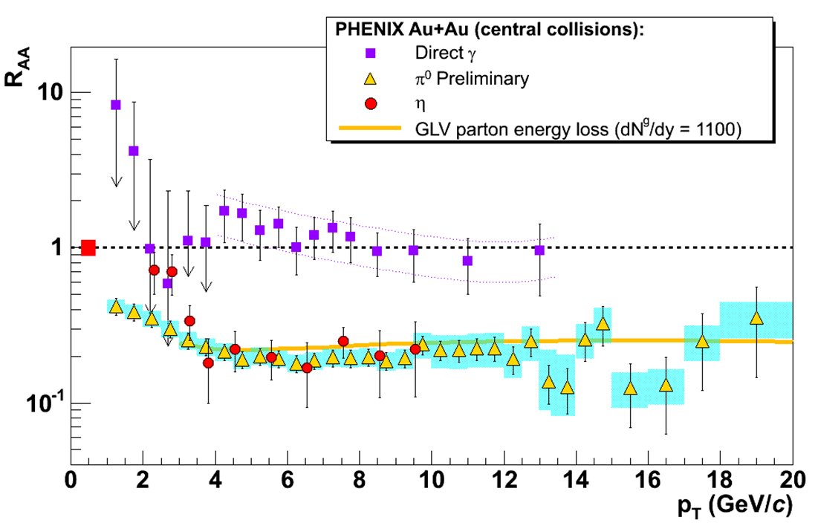
pQCD Success at RHIC:
(circa 2005)
Y. Akiba for the PHENIX collaboration, hep-ex/0510008
Consistency: R_{AA}(η)~R_{AA}(π)
Null Control: R_{AA}(γ)~1
GLV Prediction: Theory~Data for reasonable fixed L~5 fm and dN_{g}/dy~dN_{π}/dy

Slide 14
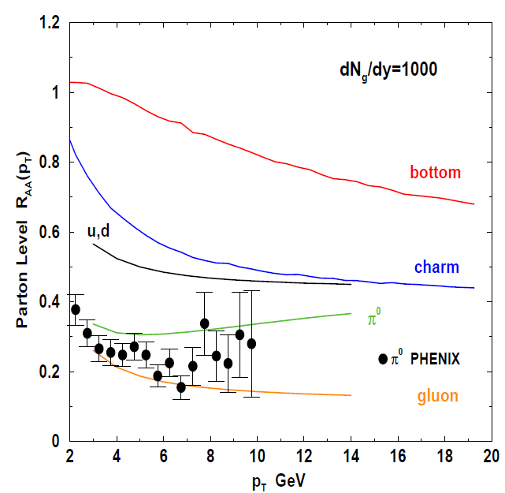
Qualitative Disagreement
pQCD Rad. E-loss does not give a consistent picture of gluon, light quark, and heavy quark suppression
e⁻
Djordjevic, Gyulassy, Vogt, and Wicks, PLB632 (2006)

Slide 15
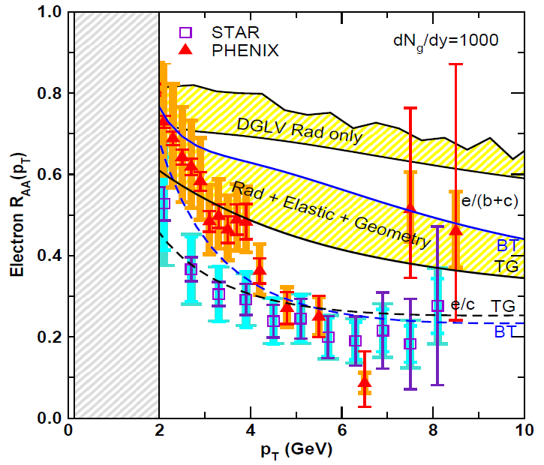
Quantitative Disagreement Remains
Include elastic energy loss, proper geometry
Wicks, WAH, Gyulassy, Djordjevic, NPA784 (2007)
Pert. at LHC energies?

Slide 16
Jets in AdS/CFT
Model heavy quark jet energy loss by embedding string in AdS space
dp_{T}/dt = - μ p_{T}
μ = πλ^{1/2} T²/2M_{q}
Similar to Bethe-Heitler
dp_{T}/dt ~ -(T³/M_{q}²) p_{T}
Very different from LPM
dp_{T}/dt ~ -LT³ log(p_{T}/M_{q})
J Friess, S Gubser, G Michalogiorgakis, S Pufu, Phys Rev D75 (2007)

Slide 17
Compared to Data
String drag: qualitative agreement
WAH, PhD Thesis

Slide 18
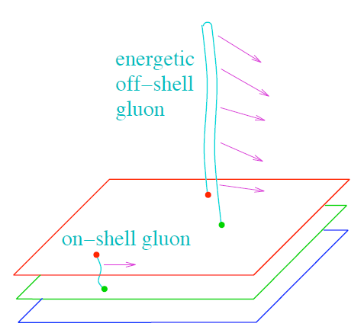
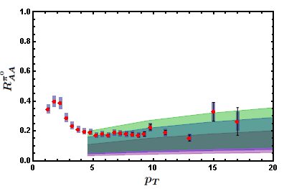
Light Quark and Gluon E-Loss
Gubser et al., JHEP 2008
Chesler et al., PRD 2009
WAH, in preparation
ΔL^{g}_{therm} ~ E^{1/3}
ΔL^{q}_{therm} ~ (2E)^{1/3}

Slide 19
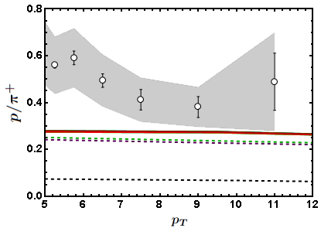
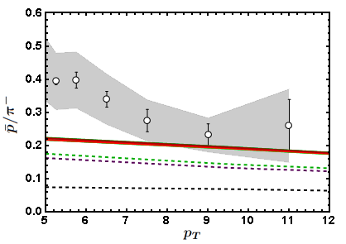
Baryon to Meson Ratios
Idea: try to measure Casimir effect from ratios of baryons to meson
STAR
STAR
AdS/CFT
AdS/CFT
pQCD
pQCD
WAH, in preparation

Slide 20
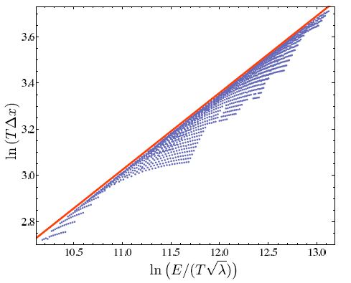
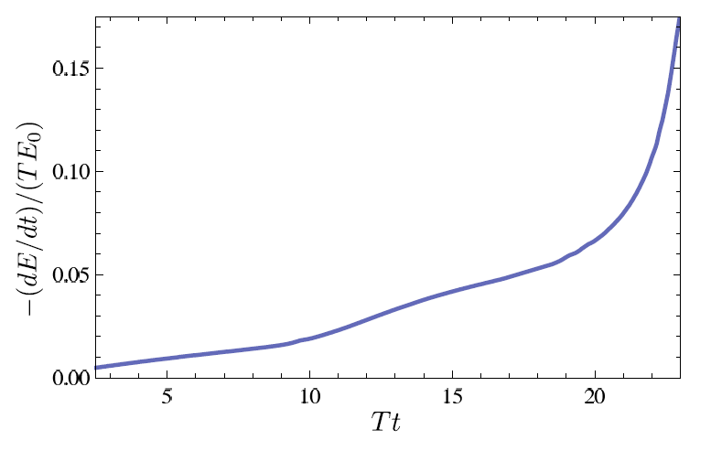
Quantitative g, q from AdS?
Sensitive to IC
Chesler et al., Phys.Rev.D79:125015,2009

Slide 21
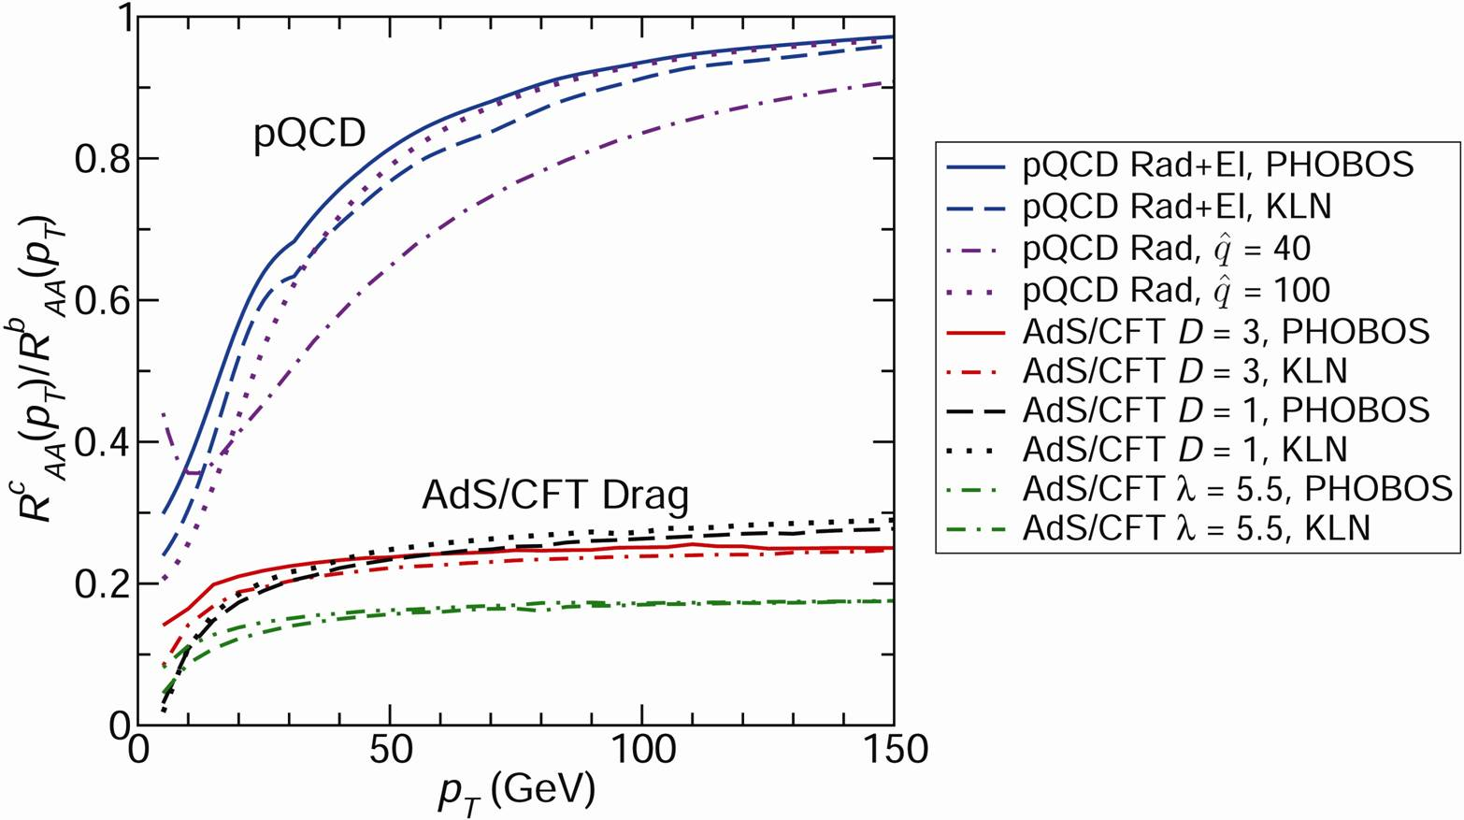
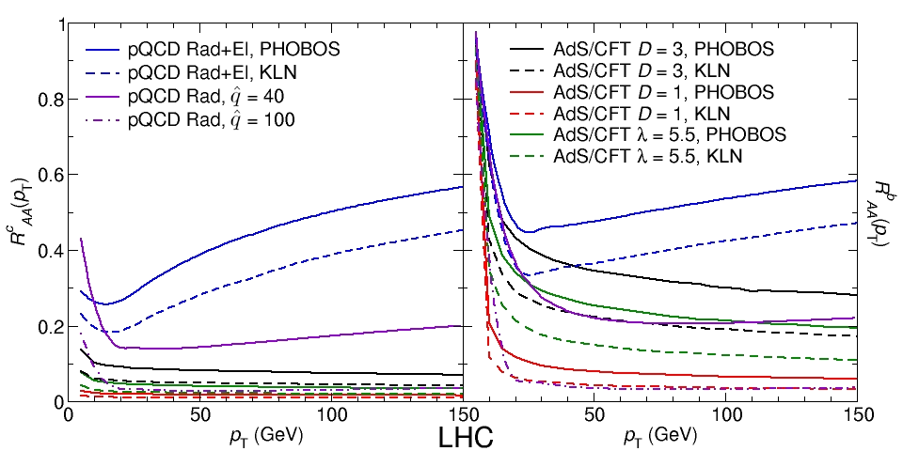
pQCD vs. AdS/CFT at LHC
Plethora of Predictions:
WAH, M. Gyulassy, PLB666 (2008)
Taking the ratio cancels most normalization differences
pQCD ratio asymptotically approaches 1, and more slowly so for increased quenching (until quenching saturates)
AdS/CFT ratio is flat and many times smaller than pQCD at only moderate p_{T}
WAH, M. Gyulassy, PLB666 (2008)

Slide 22
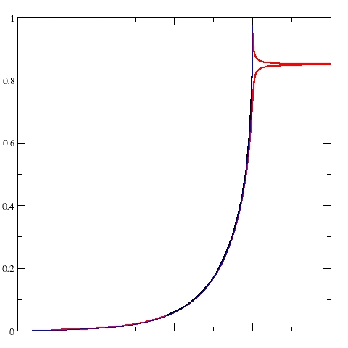
Not So Fast!
Speed limit estimate for applicability of AdS drag
γ < γ_{crit} = (1 + 2M_{q}/λ^{1/2} T)²
~ 4M_{q}²/(λ T²)
Limited by M_{charm} ~ 1.2 GeV
Similar to BH LPM
γ_{crit} ~ M_{q}/(λT)
No Single T for QGP
smallest γ_{crit} for largest T
T = T(τ₀, x=y=0): “(”
largest γ_{crit} for smallest T
T = T_{c}: “]”
D7 Probe Brane
Q
Worldsheet boundary Spacelike if γ > γ_{crit}
x₅
Trailing
String
“Brachistochrone”
“z”
D3 Black Brane

Slide 23
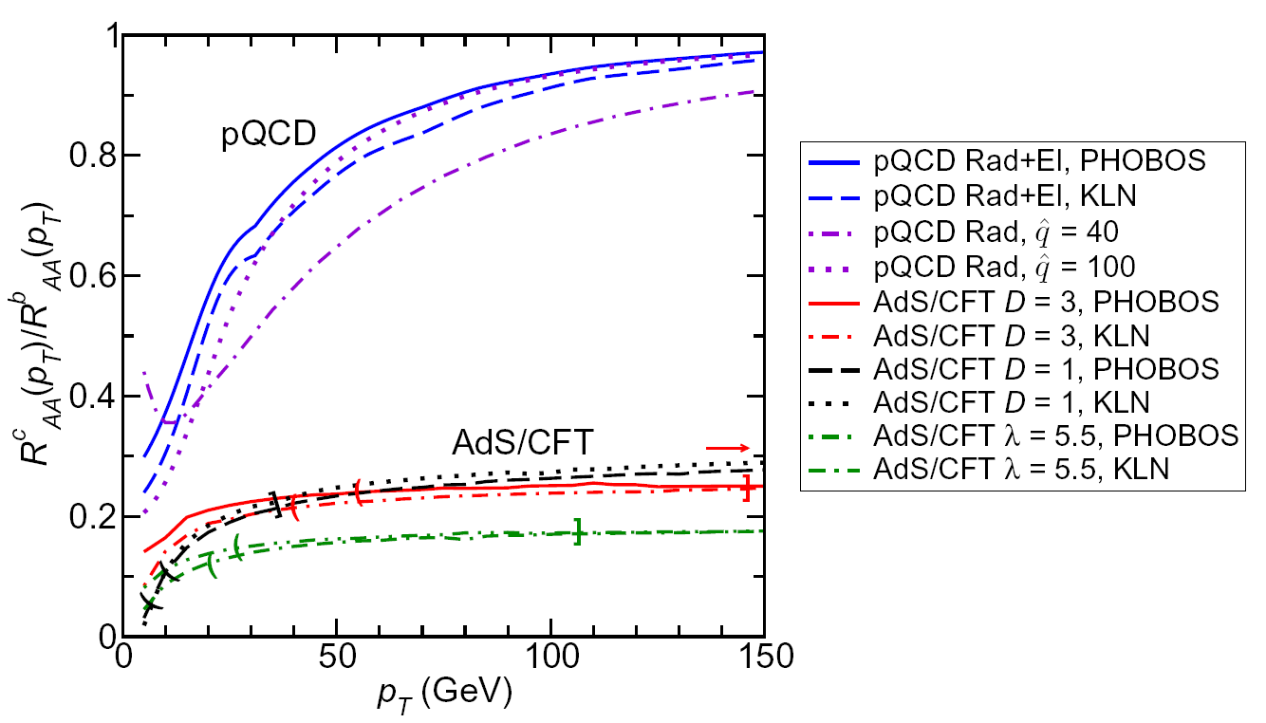
LHC R^{c}_{AA}(p_{T})/R^{b}_{AA}(p_{T}) Prediction (with speed limits)
WAH, M. Gyulassy, PLB666 (2008)
T(τ₀): “(”, corrections likely small for smaller momenta
T_{c}: “]”, corrections likely large for higher momenta

Slide 24
Conclusions
pQCD and AdS/CFT: qualitatively consistent
s, η/s, π and e⁻
For suppression, AdS—surprisingly—somewhat better
Future: Distinguish between the two qualitatively & Push from qualitative to quantitative
Double ratio (M_{q} vs. p_{T} dependence)
Regimes of applicability/Theoretical uncertainty
High-p_{T} corrections for HQ drag
Control over jet IC
Importance of QCD dual?

