Slide 1
Theory Update on Energy Loss
W. A. Horowitz
The Ohio State University
June 8, 2010
With many thanks to Brian Cole, Miklos Gyulassy,
Jiangyong Jia, and Yuri Kovchegov

Slide 2
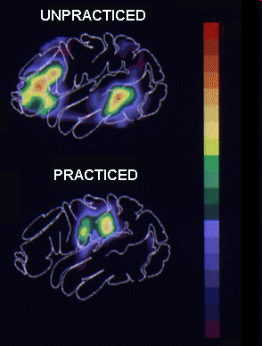
Why High-p_{T} Particles?
Tomography in medicine
One can learn a lot from a single probe…
and even more with multiple probes
SPECT-CT Scan uses internal γ photons and external X-rays
PET Scan
http://www.fas.org/irp/imint/docs/rst/Intro/Part2_26d.html

Slide 3
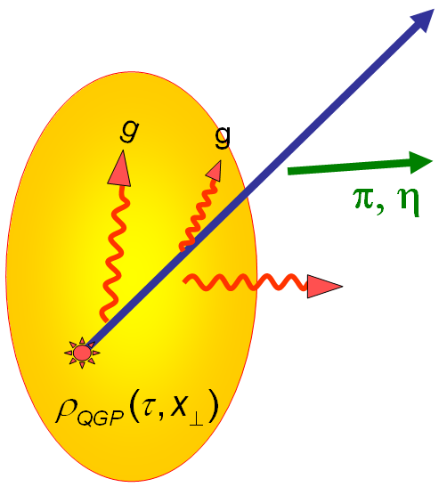
Tomography in QGP
Indep. check on hydro
geom. meas. vital for quant. η/s
Requires well-controlled theory of:
production of rare, high-p_{T} probes
g, u, d, s, c, b
in-medium E-loss
hadronization
Requires precision measurements of decay fragments
p_{T}
, γ, e⁻
φ
Invert attenuation pattern => measure medium properties
Alt: learn about med & E-loss

Slide 4
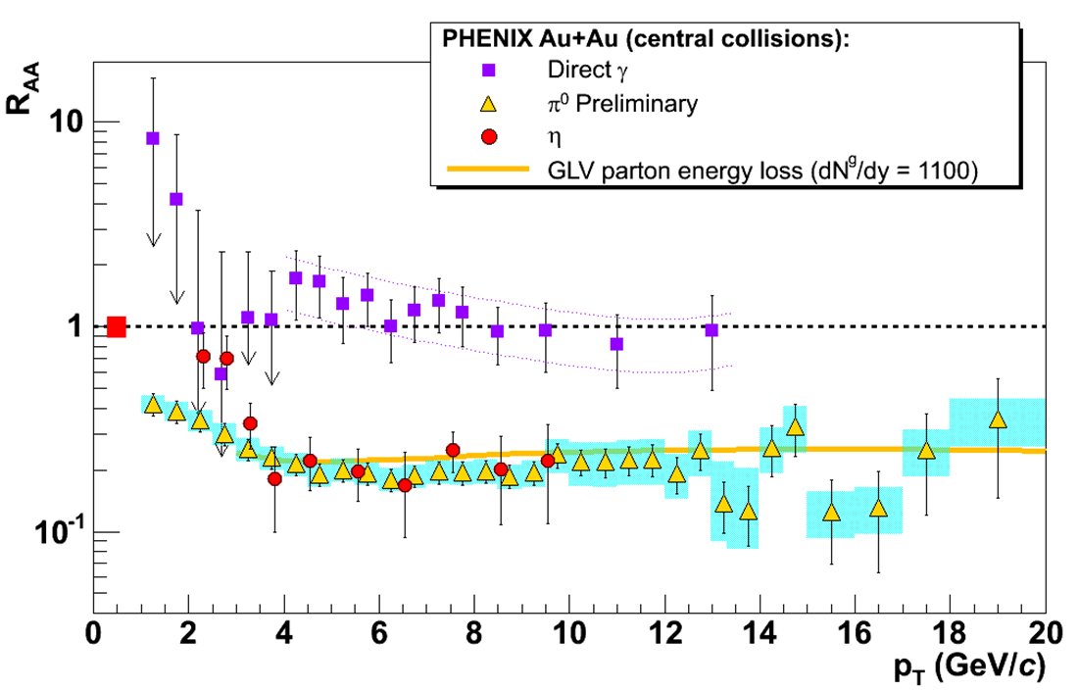
pQCD Success at RHIC:
(circa 2005)
Y. Akiba for the PHENIX collaboration, hep-ex/0510008
Consistency: R_{AA}(η)~R_{AA}(π)
Null Control: R_{AA}(γ)~1
GLV Prediction: Theory~Data for reasonable fixed L~5 fm and dN_{g}/dy~dN_{π}/dy

Slide 5
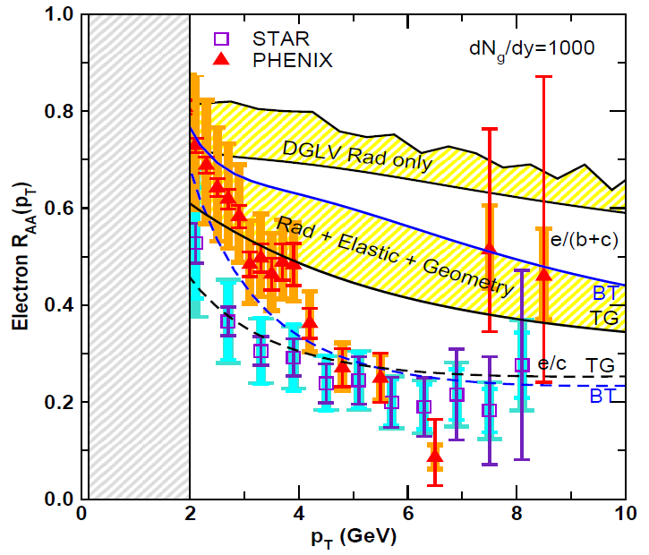
Irony of Multiple Observables (I)
v₂ too small
NPE supp. too large
π⁰ v₂
WHDG
NPE v₂
C. Vale, QM09 Plenary (analysis by R. Wei)
Wicks, WAH, Gyulassy, Djordjevic, NPA784 (2007)
PHENIX, Phys. Rev. Lett. 98, 172301 (2007)

Slide 6
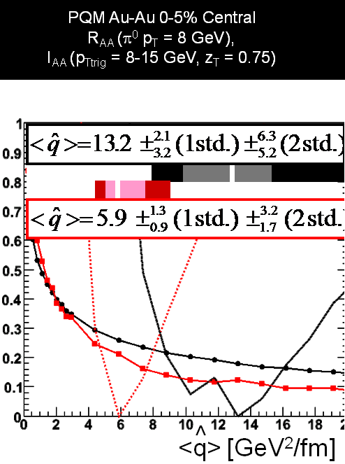
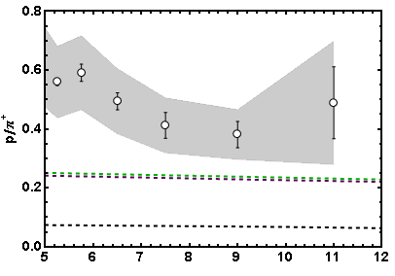
Irony of Multiple Observables (II)
I_{AA}
WHDG soon
Baryon/Meson Ratio
STAR
pQCD w/ DSS
pQCD w/ KKP
p_{T}
WAH, in preparation
Jamie Nagle, QM09
Pert. at LHC energies?

Slide 7
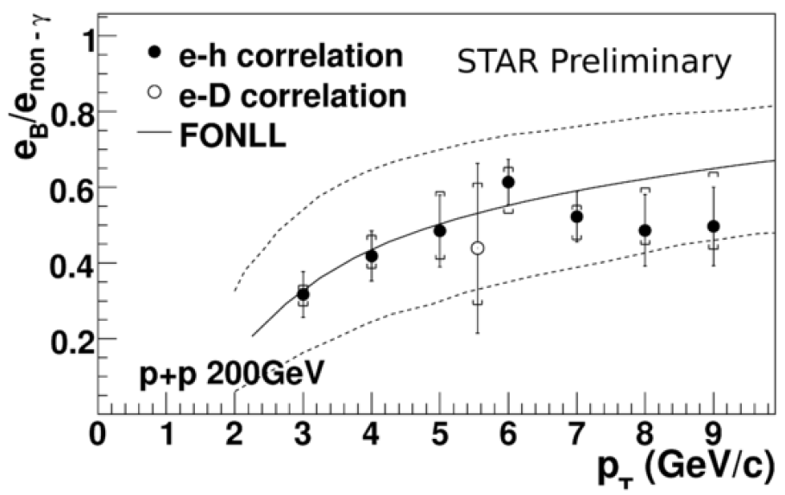
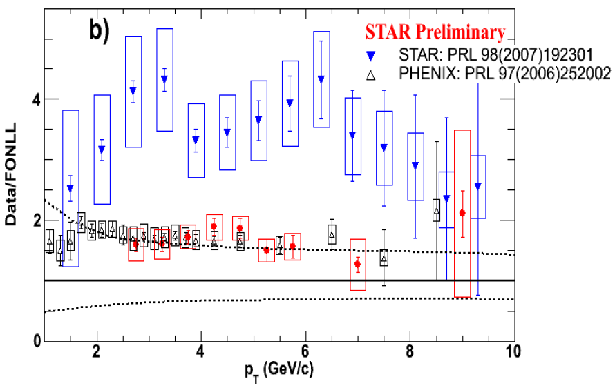
Comments on NPE (I)
c/b production ~ FONLL predictions
Large b contribution
STAR & PHENIX now consistent in p+p
R_{AA}?
Bertrand Biritz, QM09
Wei Xie, DIS10

Slide 8
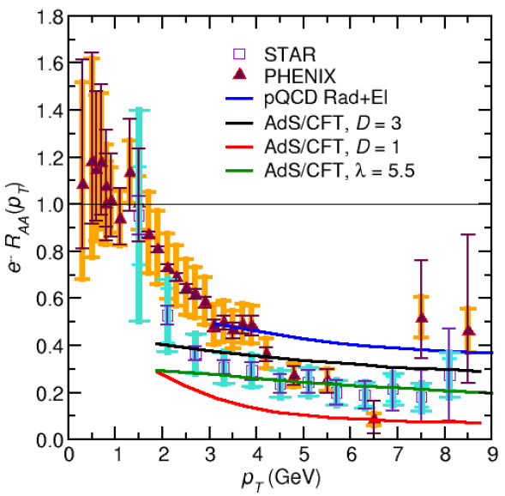
Comments on NPE (II)
NB: pQCD calculations so far assume M << E
b corrections likely large
c and b separation
Success of AdS/CFT?
dp_{T}/dt = - μ p_{T}
μ = πλ^{1/2} T²/2M_{q}
WAH, PhD Thesis

Slide 9
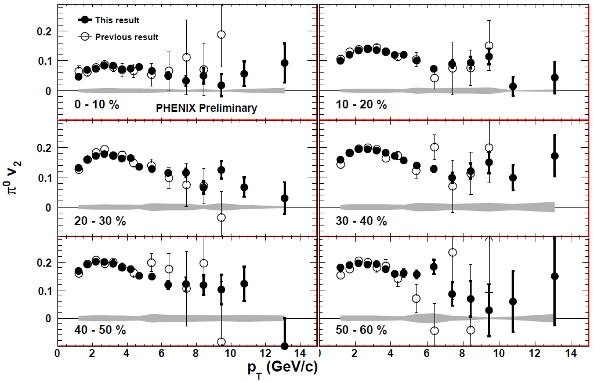
Comments on v₂ (I)
Data improves, pQCD falsified to higher p_{T}
Does v₂ becomes constant, >> pQCD?
Rui Wei, for PHENIX, QM09

Slide 10
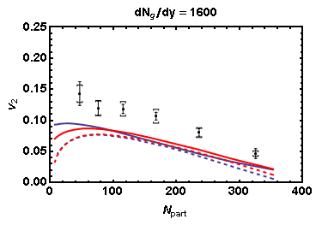
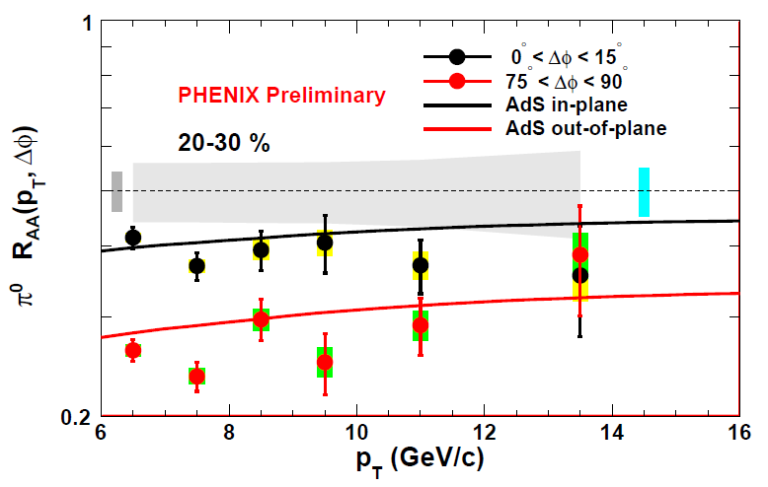
Comments on v₂ (II)
CGC, fluctuations not enough for pQCD
AdS/CFT: ΔE ~ L³
Better job?
PHENIX π⁰
Glauber
CGC
Solid: analytic
Dashed: fluctuating
WAH and J Jia, in preparation
Marquet and Renk, PLB685 (2010)

Slide 11
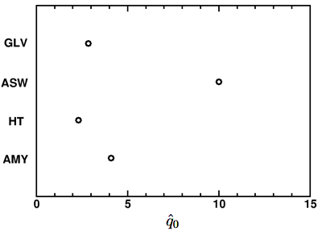
Theoretical Uncertainties: Different Formalisms, Different Results
Very diff. ideas about relevant physics
pQCD
AMY, BDMPS, GLV, HT
Is this a systematic th. unc.? Can we falsify?
Bass et al., Phys.Rev.C79:
024901,2009
What about AdS/CFT?

Slide 12
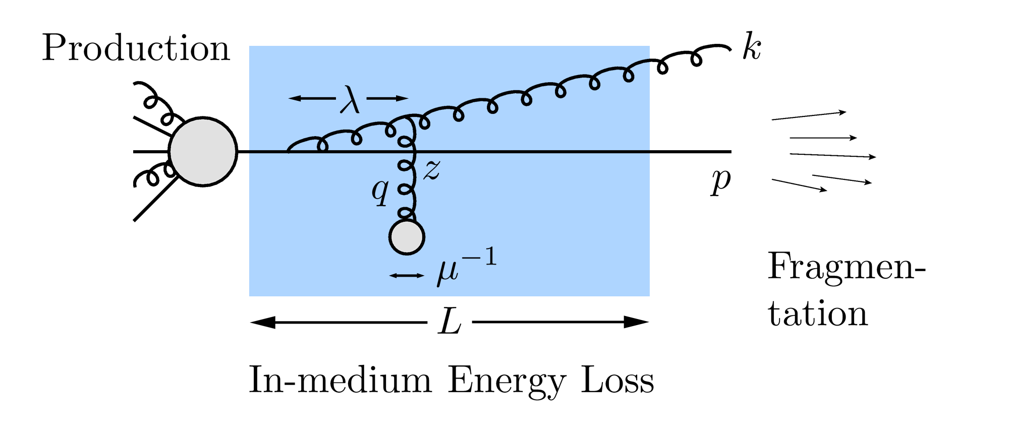
Mechanics of Energy Loss
R_{AA} ~ ∫(1-ϵ)^{n} P(ϵ) dϵ
p_{f} = (1-ϵ)p_{i}
Opacity expansions finds single inclusive gluon emission spectrum
dN_{g}/dxdk_{T}dq_{T}

Slide 13
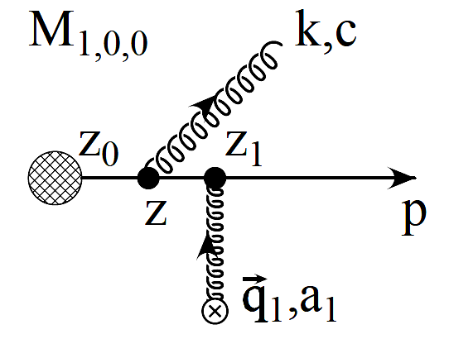
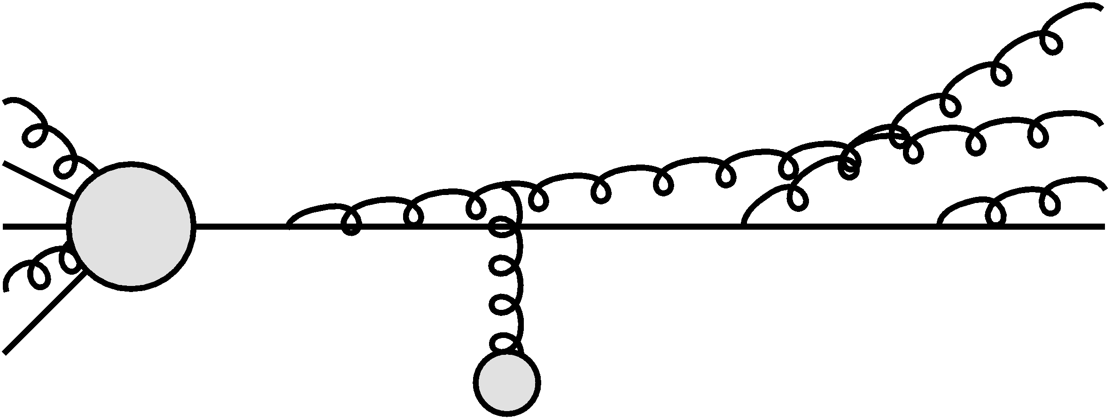
Poisson Convolution
Find P(ϵ) by convolving dN_{g}/dx
Approximates probabilistic multiple gluon emission, Sudakov
assume independent emissions
NB: ϵ is a momentum fraction
Gyulassy, Levai, and Vitev NPB594 (2001)

Slide 14
Opacity Expansion Calculation
Want to find dN_{g}/dx
Make approximations to simplify derivation
Small angle emission: k_{T} << xE
Note: ALL current formalisms use collinear approximation
Derived dN_{g}/dxdk_{T} violates collinear approx
Both IR and UV safe
Enforce small angle emission through UV cutoff in k_{T}

Slide 15
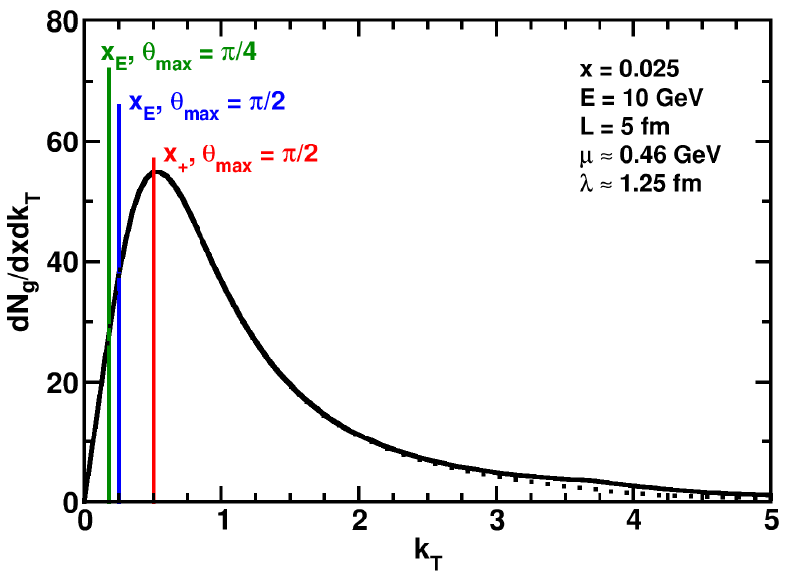
Uncertainty from Collinear Approx
Derived dN_{g}/dxdk_{T} maximally violates collinear approximation
dN_{g}/dx depends sensitively on k_{T} cutoff
Despite UV safety
For effect on extracted prop., must understand x
WAH and B Cole, PRC81, 2010

Slide 16
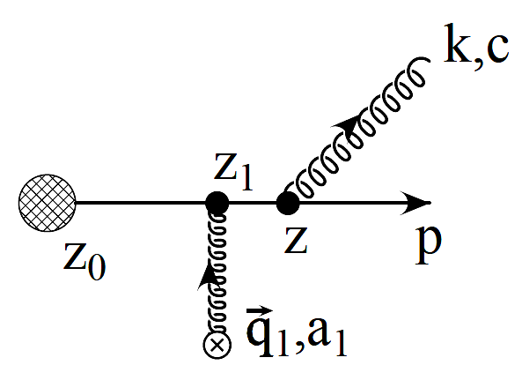
Two Standard x Definitions
ASW-SH: x_{E}
Energy fraction
GLV: x₊
Plus momentum fraction
P
NB: gluon always on-shell

Slide 17
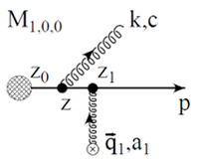
Coordinate Transformations
Same in the limit k_{T}/xE → 0!
UV cutoff given by restricting maximum angle of emission
Previous comparisons with data took θ_{max}=π/2
Vary θ_{max} to estimate systematic theoretical uncertainty
θ
P

Slide 18
Jacobians
ϵ is fraction of longitudinal momentum
Need dN_{g}/dx_{E} to find P(ϵ)
A Jacobian is required for x = x₊ interpretation

Slide 19
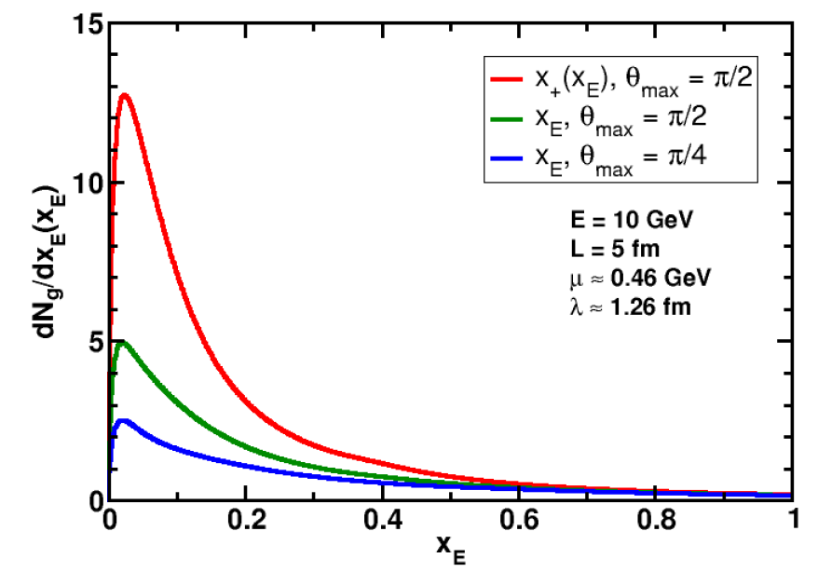
Rad. Gluon Kin. Sensitivities
UV
What about IR?
WAH and B Cole, PRC81, 2010

Slide 20
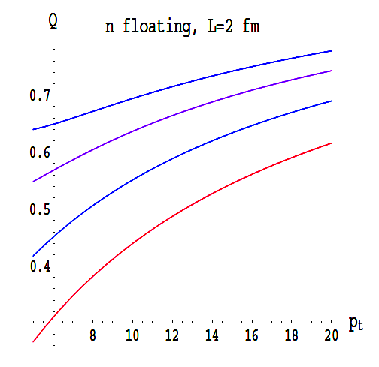
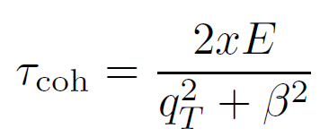
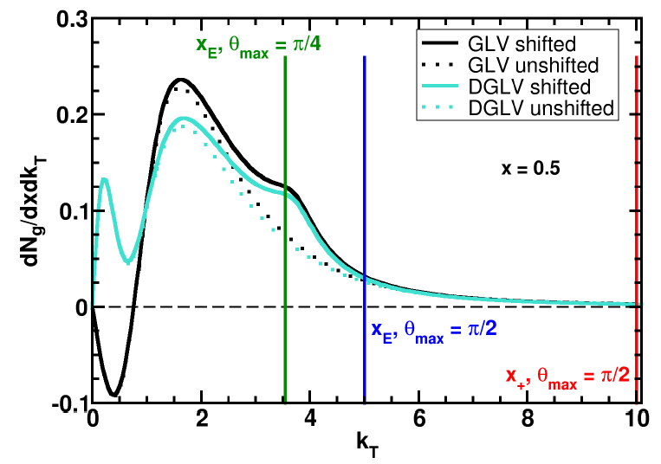
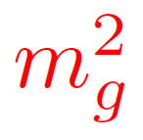
Collinearity and Gluon Mass
Massless gluons:
Large IR cutoff sensitivity
Gluons with thermal mass
BDMS, JHEP 0109 (2001)
~
Larger x better respects k_{T} << xE
WAH and B Cole, PRC81, 2010

Slide 21
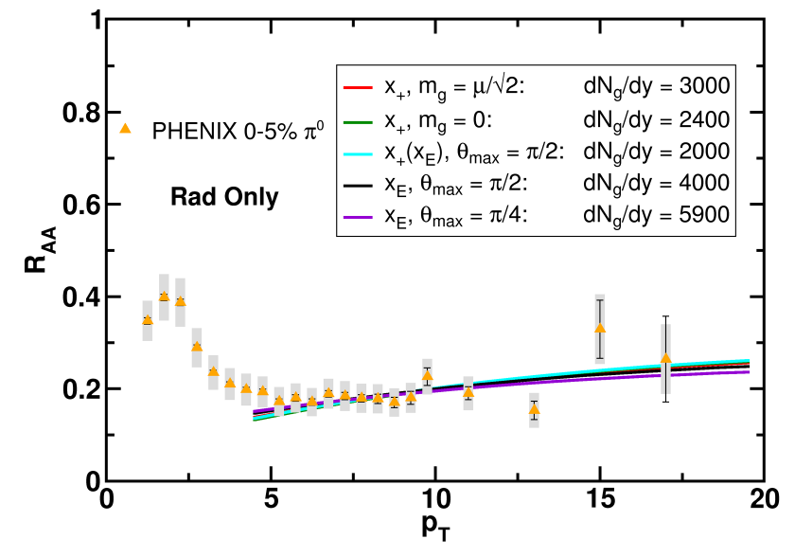
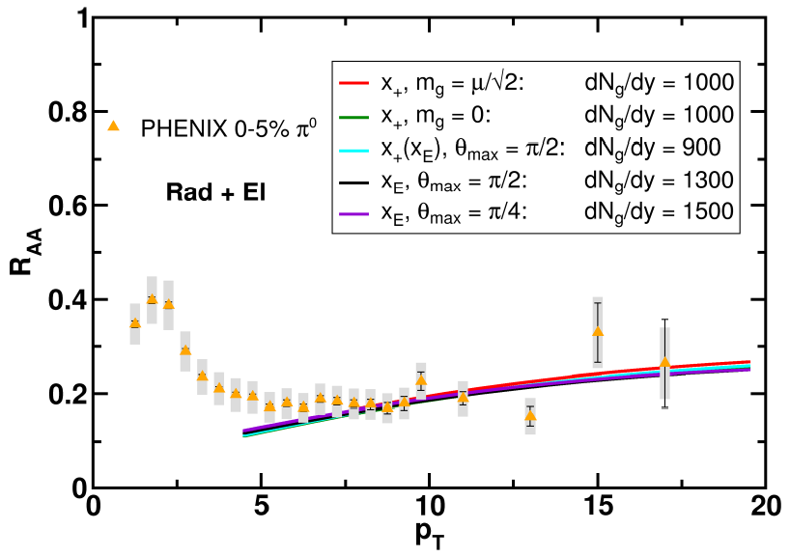
Results
Quantitatively compare to PHENIX data
Assumed infinite Elastic precision
WAH and B Cole, PRC81, 2010

Slide 22
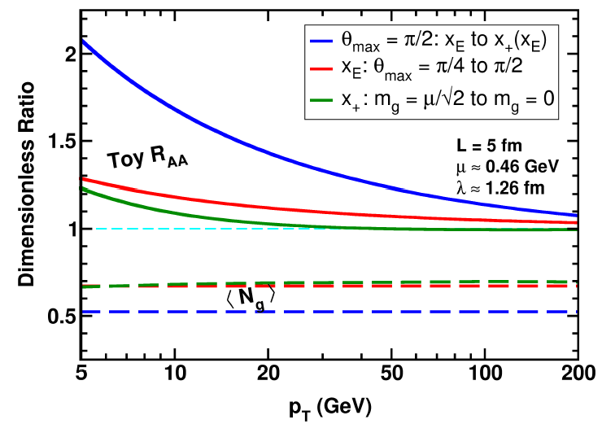
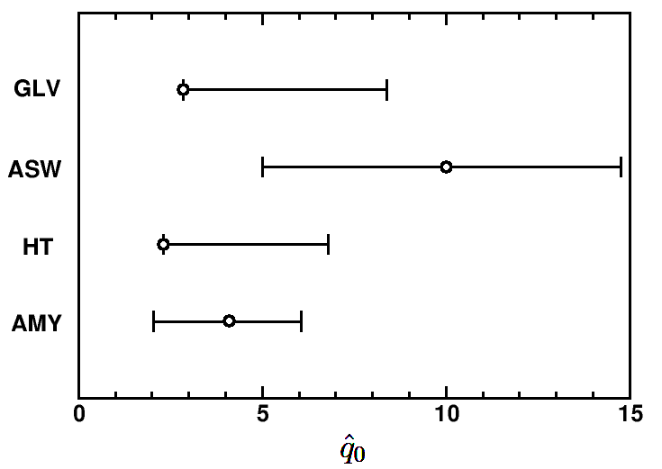
Parton Energy Dependence
Dependence on parton energy
Uncertainty on qhat
Assume all formalisms equally affected
WAH and B Cole, PRC81, 2010

Slide 23
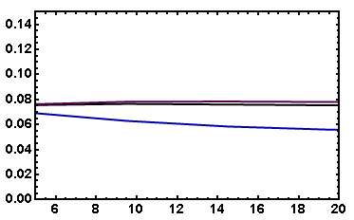
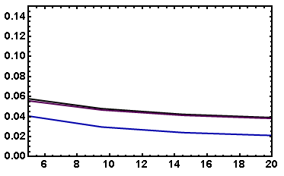
v₂ Variation
Fix dN_{g}/dy from R_{AA}, calculate v₂
Expect larger v₂ for smaller opening angle
I_{AA}: coming soon
Rad Only
Rad + El
20-30% π⁰
20-30% π⁰
v₂
v₂
p_{T}
p_{T}
WAH, in preparation

Slide 24
Conclusions
pQCD in HI collisions is in trouble
Multiple observables not simul. well described
Fewer and fewer places for pQCD to hide
Important future exp work: is there a pQCD regime? (higher p_{T})
v2:
Difficult (impossible?) to deconvolute geometry & E-loss
> L² dependence (AdS/CFT?), but
Need for e-RHIC (also for η/s)
NPE:
Separate c and b: c is under better th. control
Future theory work:
Compute more obs (I_{AA}, etc.)
Remove collinear, M<<E approx
Uncertainties in AdS/CFT, pQCD => Falsification

