Slide 1
Theory Comparisons
W. A. Horowitz
The Ohio State University
June 19, 2010
With many thanks to Brian Cole, Miklos Gyulassy,
Ulrich Heinz, Jiangyong Jia, and Yuri Kovchegov

Slide 2
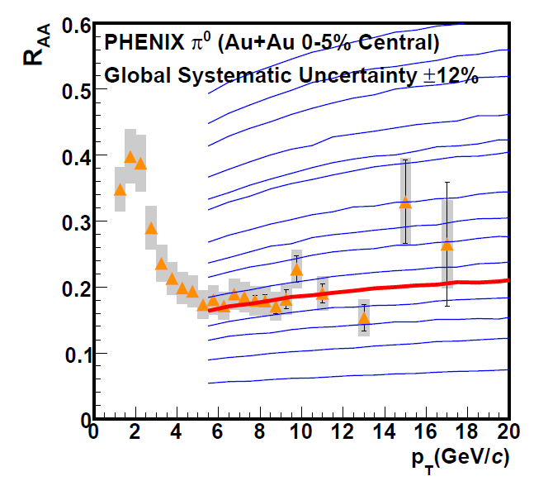
Motivation for pQCD Theory Comparison?
Death of fragility:
Density extracted (assuming infinite thy prec) to w/i 20-30%
Proof of Principle
What about other
observables?
Falsify before
we quantify
PHENIX PRL101 (2008)

Slide 3
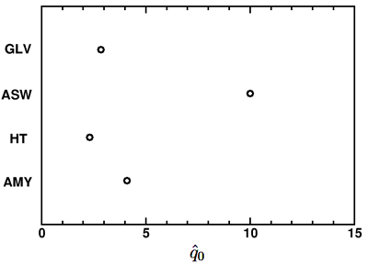
Uncertainty in Medium Extraction?
Is this a sys. th. unc. on a medium parameter?
No! Experimentally all these models are falsified by data
v₂, I_{AA}, NPE, ...
No! Known important physics is missing
Elastic E-loss (dyn sc cent, vacuum rad, ...)
What is the qhat from fully strongly coupled AdS?
AdS is at least as right/wrong as pQCD
Apples to oranges comparison

Slide 4
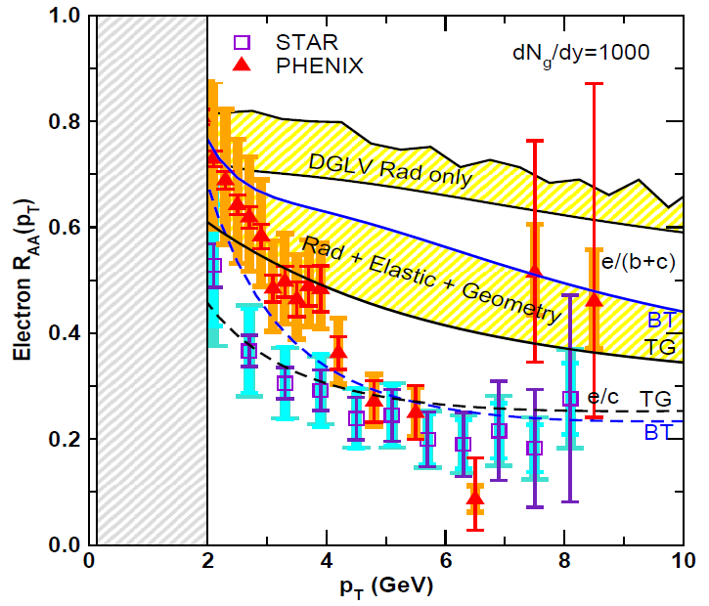
Irony of Multiple Observables
v₂ too small
NPE supp. too large
π⁰ v₂
WHDG
NPE v₂
C. Vale for PHENIX, QM09 Plenary (analysis by R. Wei)
Wicks, WAH, Gyulassy, Djordjevic, NPA784 (2007)
I_{AA}, B/M, γ-h, ...
Pert. at LHC?
PHENIX, Phys. Rev. Lett. 98, 172301 (2007)

Slide 5
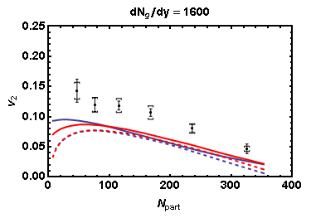
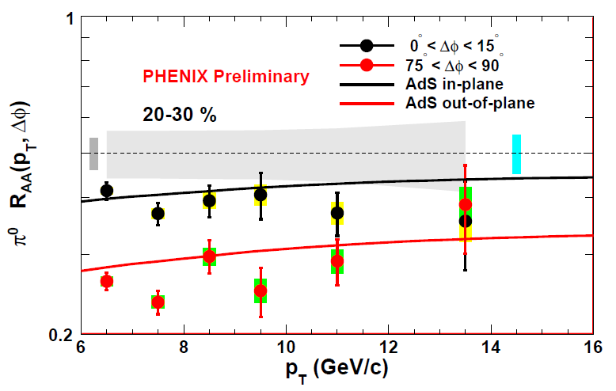
Comments on v₂
CGC, fluctuations not enough for pQCD
AdS/CFT: ΔE ~ L³
Better job?
PHENIX π⁰
Glauber
KLN CGC
Solid: rotated
Dashed: not rotated
WAH and J Jia, in preparation
Marquet and Renk, PLB685 (2010)
Largest medium density w/i unc. from R_{AA}

Slide 6
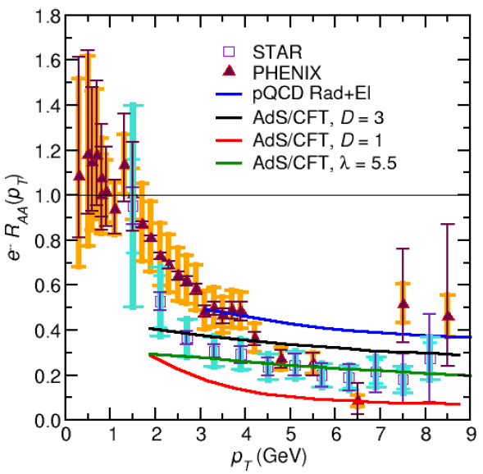
Comments on NPE
Exp. converge in pp
NB: pQCD calculations so far assume M << E
b corrections likely large
c and b separation
Success of AdS/CFT?
dp_{T}/dt = - μ p_{T}
μ = πλ^{1/2} T²/2M_{q}
WAH, PhD Thesis

Slide 7
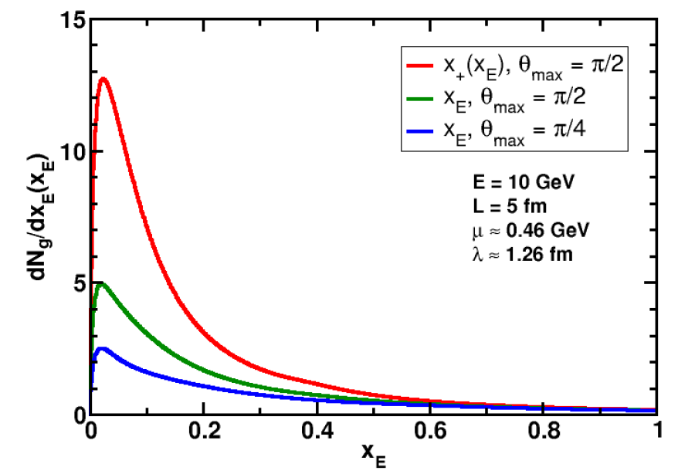
Uncertainties in Wide Angle Radiation
UV
What about IR?
WAH and B Cole, PRC81, 2010

Slide 8
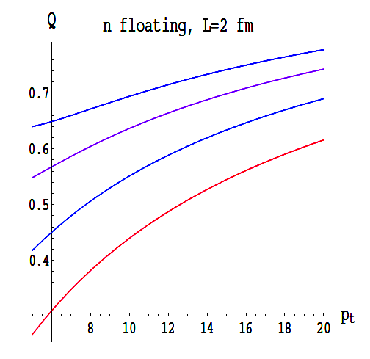
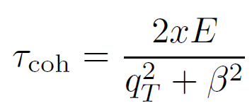
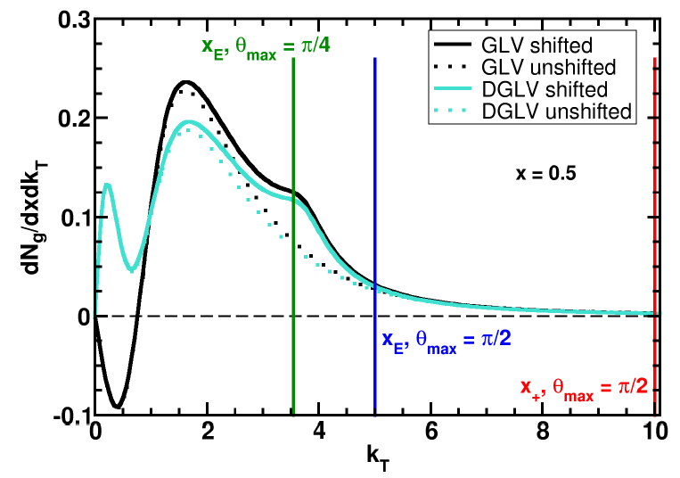
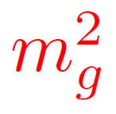
Collinearity and Gluon Mass
Massless gluons:
Large IR cutoff sensitivity
Gluons with thermal mass
BDMS, JHEP 0109 (2001)
~
Larger x better respects k_{T} << xE
WAH and B Cole, PRC81, 2010

Slide 9
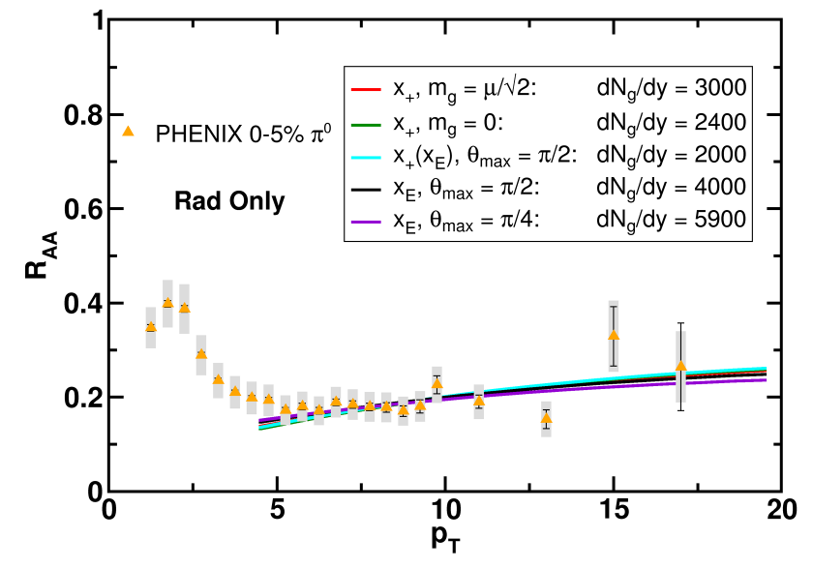
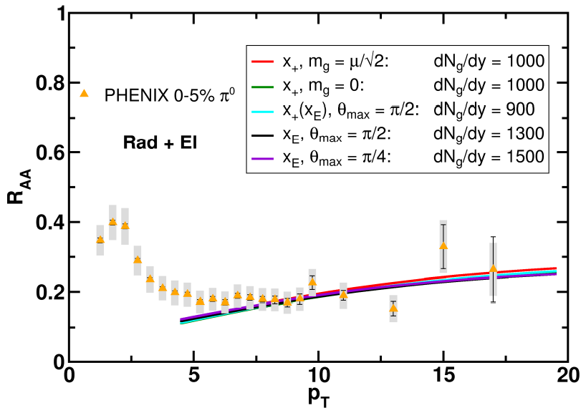
Results
Quantitatively compare to PHENIX data
Assumed infinite Elastic precision
WAH and B Cole, PRC81, 2010

Slide 10
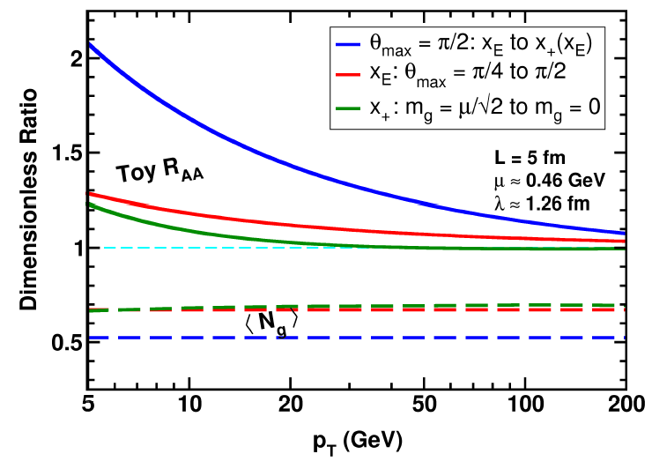
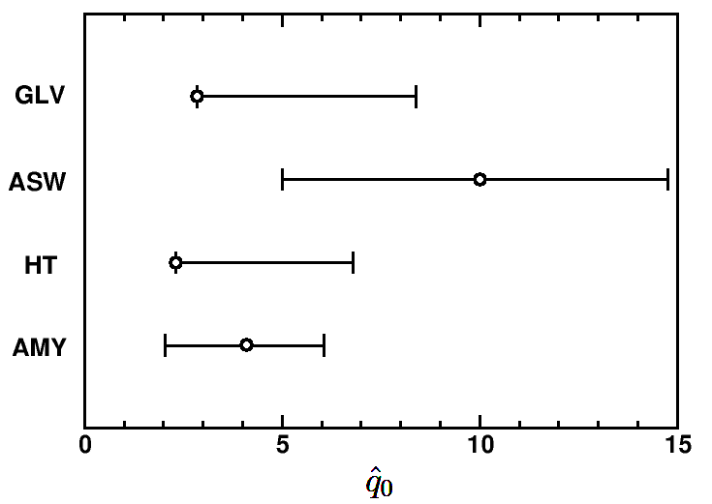
Parton Energy Dependence
Dependence on parton energy
Uncertainty on qhat
Assume all formalisms equally affected
WAH and B Cole, PRC81, 2010

Slide 11
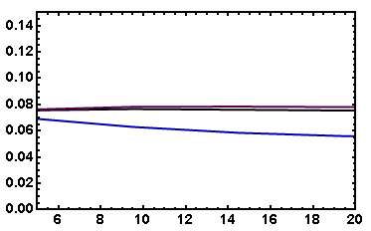
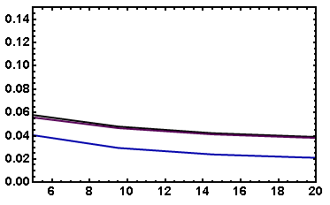
v₂: “Collinearly Safe”
Fix dN_{g}/dy from R_{AA}, calculate v₂
Expect larger v₂ for smaller opening angle
( τ_{coh} ~ 1/k_{T}² )
I_{AA}: coming soon
Rad Only
Rad + El
20-30% π⁰
20-30% π⁰
Data
Data
v₂
v₂
p_{T}
p_{T}
WAH, in preparation

Slide 12
Comments/Conclusions
These should be addressed in general (JET) and in TECHQM report in particular
Consensus on missing & important physics?
Wide angle radiation, dyn vs. static sc. cent., Poisson vs. Fokker-Planck, vacuum radiation,...
NB: Elastic loss not yet addressed at all
Importance/uncertainties?
Falsify first, then quantify
Consensus that pQCD HI picture is in serious trouble?
v₂, I_{AA,} NPE, ...
Sim. mult. obs. description not possible, even with large unc. from wide angle radiation
Future work:
Include missing physics
Sim. remove collinear and small mass approx?
Calculate more observables in pQCD and AdS/CFT: I_{AA}, etc.

