Slide 1
Energy Loss Mechanisms and Jet Physics
W. A. Horowitz
The Ohio State University
July 12, 2010
With many thanks to Brian Cole, Miklos Gyulassy,
Ulrich Heinz, Jiangyong Jia, and Yuri Kovchegov

Slide 2
RHIC in the Age of the LHC

Slide 3
Questions to Answer in the Next 10 Years

Slide 4
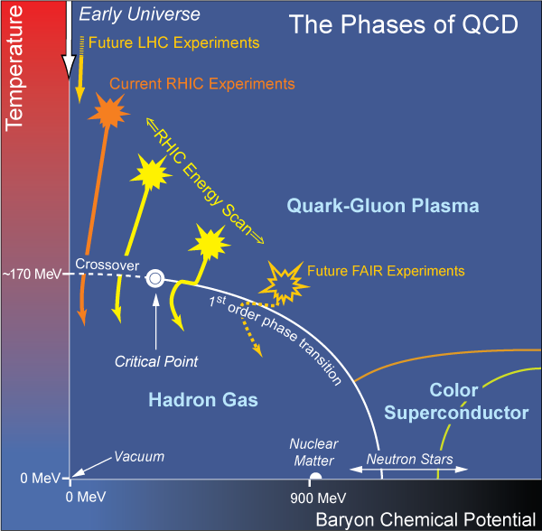
What are we interested in?
Measure many-body physics of strong force
Test & understand theory of many-body non-Abelian fields
Long Range Plan, 2008
Notes:
Unique as compared to strongly coupled Abelian problems

Slide 5
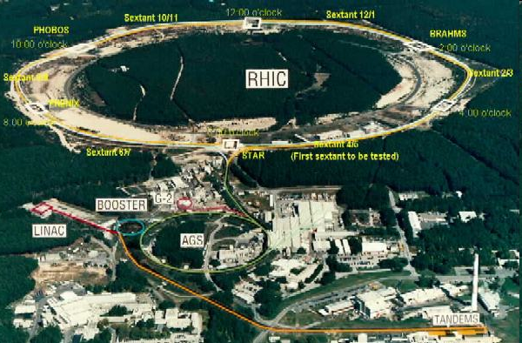
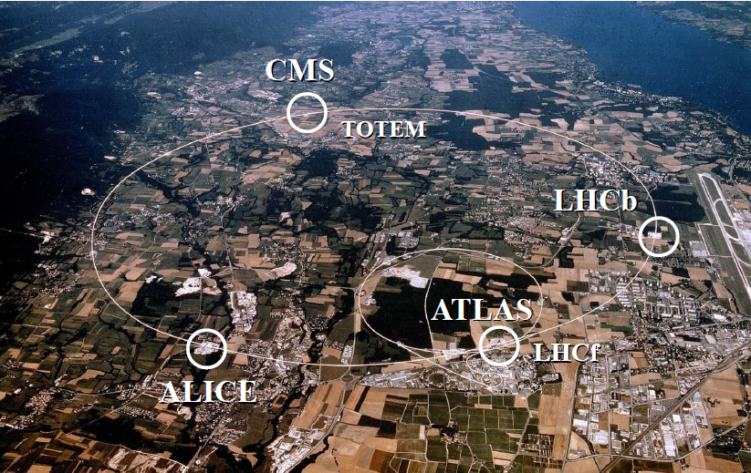
HI Collisions Tool for Strong Force Physics Study
Want a consistent picture of matter produced in HI collisions
Then, want to quantify the properties of the produced matter

Slide 6
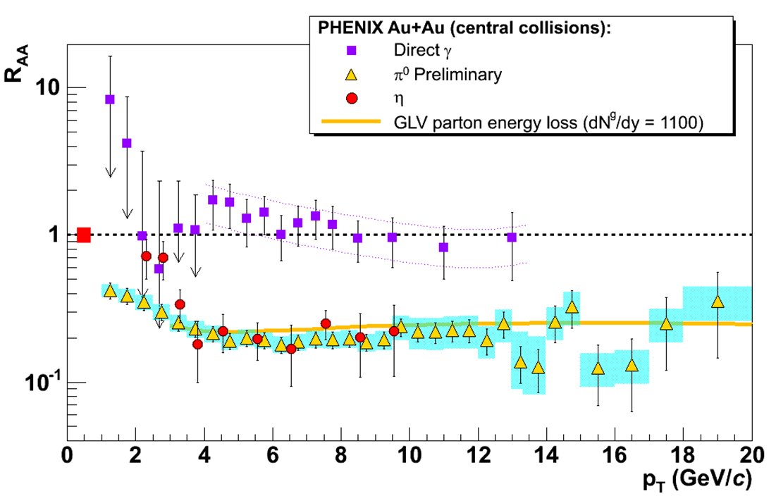
10 Years of RHIC: Two Pillars
Huge low-p_{T} v₂
Described by hydro with low viscosity
Huge high-p_{T} supp.
π⁰ R_{AA} described by pQCD
Luzum and Romatschke, Phys.Rev.C78:034915,2008
Y. Akiba for the PHENIX collaboration, hep-ex/0510008
Inconsistent picture?

Slide 7
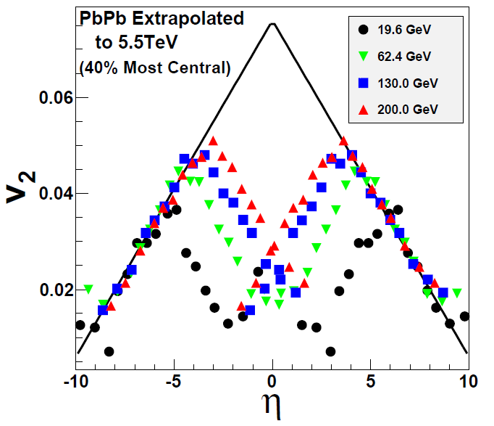
Two Big Qualitative Questions: I
Is hydro at RHIC a fluke?
Day 1 LHC will tell us
If v₂ breaks hydro limit a la Busza extrapolation, what the heck is happening at RHIC?
NA49, Phys.Rev.C68:034903,2003
W Busza, NPA 830,2009

Slide 8
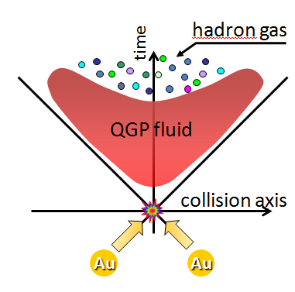
Hydro for the Next 10 Years
Suppose hydro works at LHC (likely)
Want to understand full spacetime evolution

Slide 9
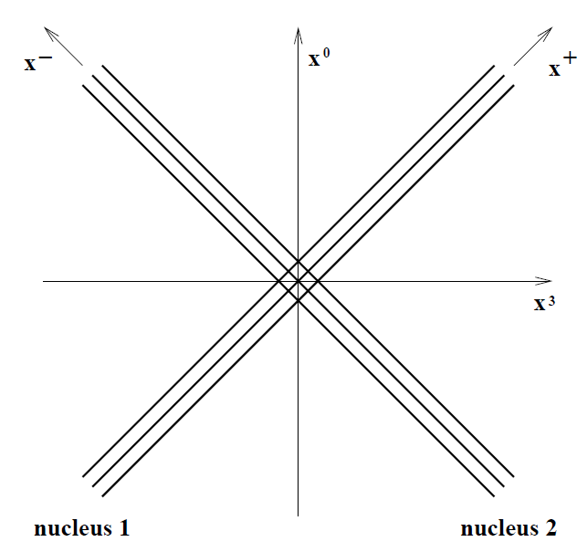
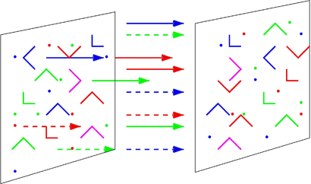
Understanding IC
Suppose hydro works at LHC (likely)
How does the medium thermalize?
What happens for t < τ_{therm}, what are IC for hydro?
AdS
Stopping?
McLerran and Gyulassy, NPA750, 2005
Albacete, Kovchegov, Taliotis, JHEP 0905, 2009

Slide 10
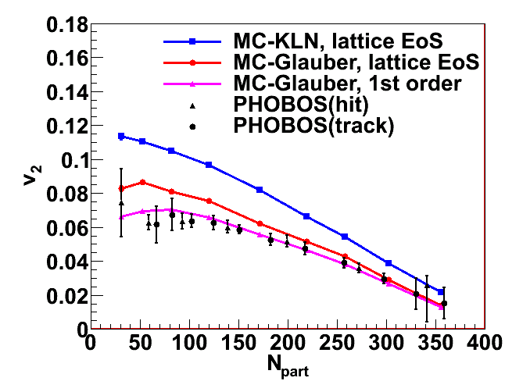
Quantify the Transport Properties
Suppose hydro works at LHC (likely)
What, quantitatively, is its viscosity?
What is the initial geom. & its fluct. (100% effect)
Need for γ-γ cor? e-RHIC?

Slide 11
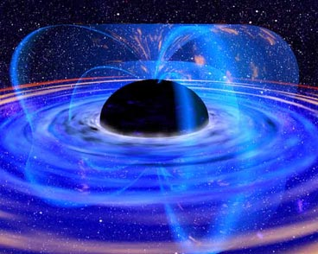
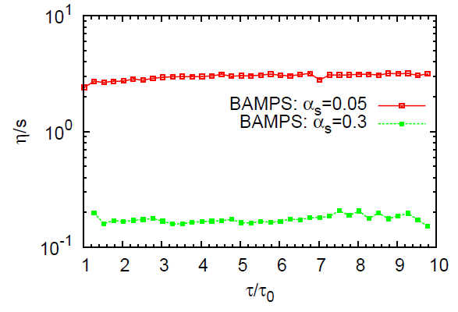
Physics of the Thermal Medium
Suppose hydro works at LHC (likely)
Is the soft-soft physics described by
a) AdS/CFT, b) pQCD or, c) other?
Low viscosity ≠ strong coupling
El et al, PRC79, 2009

Slide 12
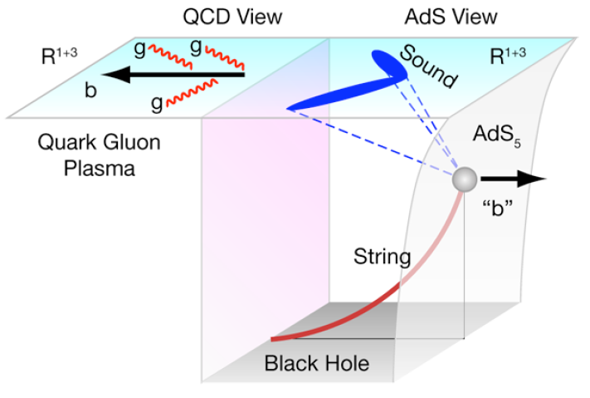
Two Big Qualitative Questions: II
How do high-p_{T} partons lose E to med.?
What is the soft-soft physics, and how does it relate to soft-hard physics?
Puzzling,
Incomplete
Picture
M Gyulassy, Physics 2, 107 (2009)

Slide 13
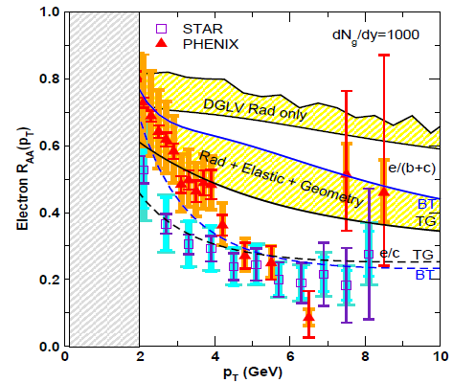
pQCD Suppression Picture Inadequate
Lack of even qualitative understanding
π⁰, η, γ R_{AA} well described, BUT
e⁻ R_{AA}, v₂ is not, even with elastic loss
NB: M_{Q}/E << 1 assumed, not well controlled for b
PHENIX, Phys. Rev. Lett. 98, 172301 (2007)
Wicks et al.

Slide 14
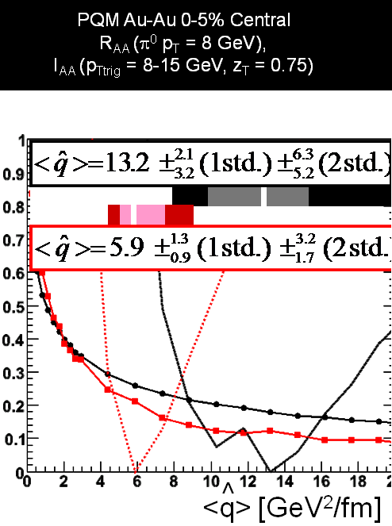
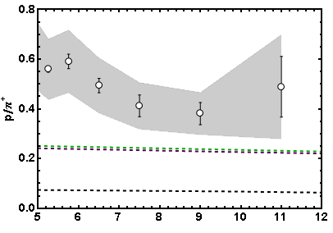
More Reasons for Concern
I_{AA}
WHDG soon
Baryon/Meson Ratio
STAR
pQCD w/ DSS
pQCD w/ KKP
p_{T}
WAH, in preparation
Jamie Nagle, QM09
Pert. at LHC energies?

Slide 15
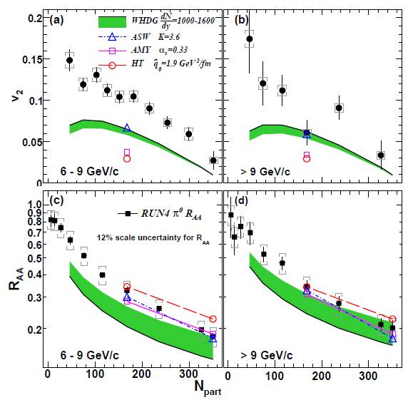
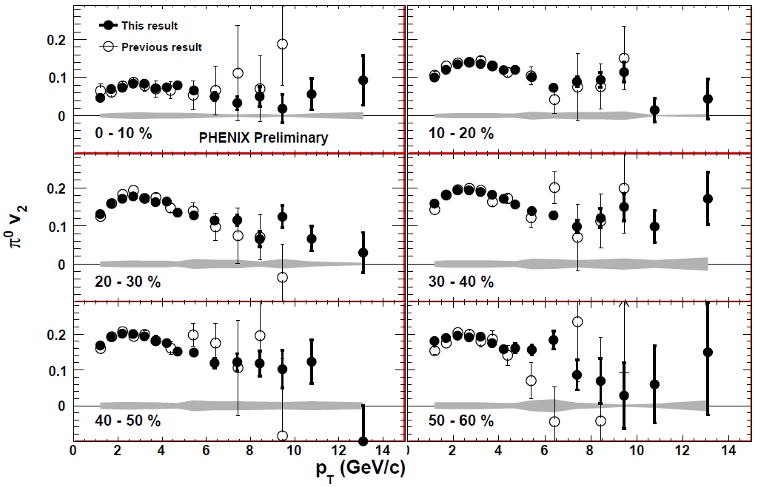
Death of pQCD at RHIC?
Failure at > 9 GeV!
Rui Wei, for PHENIX, QM09
PHENIX, arXiv:1006.3740
Notes:
Important to get to >~ 10 GeV to avoid IS, hadronization effects

Slide 16
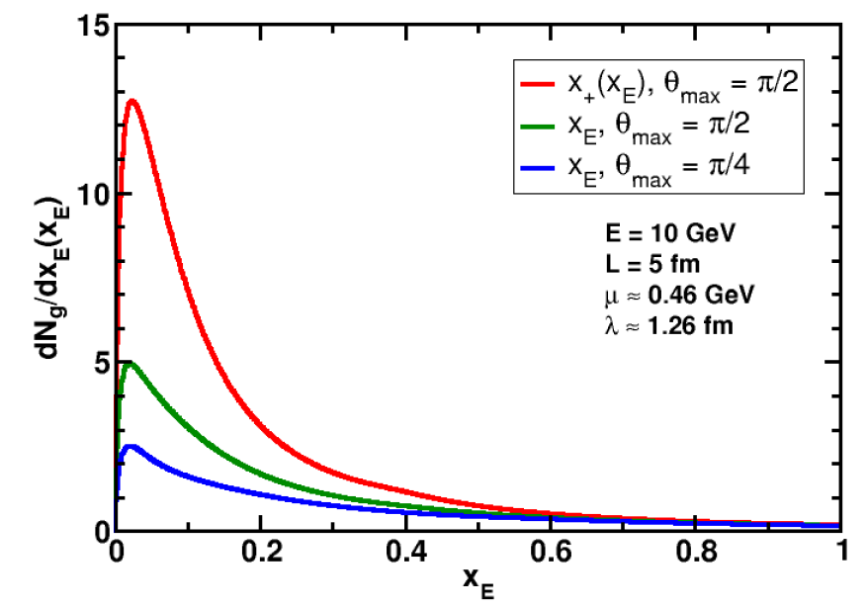
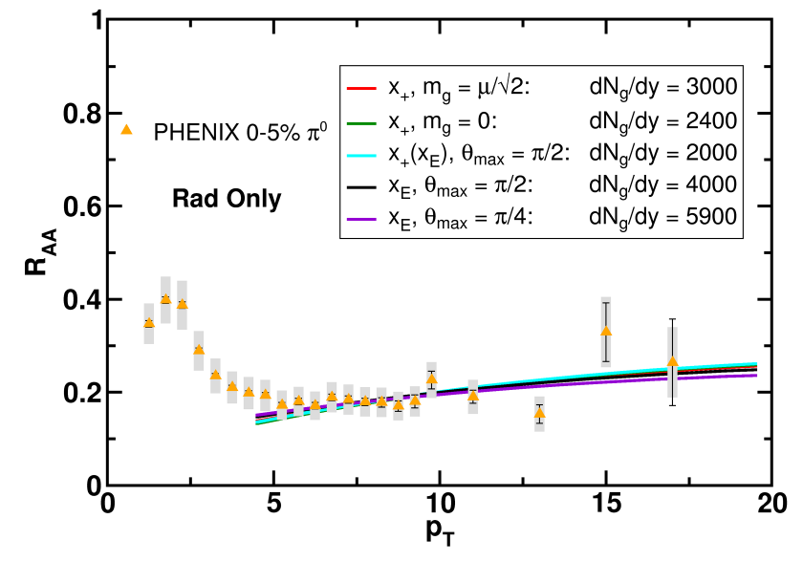
What About Theoretical Uncertainty?
Wide angle radiation not under th. control
Large unc. in dNg/dy for given R_{AA}
WAH and B Cole, PRC81, 2010
R_{AA} ~ ∫(1- ϵ)^{n}P(ϵ);
P(ϵ) from Poisson conv. of dN_{g}/dx_{E}

Slide 17
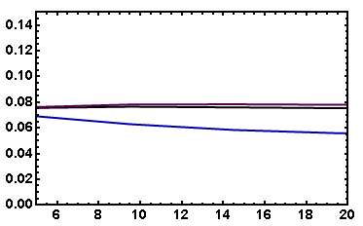
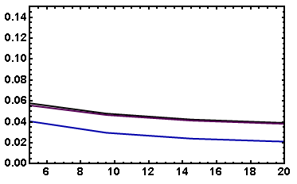
v₂: “Collinearly Safe”
Fix dN_{g}/dy from R_{AA}, calculate v₂
Expect larger v₂ for smaller opening angle
( τ_{coh} ~ 1/k_{T}² )
I_{AA}: coming soon
Rad Only
Rad + El
20-30% π⁰
20-30% π⁰
v₂
v₂
p_{T}
p_{T}
WAH, in preparation

Slide 18
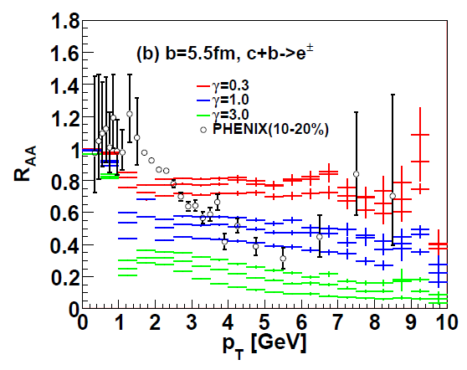
An Alternative Picture
AdS Drag: qual. agreement with NPE R_{AA}
Result less controlled at higher p_{T}
Akamatsu, Hatsuda, Hirano, PRC79, 2009

Slide 19
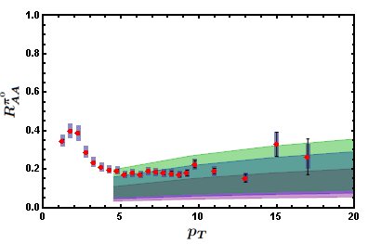
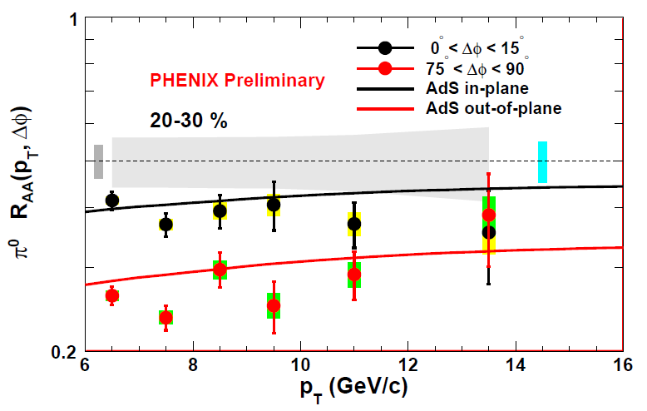
AdS Applied to π⁰
π⁰ R_{AA}
Surprisingly not oversuppressed
π⁰ v₂
ΔE ~ L³!
WAH, in preparation
Marquet and Renk, PLB685 (2010)
Convinced? Need to dot i’s and cross t’s

Slide 20
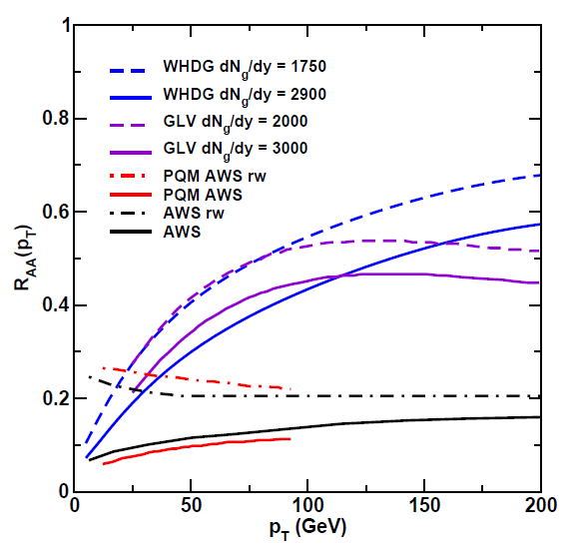
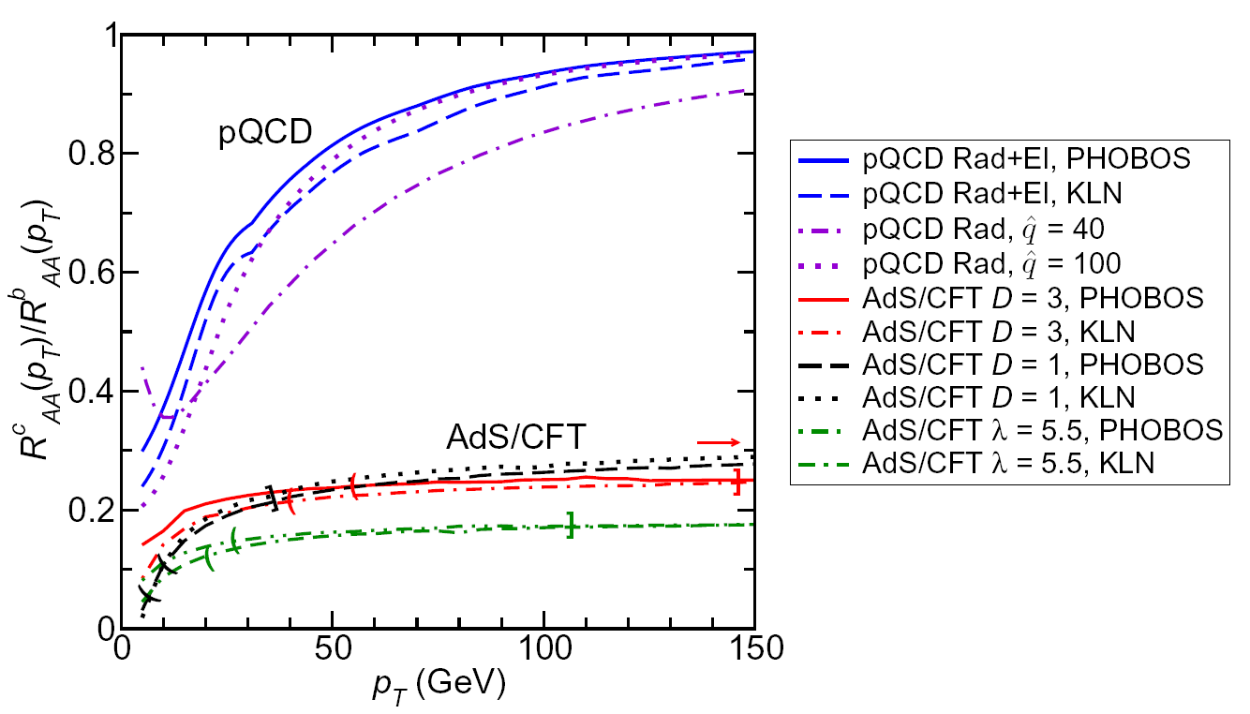
Future of High-p_{T} Physics
On one hand: Higher and higher p_{T}
Look towards LHC for qual. understanding
pQCD at extremely large, p_{T} ~ 100-200 GeV?
WAH, M. Gyulassy, PLB666 (2008)

Slide 21
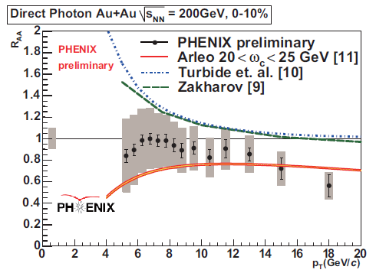
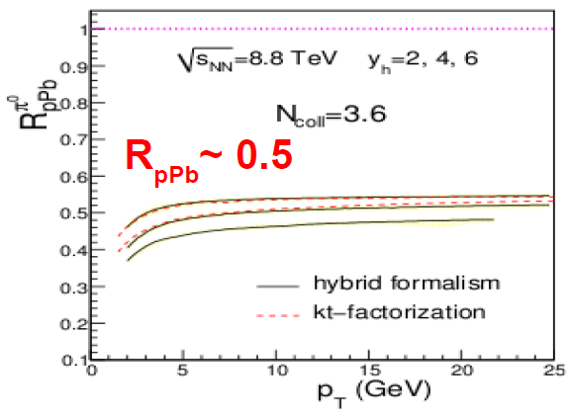
Reasons to be Cautious about LHC
Quenching due to IS or FS?
Need experimental control over production
p+A in...?
T Isobe, JPhysG34 (2007)
Albacete and Marquete, 2010
=> R_{PbPb} ~ 0.25!

Slide 22
Will LHC Solve Everything?
Two possibilities
(assuming LHC jets exist, controllable)
pQCD takes over at very high p_{T}
Strong coupling effects at all p_{T}
Either way, in order to claim full understanding want consistent picture of full spacetime evolution: must vary √s and A
Want to test in as many ways as possible
This will require a lot of flexibility & run time—Only RHIC can provide this

Slide 23
Why RHIC Will Remain Relevant
Uncertainty in every step
Uncertainty in every step
Want to turn all available exp. knobs on QGP

Slide 24
Why Vary √s and A?
Effects of t < τ_{therm}
What are the soft-soft, soft-hard modes; what is their effect on high-p_{T} partons?
Vary τ_{therm}
Importance of geometry?
Glauber vs. CGC vs. ?
Fluctuations
Edge effects, hadronization
Coupling of E-loss with low-p_{T} flow
Vary geometry
How do high-p_{T} partons lose E in HG?
Vary time in QGP vs. Hadron Gas
T dependence of E loss

Slide 25
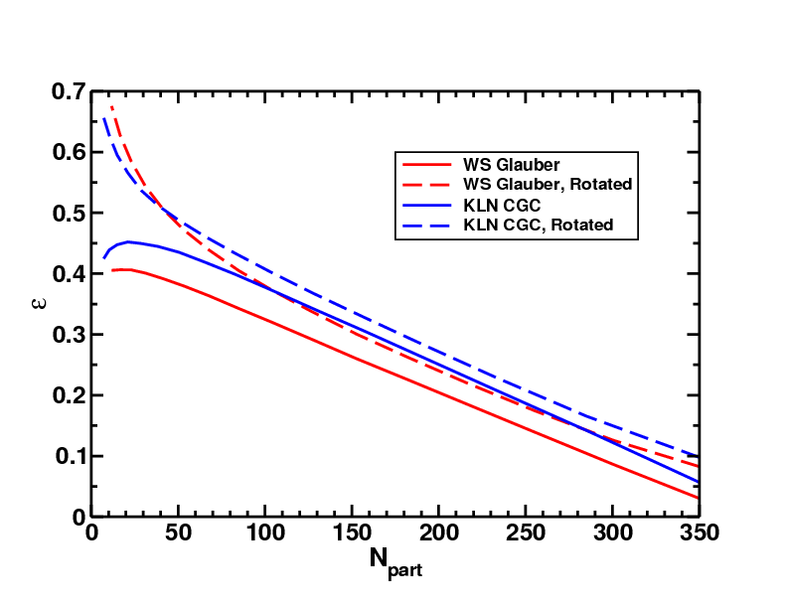
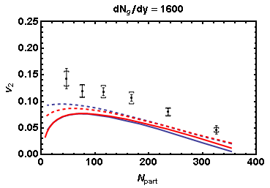
Need to Dot i’s and Cross t’s
Effects of geom. on, e.g. v₂, might be quite large
CGC vs. KLN and rotating RP
Effect not large enough
WAH and J Jia, in preparation
Possibly truly outlandish initial geometry?

Slide 26
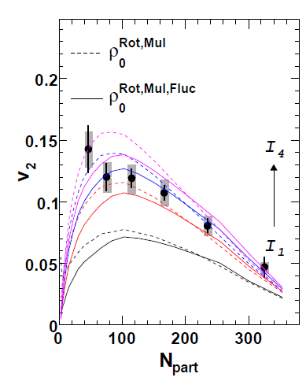
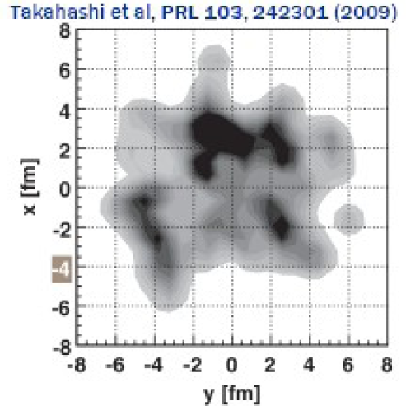
What About Fluctuations?
Hot spots can be huge
NEXUS calculation for 10% most central top RHIC energy event
For simple E-loss not a large effect
Important for fluc., opacity exp.?
Jia and Wei, arXiv:1005.0645

Slide 27
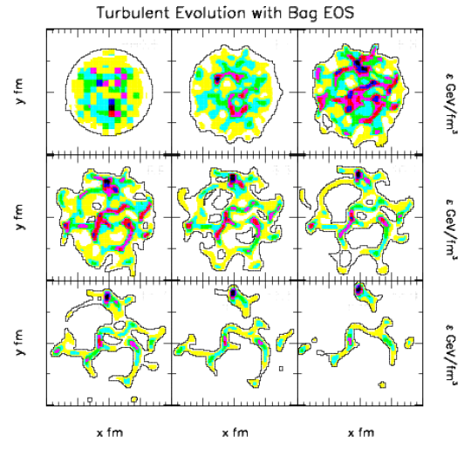
Hydro + Fluctuations
Hydro evolution may amplify fluctuations
Gyulassy, Rischke, Zhang, NPA613, 1997

Slide 28
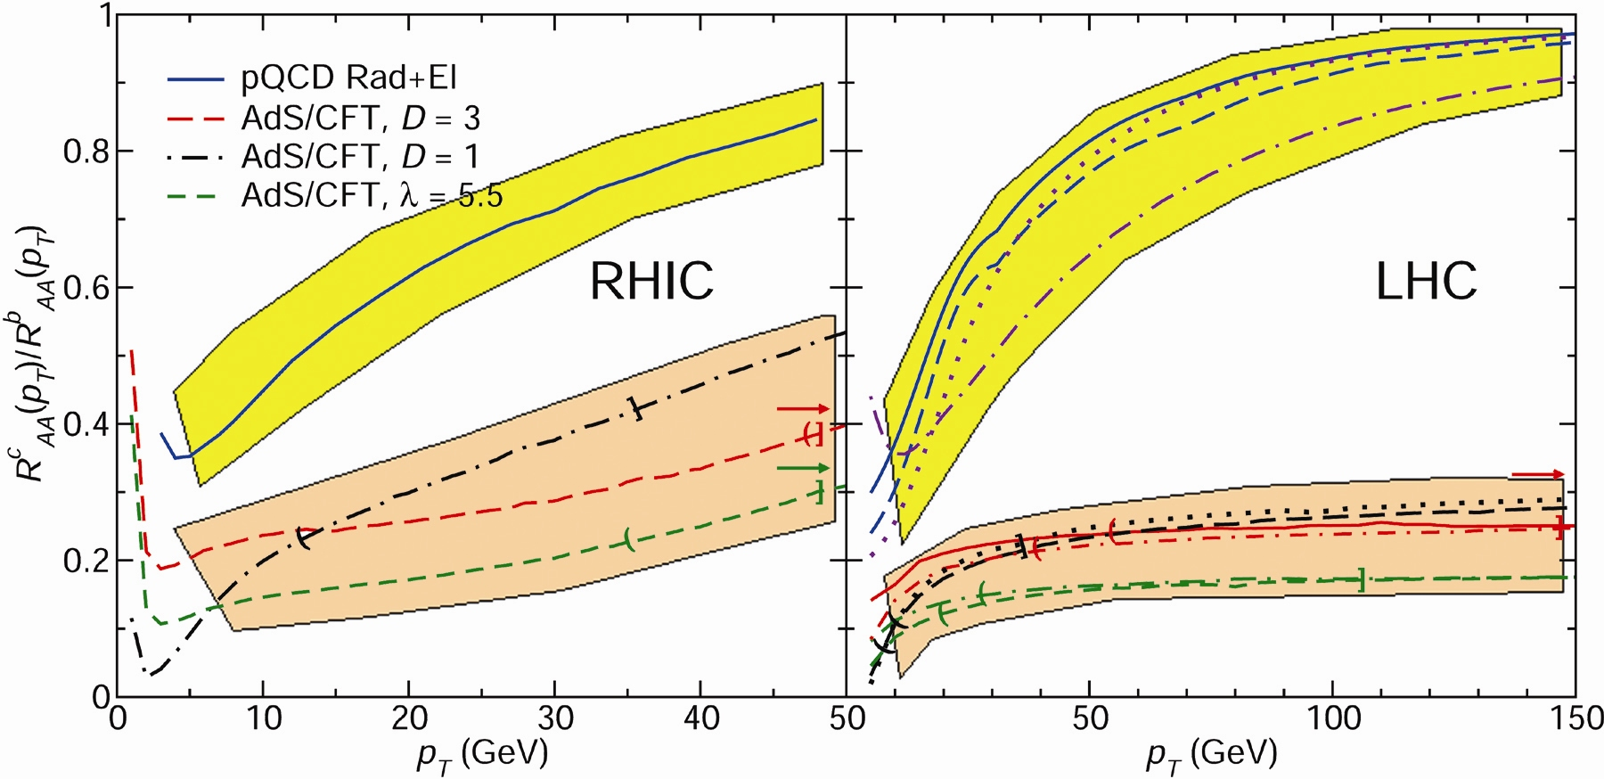
Ex: T Dependence of AdS SL
Bands for guiding the eye only
pQCD
pQCD
AdS/CFT
AdS/CFT
WAH, M. Gyulassy, JPhysG35 (2008)

Slide 29
Conclusions
After 10 years, RHIC is still surprising us
Current picture of collision is incomplete, inconsistent
LHC will open up completely new frontiers, new surprises
Likely help settle qualitative picture
However, I want a detailed, controlled understanding of med. prop., E-loss
Require knowledge of initial geometry
γ+γ; eRHIC?
Vary √s and A
Require great flexibility & run time, i.e. RHIC
Will need many d + A control runs for high-p_{T}
For high-p_{T} jet reconstruction necessary at low √s
Jet modification likely necessary to distinguish pQCD E-loss

