Slide 1
Heavy Ion Physics and Electron Ion Colliders
W. A. Horowitz
The Ohio State University
July 29, 2010
With many thanks to Brian Cole, Miklos Gyulassy,
Ulrich Heinz, Jiangyong Jia, and Yuri Kovchegov

Slide 2
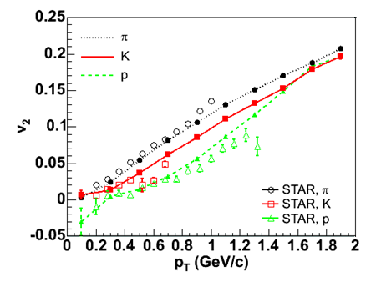

Two Major Discoveries at RHIC
Huge low-p_{T} v₂
  Described by hydro with low viscosity
Huge high-p_{T} suppression
  π⁰ R_{AA} described by pQCD
20-30%
Y. Akiba for the PHENIX collaboration, PLB630, 2005
Hirano et al., PRC77, 2008

Slide 3
Why Are These Interesting?
Want to characterize the QGP
  Can’t directly measure
    Use indirect tools
Is QGP:
  Most perfect fluid ever created/studied?
  Can one use strongly and/or weakly coupled field theory methods?
    pQCD vs. AdS/CFT
Enormous influence of geometry

Slide 4


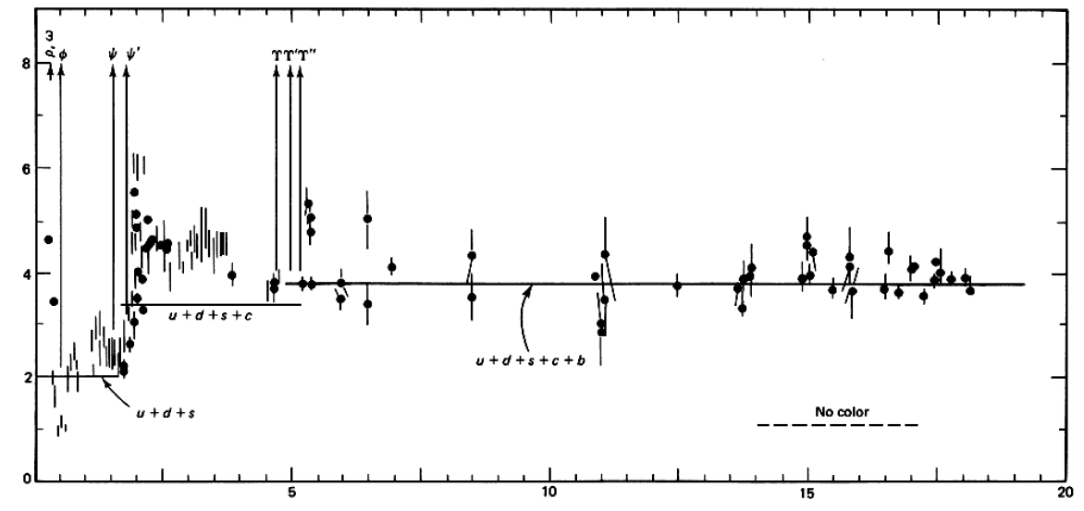

QCD: Theory of the Strong Force
    Running α_{s}
      -β-fcn
    SU(N_{c} = 3)
    N_{f}(E)
      N_{f}(RHIC) ≈ 2.5
PDG
ALEPH, PLB284, (1992)
Griffiths Particle Physics

Slide 5

What are We Interested In?
Measure many-body physics of strong force
Test & understand theory of many-body non-Abelian fields
Long Range Plan, 2008
Notes:
Unique as compared to strongly coupled Abelian problems

Slide 6
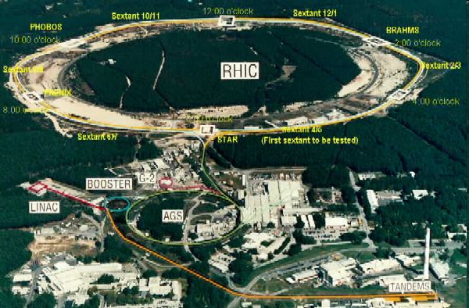
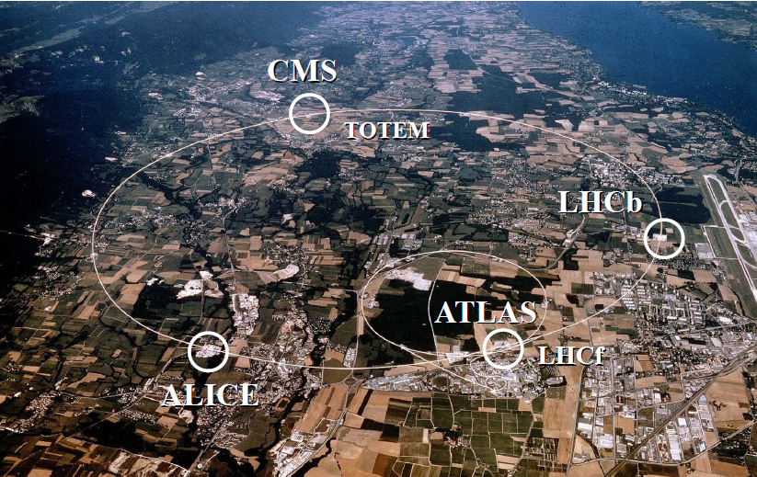
HI Collisions Tool for Strong Force Physics Study
Want a consistent picture of matter produced in HI collisions
  Then, want to quantify the properties of the produced matter

Slide 7
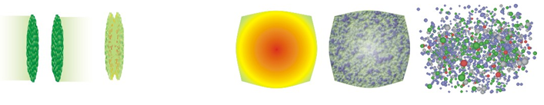
Spacetime Evolution of a HI Collision
At RHIC
  Nontrivial to learn about QGP through HIC
t = - ∞
t = 0
t = 1 fm/c
t = 3 fm/c
t = 4 fm/c
t = + ∞
Initial State
Initial Overlap
Thermalization
QGP
Hadronization
Hadron Gas

Slide 8


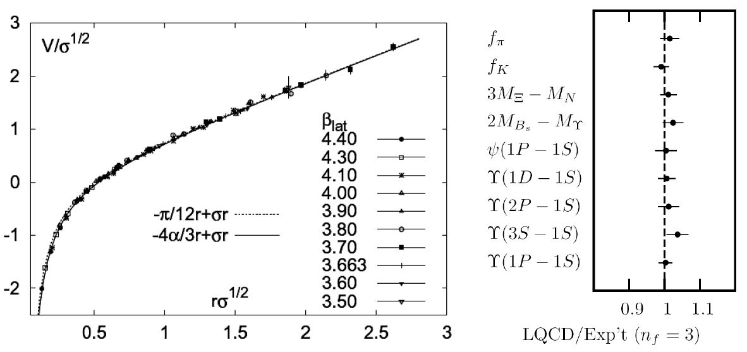
Methods of QCD Calculation I: Lattice
Long Range Plan, 2008
    All momenta
    Euclidean correlators
Kaczmarek and Zantow, PRD71 (2005)
Davies et al. (HPQCD), PRL92 (2004)

Slide 9


Methods of QCD Calculation II: pQCD
(perturbative QCD)
d’Enterria, 0902.2011
Jäger et al., PRD67 (2003)
    Any quantity
    Small coupling (large momenta only)

Slide 10




Methods III: AdS/CFT
Maldacena conjecture: SYM in d ⬄ IIB in d+1
Gubser, QM09
    All quantities
    N_{c} → ∞ SYM, not QCD
      Probably not good approx. for p+p; maybe A+A?
    Applicable to condensed matter systems?
Notes:
Next up, experiments!

Slide 11

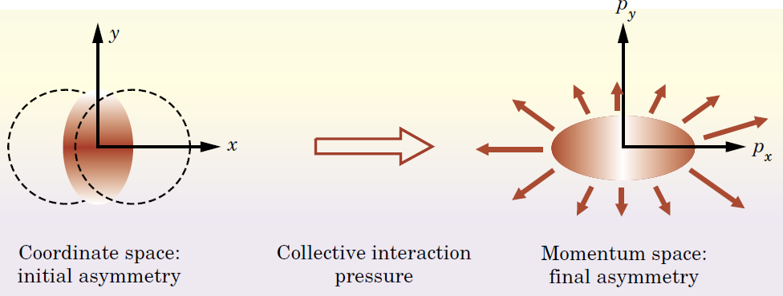
Geometry and Flow
Qualitative picture:
  Anisotropic initial
  geometry =>
  anisotropic flow

Slide 12
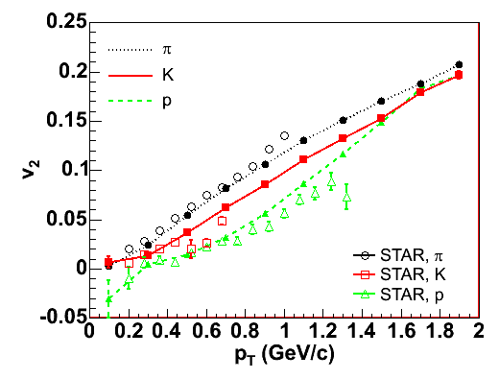

Hydrodynamics and v₂
Hydro
  Early therm.
  ∂_{μ}T^{μν} = 0
  Equation of State (EOS)
  Ideal: η/s = 0
  v₂: 2nd Fourier coef of particle spectrum:

Slide 13
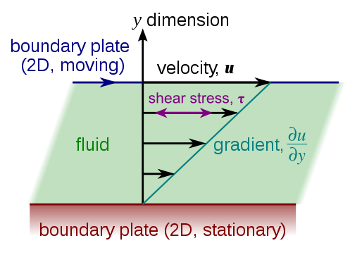
Viscous Hydrodynamics
Viscosity reduces elliptic flow
  Naive pQCD => η/s ~ 1
  Naive AdS/CFT => η/s ~ 1/4π
    => Strongly coupled medium?
Shear Viscosity, Wikipedia
Luzum and Romatschke,
Phys.Rev.C78:034915,2008

Slide 14
Geometry in Viscosity Extraction
Poorly constrained initial geom => 100% uncertainty in viscosity
  KLN CGC breaks down at edge of nuclear overlap
    Whole effect comes from edges!
    Experimental constraints needed!
T Hirano, et al.,
Phys.Lett.B636:299-304,2006

Slide 15

Why High-p_{T} Particles?
Tomography in medicine
One can learn a lot from a single probe…
and even more with multiple probes
SPECT-CT Scan uses internal γ photons and external X-rays
PET Scan
http://www.fas.org/irp/imint/docs/rst/Intro/Part2_26d.html

Slide 16

Tomography in QGP
Requires well-controlled theory of:
  production of rare, high-p_{T} probes
    g, u, d, s, c, b
  in-medium E-loss
  hadronization
Requires precision measurements of decay fragments
p_{T}
, γ, e⁻
φ
Invert attenuation pattern => measure medium properties

Slide 17


QGP Energy Loss
Learn about E-loss mechanism
  Most direct probe of DOF
pQCD Picture
AdS/CFT Picture

Slide 18

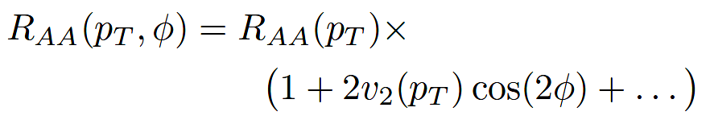
High-p_{T} Observables
    Naively: if medium has no effect, then R_{AA} = 1
    Common variables used are transverse momentum, p_{T}, and angle with respect to the reaction plane, φ
p_{T}
, γ, e⁻
    Fourier expand R_{AA}:
φ

Slide 19

pQCD Rad Picture
Bremsstrahlung Radiation
  Weakly-coupled plasma
    Medium organizes into Debye-screened centers
  T ~ 250 MeV, g ~ 2
    μ ~ gT ~ 0.5 GeV
    λ_{mfp} ~ 1/g²T ~ 1 fm
    R_{Au} ~ 6 fm
  1/μ << λ_{mfp} << L
    mult. coh. em.
Gyulassy, Levai, and Vitev, NPB571 (200)
  LPM
    dp_{T}/dt ~ -LT³ log(p_{T}/M_{q})
  Bethe-Heitler
    dp_{T}/dt ~ -(T³/M_{q}²) p_{T}

Slide 20
pQCD Success at RHIC:
(circa 2005)
Y. Akiba for the PHENIX collaboration, PLB630, 2005
  Consistency: R_{AA}(η)~R_{AA}(π)
  Null Control: R_{AA}(γ)~1
  GLV Prediction: Theory~Data for reasonable fixed L~5 fm and dN_{g}/dy~dN_{π}/dy

Slide 21
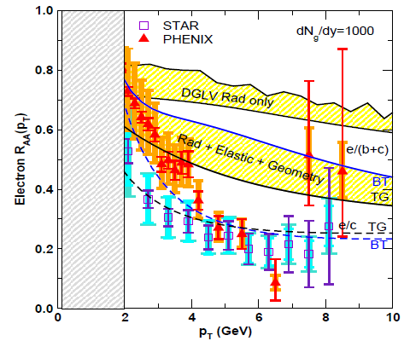
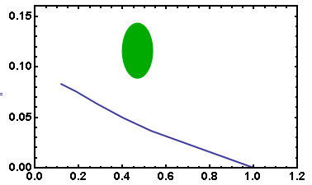
pQCD Seemingly Inadequate
Lack of even qualitative understanding
  π⁰, η, γ R_{AA} well described, BUT
  e⁻ R_{AA}, v₂ is not, even with elastic loss
PHENIX π⁰
9.5 GeV!
π⁰ v₂
WHDG
30-40% Centrality
π⁰ R_{AA}
Wicks et al.
pQCD assumes M << E:
b E-loss not under control
Death of pQCD at RHIC?

Slide 22
Jets in AdS/CFT
Model heavy quark jet energy loss by embedding string in AdS space
  dp_{T}/dt = - μ p_{T}
  μ = πλ^{1/2} T²/2M_{q}
  Similar to Bethe-Heitler
    dp_{T}/dt ~ -(T³/M_{q}²) p_{T}
  Very different from LPM
    dp_{T}/dt ~ -LT³ log(p_{T}/M_{q})
J Friess, S Gubser, G Michalogiorgakis, S Pufu, Phys Rev D75 (2007)

Slide 23
Compared to Data
String drag: qualitative agreement
WAH, PhD Thesis

Slide 24


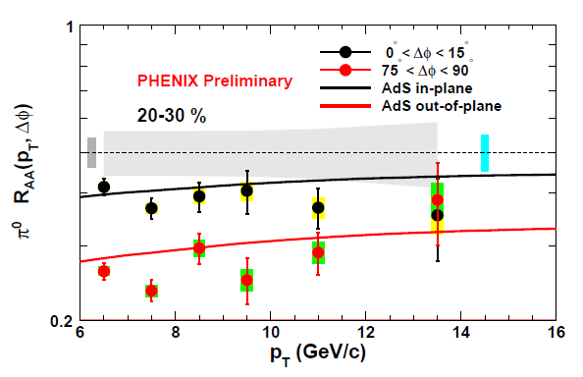
Light Quark and Gluon E-Loss
WAH, in preparation
ΔL^{g}_{therm} ~ E^{1/3}
ΔL^{q}_{therm} ~ (2E)^{1/3}
Renk and Marquet, PLB685, 2010

Slide 25
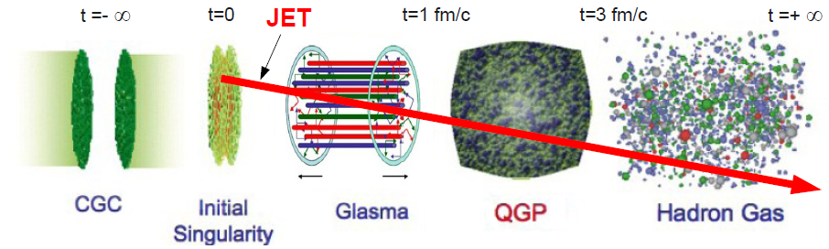
High-p_{T} and HIC Spacetime Evolution

Slide 26
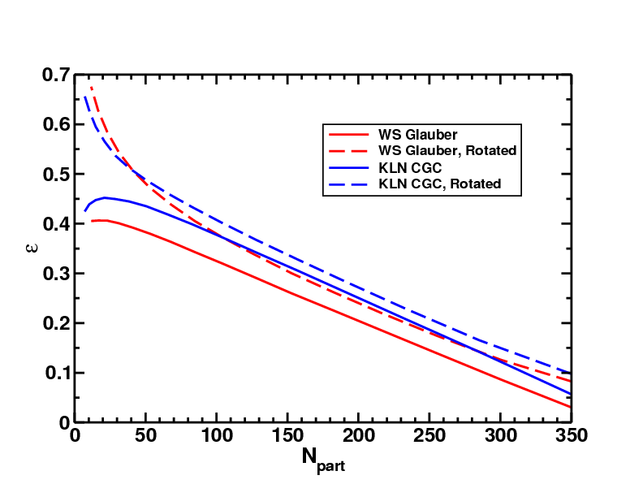
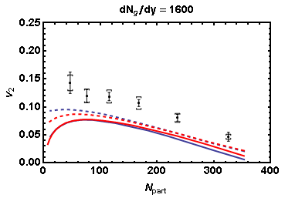
Geometry and High-p_{T} v₂
Effects of geom. on, e.g. v₂, might be quite large
  CGC vs. KLN and rotating RP
  Effect not large enough
WAH and J Jia, in preparation
Need experimental constraints on initial geometry!

Slide 27
Conclusions
Tantalizing physics discoveries at RHIC
  Large low-p_{T} v₂
    nearly perfect strongly coupled fluid
  Large high-p_{T} suppression
    weakly coupled quasiparticle plasma
Statement that QGP at RHIC is strongly coupled nearly ideal fluid depends sensitively on the IC
  Diffuse medium and AdS/CFT
  Sharp medium and pQCD
Exciting eRHIC and LHeC HI physics opportunities
  Knowledge of ρ (b) extremely important for quantitative (qualitative?) HI physics

