Slide 1
RHIC in the Age of the LHC
W. A. Horowitz
The Ohio State University
August 24, 2010
With many thanks to Brian Cole, Miklos Gyulassy, Ulrich Heinz, Jiangyong Jia, Jamie Nagle, and Yuri Kovchegov

Slide 2
Questions to Answer in the Next 10 Years

Slide 3
Some More Context
RHIC status quo over next few years:
  c and b separation
  U + U run
  ...?
Simultaneously LHC turns on
  November 9!
    Naively puts RHIC out of business
Is there a physics case for continuing RHIC?

Slide 4
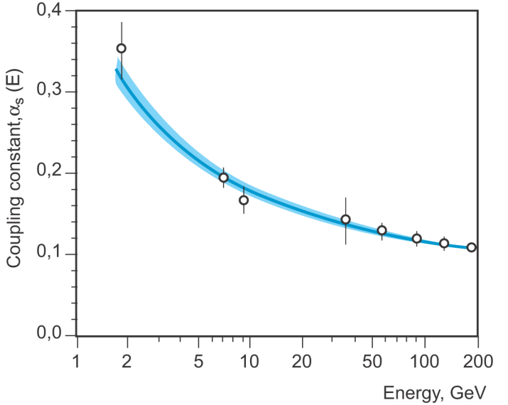
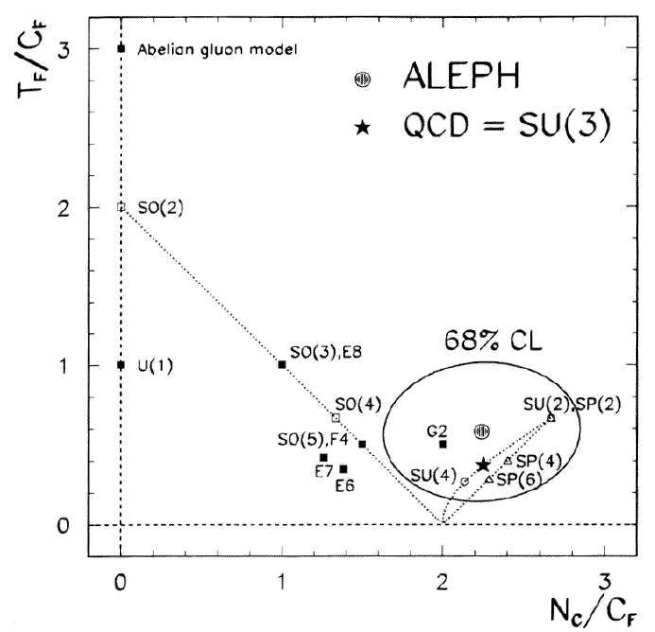
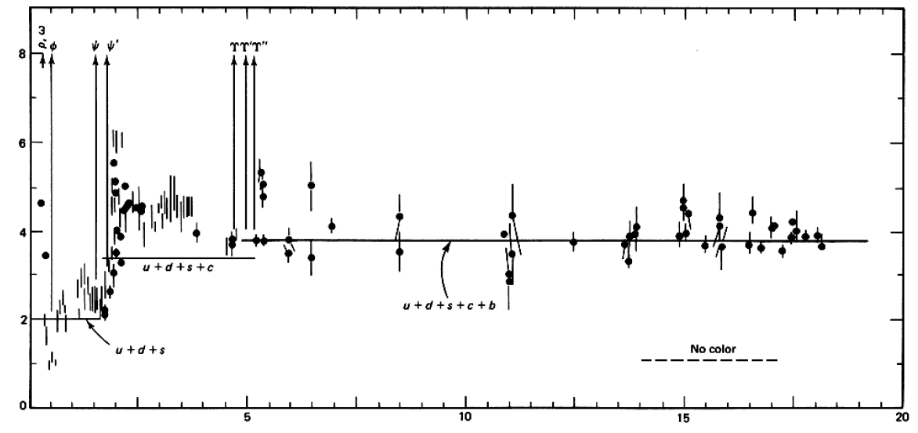

QCD: Theory of the Strong Force
    Running α_{s}
      -β-fcn
    SU(N_{c} = 3)
    N_{f}(E)
      N_{f}(RHIC) ≈ 2.5
PDG
ALEPH, PLB284, (1992)
Griffiths Particle Physics

Slide 5
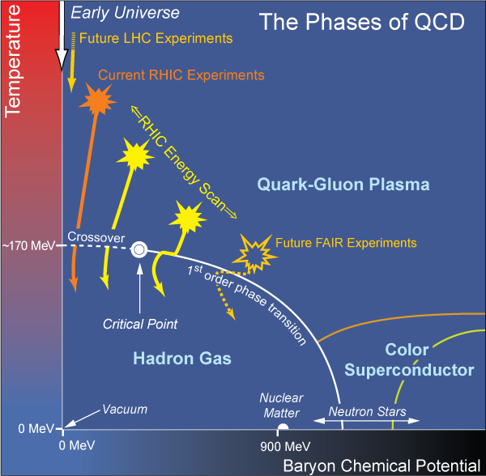
What are we interested in?
Measure many-body physics of strong force
Test & understand theory of many-body non-Abelian fields
Long Range Plan, 2008
Notes:
Unique as compared to strongly coupled Abelian problems

Slide 6
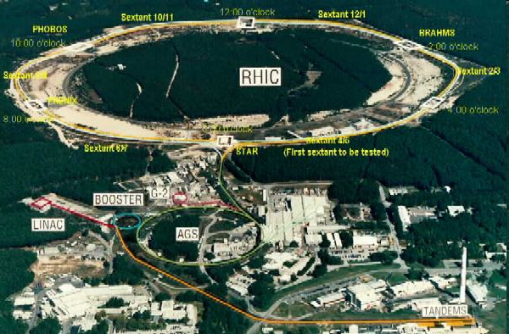
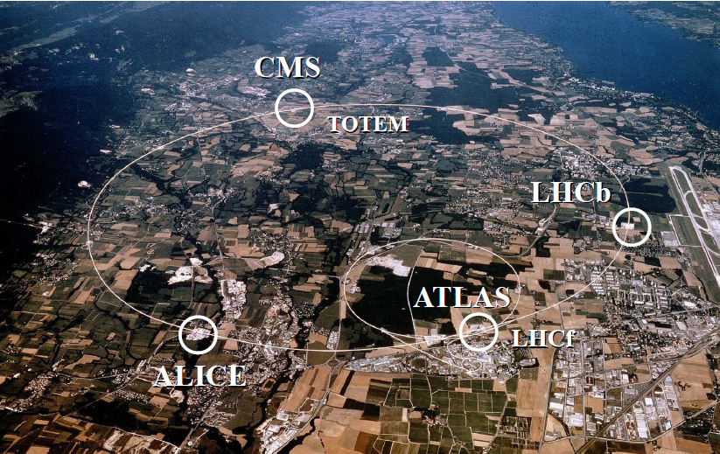
HI Collisions Tool for Strong Force Physics Study
Want a consistent picture of matter produced in HI collisions
  Then, want to quantify the properties of the produced matter

Slide 7
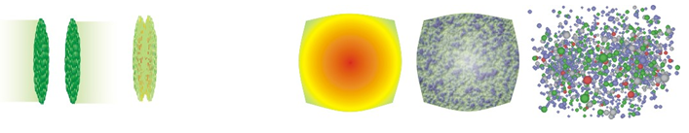
Spacetime Evolution of a HI Collision
At RHIC (LHC, too, but diff. time scales)
  Nontrivial to learn about QGP through HIC
t = - ∞
t = 0
t = 1 fm/c
t = 3 fm/c
t = 4 fm/c
t = + ∞
Initial State
Initial Overlap
Thermalization
QGP
Hadronization
Hadron Gas

Slide 8
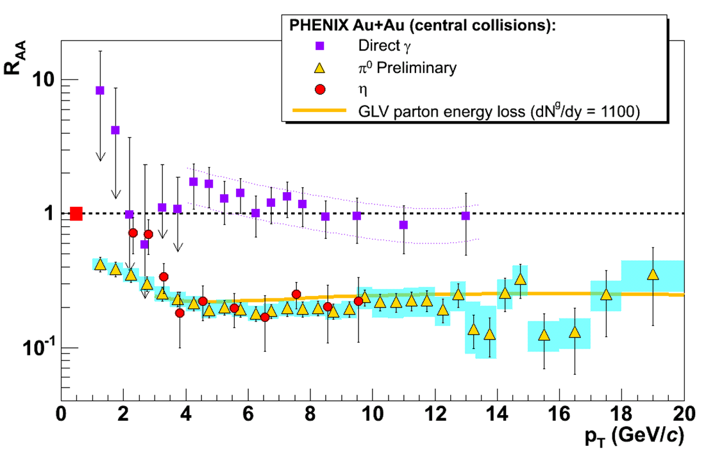
10 Years of RHIC: Two Pillars
Huge low-p_{T} v₂
  Described by hydro with low viscosity
Huge high-p_{T} supp.
  π⁰ R_{AA} described by pQCD
Luzum and Romatschke, Phys.Rev.C78:034915,2008
Y. Akiba for the PHENIX collaboration, hep-ex/0510008
Inconsistent picture?

Slide 9
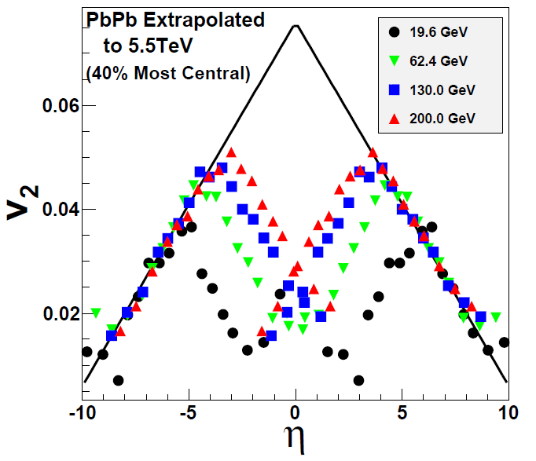
Two Big Qualitative Questions: I
Is hydro at RHIC a fluke?
  LHC will tell us on Nov. 9
    If v₂ breaks hydro limit a la Busza extrapolation, what the heck is happening at RHIC?
NA49, Phys.Rev.C68:034903,2003
W Busza, NPA 830,2009

Slide 10
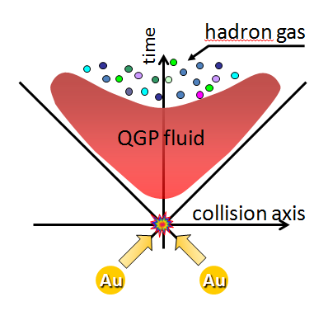
Hydro for the Next 10 Years
Suppose hydro works at LHC (likely)
  Want to understand full spacetime evolution

Slide 11
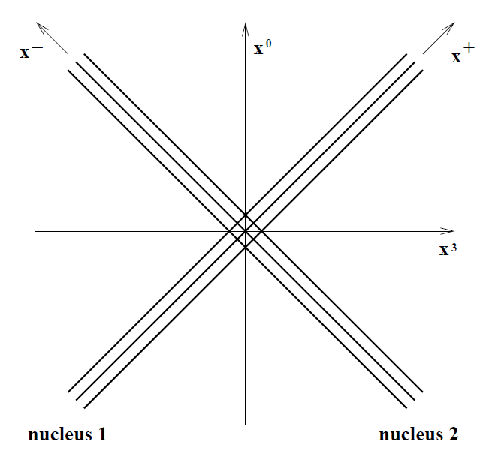
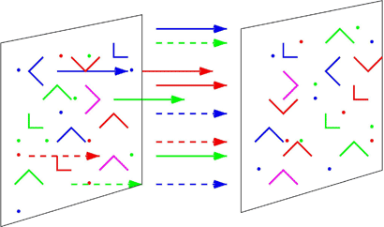
Understanding IC
Suppose hydro works at LHC (likely)
  How does the medium thermalize?
    What happens for t < τ_{therm}, what are IC for hydro?
AdS
Stopping?
McLerran and Gyulassy, NPA750, 2005
Albacete, Kovchegov, Taliotis, JHEP 0905, 2009

Slide 12
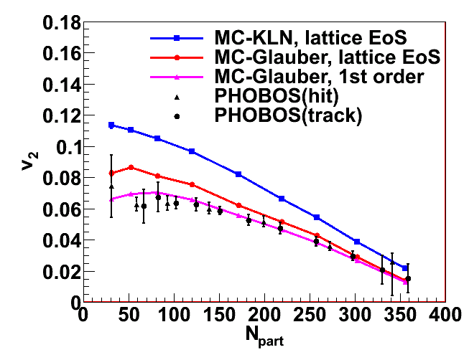
Quantify the Transport Properties
Suppose hydro works at LHC (likely)
  What, quantitatively, is its viscosity?
    What is the initial geom. & its fluct. (100% effect)
  Need for γ-γ cor? e-RHIC?
T Hirano, et al., Phys.Lett.B636:299-304,2006
Hirano and Nara, Phys.Rev.C79:064904,2009

Slide 13
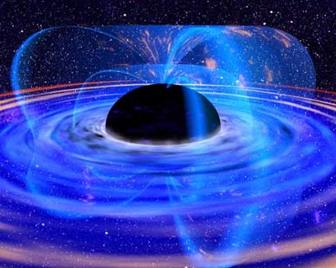
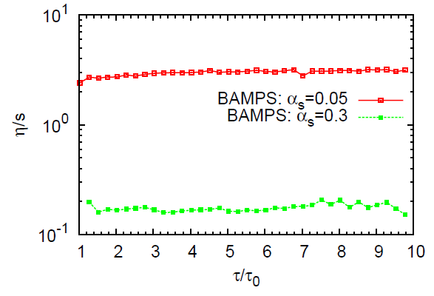
Physics of the Thermal Medium
Suppose hydro works at LHC (likely)
  Is the soft-soft physics described by
  a) AdS/CFT, b) pQCD or, c) other?
    Low viscosity ≠ strong coupling
El et al, PRC79, 2009

Slide 14
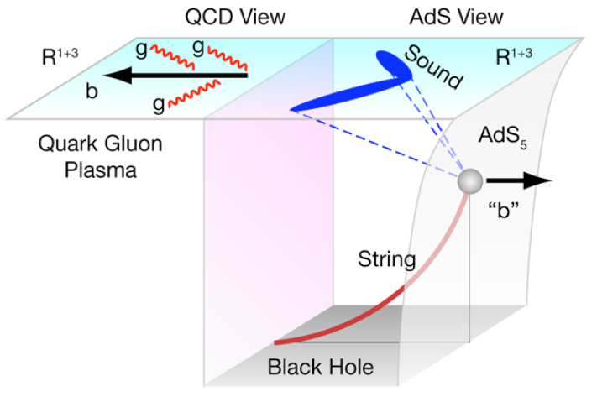

Two Big Qualitative Questions: II
How do high-p_{T} partons lose E to med.?
  What is the soft-soft physics, and how does it relate to soft-hard physics?
Puzzling,
Incomplete
Picture
M Gyulassy, Physics 2, 107 (2009)

Slide 15
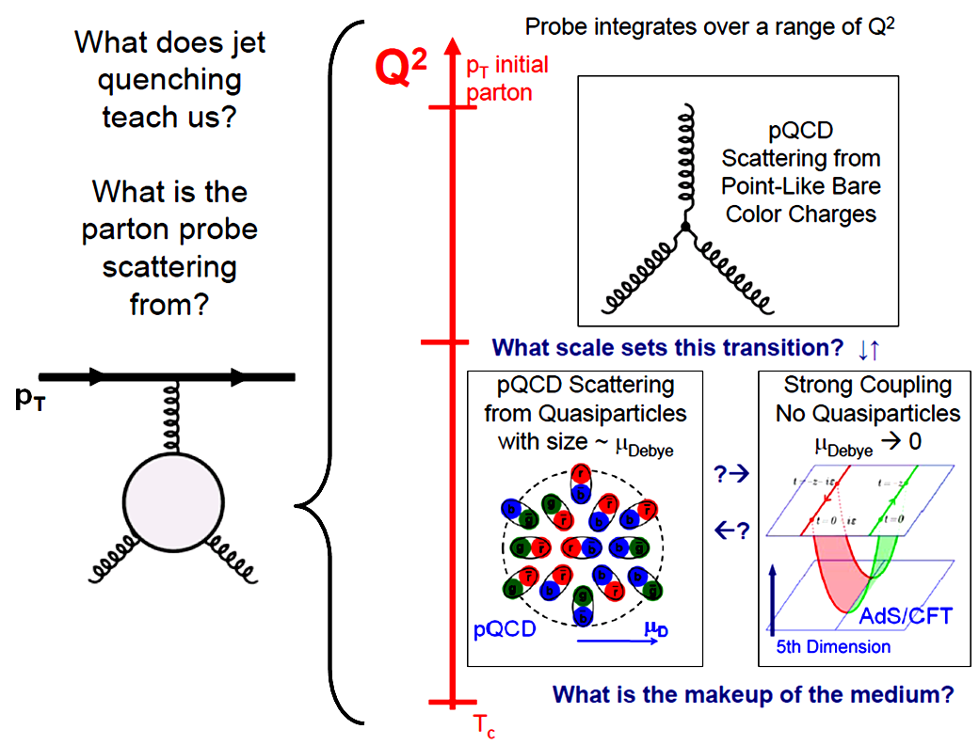
Pictorial Soft-Soft vs. Soft-Hard

Slide 16
pQCD Success at RHIC:
(circa 2005)
Y. Akiba for the PHENIX collaboration, hep-ex/0510008
  Consistency: R_{AA}(η)~R_{AA}(π)
  Null Control: R_{AA}(γ)~1
  GLV Prediction: Theory~Data for reasonable fixed L~5 fm and dN_{g}/dy~dN_{π}/dy

Slide 17
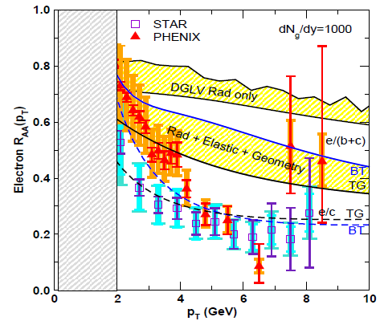
pQCD Suppression Picture Inadequate
Lack of even qualitative understanding
  π⁰, η, γ R_{AA} well described, BUT
  e⁻ R_{AA}, v₂ are not, even with elastic loss
    NB: M_{Q}/E << 1 assumed, not well controlled for b
PHENIX, Phys. Rev. Lett. 98, 172301 (2007)
Wicks et al.

Slide 18
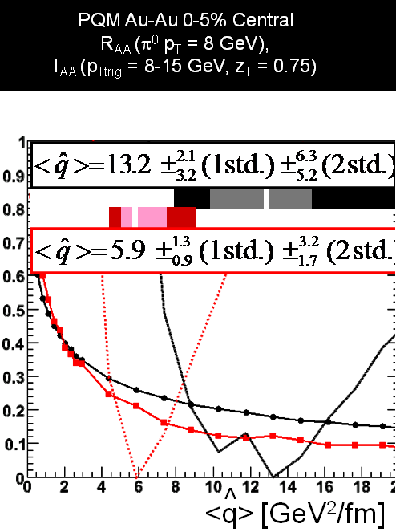
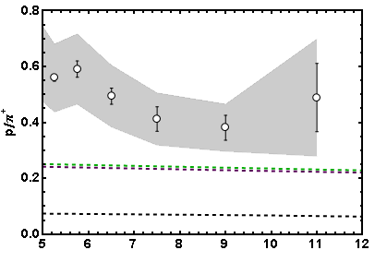
More Reasons for Concern
I_{AA}
  WHDG soon
Baryon/Meson Ratio
STAR
pQCD w/ DSS
pQCD w/ KKP
p_{T}
WAH, in preparation
Jamie Nagle, QM09
PID desired in future?

Slide 19
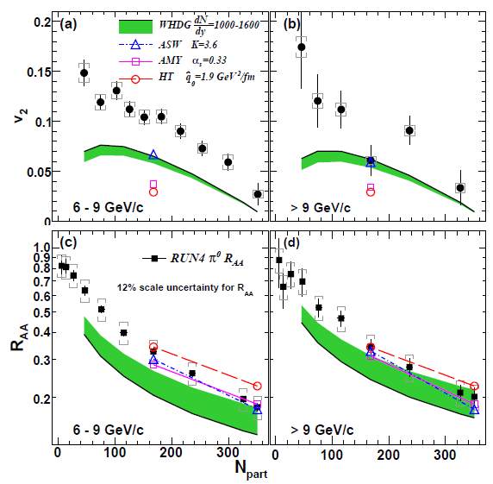
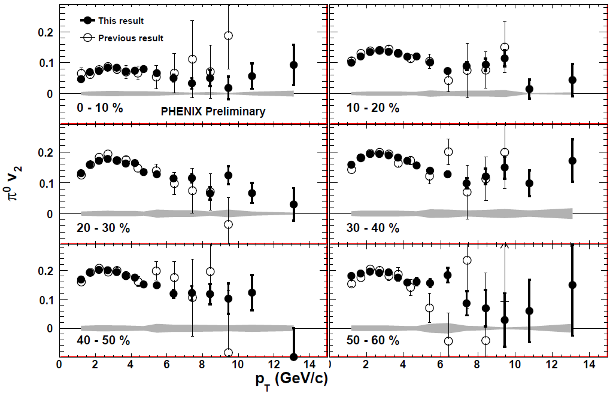
Death of pQCD at RHIC?
Failure at > 9 GeV!
Rui Wei, for PHENIX, QM09
PHENIX, arXiv:1006.3740
Pert. at LHC energies?
Notes:
Important to get to >~ 10 GeV to avoid IS, hadronization effects

Slide 20
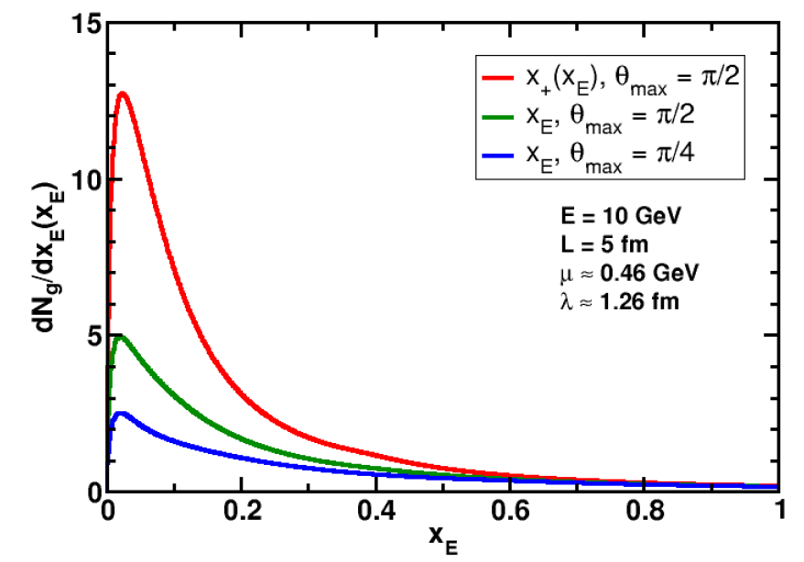
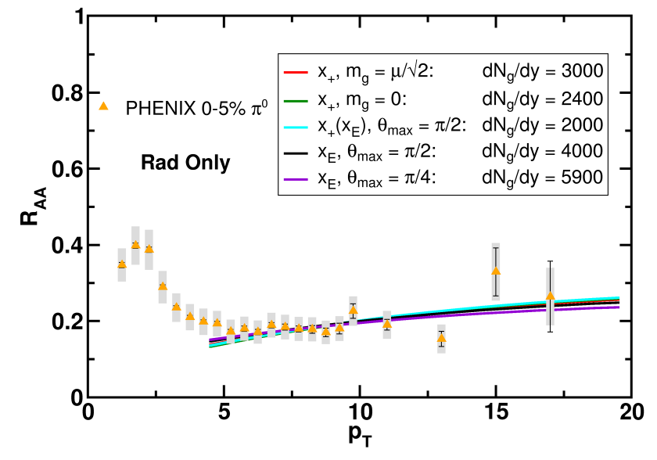
What About Theoretical Uncertainty?
Wide angle radiation not under th. control
Large unc. in dN_{g}/dy for given R_{AA}
WAH and B Cole, PRC81, 2010
R_{AA} ~ ∫(1- ϵ)^{n}P(ϵ);
P(ϵ) from Poisson conv. of dN_{g}/dx_{E}

Slide 21
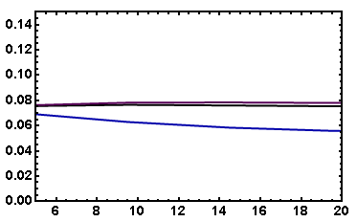
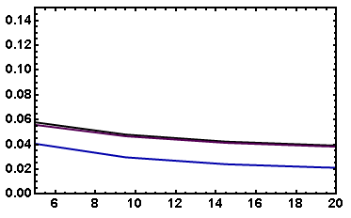
v₂: “Collinearly Safe”
Fix dN_{g}/dy from R_{AA}, calculate v₂
  Expect larger v₂ for smaller opening angle
    ( τ_{coh} ~ 1/k_{T}² )
  I_{AA}: coming soon
    Rad Only
    Rad + El
20-30% π⁰
20-30% π⁰
v₂
v₂
p_{T}
p_{T}
WAH, in preparation

Slide 22
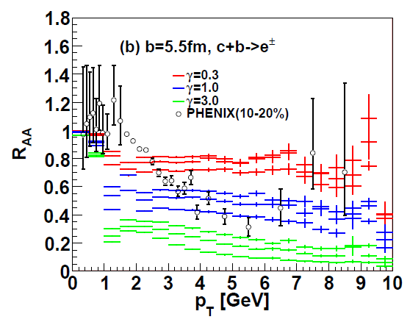
An Alternative Picture
AdS Drag: qual. agreement with NPE R_{AA}
  Result less controlled at higher p_{T}
Akamatsu, Hatsuda, Hirano, PRC79, 2009

Slide 23
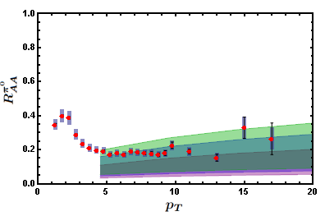
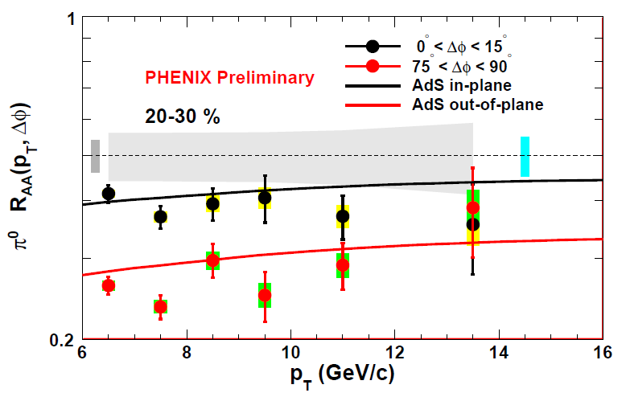
AdS Applied to π⁰
π⁰ R_{AA}
  Surprisingly not oversuppressed
π⁰ v₂
  ΔE ~ L³!
WAH, in preparation
Marquet and Renk, PLB685 (2010)
Convinced? Need to dot i’s and cross t’s

Slide 24
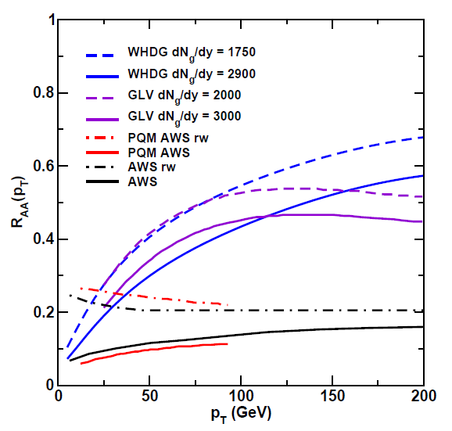
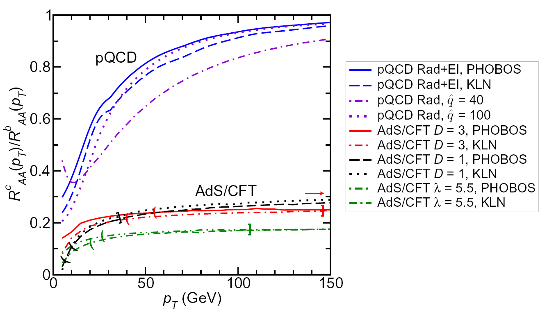
Future of High-p_{T} Physics
On one hand: Higher and higher p_{T}
  Look towards LHC for qual. understanding
    pQCD at extremely large, p_{T} ~ 100-200 GeV?
WAH, M. Gyulassy, PLB666 (2008)

Slide 25
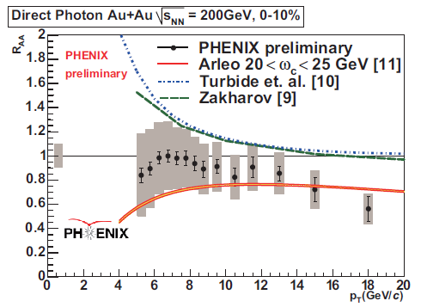
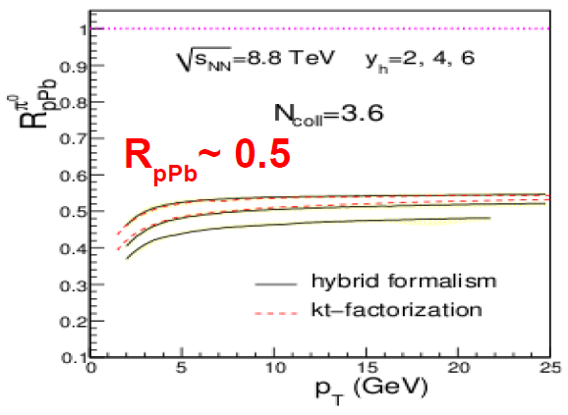
Reasons to be Cautious about LHC
Quenching due to IS or FS?
  Need experimental control over production
    p + A in...?
T Isobe, JPhysG34 (2007)
Albacete and Marquet, PLB687, 2010
=> R_{PbPb} ~ 0.25!

Slide 26
Will LHC Solve Everything?
Two possibilities
(assuming LHC jets exist, controllable)
  pQCD takes over at very high p_{T}
  Strong coupling effects at all p_{T}
Either way, full understanding requires consistent picture of full spacetime evolution: must vary √s and A, control IC
  Want to test in as many ways as possible
This will require a lot of flexibility & run time—Only RHIC + eRHIC can provide this

Slide 27
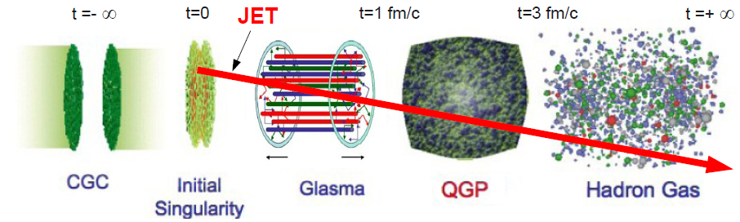
Why RHIC Will Remain Relevant
Uncertainty in every step
Uncertainty in every step
Want to turn all available exp. knobs on QGP

Slide 28
Why Vary √s and A?
Effects of t < τ_{therm}
  What are the soft-soft, soft-hard modes; what is their effect on high-p_{T} partons?
    Vary τ_{therm}
Importance of geometry?
  Glauber vs. CGC vs. ?
  Fluctuations
  Edge effects, hadronization
  Coupling of E-loss with low-p_{T} flow
    Vary geometry
How do high-p_{T} partons lose E in HG?
  Vary time in QGP vs. Hadron Gas
  e + A and/or JLab
T dependence of E loss

Slide 29
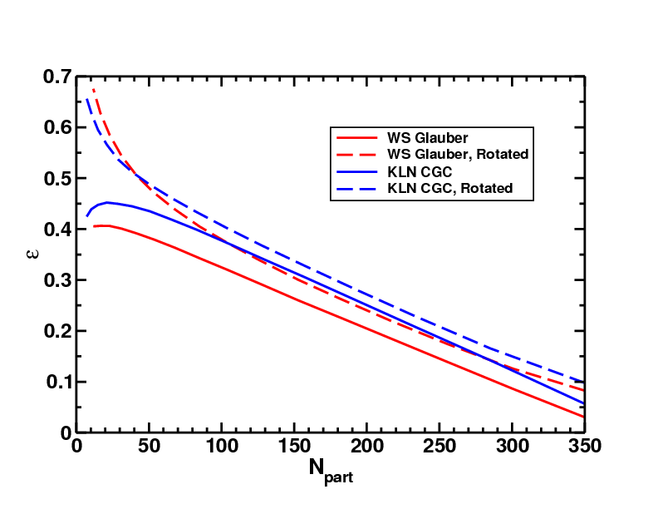
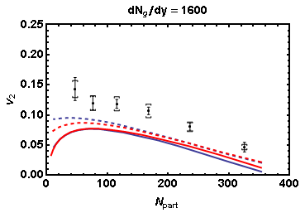
Need to Dot i’s and Cross t’s
Effects of geom. on, e.g. v₂, might be quite large
  CGC vs. KLN and rotating RP
  Effect not large enough
WAH and J Jia, in preparation
Possibly truly outlandish initial geometry?

Slide 30
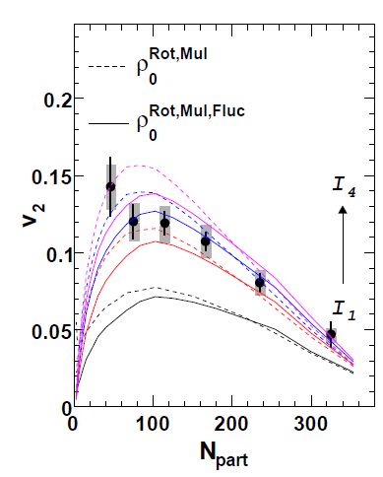
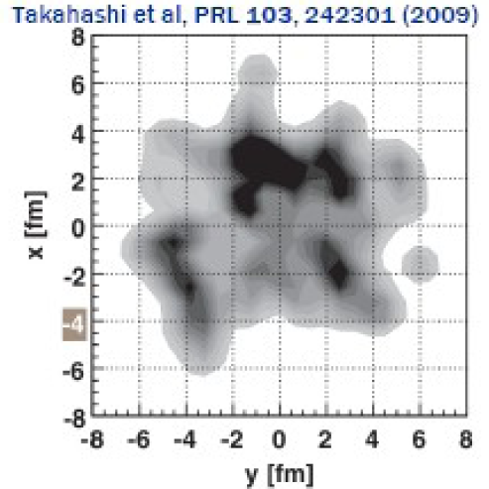
What About Fluctuations?
Hot spots can be huge
  NEXUS calculation for 10% most central top RHIC energy event
For simple E-loss not a large effect
  Important for fluc., opacity exp.?
Jia and Wei,
arXiv:1005.0645

Slide 31
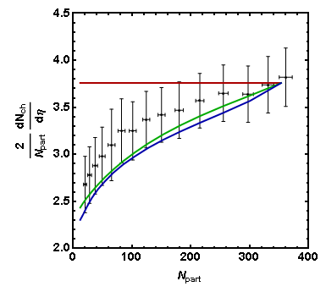
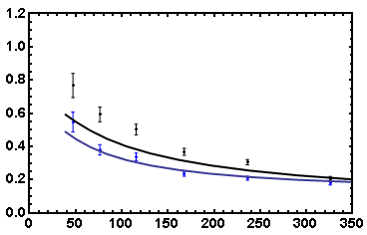
Coupling of Flow to Eloss
Is high-p_{T} v₂ huge b/c medium push?
  R_{AA}(φ = 0, N_{part}) vs. R_{AA}(φ = π/2, N_{part})
WS Glauber
HN Mixed
KLN CGC
PHENIX Preliminary
7-8 GeV π⁰
R_{AA} in
R_{AA} out
R_{AA}
PHOBOS 2008 Data
N_{part}
Care taken with dN_{g}/dy(N_{part})
Horowitz and Jia, in preparation
Smaller influence of fluc.?

Slide 32
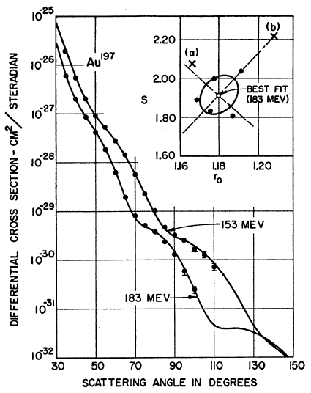
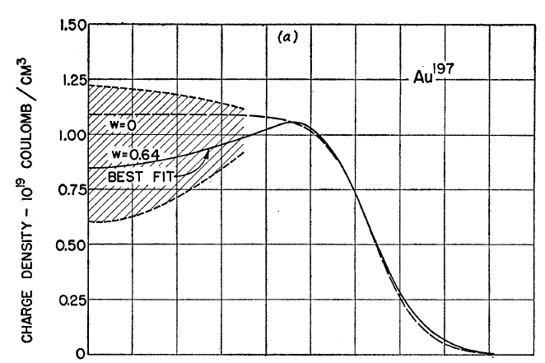
Measuring the IC
eRHIC could give experimental handle on initial geometry
  Recall e + A diffraction exps. on A at rest
Hahn, Ravenhall, and Hofstadter, Phys Rev 101 (1956)

Slide 33
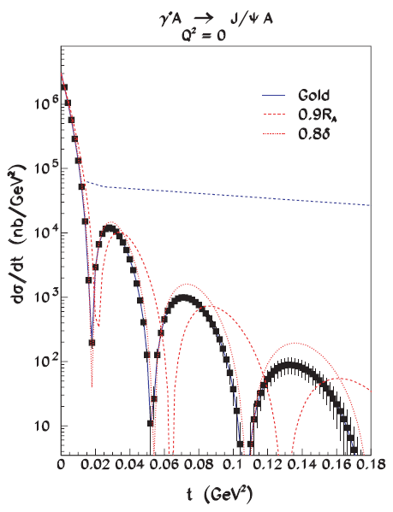
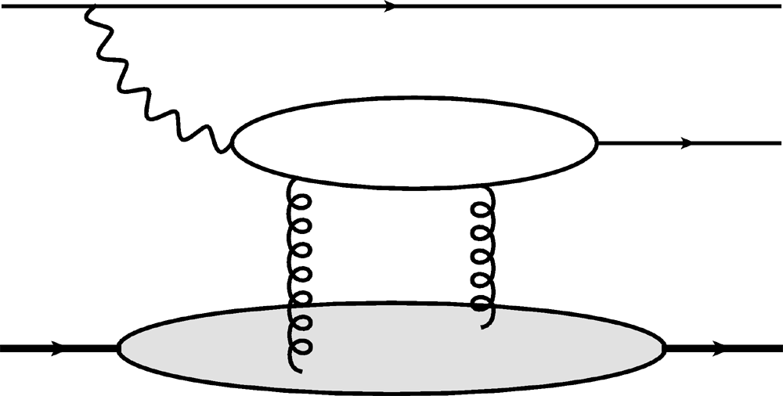
Gluon Distribution of A at x ~ 10⁻³
Coherent vector meson production in e + A
e
e’
J/ψ
γ*
Must reject incoherent
collisions at ~100%
A
A’
  2 gluon exchange
  => mean & correlations
Also DVCS and
Incoherent production
10⁶ J/ψ Events
Caldwell and Kowalski, PRC 81 (2010)

Slide 34
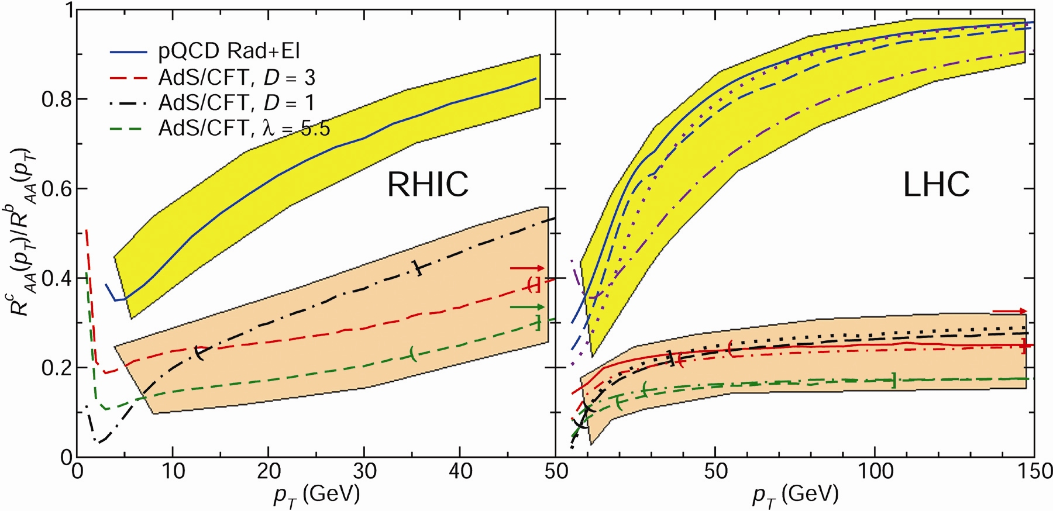
Ex: T Dependence of AdS SL
  Bands for guiding the eye only
pQCD
pQCD
AdS/CFT
AdS/CFT
WAH, M. Gyulassy, JPhysG35 (2008)

Slide 35
Conclusions
After 10 years, RHIC is still surprising us
  Current picture of collision is incomplete, inconsistent
LHC will open up completely new frontiers, new surprises
  Likely help settle qualitative picture
However, I want a detailed, controlled understanding of med. prop., E-loss: RHIC + eRHIC
  Knowledge of initial geometry required
  Vary √s and A
    Require great flexibility & run time, i.e. RHIC
      Will need many d + A control runs for high-p_{T}
    For high-p_{T} jet reconstruction necessary at low √s
  Jet modification likely necessary to distinguish pQCD E-loss

