Slide 1
Phenomenology of the
Quark-Gluon Plasma
W. A. Horowitz
The Ohio State University
September 13, 2010
With many thanks to Miklos Gyulassy,
Ulrich Heinz, and Yuri Kovchegov

Slide 2


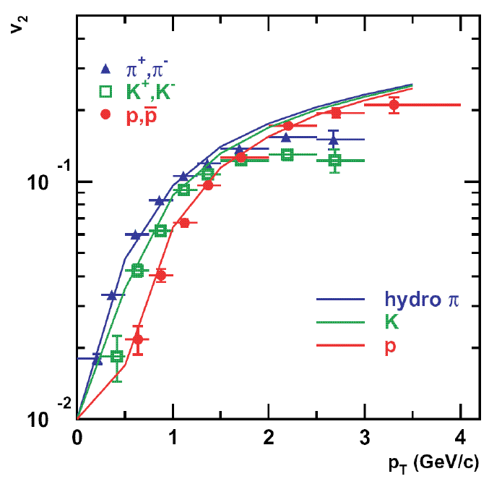
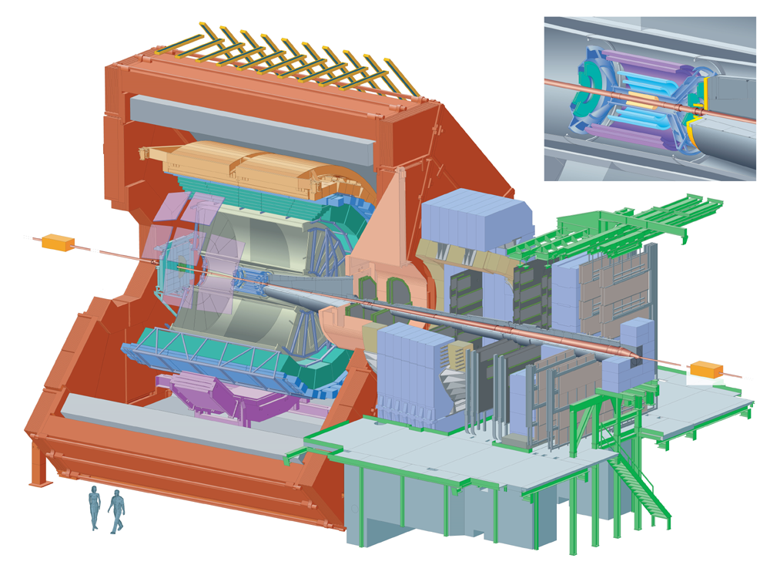

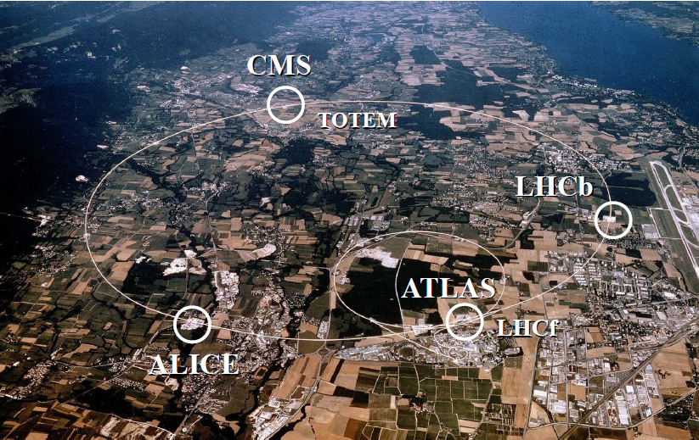
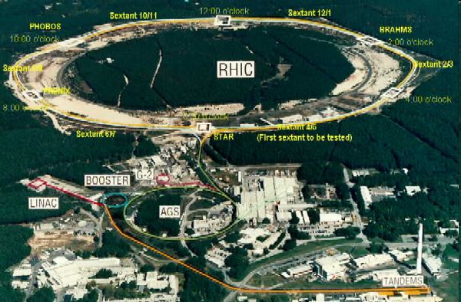

Outline
Motivation
Introduction
  Heavy Ion Collisions
  Experiments
  Theory
Current Status
  Hydrodynamics
  Energy loss
Future Outlook
Conclusions
ALICE Collaboration
PHENIX White Paper
Y. Akiba for the PHENIX collaboration, hep-ex/0510008
Jäger et al., PRD67 (2003)
Long Range Plan, 2008

Slide 3

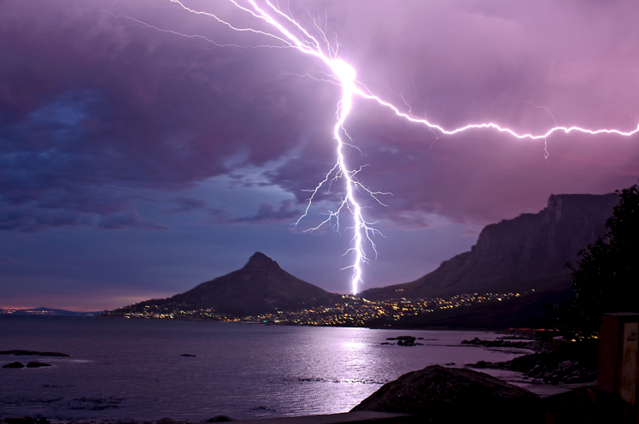


Four Fundamental Forces
Gravity
Electromagnetism
starchild.gsfc.nasa.gov
John Maarschalk, travelblog.portfoliocollection.com
Weak
Strong
lhs.lps.org/staff/sputnam/chem_notes/tritium_decay.gif

Slide 4

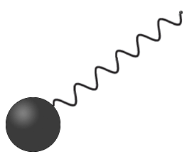
Strong compared to E&M
Electromagnetism
  Electric charge (+)
    electrons
  Carriers: photons
  Field theory:
    Quantum electro-dynamics (QED)
Strong
  Color charge (r, g, b)
    quarks
  Carriers: gluons
  Field theory:
    Quantum chromo-dynamics (QCD)
-
Hydrogen
Look Inside
+
Proton
nobelprize.org

Slide 5

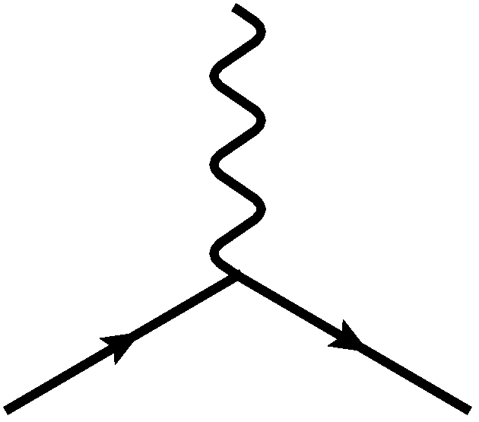
E&M Particle Physics Well Understood
Lagrangian known:
QED Vertex:
Ex. of Precision QED: g - 2
Gabrielse et al., PRL97 (2006)
Hanneke, Fogwell, and Gabrielse, PRL100 (2008)

Slide 6
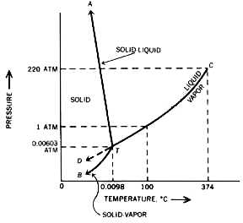

E&M and Phase Diagrams
Many body physics less well understood
Water
Hydrogen
www.sv.vt.edu/classes/MSE2094_NoteBook/96ClassProj/examples/triplpt.html
Calculated, Burkhard Militzer,
Diploma Thesis, Berlin, 2000

Slide 7




QCD Particle Physics Well Understood
Lagr. known:
QCD Vertices:
Qual. & Quant. agreement w/ data
ALEPH,
PLB284
(1992)
PDG

Slide 8
What Are We Interested In?
Measure many-body physics of strong force
Test & understand theory of many-body non-Abelian fields
Long Range Plan, 2008
Notes:
Unique as compared to strongly coupled Abelian problems

Slide 9
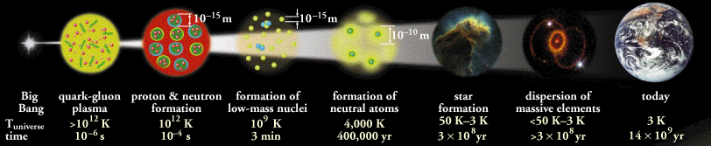
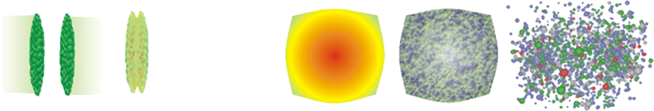
Big Bang vs. Little Bang
ALICE Collaboration
t = - ∞
t = 0
t = 1 fm/c
t = 3 fm/c
t = 4 fm/c
t = + ∞
Initial State
Initial Overlap
Thermalization
QGP
Hadronization
Hadron Gas

Slide 10
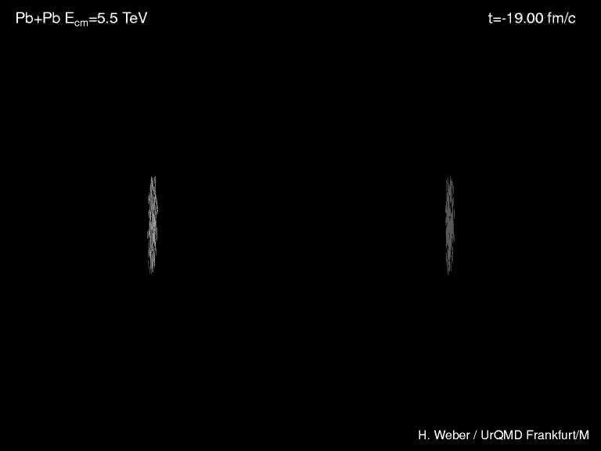
Heavy Ion Collisions
Collider machines: RHIC, LHC
Relativistic Heavy Ion Collider
Large Hadron Collider

Slide 11

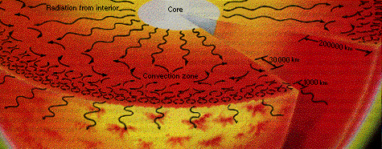
Orders of Magnitude
Units: MeV, GeV
  At RHIC, nuclei acc. to 100 GeV per nucleon
    Energy of collision ~ two mosquitoes colliding
  T_{c} ~ Λ_{QCD} ~ 200 MeV
    Temp. at RHIC ~ 10,000 times hotter than the core of the sun (15,000,000 Kelvin)
www.answersingenesis.org
Chaisson and McMillan,
Astronomy Today (1993)

Slide 12
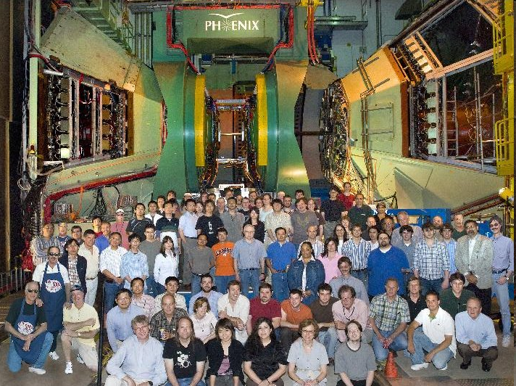
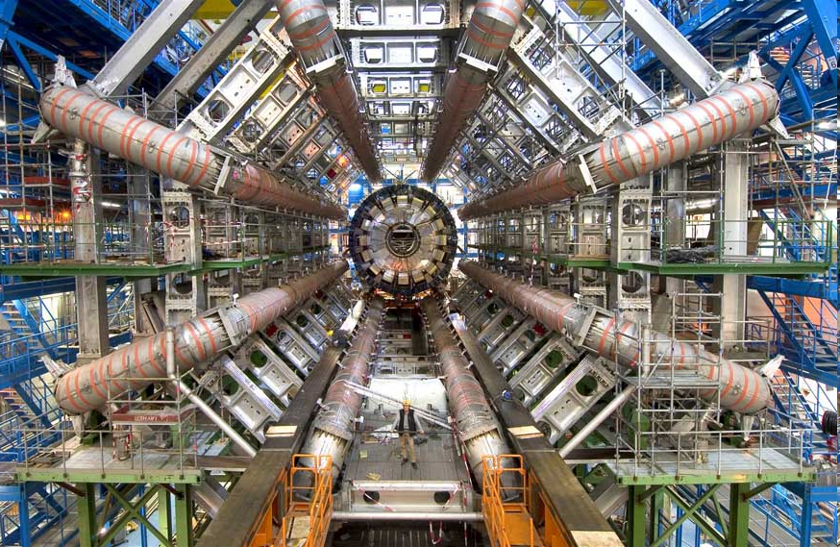
Experiments
RHIC
  BRAHMS
  PHENIX
  PHOBOS
  STAR
LHC
  ALICE
  ATLAS
  CMS
  LHCb
PHENIX
ATLAS

Slide 13


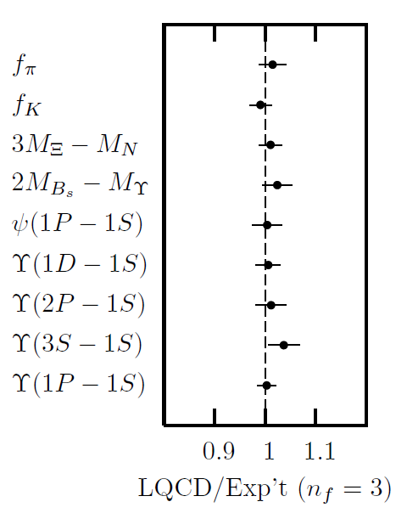
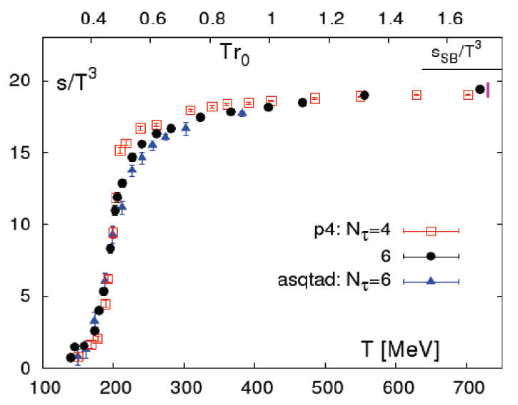
Methods of QCD Calculation I: Lattice
Long Range Plan, 2008
    All momenta
    Euclidean correlators
Cheng et al., PRD77 (2008)
Davies et al. (HPQCD),
PRL92 (2004)

Slide 14

Methods of QCD Calculation II: pQCD
(perturbative QCD)
d’Enterria, 0902.2011
Jäger et al., PRD67 (2003)
    Any quantity
    Small coupling (large momenta only)

Slide 15




Methods III: AdS/CFT
Maldacena conjecture: SYM in d ⬄ IIB in d+1
Gubser, QM09
    All quantities
    N_{c} → ∞ SYM, not QCD
      Probably not good approx. for p+p; maybe A+A?
    Applicable to condensed matter systems?
Notes:
Next up, experiments!

Slide 16
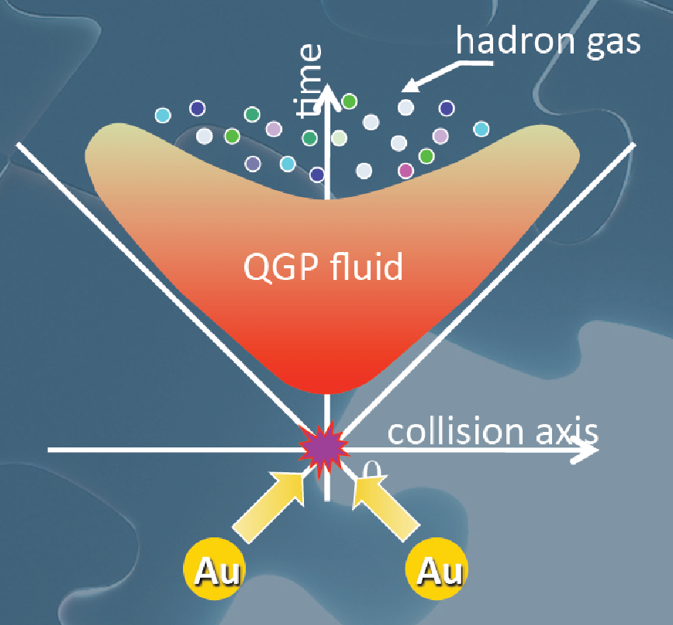
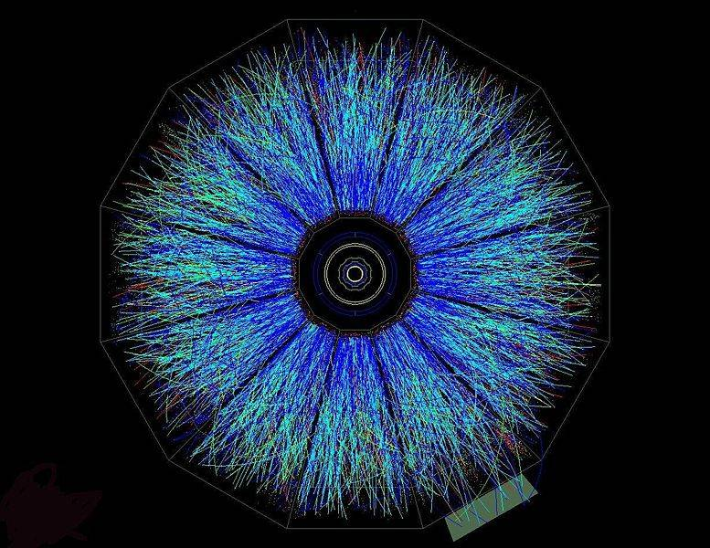
Evolution of a HI Collision
T Hirano, Colliding Nuclei from AMeV to ATeV
STAR

Slide 17
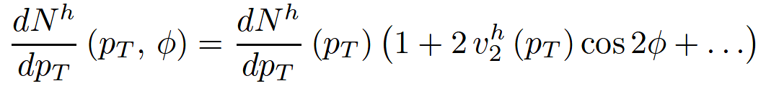

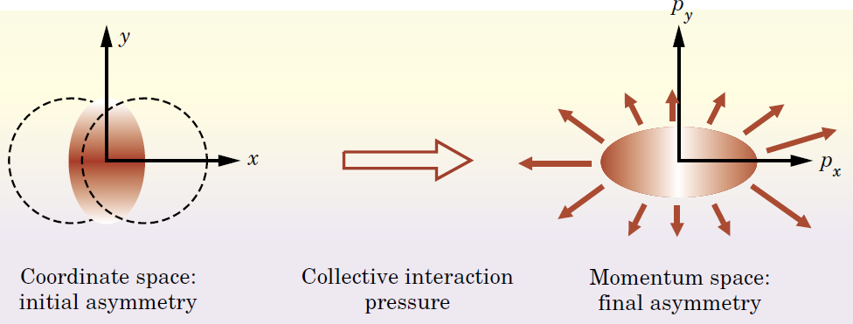
Geometry and Flow
Qualitative picture:
  Anisotropic initial
  geometry =>
  anisotropic flow
M Kaneta, Results from
the Relativistic Heavy
Ion Collider (Part II)
T Ludlum and L McLerran,
Phys. Today 56N10 (2003)

Slide 18
Hydrodynamics and v₂
Ideal Hydro
  ∂_{μ}T^{μν} = 0
  Equation of State (EOS)
  Ideal: η/s = 0
  v₂: 2nd Fourier coef of particle spectrum:
PHENIX White Paper

Slide 19
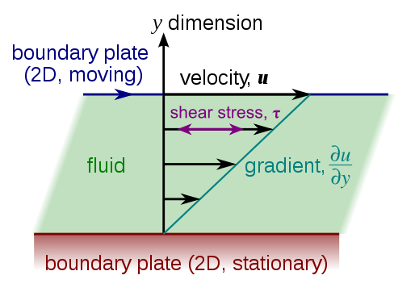
Viscous Hydrodynamics
Viscosity reduces elliptic flow
  Naive pQCD => η/s ~ 1
  Naive AdS/CFT => η/s ~ 1/4π
Shear Viscosity, Wikipedia
Luzum and Romatschke,
Phys.Rev.C78:034915,2008

Slide 20
Geometry in Viscosity Extraction
  Poorly constrained initial geom => >100% uncertainty in viscosity
    Conservative estimate: η/s < 6 x 1/4π
T Hirano, et al.,
Phys.Lett.B636:299-304,2006

Slide 21

Why High-p_{T} Jets?
Tomography in medicine
One can learn a lot from a single probe…
and even more with multiple probes
SPECT-CT Scan uses internal γ photons and external X-rays
PET Scan
http://www.fas.org/irp/imint/docs/rst/Intro/Part2_26d.html

Slide 22

Tomography in QGP
Requires well-controlled theory of:
  production of rare, high-p_{T} probes
    g, u, d, s, c, b
  in-medium E-loss
  hadronization
Requires precision measurements of decay fragments
p_{T}
, γ, e⁻
φ
Invert attenuation pattern => measure medium properties

Slide 23


QGP Energy Loss
Learn about E-loss mechanism
  Most direct probe of DOF
pQCD Picture
AdS/CFT Picture

Slide 24

pQCD Rad Picture
Bremsstrahlung Radiation
  Weakly-coupled plasma
    Medium organizes into Debye-screened centers
  T ~ 250 MeV, g ~ 2
    μ ~ gT ~ 0.5 GeV
    λ_{mfp} ~ 1/g²T ~ 1 fm
    R_{Au} ~ 6 fm
  1/μ << λ_{mfp} << L
    mult. coh. em.
Gyulassy, Levai, and Vitev, NPB571 (2000)
  LPM
    dp_{T}/dt ~ -LT³ log(p_{T}/M_{q})
  Bethe-Heitler
    dp_{T}/dt ~ -(T³/M_{q}²) p_{T}

Slide 25
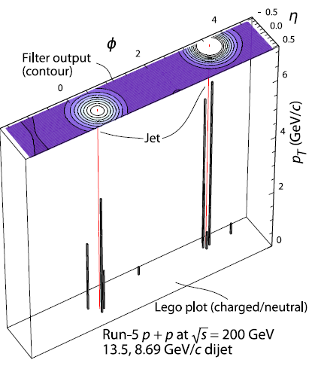
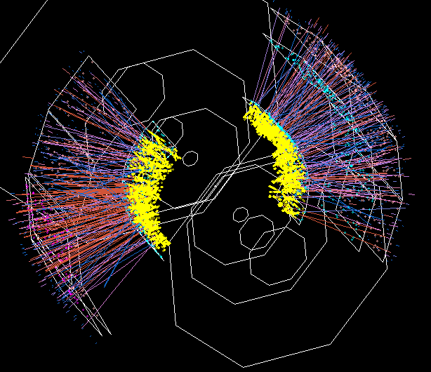

Jets in Heavy Ion Collisions
p+p
Au+Au
Y-S Lai, RHIC & AGS Users’ Meeting, 2009
PHENIX

Slide 26
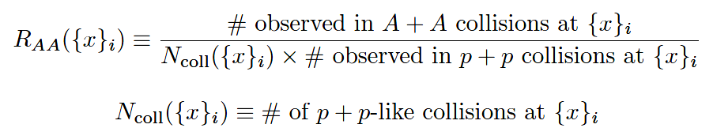
High-p_{T} Observable
    Naively: if medium has no effect, then R_{AA} = 1

Slide 27
pQCD Success at RHIC:
(circa 2005)
Y. Akiba for the PHENIX collaboration, hep-ex/0510008
  Consistency: R_{AA}(η)~R_{AA}(π)
  Null Control: R_{AA}(γ)~1
  GLV Prediction: Theory~Data for reasonable fixed L~5 fm and dN_{g}/dy~dN_{π}/dy

Slide 28

Qualitative Disagreement
Mass of quarks should be important
  Expect heavy quarks to lose less energy
Non-photonic electrons (NPE) surprisingly suppressed
  Decay fragments of c and b quarks
PHENIX NPE
e⁻
Djordjevic,et al. PLB632 (2006)

Slide 29


What About Elastic Loss?
Appreciable!
Finite time effects small
Mustafa, PRC72 (2005)
Adil, Gyulassy, WAH, Wicks, PRC75 (2007)

Slide 30

Quantitative Disagreement Remains
Wicks, WAH, Gyulassy, Djordjevic, NPA784 (2007)
Pert. at LHC energies?

Slide 31
Jets in AdS/CFT
Model heavy quark jet energy loss by embedding string in AdS space
  dp_{T}/dt = - μ p_{T}
  μ = πλ^{1/2} T²/2M_{q}
  Similar to Bethe-Heitler
    dp_{T}/dt ~ -(T³/M_{q}²) p_{T}
  Very different from LPM
    dp_{T}/dt ~ -LT³ log(p_{T}/M_{q})
J Friess, S Gubser, G Michalogiorgakis, S Pufu, Phys Rev D75 (2007)

Slide 32
Compared to Data
String drag: qualitative agreement
WAH, PhD Thesis

Slide 33

An Enhanced Signal: LHC
But what about the interplay between mass and momentum?
  Take ratio of c to b R_{AA}(p_{T})
    pQCD: Mass effects die out with increasing p_{T}
      Ratio starts below 1, asymptotically approaches 1. Approach is slower for higher quenching
    ST: drag independent of p_{T}, inversely proportional to mass. Simple analytic approx. of uniform medium gives
    R^{cb}_{pQCD}(p_{T}) ~ n_{b}M_{c}/n_{c}M_{b} ~ M_{c}/M_{b} ~ .27
      Ratio starts below 1; independent of p_{T}
R^{cb}_{pQCD}(p_{T}) ∼ 1 - α_{s} n(p_{T}) L² log(M_{b}/M_{c}) ( /p_{T})

Slide 34


LHC R^{c}_{AA}(p_{T})/R^{b}_{AA}(p_{T}) Prediction
Zoo of c and b Predictions:
WAH, M. Gyulassy, PLB666 (2008)
      Taking the ratio cancels most normalization differences seen previously
      pQCD ratio asymptotically approaches 1, and more slowly so for increased quenching (until quenching saturates)
      AdS/CFT ratio is flat and many times smaller than pQCD at only moderate p_{T}
WAH, M. Gyulassy, PLB666 (2008)

Slide 35

Not So Fast!
  Speed limit estimate for applicability of AdS drag
    γ < γ_{crit} = (1 + 2M_{q}/λ^{1/2} T)²
    ~ 4M_{q}²/(λ T²)
      Limited by M_{charm} ~ 1.2 GeV
    Similar to BH LPM
      γ_{crit} ~ M_{q}/(λT)
  No Single T for QGP
    smallest γ_{crit} for largest T
    T = T(τ₀, x=y=0): “(”
    largest γ_{crit} for smallest T
    T = T_{c}: “]”
D7 Probe Brane
Q
Worldsheet boundary Spacelike if γ > γ_{crit}
x₅
Trailing
String
“Brachistochrone”
“z”
D3 Black Brane

Slide 36

LHC R^{c}_{AA}(p_{T})/R^{b}_{AA}(p_{T}) Prediction
(with speed limits)
WAH, M. Gyulassy, PLB666 (2008)
      T(τ₀): “(”, corrections likely small for smaller momenta
      T_{c}: “]”, corrections likely large for higher momenta

Slide 37
Conclusions
Heavy Ion Physics is fascinating
  Want to understand properties of many-body QCD
Just above T_{c}, QGP is perfect fluid (?)
Traditional pQCD techniques in quantitative disagreement with data
  New, exciting theory tool with AdS/CFT, successes
LHC: much to look forward to
  Experimental signature: R^{c}_{AA}/R^{b}_{AA}
Future of HIC: qualitative => quantitative

Slide 39
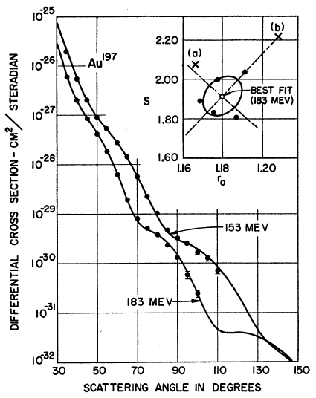
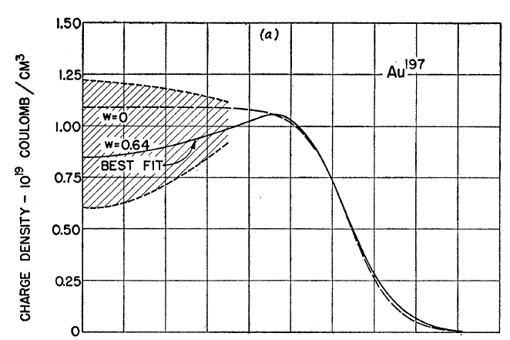
Measuring the IC
eRHIC could give experimental handle on initial geometry
  Recall e + A diffraction exps. on A at rest
Hahn, Ravenhall, and Hofstadter, Phys Rev 101 (1956)

Slide 40
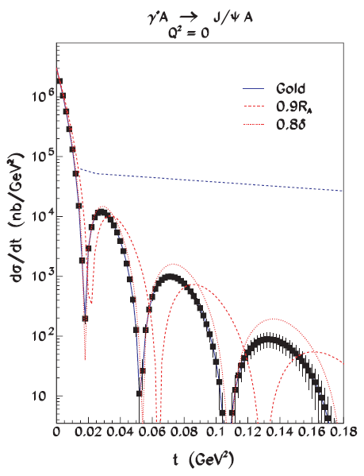
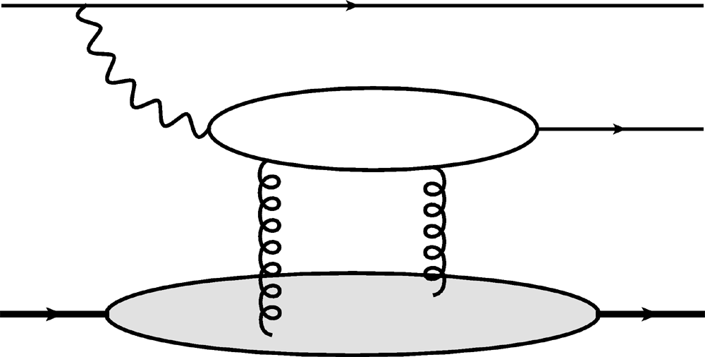
Gluon Distribution of A at x ~ 10⁻³
Coherent vector meson production in e + A
e
e’
J/ψ
γ*
Must reject incoherent
collisions at ~100%
A
A’
  2 gluon exchange
  => mean & correlations
Also DVCS and
Incoherent production
10⁶ J/ψ Events
Caldwell and Kowalski, PRC 81 (2010)

