Slide 1
The EIC, Heavy Quarks, and QGP Phenomenology
W. A. Horowitz
University of Cape Town
October 4, 2010
With many thanks to Brian Cole, Miklos Gyulassy,
Ulrich Heinz, Jiangyong Jia, and Yuri Kovchegov

Slide 2
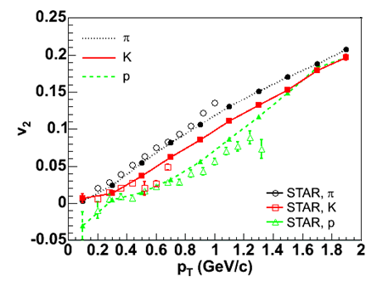
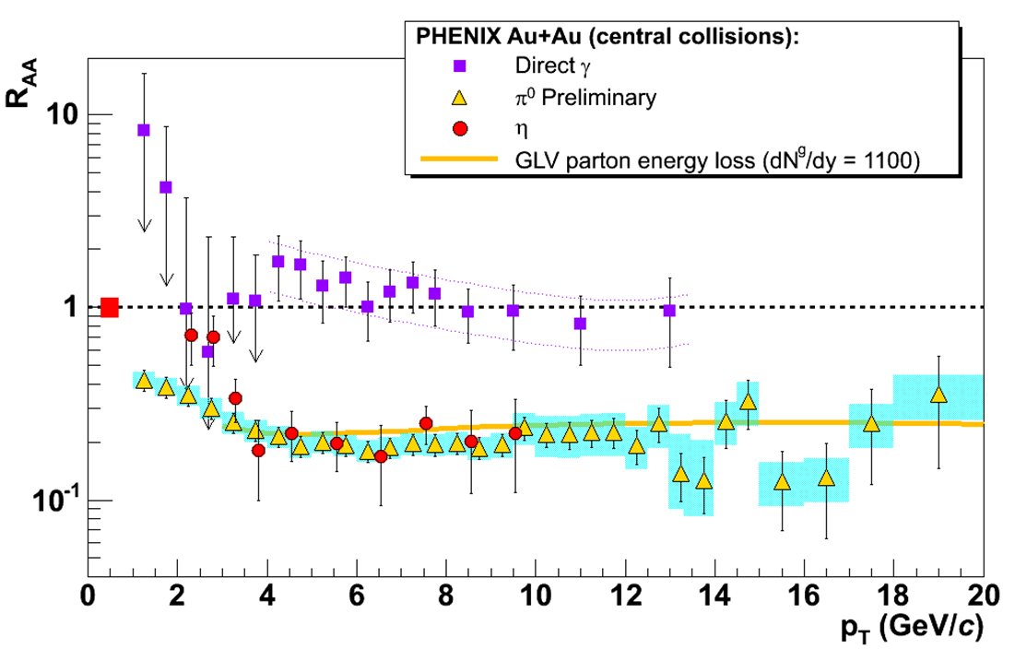
Two Major Discoveries at RHIC
Huge low-p_{T} v₂
Described by hydro with low viscosity
Huge high-p_{T} suppression
π⁰ R_{AA} described by pQCD
20-30%
Y. Akiba for the PHENIX collaboration, PLB630, 2005
Hirano et al., PRC77, 2008

Slide 3
Why Are These Interesting?
Want to characterize the QGP
Can’t directly measure
Use indirect tools
Is QGP:
Most perfect fluid ever created/studied?
Can one use strongly and/or weakly coupled field theory methods?
pQCD vs. AdS/CFT
Enormous influence of geometry

Slide 4
Spacetime Evolution of a HI Collision
At RHIC
Nontrivial to learn about QGP through HIC
t = - ∞
t = 0
t = 1 fm/c
t = 3 fm/c
t = 4 fm/c
t = + ∞
Initial State
Initial Overlap
Thermalization
QGP
Hadronization
Hadron Gas

Slide 5
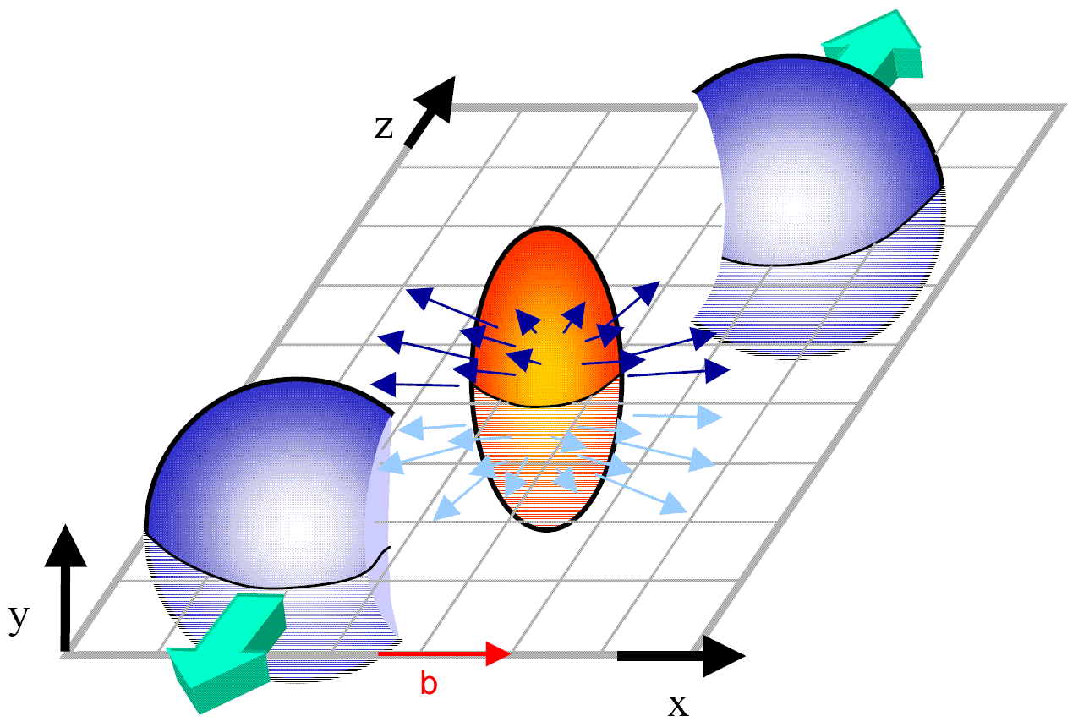
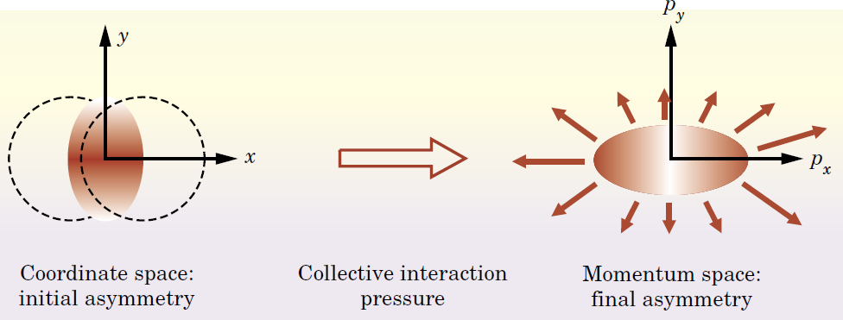
Geometry and Flow
Qualitative picture:
Anisotropic initial
geometry =>
anisotropic flow

Slide 6
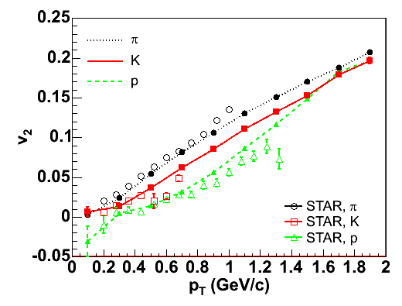
Hydrodynamics and v₂
Hydro
Early therm.
∂_{μ}T^{μν} = 0
Equation of State (EOS)
Ideal: η/s = 0
v₂: 2nd Fourier coef of particle spectrum:

Slide 7
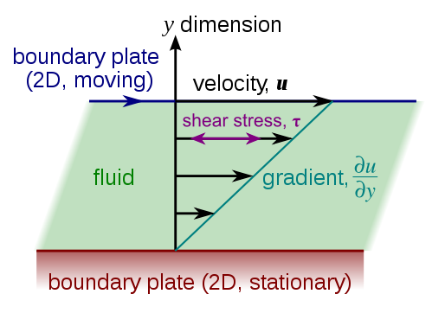
Viscous Hydrodynamics
Viscosity reduces elliptic flow
Naive pQCD => η/s ~ 1
Naive AdS/CFT => η/s ~ 1/4π
=> Strongly coupled medium?
Shear Viscosity, Wikipedia
Luzum and Romatschke,
Phys.Rev.C78:034915,2008

Slide 8
Geometry in Viscosity Extraction
Poorly constrained initial geom => 100% uncertainty in viscosity
KLN CGC breaks down at edge of nuclear overlap
Whole effect comes from edges!
Experimental constraints needed!
T Hirano, et al.,
Phys.Lett.B636:299-304,2006

Slide 9
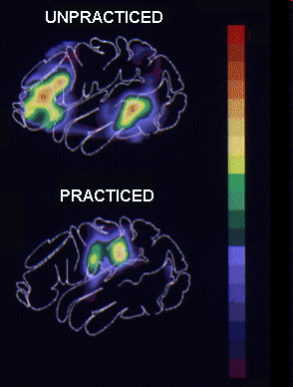
Why High-p_{T} Particles?
Tomography in medicine
One can learn a lot from a single probe…
and even more with multiple probes
SPECT-CT Scan uses internal γ photons and external X-rays
PET Scan
http://www.fas.org/irp/imint/docs/rst/Intro/Part2_26d.html

Slide 10
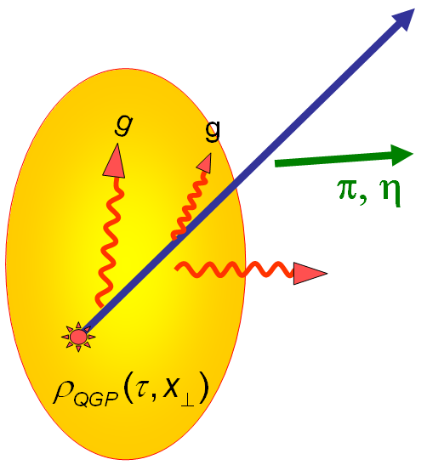
Tomography in QGP
Requires well-controlled theory of:
production of rare, high-p_{T} probes
g, u, d, s, c, b
in-medium E-loss
hadronization
Requires precision measurements of decay fragments
p_{T}
, γ, e⁻
φ
Invert attenuation pattern => measure medium properties

Slide 11
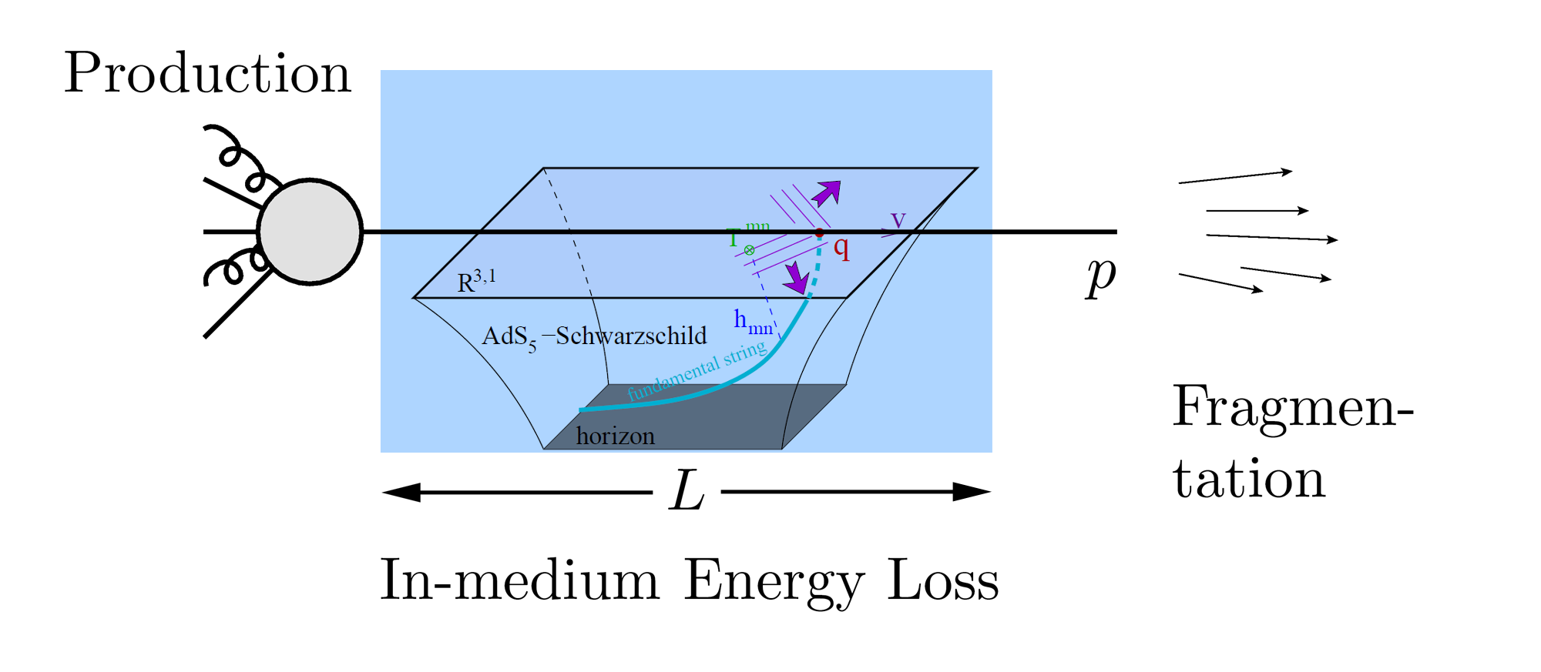
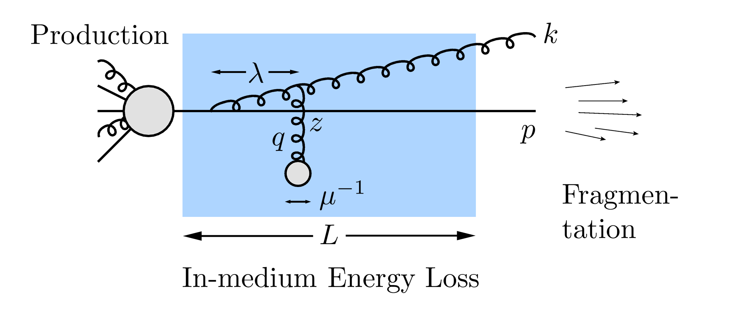
QGP Energy Loss
Learn about E-loss mechanism
Most direct probe of DOF
pQCD Picture
AdS/CFT Picture

Slide 12
High-p_{T} Observables
Naively: if medium has no effect, then R_{AA} = 1
Common variables used are transverse momentum, p_{T}, and angle with respect to the reaction plane, φ
p_{T}
, γ, e⁻
Fourier expand R_{AA}:
φ

Slide 13
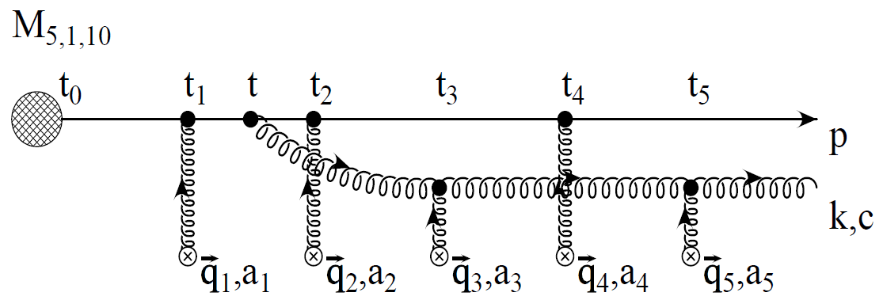
pQCD Rad Picture
Bremsstrahlung Radiation
Weakly-coupled plasma
Medium organizes into Debye-screened centers
T ~ 250 MeV, g ~ 2
μ ~ gT ~ 0.5 GeV
λ_{mfp} ~ 1/g²T ~ 1 fm
R_{Au} ~ 6 fm
1/μ << λ_{mfp} << L
mult. coh. em.
Gyulassy, Levai, and Vitev, NPB571 (200)
LPM
dp_{T}/dt ~ -LT³ log(p_{T}/M_{q})
Bethe-Heitler
dp_{T}/dt ~ -(T³/M_{q}²) p_{T}

Slide 14
pQCD Success at RHIC:
(circa 2005)
Y. Akiba for the PHENIX collaboration, PLB630, 2005
Consistency: R_{AA}(η)~R_{AA}(π)
Null Control: R_{AA}(γ)~1
GLV Prediction: Theory~Data for reasonable fixed L~5 fm and dN_{g}/dy~dN_{π}/dy

Slide 15
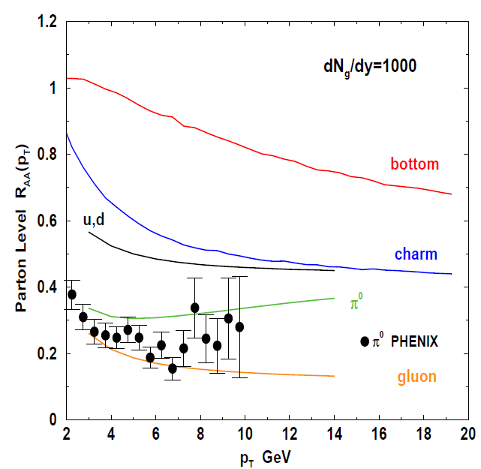
Qualitative Disagreement
Mass of quarks should be important
Expect heavy quarks to lose less energy
Non-photonic electrons (NPE) surprisingly suppressed
Decay fragments of c and b quarks
PHENIX NPE
e⁻
Djordjevic,et al. PLB632 (2006)

Slide 16
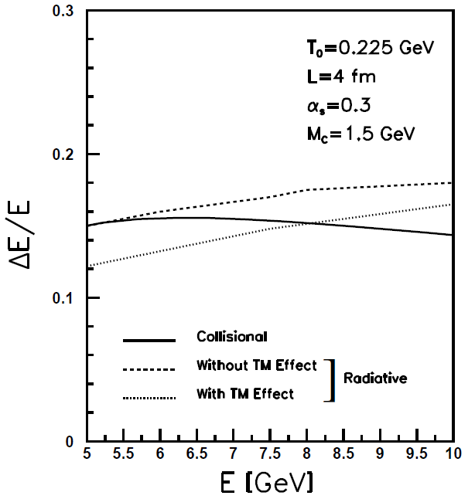
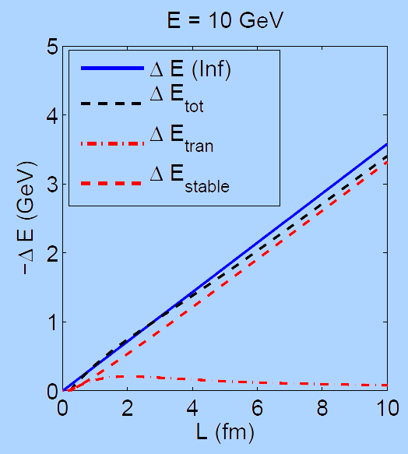
What About Elastic Loss?
Appreciable!
Finite time effects small
Mustafa, PRC72 (2005)
Adil, Gyulassy, WAH, Wicks, PRC75 (2007)

Slide 17
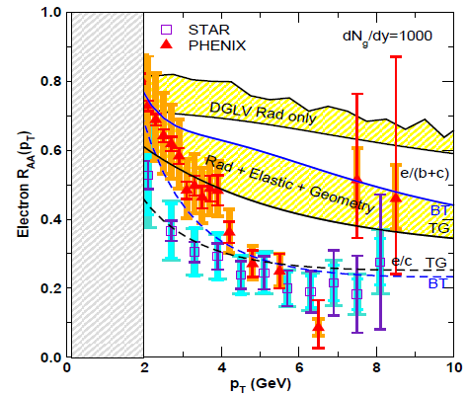
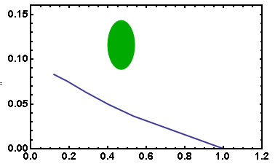
pQCD Seemingly Inadequate
Lack of qual. simultaneous understanding
π⁰, η, γ R_{AA} well described, BUT
e⁻ R_{AA}, v₂ is not, even with elastic loss
PHENIX π⁰
9.5 GeV!
π⁰ v₂
WHDG
30-40% Centrality
π⁰ R_{AA}
Wicks et al.
pQCD assumes M << E:
b E-loss not under control
Death of pQCD at RHIC?

Slide 18
Jets in AdS/CFT
Model heavy quark jet energy loss by embedding string in AdS space
dp_{T}/dt = - μ p_{T}
μ = πλ^{1/2} T²/2M_{q}
Similar to Bethe-Heitler
dp_{T}/dt ~ -(T³/M_{q}²) p_{T}
Very different from LPM
dp_{T}/dt ~ -LT³ log(p_{T}/M_{q})
J Friess, S Gubser, G Michalogiorgakis, S Pufu, Phys Rev D75 (2007)

Slide 19
Compared to Data
String drag: qualitative agreement
WAH, PhD Thesis

Slide 20
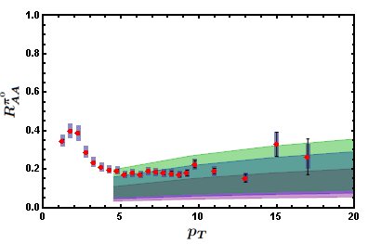
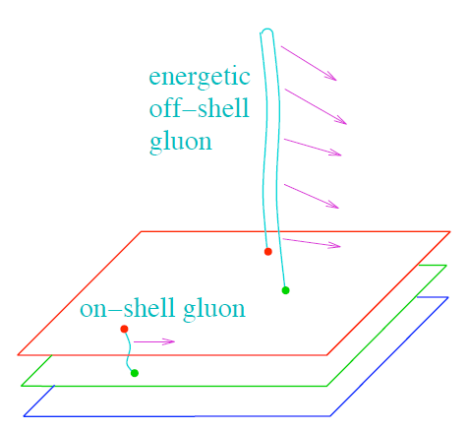
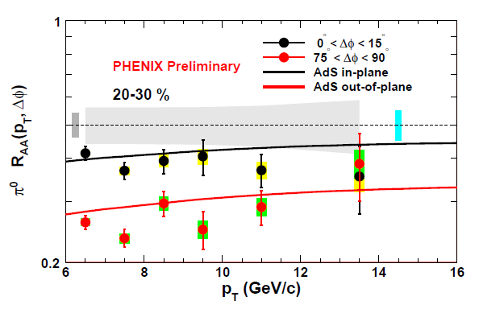
Light Quark and Gluon E-Loss
WAH, in preparation
ΔL^{g}_{therm} ~ E^{1/3}
ΔL^{q}_{therm} ~ (2E)^{1/3}
Renk and Marquet, PLB685, 2010

Slide 21
High-p_{T} and HIC Spacetime Evolution
Jet sees full spacetime evolution
Affected by:
Initial geometry
Thermalization process
E-loss in cold, hadronic matter
JET
t = - ∞
t = 0
t = 1 fm/c
t = 3 fm/c
t = 4 fm/c
t = + ∞
Initial State
Initial Overlap
Thermalization
QGP
Hadronization
Hadron Gas

Slide 22
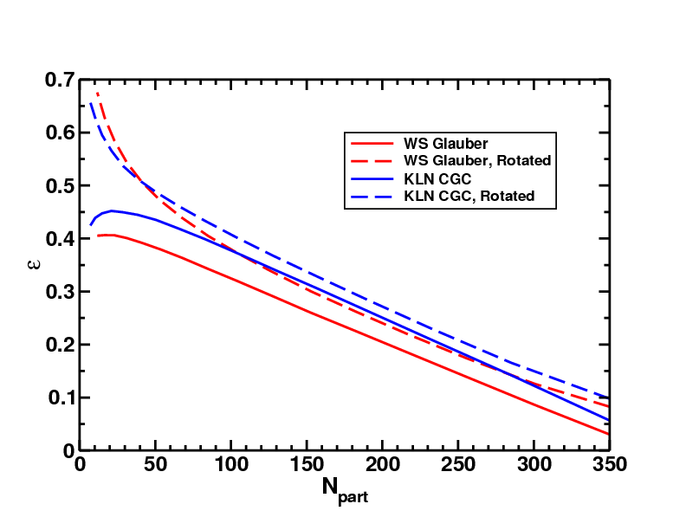
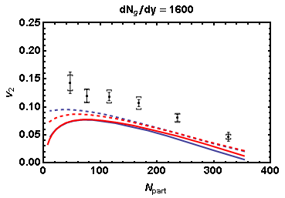
Geometry and High-p_{T} v₂
Effects of geom. on, e.g. v₂, might be quite large
CGC vs. KLN and rotating RP
Effect not large enough
WAH and J Jia, in preparation
Need experimental constraints on initial geometry!

Slide 23
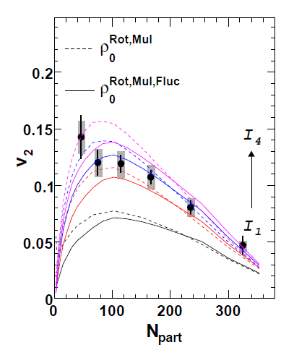
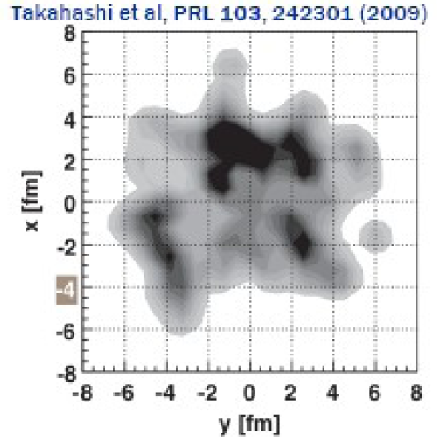
What About Fluctuations?
Hot spots can be huge
NEXUS calculation for 10% most central top RHIC energy event
For simple E-loss not a large effect
Important for fluc., opacity exp.?
Jia and Wei, arXiv:1005.0645

Slide 24
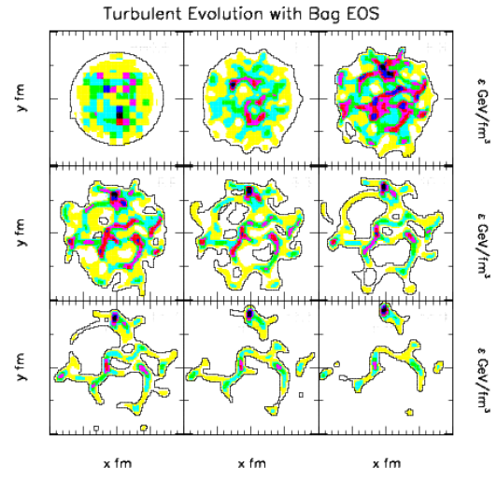
Hydro + Fluctuations
Hydro evolution may amplify fluctuations
Gyulassy, Rischke, Zhang, NPA613, 1997

Slide 25
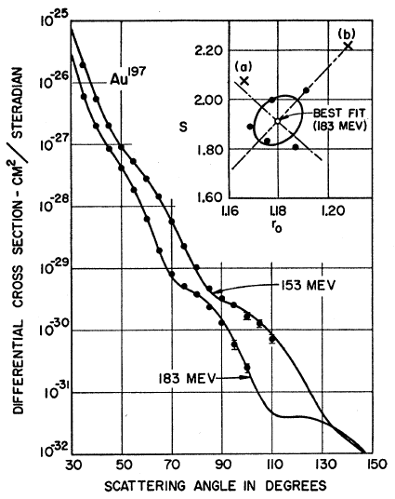
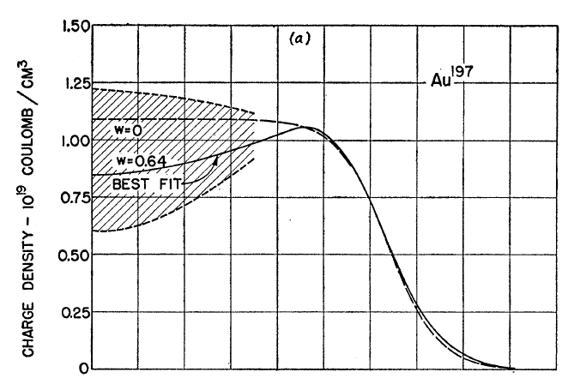
Measuring the IC
EIC could give experimental handle on initial geometry
Recall e + A diffraction exps. on A at rest
Hahn, Ravenhall, and Hofstadter, Phys Rev 101 (1956)

Slide 26
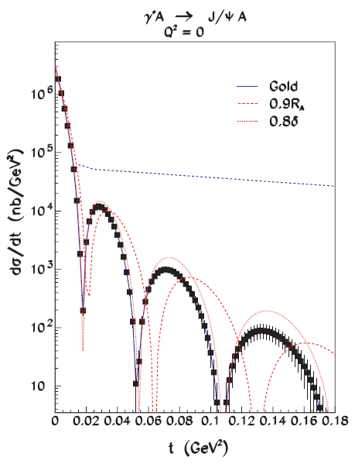
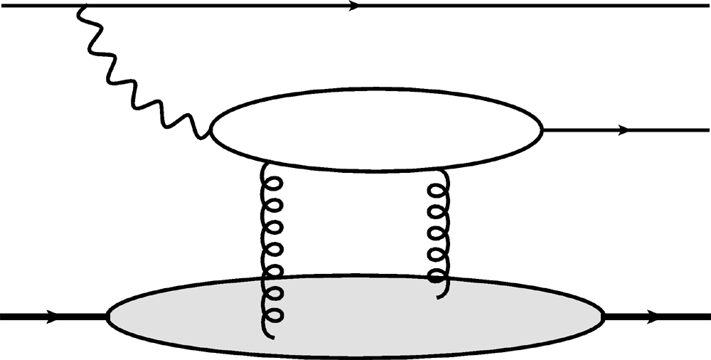
Gluon Distribution of A at x ~ 10⁻³
Coherent vector meson production in e + A
e
e’
J/ψ
γ*
Must reject incoherent
collisions at ~100%
A
A’
2 gluon exchange
=> mean & correlations
Also DVCS and
Incoherent production
10⁶ J/ψ Events
Caldwell and Kowalski, PRC 81 (2010)

Slide 27
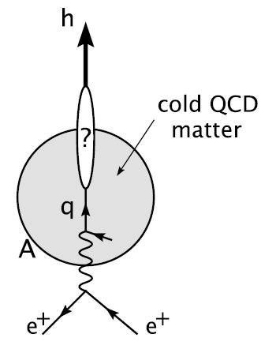
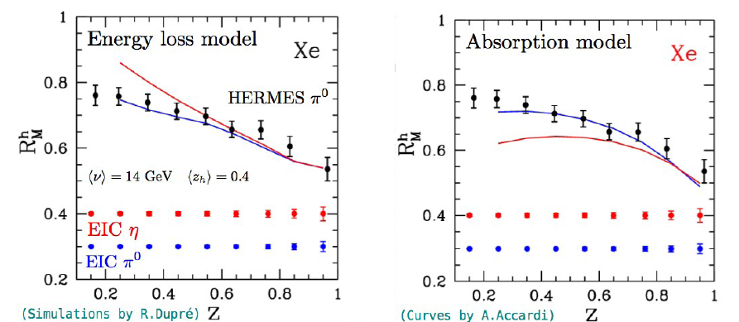
Importance of Cold Matter E-Loss
Large fraction of jet lifetime spent in hadronic matter
QGP lasts ~ 2 fm
Typical jet pathlength ~ 5 fm
Measure in EIC
Accardi et al.,
Riv.Nuovo Cim.32, 2010
Accardi, QM Italia

Slide 28
Conclusions
Tantalizing physics discoveries at RHIC
Large low-p_{T} v₂
nearly perfect strongly coupled fluid (?)
Large high-p_{T} suppression
weakly coupled quasiparticle plasma (?)
Qualitative understanding of QGP physics requires constraints on full spacetime evolution of HI collision
Exciting eA physics opportunities for AA
Knowledge of:
ρ (b), thermalization, cold matter E-loss
a qualitative advance of HI via EIC

