Slide 1
Phenomenology of the
Quark-Gluon Plasma
W. A. Horowitz
University of Cape Town
March 29, 2011
With many thanks to Miklos Gyulassy,
Ulrich Heinz, and Yuri Kovchegov

Slide 2
Outline
High Energy, Many Body QCD
  Motivation
  Introduction to HIC
Heavy Ion Phenomenology
  Theoretical tools
  Connections between theory and data
    Focus on applications of pQCD and AdS/CFT
Discussion/Conclusions

Slide 3




Four Fundamental Forces
Gravity
Electromagnetism
starchild.gsfc.nasa.gov
John Maarschalk, travelblog.portfoliocollection.com
Weak
Strong
lhs.lps.org/staff/sputnam/chem_notes/tritium_decay.gif

Slide 4

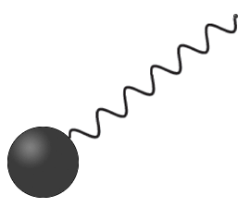
Strong compared to E&M
Electromagnetism
  Electric charge (+)
    electrons
  Carriers: photons
  Field theory:
    Quantum electro-dynamics (QED)
Strong
  Color charge (r, g, b)
    quarks
  Carriers: gluons
  Field theory:
    Quantum chromo-dynamics (QCD)
-
Hydrogen
Look Inside
+
Proton
nobelprize.org

Slide 5

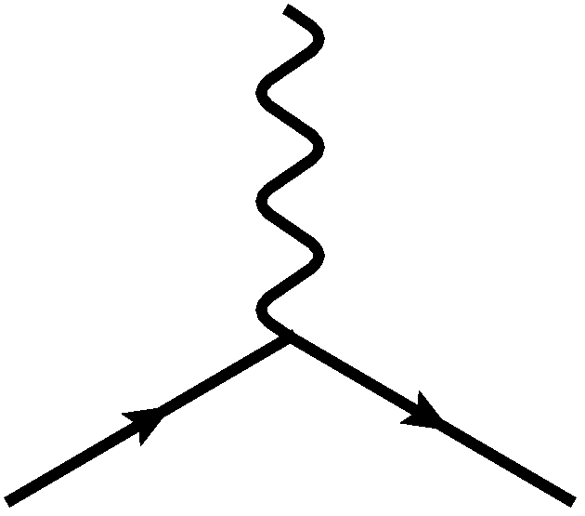
E&M Particle Physics Well Understood
Lagrangian known:
QED Vertex:
Ex. of Precision QED: g - 2
Gabrielse et al., PRL97 (2006)
Hanneke, Fogwell, and Gabrielse, PRL100 (2008)

Slide 6
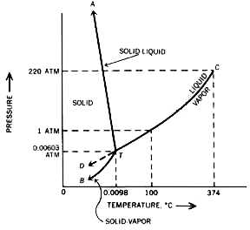

E&M and Phase Diagrams
Many body physics less well understood
Water
Hydrogen
www.sv.vt.edu/classes/MSE2094_NoteBook/96ClassProj/examples/triplpt.html
Calculated, Burkhard Militzer,
Diploma Thesis, Berlin, 2000

Slide 7




QCD Particle Physics Well Understood
Lagr. known:
QCD Vertices:
Qual. & Quant. agreement w/ data
ALEPH,
PLB284
(1992)
PDG

Slide 8

What Are We Interested In?
Measure many-body physics of strong force
Test & understand theory of many-body non-Abelian fields
Long Range Plan, 2008
Notes:
Unique as compared to strongly coupled Abelian problems

Slide 9
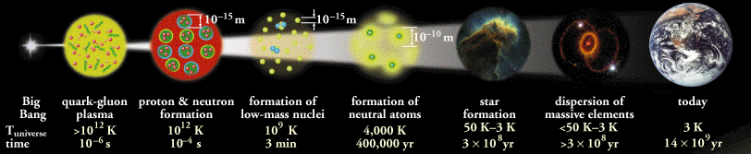
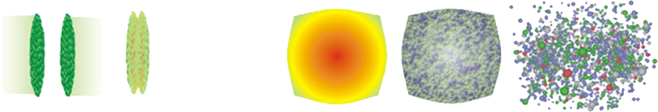
Big Bang vs. Little Bang
ALICE Collaboration
t = - ∞
t = 0
t = 1 fm/c
t = 3 fm/c
t = 4 fm/c
t = + ∞
Initial State
Initial Overlap
Thermalization
QGP
Hadronization
Hadron Gas

Slide 10
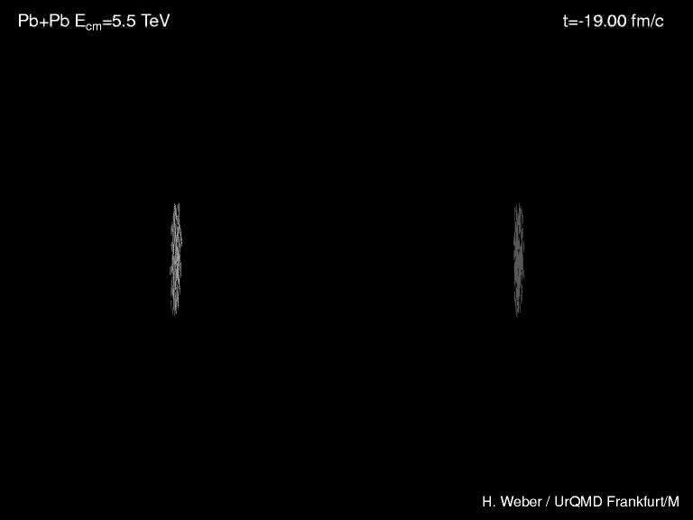
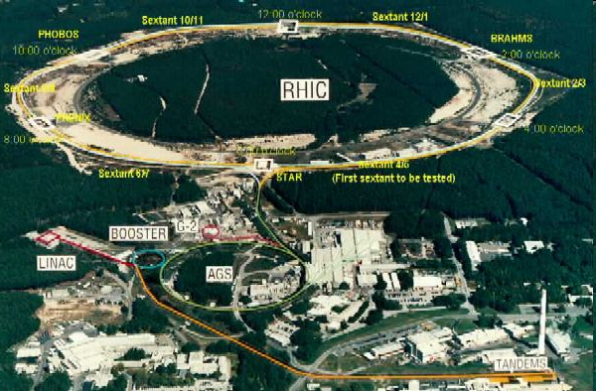
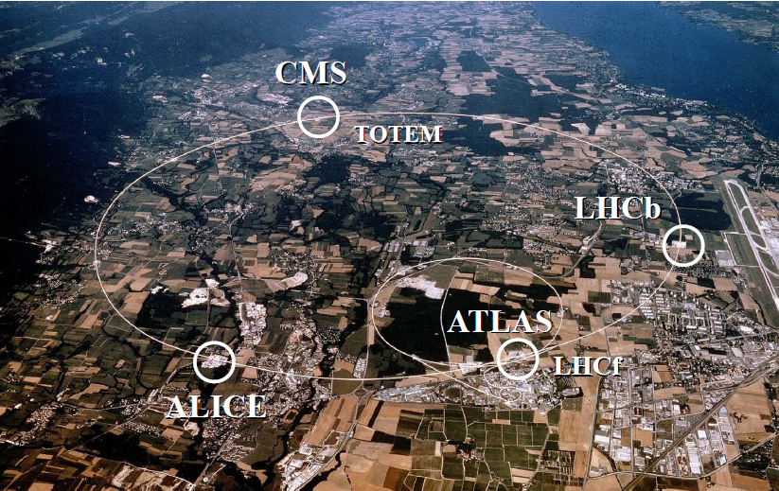
Heavy Ion Collisions
Collider machines: RHIC, LHC
Relativistic Heavy Ion Collider
Large Hadron Collider

Slide 11

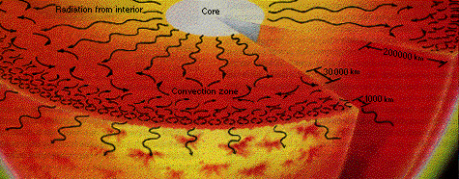
Orders of Magnitude
Units: MeV, GeV, TeV
  At RHIC, nuclei acc. to 100 GeV per nucleon
    Energy of collision ~ two mosquitoes colliding
    LHC: 10x higher energy
  T_{c} ~ Λ_{QCD} ~ 200 MeV
    Temp. at RHIC ~ 10,000 times hotter than the core of the sun (15,000,000 Kelvin)
www.answersingenesis.org
Chaisson and McMillan,
Astronomy Today (1993)

Slide 12
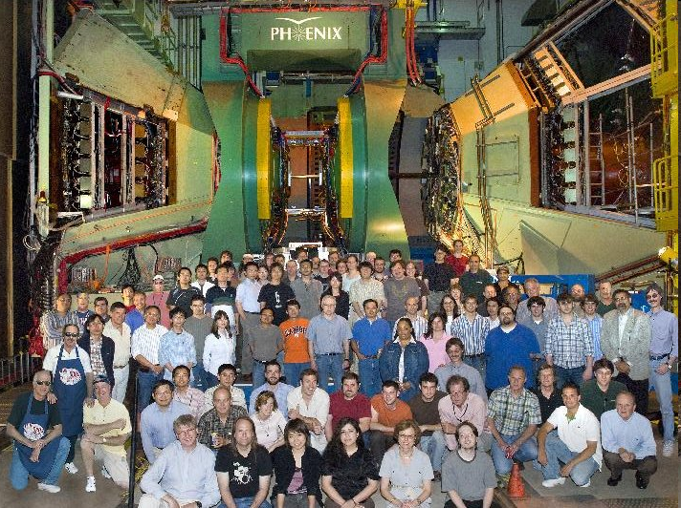
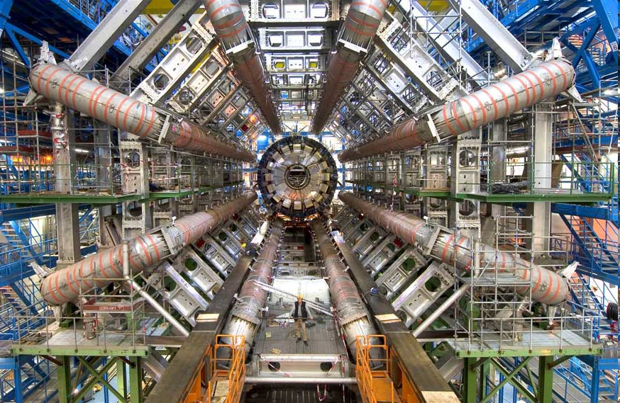
Experiments
RHIC
  BRAHMS
  PHENIX
  PHOBOS
  STAR
LHC
  ALICE
  ATLAS
  CMS
  LHCb
PHENIX
ATLAS

Slide 13


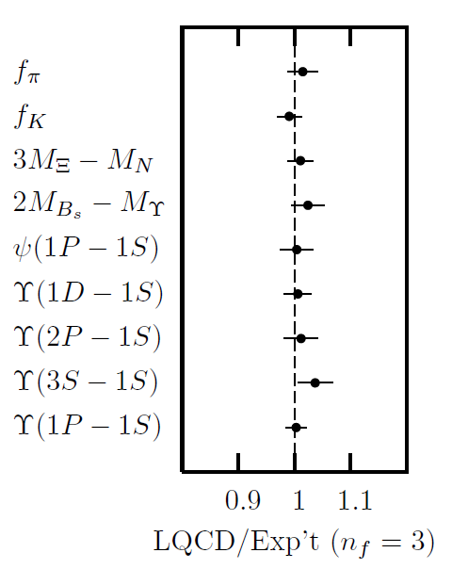
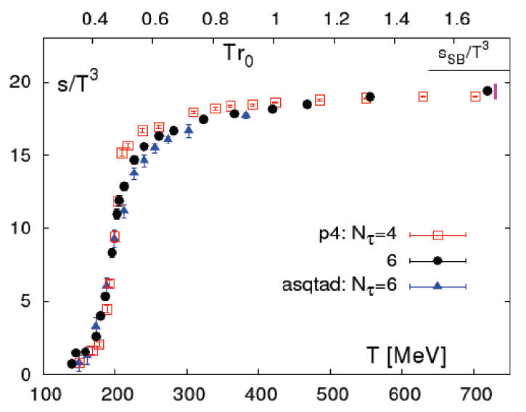
Methods of QCD Calculation I: Lattice
Long Range Plan, 2008
    All momenta
    Euclidean correlators
Cheng et al., PRD77 (2008)
Davies et al. (HPQCD),
PRL92 (2004)

Slide 14


Methods of QCD Calculation II: pQCD
(perturbative QCD)
d’Enterria, 0902.2011
Jäger et al., PRD67 (2003)
    Any quantity
    Small coupling (large momenta only)

Slide 15




Methods III: AdS/CFT
Maldacena conjecture: SYM in d ⬄ IIB in d+1
Gubser, QM09
    All quantities
    N_{c} → ∞ SYM, not QCD
      Probably not good approx. for p+p; maybe A+A?
    Applicable to condensed matter systems?
Notes:
Next up, experiments!

Slide 16
Calculational Validity
Relevant scale for pQCD depends on process
  α_{s}(2 π T) ~ 0.4 for T = 300 MeV
Most AdS/CFT calculations: SYM, N_{c} -> inf, λ -> inf.
  N_{c} = 3
  λ ~ 5.5 from energy density matching to lattice
  λ ~ 6π for α_{s} = 0.5
RHIC and LHC are in a regime where physics is hard
  For pQCD and AdS/CFT theory is at qualitative, not quantitative level

Slide 17
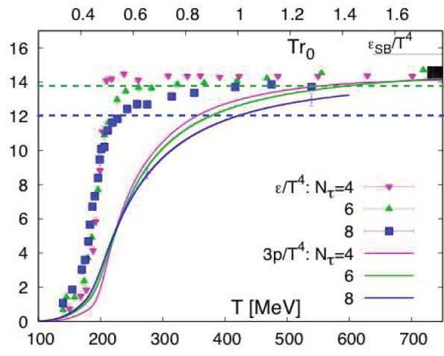
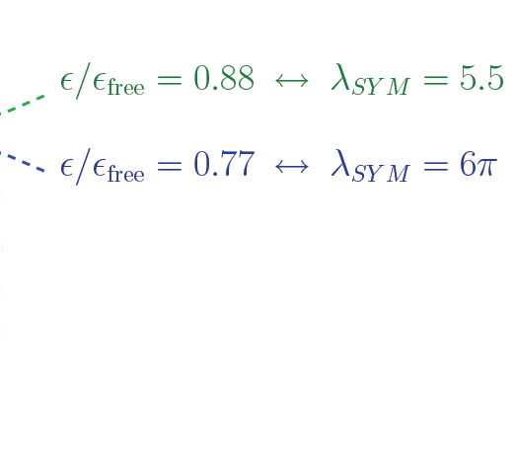
Comparing AdS/CFT to Lattice
“Intriguing” similarity of results
Gubser, QM ‘09
S/S_{SB}
AdS/CFT
J. P. Blaizot, E. Iancu, U. Kraemmer, A. Rebhan, JHEP 0706 (2007) 035

Slide 18
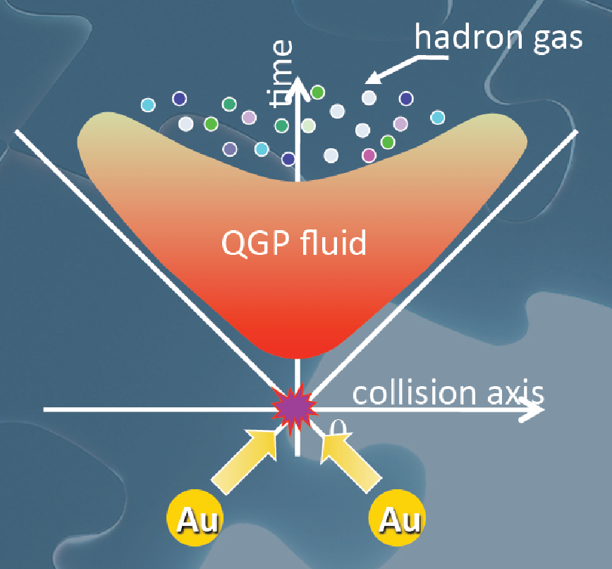
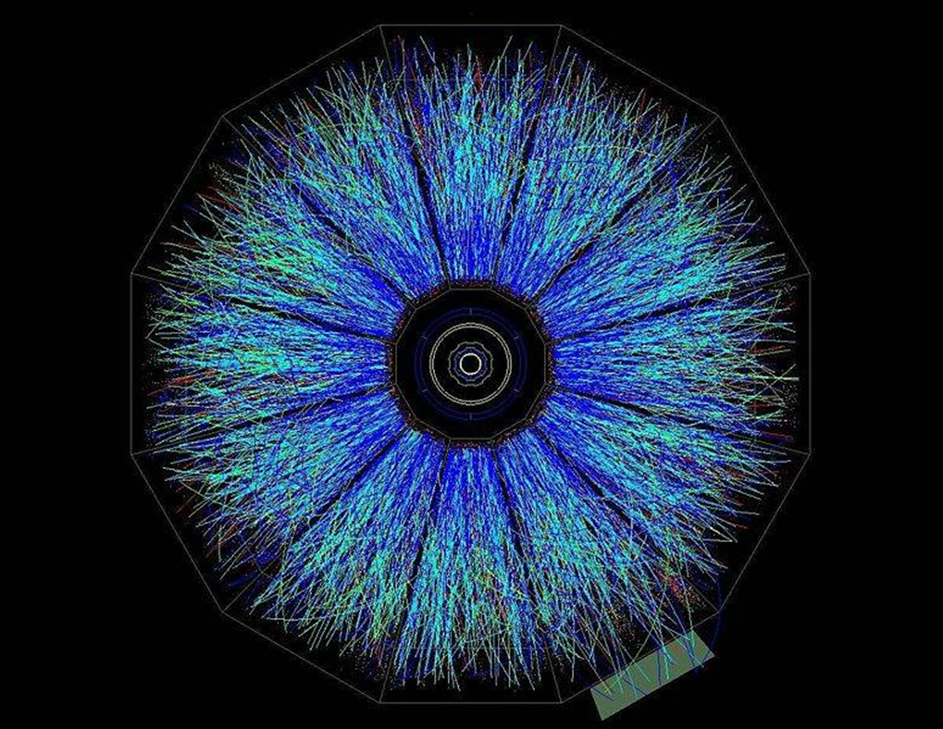
Evolution of a HI Collision
STAR, event
T Hirano, Colliding Nuclei from AMeV to ATeV

Slide 19
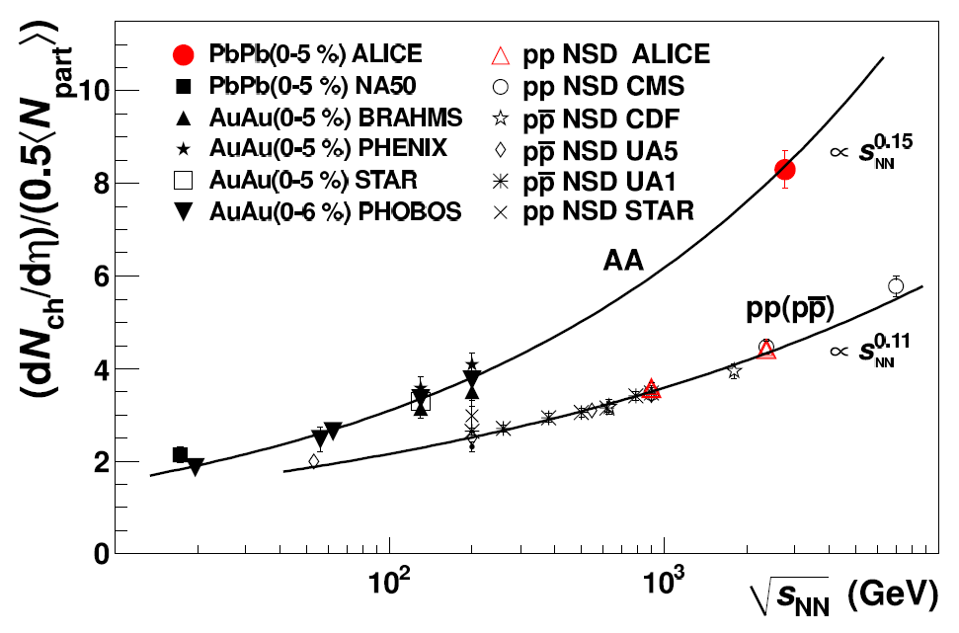
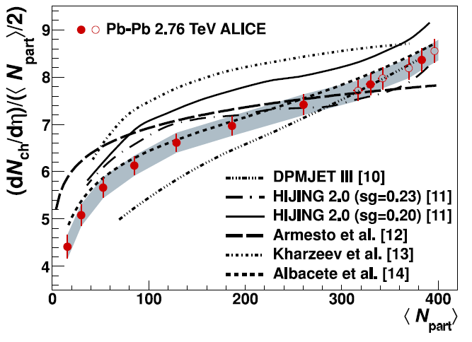
Simplest Measurement: No. of Particles
Multiplicity results appear ~perturbative
  Naive AdS trapped surface results ~ E^{1/3}
  LHC ~2x RHIC
ALICE, Phys.Rev.Lett.105:252301,2010
ALICE, PRL106 (2011)

Slide 20

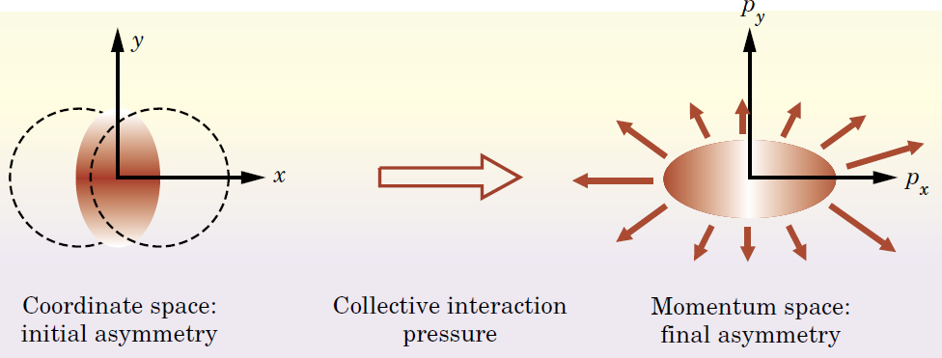
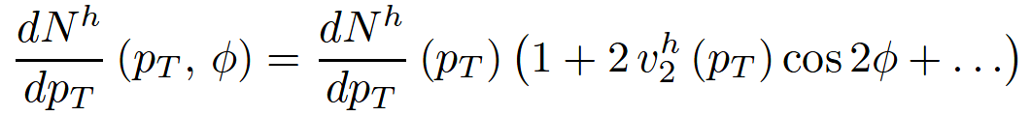
Flow: More Nontrivial Measurement
Qualitative picture:
  Anisotropic initial
  geometry =>
  anisotropic flow
M Kaneta, Results from
the Relativistic Heavy
Ion Collider (Part II)
T Ludlum and L McLerran,
Phys. Today 56N10 (2003)

Slide 21
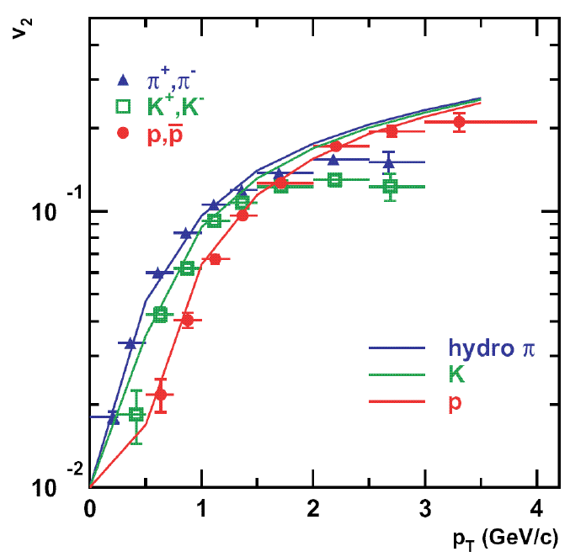
Hydrodynamics and v₂
Ideal Hydro
  ∂_{μ}T^{μν} = 0
  Equation of State (from lattice QCD)
  Ideal: η/s = 0
  v₂: 2nd Fourier coef of particle spectrum:
PHENIX White Paper

Slide 22
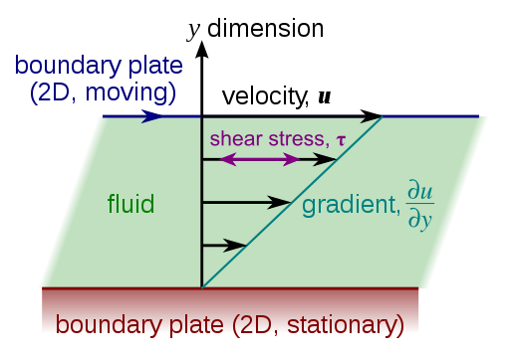
Viscous Hydrodynamics
Viscosity reduces elliptic flow
  Naive pQCD => η/s ~ 1
  Naive AdS/CFT => η/s ~ 1/4π
Similar story for hydro at LHC
Shear Viscosity, Wikipedia
Luzum and Romatschke,
Phys.Rev.C78:034915,2008

Slide 23
Geometry in Viscosity Extraction
  Poorly constrained initial geom => >100% uncertainty in viscosity
    Conservative estimate: η/s < 6 x 1/4π
T Hirano, et al.,
Phys.Lett.B636:299-304,2006

Slide 24

Why High-p_{T} Jets?
Tomography in medicine
One can learn a lot from a single probe…
and even more with multiple probes
SPECT-CT Scan uses internal γ photons and external X-rays
PET Scan
http://www.fas.org/irp/imint/docs/rst/Intro/Part2_26d.html

Slide 25

Tomography in QGP
Requires well-controlled theory of:
  production of rare, high-p_{T} probes
    g, u, d, s, c, b
  in-medium E-loss
  hadronization
Requires precision measurements of decay fragments
p_{T}
, γ, e⁻
φ
Invert attenuation pattern => measure medium properties

Slide 26


QGP Energy Loss
Learn about E-loss mechanism
  Most direct probe of DOF
pQCD Picture
AdS/CFT Picture

Slide 27

pQCD Rad Picture
Bremsstrahlung Radiation
  Weakly-coupled plasma
    Medium organizes into Debye-screened centers
  T ~ 250 MeV, g ~ 2
    μ ~ gT ~ 0.5 GeV
    λ_{mfp} ~ 1/g²T ~ 1 fm
    R_{Au} ~ 6 fm
  1/μ << λ_{mfp} << L
    mult. coh. em.
Gyulassy, Levai, and Vitev, NPB571 (2000)
  LPM
    dp_{T}/dt ~ -LT³ log(p_{T}/M_{q})
  Bethe-Heitler
    dp_{T}/dt ~ -(T³/M_{q}²) p_{T}

Slide 28
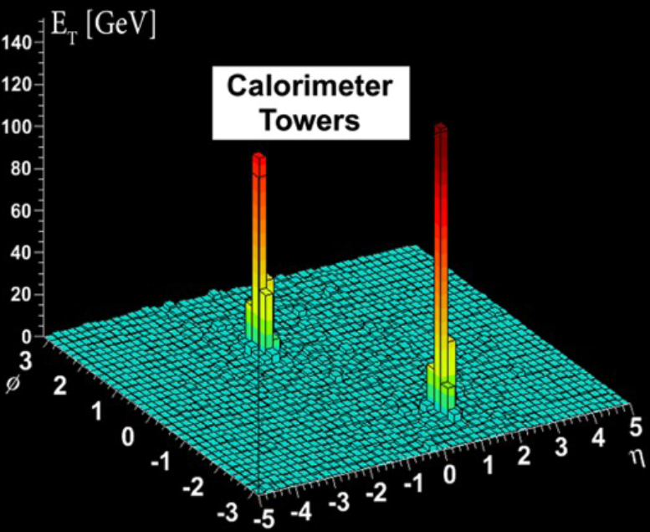
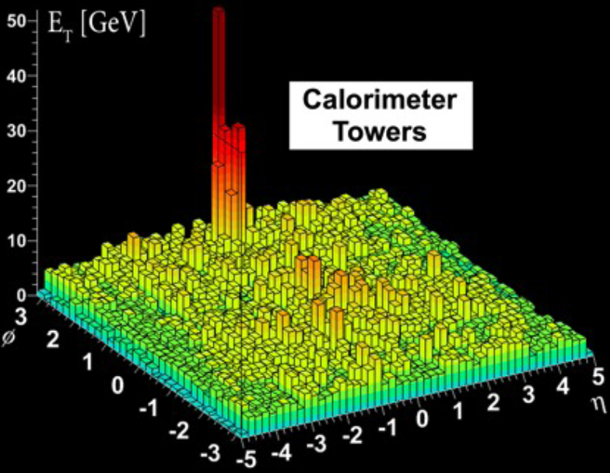
Hard-to-Find Jets
Peripheral Collision
  similar to p + p
Central Collision
ATLAS measurements from Steinberg, HI at LHC

Slide 29
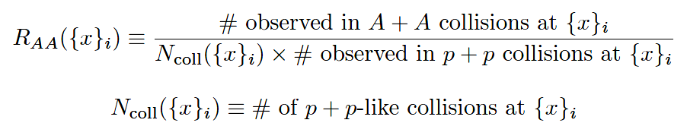
High-p_{T} Observable
    Naively: if medium has no effect, then R_{AA} = 1

Slide 30

pQCD Success at RHIC:
(circa 2005)
Y. Akiba for the PHENIX collaboration, hep-ex/0510008
  Consistency: R_{AA}(η)~R_{AA}(π)
  Null Control: R_{AA}(γ)~1
  GLV Prediction: Theory~Data for reasonable fixed L~5 fm and dN_{g}/dy~dN_{π}/dy

Slide 31

Qualitative Disagreement
Mass of quarks should be important
  Expect heavy quarks to lose less energy
Non-photonic electrons (NPE) surprisingly suppressed
  Decay fragments of c and b quarks
PHENIX NPE
e⁻
Djordjevic,et al. PLB632 (2006)

Slide 32


What About Elastic Loss?
Appreciable!
Finite time effects small
Mustafa, PRC72 (2005)
Adil, Gyulassy, WAH, Wicks, PRC75 (2007)

Slide 33

Quantitative Disagreement Remains
Wicks, WAH, Gyulassy, Djordjevic, NPA784 (2007)
Pert. at LHC energies?

Slide 34
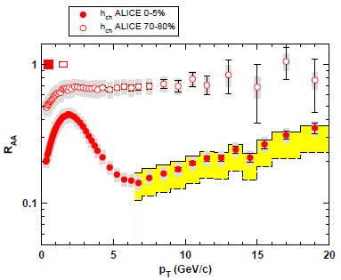
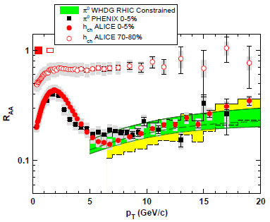
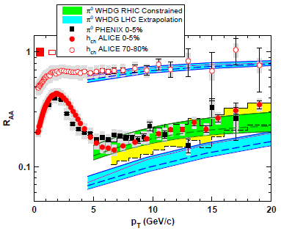
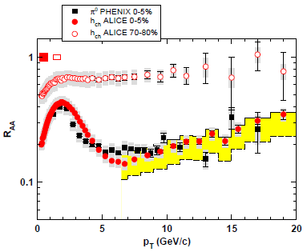
R_{AA} at LHC: First Results
Many caveats
  But, difficult to reconcile large increase in multiplicity and minor increase in suppression
WAH and M Gyulassy, in prep

Slide 35
Jets in AdS/CFT
Model heavy quark jet energy loss by embedding string in AdS space
  dp_{T}/dt = - μ p_{T}
  μ = πλ^{1/2} T²/2M_{q}
  Similar to Bethe-Heitler
    dp_{T}/dt ~ -(T³/M_{q}²) p_{T}
  Very different from LPM
    dp_{T}/dt ~ -LT³ log(p_{T}/M_{q})
J Friess, S Gubser, G Michalogiorgakis, S Pufu, Phys Rev D75 (2007)

Slide 36
Compared to Data
String drag: qualitative agreement
WAH, PhD Thesis

Slide 37


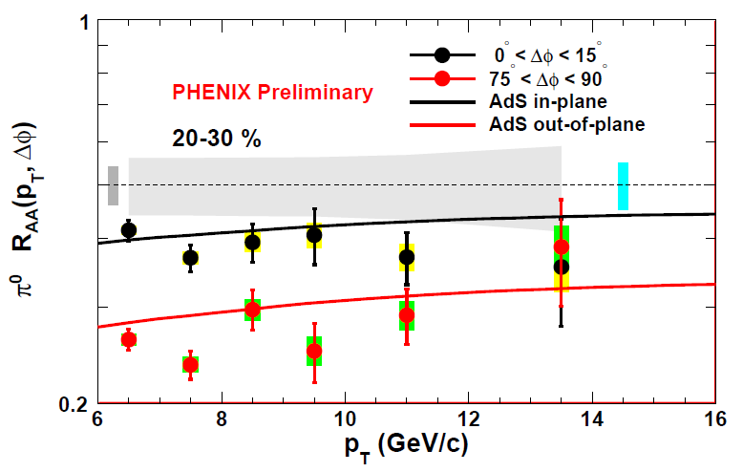
Light Quark and Gluon E-Loss
WAH, in preparation
SS Gubser, QM08
ΔL^{g}_{therm} ~ E^{1/3}
ΔL^{q}_{therm} ~ (2E)^{1/3}
Gubser et al., JHEP0810 (2008)
Chesler et al., PRD79 (2009)
Marquet and Renk, PLB685 (2010)

Slide 38

An Enhanced Signal: LHC
But what about the interplay between mass and momentum?
  Take ratio of c to b R_{AA}(p_{T})
    pQCD: Mass effects die out with increasing p_{T}
      Ratio starts below 1, asymptotically approaches 1. Approach is slower for higher quenching
    ST: drag independent of p_{T}, inversely proportional to mass. Simple analytic approx. of uniform medium gives
    R^{cb}_{pQCD}(p_{T}) ~ n_{b}M_{c}/n_{c}M_{b} ~ M_{c}/M_{b} ~ .27
      Ratio starts below 1; independent of p_{T}
R^{cb}_{pQCD}(p_{T}) ∼ 1 - α_{s} n(p_{T}) L² log(M_{b}/M_{c}) ( /p_{T})

Slide 39


LHC R^{c}_{AA}(p_{T})/R^{b}_{AA}(p_{T}) Prediction
Zoo of c and b Predictions:
WAH, M. Gyulassy, PLB666 (2008)
      Taking the ratio cancels most normalization differences seen previously
      pQCD ratio asymptotically approaches 1, and more slowly so for increased quenching (until quenching saturates)
      AdS/CFT ratio is flat and many times smaller than pQCD at only moderate p_{T}
WAH, M. Gyulassy, PLB666 (2008)

Slide 40

Not So Fast!
  Speed limit estimate for applicability of AdS drag
    γ < γ_{crit} = (1 + 2M_{q}/λ^{1/2} T)²
    ~ 4M_{q}²/(λ T²)
      Limited by M_{charm} ~ 1.2 GeV
    Similar to BH LPM
      γ_{crit} ~ M_{q}/(λT)
  No Single T for QGP
    smallest γ_{crit} for largest T
    T = T(τ₀, x=y=0): “(”
    largest γ_{crit} for smallest T
    T = T_{c}: “]”
D7 Probe Brane
Q
Worldsheet boundary Spacelike if γ > γ_{crit}
x₅
Trailing
String
“Brachistochrone”
“z”
D3 Black Brane

Slide 41

LHC R^{c}_{AA}(p_{T})/R^{b}_{AA}(p_{T}) Prediction
(with speed limits)
WAH, M. Gyulassy, PLB666 (2008)
      T(τ₀): “(”, corrections likely small for smaller momenta
      T_{c}: “]”, corrections likely large for higher momenta

Slide 42
Conclusions
Heavy Ion Physics is fascinating
  Want to understand properties of many-body, non-Abelian QCD
  Able to experimentally test theory
Number of computable observables
  Particle production; thermalization time; viscosity (shear and bulk); correlations between low-p_{T} particles, high-p_{T} particles, and high- and low-p_{T} particles; energy loss and its redistribution
Traditional pQCD techniques in quantitative disagreement with data
  New, exciting theory tool with AdS/CFT, successes
LHC: already exciting new results
  Experimental signature: R^{c}_{AA}/R^{b}_{AA}
Future of HIC: qualitative => quantitative

Slide 44
high-pT v2: JHL plots
baryons/mesons AdS
AdS light quarks/gluons
bulk vs shear viscosity
Distribution of lost energy in AdS: correlations
Thermalization time

Slide 45
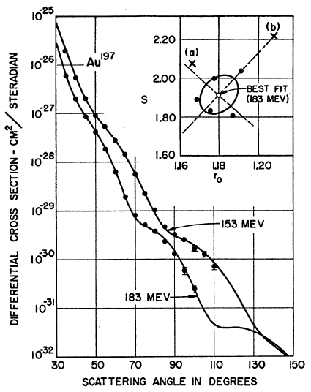
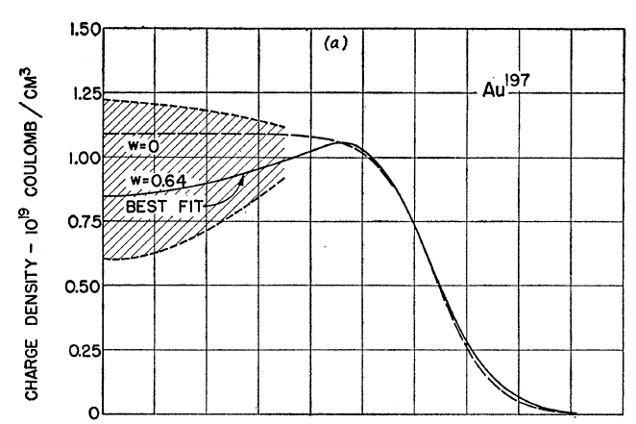
Measuring the IC
eRHIC could give experimental handle on initial geometry
  Recall e + A diffraction exps. on A at rest
Hahn, Ravenhall, and Hofstadter, Phys Rev 101 (1956)

Slide 46
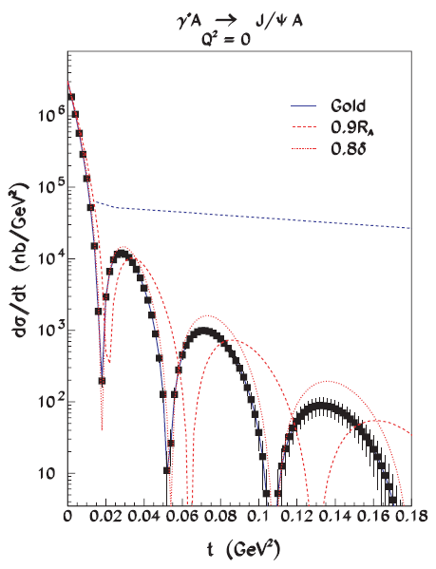
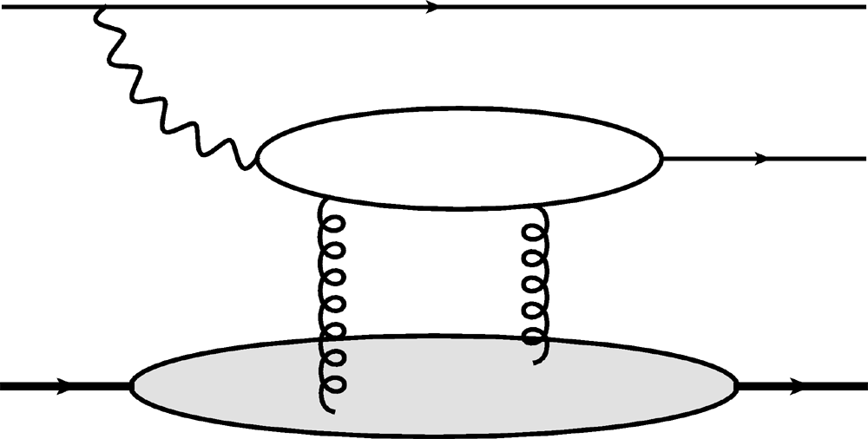
Gluon Distribution of A at x ~ 10⁻³
Coherent vector meson production in e + A
e
e’
J/ψ
γ*
Must reject incoherent
collisions at ~100%
A
A’
  2 gluon exchange
  => mean & correlations
Also DVCS and
Incoherent production
10⁶ J/ψ Events
Caldwell and Kowalski, PRC 81 (2010)

Slide 47
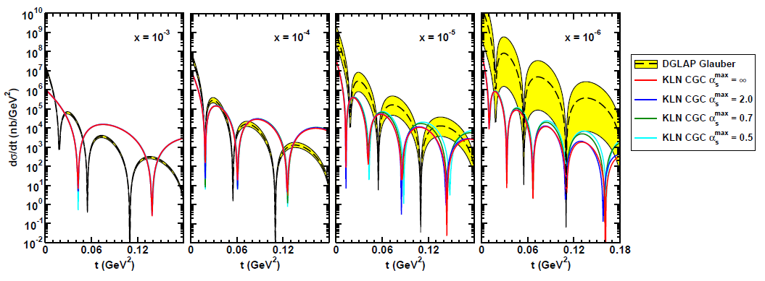
WAH, arXiv:1102.5058

Slide 48
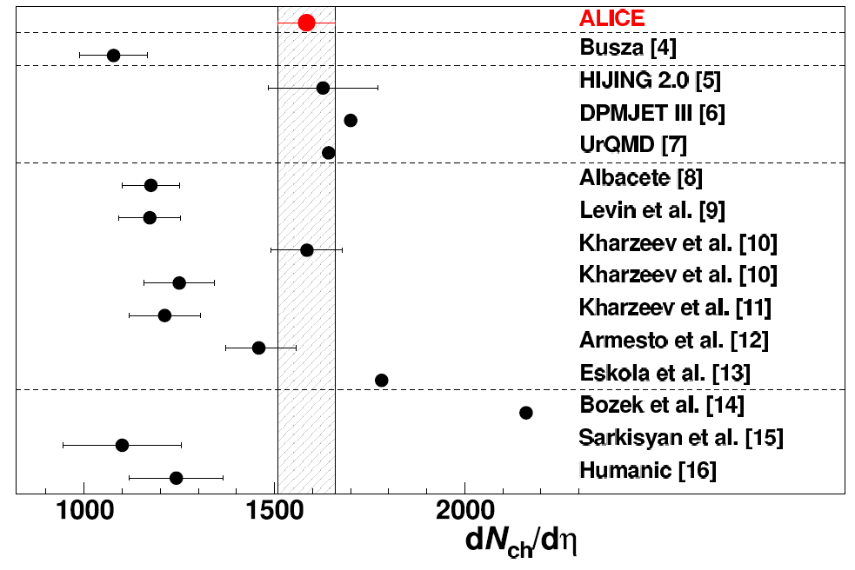
ALICE, PRL105 (2010), 252301

Slide 49
ALICE, PRL105 (2010), 252301

Slide 50
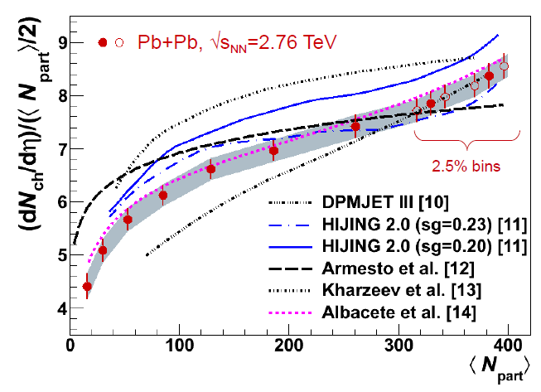
K Loizides, HI at the LHC (2011)

Slide 51
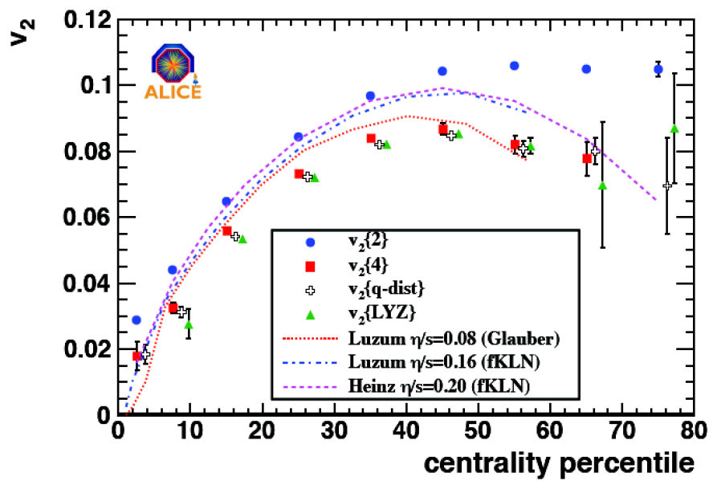
Hydro at LHC
Loizides, HI at LHC 2011

Slide 52
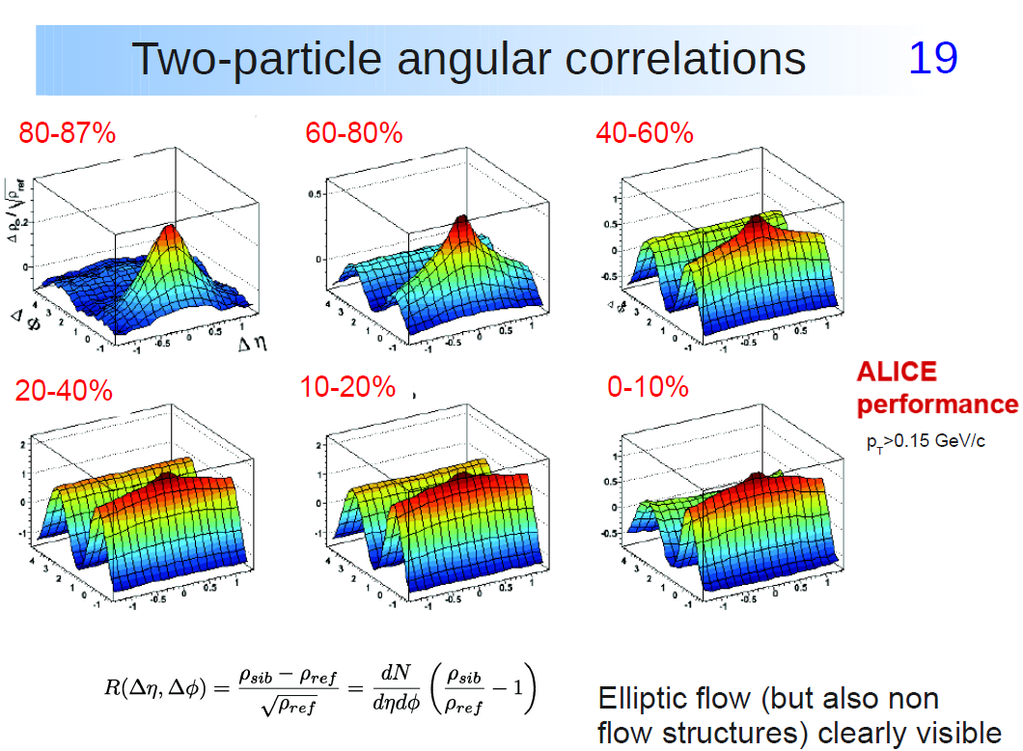
K Loizides, HI at the LHC (2011)

Slide 53
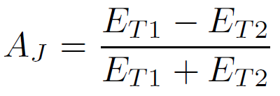
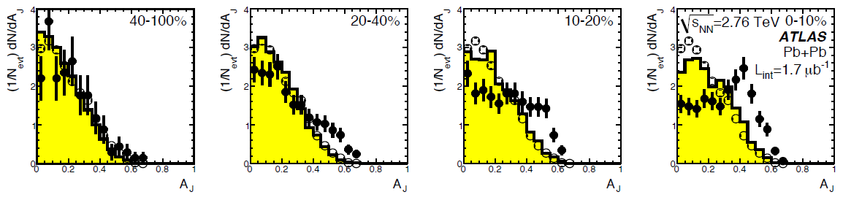
ATLAS, PRL105:252303 (2010)

Slide 54
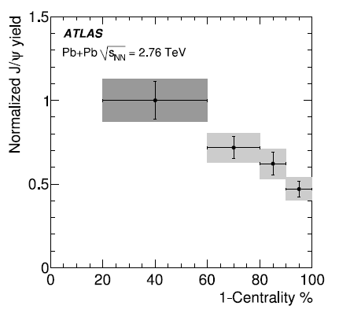
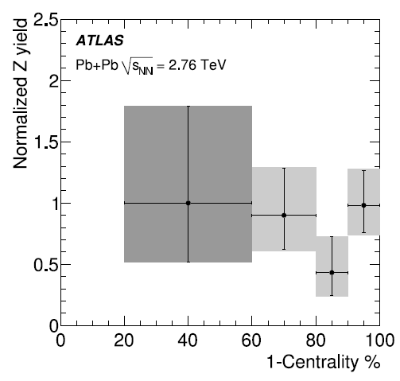

Slide 55
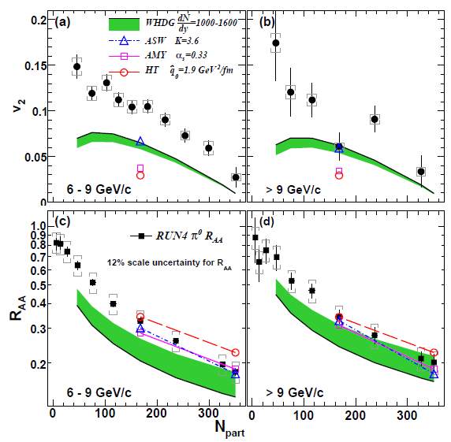
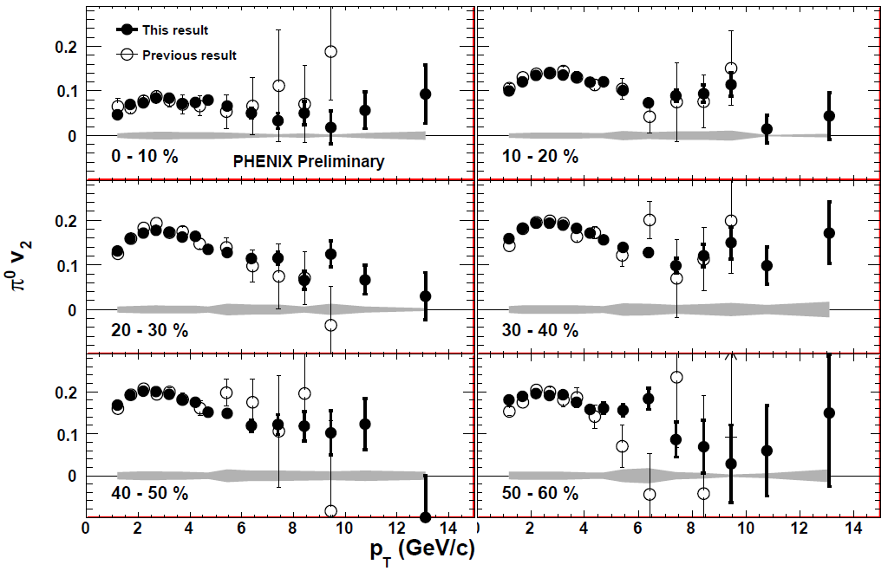
Death of pQCD at RHIC?
Failure at > 9 GeV!
Rui Wei, for PHENIX, QM09
PHENIX, arXiv:1006.3740
Pert. at LHC energies?
Notes:
Important to get to >~ 10 GeV to avoid IS, hadronization effects

Slide 56
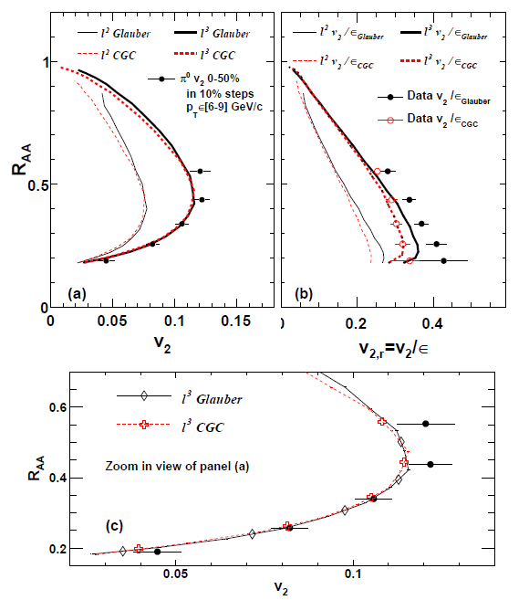
J Jia, WAH, J Liao, arXiv:1101.0290

Slide 57
HI Collisions Tool for Strong Force Physics Study
Want a consistent picture of matter produced in HI collisions
  Then, want to quantify the properties of the produced matter

Slide 58
10 Years of RHIC: Two Pillars
Huge low-p_{T} v₂
  Described by hydro with low viscosity
Huge high-p_{T} supp.
  π⁰ R_{AA} described by pQCD
Luzum and Romatschke, Phys.Rev.C78:034915,2008
Y. Akiba for the PHENIX collaboration, hep-ex/0510008
Inconsistent picture?

Slide 59
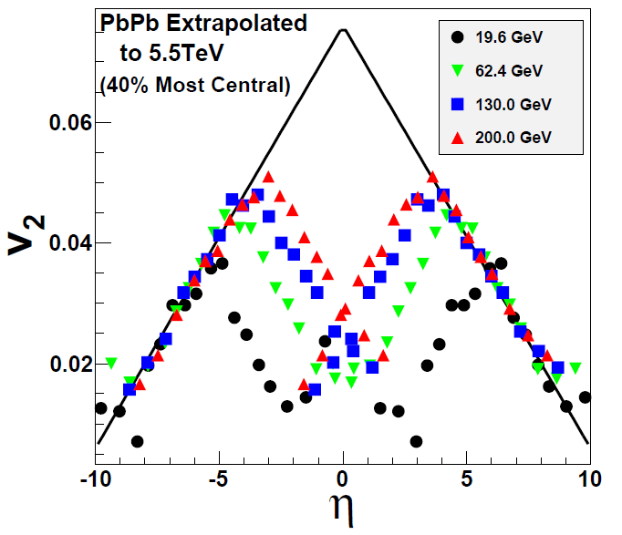
Two Big Qualitative Questions: I
Is hydro at RHIC a fluke?
  LHC will tell us on Nov. 9
    If v₂ breaks hydro limit a la Busza extrapolation, what the heck is happening at RHIC?
NA49, Phys.Rev.C68:034903,2003
W Busza, NPA 830,2009

Slide 60
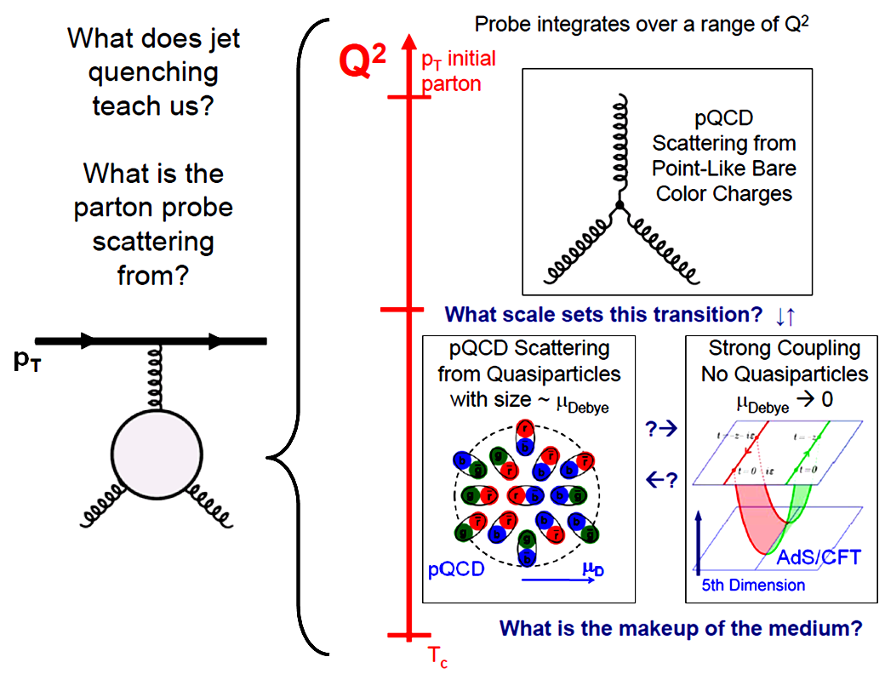
Pictorial Soft-Soft vs. Soft-Hard

Slide 61
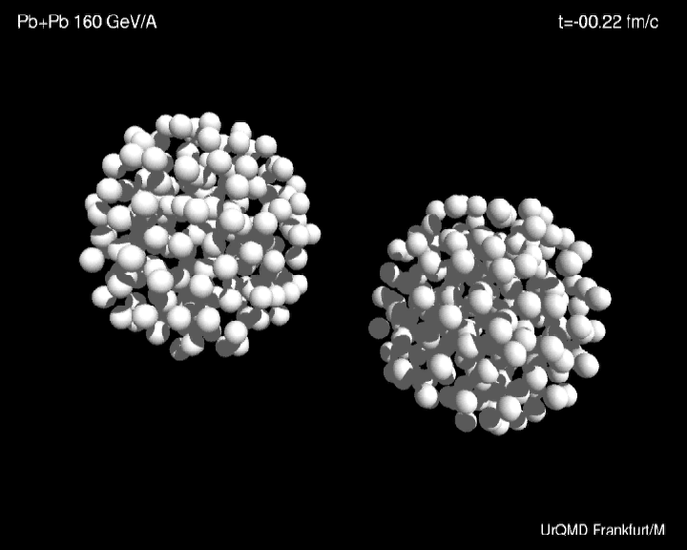

Slide 62
Crucial QCD Facts
Yang-Mills Theory: non-Abelian
  Gluons carry color charge
  “Strong” over long distances, “weak” over short distances
    Rigorous analytic calculations only for large momentum processes
      Large compared to Λ_{QCD} ~ 200 MeV
Quarks and gluons are confined
    no bare quark or gluon has ever been detected
      1,000,000 USD Clay Millenium prize for proof of confinement in Yang-Mills theories

Slide 63

Low-p_{T} Measurements (I)
  Partonic DOF at hadronization!
LRP 2008

Slide 64

Low-p_{T} Measurements (II)
EOS from lattice
Anisotropy from (ideal) Hydro + IC
LRP 2008
PHENIX White Paper

Slide 65

An Alternative Picture
AdS Drag: qual. agreement with NPE R_{AA}
  Result less controlled at higher p_{T}
Akamatsu, Hatsuda, Hirano, PRC79, 2009

Slide 66
AdS Applied to π⁰
π⁰ R_{AA}
  Surprisingly not oversuppressed
π⁰ v₂
  ΔE ~ L³!
WAH, in preparation
Marquet and Renk, PLB685 (2010)
Convinced? Need to dot i’s and cross t’s

Slide 67

Future of High-p_{T} Physics
On one hand: Higher and higher p_{T}
  Look towards LHC for qual. understanding
    pQCD at extremely large, p_{T} ~ 100-200 GeV?
WAH, M. Gyulassy, PLB666 (2008)

Slide 68


Reasons to be Cautious about LHC
Quenching due to IS or FS?
  Need experimental control over production
    p + A in...?
T Isobe, JPhysG34 (2007)
Albacete and Marquet, PLB687, 2010
=> R_{PbPb} ~ 0.25!

Slide 69
Conclusions
Heavy Ion Physics is fascinating
  Hydrodynamics/jets provide unique tools for study
Traditional pQCD techniques in quantitative disagreement with data
  New, exciting theory tool with AdS/CFT, successes
Experimental signature: R^{c}_{AA}/R^{b}_{AA}
Recent and future work:
  Double ratio at RHIC
  Ultimately want to be able to rigorously falsify
    Universality of AdS result
    Uncertainties in pQCD
    Comparison to additional exp. observables
    Corrections to pQCD and AdS/CFT
WAH, J.Phys.G35:044025,2008
WAH and Y Kovchegov, PLB680:56-61,2009
WAH and B Cole, arXiv:0910.1823 [hep-ph]

Slide 70

RHIC R^{cb} Ratio
pQCD
pQCD
AdS/CFT
AdS/CFT
WAH, M. Gyulassy, JPhysG35 (2008)
    Wider distribution of AdS/CFT curves due to large n: increased sensitivity to input parameters
    Advantage of RHIC: lower T => higher AdS speed limits

Slide 71
Looking for a Qualitative, Distinguishing Signal
  Use LHC’s large p_{T} reach and identification of c and b to distinguish between pQCD, AdS/CFT
    Asymptotic pQCD momentum loss:
    String theory drag momentum loss:
      Independent of p_{T} and strongly dependent on M_{q}!
      T² dependence in exponent makes for a very sensitive probe
  Expect: ε_{pQCD} 0 vs. ε_{AdS} indep of p_{T}!!
    dR_{AA}(p_{T})/dp_{T} > 0 => pQCD; dR_{AA}(p_{T})/dp_{T} < 0 => ST
ε_{rad} ∼ α_{s} L² log(p_{T}/M_{q})/p_{T}
ε_{ST} ∼ 1 - Exp(-μ L), μ = πλ^{1/2} T²/2M_{q}
S. Gubser, Phys.Rev.D74:126005 (2006); C. Herzog et al. JHEP 0607:013,2006

Slide 72



LHC c, b R_{AA} p_{T} Dependence
WAH, M. Gyulassy, PLB666 (2008)
      LHC Prediction Zoo: What a Mess!
      Let’s go through step by step
      Unfortunately, large suppression pQCD similar to AdS/CFT
      Large suppression leads to flattening
      Use of realistic geometry and Bjorken expansion allows saturation below .2
      Significant rise in R_{AA}(p_{T}) for pQCD Rad+El
      Naïve expectations met in full numerical calculation:
      dR_{AA}(p_{T})/dp_{T} > 0 => pQCD; dR_{AA}(p_{T})/dp_{T} < 0 => ST

Slide 73


Outline
Motivation
Introduction
  Heavy Ion Collisions
  Experiments
  Theory
Current Status
  Hydrodynamics
  Energy loss
Future Outlook
Conclusions
ALICE Collaboration
PHENIX White Paper
Y. Akiba for the PHENIX collaboration, hep-ex/0510008
Jäger et al., PRD67 (2003)
Long Range Plan, 2008

Slide 74



Jets in Heavy Ion Collisions
p+p
Au+Au
Y-S Lai, RHIC & AGS Users’ Meeting, 2009
PHENIX

Slide 75
Conclusions
Heavy Ion Physics is fascinating
  Want to understand properties of many-body QCD
Just above T_{c}, QGP is perfect fluid (?)
Traditional pQCD techniques in quantitative disagreement with data
  New, exciting theory tool with AdS/CFT, successes
LHC: much to look forward to
  Experimental signature: R^{c}_{AA}/R^{b}_{AA}
Future of HIC: qualitative => quantitative

