Slide 1
Testing Energy Loss and the Pion Puzzle (?) at LHC
W. A. Horowitz
University of Cape Town
April 4, 2011
With many thanks to Brian Cole, Miklos Gyulassy,
Ulrich Heinz, Jiangyong Jia, and Yuri Kovchegov

Slide 2
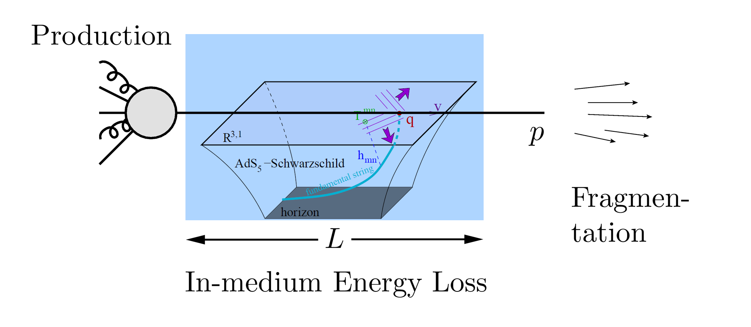
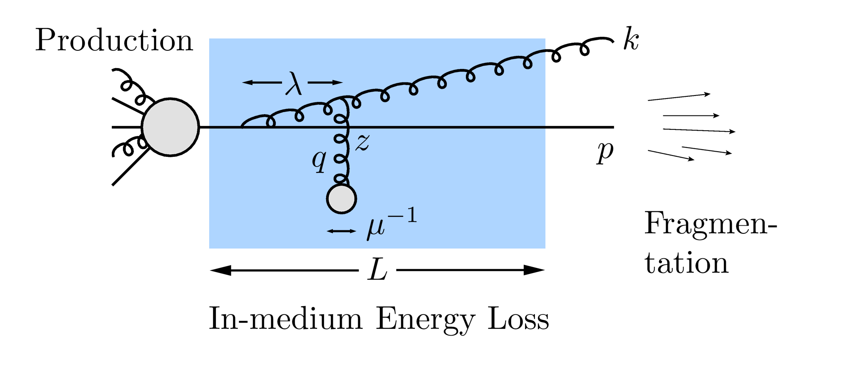
QGP Energy Loss
Learn about E-loss mechanism
Most direct probe of DOF
pQCD Picture
AdS/CFT Picture

Slide 3
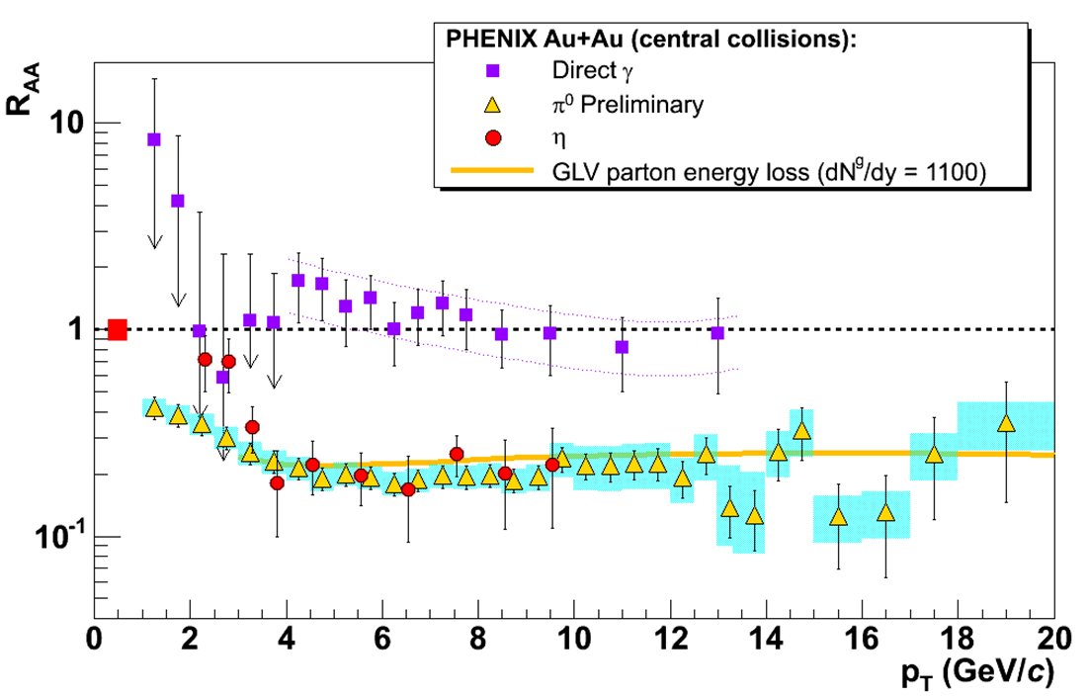
pQCD Success at RHIC:
(circa 2005)
Y. Akiba for the PHENIX collaboration, hep-ex/0510008
Consistency: R_{AA}(η)~R_{AA}(π)
Null Control: R_{AA}(γ)~1
GLV Prediction: Theory~Data for reasonable fixed L~5 fm and dN_{g}/dy~dN_{π}/dy

Slide 4
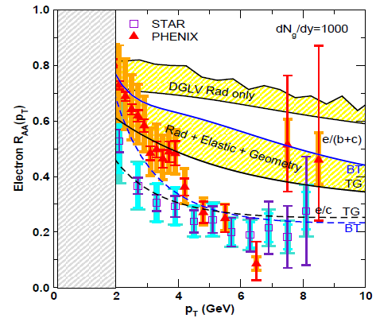
pQCD Suppression Picture Inadequate
Lack of even qualitative understanding
π⁰, η, γ R_{AA} well described, BUT
e⁻ R_{AA}, v₂ are not, even with elastic loss
PHENIX, Phys. Rev. Lett. 98, 172301 (2007)
Wicks et al., NPA784, 2007

Slide 5
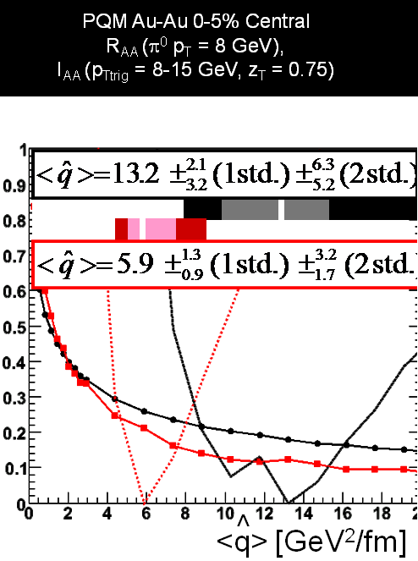
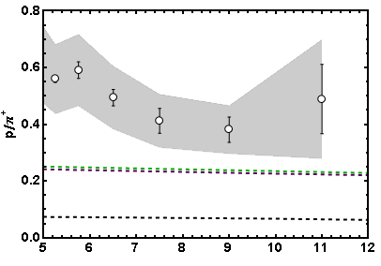
More Reasons for Concern
I_{AA}
Baryon/Meson Ratio
STAR
pQCD w/ DSS
pQCD w/ KKP
p_{T}
WAH, in preparation
Jamie Nagle, QM09

Slide 6
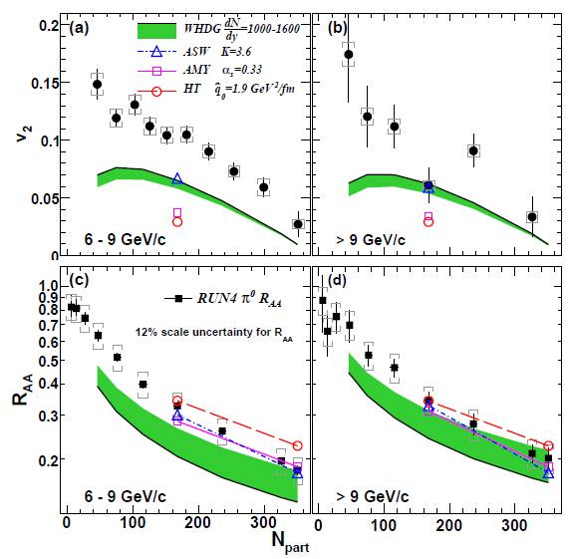
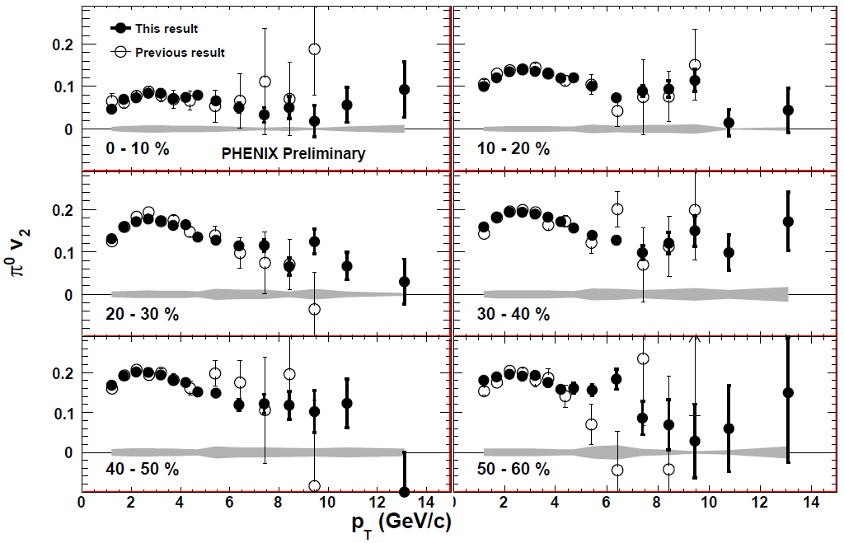
Death of pQCD at RHIC?
Failure at > 9 GeV!
Rui Wei, for PHENIX, QM09
PHENIX, PRL 105 (2010)
See also J Jia from QM09
and Jia, WAH, Liao, arXiv:1101.0290
Pert. at LHC energies?
Notes:
Important to get to >~ 10 GeV to avoid IS, hadronization effects

Slide 7
Before We Make Any Conclusions...
While experiments are converging
Theoretically, what are the effects of
higher orders in
α_{s} (large)
k_{T}/xE (large)
M_{Q}/E (large?)
opacity (large?)
geometry
uncertainty in IC (small)
coupling to flow (large?)
better treatment of
elastic E-loss
E-loss in confined matter

Slide 8
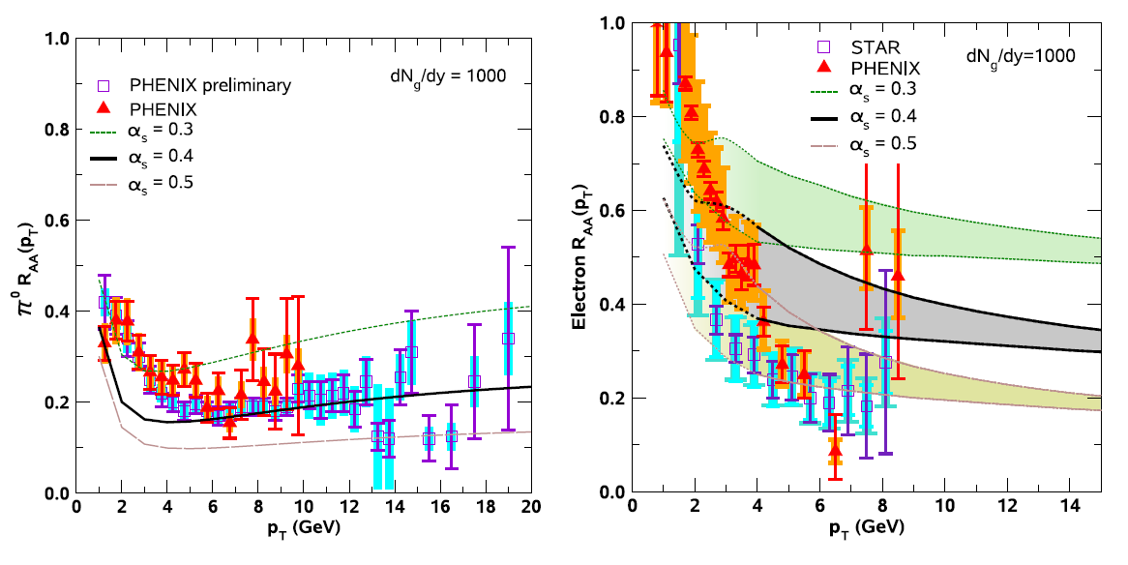
Influence of α_{s}
Varying α_{s} has huge effect
Role of running coupling, irreducible uncertainty from non-pert. physics?
Also large changes from better elastic treatment
S Wicks, PhD Thesis

Slide 9
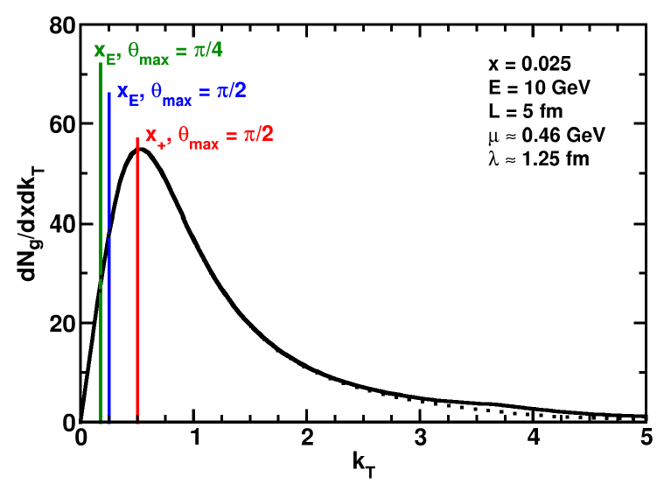
Uncertainty from Wide Angle Radiation
Single inclusive dN_{g}/dx leads to energy loss
All current Eloss calculations assume small angle emission (k_{T} << xE)
This is a bad assumption for RHIC kinematics
WAH and B Cole, PRC81, 2010

Slide 10
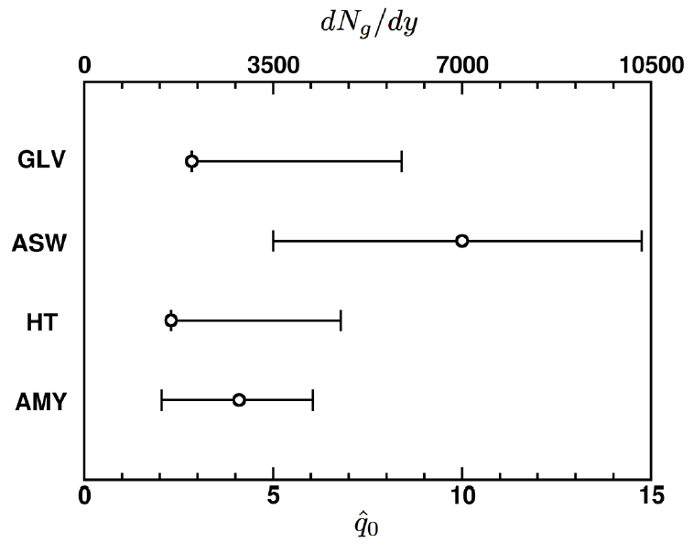
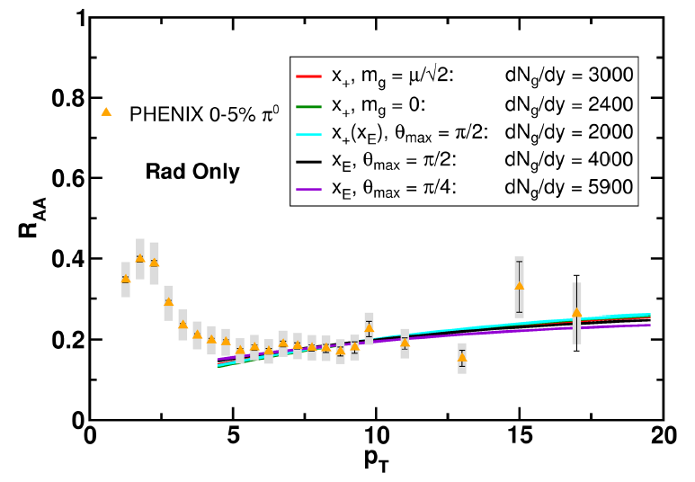
Quantification of Collinear Uncertainty
Factor ~ 3 uncertainty in extracted medium density!
“qhat” values from different formalisms consistent w/i unc.
WAH and B Cole, PRC81, 2010

Slide 11
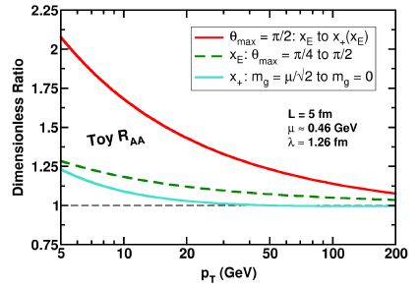
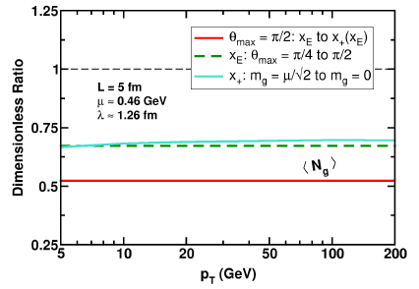
Applicability of Collinear Approximation
Unc. wrt some obs. decreases with p_{T}
Although not true for all observables

Slide 12
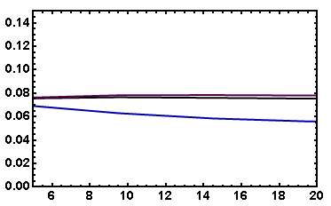
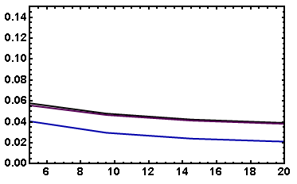
v₂: “Collinearly Safe”
Fix dN_{g}/dy from R_{AA}, calculate v₂
Expect larger v₂ for smaller opening angle
( τ_{coh} ~ 1/k_{T}² )
Rad Only
Rad + El
20-30% π⁰
20-30% π⁰
v₂
v₂
p_{T}
p_{T}
WAH, in preparation

Slide 13
Quark Mass Corrections
All calculations assume M_{Q} << p_{T}
Large corrections expected for observed NPE
NB:
M_{bottom} ~ 4.75 GeV
9 GeV e⁻ from ~ 15 GeV b
c and b separation will help tremendously
Wicks et al., NPA784, 2007

Slide 14
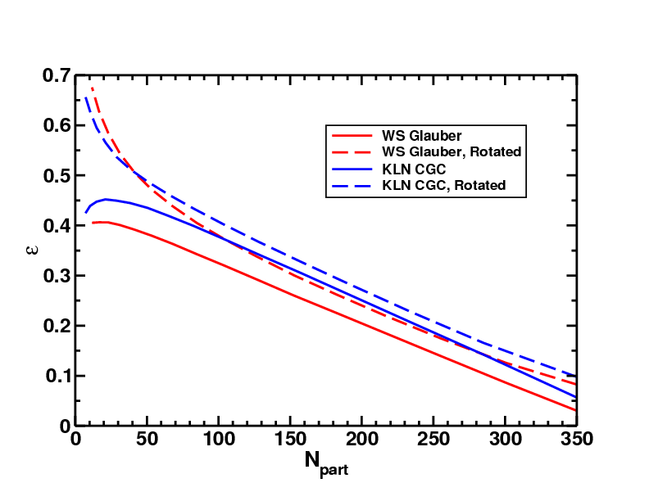
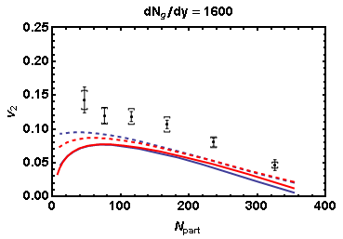
Quantifying Sensitivity to Geometry IC
Effects of geom. on, e.g. v₂, might be quite large
KLN CGC vs. WS Glaub. and rotating RP
Effect not large enough
WAH and J Jia, in preparation
Possibly truly outlandish initial geometry?
See also Renk et al., PRC83 (2011)

Slide 15
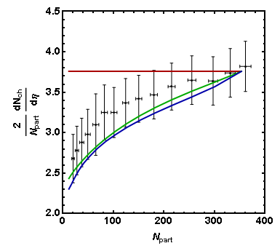
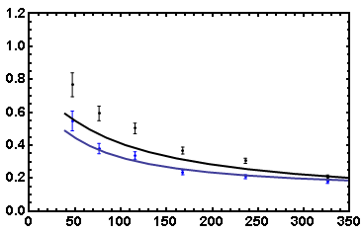
Coupling of Flow to Eloss
Is high-p_{T} v₂ huge due to medium push?
R_{AA}(φ = 0, N_{part}) vs. R_{AA}(φ = π/2, N_{part})
WS Glauber
HN Mixed
KLN CGC
PHENIX Preliminary
7-8 GeV π⁰
R_{AA} in
R_{AA} out
R_{AA}
PHOBOS 2008 Data
N_{part}
Care taken with dN_{g}/dy(N_{part})
Horowitz and Jia, in preparation
Smaller influence of fluc.?

Slide 16
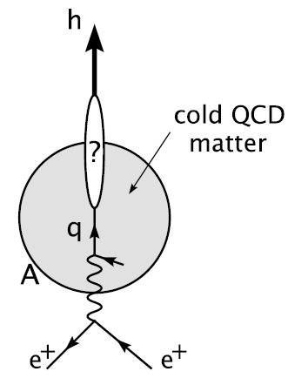
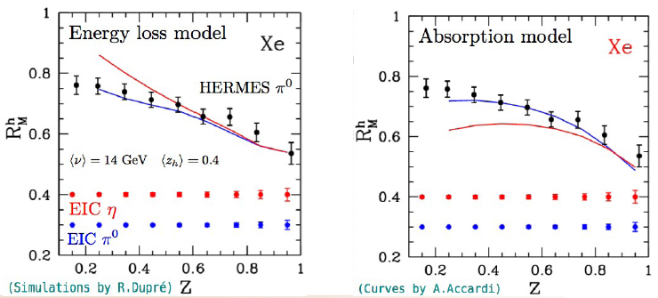
Importance of Cold Matter E-Loss
Large fraction of jet lifetime spent in hadronic matter
QGP lasts ~ 2-4 fm
Typical jet pathlength ~ 5 fm
Measure in EIC
Accardi et al.,
Riv.Nuovo Cim.32, 2010
Accardi, QM Italia

Slide 17
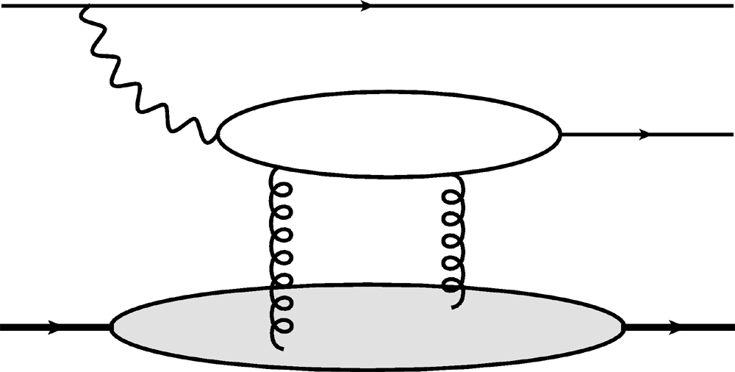
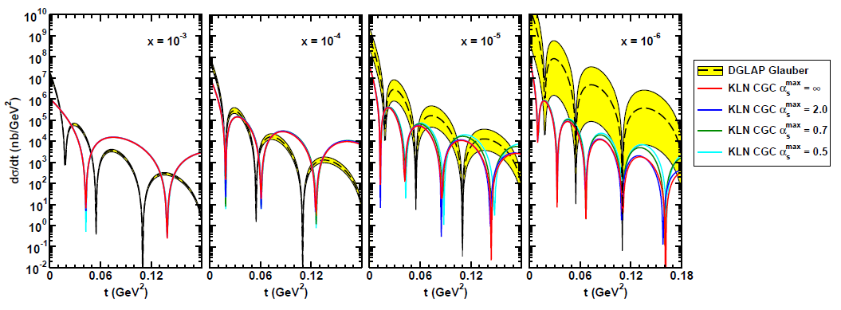
Gluon Distribution of A at x ~ 10⁻³
e
e
Coherent vector meson production in e + A
2 gluon exchange => mean & fluc.
γ*
J/ψ
A
A
Must reject incoherent
collisions at ~100%
WAH, arXiv:1102.5058
Also DVCS and Incoherent production; see talk by Kowalski

Slide 18
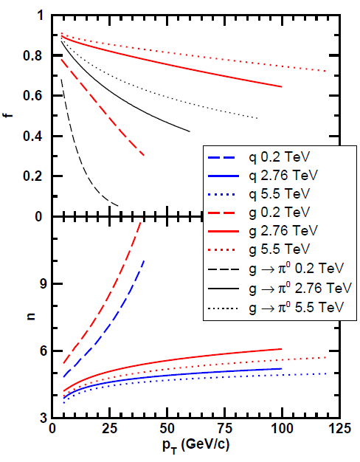
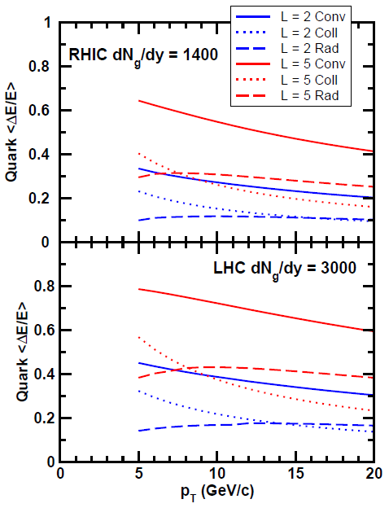
LHC Context
LHC is gluon machine
Flatter spectra
Elastic ~ Radiative
WAH and M Gyulassy, in preparation

Slide 19
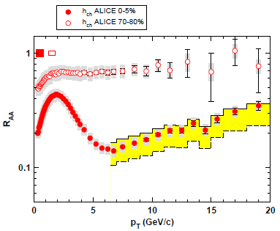
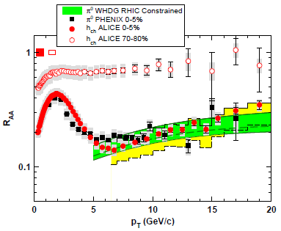
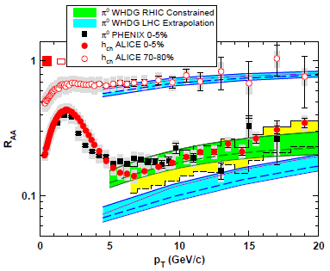
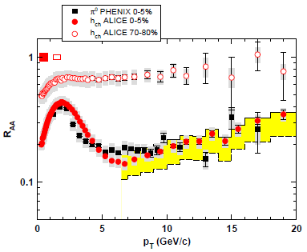
R_{AA} at LHC: First Results
Generically, difficult to reconcile 2.4x increase in multiplicity and minor decrease in R_{AA}
Shown at Kruger2010
WAH and M Gyulassy, in prep

Slide 20
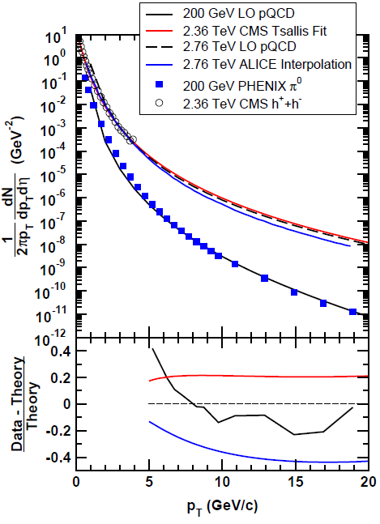
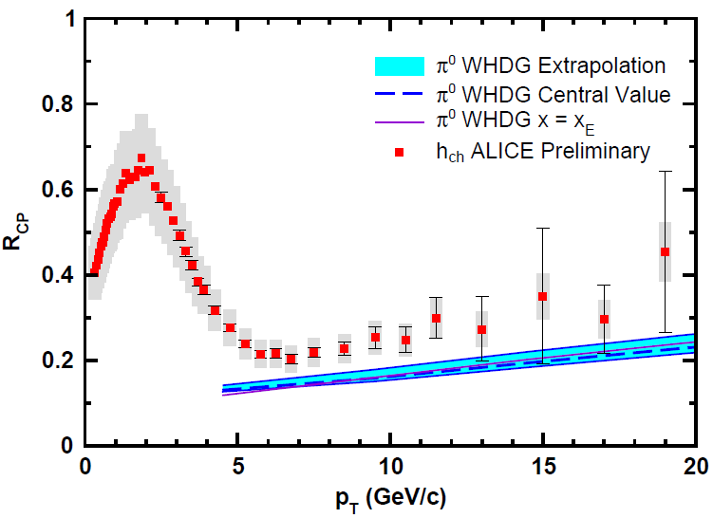
Spectral Uncertainty
Need for p + p baseline
R_{AA}(b) and π⁰ very useful
Apples-to-apples compar-ison to RHIC, theory
WAH and M Gyulassy, in preparation

Slide 21
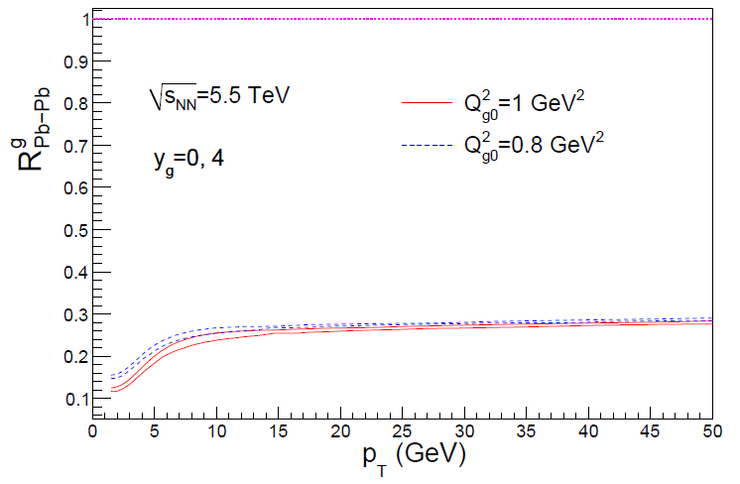
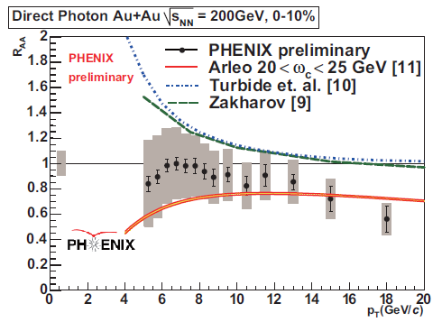
Reasons to be Cautious about LHC
Quenching due to IS or FS?
Need experimental control over production
p + A
T Isobe, JPhysG34 (2007)
Albacete and Marquet, PLB687, 2010

Slide 22
Jets in AdS/CFT
Model heavy quark jet energy loss by embedding string in AdS space
dp_{T}/dt = - μ p_{T}
μ = πλ^{1/2} T²/2M_{q}
Similar to Bethe-Heitler
dp_{T}/dt ~ -(T³/M_{q}²) p_{T}
Very different from usual pQCD and LPM
dp_{T}/dt ~ -LT³ log(p_{T}/M_{q})
J Friess, S Gubser, G Michalogiorgakis, S Pufu, Phys Rev D75 (2007)

Slide 23
Compared to Data
String drag: qualitative agreement
WAH, PhD Thesis

Slide 24
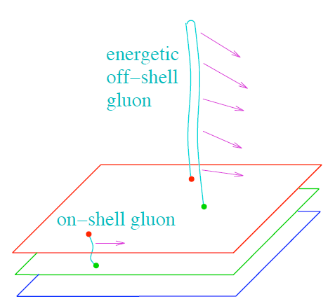
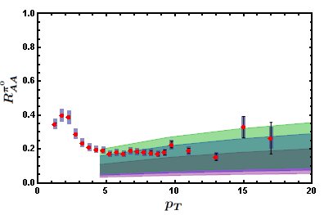
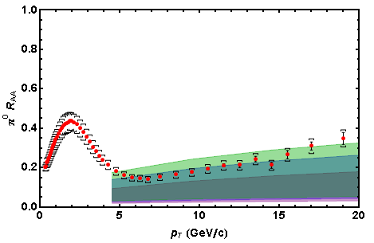
Light Quark and Gluon E-Loss
0.2 TeV
WAH, in preparation
SS Gubser, QM08
2.76 TeV
ΔL^{q}_{therm} ~ E^{1/3}
ΔL^{q}_{therm} ~ (2E)^{1/3}
Gubser et al., JHEP0810 (2008)
Chesler et al., PRD79 (2009)
See also Marquet and Renk,
PLB685 (2010), and
Jia, WAH, and Liao,
arXiv:1101.0290, for v₂

Slide 25
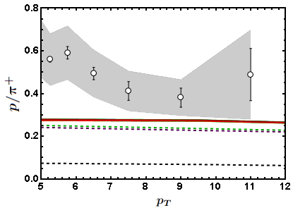
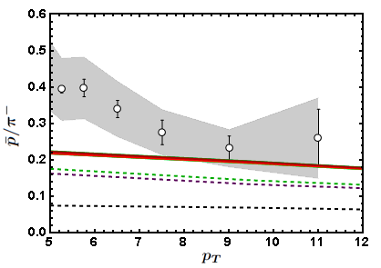
Baryon to Meson Ratios
Distinguishing measurement?
STAR
STAR
AdS/CFT
AdS/CFT
pQCD
pQCD
WAH, in preparation

Slide 26
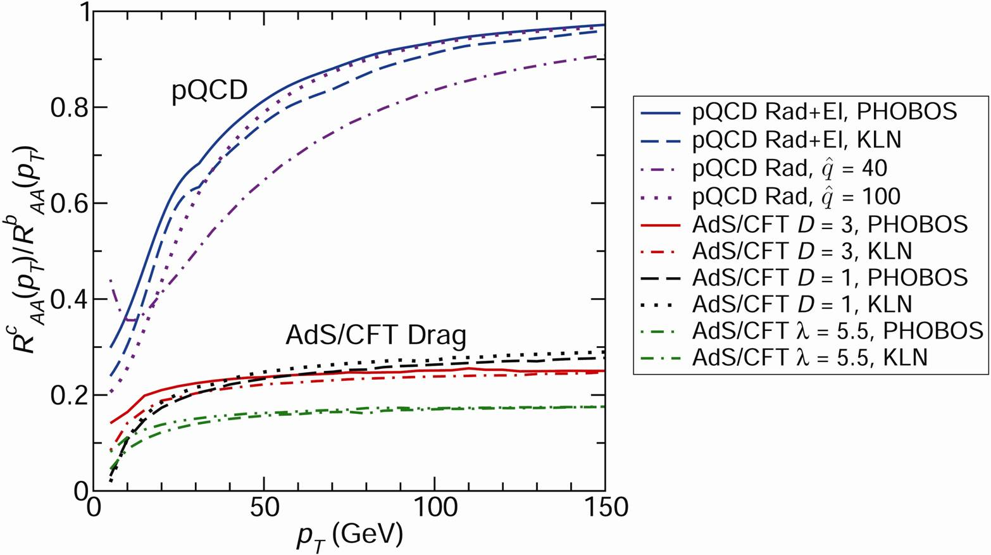
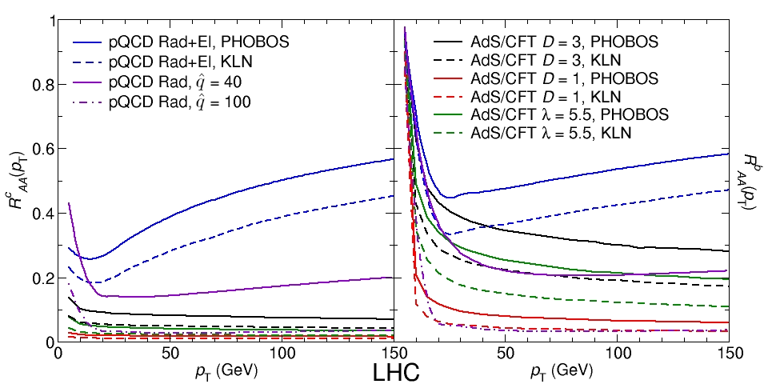
pQCD vs. AdS/CFT at LHC
Plethora of Predictions:
WAH, M. Gyulassy, PLB666 (2008)
Taking the ratio cancels most normalization differences
pQCD ratio asymptotically approaches 1, and more slowly so for increased quenching (until quenching saturates)
AdS/CFT ratio is flat and many times smaller than pQCD at only moderate p_{T}
WAH, M. Gyulassy, PLB666 (2008)

Slide 27
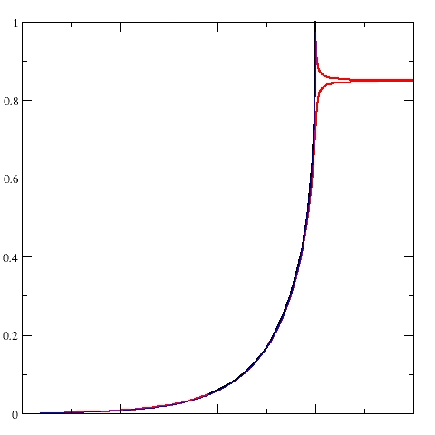
Not So Fast!
Speed limit estimate for applicability of AdS drag
γ < γ_{crit} = (1 + 2M_{q}/λ^{1/2} T)²
~ 4M_{q}²/(λ T²)
Limited by M_{charm} ~ 1.2 GeV
Similar to BH LPM
γ_{crit} ~ M_{q}/(λT)
No Single T for QGP
smallest γ_{crit} for largest T
T = T(τ₀, x=y=0): “(”
largest γ_{crit} for smallest T
T = T_{c}: “]”
D7 Probe Brane
Q
Worldsheet boundary Spacelike if γ > γ_{crit}
x₅
Trailing
String
“Brachistochrone”
“z”
D3 Black Brane

Slide 28
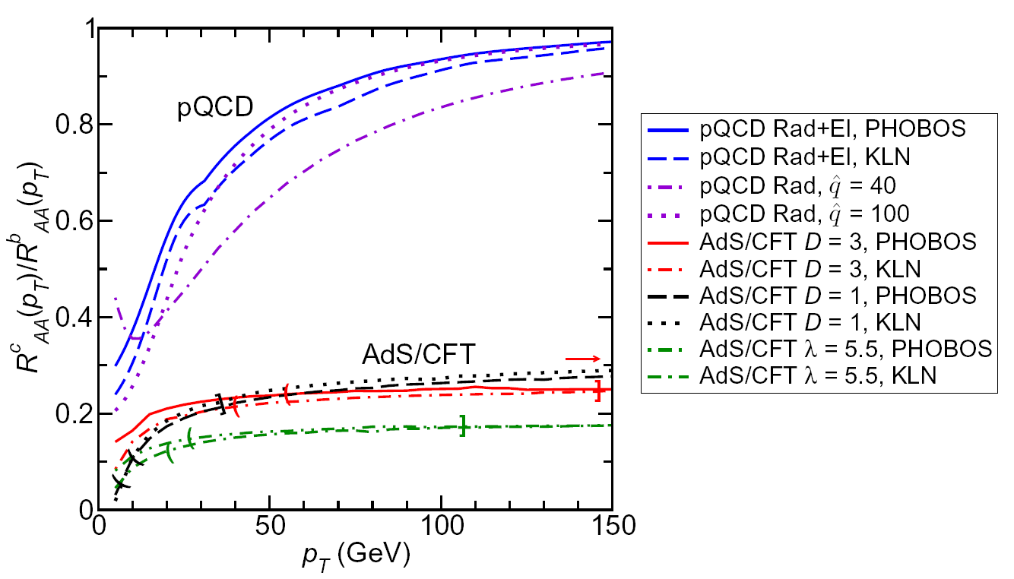
LHC R^{c}_{AA}(p_{T})/R^{b}_{AA}(p_{T}) Prediction (with speed limits)
WAH, M. Gyulassy, PLB666 (2008)
T(τ₀): “(”, corrections likely small for smaller momenta
T_{c}: “]”, corrections likely large for higher momenta
Qualitatively, corrections to AdS/CFT result will drive double ratio to unity

Slide 29
Conclusions
pQCD fails to quant. simul. describe R_{AA}, v₂, I_{AA}, ... for π, e, RHIC and LHC (?)
Higher order effects are important
α_{s}, k_{T}/xE, M_{Q}/xE, opacity
HO effects can be mitigated in some cases by
examining simultaneous observables
going to higher energies
IC effects seem small and under control at RHIC
LHC?? Need p + p and p + A, R_{AA} for other centralities
Coupling of low-p_{T} flow to E-loss possibly very important
AdS/CFT qualitatively agrees with π and e R_{AA}
Also better agreement with B/M ratio, v₂
Lots of interesting theory work needed for rigorous conclusions
c and b separation at RHIC and LHC likely key to understanding E-loss mechanism, QGP
e + A physics useful for init. state and cold NM E-loss

Slide 31
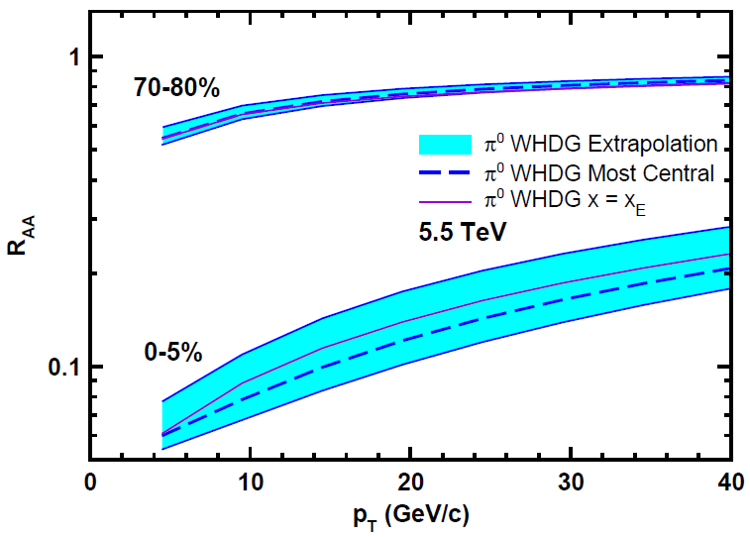
Top Energy Predictions
For posterity:
WAH and M Gyulassy, in preparation

Slide 32
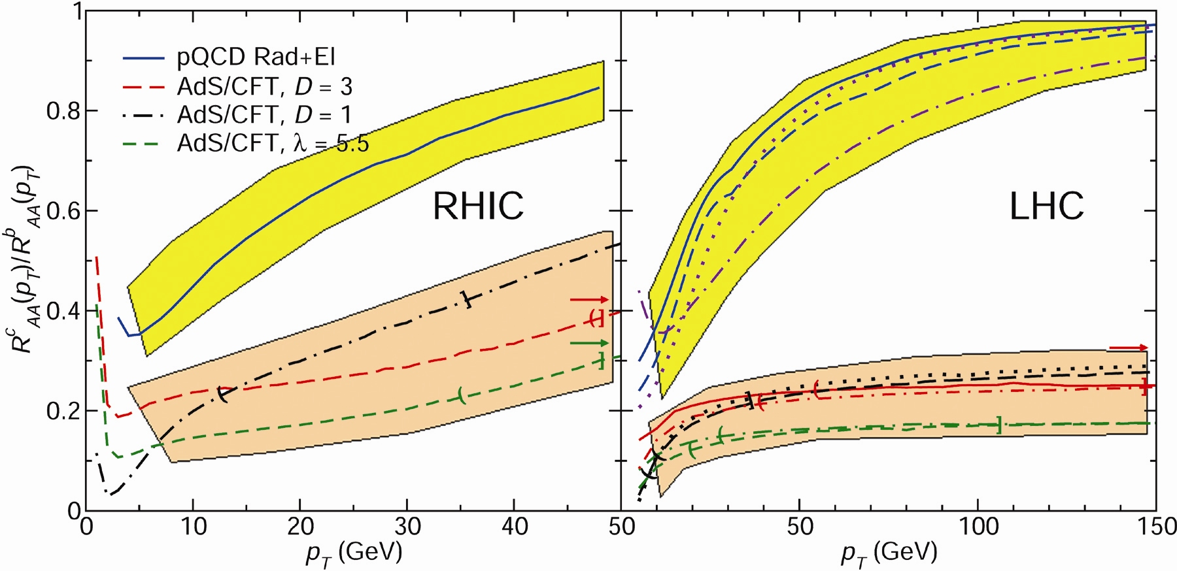
RHIC R^{cb} Ratio
pQCD
pQCD
AdS/CFT
AdS/CFT
WAH, M. Gyulassy, JPhysG35 (2008)
Wider distribution of AdS/CFT curves due to large n: increased sensitivity to input parameters
Advantage of RHIC: lower T => higher AdS speed limits

Slide 33
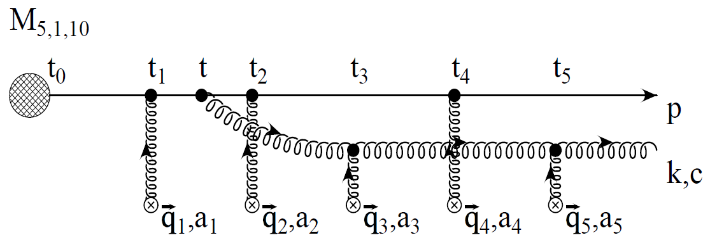
pQCD Rad Picture
Bremsstrahlung Radiation
Weakly-coupled plasma
Medium organizes into Debye-screened centers
T ~ 250 MeV, g ~ 2
μ ~ gT ~ 0.5 GeV
λ_{mfp} ~ 1/g²T ~ 1 fm
R_{Au} ~ 6 fm
1/μ << λ_{mfp} << L
mult. coh. em.
Gyulassy, Levai, and Vitev, NPB571 (200)
LPM
dp_{T}/dt ~ -LT³ log(p_{T}/M_{q})
Bethe-Heitler
dp_{T}/dt ~ -(T³/M_{q}²) p_{T}

Slide 34
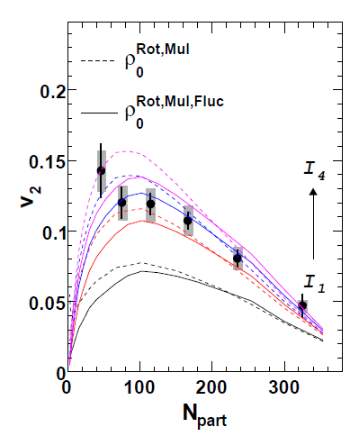
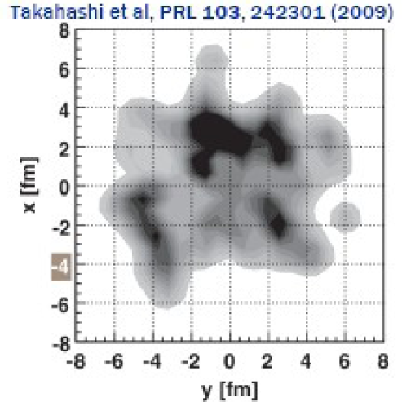
What About Fluctuations?
Hot spots can be huge
NEXUS calculation for 10% most central top RHIC energy event
For simple E-loss not a large effect
Important for fluc., opacity exp.?
Jia and Wei, arXiv:1005.0645

Slide 35
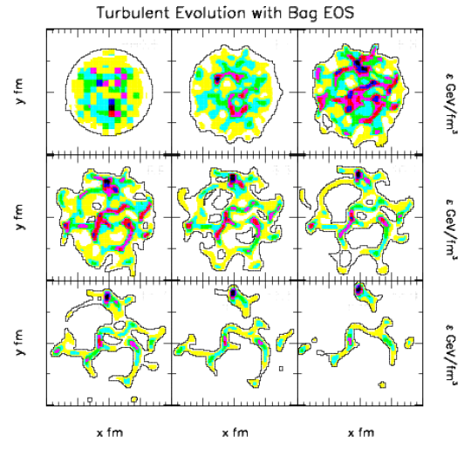
Hydro + Fluctuations
Hydro evolution may amplify fluctuations
Gyulassy, Rischke, Zhang, NPA613, 1997

Slide 36
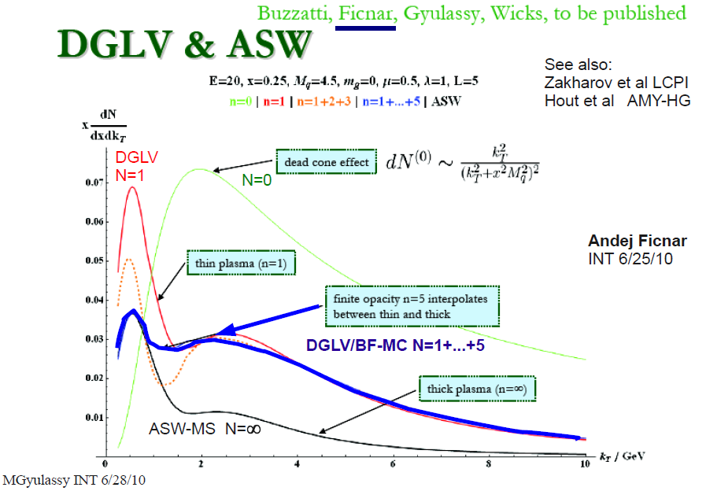
Opacity Corrections
Likely important, but integration over many variables required for comparison to data

Slide 37
Pictorial Soft-Soft vs. Soft-Hard

Slide 38
Chesler et al., PRD79 (2009)

