Slide 1
Phenomenology of the
Quark-Gluon Plasma
W. A. Horowitz
University of Cape Town
April 15, 2011
With many thanks to Miklos Gyulassy,
Ulrich Heinz, and Yuri Kovchegov

Slide 2

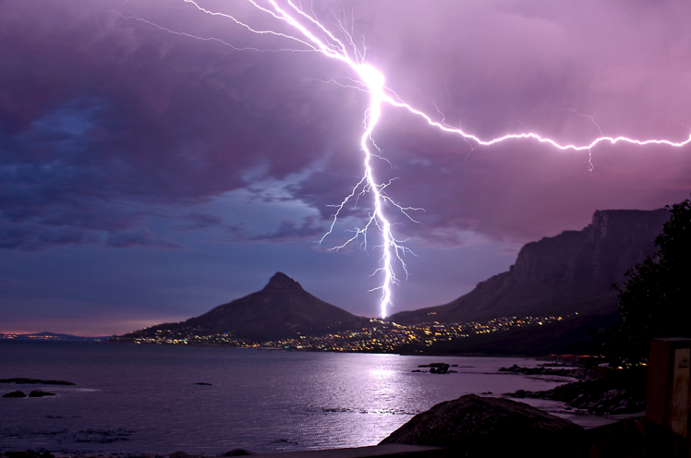

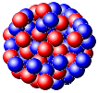
Four Fundamental Forces
Gravity
Electromagnetism
starchild.gsfc.nasa.gov
John Maarschalk, travelblog.portfoliocollection.com
Weak
Strong
lhs.lps.org/staff/sputnam/chem_notes/tritium_decay.gif

Slide 3

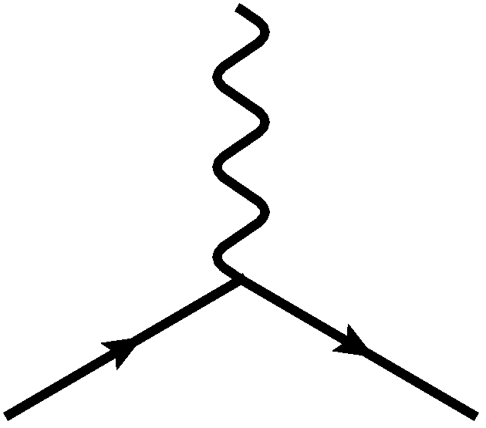
E&M Particle Physics Well Understood
Lagrangian known:
QED Vertex:
Ex. of Precision QED: g - 2
Gabrielse et al., PRL97 (2006)
Hanneke, Fogwell, and Gabrielse, PRL100 (2008)

Slide 4
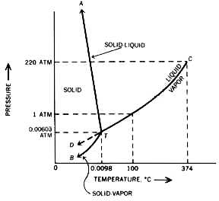

E&M and Phase Diagrams
Many body physics less well understood
Water
Hydrogen
www.sv.vt.edu/classes/MSE2094_NoteBook/96ClassProj/examples/triplpt.html
Calculated, Burkhard Militzer,
Diploma Thesis, Berlin, 2000

Slide 5

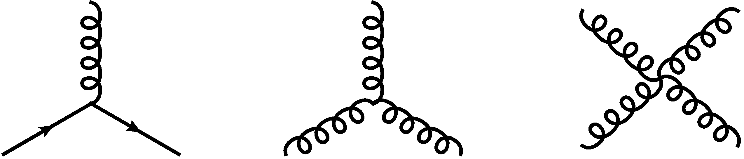


QCD Particle Physics Well Understood
Lagr. known:
QCD Vertices:
Qual. & Quant. agreement w/ data
ALEPH,
PLB284
(1992)
PDG

Slide 6

What Are We Interested In?
Measure many-body physics of strong force
Test & understand theory of many-body non-Abelian fields
Long Range Plan, 2008
Notes:
Unique as compared to strongly coupled Abelian problems

Slide 7
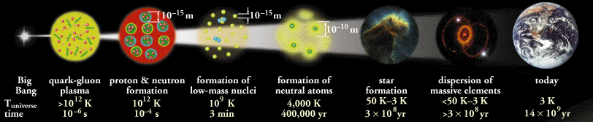
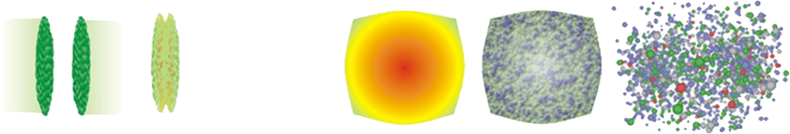
Big Bang vs. Little Bang
ALICE Collaboration
t = - ∞
t = 0
t = 1 fm/c
t = 3 fm/c
t = 4 fm/c
t = + ∞
Initial State
Initial Overlap
Thermalization
QGP
Hadronization
Hadron Gas

Slide 8
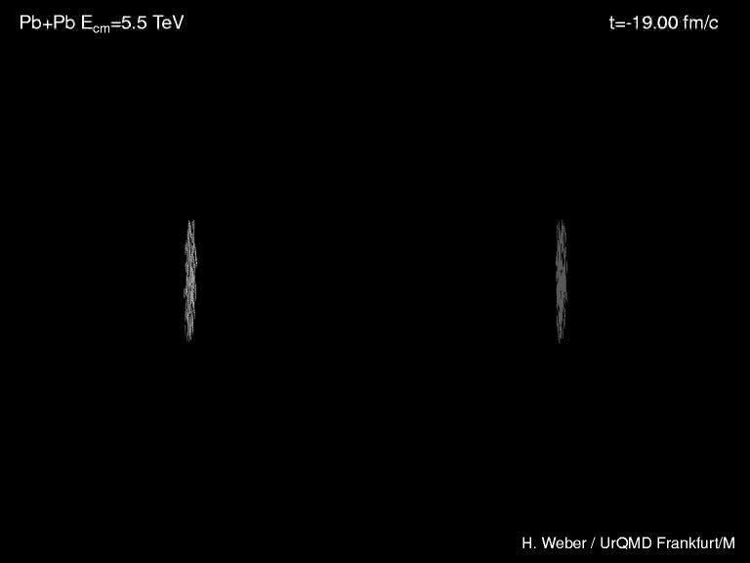
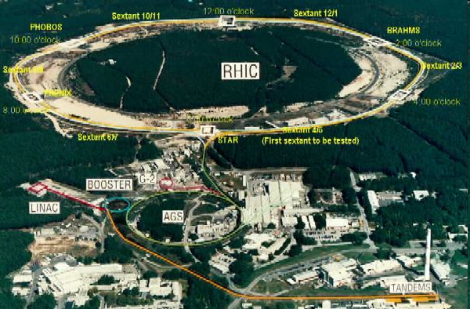
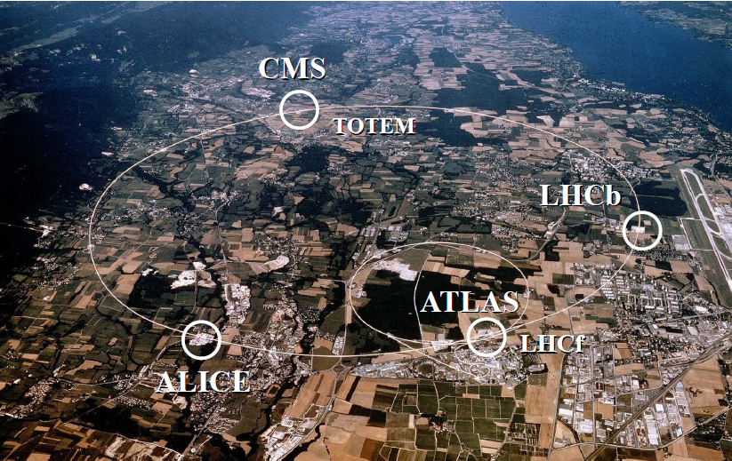
Heavy Ion Collisions
Collider machines: RHIC, LHC
Relativistic Heavy Ion Collider
Large Hadron Collider

Slide 9

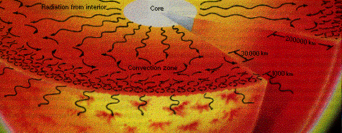
Orders of Magnitude
Units: MeV, GeV, TeV
  At RHIC, nuclei acc. to 100 GeV per nucleon
    Energy of collision ~ two mosquitoes colliding
    LHC: 10x higher energy
  T_{c} ~ Λ_{QCD} ~ 200 MeV
    Temp. at RHIC ~ 10,000 times hotter than the core of the sun (15,000,000 Kelvin)
www.answersingenesis.org
Chaisson and McMillan,
Astronomy Today (1993)

Slide 10
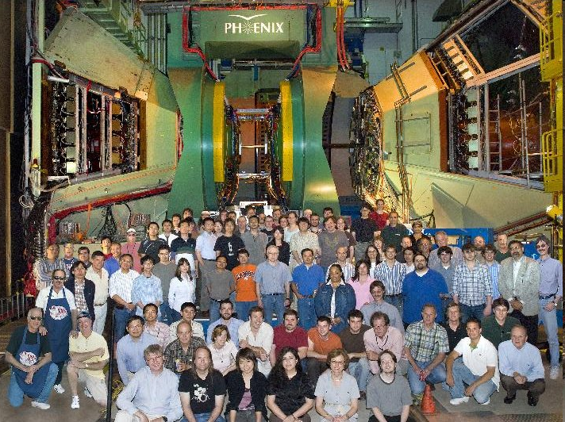
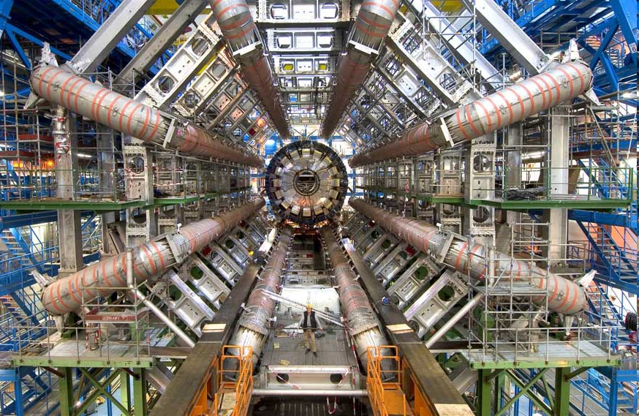
Experiments
RHIC
  BRAHMS
  PHENIX
  PHOBOS
  STAR
LHC
  ALICE
  ATLAS
  CMS
  LHCb
PHENIX
ATLAS

Slide 11


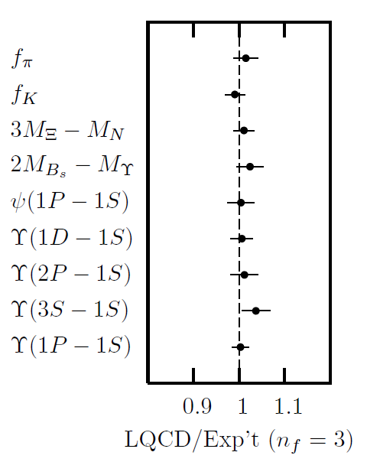
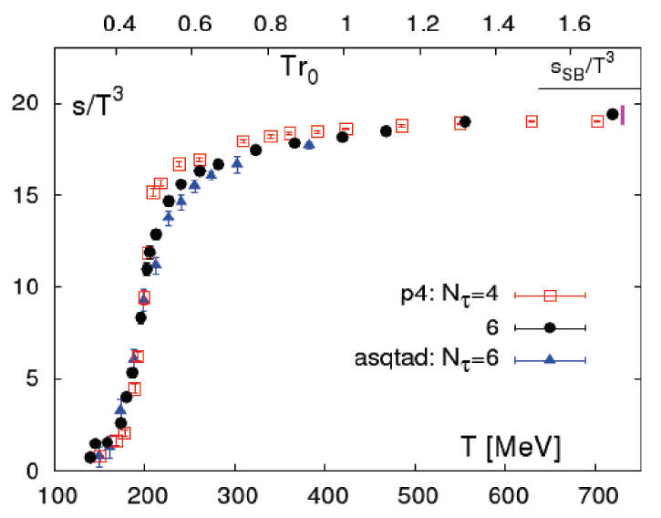
Methods of QCD Calculation I: Lattice
Long Range Plan, 2008
    All momenta
    Euclidean correlators
Cheng et al., PRD77 (2008)
Davies et al. (HPQCD),
PRL92 (2004)

Slide 12


Methods of QCD Calculation II: pQCD
(perturbative QCD)
d’Enterria, 0902.2011
Jäger et al., PRD67 (2003)
    Any quantity
    Small coupling (large momenta only)

Slide 13




Methods III: AdS/CFT
Maldacena conjecture: SYM in d ⬄ IIB in d+1
Gubser, QM09
    All quantities
    N_{c} → ∞ SYM, not QCD
      Probably not good approx. for p+p; maybe A+A?
    Applicable to condensed matter systems?
Notes:
Next up, experiments!

Slide 14
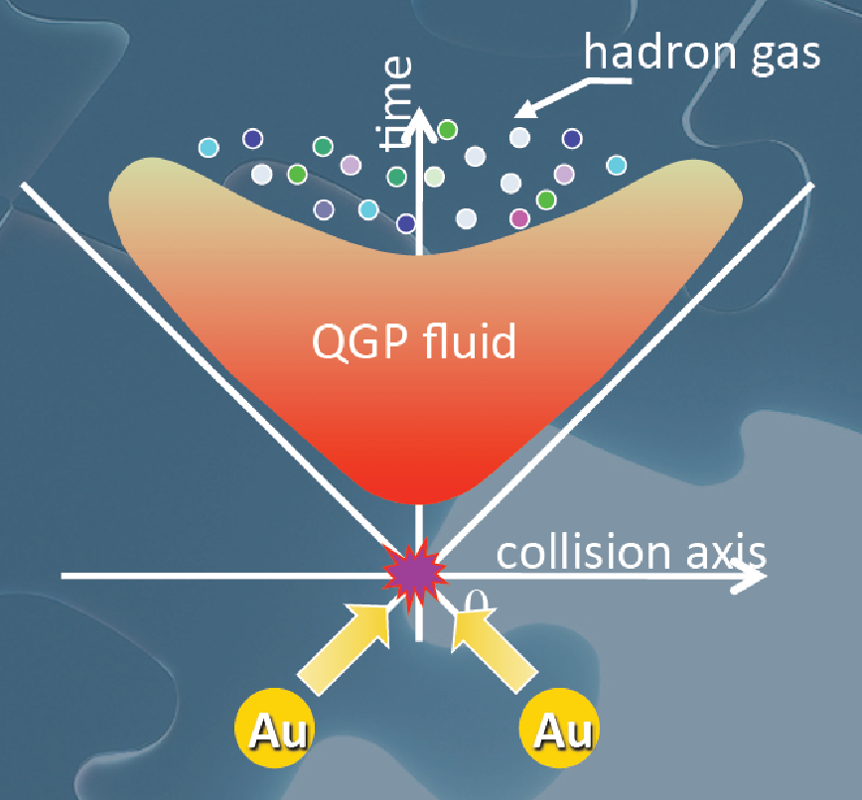
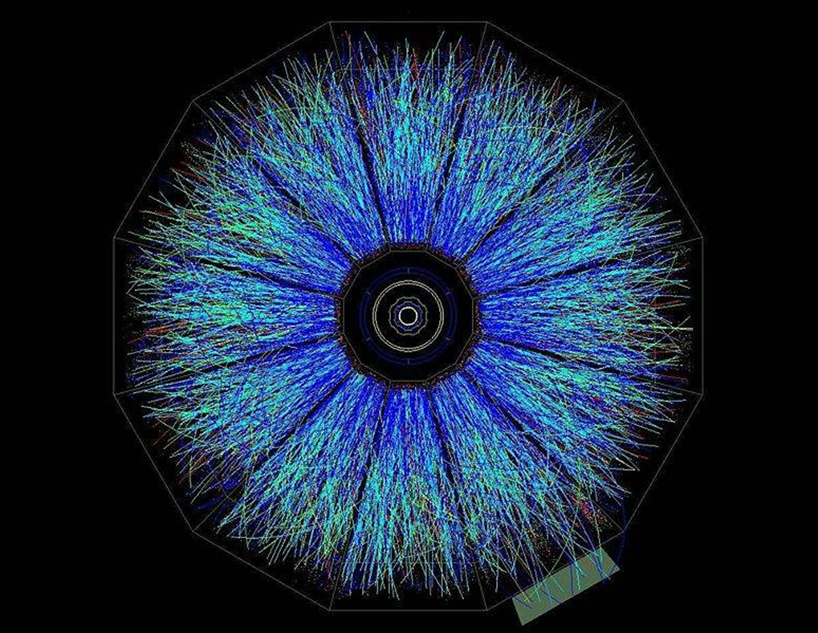
Evolution of a HI Collision
STAR, event
T Hirano, Colliding Nuclei from AMeV to ATeV

Slide 15

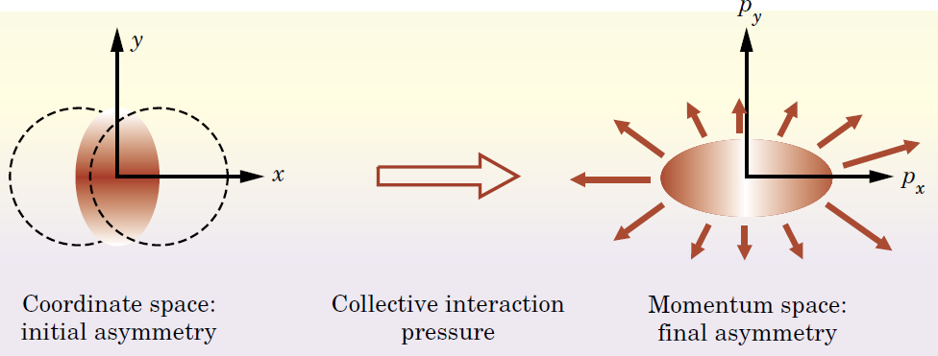
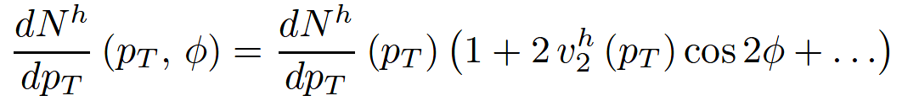
Particle Flow
Qualitative picture:
  Anisotropic initial
  geometry =>
  anisotropic flow
M Kaneta, Results from
the Relativistic Heavy
Ion Collider (Part II)
T Ludlum and L McLerran,
Phys. Today 56N10 (2003)

Slide 16
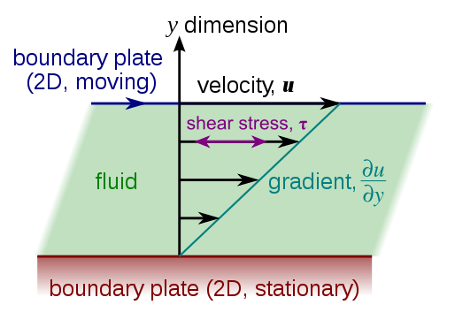
Viscous Hydrodynamics
Viscosity reduces elliptic flow
  Naive pQCD => η/s ~ 1
  Naive AdS/CFT => η/s ~ 1/4π
Similar story for hydro at LHC
Shear Viscosity, Wikipedia
Luzum and Romatschke,
Phys.Rev.C78:034915,2008

Slide 17

Why High-p_{T} Jets?
Tomography in medicine
One can learn a lot from a single probe…
and even more with multiple probes
SPECT-CT Scan uses internal γ photons and external X-rays
PET Scan
http://www.fas.org/irp/imint/docs/rst/Intro/Part2_26d.html

Slide 18

Tomography in QGP
Requires well-controlled theory of:
  production of rare, high-p_{T} probes
    g, u, d, s, c, b
  in-medium E-loss
  hadronization
Requires precision measurements of decay fragments
p_{T}
, γ, e⁻
φ
Invert attenuation pattern => measure medium properties

Slide 19


QGP Energy Loss
Learn about E-loss mechanism
  Most direct probe of DOF
pQCD Picture
AdS/CFT Picture

Slide 20

pQCD Rad Picture
Bremsstrahlung Radiation
  Weakly-coupled plasma
    Medium organizes into Debye-screened centers
  T ~ 250 MeV, g ~ 2
    μ ~ gT ~ 0.5 GeV
    λ_{mfp} ~ 1/g²T ~ 1 fm
    R_{Au} ~ 6 fm
  1/μ << λ_{mfp} << L
    mult. coh. em.
Gyulassy, Levai, and Vitev, NPB571 (2000)
  LPM
    dp_{T}/dt ~ -LT³ log(p_{T}/M_{q})
  Bethe-Heitler
    dp_{T}/dt ~ -(T³/M_{q}²) p_{T}

Slide 21
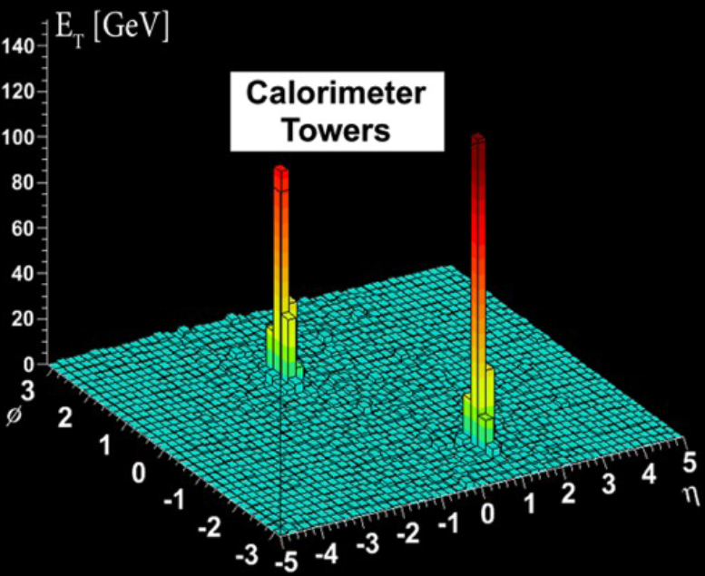
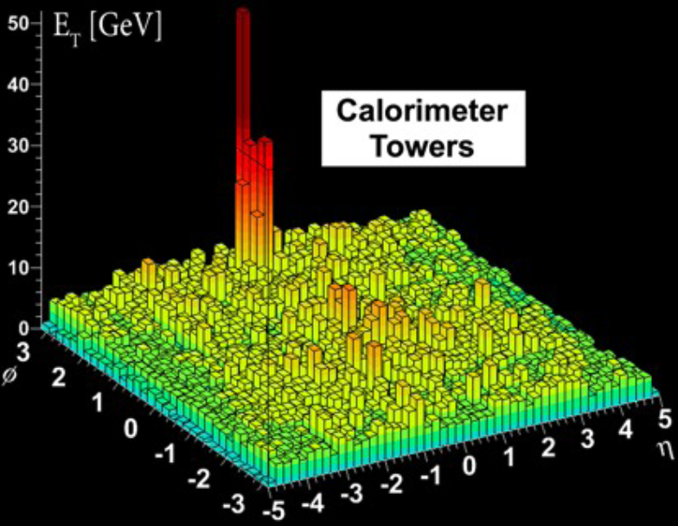
Hard-to-Find Jets
Peripheral Collision
  similar to p + p
Central Collision
ATLAS measurements from Steinberg, HI at LHC

Slide 22
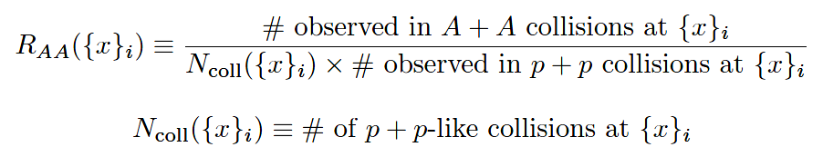
High-p_{T} Observable
    Naively: if medium has no effect, then R_{AA} = 1

Slide 23

pQCD Success at RHIC:
(circa 2005)
Y. Akiba for the PHENIX collaboration, hep-ex/0510008
  Consistency: R_{AA}(η)~R_{AA}(π)
  Null Control: R_{AA}(γ)~1
  GLV Prediction: Theory~Data for reasonable fixed L~5 fm and dN_{g}/dy~dN_{π}/dy

Slide 24

Quantitative Disagreement
Wicks, WAH, Gyulassy, Djordjevic, NPA784 (2007)
Pert. at LHC energies?

Slide 25
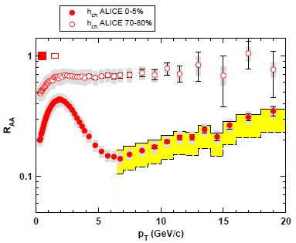
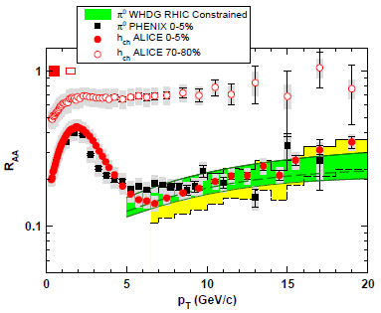
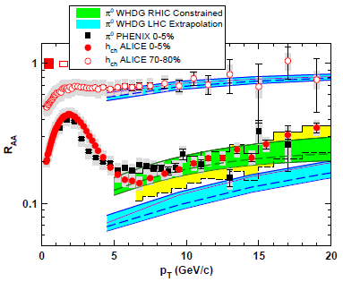
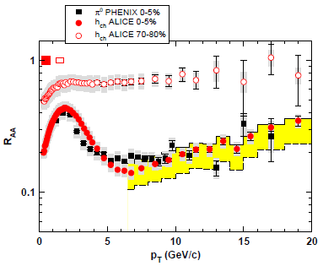
R_{AA} at LHC: First Results
Many caveats
  But, difficult to reconcile large increase in multiplicity and minor increase in suppression
WAH and M Gyulassy, in prep

Slide 26
R_{AA} at LHC: First Results
Many caveats
  But, difficult to reconcile large increase in multiplicity and minor increase in suppression
WAH and M Gyulassy, in prep

Slide 27
Jets in AdS/CFT
Model heavy quark jet energy loss by embedding string in AdS space
  dp_{T}/dt = - μ p_{T}
  μ = πλ^{1/2} T²/2M_{q}
  Similar to Bethe-Heitler
    dp_{T}/dt ~ -(T³/M_{q}²) p_{T}
  Very different from LPM
    dp_{T}/dt ~ -LT³ log(p_{T}/M_{q})
J Friess, S Gubser, G Michalogiorgakis, S Pufu, Phys Rev D75 (2007)

Slide 28
Compared to Data
String drag: qualitative agreement
WAH, PhD Thesis

Slide 29


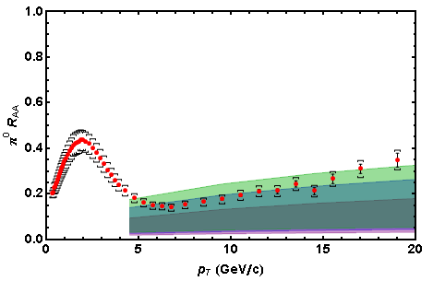
Light Quark and Gluon E-Loss
0.2 TeV
WAH, in preparation
SS Gubser, QM08
2.76 TeV
ΔL^{q}_{therm} ~ E^{1/3}
ΔL^{q}_{therm} ~ (2E)^{1/3}
Gubser et al., JHEP0810 (2008)
Chesler et al., PRD79 (2009)
See also Marquet and Renk,
PLB685 (2010), and
Jia, WAH, and Liao,
arXiv:1101.0290, for v₂

Slide 30

An Enhanced Signal: LHC
But what about the interplay between mass and momentum?
  Take ratio of c to b R_{AA}(p_{T})
    pQCD: Mass effects die out with increasing p_{T}
      Ratio starts below 1, asymptotically approaches 1. Approach is slower for higher quenching
    ST: drag independent of p_{T}, inversely proportional to mass. Simple analytic approx. of uniform medium gives
    R^{cb}_{pQCD}(p_{T}) ~ n_{b}M_{c}/n_{c}M_{b} ~ M_{c}/M_{b} ~ .27
      Ratio starts below 1; independent of p_{T}
R^{cb}_{pQCD}(p_{T}) ∼ 1 - α_{s} n(p_{T}) L² log(M_{b}/M_{c}) ( /p_{T})

Slide 31


LHC R^{c}_{AA}(p_{T})/R^{b}_{AA}(p_{T}) Prediction
Zoo of c and b Predictions:
WAH, M. Gyulassy, PLB666 (2008)
      Taking the ratio cancels most normalization differences seen previously
      pQCD ratio asymptotically approaches 1, and more slowly so for increased quenching (until quenching saturates)
      AdS/CFT ratio is flat and many times smaller than pQCD at only moderate p_{T}
WAH, M. Gyulassy, PLB666 (2008)

Slide 32

Not So Fast!
  Speed limit estimate for applicability of AdS drag
    γ < γ_{crit} = (1 + 2M_{q}/λ^{1/2} T)²
    ~ 4M_{q}²/(λ T²)
      Limited by M_{charm} ~ 1.2 GeV
    Similar to BH LPM
      γ_{crit} ~ M_{q}/(λT)
  No Single T for QGP
    smallest γ_{crit} for largest T
    T = T(τ₀, x=y=0): “(”
    largest γ_{crit} for smallest T
    T = T_{c}: “]”
D7 Probe Brane
Q
Worldsheet boundary Spacelike if γ > γ_{crit}
x₅
Trailing
String
“Brachistochrone”
“z”
D3 Black Brane

Slide 33

LHC R^{c}_{AA}(p_{T})/R^{b}_{AA}(p_{T}) Prediction
(with speed limits)
WAH, M. Gyulassy, PLB666 (2008)
      T(τ₀): “(”, corrections likely small for smaller momenta
      T_{c}: “]”, corrections likely large for higher momenta

Slide 34
Conclusions
Heavy Ion Physics is fascinating
  Want to theoretically calculate properties of high energy, many-body, non-Abelian QCD
  Able to experimentally test theory
Lattice, pQCD, and AdS/CFT all useful techniques
Rich variety of physics regimes to investigate
Many open, interesting problems
  Traditional pQCD techniques in quantitative disagreement with data
  New theory tool with AdS/CFT, successes
LHC: already exciting new results
  Experimental signature: R^{c}_{AA}/R^{b}_{AA}
Future of High Energy QCD:
  qualitative -> quantitative
  electron-ion collisions

