Slide 1
Gluon Tomography with EVMP
W. A. Horowitz
University of Cape Town
June 30, 2011
With many thanks to Elke, Thomas, Raju, Tuomas, ...

Slide 2
Motivation
4 fundamental forces
QCD is only exp. accessible & non-Abel.
What are the properties of thermalized QCD matter produced at RHIC and LHC?
c_{s}, η/s, qhat, ...
Extracting these quantities requires understanding of medium geometry
Hydro requires IC: medium quantities depend sensitively on IC

Slide 3
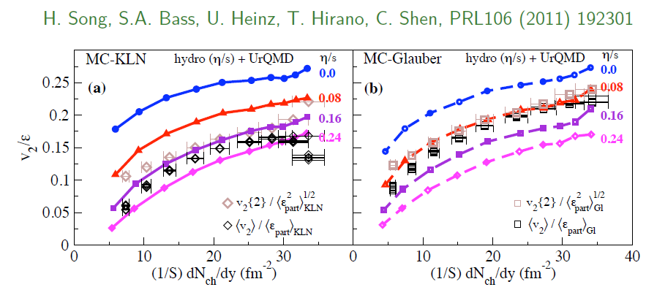
η/s Extraction
Factor at least 2 uncertainty in η/s from IC
Naive pQCD => η/s ~ 1
Naive AdS/CFT => η/s ~ 1/4π
Teaney, Users’ Meeting 2011

Slide 4
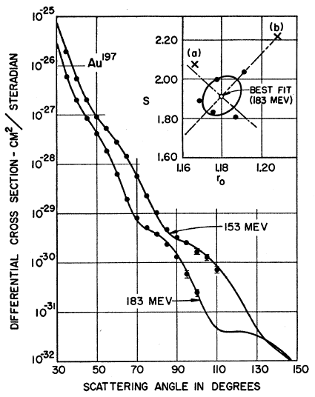
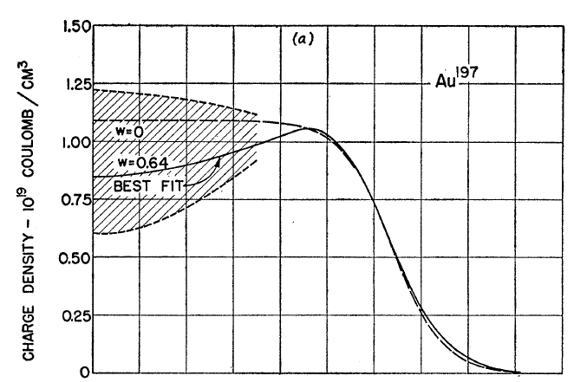
Measuring the IC
eRHIC: exp. meas. of initial glue?
Recall e + A diffraction exps. on A at rest
Yielded Woods-Saxon distribution!
Hahn, Ravenhall, and Hofstadter, Phys Rev 101 (1956)

Slide 5
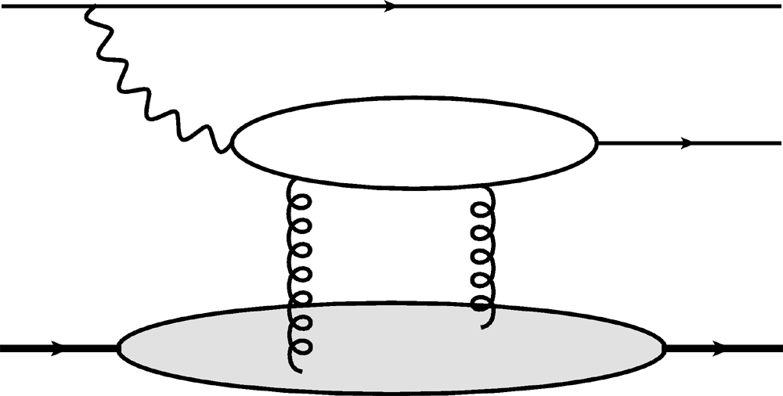
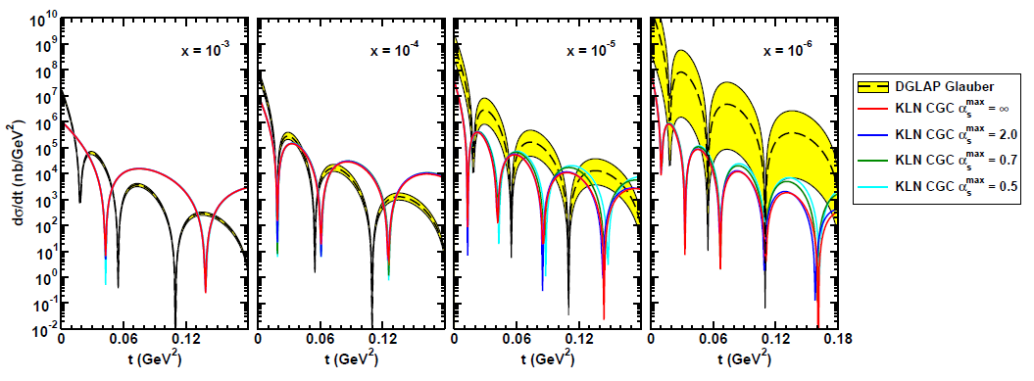
Gluon Distribution of A at x ~ 10⁻³
e
e
Coherent vector meson production in e + A
2 gluon exchange => mean & fluc.
γ*
J/ψ
A
A
Must reject incoherent
collisions at ~100%
WAH, arXiv:1102.5058

