Slide 1
Energy Loss Calculations, RHIC, and First Results from LHC
W. A. Horowitz
University of Cape Town
July 14, 2011
With many thanks to Alessandro Buzzatti, Brian Cole, Miklos Gyulassy, Jiangyong Jia, and Yuri Kovchegov

Slide 2
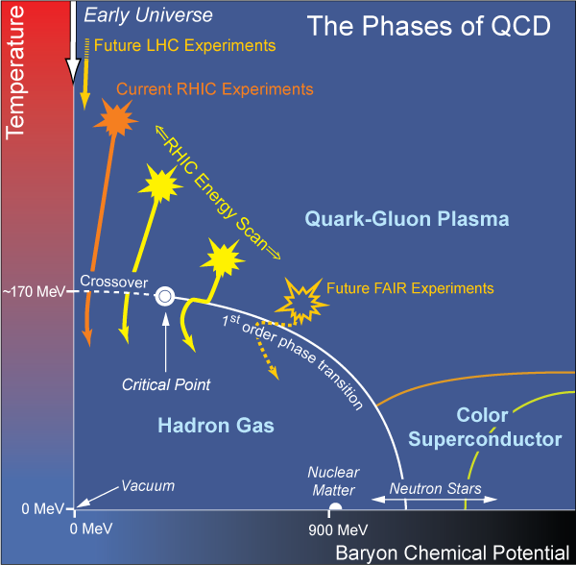
What Are We Interested In?
Measure many-body physics of strong force
Test & understand theory of many-body non-Abelian fields
Long Range Plan, 2008
Notes:
Unique as compared to strongly coupled Abelian problems

Slide 3
Big Bang vs. Little Bang
ALICE Collaboration
High Momentum Particle
t = - ∞
t = 0
t ~ 1 fm/c
t = + ∞
Initial State
Initial Overlap
Thermalization
QGP
Hadronization
Hadron Gas

Slide 4
Motivating High Momentum Probes

Slide 5
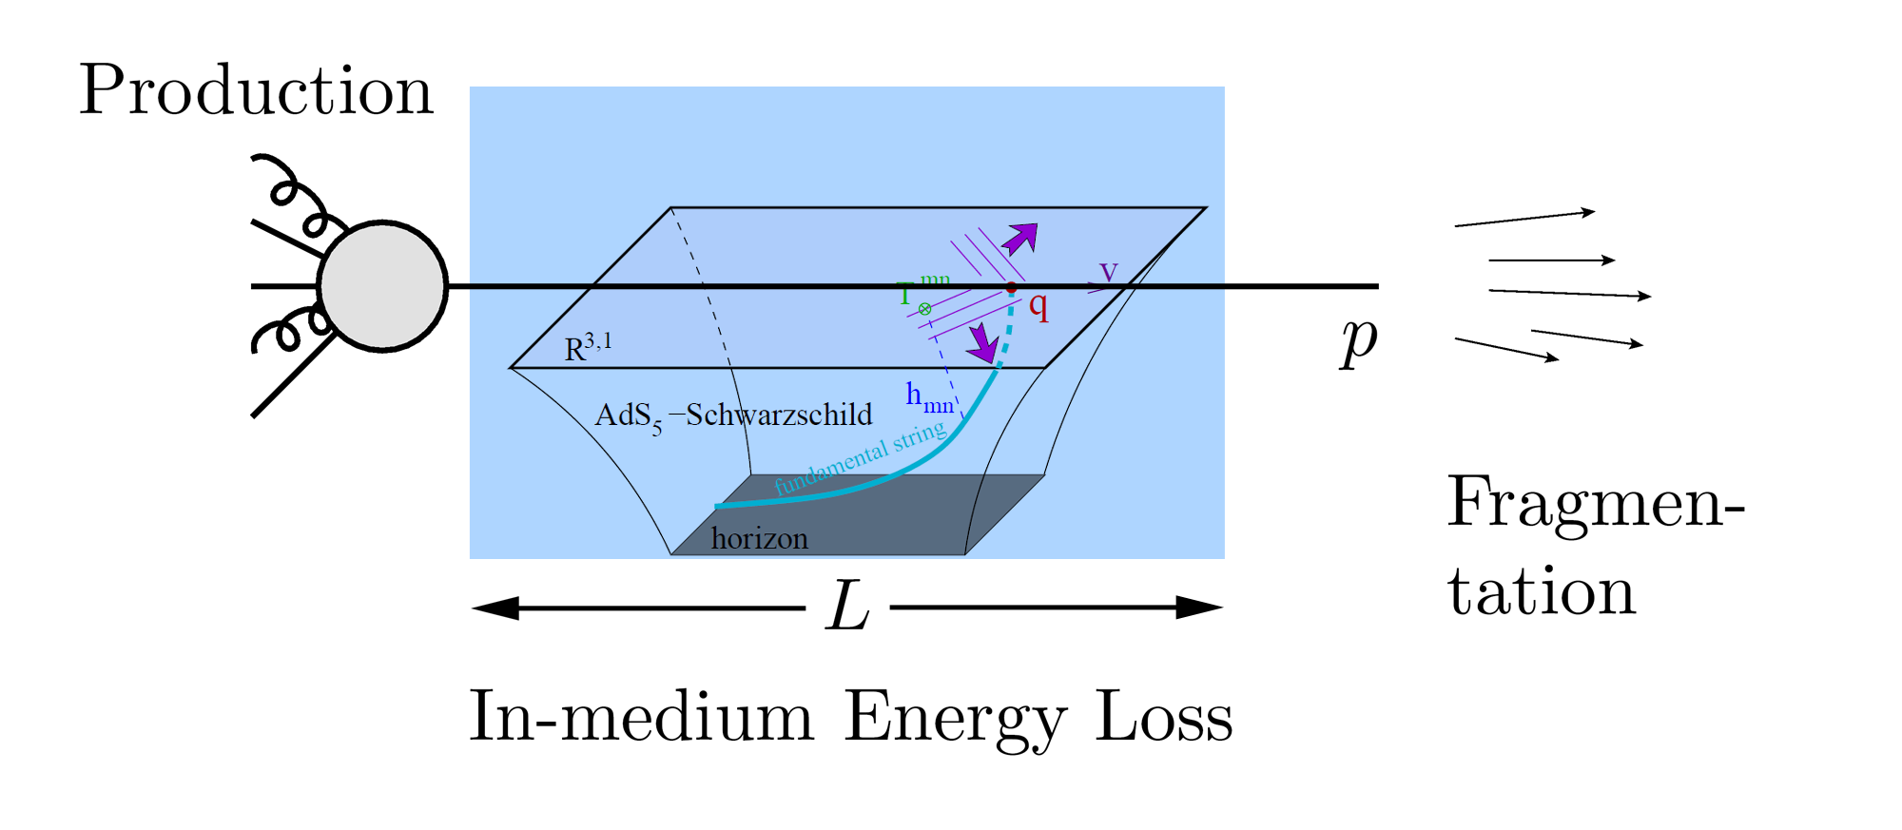
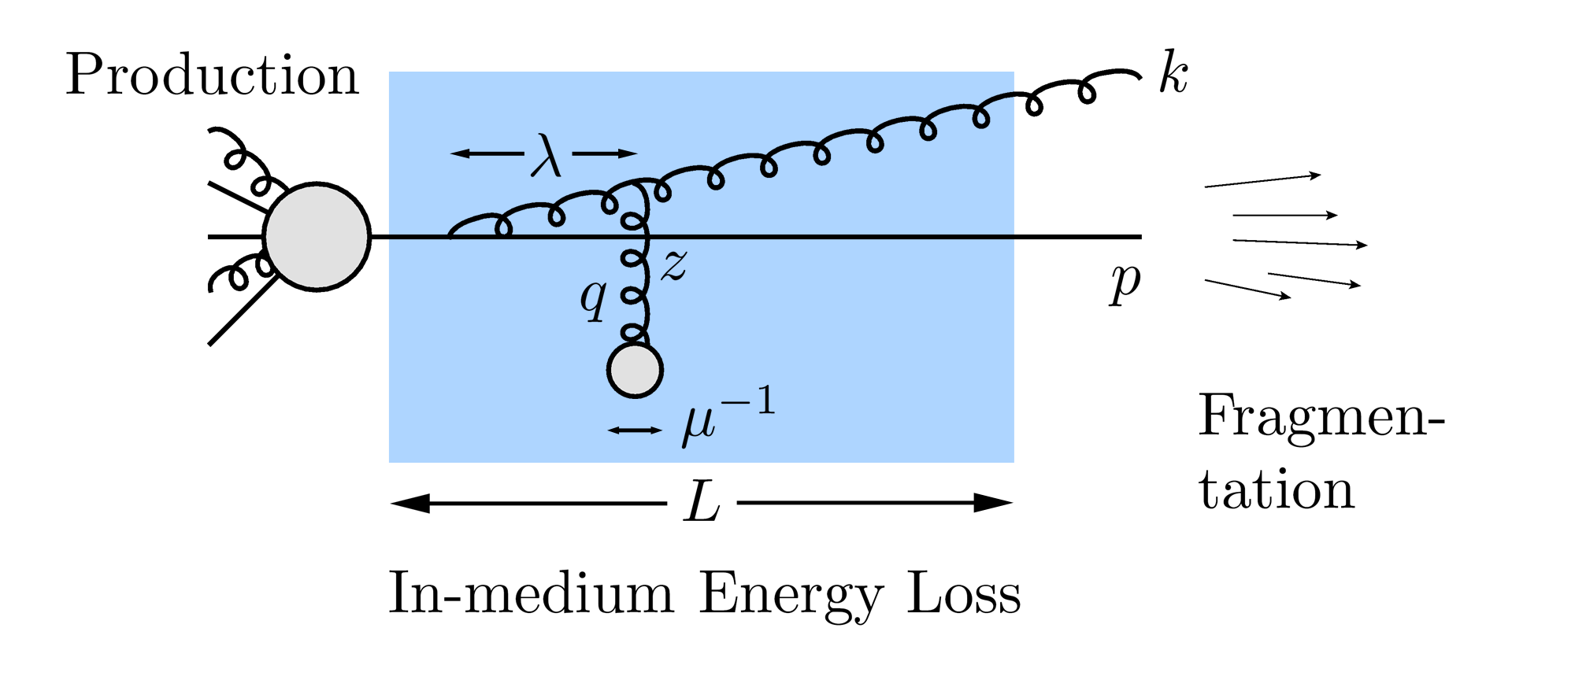
QGP Energy Loss
Learn about E-loss mechanism
Most direct probe of DOF
pQCD Picture
AdS/CFT Picture

Slide 6
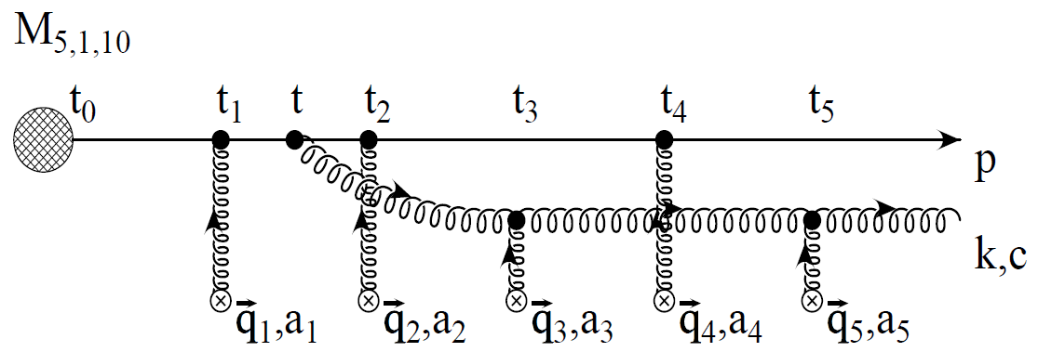
pQCD Rad Picture
Bremsstrahlung Radiation
Weakly-coupled plasma
Medium organizes into Debye-screened centers
T ~ 250 MeV, g ~ 2
μ ~ gT ~ 0.5 GeV
λ_{mfp} ~ 1/g²T ~ 1 fm
R_{Au} ~ 6 fm
1/μ << λ_{mfp} << L
mult. coh. em.
Gyulassy, Levai, and Vitev, NPB571 (2000)
LPM
dp_{T}/dt ~ -LT³ log(p_{T}/M_{q})
Bethe-Heitler
dp_{T}/dt ~ -(T³/M_{q}²) p_{T}

Slide 7
High Momentum Particles in AdS/CFT
Model heavy quark jet energy loss by embedding string in AdS space
dp_{T}/dt = - μ p_{T}
μ = πλ^{1/2} T²/2M_{q}
Similar to Bethe-Heitler
dp_{T}/dt ~ -(T³/M_{q}²) p_{T}
Very different from usual pQCD and LPM
dp_{T}/dt ~ -LT³ log(p_{T}/M_{q})
J Friess, S Gubser, G Michalogiorgakis, S Pufu, Phys Rev D75 (2007)

Slide 8
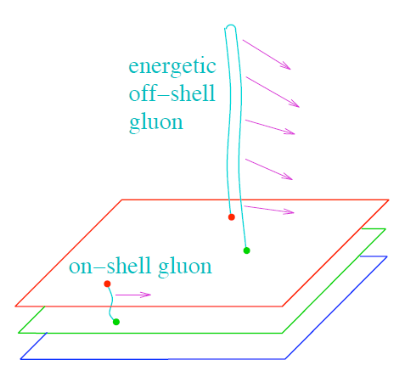
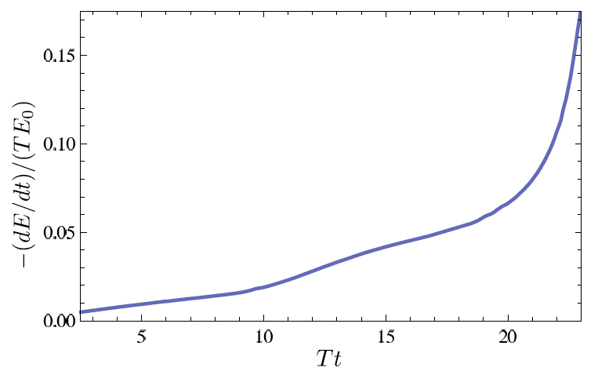
Light Quark and Gluon E-Loss
Chesler et al., PRD79 (2009)
SS Gubser, QM08
Light quarks and gluons: generic Bragg peak
Leads to lack of T dependence?
ΔL^{q}_{therm} ~ E^{1/3}
ΔL^{q}_{therm} ~ (2E)^{1/3}
Gubser et al., JHEP0810 (2008)
Chesler et al., PRD79 (2009)
See also Marquet and Renk,
PLB685 (2010), and
Jia, WAH, and Liao,
arXiv:1101.0290, for v₂

Slide 9
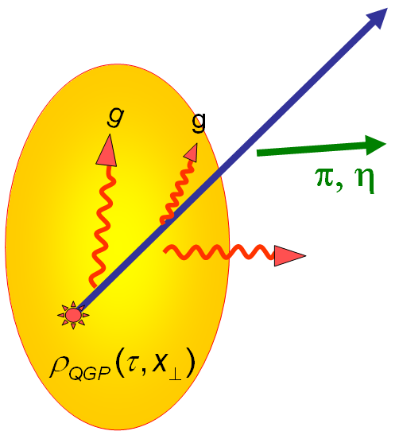
High-p_{T} Observables
Naively: if medium has no effect, then R_{AA} = 1
Common variables used are transverse momentum, p_{T}, and angle with respect to the reaction plane, φ
p_{T}
, γ, e⁻
Fourier expand R_{AA}:
φ

Slide 10
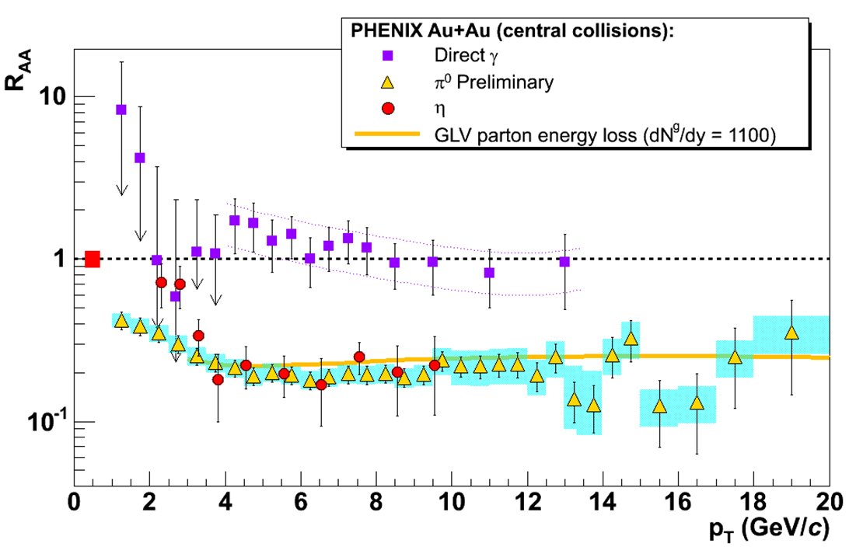
pQCD Success at RHIC:
(circa 2005)
Y. Akiba for the PHENIX collaboration, hep-ex/0510008
Consistency: R_{AA}(η)~R_{AA}(π)
Null Control: R_{AA}(γ)~1
GLV Prediction: Theory~Data for reasonable fixed L~5 fm and dN_{g}/dy~dN_{π}/dy

Slide 11
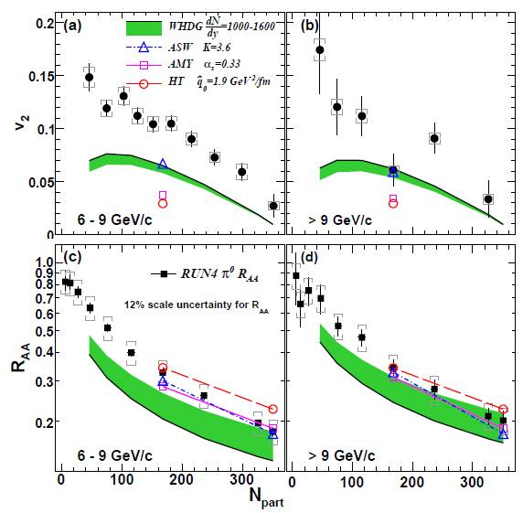
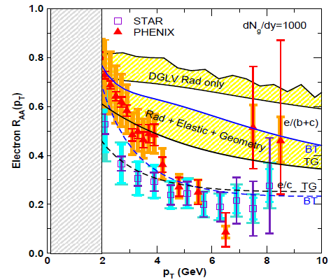
pQCD Picture Inadequate at RHIC
Lack of simultaneous description of multiple observables
even with inclusion of elastic loss
PHENIX, PRL 105 (2010)
Wicks et al., NPA784, 2007
See also J Jia from QM09,
J Nagle QM09
Pert. at LHC energies?

Slide 12
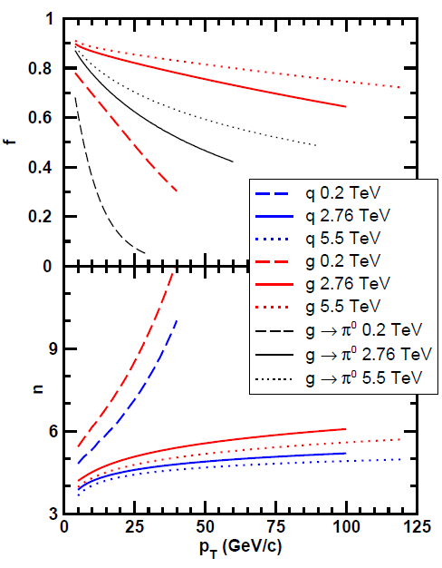
Qualitative Expectations for LHC
For approx. power law production and energy loss probability P(ε), ε = (E_{i} - E_{f})/E_{i}
Asymptotically, pQCD => ΔE/E ~ log(E/μ)
~ flat R_{AA}(p_{T}) at RHIC
Rising R_{AA}(p_{T}) at LHC
NB: LHC is a glue machine

Slide 13
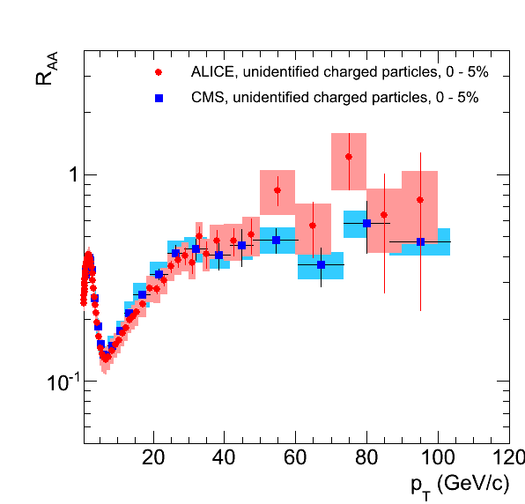
pQCD at LHC?
Appelshauser, ALICE, QM11
p_{T} rise in data readily understood from generic perturbative physics!

Slide 14
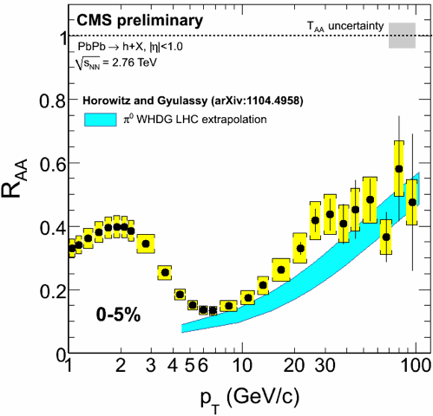
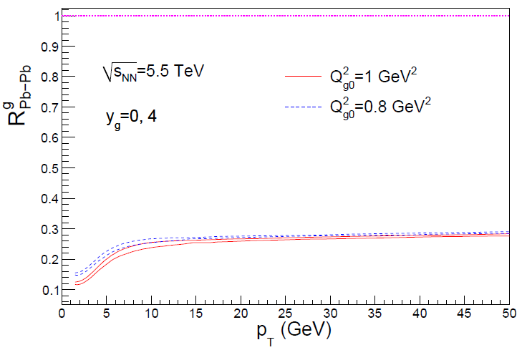
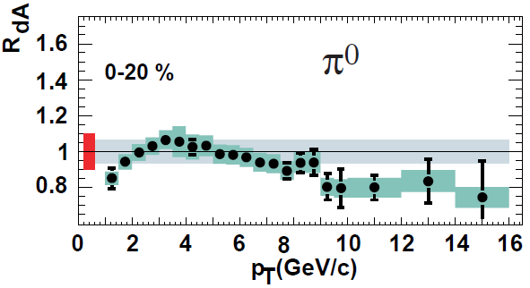
Rise in R_{AA} a Final State Effect?
Is rise really due to pQCD?
Or other quench (flat?)
+ initial state CNM effects a la CGC?
Y-J Lee, QM11
Albacete and Marquet, PLB687 (2010)
Require p + A and/or direct γ
PHENIX PRL98, 2007

Slide 15
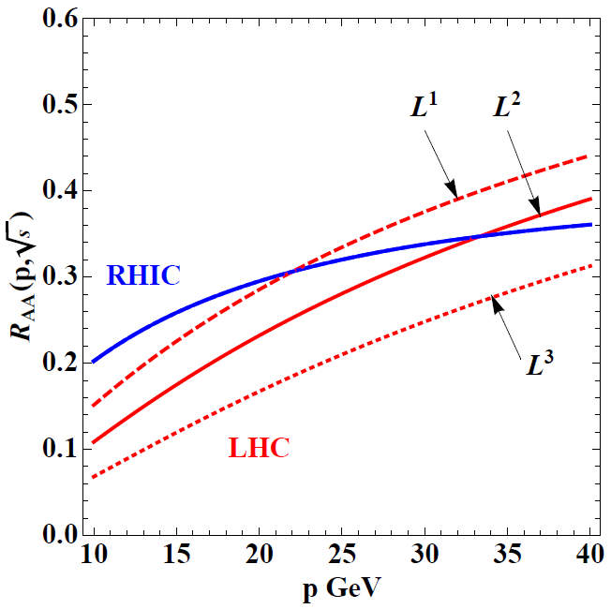
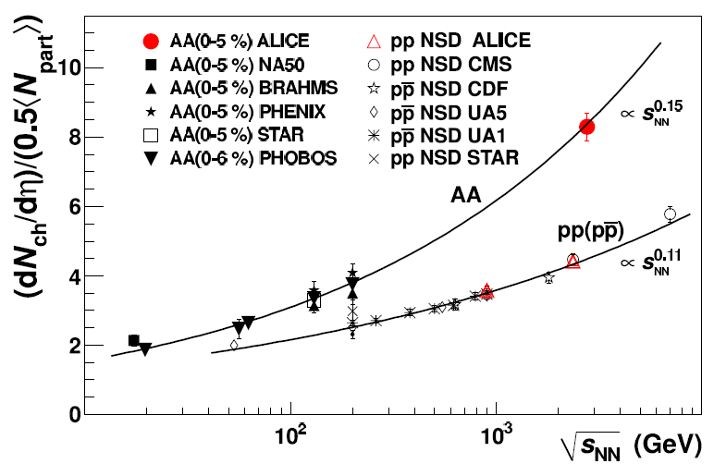
Qual Norm of R_{AA} From RHIC to LHC
Assume QGP density scales with observed particle multiplicity: ~2.5x more dense than RHIC
ALICE, PRL105, 2010
WAH and M Gyulassy, arXiv:1104.4958
Suppression from RHIC to LHC generically increases

Slide 16
Quant. (Qual?) Conclusions Require...
Further experimental results
Theoretically, investigation of the effects of
higher orders in
α_{s} (large)
k_{T}/xE (large)
M_{Q}/E (large?)
opacity (large?)
geometry
uncertainty in IC (small)
coupling to flow (large?)
Eloss geom. approx. (?)
τ < τ₀ (large: see Buzzatti and Gyulassy)
dyn. vs. static centers (see Buzzatti and Gyulassy)
hydro background (see Renk, Majumder)
better treatment of
Coh. vs. decoh. multigluons (see Mehtar-Tani)
elastic E-loss
E-loss in confined matter

Slide 17
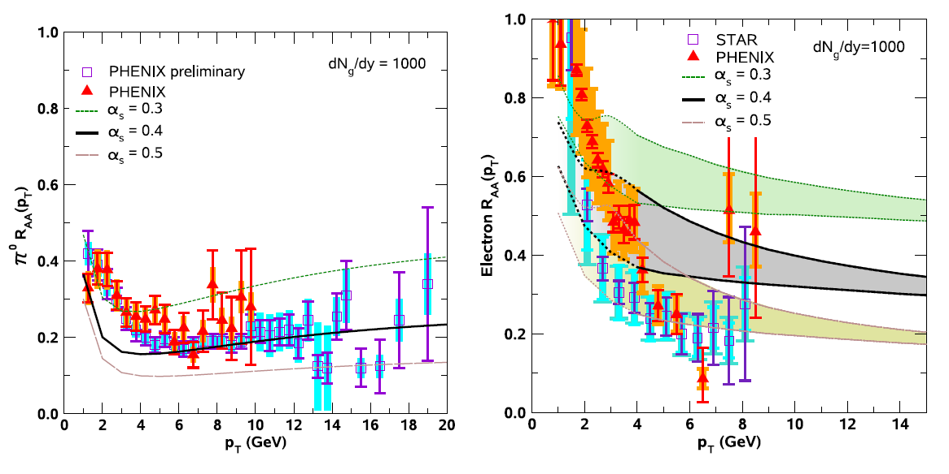
Varying α_{s} has huge effect
<ε>_{rad,pQCD} ~ α_{s}³; <ε>_{el,pQCD} ~ α_{s}²
Role of running coupling, irreducible uncertainty from non-pert. physics?
Nontrivial changes from better elastic treatment
S Wicks, PhD Thesis

Slide 18
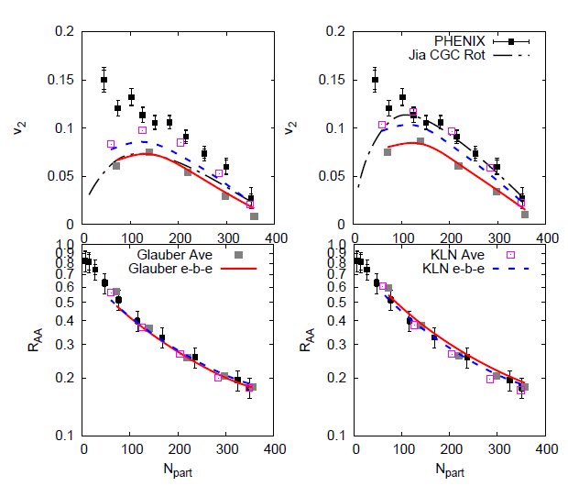
Quantifying Sensitivity to Geometry IC
Effects of geom. on, e.g. v₂, might be quite large
KLN CGC vs. WS Glaub. and rotating RP
Effect not large enough for pQCD
Possibly truly extreme
initial geometry?
See also Renk et al., PRC83 (2011), Jia, WH, Liao, 1101.0290
Betz, Gyulassy, and Torrieri, arXiv:1102.5416 [nucl-th]

Slide 19
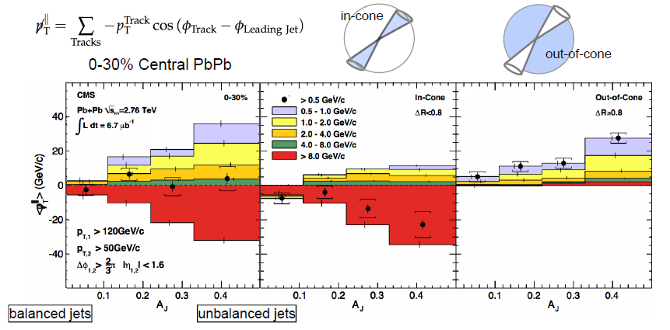
Aside: pQCD and Jet Measurements
CMS sees redistribution of lost energy at large angles
Naive pQCD expectation: collinear radiation
Wyslouch, CMS, QM11

Slide 20
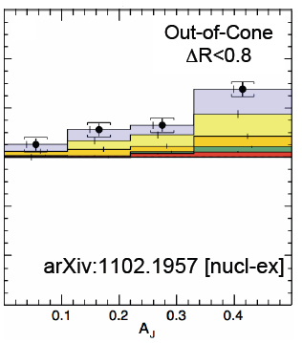
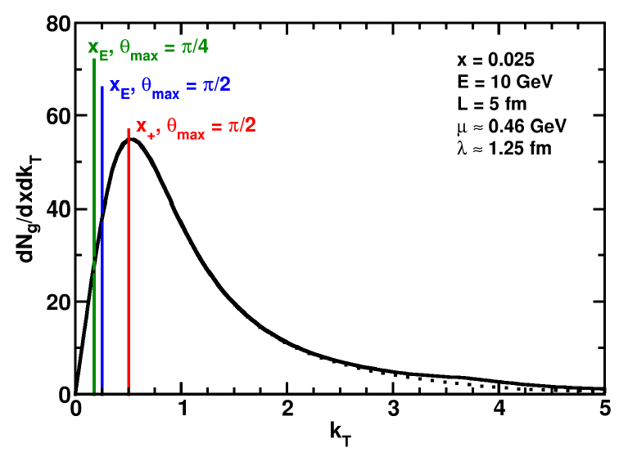
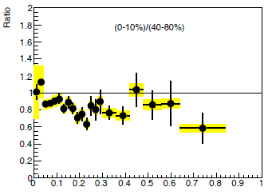
pQCD and Wide Angle Radiation
Naively, pQCD =>
x_{typical}, θ_{typical} ~ μ/E; μ ~ 0.5 GeV
All current Eloss calculations assume small angle emission
(k_{T} << xE)
Collinear approximation is (maximally) violated; x_{typ} ~ μ/E
pQCD not obviously inconsistent
C Roland, CMS, QM11
z
WAH and B Cole, PRC81, 2010
B Cole, ATLAS, QM11

Slide 21
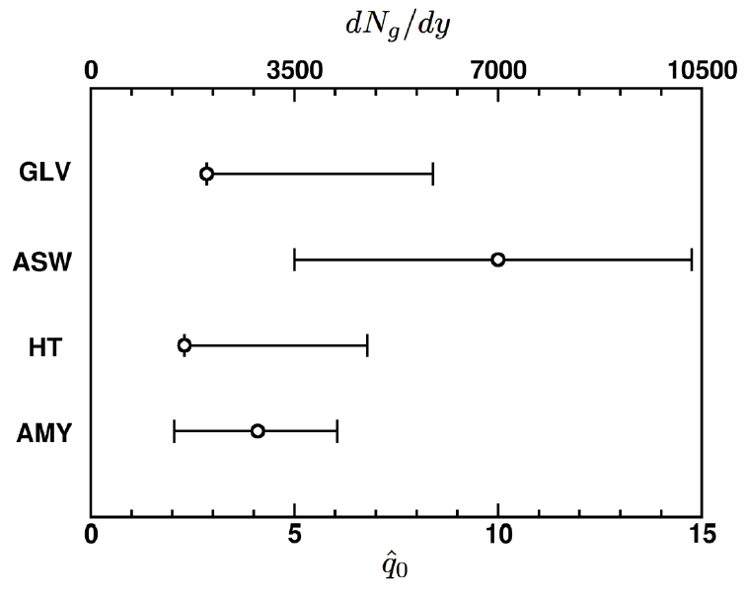
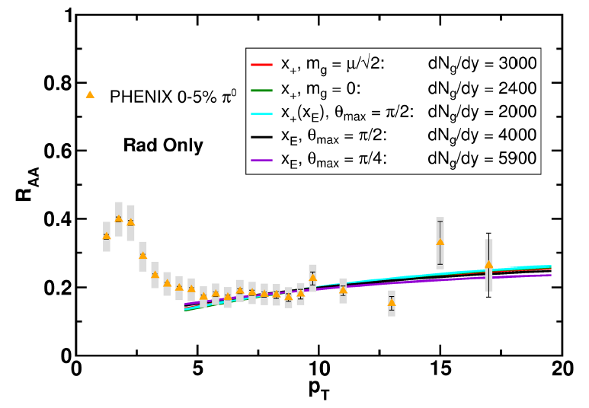
Quantification of Collinear Uncertainty
Factor ~ 3 uncertainty in extracted medium density!
“qhat” values from different formalisms consistent w/i unc.
WAH and B Cole, PRC81, 2010

Slide 22
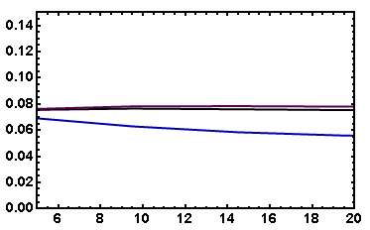
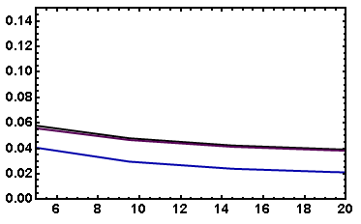
Coll. Approx. and Constrained v₂
Fix dN_{g}/dy from R_{AA}, calculate v₂
Expect: larger v₂ for smaller opening angle
τ_{coh} = xE/k_{T}² larger for smaller θ_{max}
more paths in deep LPM (ΔE ~ L²) region
Not large sensitivity
Rad Only
Rad + El
20-30% π⁰
20-30% π⁰
v₂
v₂
p_{T}
WAH, in preparation
p_{T}

Slide 23
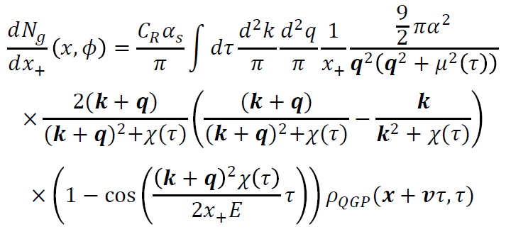
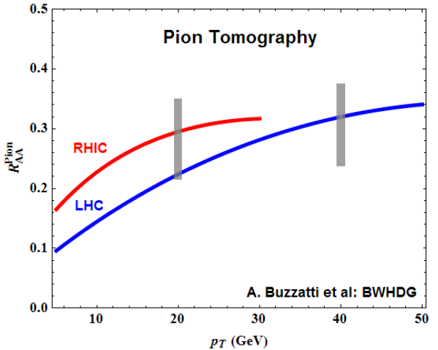
Geometry, Early Time Investigation
Significant progress made
Full geometry integration, dynamical scattering centers
RHIC suppression with dN_{g}/dy = 1000
Large uncertainty due to unconstrained, non-equilibrium τ < τ₀ physics
Future work: higher orders in opacity
Buzzatti and Gyulassy, 1106.3061

Slide 24
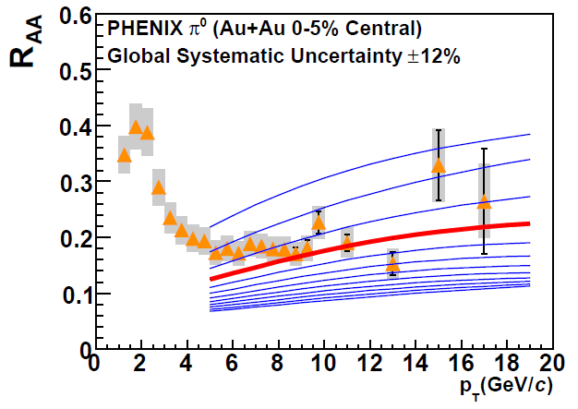
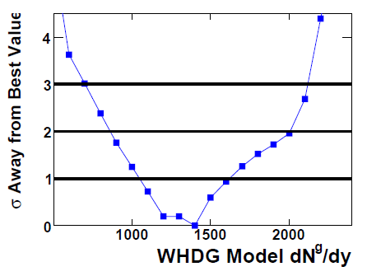
With Caveats in Mind...
Quantitatively compare a parameter free “prediction” from WHDG for LHC, rigorously constrained by RHIC
Increase density at LHC by observed increase in particle multiplicity
PHENIX PRC77, 2008

Slide 25
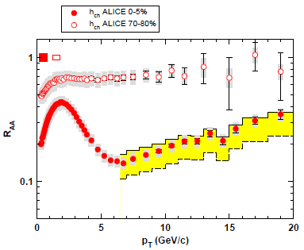
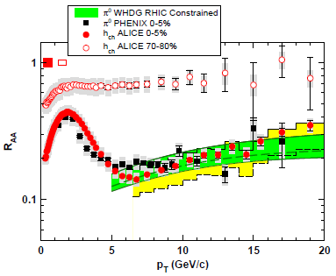
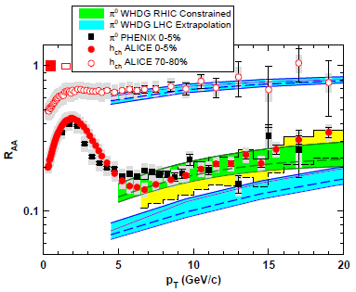
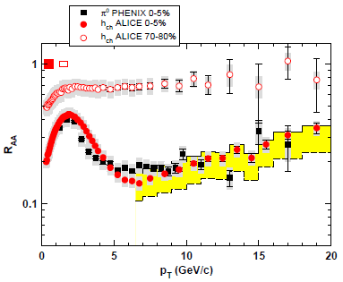
WHDG π⁰ R_{AA} at LHC: First Results
WHDG band from 1-σ RHIC dN_{g}/dy extraction
Note that constrained predictions have small uncertainty from collinear approx
Constrain WHDG at RHIC
Make LHC predictions assuming dN_{g}/dy ~ dN_{ch}/dη
=> dN_{g}^{LHC}/dy = 2.4 dN_{g}^{RHIC}/dy
Data shown at Kruger2010
WAH and M Gyulassy, arXiv:1104.4958

Slide 26
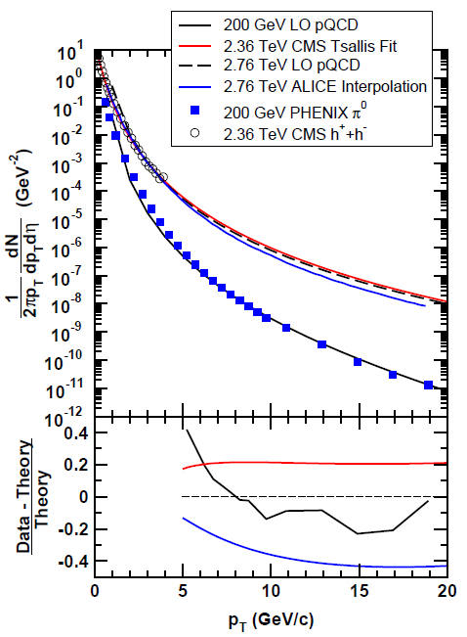
ALICE Published Results
NB: ALICE unmeasured p + p interpolation > LO pQCD
Also, small reported unc. in N_{bin}
Fluctuations important at large centralities
WAH and M Gyulassy,
arXiv:1104.4958

Slide 27
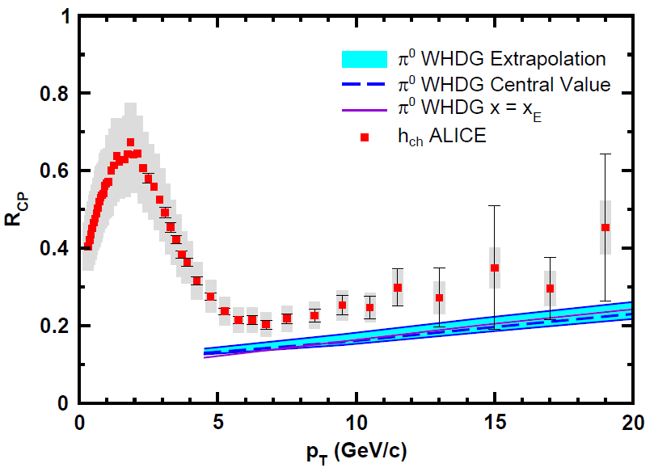
WHDG Compared to R_{CP}
Examine R_{CP}, ratio of central to peripheral R_{AA}
p + p uncertainty cancels
0-5% R_{AA} to
70-80% R_{AA}
Validity of E-loss in very peripheral collisions?
WAH and M Gyulassy, arXiv:1104.4958

Slide 28
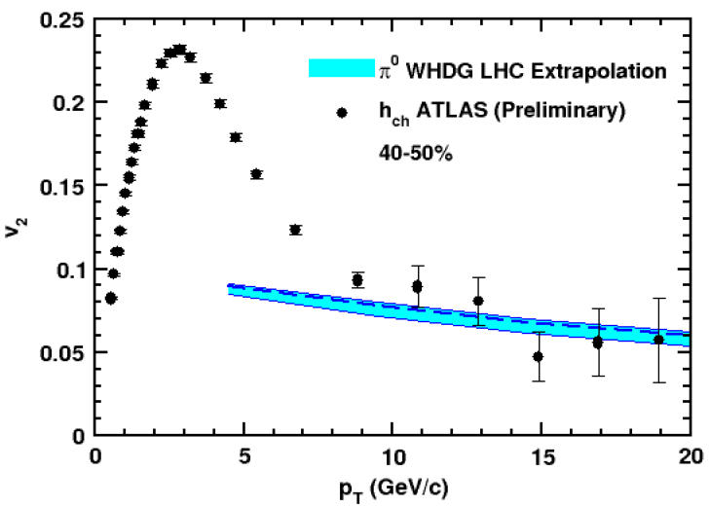
WHDG Describes R_{AA} and v₂?
Fixed by RHIC data, parameter-free WHDG describes preliminary R_{AA} and v₂ quite well
v₂ at very high p_{T}?
Y-J Lee, QM11 and
cdsweb.cern.ch/record/1352777
WAH and M Gyulassy,
arXiv:1107.2136

Slide 29
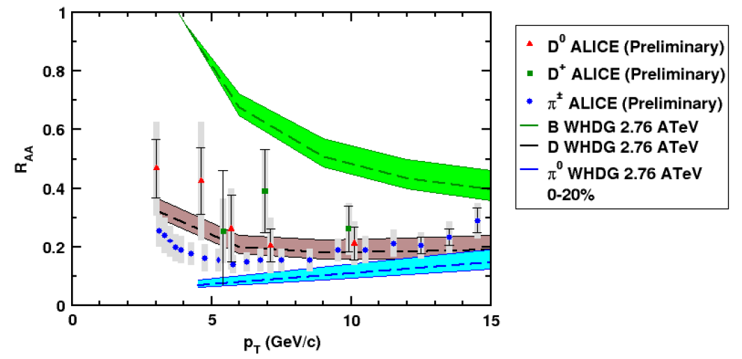
And D R_{AA} at LHC?
NB: R_{AA} requires production, E-loss, FF
Does not immediately follow that R^{π}_{AA} << R^{D}_{AA} << R^{B}_{AA}
WAH and M Gyulassy, arXiv:1107.2136

Slide 30
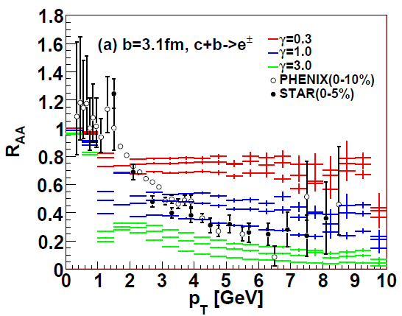
AdS/CFT at RHIC
String drag: qualitative agreement in heavy flavor sector
WAH, PhD Thesis
Akamatsu, Hatsuda, and Hirano, PRC79, 2009

Slide 31
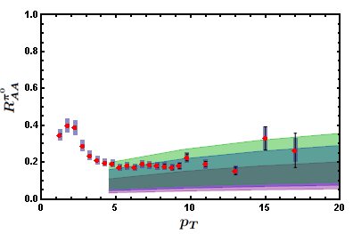
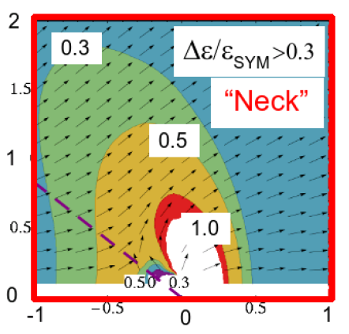
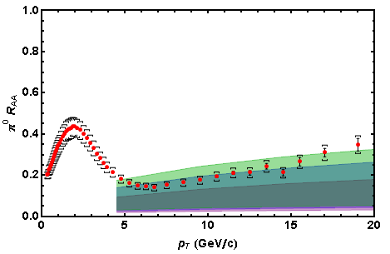
AdS/CFT Energy Loss and Distribution
0.2 TeV
2.76 TeV
Jo Noronha, M Gyulassy, and G Torrieri, PRL102 (2009)
In AdS/CFT, heavy quarks: wide angle energy loss
WAH, in preparation
Simple Bragg peak model

Slide 32
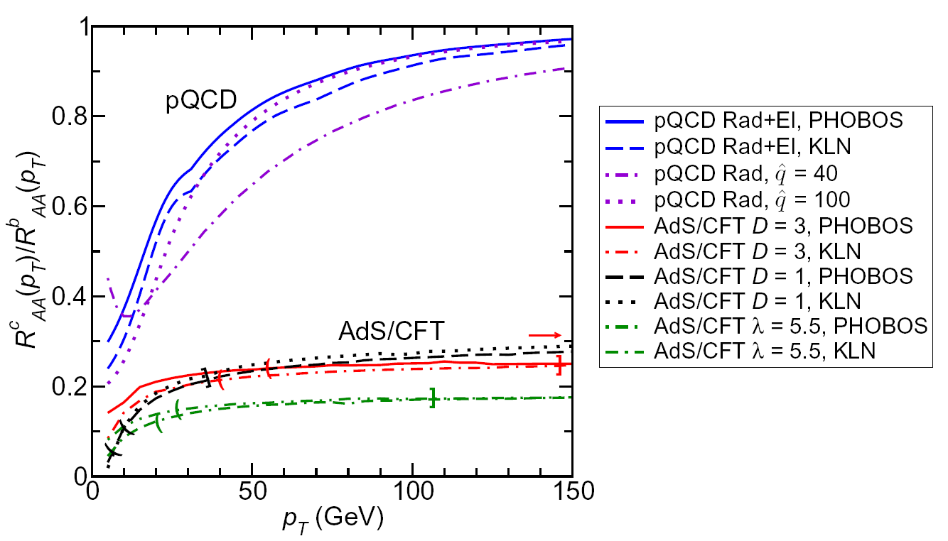
LHC R^{c}_{AA}(p_{T})/R^{b}_{AA}(p_{T}) Prediction (with speed limits)
WAH, M. Gyulassy, PLB666 (2008)
T(τ₀): “(”, corrections likely small for smaller momenta
T_{c}: “]”, corrections likely large for higher momenta
Qualitatively, corrections to AdS/CFT result will drive double ratio to unity

Slide 33
Measuring the Initial Gluon State
What is the spatial distribution of gluons in a highly boosted nucleus?
What are the initial conditions fed into hydro in HIC?
T Hirano, et al.,
Phys.Lett.B636, 2006

Slide 34
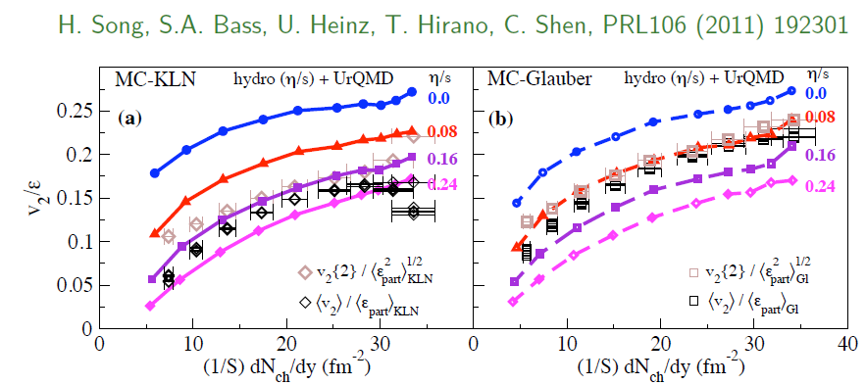
η/s Extraction
Factor at least 2 uncertainty in η/s from IC
Naive pQCD => η/s ~ 1
Naive AdS/CFT => η/s ~ 1/4π
Teaney, Users’ Meeting 2011

Slide 35
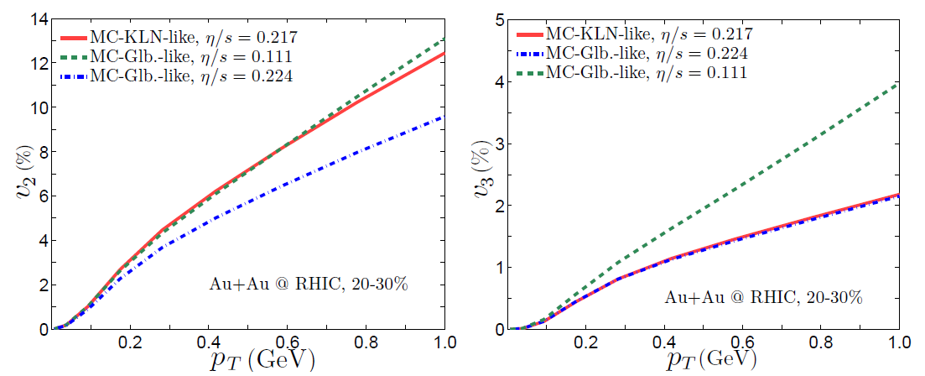
IC from Higher Harmonics
Chen et al., arXiv:1106.6350

Slide 36
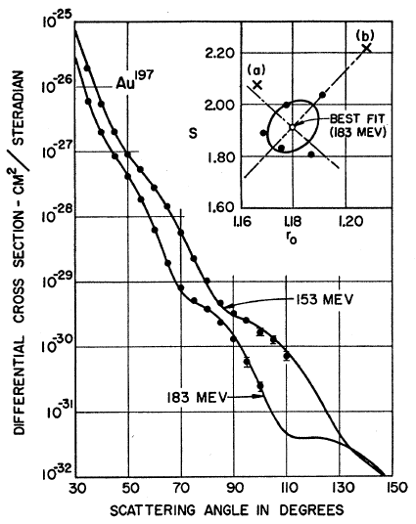
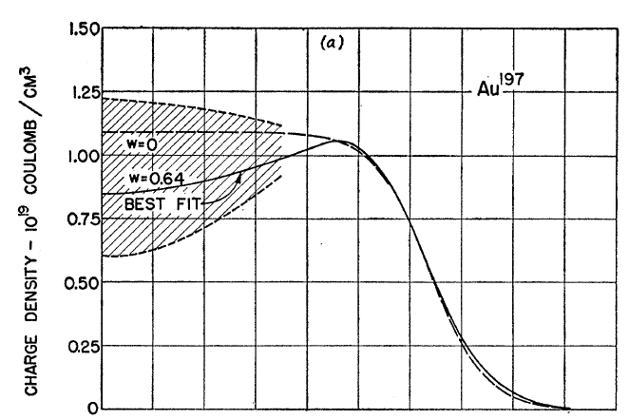
Measuring the IC
eRHIC could give experimental handle on initial geometry
Recall e + A diffraction exps. on A at rest
Hahn, Ravenhall, and Hofstadter, Phys Rev 101 (1956)

Slide 37
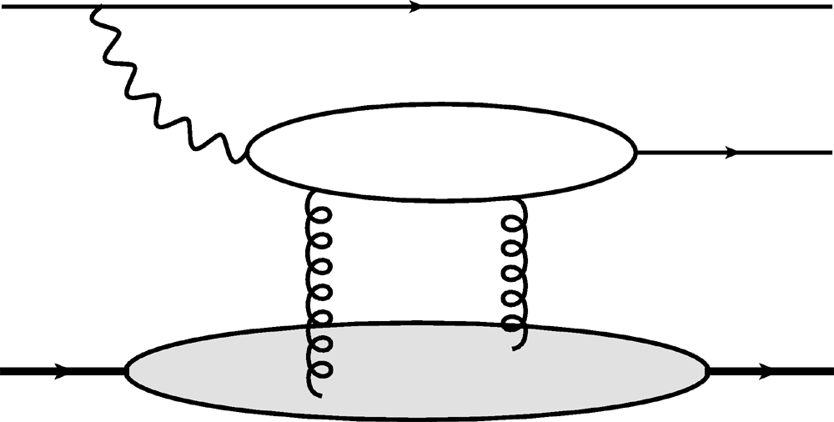
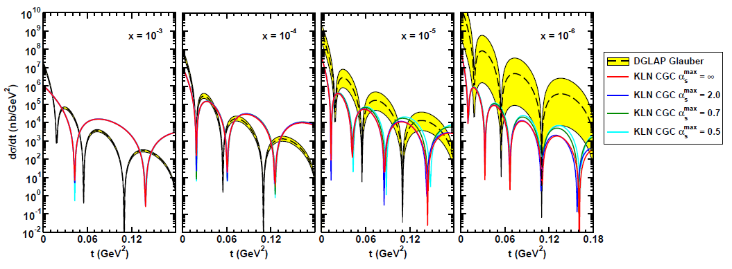
Gluon Distribution of A at x ~ 10⁻³
e
e
γ*
J/ψ
Coherent vector meson production in e + A
A
A
Must reject incoherent
collisions at ~100%
WAH, arXiv:1102.5058

Slide 38
Conclusions (1 of 2)
Does rise in R_{AA}(p_{T}) imply perturbative E-loss dominant at LHC?
To make a qualitative statement need:
Experimental control over production effects
Reduced exp. uncertainties at large (~100 GeV/c) p_{T}
Consistency check btwn pQCD and multiple observables at large (~100 GeV/c) p_{T}, especially v₂
Recent LHC Results:
Published ALICE R_{AA} suppression generically difficult to understand in typical dE/dx picture (both pQCD and AdS/CFT)
E-loss in (currently) uncontrolled pre-thermalization dynamics?
Possibly signal of AdS/CFT Bragg peak physics
Soft particle energy loss at very wide angles
Not inconsistent with pQCD or AdS/CFT pictures

Slide 39
Conclusions (2 of 2)
WHDG zero parameter LHC predictions constrained by RHIC appear to:
(Possibly) systematically oversuppress light hadron R_{AA}
Describe light hadron v₂ at “intermediate” p_{T} ~ 20 GeV/c
Describe D meson suppression
CAUTION: many important effects not currently under theoretical control
HOWEVER: qualitative agreement suggests continued effort interesting and worthwhile
AdS Eloss: consistent with RHIC and LHC within large theoretical uncertainties
Looking forward to exciting future distinguishing measurements, esp. heavy quark suppression separation
Exciting prospects for measuring initial spatial distribution of gluons in a highly relativistic nucleus at an EIC

