Slide 1
Determining the Emergent Properties of Hot and Dense Nuclear Matter
W. A. Horowitz
University of Cape Town
September 26th, 2011

Slide 2
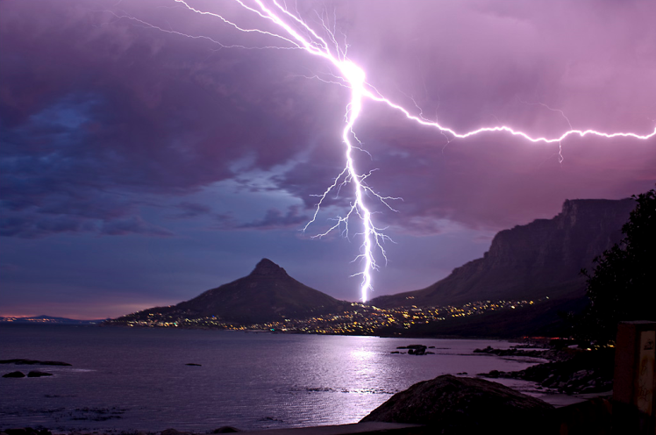
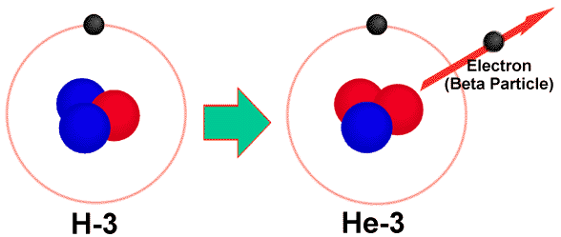
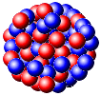
Four Fundamental Forces
Gravity
Electromagnetism
starchild.gsfc.nasa.gov
John Maarschalk, travelblog.portfoliocollection.com
Weak
Strong
lhs.lps.org/staff/sputnam/chem_notes/tritium_decay.gif

Slide 3
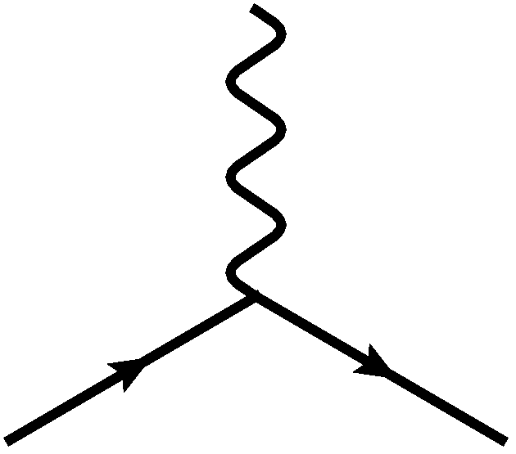
E&M Particle Physics Well Understood
Lagrangian known:
QED Vertex:
Ex. of Precision QED: g - 2
Gabrielse et al., PRL97 (2006)
Hanneke, Fogwell, and Gabrielse, PRL100 (2008)

Slide 4
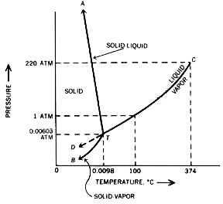
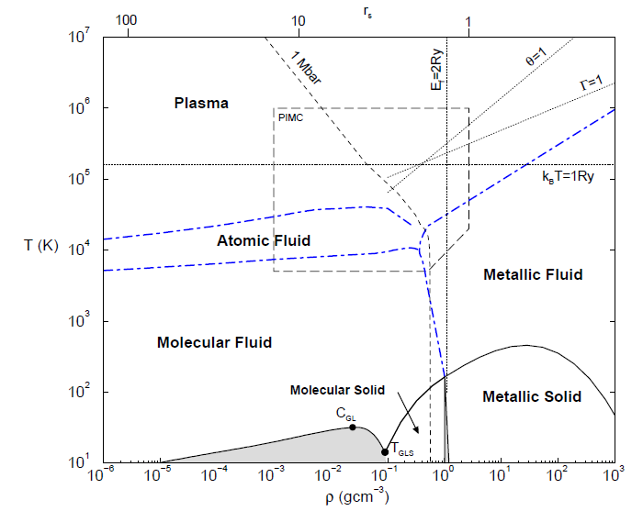
E&M and Phase Diagrams
Many body physics less well understood
Water
Hydrogen
www.sv.vt.edu/classes/MSE2094_NoteBook/96ClassProj/examples/triplpt.html
Calculated, Burkhard Militzer,
Diploma Thesis, Berlin, 2000

Slide 5
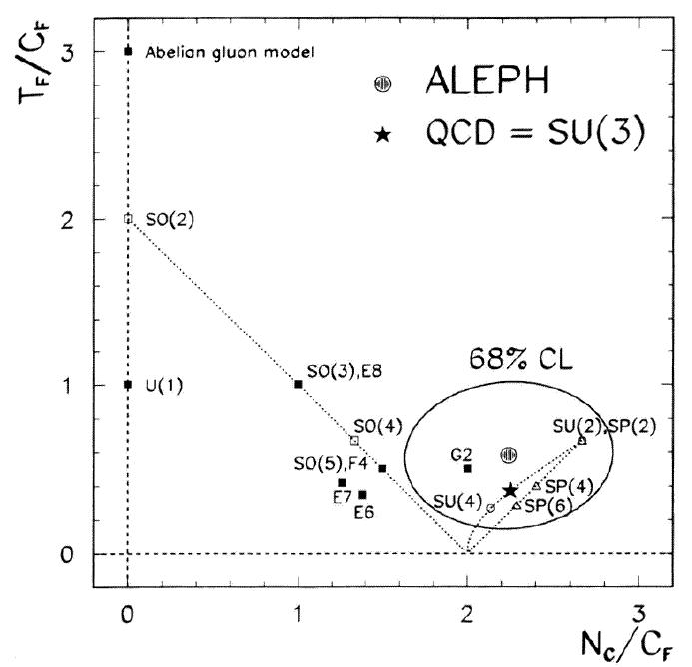
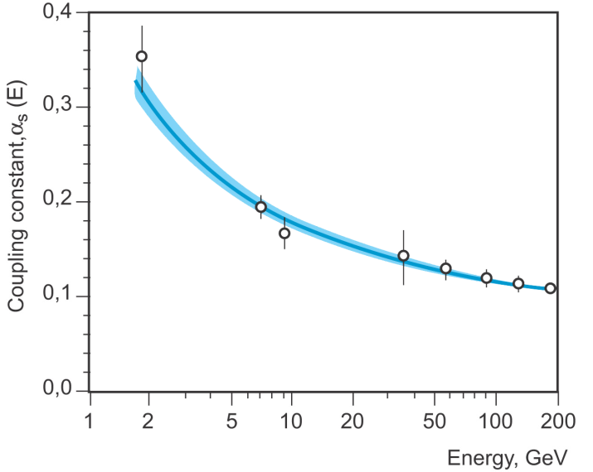
QCD Particle Physics Well Understood
Lagr. known:
QCD Vertices:
Qual. & Quant. agreement w/ data
ALEPH,
PLB284
(1992)
PDG

Slide 6
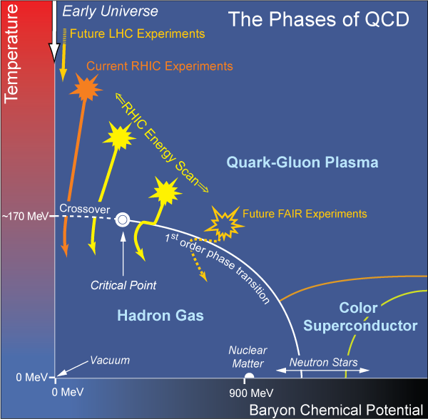
What Are We Interested In?
Measure many-body physics of strong force
Test & understand theory of many-body non-Abelian fields
Long Range Plan, 2008
Notes:
Unique as compared to strongly coupled Abelian problems

Slide 7
Big Bang vs. Little Bang
ALICE Collaboration
High Momentum Particle
t = - ∞
t = 0
t ~ 1 fm/c
t = + ∞
Initial State
Initial Overlap
Thermalization
QGP
Hadronization
Hadron Gas

Slide 8
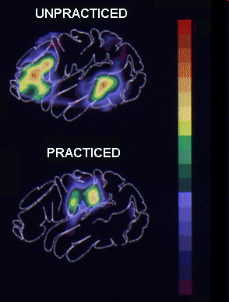
Why High-p_{T} Jets?
Tomography in medicine
One can learn a lot from a single probe…
and even more with multiple probes
SPECT-CT Scan uses internal γ photons and external X-rays
PET Scan
http://www.fas.org/irp/imint/docs/rst/Intro/Part2_26d.html

Slide 9
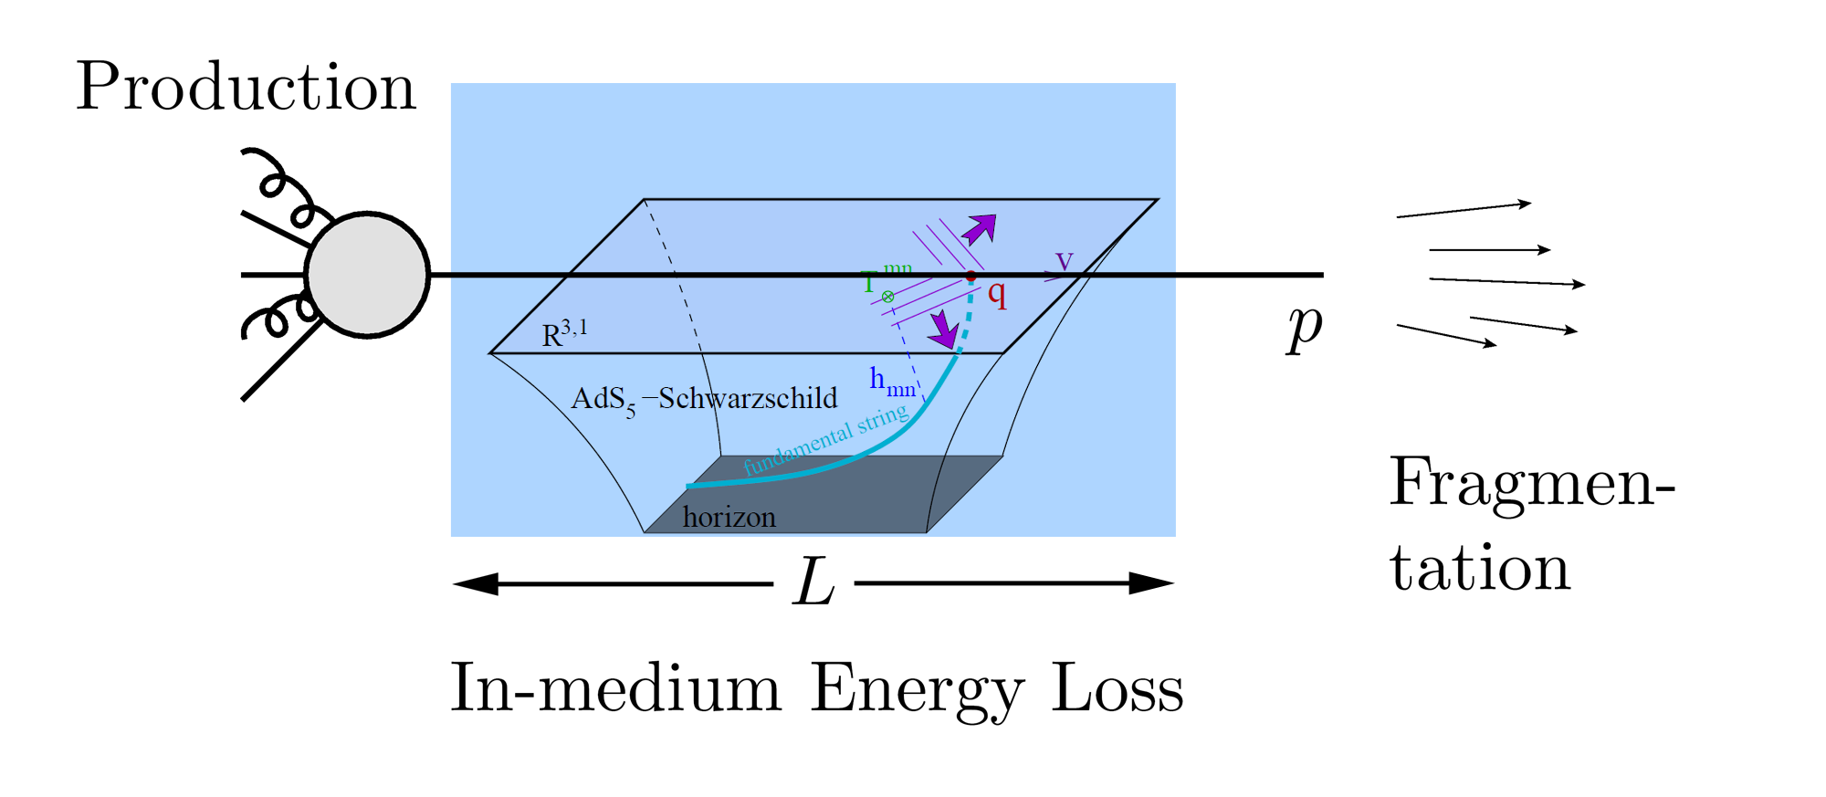
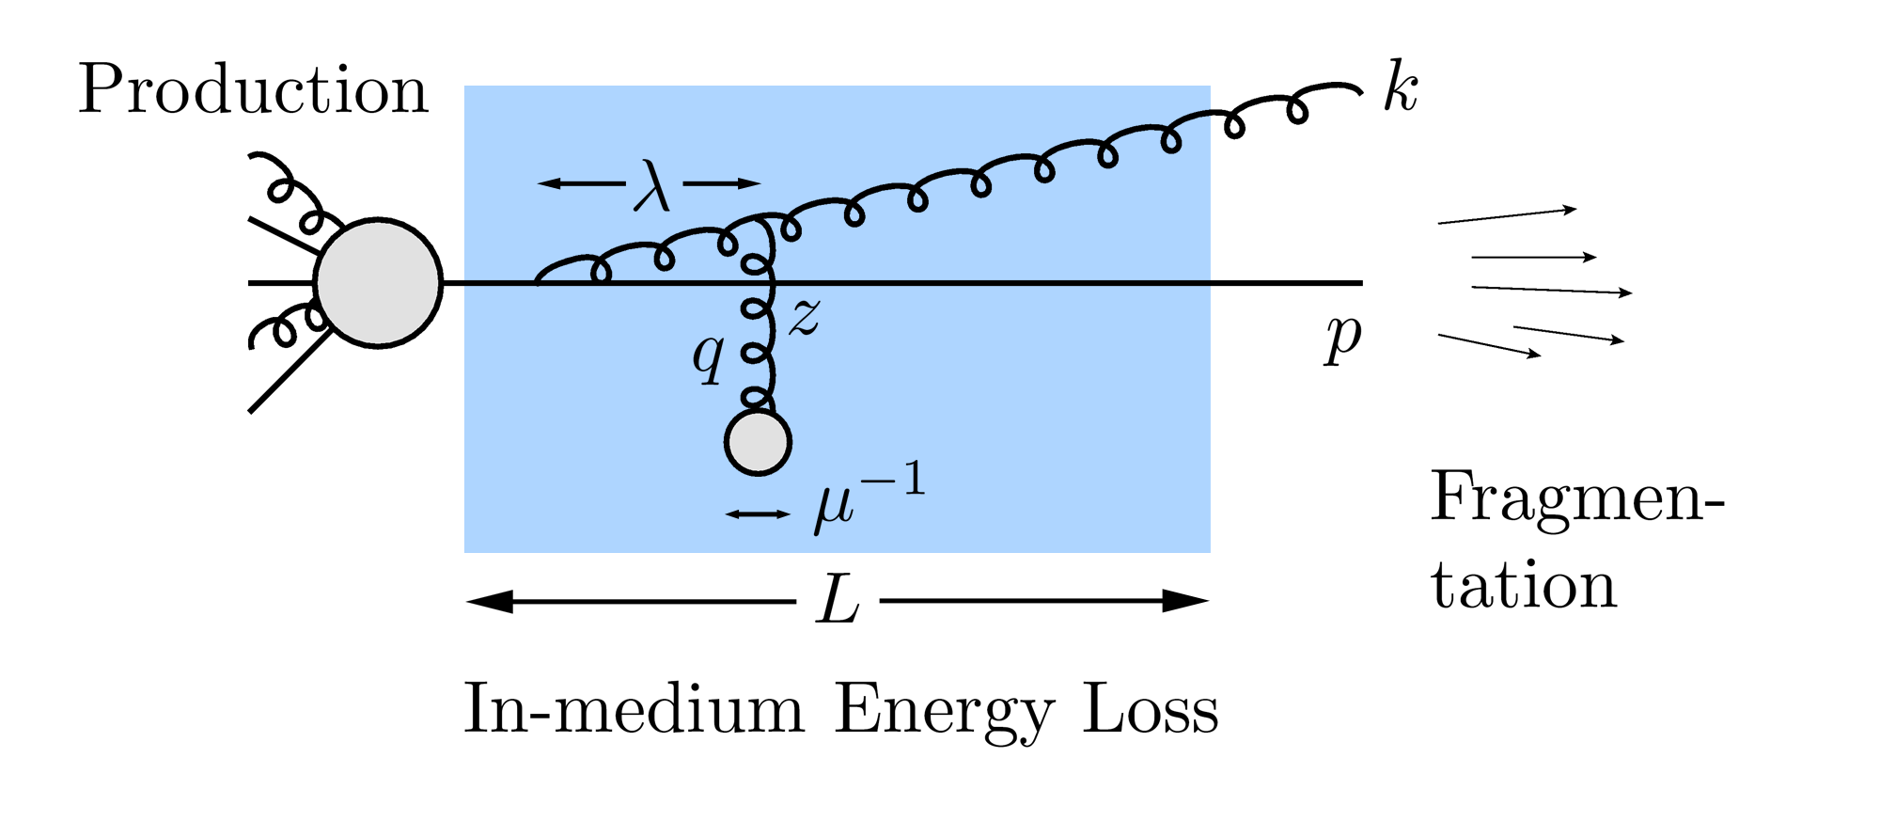
QGP Energy Loss
Learn about E-loss mechanism
Most direct probe of DOF
pQCD Picture
AdS/CFT Picture

Slide 10
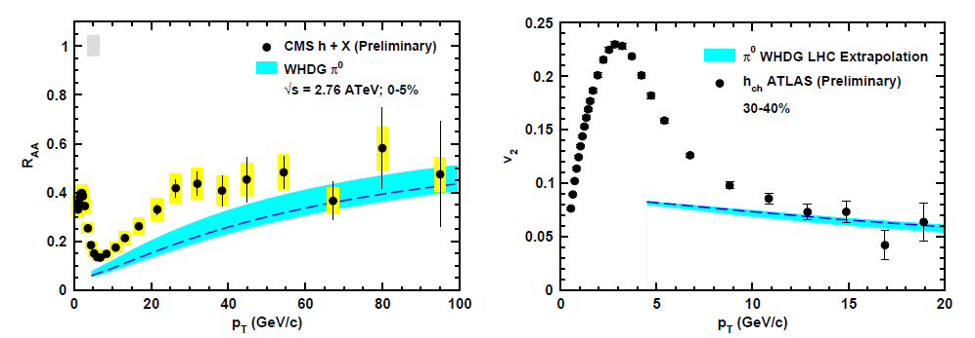
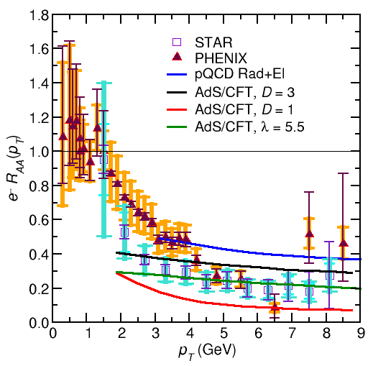
Stunning Qualitative Successes
Compared to recent LHC Data
Compared to
older RHIC Data

Slide 11
Conclusions
Consistent picture of the emergent properties of a quark-gluon plasma is developing
Lots of interesting work to be done
Improve calculations, attempt quantitative description
Derivations with fewer approximations
Higher order corrections
Better modeling
Compare to novel RHIC and LHC data

