Slide 1
Do We Understand Energy Loss? The Critical Mass Dependence Test
W. A. Horowitz
University of Cape Town
April 30, 2012
With many thanks to Razieh Morad, Brian Cole,
Miklos Gyulassy, and Yuri Kovchegov

Slide 2
Outline
Muons as High-p_{T} Probes
  Energy Loss => DOF in QGP
    Photons, gluons, light q., heavy quarks (MUONS!)
      Central vs. Forward
Muons for Measuring the Initial State
  AdS E-loss in CNM
    Heavy Quarks (MUONS!)
  Dipoles => DOF in CNM
    Forward J/ψ (MUONS!)

Slide 3
Hot Nuclear Matter
Introduction

Slide 4

What Are We Interested In?
Measure many-body physics of strong force
Test & understand theory of many-body non-Abelian fields
Long Range Plan, 2008
Notes:
Unique as compared to strongly coupled Abelian problems

Slide 5


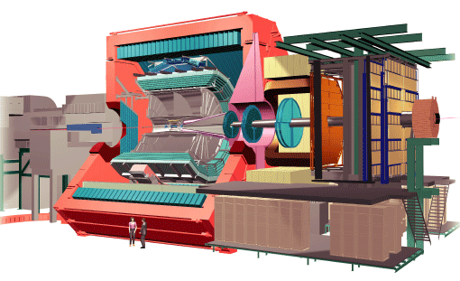
QGP Energy Loss
Learn about E-loss mechanism
  Most direct probe of DOF
Measurement!
pQCD Picture
AdS/CFT Picture

Slide 6
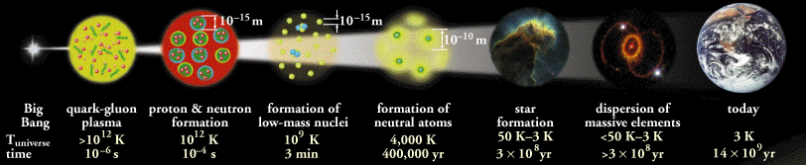
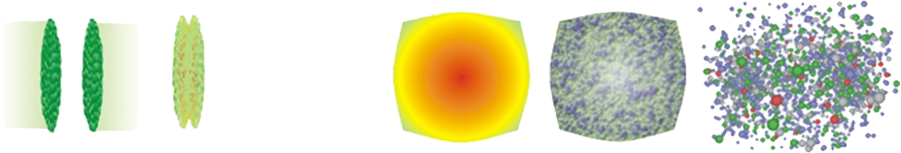
Big Bang vs. Little Bang
ALICE Collaboration
High Momentum Particle
t = - ∞
t = 0
t ~ 1 fm/c
t = + ∞
Initial State
Initial Overlap
Thermalization
QGP
Hadronization
Hadron Gas

Slide 7
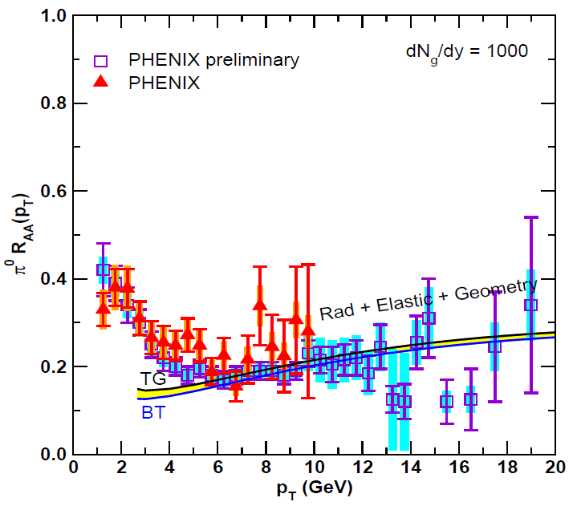
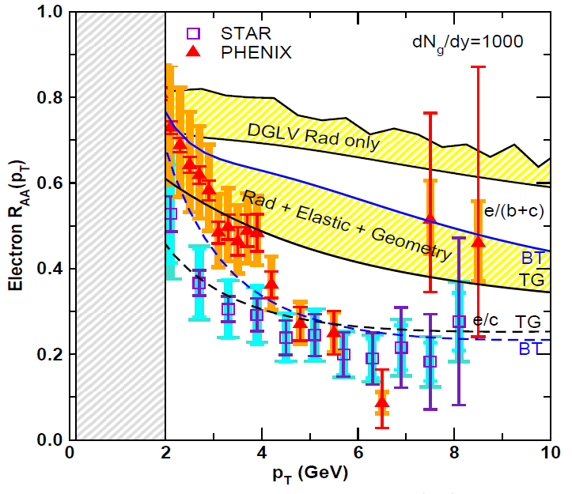
Lesson from RHIC
Extremely difficult to construct a theoretical model that consistently describes all observables
  A simultaneous description of gluon/light quark AND heavy quark suppression places stringent constraint on possible E-loss mechanism
Wicks, WAH, Djordjevic, Gyulassy, NPA784 (2007)

Slide 8
Energy Loss in QGP
Claim: LHC predictions from rigorously RHIC constrained pQCD E-loss in qualitative/quantitative agreement with current data
  Want to stress test the theory with as many experimental levers as possible
Counter-claim: LHC predictions from AdS/CFT not falsified by current data
  Want an obvious distinguishing measurement

Slide 9
Hot Nuclear Matter
Energy Loss Theory

Slide 10

pQCD Rad Picture
Bremsstrahlung Radiation
  Weakly-coupled plasma
    Medium organizes into Debye-screened centers
  T ~ 350 (450) MeV, g ~ 1.9 (1.8)
    μ ~ gT ~ 0.7 (0.8) GeV
    λ_{mfp} ~ 1/g²T ~ 0.8 (0.7) fm
    R_{Au/Pb} ~ 6 fm
  1/μ << λ_{mfp} << L
    multiple coherent emission
Gyulassy, Levai, and Vitev, NPB571 (2000)
  LPM
    dp_{T}/dt ~ -LT³ log(p_{T}/M_{q})
  Bethe-Heitler
    dp_{T}/dt ~ -(T³/M_{q}²) p_{T}

Slide 11


What About Elastic Loss?
Appreciable!
Finite time effects small
Mustafa, PRC72 (2005)
Adil, Gyulassy, WAH,
Wicks, PRC75 (2007)
  For pQCD comparisons with data, use WHDG Rad+El+Geom model; formalism valid for g/lq & hq

Slide 12
Quant. (Qual?) Conclusions Require...
Further experimental results
Theoretically, investigation of the effects of
  higher orders in
    α_{s} (large)
    k_{T}/xE (large)
    M_{Q}/E (large?)
    opacity (large?)
  geometry
    uncertainty in IC (small)
    coupling to flow (large?)
    Eloss geom. approx. (?)
    τ < τ₀ (large: see Buzzatti and Gyulassy)
    dyn. vs. static centers (see Buzzatti and Gyulassy)
    hydro background (see Renk, Majumder)
  better treatment of
    Coh. vs. decoh. multigluons (see Mehtar-Tani)
    elastic E-loss
    E-loss in confined matter

Slide 13
Strong Coupling Calculation
The supergravity double conjecture:
QCD ⬄ SYM ⬄ IIB
  IF super Yang-Mills (SYM) is not too different from QCD, &
  IF Maldacena conjecture is true
  Then a tool exists to calculate strongly-coupled QCD in SUGRA

Slide 14
Heavy Quark E-Loss in AdS/CFT
Model heavy quark jet energy loss by embedding string in AdS space
  dp_{T}/dt = - μ p_{T}
  μ = πλ^{1/2} T²/2M_{q}
  Similar to Bethe-Heitler
    dp_{T}/dt ~ -(T³/M_{q}²) p_{T}
  Very different from usual pQCD and LPM
    dp_{T}/dt ~ -LT³ log(p_{T}/M_{q})
J Friess, S Gubser, G Michalogiorgakis, S Pufu, Phys Rev D75 (2007)

Slide 15
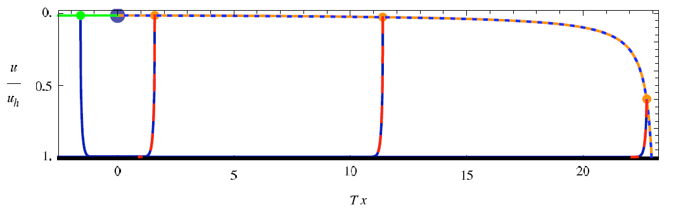
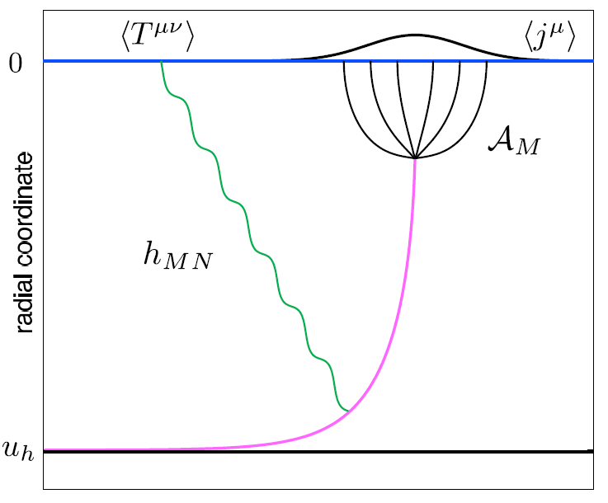
Light Quark E-Loss in AdS
Chesler et al., PRD79 (2009)
Complications:
  string endpoints fall
    => painful numerics
  relation to HI meas.
    less obvious than HQ

Slide 16
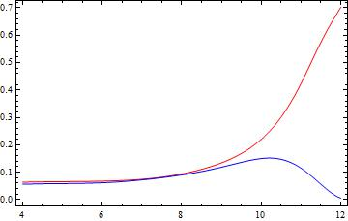

Light Quark E-Loss in AdS
Early Result: generic Bragg peak
  Missing term kills peak
    Calculation assumes
      T ~ 1/τ^{1/3}
      T_{therm} ~ 300 MeV
      E_{q} ~ 180 GeV
-(dE/dt)/(T E₀)
t T
Razieh Morad and WAH, in prep
Chesler et al. PRD79 (2009)
Ficnar, arXiv:1201.1780
  Jury is still out: Stay Tuned!

Slide 17
Hot Nuclear Matter
Phenomenology

Slide 18


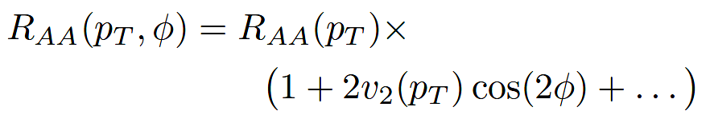
High-p_{T} Observables
    Naively: if medium has no effect, then R_{AA} = 1
    Common variables used are transverse momentum, p_{T}, and angle with respect to the reaction plane, φ
p_{T}
, γ, e⁻
    Fourier expand R_{AA}:
φ

Slide 19

Naive pQCD Success at RHIC:
(circa 2005)
Y. Akiba for the PHENIX collaboration, hep-ex/0510008
  Consistency: R_{AA}(η)~R_{AA}(π)
  Null Control: R_{AA}(γ)~1
  GLV Prediction: Theory~Data for reasonable fixed L~5 fm and dN_{g}/dy~dN_{π}/dy

Slide 20
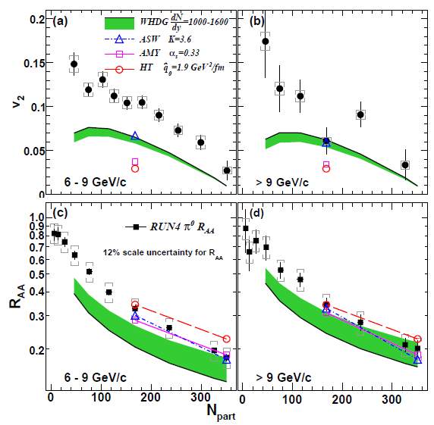
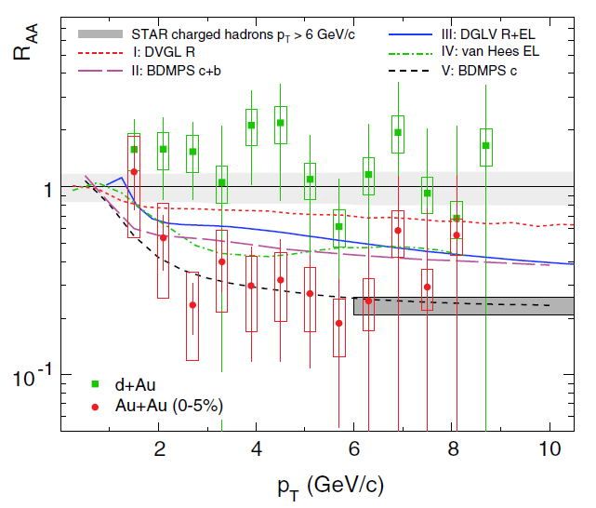
pQCD Not Quantitative at RHIC
Lack of simultaneous description of multiple observables
  even with inclusion of elastic loss
PHENIX, PRL 105 (2010)
STAR, PRL106 (2011)
See also J Jia from QM09,
J Nagle QM09
LHC energies?

Slide 21
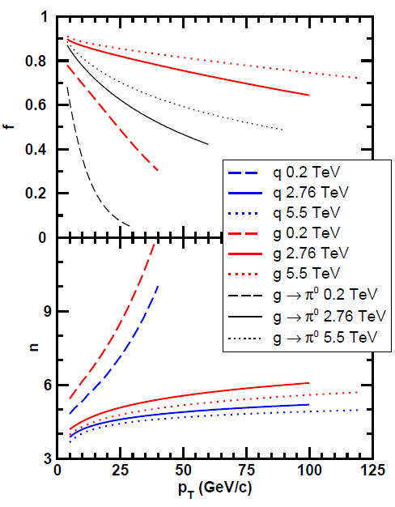
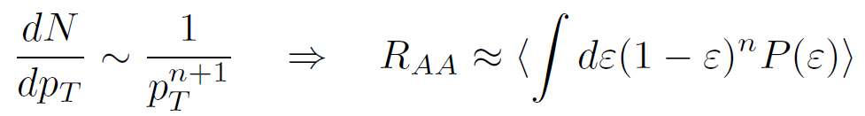
Qualitative Expectations for LHC
  For approx. power law production and energy loss probability P(ε), ε = (E_{i} - E_{f})/E_{i}
  Asymptotically, pQCD => ΔE/E ~ log(E/μ)/E
    ~ flat R_{AA}(p_{T}) at RHIC
    Rising R_{AA}(p_{T}) at LHC
  NB: LHC is a glue machine

Slide 22
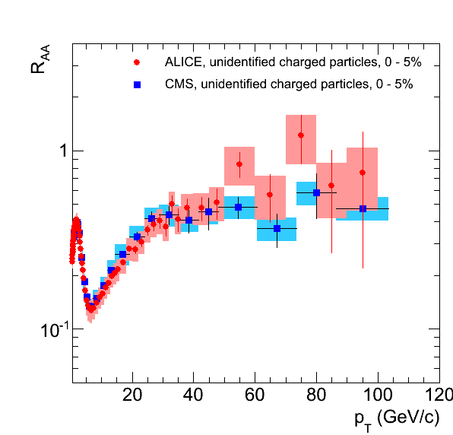
Qualitatively Perturbative at LHC
Appelshauser, ALICE, QM11
p_{T} rise in data readily understood from generic perturbative physics!

Slide 23
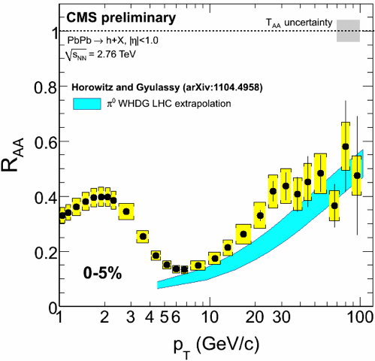
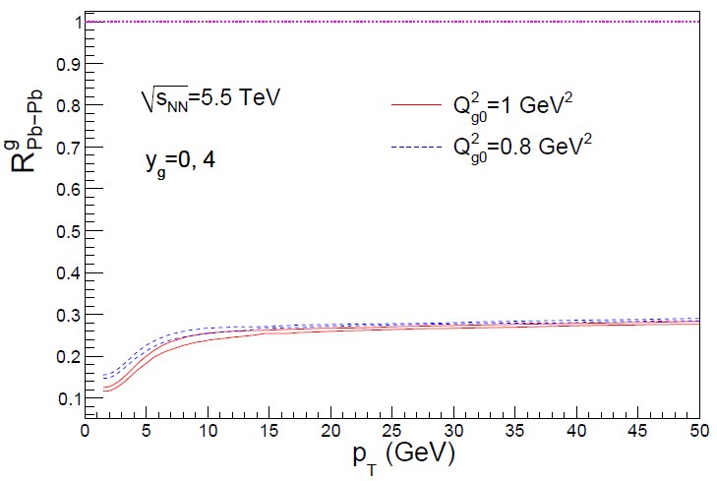
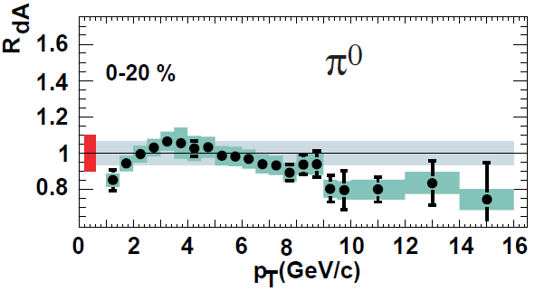
Rise in R_{AA} a Final State Effect?
  Is rise really due to pQCD?
  Or other quench (flat?)
+ initial state CNM effects a la CGC?
Y-J Lee, QM11
Albacete and Marquet, PLB687 (2010)
Require p + A and/or direct γ
PHENIX PRL98, 2007

Slide 24
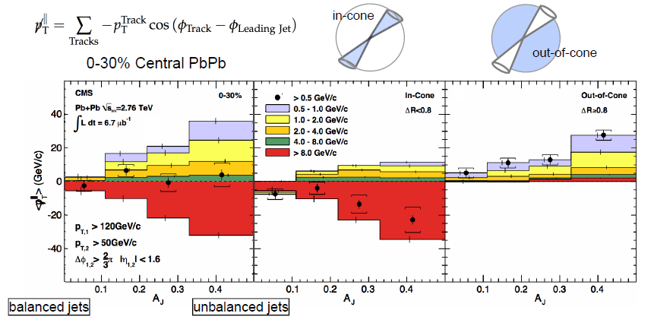
pQCD and Jet Measurements
  CMS sees redistribution of lost energy at large angles
    Naive pQCD expectation: collinear radiation
Wyslouch, CMS, QM11

Slide 25
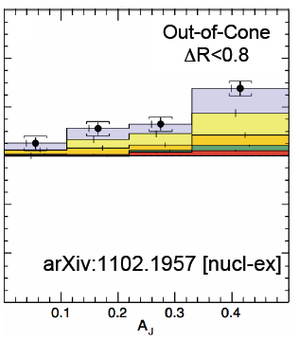
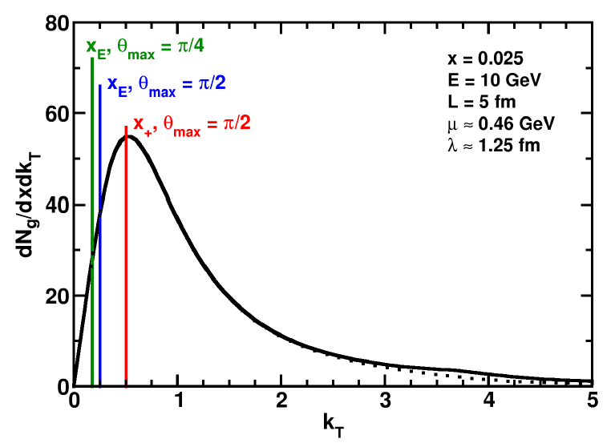
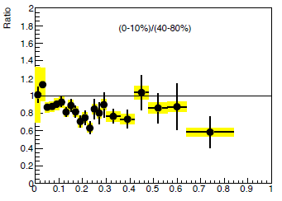
pQCD and Wide Angle Radiation
  Naively, pQCD =>
  x_{typical}, θ_{typical} ~ μ/E; μ ~ 0.5 GeV
  All current Eloss calculations assume small angle emission
  (k_{T} << xE)
  Collinear approximation is (maximally) violated; x_{typ} ~ μ/E
  pQCD is not inconsistent with data
C Roland, CMS, QM11
z
WAH and B Cole, PRC81, 2010
B Cole, ATLAS, QM11

Slide 26
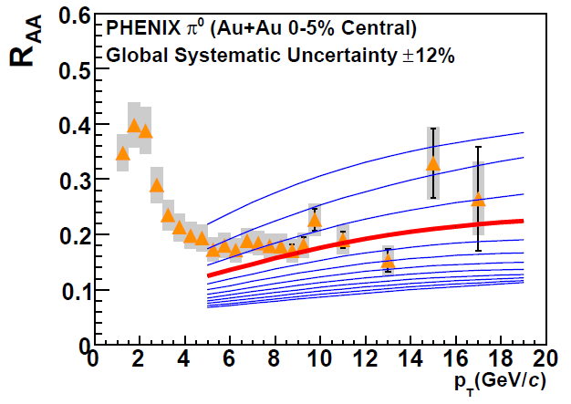
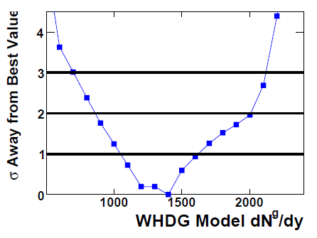
With Caveats in Mind...
Quantitatively compare a parameter free prediction from WHDG for LHC, rigorously constrained by RHIC
  Increase density at LHC by observed increase in particle multiplicity
PHENIX PRC77, 2008

Slide 27
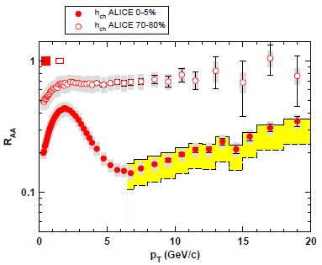
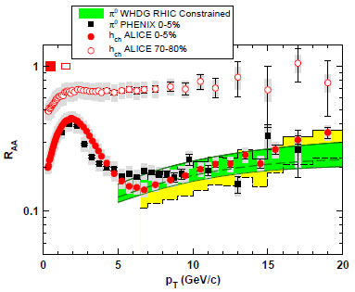
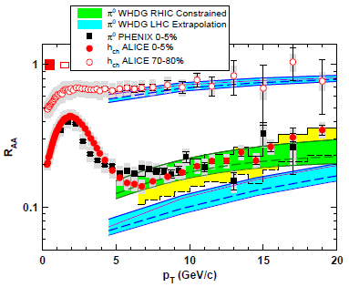
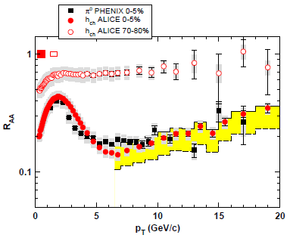
WHDG π⁰ R_{AA} at LHC: First Results
  WHDG band from 1-σ RHIC dN_{g}/dy extraction
  Note that constrained predictions have small uncertainty from collinear approx
  Constrain WHDG at RHIC
  Make LHC predictions assuming dN_{g}/dy ~ dN_{ch}/dη
  => dN_{g}^{LHC}/dy = 2.4 dN_{g}^{RHIC}/dy
Data shown at Kruger2010
WAH and M Gyulassy, NPA872 (2011)

Slide 28
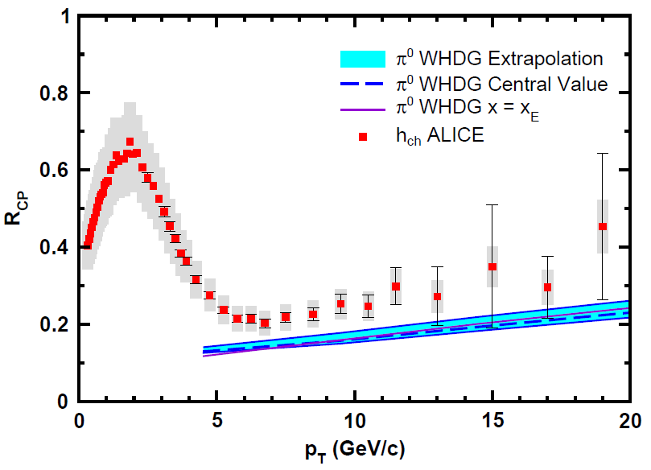
WHDG Compared to R_{CP}
Examine R_{CP}, ratio of central to peripheral R_{AA}
  p + p uncertainty cancels
  0-5% R_{AA} to
  70-80% R_{AA}
  Validity of E-loss in very peripheral collisions?
WAH and M Gyulassy, NPA872 (2011)

Slide 29
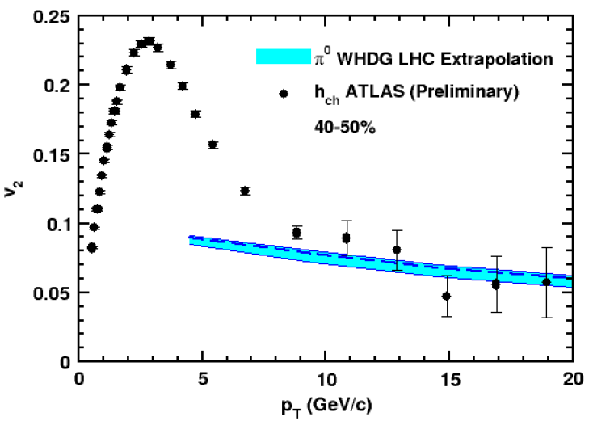
WHDG Describes LQ R_{AA} and v₂!
  Fixed by RHIC data, parameter-free WHDG describes preliminary R_{AA} and v₂ quite well
    v₂ at very high p_{T}?
Y-J Lee, QM11 and
cdsweb.cern.ch/record/1352777
WAH and M Gyulassy,
JPhysG38 (2011)

Slide 30
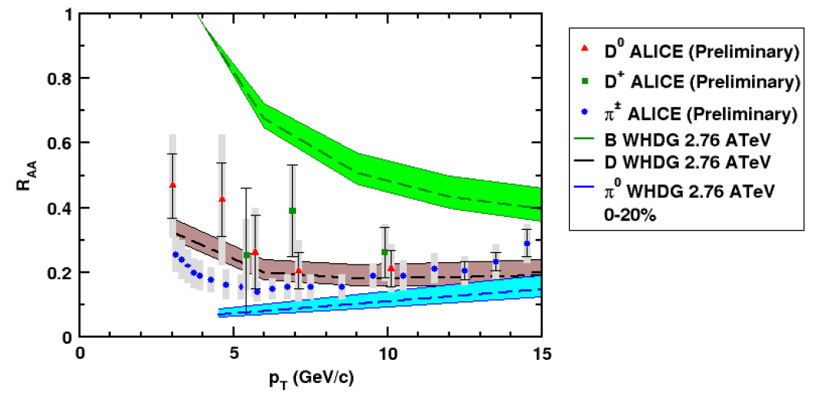
And D, B (?) R_{AA} at LHC
  NB: R_{AA} requires production, E-loss, FF
    Does not immediately follow that R^{π}_{AA} << R^{D}_{AA} << R^{B}_{AA}
CMS B → J/ψ
WAH and M Gyulassy, PANIC11 (arXiv:1107.2136)
ALICE, 1203.2160

Slide 31
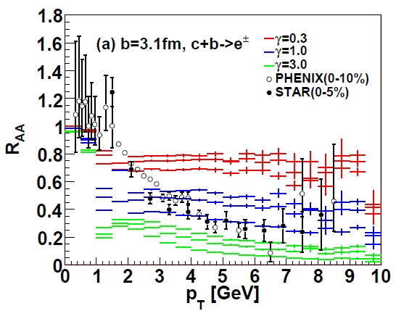
AdS/CFT at RHIC
String drag: qualitative agreement in heavy flavor sector
WAH, PhD Thesis
Akamatsu, Hatsuda, and Hirano, PRC79, 2009

Slide 32
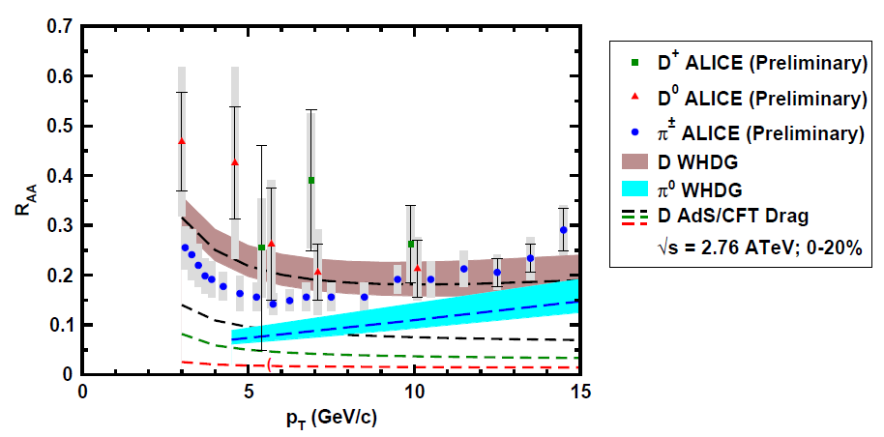
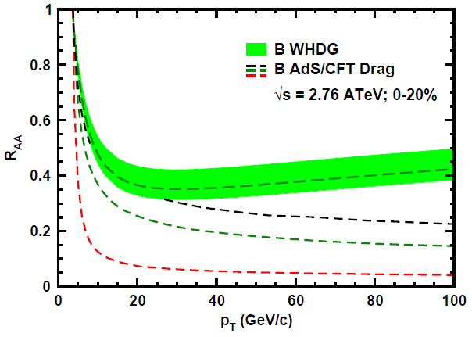
AdS/CFT and HQ at LHC
D Predictions
B Predictions
CMS B→J/ψ
WAH, PANIC11 (arXiv:1108.5876)
ALICE, arXiv:1203.2160
AdS HQ Drag appears to oversuppress D
Roughly correct description of B→J/ψ

Slide 33

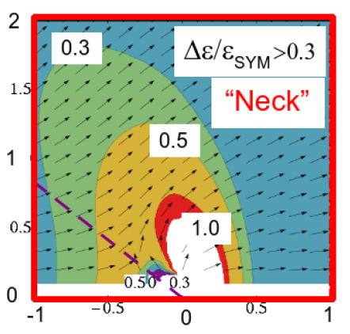
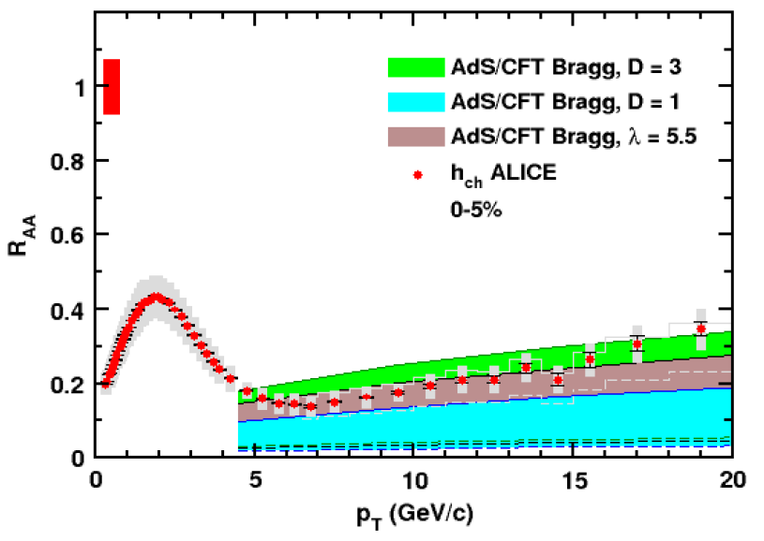
AdS/CFT Light q E-Loss & Dist.
0.2 TeV
2.76 TeV
Jo Noronha, M Gyulassy, and G Torrieri, PRL102 (2009)
Suggests wide angle energy loss
WAH, JPhysG38 (2011)
Simple Bragg peak model

Slide 34

Comparing AdS and pQCD
But what about the interplay between mass and momentum?
  Take ratio of c to b R_{AA}(p_{T})
    pQCD: Mass effects die out with increasing p_{T}
      Ratio starts below 1, asymptotically approaches 1. Approach is slower for higher quenching
    ST: drag independent of p_{T}, inversely proportional to mass. Simple analytic approx. of uniform medium gives
    R^{cb}_{pQCD}(p_{T}) ~ n_{b}M_{c}/n_{c}M_{b} ~ M_{c}/M_{b} ~ .27
      Ratio starts below 1; independent of p_{T}
R^{cb}_{pQCD}(p_{T}) ∼ 1 - α_{s} n(p_{T}) L² log(M_{b}/M_{c}) ( /p_{T})

Slide 35
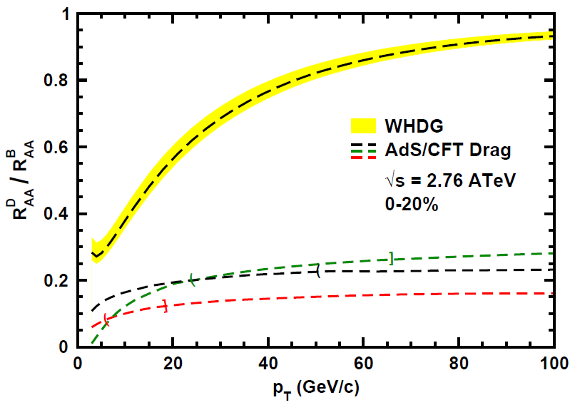
LHC R^{c}_{AA}(p_{T})/R^{b}_{AA}(p_{T}) Prediction
(with speed limits)
WAH, PANIC11 (arXiv:1108.5876)
      T(τ₀): “(”, corrections likely small for smaller momenta
      T_{c}: “]”, corrections likely large for higher momenta
Qualitatively, corrections to AdS/CFT result will drive double ratio to unity
See also:
WAH, M. Gyulassy, PLB666 (2008)

Slide 36
Cold Nuclear Matter
Energy Loss

Slide 37
New Geometries
Constant T Thermal Black Brane
Shock Geometries
P Chesler,
Quark Matter 2009
Nucleus as Shock
DIS
Embedded String in Shock
Albacete, Kovchegov, Taliotis,
JHEP 0807, 074 (2008)
Before
After
v_{shock}
z
Q
v_{shock}
z
Q
x
x
WAH and Kovchegov, PLB680 (2009)

Slide 38
Putting It All Together
This leads to
Can test AdS HQ E-Loss in both hot and cold nuclear matter!
  Recall for BH:
  Shock gives exactly the same drag as BH for Λ = π T
    Λ is typical mom. scale of nucleus

Slide 39
Cold Nuclear Matter
Imaging/IC for HIC

Slide 40
Motivation
Many-body QCD:
  Quantitative extraction of properties (η/s, E-loss,...) requires quantitative knowledge of the geometry
    Physics of “the edge” very important, not under good theoretical control (non-perturbative)
EVMP provides an independent, direct measurement of the small-x nuclear profile
  Very sensitive to edge physics

Slide 41
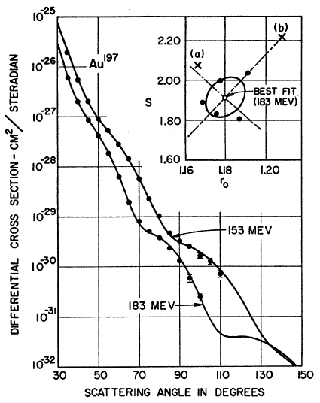
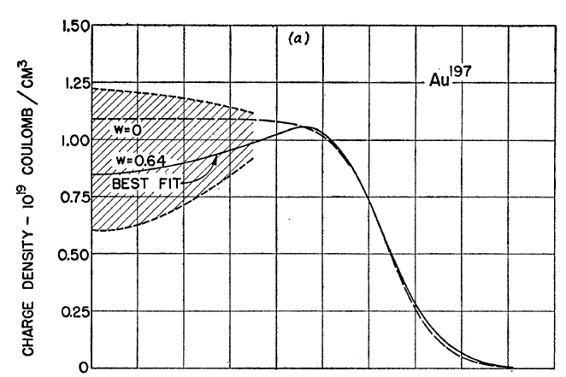
Measuring the IC
LHeC could give experimental handle on initial geometry
  Recall e + A diffraction exps. on A at rest
Hahn, Ravenhall, and Hofstadter, Phys Rev 101 (1956)

Slide 42
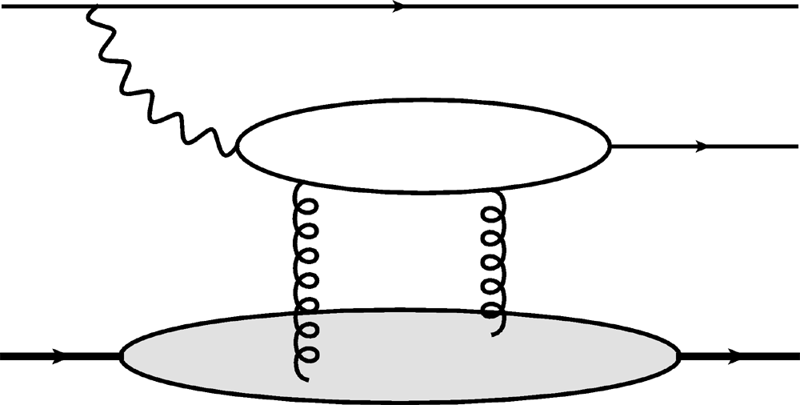
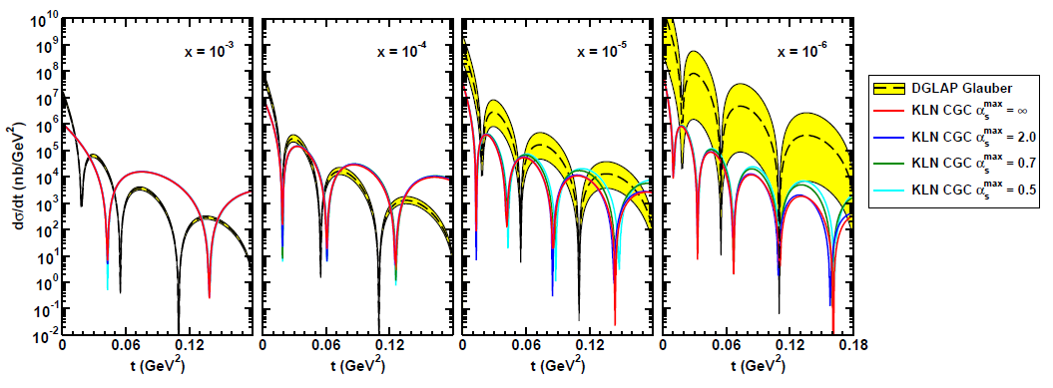
Gluon Distribution in A
e
e
γ*
J/ψ
Coherent vector meson production in e + A
A
A
Must reject incoherent
collisions at ~100%
WAH, arXiv:1102.5058

Slide 43
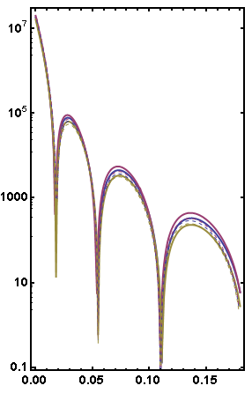
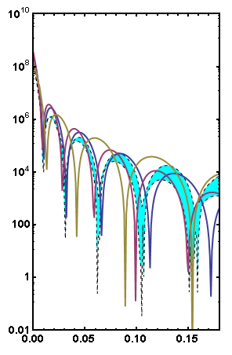
Unitarized Results
DGLAPU (B, P, G; solid)
DGLAP (B, P, G; dashed)
DGLAPU (B, P, G)
KLNU (Teal Band)
x = 10⁻³
x = 10⁻⁶
dσ/dt
dσ/dt
t (GeV²)
t (GeV²)
  Sig. shape diff. from unitarization. NB esp. changes due to MSTW uncertainties, KLN’s slower dropoff
  Little Change at “large” x

Slide 44
Conclusions
Muons provide a powerful and unique tool for investigating the novel many-body non-Abelian physics of QCD
  Energy Loss:
    c, b → D, B → μ provide insight into HQ E-Loss
      Changing mid- to forward-rapidity: vary input spectrum, medium path
    Vitally important consistency check on theory
  Cold Nuclear Matter:
    Additional consistency constraints on E-Loss theory
    e + A → J/ψ: Direct measure of glue in boosted A

Slide 46
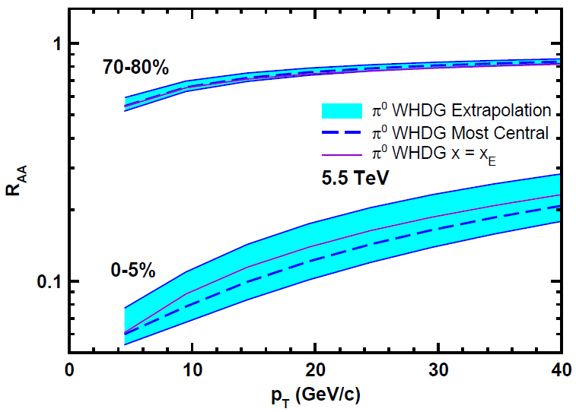
Top Energy Predictions
For posterity:
WAH and M Gyulassy, in preparation

Slide 47

RHIC R^{cb} Ratio
pQCD
pQCD
AdS/CFT
AdS/CFT
WAH, M. Gyulassy, JPhysG35 (2008)
    Wider distribution of AdS/CFT curves due to large n: increased sensitivity to input parameters
    Advantage of RHIC: lower T => higher AdS speed limits

Slide 48
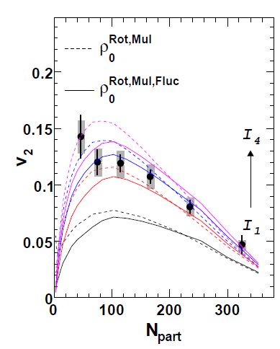
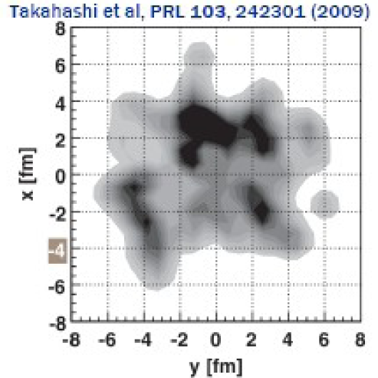
What About Fluctuations?
Hot spots can be huge
  NEXUS calculation for 10% most central top RHIC energy event
For simple E-loss not a large effect
  Important for fluc., opacity exp.?
Jia and Wei, arXiv:1005.0645

Slide 49
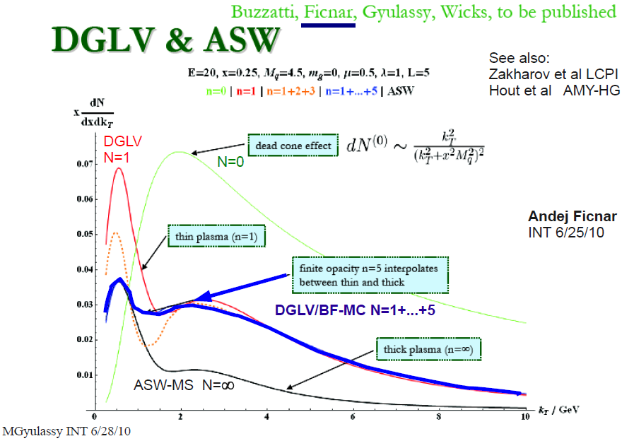
Opacity Corrections
Likely important, but integration over many variables required for comparison to data

Slide 50
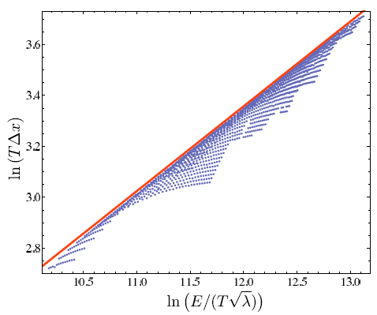
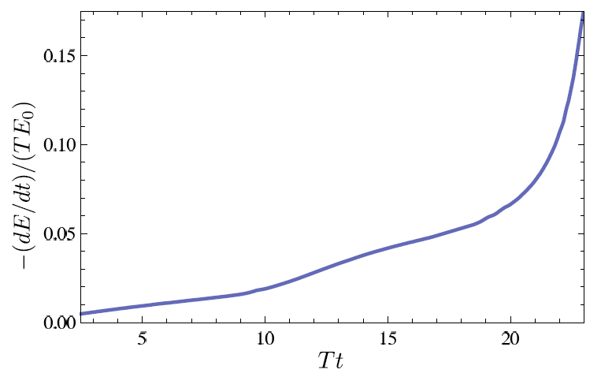
Chesler et al., PRD79 (2009)

Slide 51
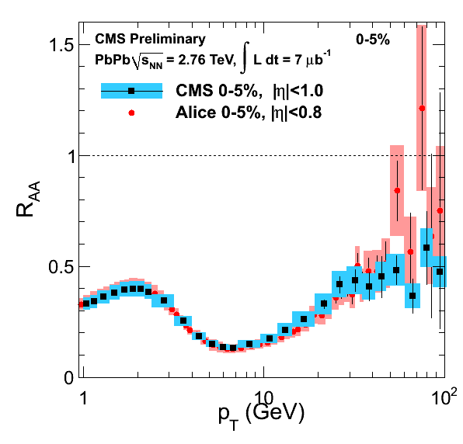
Appelshauser, ALICE, QM11

Slide 52
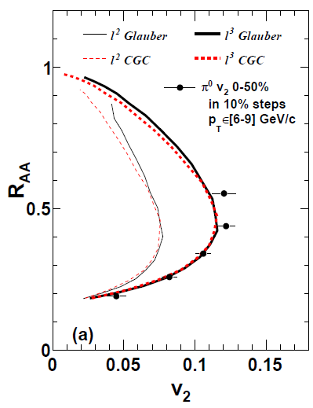

Mult. Obs. at LHC?
RHIC
J Jia, WAH, J Liao,
arXiv:1101.0290
Are pQCD predictions of both R_{AA} & v₂ consistent with data? At 100 GeV/c?
Jia, ATLAS, QM11
Wenger, private communication

Slide 53


Motivating High Momentum Probes
Probe
Medium
Medium

Slide 54

Light Quark and Gluon E-Loss
Chesler et al., PRD79 (2009)
SS Gubser, QM08
Light quarks and gluons: generic Bragg peak
  Leads to lack of T dependence?
ΔL^{q}_{therm} ~ E^{1/3}
ΔL^{q}_{therm} ~ (2E)^{1/3}
Gubser et al., JHEP0810 (2008)
Chesler et al., PRD79 (2009)
Arnold and Vaman, JHEP 1104 (2011)
See also Marquet and Renk,
PLB685 (2010), and
Jia, WAH, and Liao,
arXiv:1101.0290, for v₂

Slide 55


Qual Norm of R_{AA} From RHIC to LHC
Assume QGP density scales with observed particle multiplicity: ~2.5x more dense than RHIC
ALICE, PRL105, 2010
WAH and M Gyulassy, arXiv:1104.4958
  Suppression from RHIC to LHC generically increases

Slide 56


Strongly Coupled Qualitative Successes
AdS/CFT
Blaizot et al., JHEP0706
T. Hirano and M. Gyulassy, Nucl. Phys. A69:71-94 (2006)
STAR, PRL102 (2009)
Betz, Gyulassy, Noronha, Torrieri, 0807.4526

Slide 57

IC from Higher Harmonics
Chen et al., arXiv:1106.6350

Slide 58


ALICE Published Results
  NB: ALICE unmeasured p + p interpolation > LO pQCD
  Also, small reported unc. in N_{bin}
    Fluctuations important at large centralities
WAH and M Gyulassy,
arXiv:1104.4958

Slide 59
Hot Nuclear Matter
pQCD E-Loss Uncertainties

Slide 60

Varying α_{s} has huge effect
<ε>_{rad,pQCD} ~ α_{s}³; <ε>_{el,pQCD} ~ α_{s}²
  Role of running coupling, irreducible uncertainty from non-pert. physics?
  Nontrivial changes from better elastic treatment
S Wicks, PhD Thesis

Slide 61

Quantifying Sensitivity to Geometry IC
Effects of geom. on, e.g. v₂, might be quite large
  KLN CGC vs. WS Glaub. and rotating RP
  Effect not large enough for pQCD
Possibly truly extreme
initial geometry?
      See also Renk et al., PRC83 (2011), Jia, WH, Liao, 1101.0290
Betz, Gyulassy, and Torrieri, arXiv:1102.5416 [nucl-th]

Slide 62


Quantification of Collinear Uncertainty
Factor ~ 3 uncertainty in extracted medium density!
“qhat” values from different formalisms consistent w/i unc.
WAH and B Cole, PRC81, 2010

Slide 63


Coll. Approx. and Constrained v₂
Fix dN_{g}/dy from R_{AA}, calculate v₂
  Expect: larger v₂ for smaller opening angle
    τ_{coh} = xE/k_{T}² larger for smaller θ_{max}
      more paths in deep LPM (ΔE ~ L²) region
  Not large sensitivity
    Rad Only
    Rad + El
20-30% π⁰
20-30% π⁰
v₂
v₂
p_{T}
WAH, in preparation
p_{T}

Slide 64


Geometry, Early Time Investigation
    Significant progress made
      Full geometry integration, dynamical scattering centers
      RHIC suppression with dN_{g}/dy = 1000
      Large uncertainty due to unconstrained, non-equilibrium τ < τ₀ physics
      Future work: higher orders in opacity
Buzzatti and Gyulassy, 1106.3061

Slide 65
Measuring the Initial Gluon State
What is the spatial distribution of gluons in a highly boosted nucleus?
What are the initial conditions fed into hydro in HIC?
T Hirano, et al.,
Phys.Lett.B636, 2006

Slide 66

η/s Extraction
Factor at least 2 uncertainty in η/s from IC
  Naive pQCD => η/s ~ 1
  Naive AdS/CFT => η/s ~ 1/4π
Teaney, Users’ Meeting 2011

Slide 67

Not So Fast!
  Speed limit estimate for applicability of AdS drag
    γ < γ_{crit} = (1 + 2M_{q}/λ^{1/2} T)²
    ~ 4M_{q}²/(λ T²)
      Limited by M_{charm} ~ 1.2 GeV
    Similar to BH LPM
      γ_{crit} ~ M_{q}/(λT)
  No Single T for QGP
    smallest γ_{crit} for largest T
    T = T(τ₀, x=y=0): “(”
    largest γ_{crit} for smallest T
    T = T_{c}: “]”
D7 Probe Brane
Q
Worldsheet boundary Spacelike if γ > γ_{crit}
x₅
Trailing
String
“Brachistochrone”
“z”
D3 Black Brane

Slide 68

pQCD Precision
What level of precision should we expect?
  NLO pQCD p + p → h + X is only good to w/i factor of ~2
CMS, arXiv:1202.2554

