Slide 1



Perturbative Probes of
Heavy Ion Collisions?
W. A. Horowitz
University of Cape Town
June 14, 2012
With many thanks to Razieh Morad,
Miklos Gyulassy, and Yuri Kovchegov

Slide 2

What Are We Interested In?
Measure many-body physics of strong force
Test & understand theory of many-body non-Abelian fields
Long Range Plan, 2008
Notes:
Unique as compared to strongly coupled Abelian problems

Slide 3

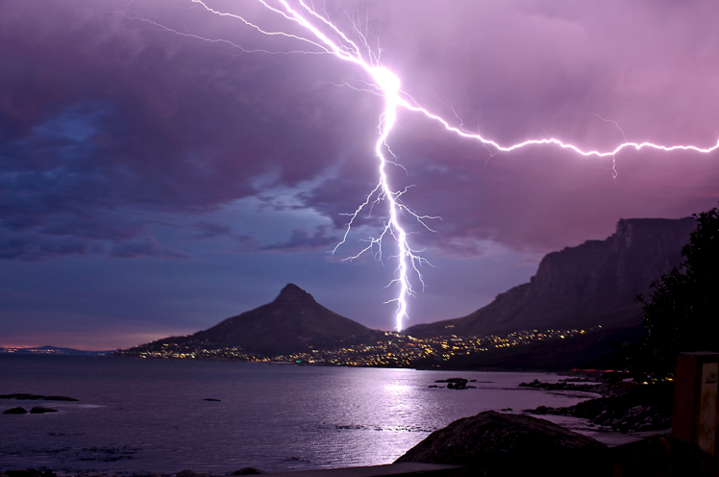


Four Known Forces
Gravity
Electromagnetism
starchild.gsfc.nasa.gov
John Maarschalk, travelblog.portfoliocollection.com
Weak
Strong
lhs.lps.org/staff/sputnam/chem_notes/tritium_decay.gif

Slide 4
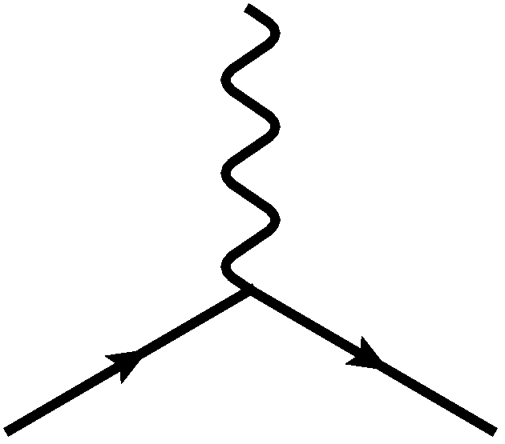


Many Body Electromagnetism
=>
“Simple” Hydrogen
Phase Diagram
Hanneke, Fogwell, and Gabrielse, PRL100 (2008)
Calculated, Burkhard Militzer,
Diploma Thesis, Berlin, 2000

Slide 5

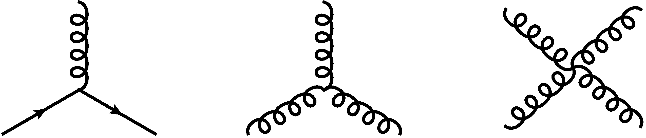
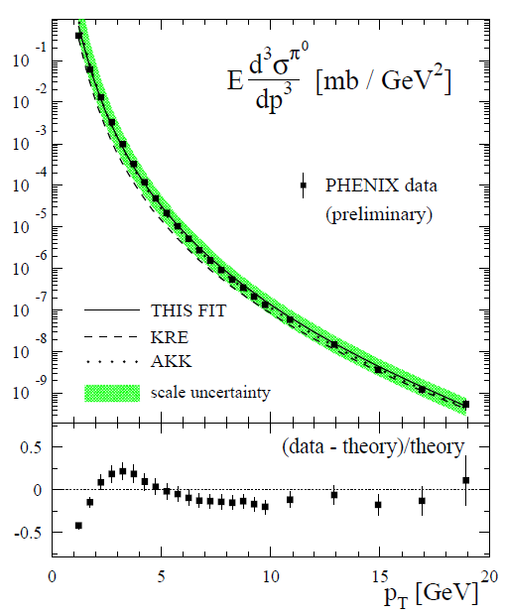

Many Body QCD
=>
PDG
de Florian, Sassot, Stratmann,
PRD75 (2007)

Slide 6


QGP Energy Loss
Learn about E-loss mechanism
  Most direct probe of DOF
pQCD Picture
AdS/CFT Picture

Slide 7
Hot Nuclear Matter: pQCD

Slide 8

pQCD Rad Picture
Bremsstrahlung Radiation
  Weakly-coupled plasma
    Medium organizes into Debye-screened centers
  T ~ 350 (450) MeV, g ~ 1.9 (1.8)
    μ ~ gT ~ 0.7 (0.8) GeV
    λ_{mfp} ~ 1/g²T ~ 0.8 (0.7) fm
    R_{Au,Pb} ~ 6 fm
  1/μ << λ_{mfp} << L
    multiple coherent emission
Gyulassy, Levai, and Vitev, NPB571 (2000)
  LPM
    dp_{T}/dt ~ -LT³ log(p_{T}/M_{q})
  Bethe-Heitler
    dp_{T}/dt ~ -(T³/M_{q}²) p_{T}

Slide 9


What About Elastic Loss?
Appreciable!
Finite time effects small
Mustafa, PRC72 (2005)
Adil, Gyulassy, WAH,
Wicks, PRC75 (2007)
  For pQCD comparisons with data, use WHDG Rad+El+Geom model; formalism valid for g/lq & hq

Slide 10
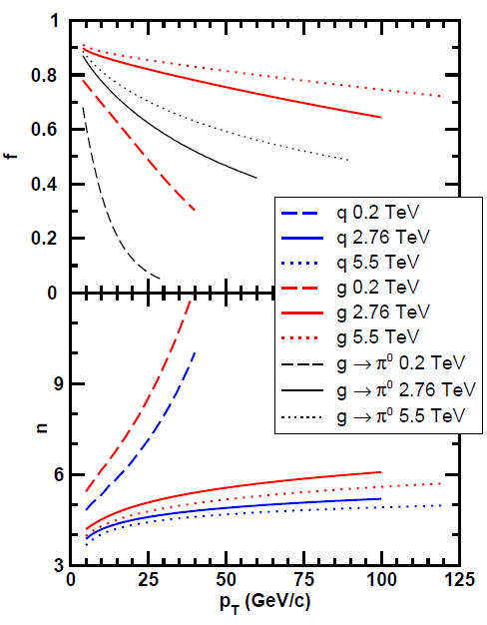
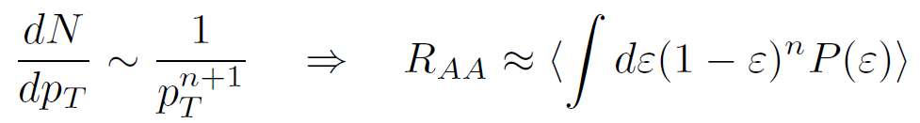
Qualitative Expectations for LHC
  For approx. power law production and energy loss probability P(ε), ε = (E_{i} - E_{f})/E_{i}
  Asymptotically, pQCD => ΔE/E ~ log(E/μ)/E
    ~ flat R_{AA}(p_{T}) at RHIC
    Rising R_{AA}(p_{T}) at LHC
      True for glue, lights, & heavies
  NB: LHC is a glue machine

Slide 11
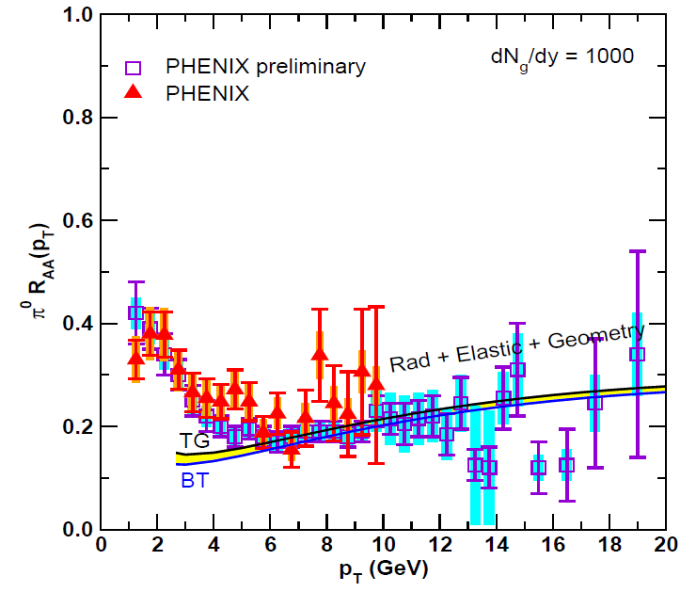
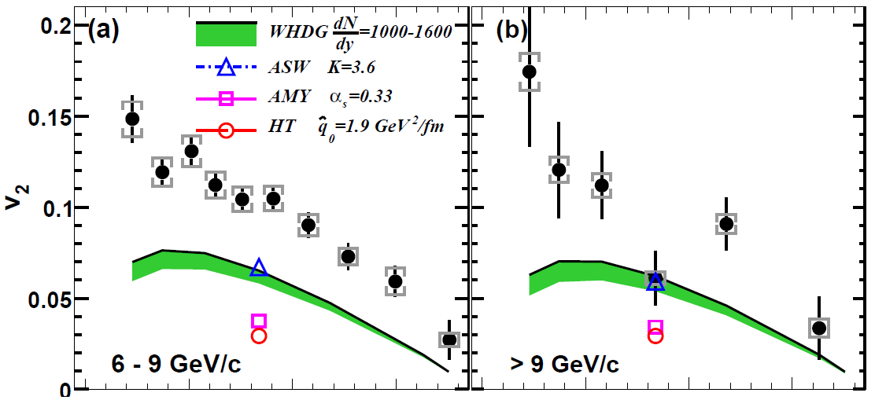
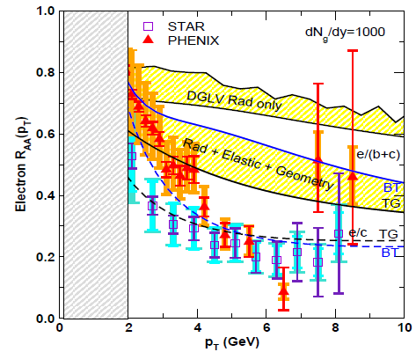
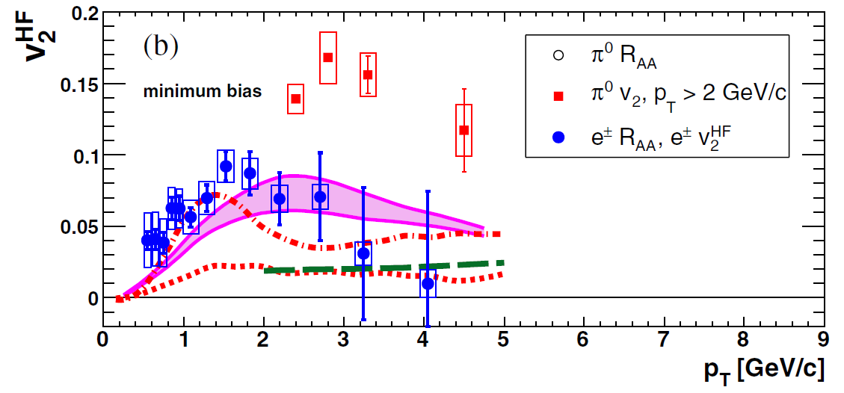
pQCD Picture Inadequate at RHIC?
PHENIX, PRL 105 (2010)
PHENIX, PRL 98 (2007)
Pert. at LHC energies?
Wicks et al., NPA784, 2007

Slide 12
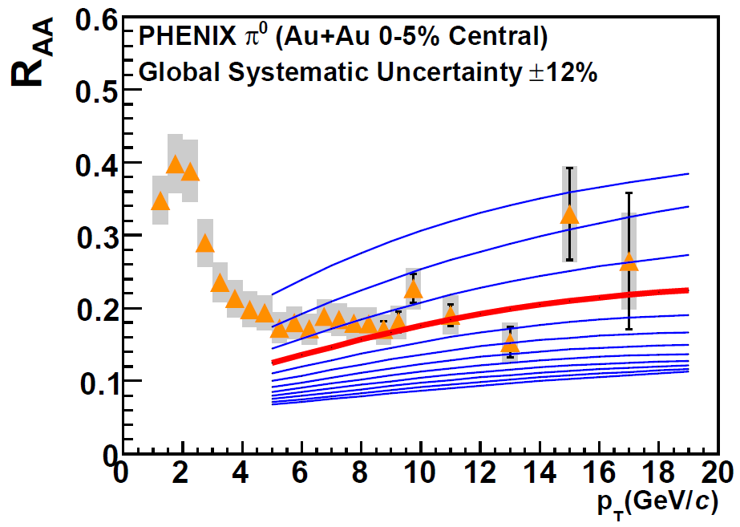
Constrain to RHIC
Best fit WHDG to PHENIX π⁰ R_{AA}
  dN_{g}/dy = 1400⁺²⁰⁰
  1400₋₃₇₅
PHENIX, PRC77 (2008)
Extremely conservative zero parameter extrapolation to LHC
  Assume ρ_{medium} ~ dN_{ch}/dη
  Keep α_{s} = 0.3 fixed

Slide 13
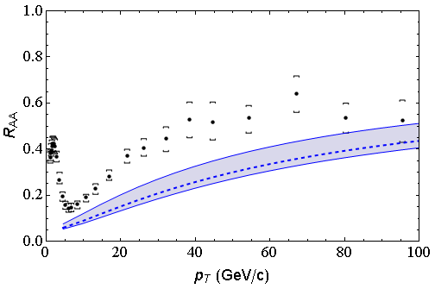
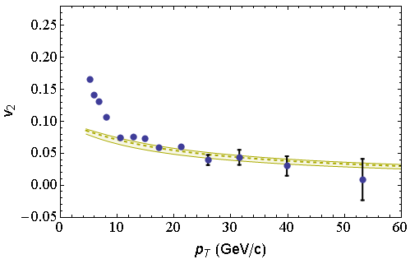
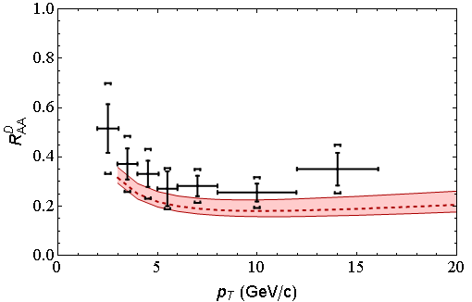
LHC Predictions vs. Data
CMS 0-5%
h±
CMS 40-50%
h±
CMS, arXiv:1202.2554
CMS, arXiv:1204.1850
ALICE 0-20%
D
All data preliminary
√s = 2.76 ATeV
ALICE, arXiv:1203.2160

Slide 14
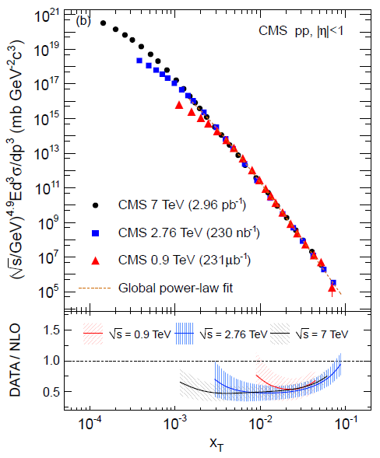
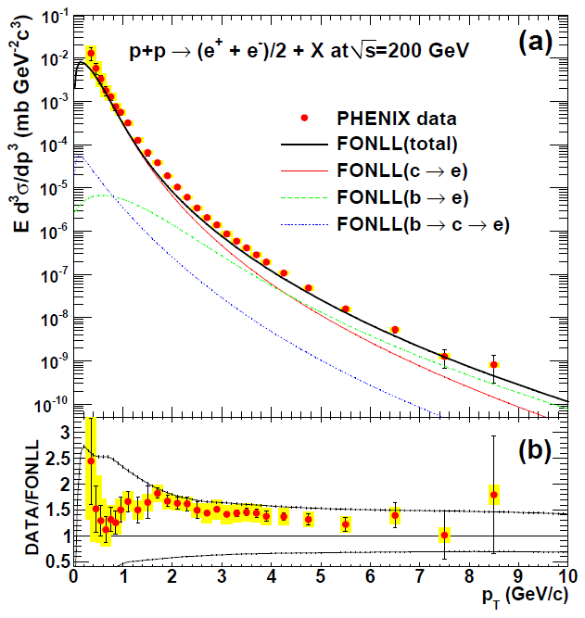
pQCD pp Predictions vs. Data
PHENIX, PRC84 (2011)
CMS, arXiv:1202.2554

Slide 15
Quant. (Qual?) Conclusions Require...
Further experimental results
Theoretically, investigation of the effects of
  higher orders in
    α_{s} (large)
    k_{T}/xE (large)
    M_{Q}/E (large?)
    opacity (large?)
  geometry
    uncertainty in IC (small)
    coupling to flow (large?)
    Eloss geom. approx. (?)
    τ < τ₀ (large: see Buzzatti and Gyulassy)
    dyn. vs. static centers (see Djordjevic)
    hydro background (see Renk, Majumder)
  better treatment of
    Coh. vs. decoh. multigluons (see Mehtar-Tani)
    elastic E-loss
    E-loss in confined matter

Slide 16
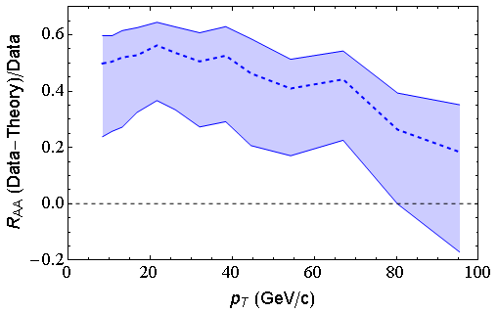
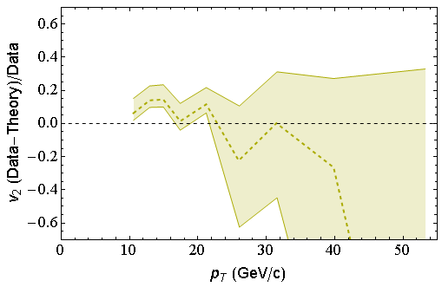
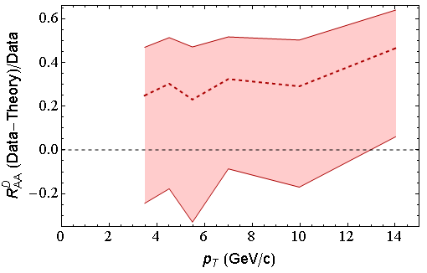
(Data – pQCD)/Data
CMS 40-50%
h±
CMS 0-5%
h±
LO
Calculation
ALICE 0-20%
D

Slide 17
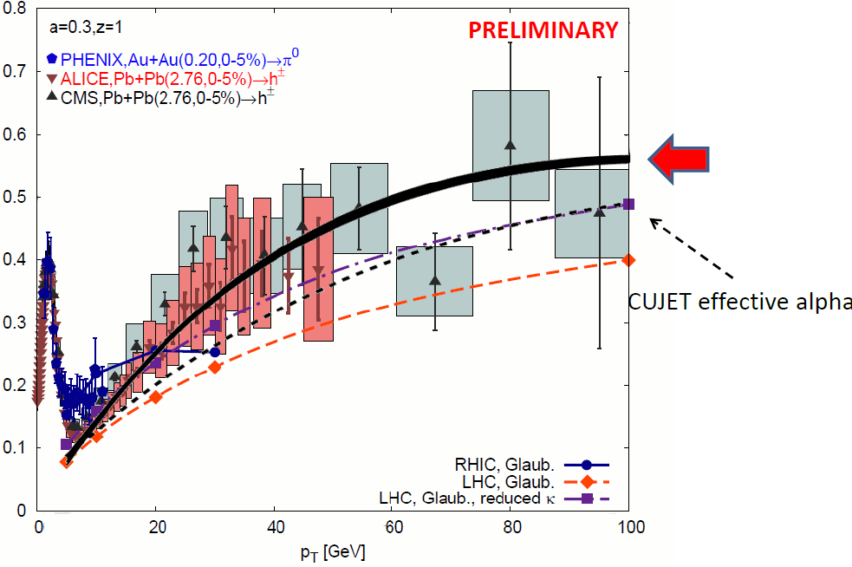
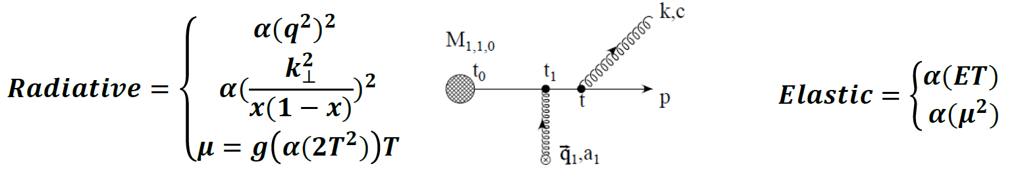
Attempt at NLO
Running coupling ansatz
A Buzzatti, HP2012

Slide 18
Hot Nuclear Matter: AdS

Slide 19
Strong Coupling Calculation
The supergravity double conjecture:
QCD ⬄ SYM ⬄ IIB
  IF super Yang-Mills (SYM) is not too different from QCD, &
  IF we believe Maldacena conjecture
  Then a tool exists to calculate strongly-coupled QCD in SUGRA

Slide 20
Heavy Quark E-Loss in AdS/CFT
Model heavy quark jet energy loss by embedding string in AdS space
  dp_{T}/dt = - μ p_{T}
  μ = πλ^{1/2} T²/2M_{q}
  Similar to Bethe-Heitler
    dp_{T}/dt ~ -(T³/M_{q}²) p_{T}
  Very different from usual pQCD and LPM
    dp_{T}/dt ~ -LT³ log(p_{T}/M_{q})
J Friess, S Gubser, G Michalogiorgakis, S Pufu, Phys Rev D75 (2007)

Slide 21
Qual. Expectations: pQCD vs. AdS/CFT
For ε = Δp_{T}/p_{T}
  Asymptotic pQCD
  Asymptotic AdS
      Independent of p_{T} and strongly dependent on M_{q}!
      T² dependence in exponent makes for a very sensitive probe
  Expect: ε_{pQCD} 0 vs. ε_{AdS} indep of p_{T}!!
    dR_{AA}(p_{T})/dp_{T} > 0 => pQCD; dR_{AA}(p_{T})/dp_{T} < 0 => ST
ε_{rad} ∼ α_{s} L² log(p_{T}/M_{q})/p_{T}
ε_{ST} ∼ 1 - Exp(-μ L), μ = πλ^{1/2} T²/2M_{q}

Slide 22
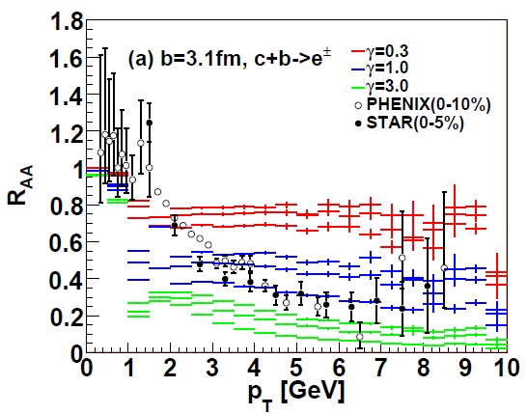
AdS/CFT and HQ at RHIC
String drag: qualitative agreement in heavy flavor sector
WAH, PhD Thesis
Akamatsu, Hatsuda, and Hirano, PRC79, 2009

Slide 23
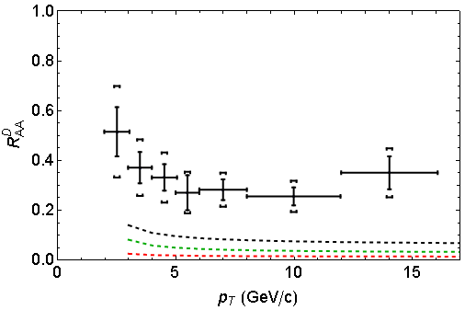
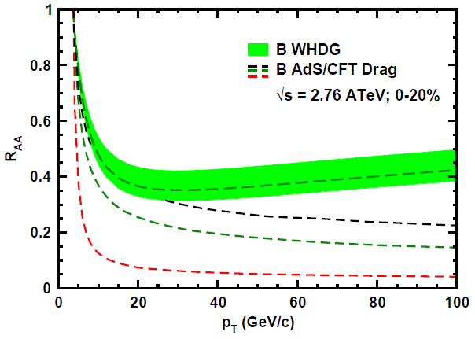
AdS/CFT and HQ at LHC
D Predictions
B Predictions
ALICE 0-20%
D
CMS B→J/ψ
WAH, PANIC11 (arXiv:1108.5876)
ALICE, arXiv:1203.2160
CMS, JHEP 1205 (2012) 063
AdS HQ Drag appears to oversuppress D
Roughly correct description of B→J/ψ

Slide 24
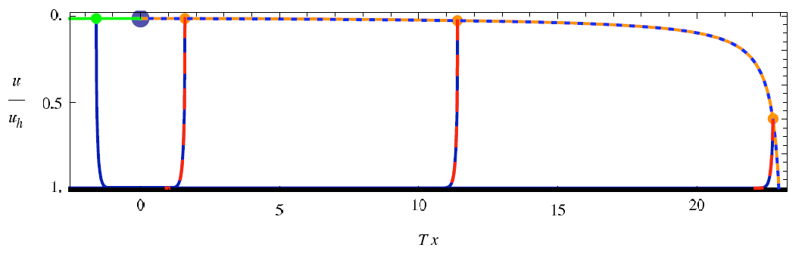
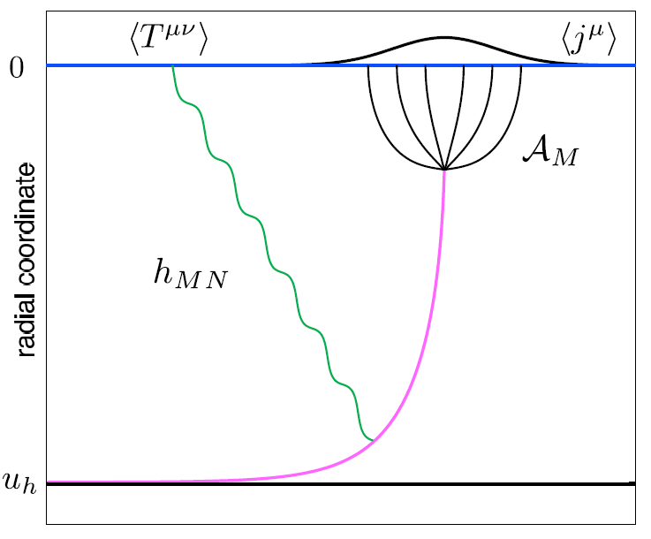
Light Quark E-Loss in AdS
Chesler et al., PRD79 (2009)
Complications:
  string endpoints fall
    => painful numerics
  relation to HI meas.
    less obvious than HQ
In principle, compute T^{μν} from graviton emission
  Extremely hard

Slide 25
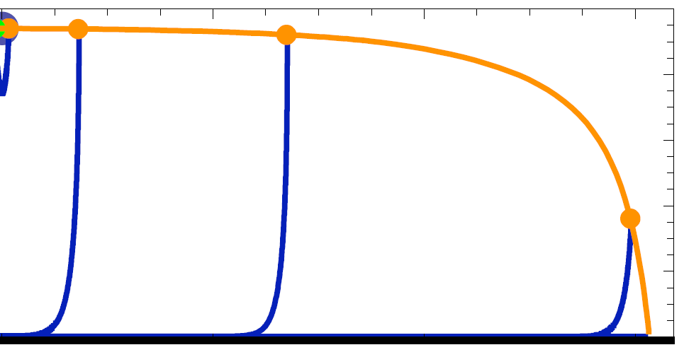

AdS/CFT Lights E-Loss Prescription
Make jet def., hope not too diff from T^{μν}
  Orig: define jet as string Δx ~ 1/T from end
  E-Loss:
Δx ~ 1/T
Chesler et al., PRD79 (2009)

Slide 26
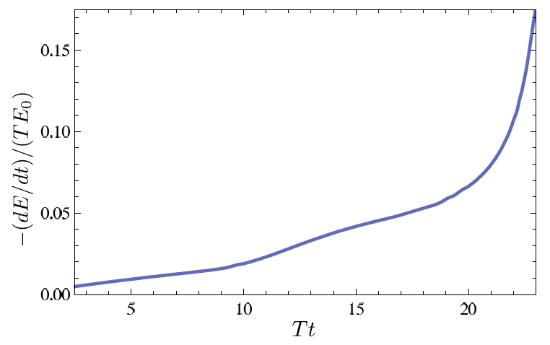
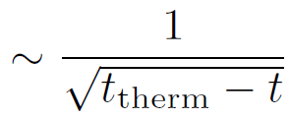

dE/dt for Lights from AdS/CFT
Original definition + original energy loss calculation => generic Bragg peak
  Intermediate-t dE/dt depends strongly on IC
Chesler et al., PRD79 (2009)
See also: Gubser et al., JHEP 0810 (2008) Arnold and Vaman, JHEP 1010 (2010)

Slide 27

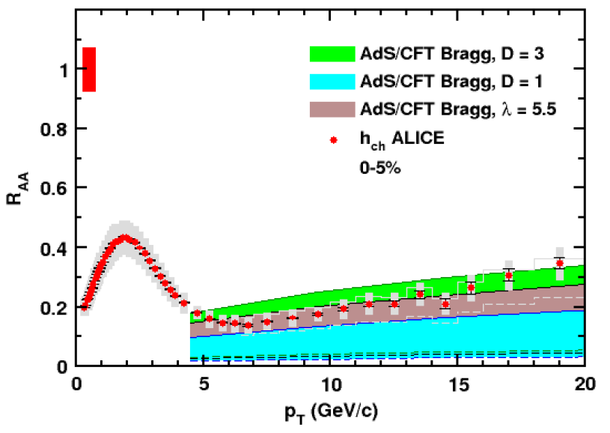
AdS/CFT Light Parton Energy Loss
Simple Bragg Peak Model
  E_{f} ~ θ(t_{therm} – t)
    Large uncertainty due to T(t)
0.2 TeV
2.76 TeV
WAH, JPhysG38 (2011)

Slide 28
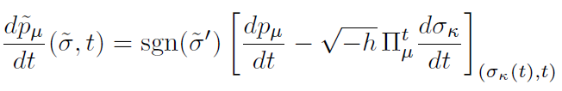
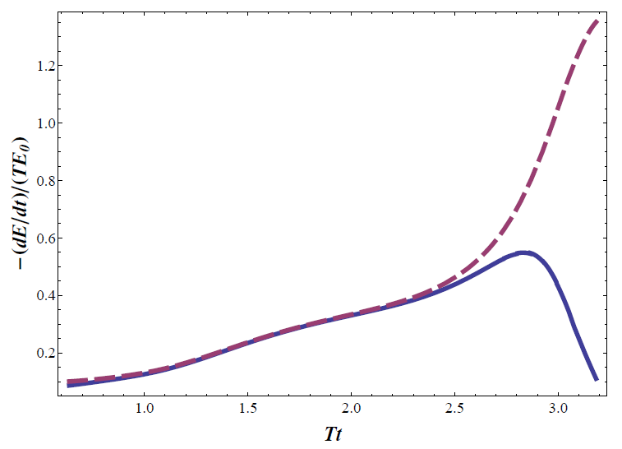
Recent AdS Lights Developments
Corrected E-loss formula
Bragg peak
disappears
  But now ΔE ≠ E
  at t_{therm}!
A Ficnar, arXiv:1201.1780

Slide 29
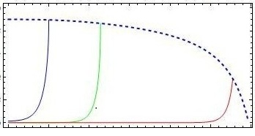
New Prescription
Define jet by sep. hard and soft scales
  ΔE = E for t = t_{therm}

Slide 30
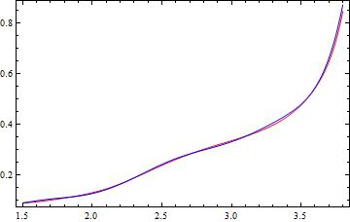
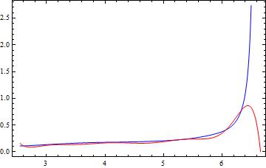
Results
In usual AdS/Sch. Bragg reappears!
  t_{therm} very short
Use T(τ) ~ τ^{-1/3} Janik & Peschanski metric
  Bragg peak gone!
-(dE/dt)/(T E₀)
T t
T t
R Morad and WAH, in prep.

Slide 31

AdS/CFT Light q E-Loss
Static thermal medium => very short therm. time
  τ_{th} ~ 2.7 fm
    AdS likely oversuppresses compared to data
Examine T ~ 1/τ^{1/3} geom
  τ_{th} ~ 4.1 fm
0.2 TeV
R Morad
2.76 TeV
WAH, JPhysG38 (2011)
Simple Bragg peak model

Slide 32

Asymptotic pQCD vs. AdS/CFT
But what about the interplay between mass and momentum?
  Take ratio of c to b R_{AA}(p_{T})
    pQCD: Mass effects die out with increasing p_{T}
      Ratio starts below 1, asymptotically approaches 1. Approach is slower for higher quenching
    ST: drag independent of p_{T}, inversely proportional to mass. Simple analytic approx. of uniform medium gives
    R^{cb}_{pQCD}(p_{T}) ~ n_{b}M_{c}/n_{c}M_{b} ~ M_{c}/M_{b} ~ .27
      Ratio starts below 1; independent of p_{T}
R^{cb}_{pQCD}(p_{T}) ∼ 1 - α_{s} n(p_{T}) L² log(M_{b}/M_{c}) ( /p_{T})

Slide 33
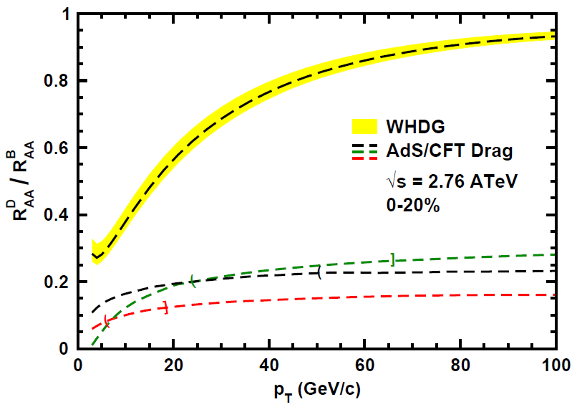
Does pQCD or AdS Yield Correct Mass & Momentum Dependecies at LHC?
WAH, PANIC11 (arXiv:1108.5876)
      T(τ₀): “(”, corrections likely small for smaller momenta
      T_{c}: “]”, corrections likely large for higher momenta
See also:
WAH, M. Gyulassy, PLB666 (2008)

Slide 34


Not So Fast!
D7 Probe Brane
Q
  Speed limit estimate for applicability of AdS drag
    γ < γ_{crit} = (1 + 2M_{q}/λ^{1/2} T)²
    ~ 4M_{q}²/(λ T²)
      Limited by M_{charm} ~ 1.2 GeV
    Similar to BH LPM
      γ_{crit} ~ M_{q}/(λT)
  Importance of longitudinal momentum fluctuations
    <(Δp_{L})²> = π λ^{1/2} T³ γ^{5/2}
      (<(Δp_{L})²>)^{1/2} ~ p_{L} => γ_{crit} ~ M_{q}/(4 T)
    Decorrelation of HF?
Worldsheet boundary Spacelike if γ > γ_{crit}
x₅
Trailing
String
“Brachistochrone”
“z”
D3 Black Brane

Slide 35
AdS HQ E-Loss in Cold Nuclear Matter
Constant T Thermal Black Brane
Shock Geometries
P Chesler,
Quark Matter 2009
Nucleus as Shock
DIS
Embedded String in Shock
Albacete, Kovchegov, Taliotis,
JHEP 0807, 074 (2008)
Before
After
v_{shock}
z
Q
v_{shock}
z
Q
x
x
WAH and Kovchegov, PLB680 (2009)

Slide 36
Putting It All Together
This leads to
Can test AdS HQ E-Loss in both hot and cold nuclear matter!
  Recall for BH:
  Shock gives exactly the same drag as BH for Λ = π T
    Λ is typical mom. scale of nucleus

Slide 37
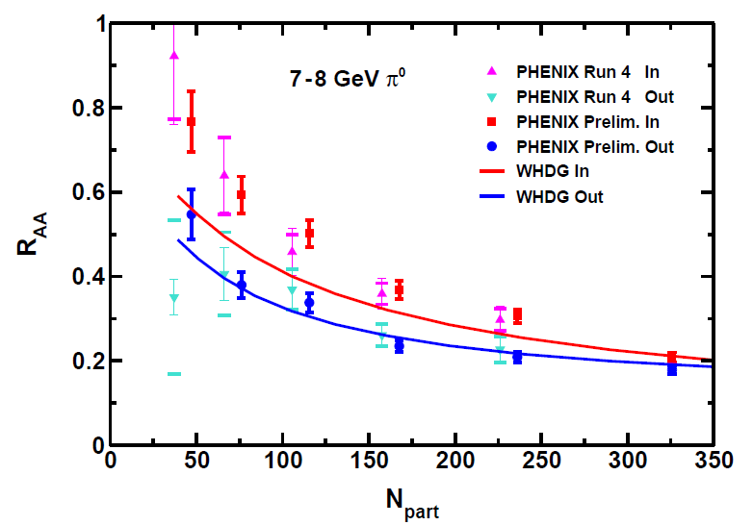
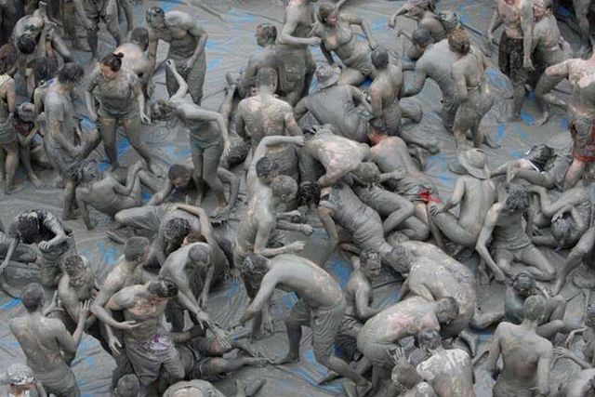
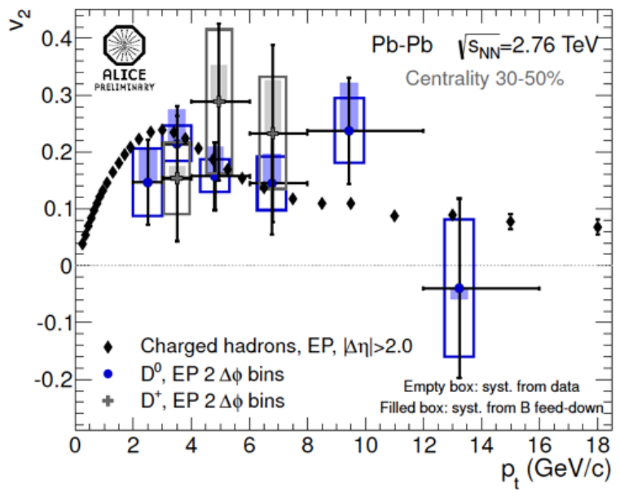
Intermediate-p_{T} Muck at RHIC and LHC
Messy (non-perturbative) physics below ~ 10 GeV/c
P Jacobs, HP2012

Slide 38


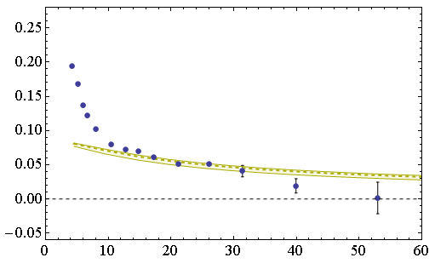
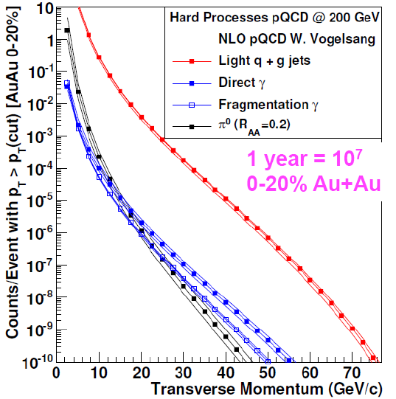
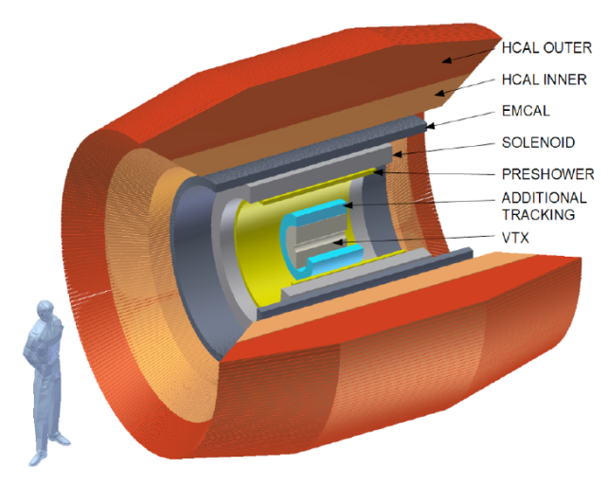
Clean High-p_{T} Probes
CMS 40-50%
h±
v₂
p_{T} (GeV/c)
  RHIC
    HF sep.
    sPHENIX
  LHC
    High-p_{T} HF
      R_{AA}, v₂, corr.
    Control p+A
      CNM AdS
B Cole, HP2012

Slide 39
Conclusions
Exciting times in HI physics!
LHC & RHIC converging on picture of pQCD E-loss in sQGP
  LO thermal pQCD qualitatively describes LHC single particle observables
    Constrained by conservative assumptions & RHIC
    Corrections likely large; drive towards data?
Difficult to reconcile AdS/CFT with new LHC data
  D mesons oversuppressed
  Light flavor hard to compare, but likely oversuppressed
Much interesting research to do:
  HF sep. at RHIC, and esp. LHC; RAA and v2
    Does bottom flow??
  Properly include, e.g. NLO effects in pQCD E-Loss
  Understand AdS E-Loss better
    Importance of fluctuations
    Light parton jets
    p+A

Slide 40
Backup Slides

Slide 41
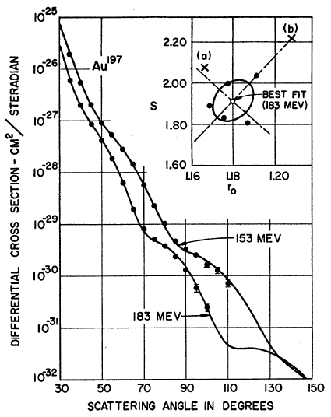
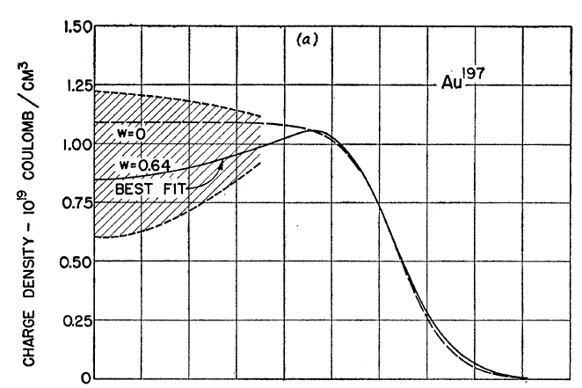
Measuring the IC
eRHIC could give experimental handle on initial geometry
  Recall e + A diffraction exps. on A at rest
Hahn, Ravenhall, and Hofstadter, Phys Rev 101 (1956)

Slide 42
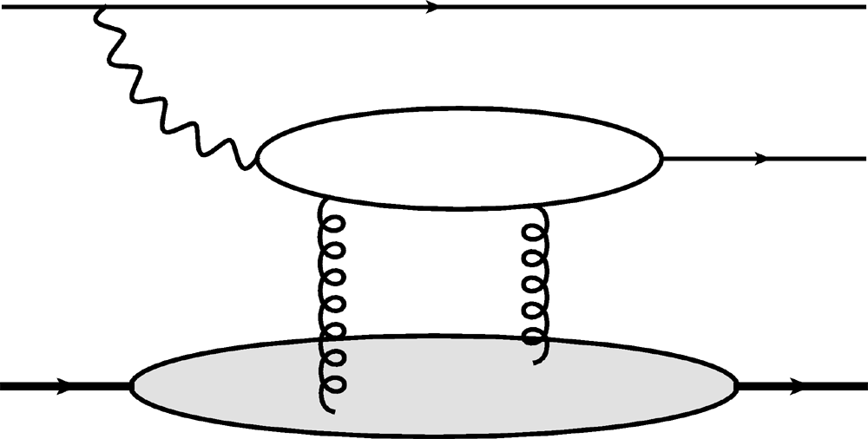
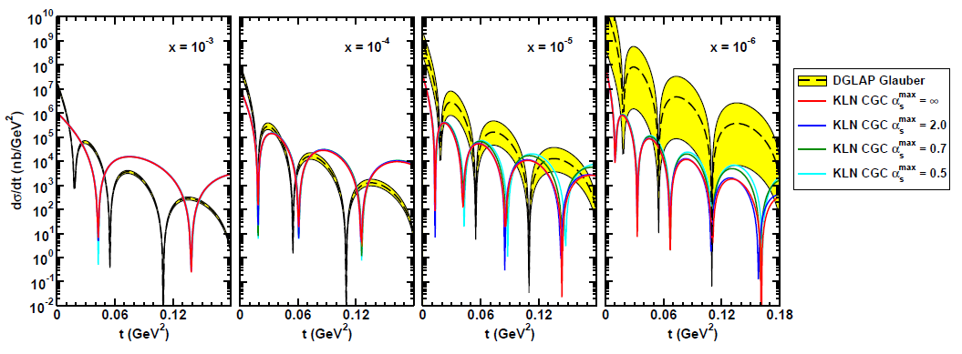
Gluon Distribution of A at x ~ 10⁻³
e
e
γ*
J/ψ
Coherent vector meson production in e + A
A
A
Must reject incoherent
collisions at ~100%
WAH, arXiv:1102.5058

Slide 43
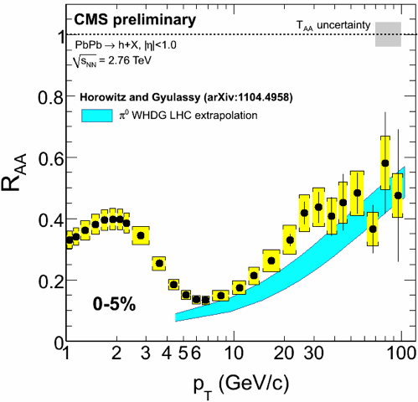
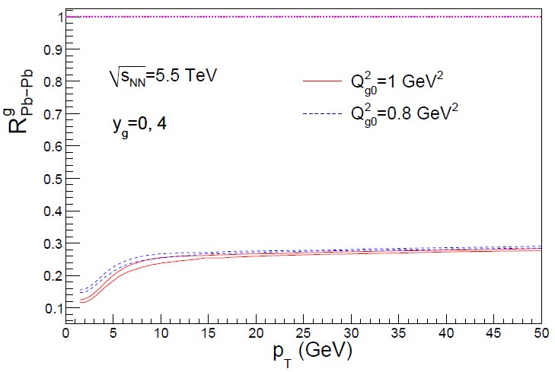
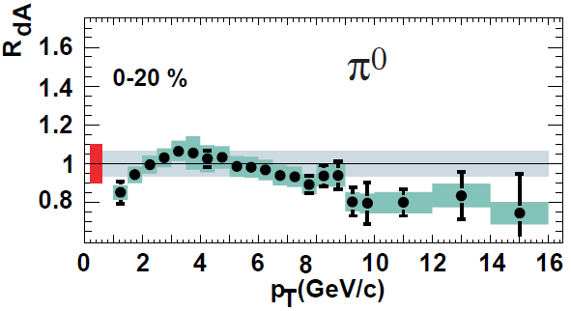
Rise in R_{AA} a Final State Effect?
  Is rise really due to pQCD?
  Or other quench (flat?)
+ initial state CNM effects a la CGC?
Y-J Lee, QM11
Albacete and Marquet, PLB687 (2010)
Require p + A and/or direct γ
PHENIX PRL98, 2007

Slide 44
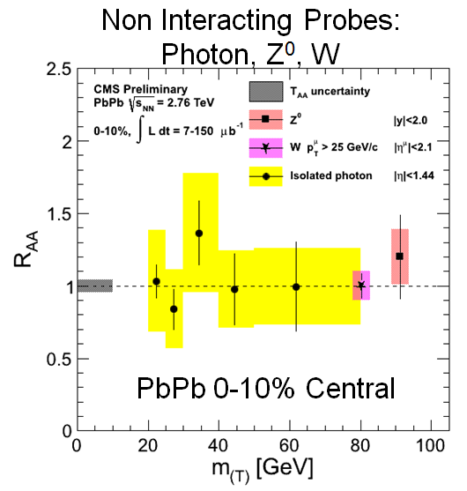

Null IS at LHC
Direct photon R_{AA} ~ 1
  Soon add’l p + A null control exp.
    CNM E-Loss?
C Roland, HP2012
D Perepelitsa, HP2012

Slide 45

Null IS at RHIC
Direct photon R_{AA} ~ 1; E-loss irr of hadron m

