Slide 1


Studying Hot Many Body QCD
W. A. Horowitz
University of Cape Town
June 25, 2012
With many thanks to Razieh Morad,
Miklos Gyulassy, and Yuri Kovchegov

Slide 2

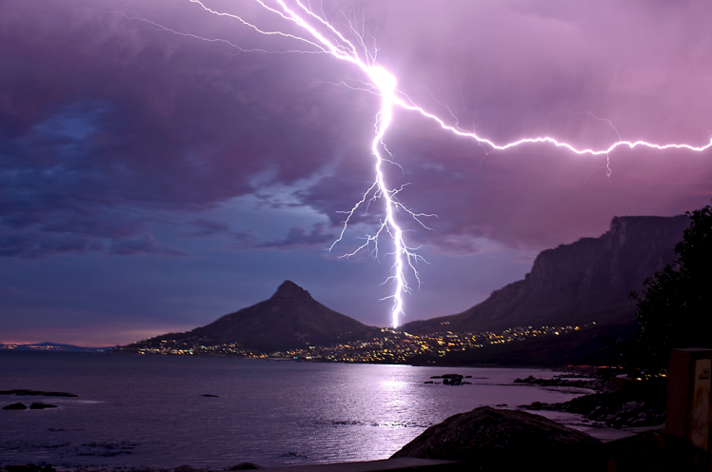


Four Known Forces
Gravity
Electromagnetism
starchild.gsfc.nasa.gov
John Maarschalk, travelblog.portfoliocollection.com
Weak
Strong
lhs.lps.org/staff/sputnam/chem_notes/tritium_decay.gif

Slide 3

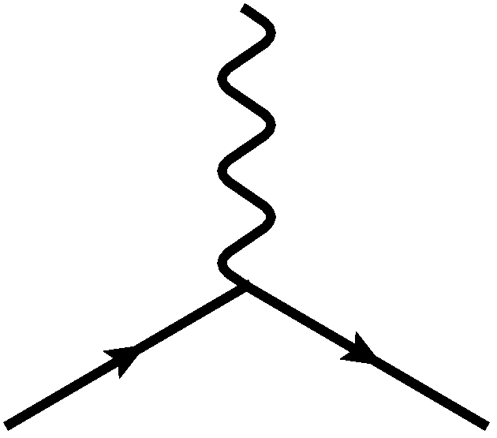
E&M Particle Physics Well Understood
Lagrangian known:
QED Vertex:
Ex. of Precision QED: g - 2
Gabrielse et al., PRL97 (2006)
Hanneke, Fogwell, and Gabrielse, PRL100 (2008)

Slide 4
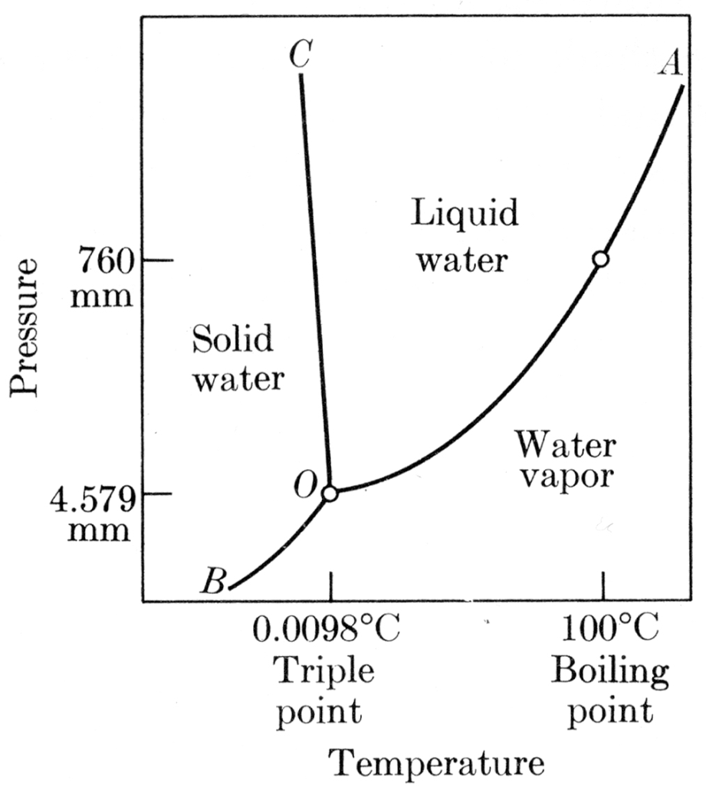

E&M and Phase Diagrams
Nontrivial emergent many-body physics
Water
Hydrogen
Calculated, Burkhard Militzer,
Diploma Thesis, Berlin, 2000

Slide 5




QCD Particle Physics Well Understood
Lagr. known:
QCD Vertices:
Qual. & Quant. agreement w/ data
ALEPH,
PLB284
(1992)
PDG

Slide 6

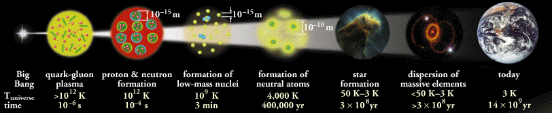
What Are We Interested In?
Measure many-body physics of strong force
Test & understand theory of many-body non-Abelian fields
Learn about the early universe
Long Range Plan, 2008
ALICE Collaboration
Notes:
Unique as compared to strongly coupled Abelian problems

Slide 7
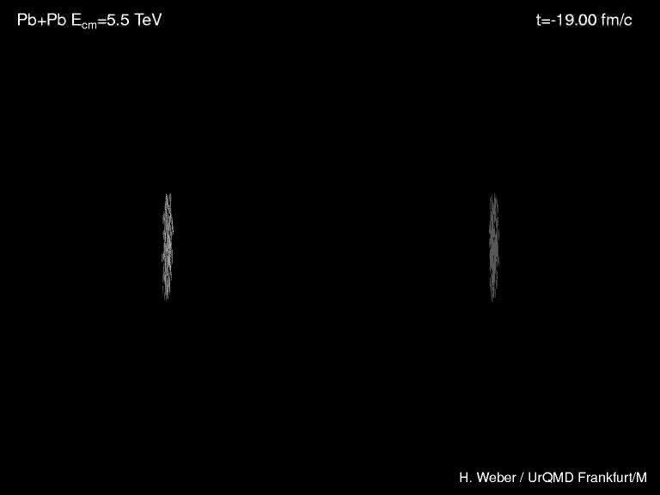
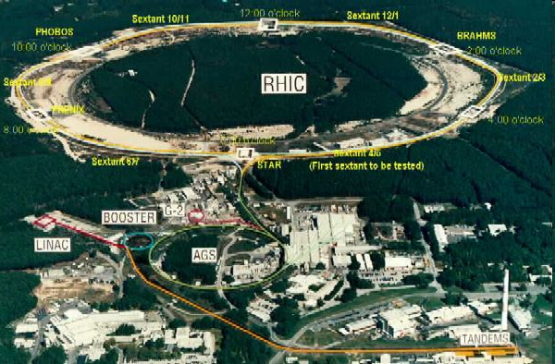
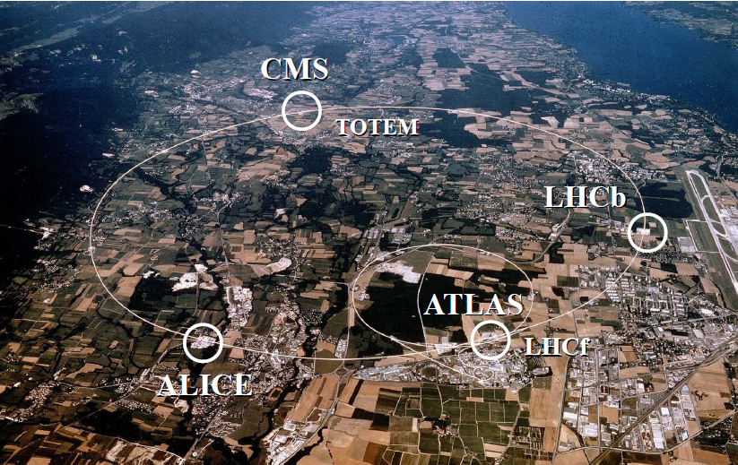
Heavy Ion Collisions
Collider machines: RHIC, LHC
Relativistic Heavy Ion Collider
Large Hadron Collider

Slide 8

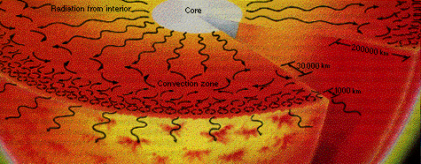
Orders of Magnitude
Units: MeV, GeV
  At RHIC, nuclei acc. to 100 GeV per nucleon
    Energy of collision ~ two mosquitoes colliding
  T_{c} ~ Λ_{QCD} ~ 200 MeV
    Temp. at RHIC ~ 10,000 times hotter than the core of the sun (15,000,000 Kelvin)
www.answersingenesis.org
Chaisson and McMillan,
Astronomy Today (1993)

Slide 9
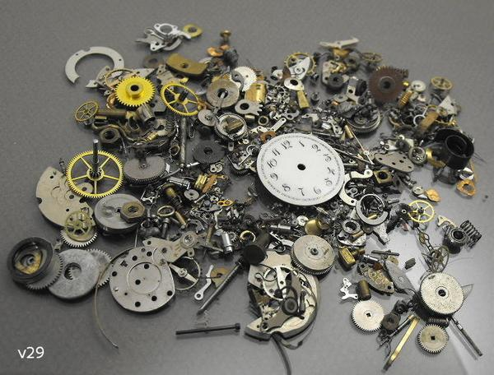


Pessimist’s View

Slide 10
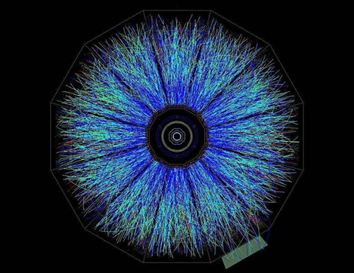
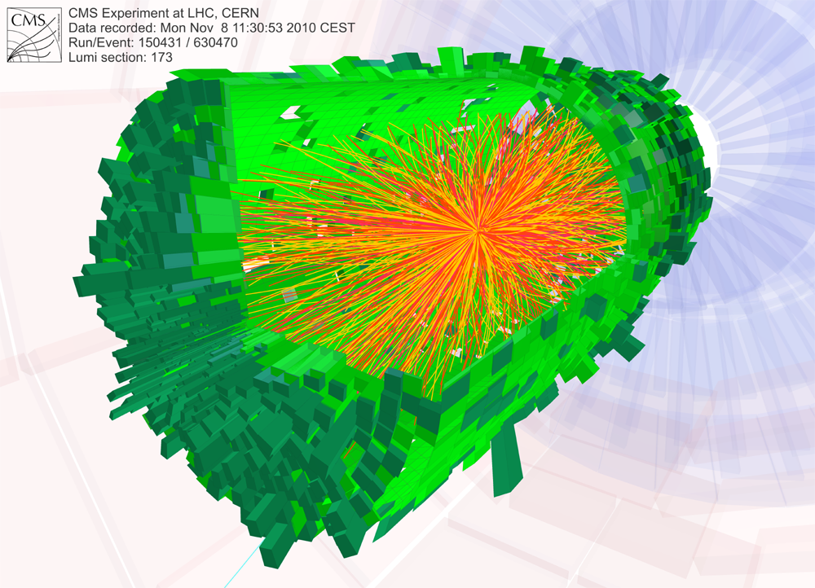
Actual Reconstructed Events
RHIC
LHC
STAR
CMS

Slide 11
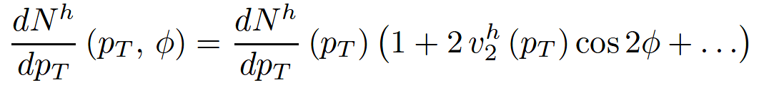

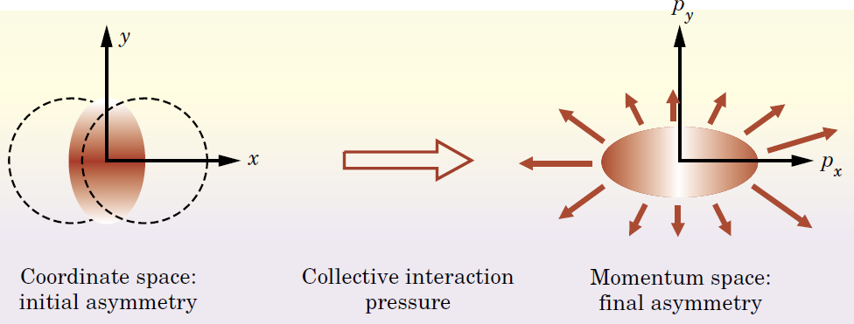
Geometry and Flow
Qualitative picture:
  Anisotropic initial
  geometry =>
  anisotropic flow
M Kaneta, Results from
the Relativistic Heavy
Ion Collider (Part II)
T Ludlum and L McLerran,
Phys. Today 56N10 (2003)

Slide 12
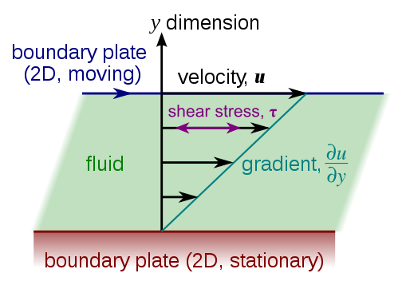
Viscous Relativistic Hydrodynamics
Viscosity reduces elliptic flow
  Naive pQCD => η/s ~ 1
  Naive AdS/CFT => η/s ~ 1/4π
Shear Viscosity, Wikipedia
Luzum and Romatschke,
Phys.Rev.C78:034915,2008

Slide 13


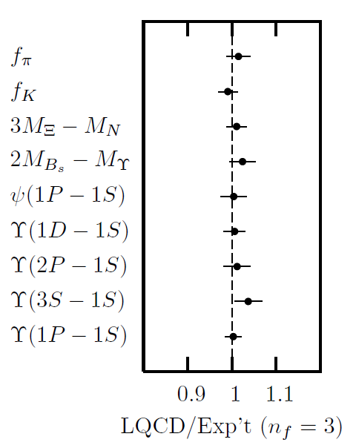
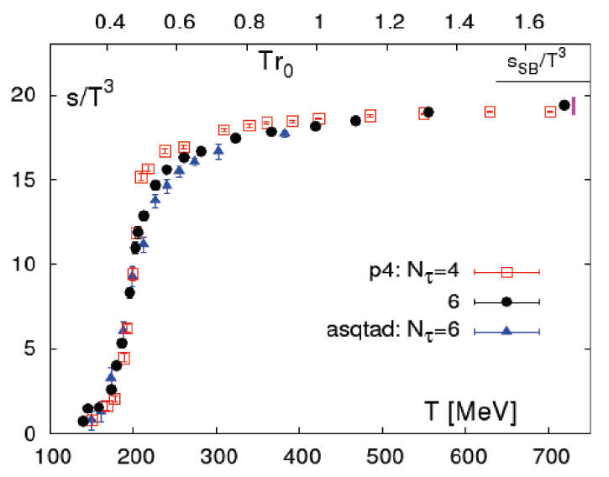
Methods of QCD Calculation I: Lattice
Long Range Plan, 2008
    All momenta
    Euclidean correlators
Cheng et al., PRD77 (2008)
Davies et al. (HPQCD),
PRL92 (2004)

Slide 14


Methods of QCD Calculation II: pQCD
(perturbative QCD)
d’Enterria, 0902.2011
Jäger et al., PRD67 (2003)
    Any quantity
    Small coupling (large momenta only)

Slide 15




Methods III: AdS/CFT
Maldacena conjecture: SYM in d ⬄ IIB in d+1
Gubser, QM09
    All gauge-invariant quantities
    N_{c} → ∞ SYM, not QCD
      Probably not good approx. for p+p; maybe A+A?
    Applicable to condensed matter systems?
Notes:
Next up, experiments!

Slide 16
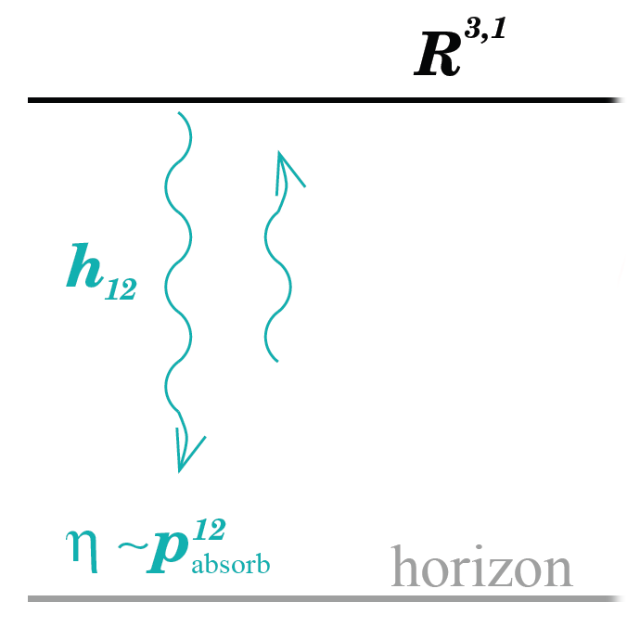
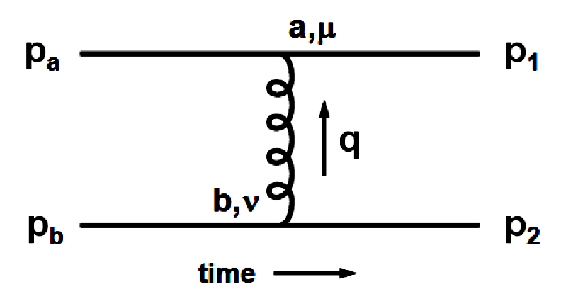
Leading Order η/s Calculation
Naive pQCD Picture
  All couplings weak
  => η/s ~ 1
Naive AdS/CFT Picture
  All couplings large
  => η/s ~ 1/4π
Gubser, QM09

Slide 17

Why High-p_{T} Jets?
Tomography in medicine
One can learn a lot from a single probe…
and even more with multiple probes
SPECT-CT Scan uses internal γ photons and external X-rays
PET Scan
http://www.fas.org/irp/imint/docs/rst/Intro/Part2_26d.html

Slide 18

Tomography in QGP
Requires well-controlled theory of:
  production of rare, high-p_{T} probes
    g, u, d, s, c, b
  in-medium E-loss
  hadronization
Requires precision measurements of decay fragments
p_{T}
, γ, e⁻
φ
Invert attenuation pattern => measure medium properties

Slide 19


QGP Energy Loss
Learn about E-loss mechanism
  Most direct probe of DOF
pQCD Picture
AdS/CFT Picture

Slide 20

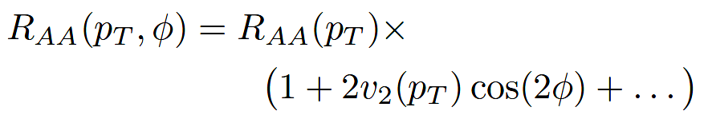
High-p_{T} Observables
    Naively: if medium has no effect, then R_{AA} = 1
    Common variables used are transverse momentum, p_{T}, and angle with respect to the reaction plane, φ
p_{T}
, γ, e⁻
    Fourier expand R_{AA}:
φ

Slide 21

pQCD Success at RHIC:
(circa 2005)
Y. Akiba for the PHENIX collaboration, hep-ex/0510008
  Consistency: R_{AA}(η)~R_{AA}(π)
  Null Control: R_{AA}(γ)~1
  GLV Prediction: Theory~Data for reasonable fixed L~5 fm and dN_{g}/dy~dN_{π}/dy

Slide 22

Qualitative Disagreement
Mass of quarks should be important
  Expect heavy quarks to lose less energy
Non-photonic electrons (NPE) surprisingly suppressed
  Decay fragments of c and b quarks
PHENIX NPE
e⁻
Djordjevic,et al. PLB632 (2006)

Slide 23


What About Elastic Loss?
Appreciable!
Finite time effects small
Mustafa, PRC72 (2005)
Adil, Gyulassy, WAH, Wicks, PRC75 (2007)

Slide 24
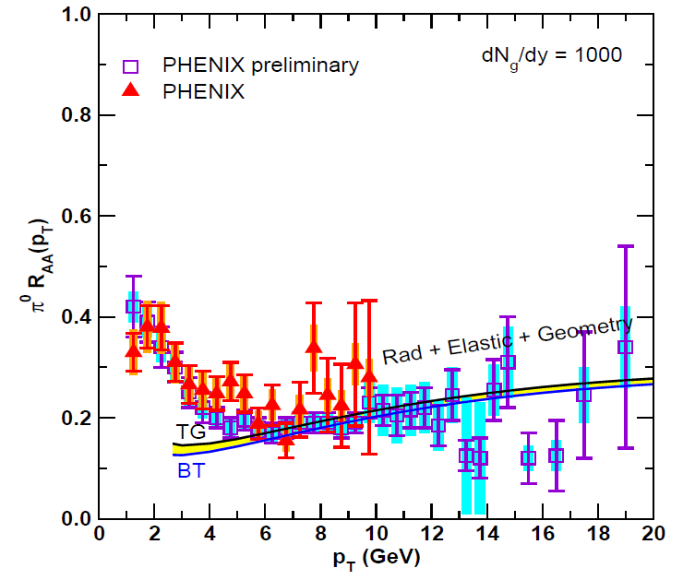
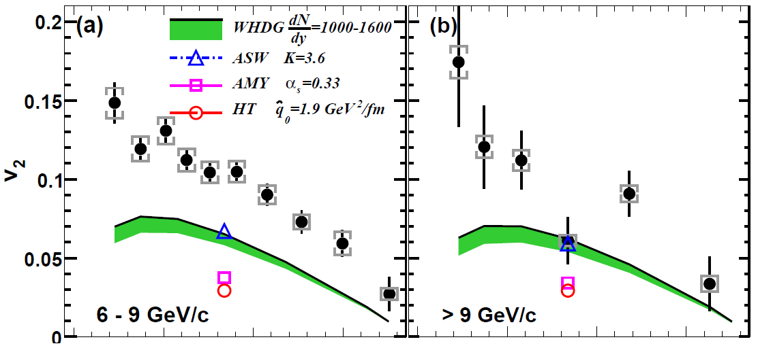
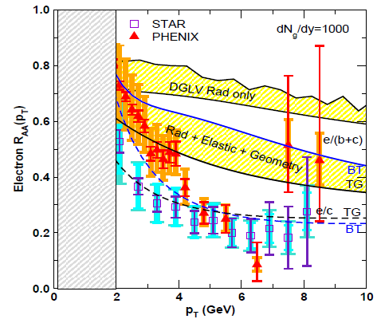
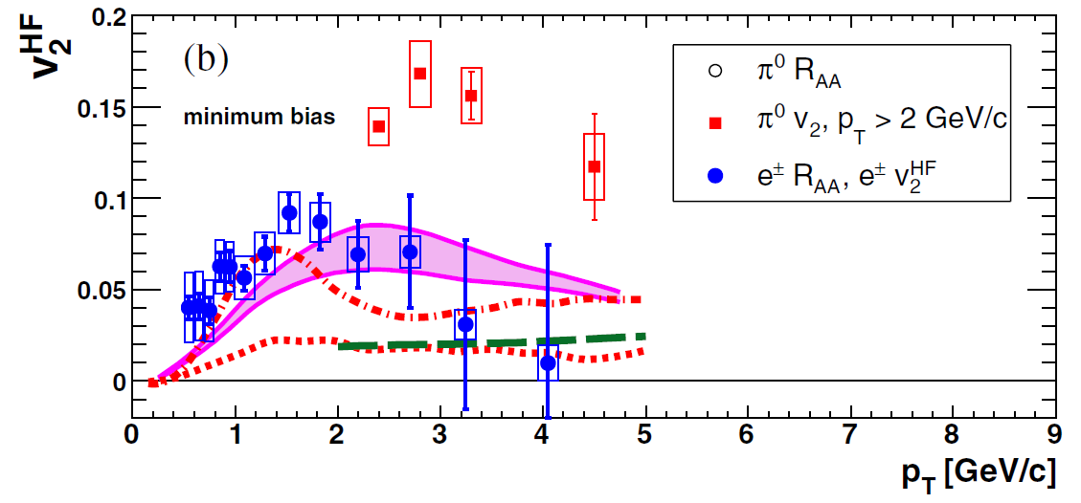
pQCD Picture Inadequate at RHIC?
PHENIX, PRL 105 (2010)
PHENIX, PRL 98 (2007)
Pert. at LHC energies?
Wicks et al., NPA784, 2007

Slide 25
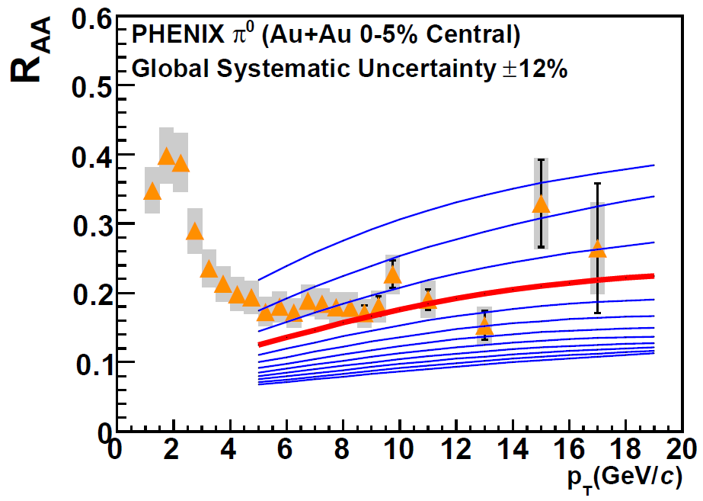
Constrain to RHIC
Best fit WHDG to PHENIX π⁰ R_{AA}
  dN_{g}/dy = 1400⁺²⁰⁰
  1400₋₃₇₅
PHENIX, PRC77 (2008)
Extremely conservative zero parameter extrapolation to LHC
  Assume ρ_{medium} ~ dN_{ch}/dη
  Keep α_{s} = 0.3 fixed

Slide 26
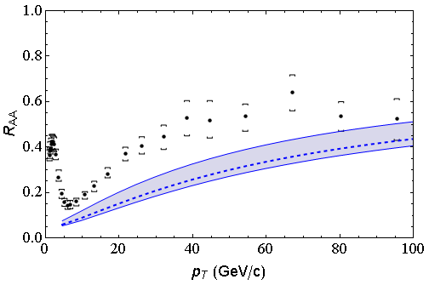
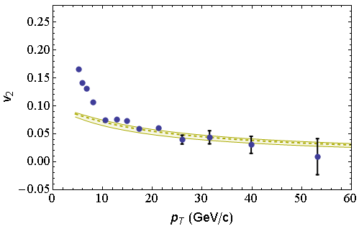
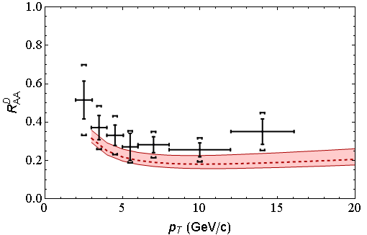
LHC Predictions vs. Data
CMS 0-5%
h±
CMS 40-50%
h±
CMS, arXiv:1202.2554
CMS, arXiv:1204.1850
ALICE 0-20%
D
All data preliminary
√s = 2.76 ATeV
ALICE, arXiv:1203.2160

Slide 27
Quant. (Qual?) Conclusions Require...
Further experimental results
Theoretically, investigation of the effects of
  higher orders in
    α_{s} (large)
    k_{T}/xE (large)
    M_{Q}/E (large?)
    opacity (large?)
  geometry
    uncertainty in IC (small)
    coupling to flow (large?)
    Eloss geom. approx. (?)
    τ < τ₀ (large: see Buzzatti and Gyulassy)
    dyn. vs. static centers (see Djordjevic)
    hydro background (see Renk, Majumder)
  better treatment of
    Coh. vs. decoh. multigluons (see Mehtar-Tani)
    elastic E-loss
    E-loss in confined matter

Slide 28
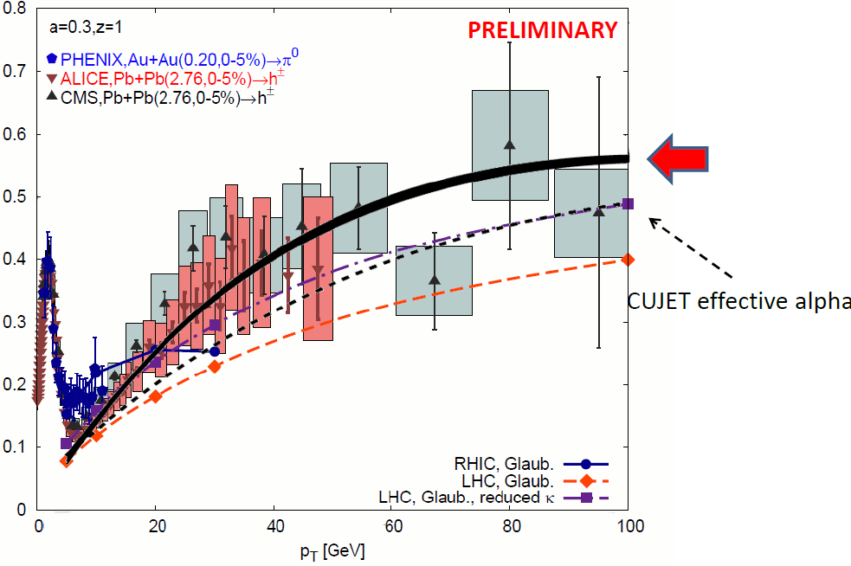
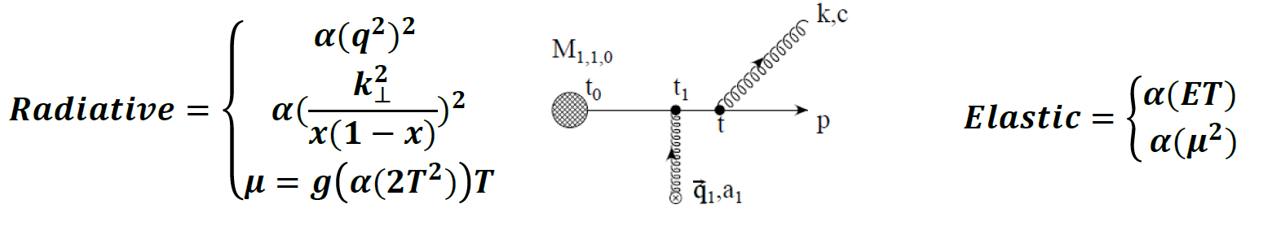
Attempt at NLO
Running coupling ansatz
A Buzzatti, HP2012

Slide 29
Heavy Quark E-Loss in AdS/CFT
Model heavy quark jet energy loss by embedding string in AdS space
  dp_{T}/dt = - μ p_{T}
  μ = πλ^{1/2} T²/2M_{q}
  Similar to Bethe-Heitler
    dp_{T}/dt ~ -(T³/M_{q}²) p_{T}
  Very different from usual pQCD and LPM
    dp_{T}/dt ~ -LT³ log(p_{T}/M_{q})
J Friess, S Gubser, G Michalogiorgakis, S Pufu, Phys Rev D75 (2007)

Slide 30
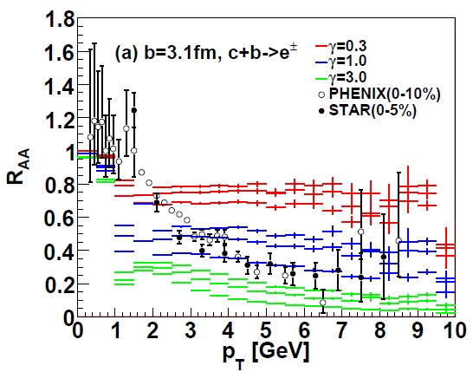
AdS/CFT and HQ at RHIC
String drag: qualitative agreement in heavy flavor sector
WAH, PhD Thesis
Akamatsu, Hatsuda, and Hirano, PRC79, 2009

Slide 31
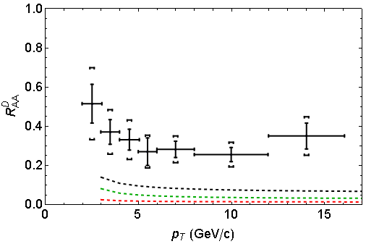
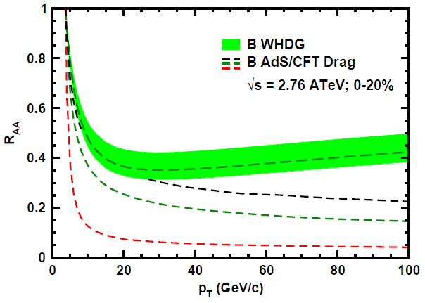
AdS/CFT and HQ at LHC
D Predictions
B Predictions
ALICE 0-20%
D
CMS B→J/ψ
WAH, PANIC11 (arXiv:1108.5876)
ALICE, arXiv:1203.2160
CMS, JHEP 1205 (2012) 063
AdS HQ Drag appears to oversuppress D
Roughly correct description of B→J/ψ

Slide 32
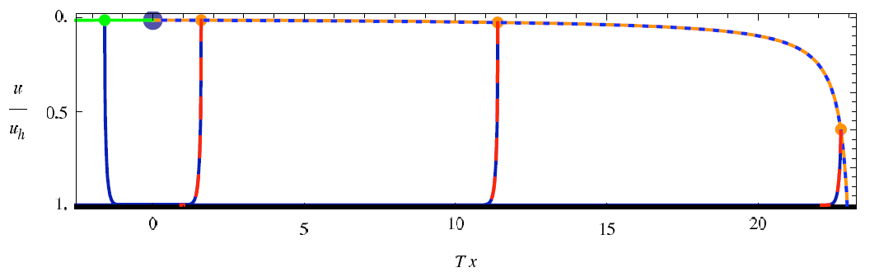
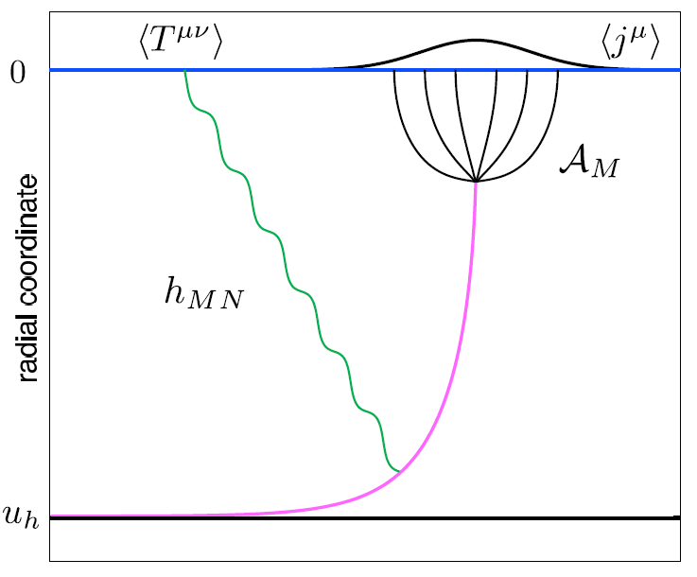
Light Quark E-Loss in AdS
Chesler et al., PRD79 (2009)
Complications:
  string endpoints fall
    => painful numerics
  relation to HI meas.
    less obvious than HQ
In principle, compute T^{μν} from graviton emission
  Extremely hard

Slide 33
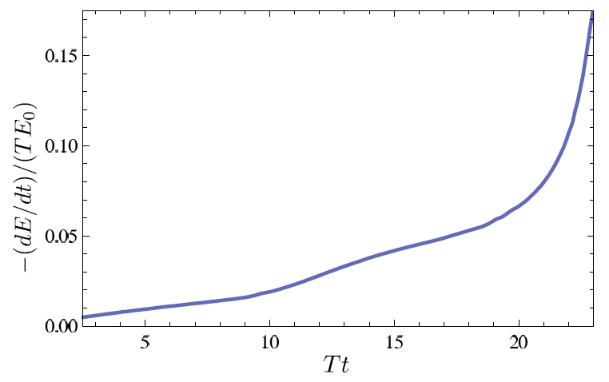
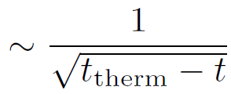

dE/dt for Lights from AdS/CFT
Original definition + original energy loss calculation => generic Bragg peak
  Intermediate-t dE/dt depends strongly on IC
Chesler et al., PRD79 (2009)
See also: Gubser et al., JHEP 0810 (2008) Arnold and Vaman, JHEP 1010 (2010)

Slide 34

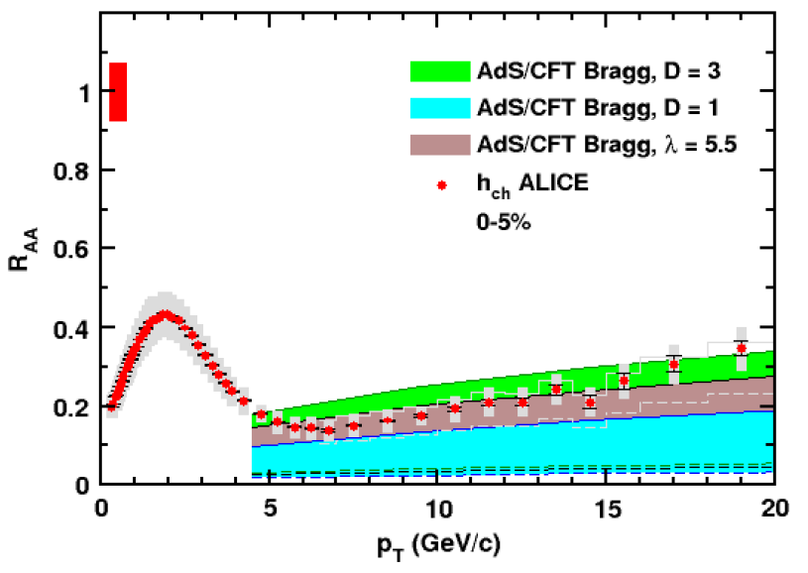
AdS/CFT Light Parton Energy Loss
Simple Bragg Peak Model
  E_{f} ~ θ(t_{therm} – t)
    Large uncertainty due to T(t)
0.2 TeV
2.76 TeV
WAH, JPhysG38 (2011)

Slide 35

AdS/CFT Light q E-Loss
Static thermal medium => very short therm. time
  τ_{th} ~ 2.7 fm
    AdS likely oversuppresses compared to data
Examine T ~ 1/τ^{1/3} geom
  τ_{th} ~ 4.1 fm
0.2 TeV
R Morad
2.76 TeV
WAH, JPhysG38 (2011)
Simple Bragg peak model

Slide 36
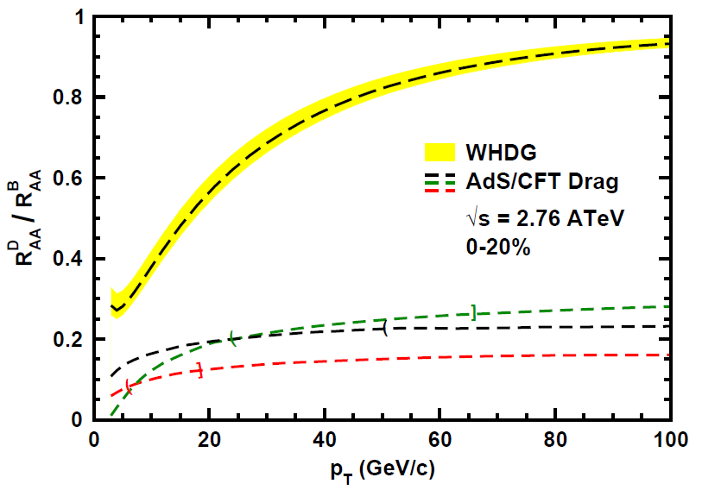
Does pQCD or AdS Yield Correct Mass & Momentum Dependecies at LHC?
WAH, PANIC11 (arXiv:1108.5876)
      T(τ₀): “(”, corrections likely small for smaller momenta
      T_{c}: “]”, corrections likely large for higher momenta
See also:
WAH, M. Gyulassy, PLB666 (2008)

Slide 37


Not So Fast!
D7 Probe Brane
Q
  Speed limit estimate for applicability of AdS drag
    γ < γ_{crit} = (1 + 2M_{q}/λ^{1/2} T)²
    ~ 4M_{q}²/(λ T²)
      Limited by M_{charm} ~ 1.2 GeV
    Similar to BH LPM
      γ_{crit} ~ M_{q}/(λT)
  Importance of longitudinal momentum fluctuations
    <(Δp_{L})²> = π λ^{1/2} T³ γ^{5/2}
      (<(Δp_{L})²>)^{1/2} ~ p_{L} => γ_{crit} ~ M_{q}/(4 T)
    Decorrelation of HF?
Worldsheet boundary Spacelike if γ > γ_{crit}
x₅
Trailing
String
“Brachistochrone”
“z”
D3 Black Brane

Slide 38
AdS HQ E-Loss in Cold Nuclear Matter
Constant T Thermal Black Brane
Shock Geometries
P Chesler,
Quark Matter 2009
Nucleus as Shock
DIS
Embedded String in Shock
Albacete, Kovchegov, Taliotis,
JHEP 0807, 074 (2008)
Before
After
v_{shock}
z
Q
v_{shock}
z
Q
x
x
WAH and Kovchegov, PLB680 (2009)

Slide 39
Putting It All Together
This leads to
Can test AdS HQ E-Loss in both hot and cold nuclear matter!
  Recall for BH:
  Shock gives exactly the same drag as BH for Λ = π T
    Λ is typical mom. scale of nucleus

Slide 40
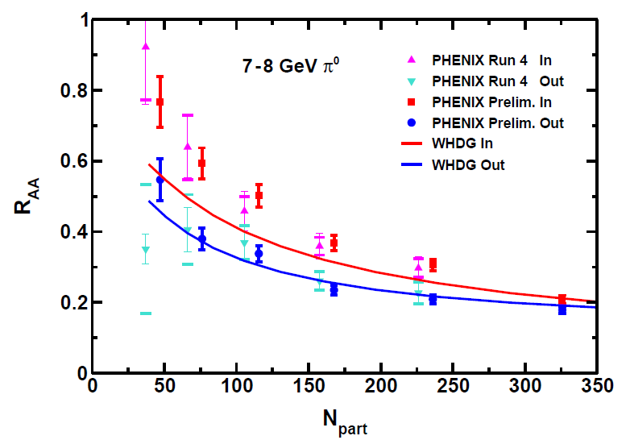
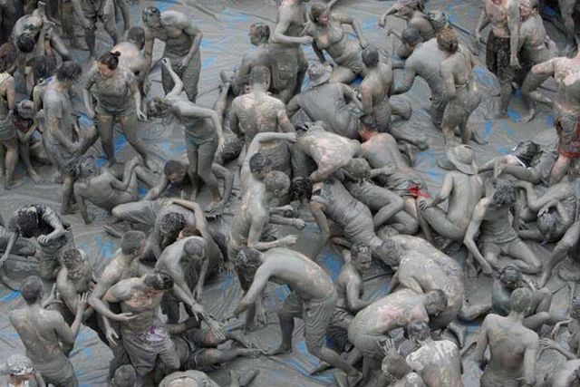
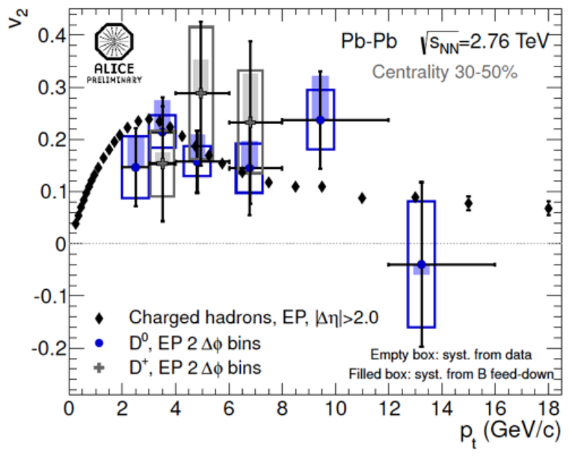
Intermediate-p_{T} Muck at RHIC and LHC
Messy (non-perturbative) physics below ~ 10 GeV/c
P Jacobs, HP2012

Slide 41
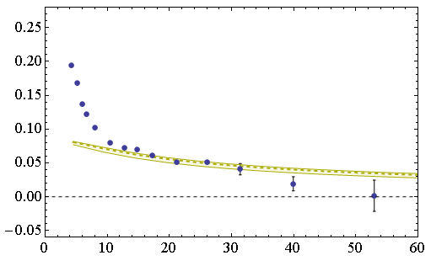

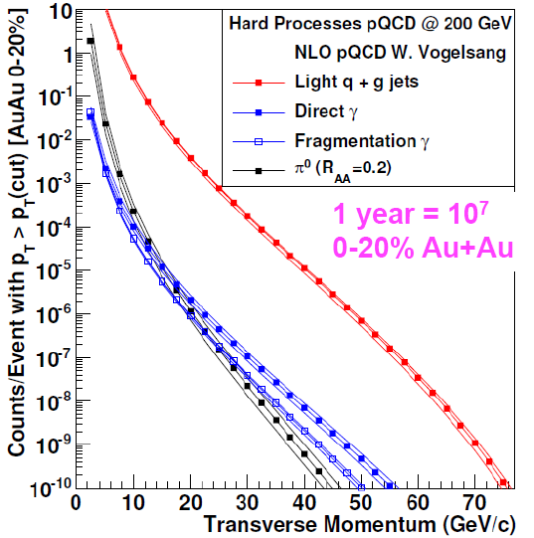
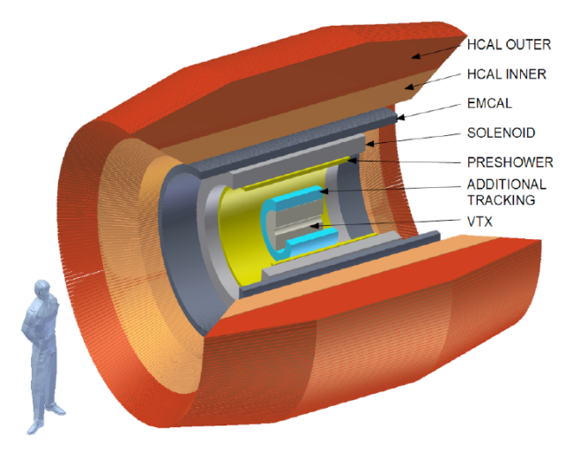
Clean & Clear High-p_{T} Probes
CMS 40-50%
h±
v₂
p_{T} (GeV/c)
  RHIC
    HF sep.
    sPHENIX
  LHC
    High-p_{T} HF
      R_{AA}, v₂, corr.
    Control p+A
      CNM AdS
B Cole, HP2012

Slide 42
Conclusions
High-energy many-body QCD is interesting
Much progress made
  η/s
  Energy Loss
Much work to be done!
  Higher order theory
  RHIC upgrades
  New LHC measurements
  EIC, LHeC, ...

Slide 43
Backup Slides

Slide 44
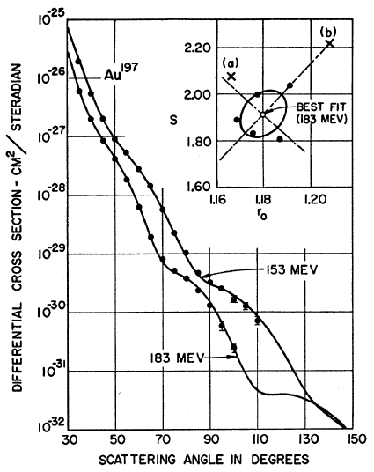
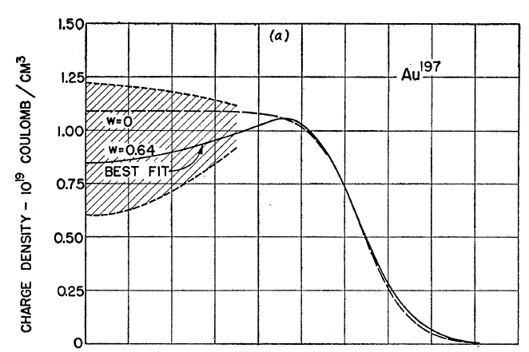
Measuring the IC
eRHIC could give experimental handle on initial geometry
  Recall e + A diffraction exps. on A at rest
Hahn, Ravenhall, and Hofstadter, Phys Rev 101 (1956)

Slide 45
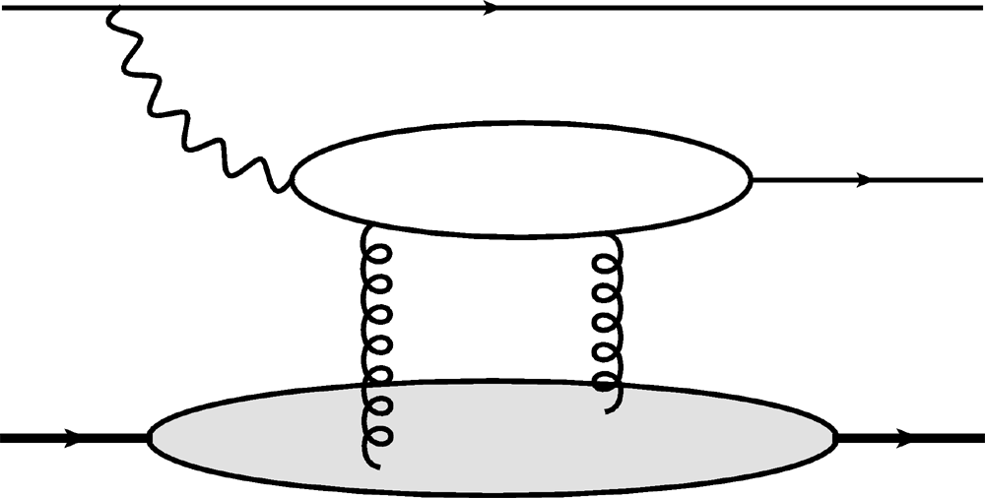
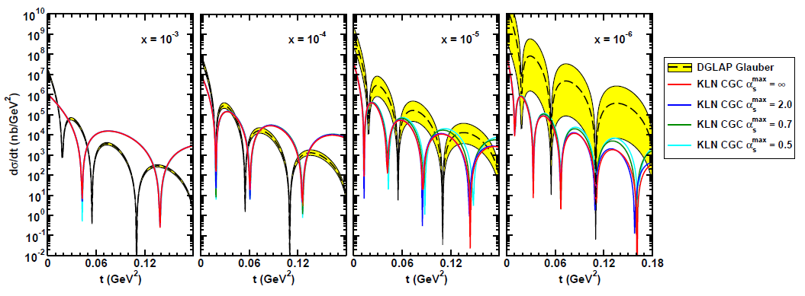
Gluon Distribution of A at x ~ 10⁻³
e
e
γ*
J/ψ
Coherent vector meson production in e + A
A
A
Must reject incoherent
collisions at ~100%
WAH, arXiv:1102.5058

Slide 46
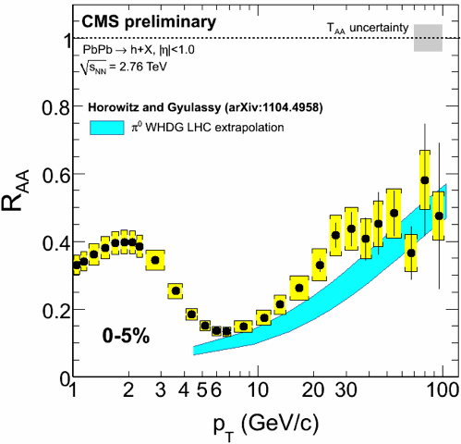
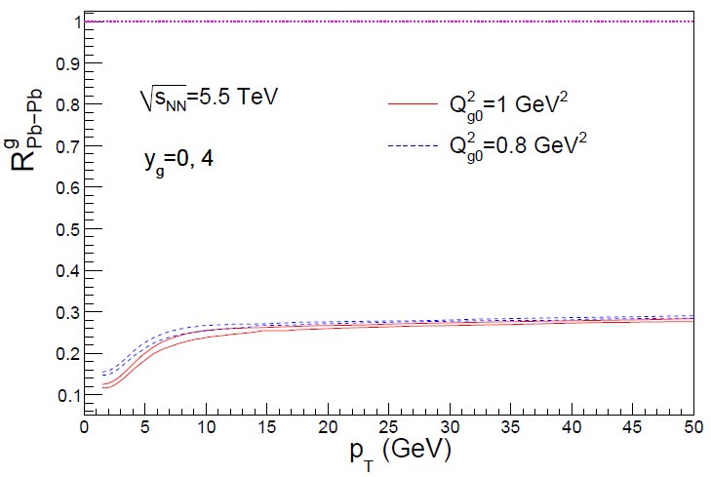

Rise in R_{AA} a Final State Effect?
  Is rise really due to pQCD?
  Or other quench (flat?)
+ initial state CNM effects a la CGC?
Y-J Lee, QM11
Albacete and Marquet, PLB687 (2010)
Require p + A and/or direct γ
PHENIX PRL98, 2007

Slide 47


Null IS at LHC
Direct photon R_{AA} ~ 1
  Soon add’l p + A null control exp.
    CNM E-Loss?
C Roland, HP2012
D Perepelitsa, HP2012

