Slide 1
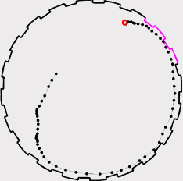
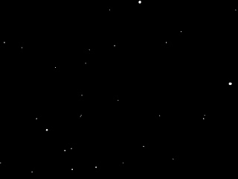
Physics of transport modelling in tumbling mills
G. B. Tupper

Slide 2
Research interests
Particle physics
Quantum field theory
String theory & braneworld
General relativity, Cosmology, Dark Matter & Dark Energy
Unification of dark matter and dark energy: The Inhomogeneous Chaplygin gas.
Neven Bilic, Gary B. Tupper, Raoul D. Viollier, (Cape Town U.) . Nov 2001. 10pp.
Published in Phys.Lett.B535:17-21,2002.
e-Print: astro-ph/0111325
TOPCITE = 250+ Cited 406 times
Transport modelling in industry

Slide 3
Outline
What are tumbling mills
Ad-hoc approaches to transport
New theory for transport
What is PEPT
Preliminary analysis of PEPT data
Conclusions & prospects

Slide 4

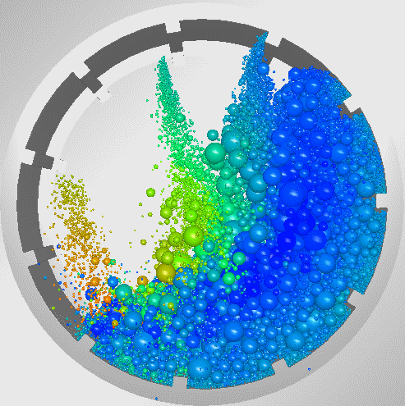
Autogenuous (AG) & Semi-autogenuous (SAG) mills
Notes:
$ [solid move]
$ Guess generalized Darcy
$ Involves relative velocity: superficial fluid velocity and “solids velocity “ V

Slide 5
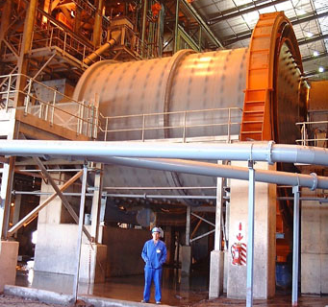
Tumbling Mills
Minerals industry (gold, platinum, copper, etc …)
1st stage of above ground mineral beneficiation
  Size reduction
  Expose valuable mineral
15% of power consumption in SA
60% of operation cost
Models are empirical
  Cannot extrapolate
  Mill specific
  Ore specific
Notes:
Want to develop models based on the mechanical environment of a tumbling mill.
DEM is only tool capable of doing this.

Slide 6
Approaches to modelling
Empirical: model, pilot & full scale mills – fit operating parameters
Computational: Discrete Element Method + Smoothed Particle Hydrodynamics or Computational Fluid Dynamics
Mechanistic: get the physics right

Slide 7
Packed static bed: Darcy’s Law
Notes:
$ Experimentally verified!
Applies to creeping flow (no inertial effects); relates pressure drop, viscosity, and superficial fluid velocity; “K” is “hydraulic conductivity.

Slide 8
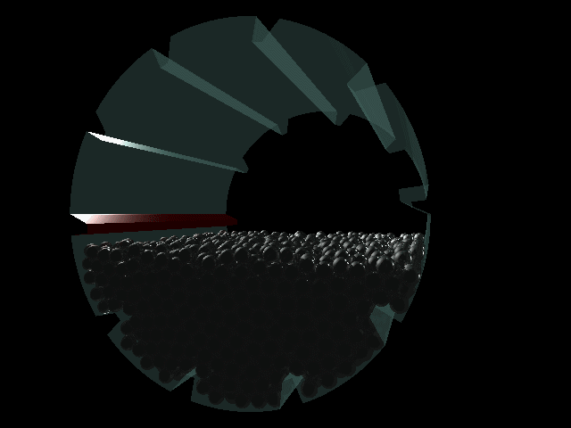
Real mills are not static packed beds

Slide 9
Dynamic bed ?
Notes:
$ [solid move]
$ Guess generalized Darcy
$ Involves relative velocity: superficial fluid velocity and “solids velocity “ V

Slide 10
Ad-hoc Model:
“Ergun Moving Bed”
Moving capillary
Assume
(as per Ergun,1952)
as given by capillary models
with tortuosity
Notes:
Or ‘Straw man’ model
$This is just what is done in studies of fluidized beds but there the porosity is often near unity and then a different correlation (Wen-Yu) is used
$ie creeping flow truncation, drop inertial (Burke-Plummer) part
$ This is just Carmen-Kozeny
$Carmen-Kozeny is based on capillary picture but in the dynamic bed there are no “capillaries” so one is (literally) on shaky grounnd And, the 0.24 is a fit involving the “tortuosity” parameter!!

Slide 11
Theory for dynamic bed
Must reproduce the result of Yoon & Kunii, 1970: for moving packed bed relevant velocity is slip velocity
Start from Navier-Stokes equations
Notes:
What one want a real theory!!
$ There is one piece of experiment to go by [they looked at vetrical downward flow of packed solids against upward flow of gas; found pressure drop constant at fixed slip velocity]
$Slip velocity has porosity factor in front of the solids velocity; at large porosity it approximates the relative velocity
We don’t want to follow ‘tortuous path’
$Minimal assumptions: incompressible, newtonian fluid; “no-slip” boundary conditions at solids surfaces.
Too much detailed info

Slide 12
Compare
Electrodynamics
Fluid mechanics
Maxwell’s equations
Newton’s 2nd law + Lorentz force
Particles source the fields
Ohm’s ‘law’ derived macroscopic
Navier-Stokes equations
Newton’s 2nd law + drag force
Particles effect fluid via boundary conditions
Darcy’s ‘law’ derived macroscopic

Slide 13
Theory for dynamic bed
Volume averaging
As for static bed
(Whitaker, 1999)
Time averaging
As for turbulence
Notes:
$ Consider some solids and fluid flowing around them
$ Enclose in say a box of total volume ‘fluid plus solids’
$Standard approach to deiiving Darcy’s law
$Complication: solids are not stationary
$Time average is very appropriate for PEPT!

Slide 14
Theory for dynamic bed
Combine volume and time averaging
Apply this to Navier-Stokes
Take T long enough – steady state
Drop inertial terms
Notes:
$Natural thing to do!
$This is how we understand & measure superficial fluid velocity
$Even for static bed the origin of the inertial term in Ergun is contravesial!
$ The last term is Brinkman’s modification of Darcy where superficial velocity varies from box to box
$ Formal result! Practical problem: how to evaluate drag

Slide 15
Theory for dynamic bed
Statistical evaluation of drag force : Cell Model (e.g. Happel, 1958; Kuwabara, 1959)
Solution of Stokes’ equations
Inner boundary condition: no slip
Outer boundary condition:
zero vorticity
New: cell average condition
Notes:
$ Fluid flows through a statistically representative spherical shell
$ Inner surface is the statistically representative solid
$ Outer surface accounts for the effect of the other particles
$ Ratio of radii related to porosity and “solidisity”
$ Time independent, spherically symmetric; four constants
$ Drag force only depends on one of the four
To fix the constants requires four conditions
$ Natural at the real solid surface, two component conditions
Cell models differ by outer boundary conditions
>Happel model has fixed free surface (two) conditions, moving solid & leads to relative velocity
$ As in Stokes flow but here “infinity” is outer boundary; this is 1 condition
>>Kuwarara took this and imposed that radial fluid velocity equals its value at infinity (whatever that means)
Need one more condition
$ Key point: this is the natural thing to do

Slide 16
Cell Averaged Model
(Drop Brinkman term)
Notes:
Brinkman unimportant if scale of variations of superficial velocity is large compared to specific surface
$ Cell averaging give slip velocity automatically
$No ad-hoc assumptions (capillaries, tortuosity, etc)
No free parameters

Slide 17
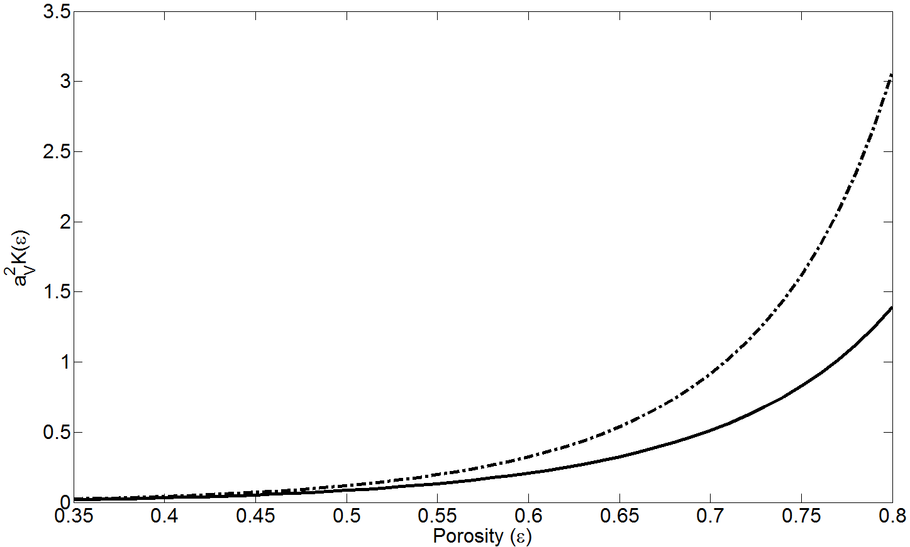
_____ Cell Averaging Model
−⋅ −⋅ −⋅ Ergun

Slide 18
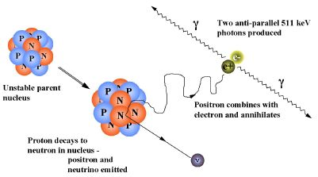
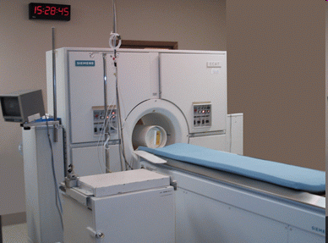
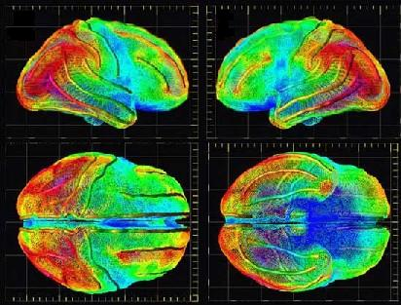
Positron Emission Tomography (PET)
Notes:
Developed initially for the medical industry.
Radioactive fluid (F-18) is injected into region of interest.
Radioactive nuclei emit positrons.
Positrons encounter the electron cloud – collide, annihilate, produce a pair of 511KeV back-to-back gamma rays which are recorded by the PET camera
The accumulation of these lines over time is used to construct a 3D density image.
Limited to static systems.

Slide 19
Positron Emission Particle Tracking (PEPT)
Parker et al 1993
γ
γ
Notes:
So what do we use it for?
Imagine this was a slurry particle in a tumbling mill / flotation cell / IsaMill / Cyclone
If we gave this particle a specific activity, it would eject positrons (positively charged electrons) from the unstable nuclei
These positrons, on emerging from the nucleus, encounter the electron cloud.
The positron is quickly captured by an electron and consequently they annihilate
This produces a pair of back-to-back gamma rays that are exactly 511 KeV each
This happens several times per second

Slide 20
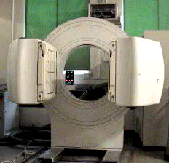
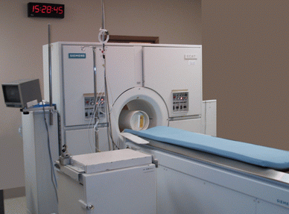
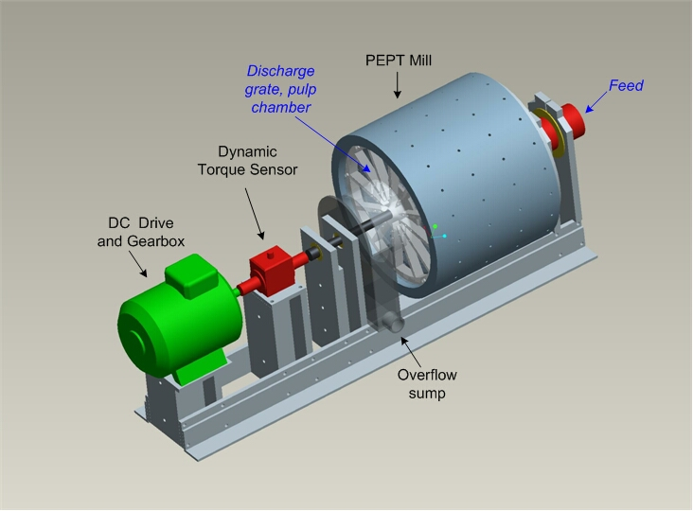
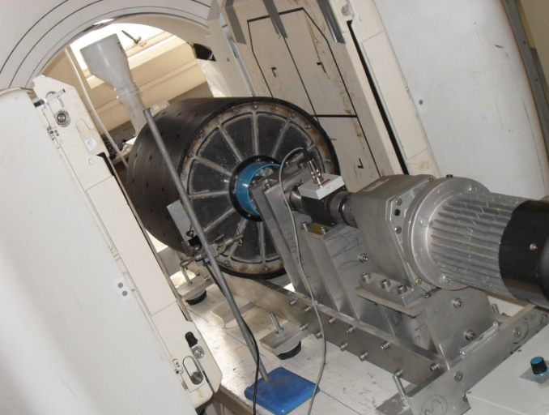
Positron Emission Particle Tracking

Slide 21
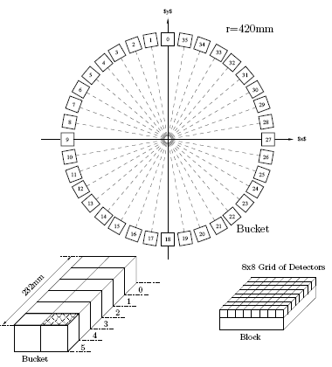
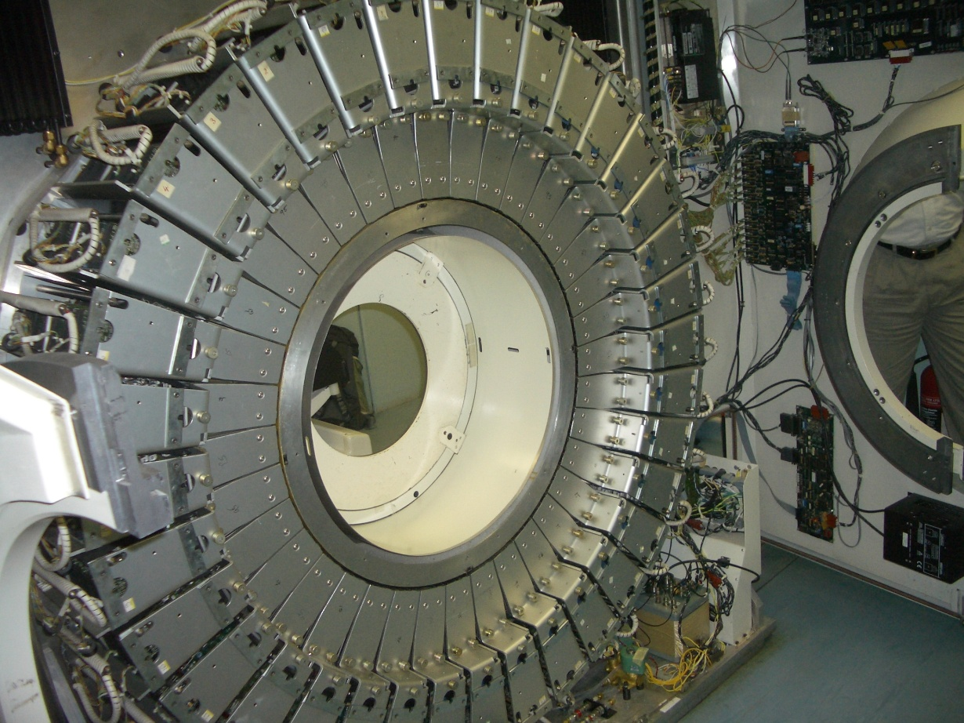
The NEW PET Camera at iThemba LABS, Cape Town
sourced from Hammersmith Hospital, Imperial College London
has 27 648 detector elements !
Detector Element size = 4.8mm x 4.8mm
Notes:
In the early 90’s, Siemens demonstrated their superiority in the medical imaging industry by building the highest resolution scanner. At the time it had approximately 10x more detector elements than any other scanner.
This was setup at Hammersmith Hospital, a world leading medical research facility. Siemens sponsored research at the lab. The scanner was used in brain imaging and produced several nature papers.
15 years later, General Electric are sponsoring the research facilities at Hammersmith Hospital, however, this high resolution scanner, now only 5x better than any other, sticks out like sore thumb.
This coupled with the fact that space is a premium in central London set in motion a series of events that culminated in the scanner being sold to us for £1 + tax.

Slide 22
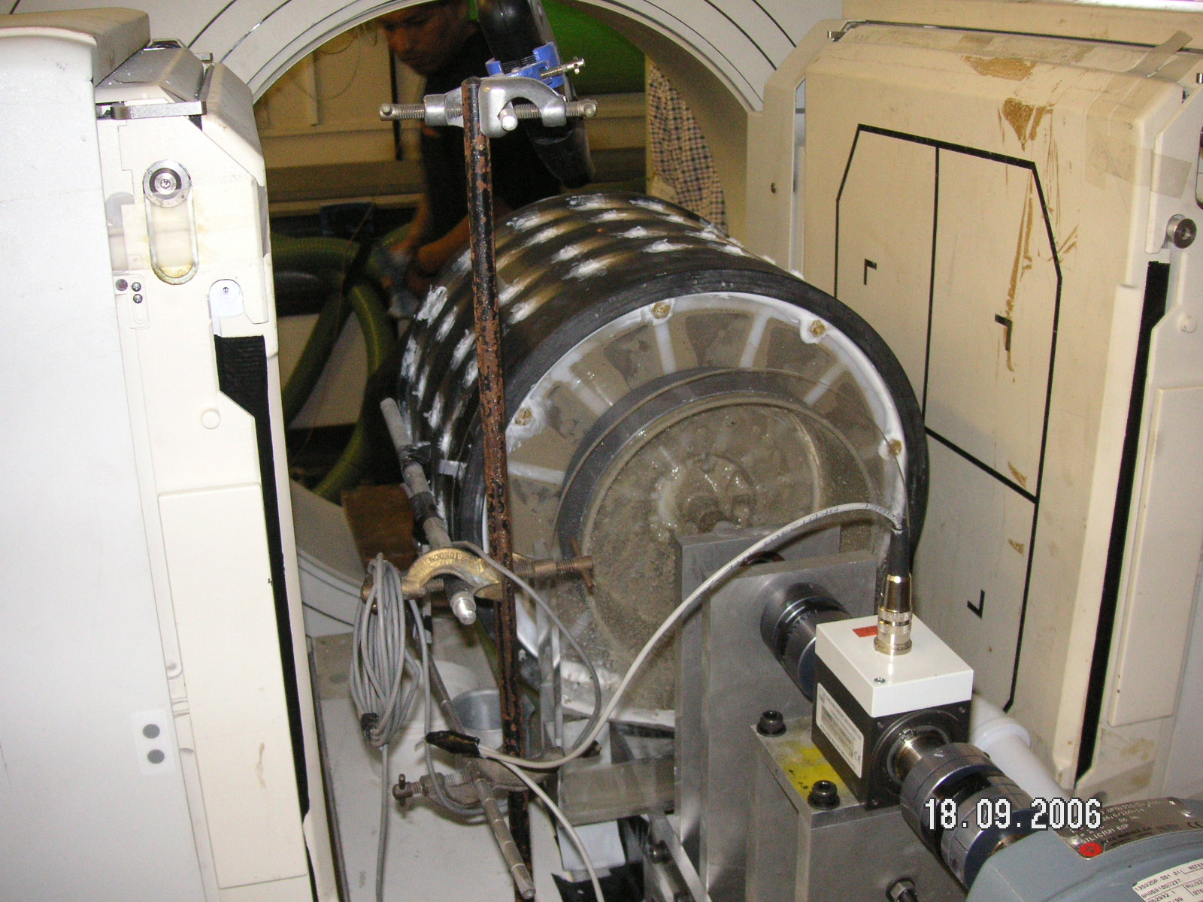
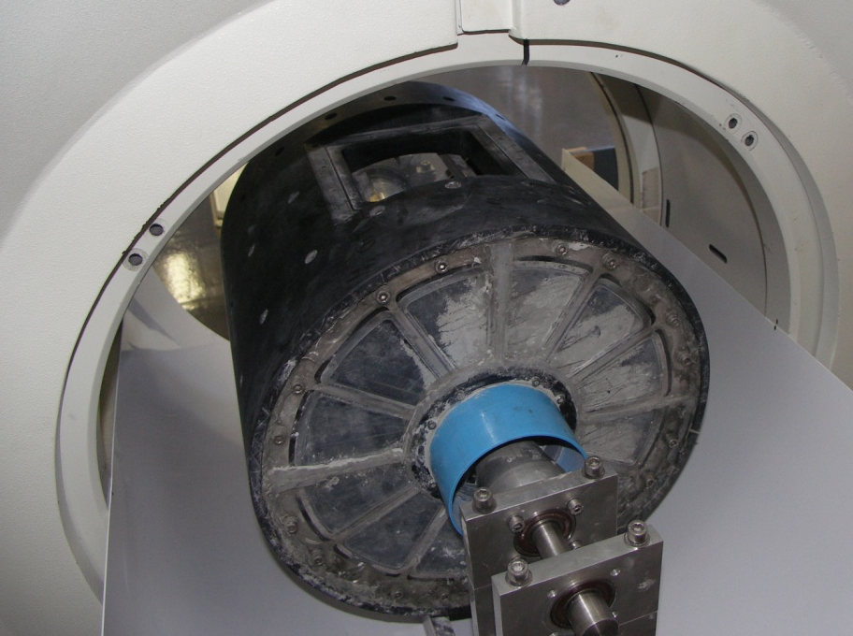
PEPT in Tumbling Mills
Scaled industrial system
  300 mm in diameter
  Real rocks, steel balls and slurry (up to 40% solids)
  Decouple breakage by using “conditioned rocks”

Slide 23
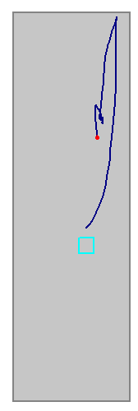
Ergodicity – Time Averaging
The assumption that the time averaged behaviour of a single particle is equivalent to the ensemble average of the bulk
Successive visits to each volume element are treated as if they are simultaneous.
Provides
  Time averaged velocity, acceleration
  Location Probability Density
  Mixing Indices

Slide 24
Description | 5mm glass + slurry
Internal mill diameter (m) | 0.3
Internal mill length (m) | 0.285
% volume fill (glass beads) | 31.25
Slurry solids concentration by volume (%) | 8
Slurry size fraction (µm) | -75 +53
Mass of 5mm glass beads (kg) | 10.2
Uncertainty, bead diameter (mm) | 0.3
Mass of water in mill (kg) | 2.3
Mass of slurry particles (kg) | 0.6
Density of glass beads (kg.m⁻³) | 2700
Density of slurry particles (kg.m⁻³) | 2800
Density of pulp (kg.m⁻³) | 1150
Mill speeds (rpm) | 46.3 57.9
Volumetric flow rate in (m³.s⁻¹) | 8.3 × 10⁻⁵
Volumetric flow rate out (m³.s⁻¹) | 8.2 × 10⁻⁵

Slide 25
Conjectured slurry flow pattern in a mill
Condori et al 2008

Slide 26
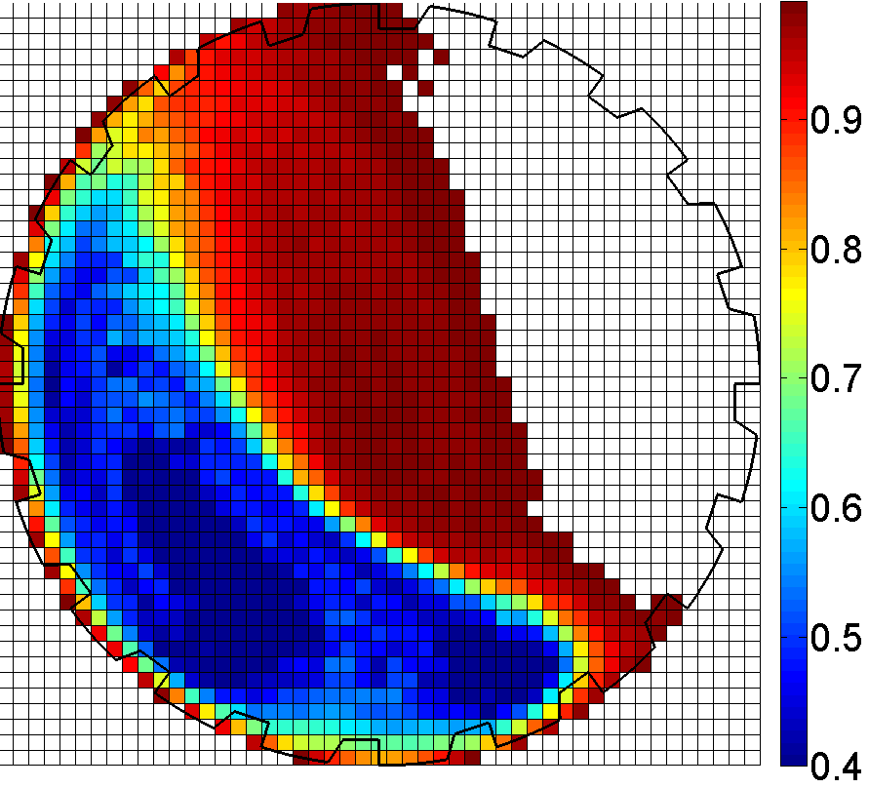
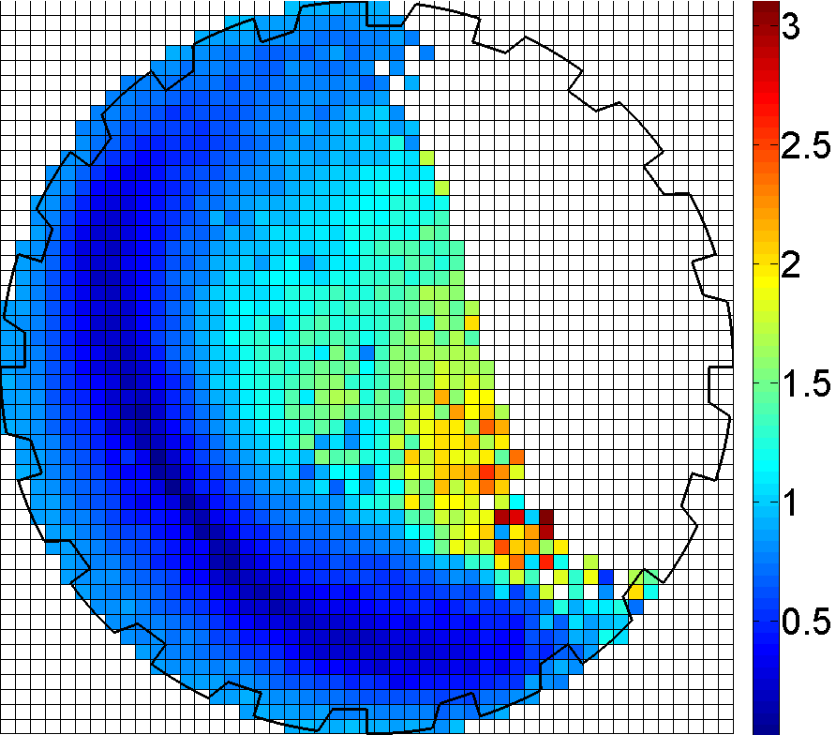
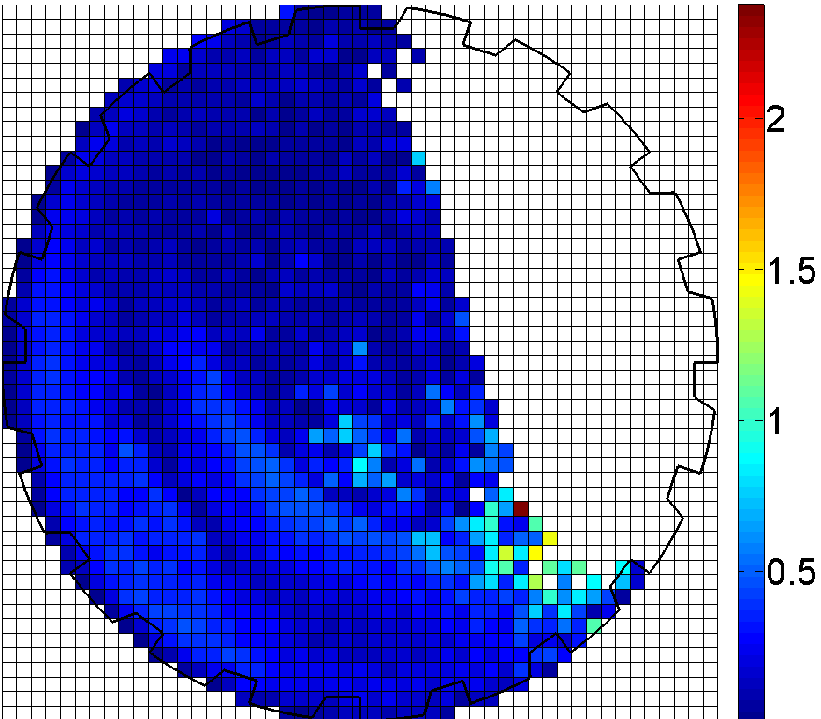
5mm glass beads (31.25% Load)
Slurry (-75μm+53μm)
Speed: 75% of critical
Govender et al 2010
Azimuthal Direction
Porosity
Slurry Velocity
Slip Velocity

Slide 27
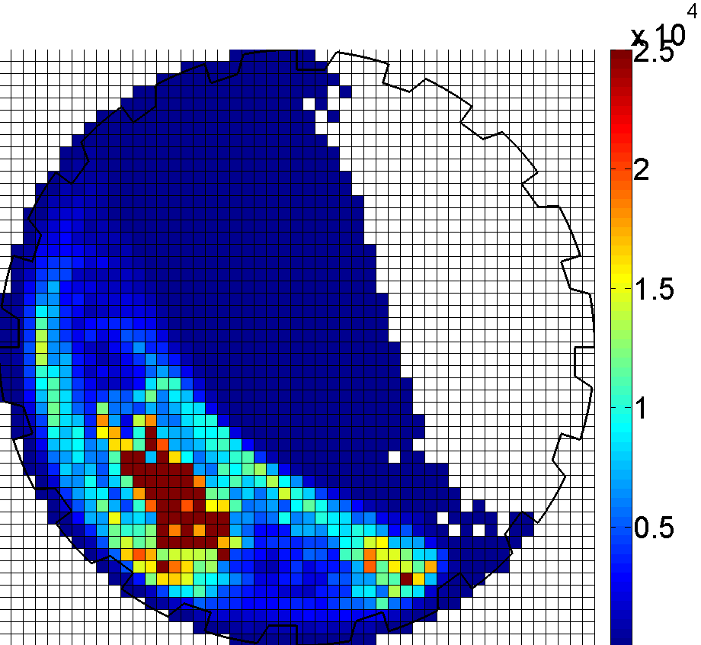
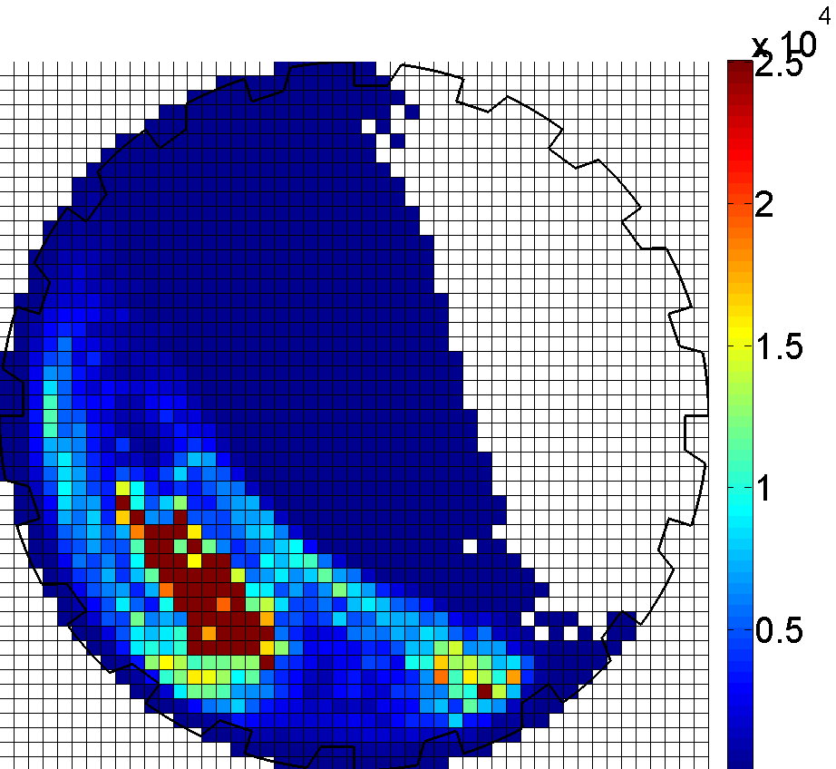
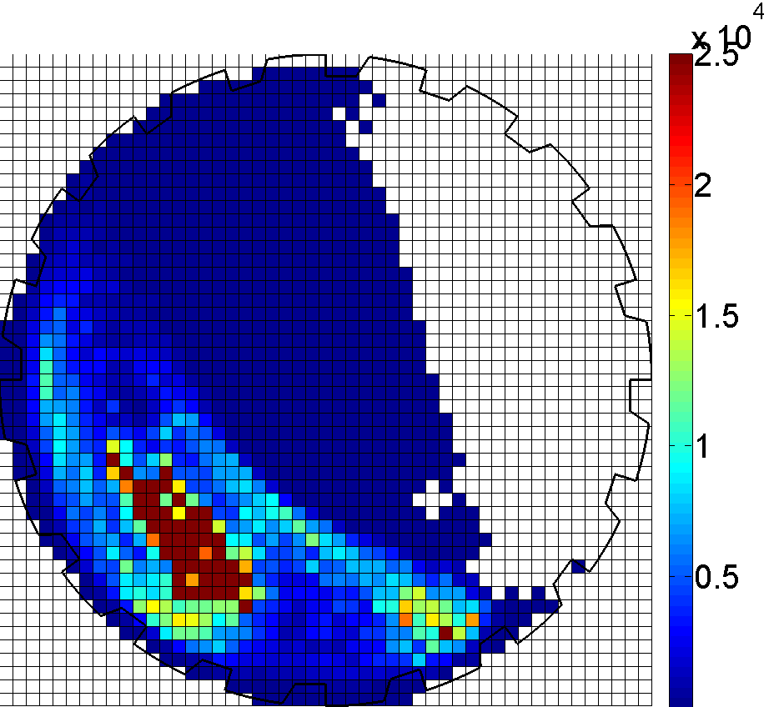
5mm glass beads (31.25% Load)
Slurry (-75μm+53μm)
Speed: 75% of critical
Azimuthal Pressure Drop
Ergun
Cell Averaging
Cell Averaging+Brinkman

Slide 28
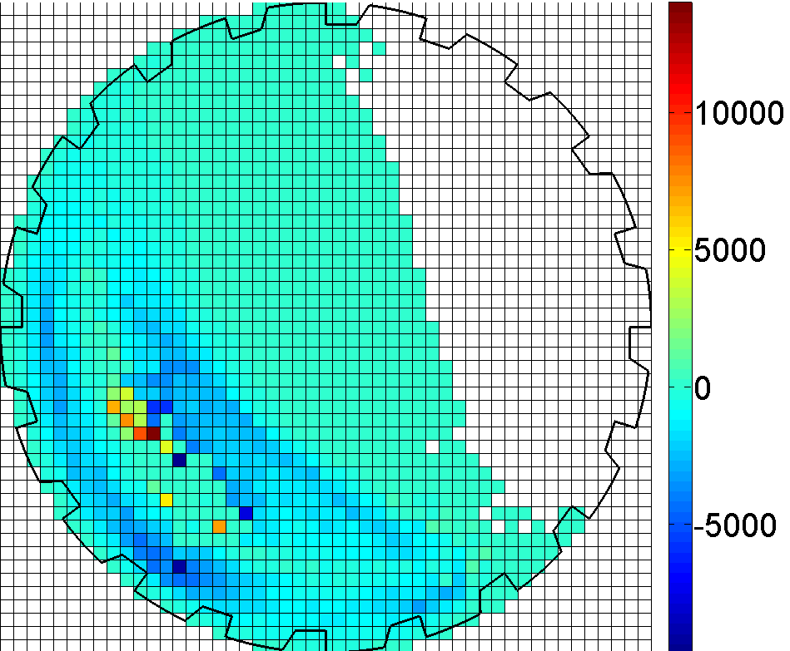
5mm glass beads (31.25% Load)
Slurry (-75μm+53μm)
Speed: 75% of critical
Azimuthal: Cell Averaging - Ergun

Slide 29
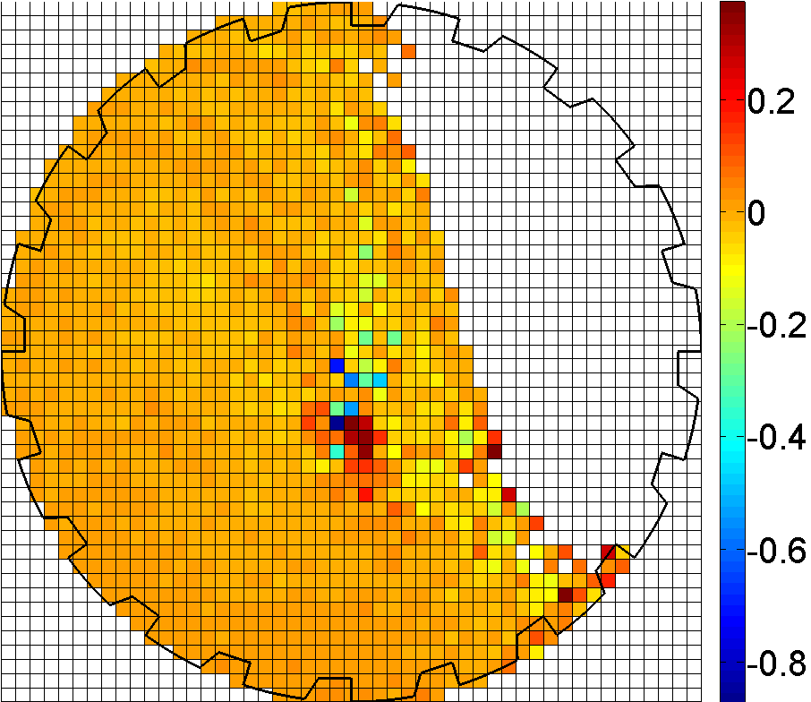
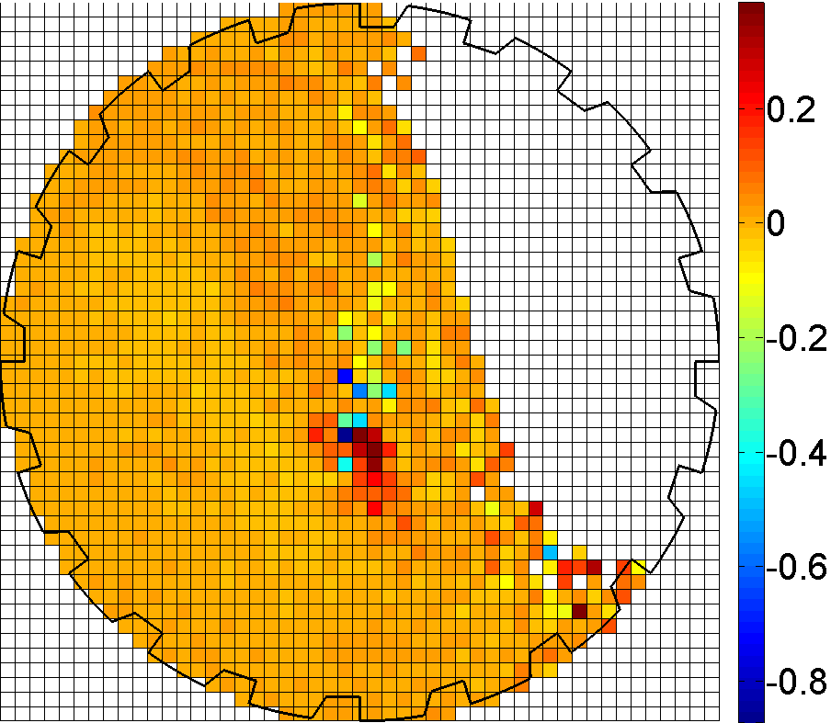
5mm glass beads (31.25% Load)
Slurry (-75μm+53μm)
Speed: 75% of critical
Axial Direction
Porosity
Slurry Velocity
Slip Velocity

Slide 30
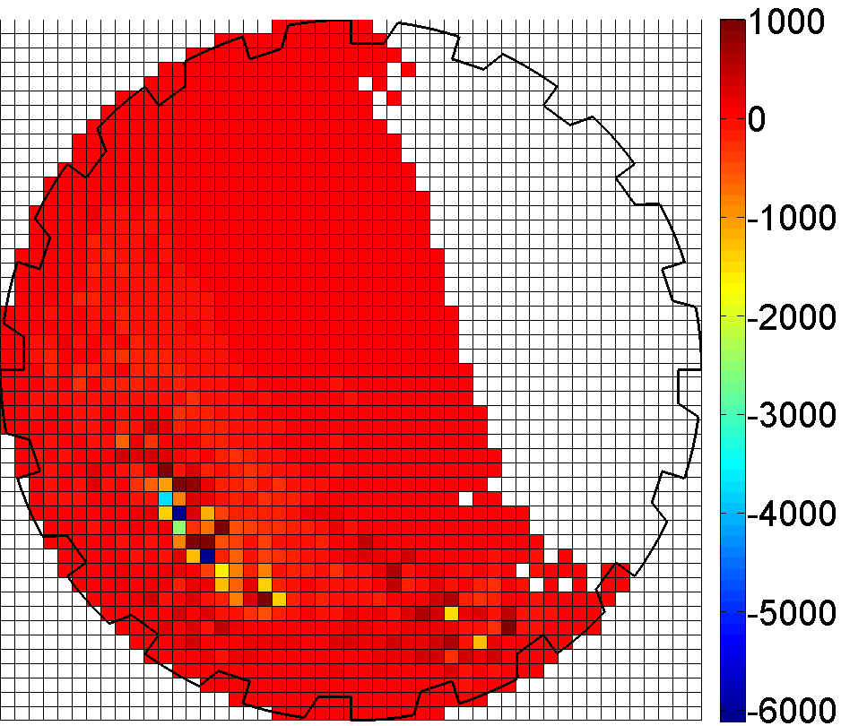
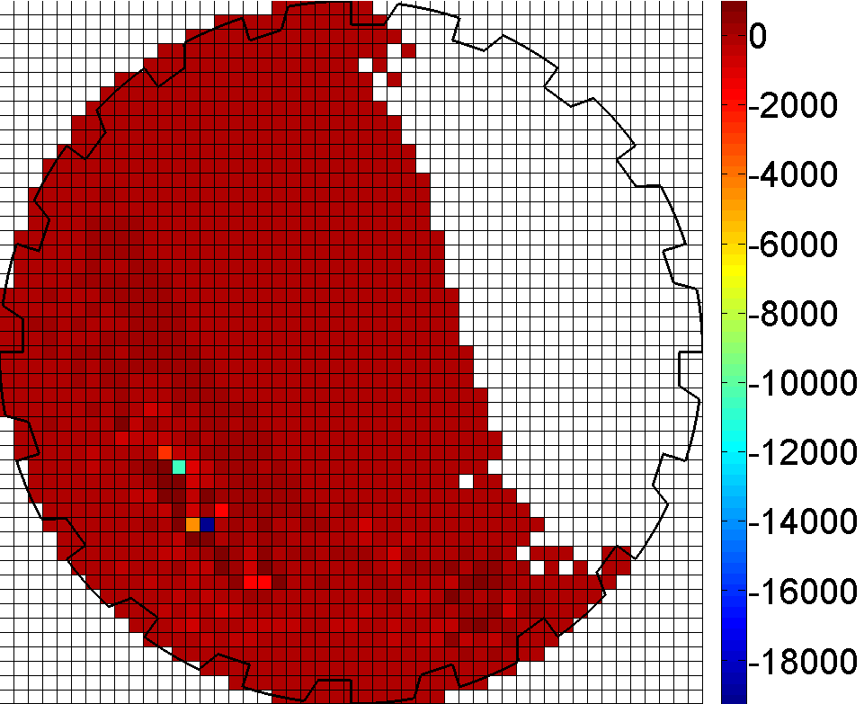
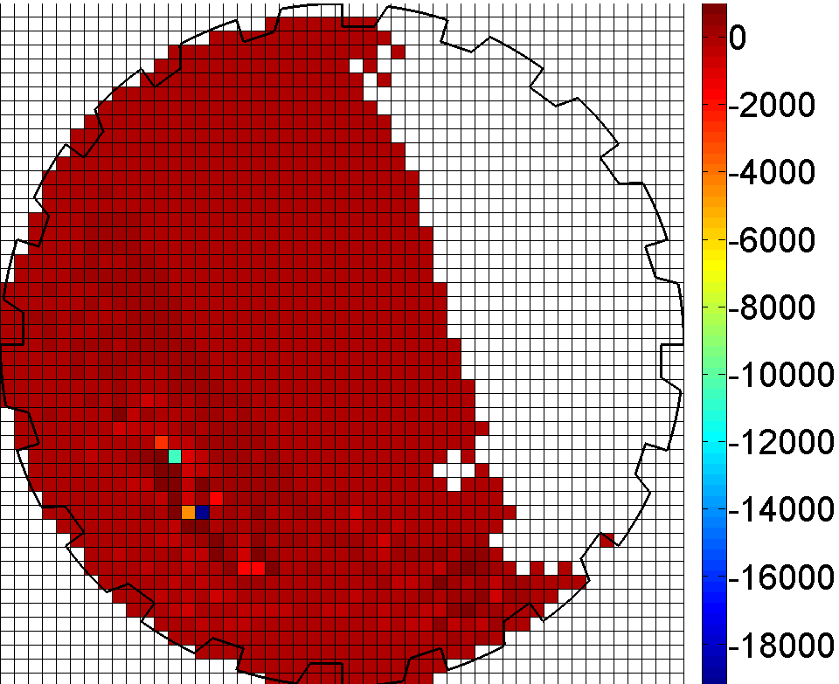
5mm glass beads (31.25% Load)
Slurry (-75μm+53μm)
Speed: 75% of critical
Axial Pressure Drop
Ergun
Cell Averaging
Cell Averaging+Brinkman

Slide 31
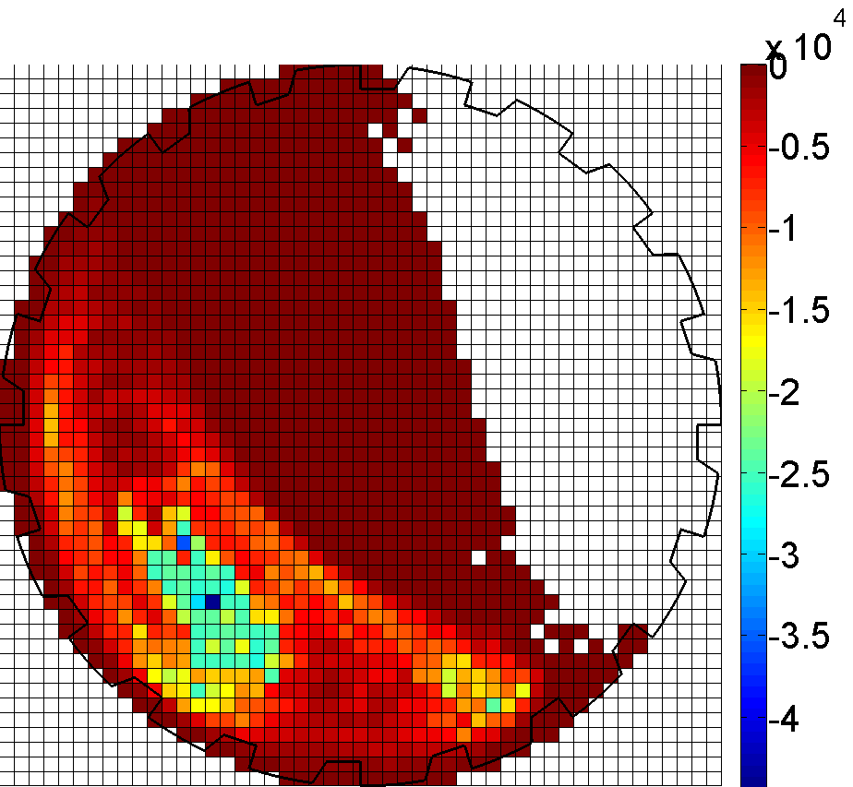
5mm glass beads (31.25% Load)
Slurry (-75μm+53μm)
Speed: 75% of critical
Axial: Cell Averaging - Ergun

Slide 32
Conclusions
First steps towards a mechanistic model
Theory based on combined volume & time averaging
New cell averaged model for permeability
PEPT data analysis
Non-newtonian ?
Inertial (non-Darcy) effects?

Slide 33
Prospect
Build a better transport model, and the industrial world will beat a path to your door

Slide 34
Thank you

Slide 35
References
Darcy, H. Les Fontaines Publiques de la Ville de Dijon. Paris: Dalmount, 1856.
Ergun, S., 1952. Fluid flow through packed columns. Chemical Engineering Progress 48, 89-94.
Yoon, S.M. and Kunii, D., 1970. Gas Flow and Pressure Drop through Moving Beds. Industrial Engineering Chemical Design Development 9, 559-565.
Whitaker, S., 1999. The Method of Volume Averaging ,Kluwer Academic Publishers.
Happel, J., 1958. Viscous flow in multiparticle systems: slow motion of fluids relative to beds of spherical particles, American Institute of Chemical Engineers Journal 4, 197-201.
Kuwabara, S., 1959. The forces experienced by randomly distributed parallel Cylinders or spheres in a viscous flow at small Reynolds numbers, Journal of the Physics Society of Japan 14, 527-532.
Parker, D.J., Broadbent, C.J., Fowles, P., Hawkesworth, M.R. and McNeil, P., 1993. Positron emission particle tracking – a technique for studying flow within Engineering equipment, Nuclear Instruments and Methods in Physics Research A326, 592-607.
Condori, P., Mainza, A., Govender, I. and Powell, M.,2008. A mechanistic APPROACH TO modelLING slurry transport in AG/SAG mills – transport through the charge. Proceeding of the 24th International Minerals Processing Congress, Beijing, China.
Govender, I. ,Tupper, G.B. , and Mainza, A.N.,2010. Towards a Mechanistic Model for Slurry Transport in Tumbling Mills. To appear in Minerals Engineering

