Slide 1
Glasma to plasma: classical coherence,
quantum decoherence & thermalization
in the little Bang
Raju Venugopalan
Lecture iV, UCT, February 2012

Slide 2
Outline of lectures
Lecture I: QCD and the Quark-Gluon Plasma
Lecture II: Gluon Saturation and the Color Glass Condensate
Lecture III: Quantum field theory in strong fields. Factorization. the Glasma and long range correlations
Lecture IV: Quantum field theory in strong fields.
Instabilities and the spectrum of initial quantum fluctuations
Lecture V: Quantum field theory in strong fields. Decoherence, hydrodynamics, Bose-Einstein Condensation and thermalization
Lecture VI: Future prospects: RHIC, LHC and the EIC

Slide 3
Talk Talk Outline
Motivation: the unreasonable effectiveness of hydrodynamics
in heavy ion collisions
An ab initio weak coupling approach:
Paradigm: Classical coherence in nuclear wavefunctions
Quantum fluctuations: Factorization, Evolution, Decoherence
Isotropization, Bose-Einstein Condensation, Thermalization ?
HI theory draws concretely on concepts in perturbative and non-perturbative QCD, string holography, reaction-diffusion systems, topological effects, plasma physics, thermodynamics and stat. mech, quantum chaos, Bose-Einstein condensates, pre-heating in inflationary cosmology

Slide 4
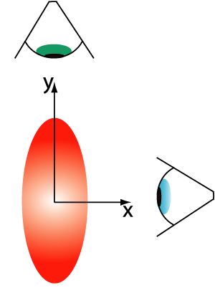
Strong flow = (nearly) ideal hydrodynamics
Spatial anisotropy
v₂ measures how efficiently hot matter converts spatial anisotropies to momentum anisotropy
– most efficient way is hydrodynamics

Slide 5
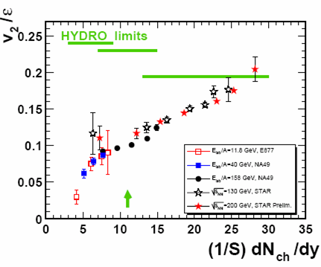
Strong flow = (nearly) ideal hydrodynamics
LHC !
CERN Press release, November 26, 2010:
‘confirms that the much hotter plasma produced at the LHC behaves as a very low viscosity liquid (a perfect fluid)..’
v₂ at RHIC and the LHC is large

Slide 6
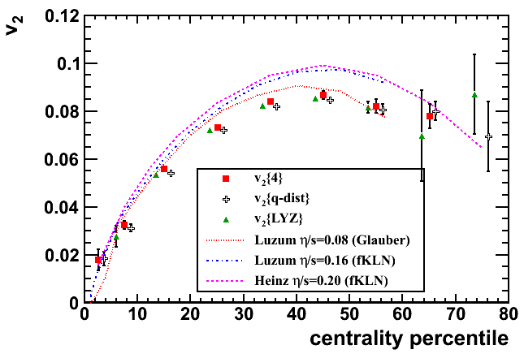
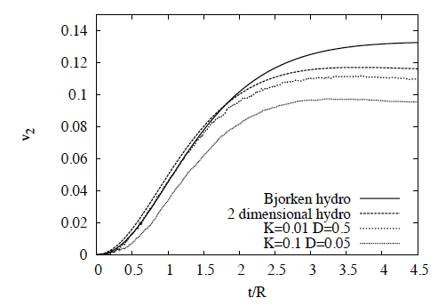
Strong flow = (nearly) ideal hydrodynamics
v₂ at LHC in agreement
with (slightly) viscous
relativistic hydrodynamics
Takes a long time ~ R/c_{S}
to build up v₂
Flow must set in very
early (≤ 1 fm)

Slide 7
Quantum decoherence from classical coherence
Color Glass
Condensates
Initial
Singularity
sQGP -
perfect fluid
Hadron
Gas
Glasma
t
Glasma (\Glahs-maa\): Noun: non-equilibrium matter
between CGC and QGP
Computational framework
Gelis,RV NPA (2006)
Quantum field theory for strong time dependent sources (ρ ~ 1/g) ,
For eg., Schwinger mechanism for pair production in QED,
Hawking radiation on Black Hole horizon, …

Slide 8
Quantum fluctuations in classical backgrounds: I
Gelis,Lappi,RV: 0804.2630
Suppressed
Factorized into energy evolution of wavefunctions
p^{η}=0 (small x !) modes that are coherent with the nuclei can be
factorized for inclusive observables - JIMWLK factorization
The W’s are universal “functional density matrices”
and can be extracted from DIS or hadronic collisions

Slide 9
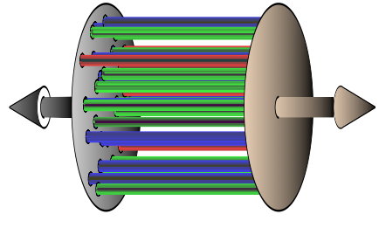
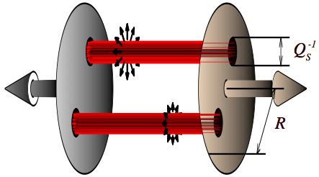
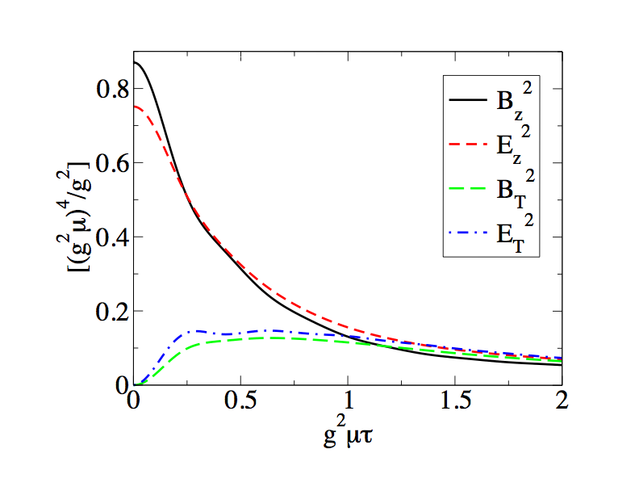
Classical features of the Glasma
Solutions of Yang-Mills equations produce (nearly) boost invariant gluon field configurations: “Glasma flux tubes”
Lumpy gluon fields are color screened in
transverse plane over distances ~ 1/Q_{S}
- Negative Binomial multiplicity distribution.
“Glasma flux tubes” have non-trivial
longitudinal color E & B fields at early times
--generate Chern-Simons topological charge

Slide 10
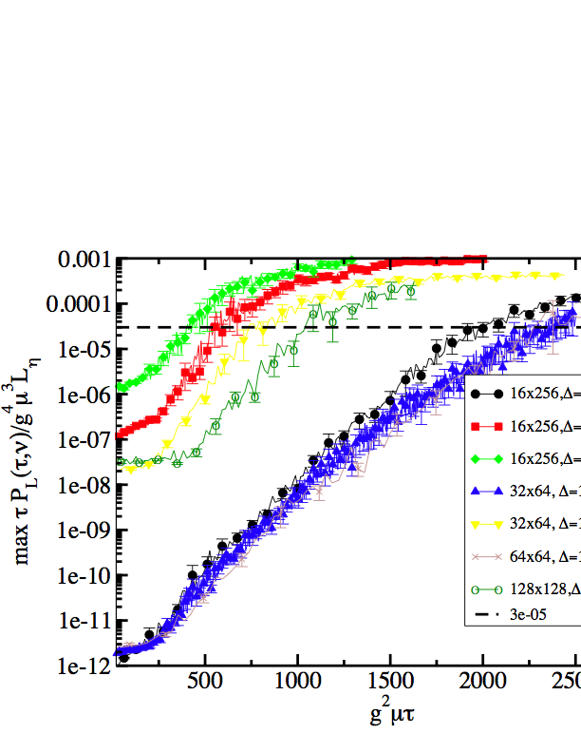
Quantum fluctuations in classical backgrounds: II
increasing
seed size
2500
Romatschke,Venugopalan
Fukushima,Gelis,McLerran
Quant. fluct.
grow exponentially
after collision
As large as classical
field at 1/Qs !
increasing
seed size
2500
p^{η} ≠ 0 (generated after collision) modes grow exponentially
with proper time can have to be resummed to all orders
So called “secular divergences”
known in condensed matter physics
The Boltzmann equation is a specific example…

Slide 11
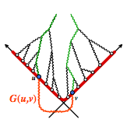
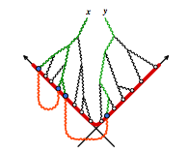
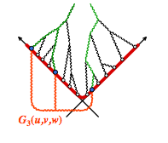
Glasma spectrum of initial quantum fluctuations
increasing
seed size
2500
Exponentiate and resum these
Parametrically suppressed
Leading quantum corrections to all orders give:
Gauge invariant Gaussian spectrum of quantum fluctuations computed ab initio
(in inflation, see Son; Khlebnikov,Tkachev; Kofman,Linde,Starobinsky)

Slide 12
Glasma spectrum of initial quantum fluctuations
increasing
seed size
2500
Path integral over small fluctuations equivalent to
Gaussian random variables
Berry conjecture: High lying quantum eigenstates of classically chaotic systems,
linear superpositions of Gaussian random variables
Srednicki: Systems that satisfy Berry’s conjecture exhibit
“eigenstate thermalization”

Slide 13
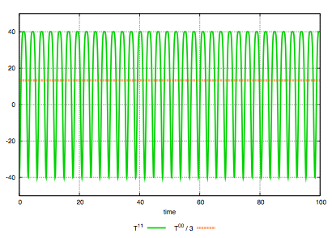
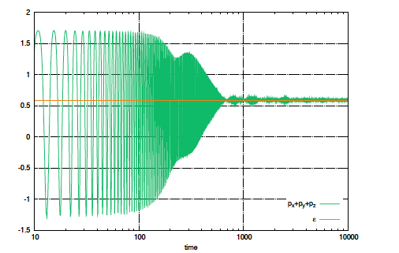
Hydrodynamics from quantum fluctuations
Dusling,Epelbaum,Gelis,RV (2011)
scalar Φ⁴ theory:
Energy density and pressure
without averaging over fluctuations
Energy density and pressure
after averaging over fluctuations
Converges to single valued
relation “EOS”

Slide 14
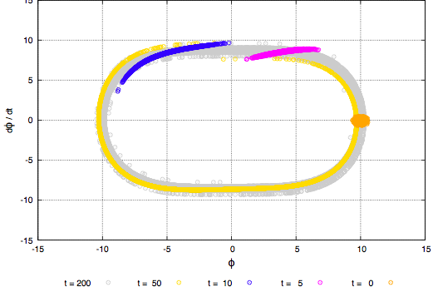
Hydrodynamics from quantum fluctuations
Dusling,Epelbaum,Gelis,RV (2011)
Anatomy of phase decoherence:
ΔΘ = Δω t
T_{period} = 2π / Δω
➔ T_{period} ≅ 18.2 / g ΔΦ_{max}
Different field amplitudes from different
initializations of the classical field
= 0
Because T_{μ}^{μ} for scalar theory is
a total derivative
and φ is periodic

Slide 15
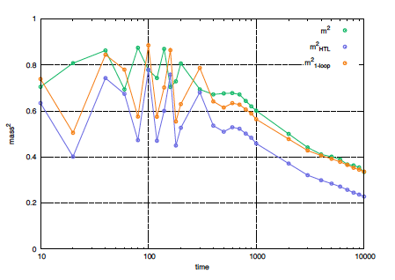
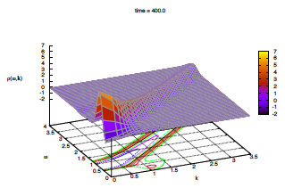
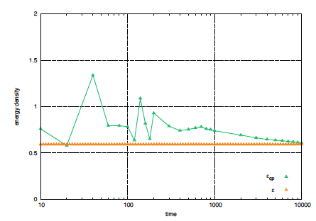
Quasi-particle description?
Epelbaum,Gelis (2011)
Spectral function ρ (ω,k)
Plasmon mass
ω
k
Energy density of free
quasi-particles
At early times, no quasi-particle description
May have quasi-particle description at late times.
Effective kinetic “Boltzmann” description in terms of
interacting quasi-particles at late times ?
Energy density on the lattice

Slide 16
Quasi-particle occupation number
Gelis,Epelbaum (2011)
Initial
mode distribution
System becomes over occupied relative to a thermal distribution…

Slide 17
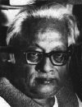
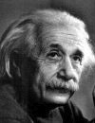
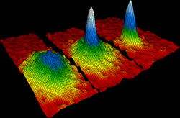
Bose-Einstein Condensation in HI Collisions ?
Cold rubidium atoms in a magnetic trap
Gell-Mann’s Totalitarian Principle of Quantum Mechanics:
Everything that is not forbidden is Compulsory

Slide 18
Bose-Einstein Condensation and Thermalization
Blaizot,Gelis,Liao,McLerran,RV: arXiv:1107.5295v2
Assumption: Evolution of “classical” fields in the Glasma can be matched to a quasi-particle transport description
All estimates are “parametric”: α_{S} << 1
See also, Mueller, Son (2002)
System is over-occupied: n ≈ Q_{S}³/α_{s} ; ε = Q_{S}⁴/α_{S}
➔ n• ε^{-3/4} ≈ 1/α_{S}^{1/4} >> 1
In a thermal system, n• ε^{-3/4} = 1
If a system is over-occupied near equilibrium and elastic scattering dominates,
it can generate a Bose-Einstein condensate
Known also in context of inflation:
Khlebnikov, Tkachev (1996)
Berges et al. (2011)

Slide 19
Bose-Einstein Condensation and Thermalization
In a many-body system, gluons develop a mass
ω_{p=0} = m ≈ α_{S}^{1/2} T
If over-occupation persists for μ = m, system develops a condensate
As α_{S} ➔ 0, most particles go into the condensate
It however carries a small fraction
of the energy density…

Slide 20
Transport in the Glasma
“Landau” equation for small angle 2 ➔ 2 scattering:
This is satisfied by a distribution where
Λ_{S} and Λ are dynamical time dependent scales determined
by the transport equation

Slide 21
Transport in the Glasma
1/α_{S}
At τ ~ 1/Q_{S}
Λ_{S}=Λ=Q_{S}
p
1/α_{S}
At τ > 1/Q_{S}
f(p)
Λ_{S}
Λ
p
When Λ_{S} = α_{S} Λ, the system thermalizes;
one gets the ordering of scales: Λ =T, m = Λ Λ_{S} = α^{1/2} T, Λ_{S} = α_{S}T

Slide 22
Thermalization: from Glasma to Plasma
Fixed box: Energy conservation gives Λ³ Λ_{S} = constant
From moments of transport eqn., , τ_{coll} = Λ / Λ_{S}² ~ t
From these two conditions,
Thermalization time:
Also, Kurkela, Moore (2011)
Entropy density s = Λ³ increases and saturates at t_{therm} as T³
We showed that system is strongly interacting with itself due to
coherence of fields

Slide 23
Thermalization: from Glasma to Plasma
Expanding box :matter is now strongly self interacting for fixed momentum
anisotropy
0 < δ ≤ 1/3
Thermalization time t_{therm}
For δ= -1, recover fixed box results…
A condensate can still form in the expanding case for δ > 1/5

Slide 24
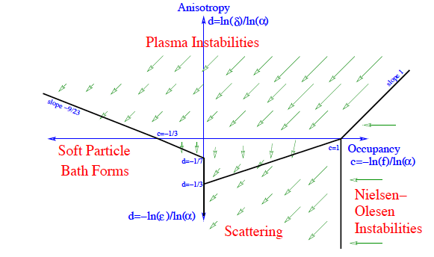
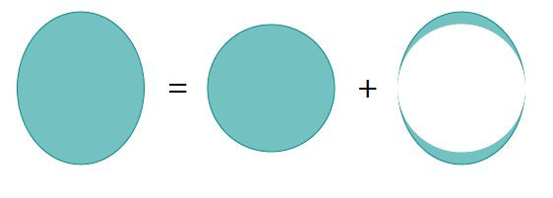
What about plasma instabilities ?
Another mechanism for isotropization, hydrodynamics, thermalization
Kurkela, Moore(2011)
Likely weak anisotropy relevant:
Needs careful study to gauge impact
on scaling solutions

Slide 25
Summary
Presented ab initio picture of collective features of multi-particle production and thermalization in heavy ion collisions
Thermalization is a subtle business even in weak coupling
Hydrodynamics is unreasonably effective because it requires rapid decoherence of classical fields and strong self-interactions, not thermalization
Exciting possibility of a transient Bose-Einstein Condensate
interesting phenomenological consequences

Slide 26
THE END

Slide 27
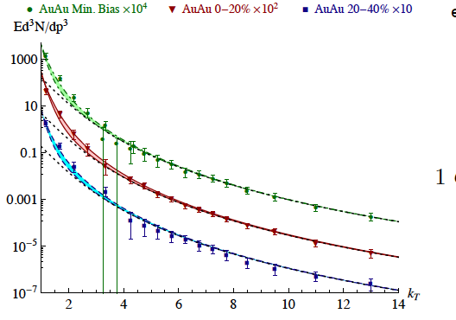
Photon & di-lepton emission in HI collisions
Photons: excess at transverse momenta 1-3 GeV; strong N_{part}² dependence
McLerran et al: distributions
sensitive to anisotropy δ

Slide 28
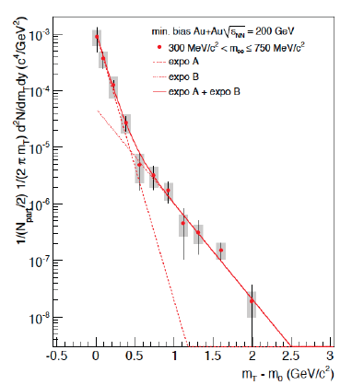
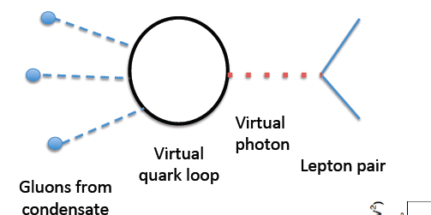
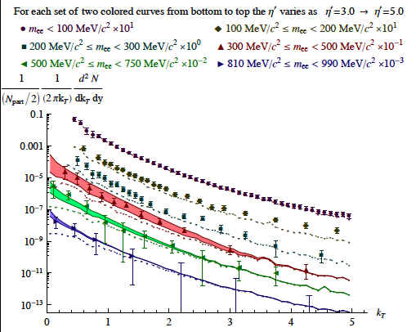
Photon & di-lepton emission in HI collisions
Di-leptons: excess in region pT < M; M ≤0.5
Fit T ~ 100 MeV; inconsistent with thermal
emission or hard scattering
Min. bias PHENIX data – predict
N_{part}^{3/2} dependence

Slide 29
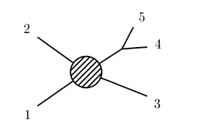
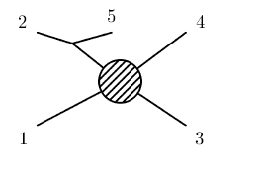
Role of inelastic processes ?
Wong (2004)
Mueller,Shoshi,Wong (2006)
Power counting for n ➔ m processes contributions to the collision integral
Vertices contribute α_{S}^{n+m-2}
Factor of (Λ_{S}/α_{S})^{n+m-2} from distribution functions
Screened infrared singularity: (1/Λ Λ_{S})^{n+m-4}
Remaining phase space integrals Λ^{n+m-5}
Net result is τ_{inelas} ~ Λ / Λ_{S}² = τ_{elas}
At most parametrically of the same order as elastic scattering.
So a transient Bose-Einstein condensate can form.
Numerical simulations will be decisive
Dusling,Epelbaum,Gelis,RV, in progress
Blaizot, Liao, McLerran

