Slide 1
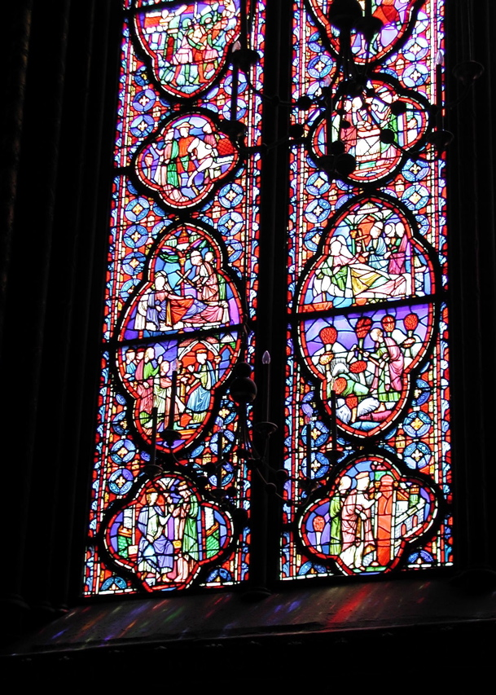
The Color Glass Condensate
Raju Venugopalan
Lecture II: UCT, February, 2012

Slide 2
Outline of lectures
Lecture I: QCD and the Quark-Gluon Plasma
Lecture II: Gluon Saturation and the Color Glass Condensate
Lecture III: Quantum field theory in strong fields. Factorization and the Glasma
Lecture IV: Quantum field theory in strong fields.
Instabilities and the spectrum of initial quantum fluctuations
Lecture V: Quantum field theory in strong fields. Decoherence, hydrodynamics, Bose-Einstein Condensation and thermalization
Lecture VI: Future prospects: RHIC, LHC and the EIC

Slide 3
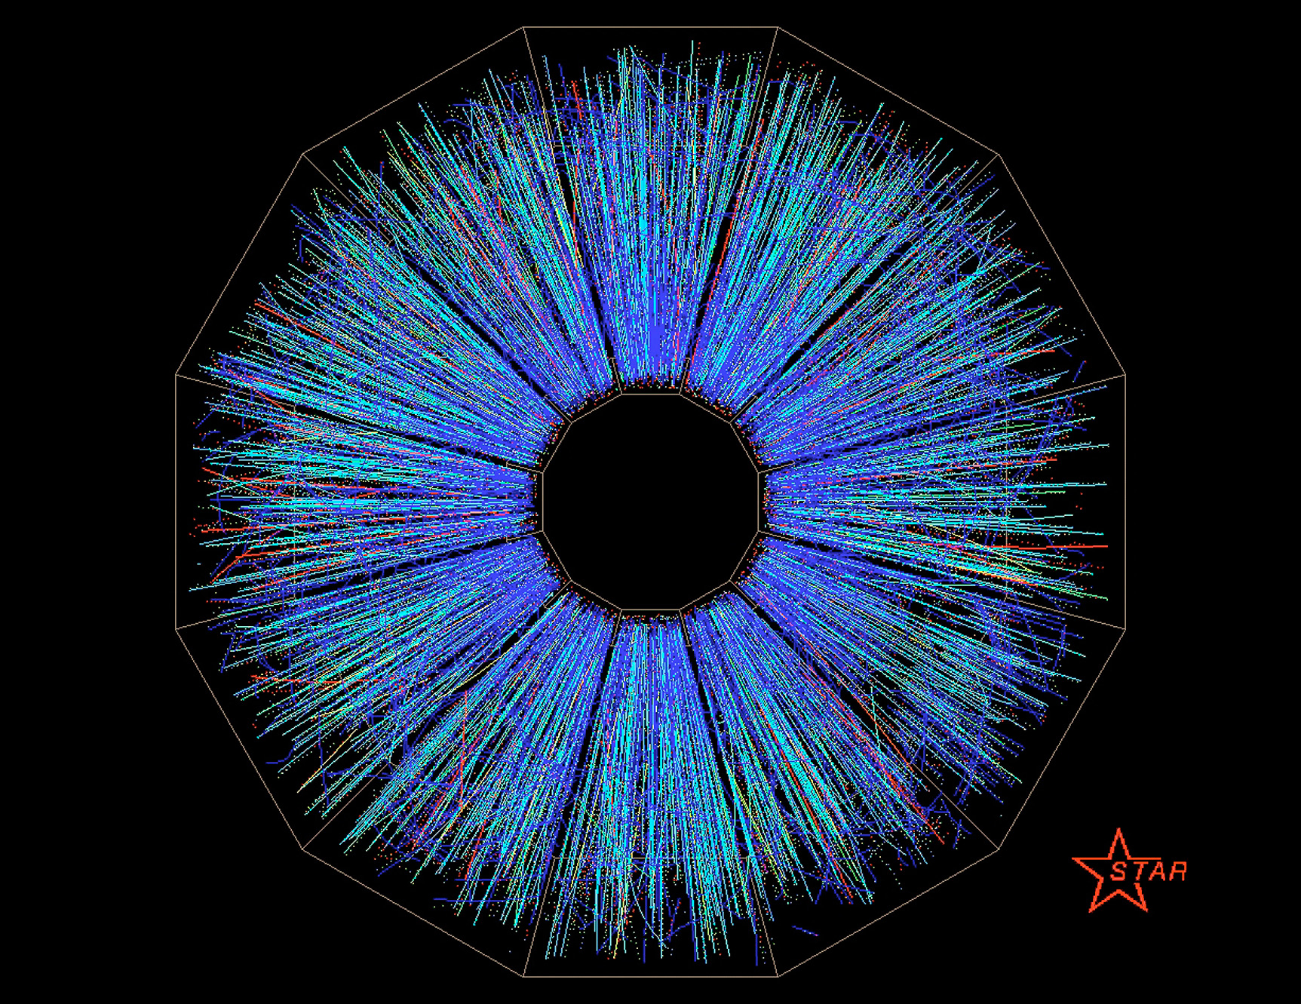
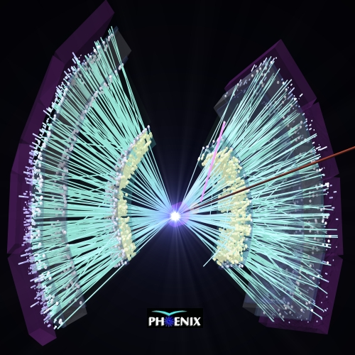
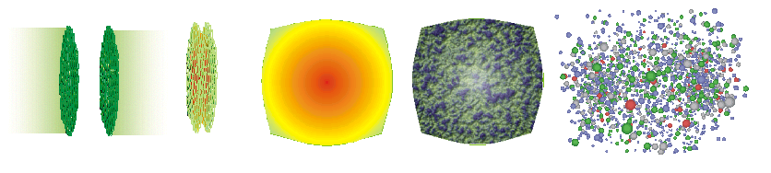
What does a heavy ion collision look like ?
Color Glass
Condensates
Initial
Singularity
Glasma
sQGP -
perfect fluid
Hadron
Gas
t

Slide 4
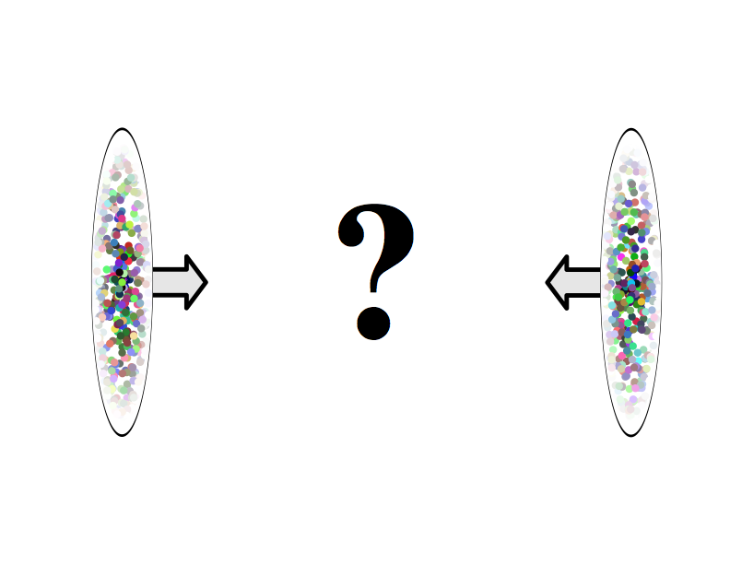
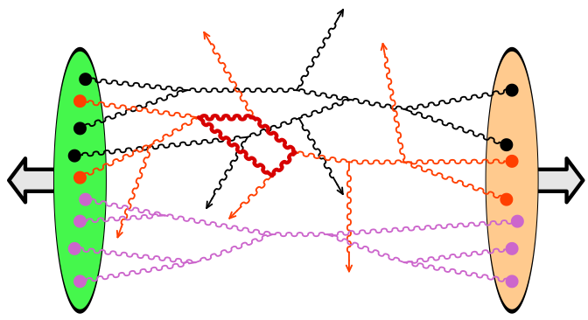
The big role of wee gluons

Slide 5
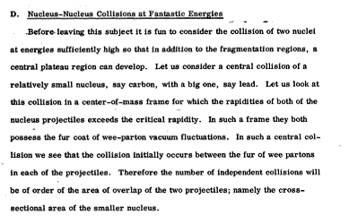
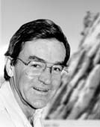
Bj, DESY lectures (1975)
The big role of wee glue
(Nucleus-Nucleus Collisions at Fantastic Energies)
At LHC, ~14 units in rapidity!
Bj, DESY lectures (1975)

Slide 6
Bj, DESY lectures (1975)
The big role of wee glue
What is the role of wee partons ? ✔
How do the wee partons interact and produce glue ? ✔
Can it be understood ab initio in QCD ? ✔

Slide 7
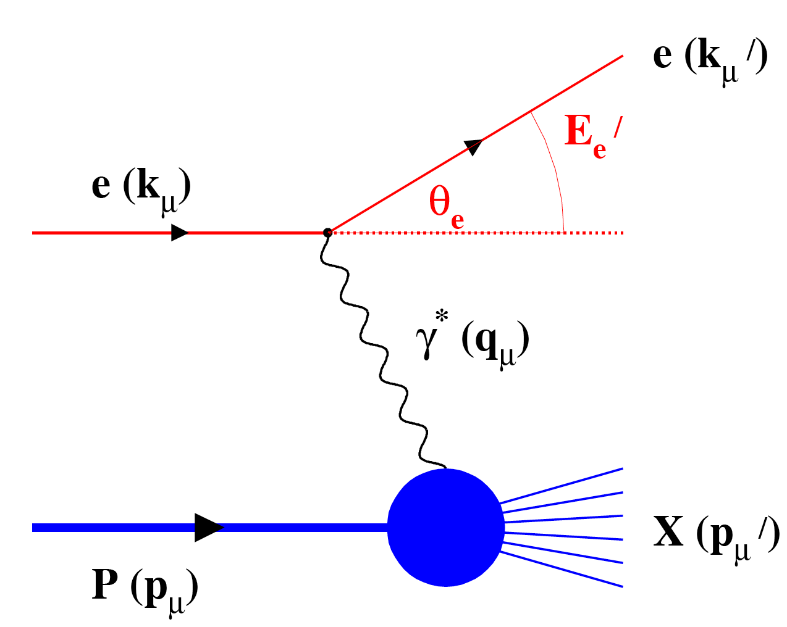
The DIS Paradigm
Measure of resolution power
Measure of inelasticity
Measure of momentum fraction of struck quark
quark+anti-quark
mom. dists.
gluon
mom. dists

Slide 8

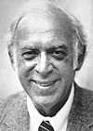
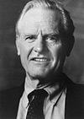

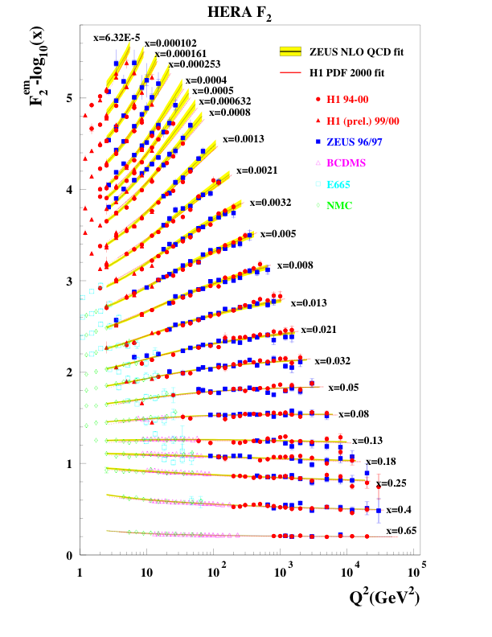
Nobel to Friedman, Kendall, Taylor
Bj-scaling: apparent scale invariance of structure functions

Slide 9
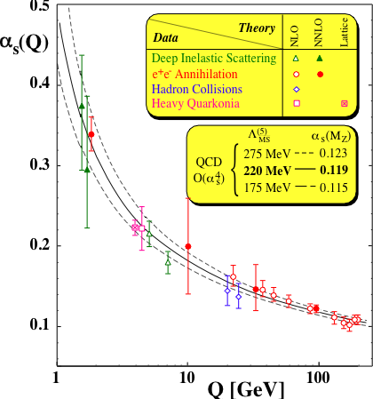




Puzzle resolved in QCD…
Gross, Wilczek, Politzer
QCD ≠ Parton Model
Logarithmic scaling violations

Slide 10
The proton at high energies
γ*
x f(x)
u
u
d
Parton model
1/3
x
γ*
x f(x)
u
g
u
g
d
~1/7
x
QCD -log corrections

Slide 11


d
d
γ*
Sea quarks
x f(x)
Valence quarks
u
g
u
g
d
x
“x-QCD”- small x evolution
# of valence quarks
# of quarks

Slide 12
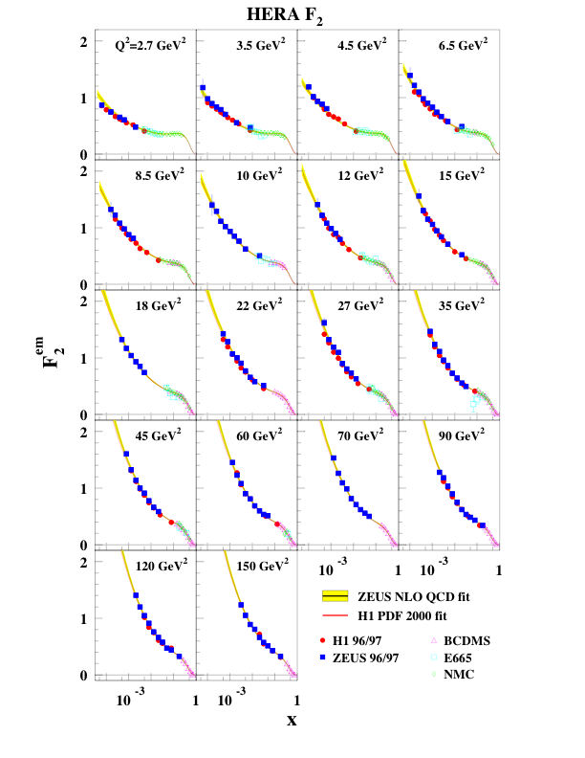
Structure functions grow rapidly at small x

Slide 13
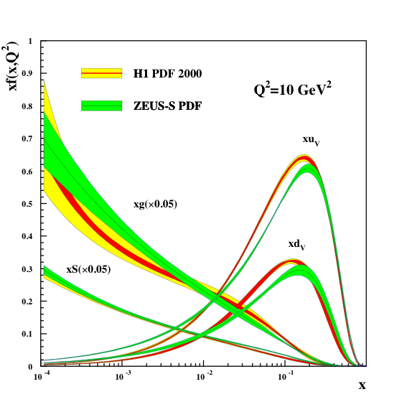
Where is the glue ?
# partons /
unit rapidity
For x < 0.01, proton dominated by glue-grows rapidly
What happens when glue density is large ?

Slide 14
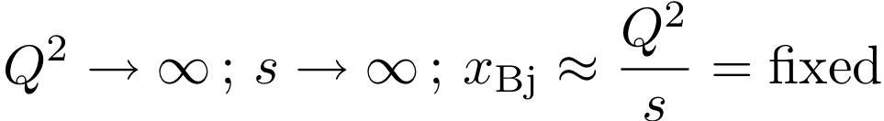
The Bjorken Limit
Operator product expansion (OPE), factorization theorems,
machinery of precision physics in QCD

Slide 15
Structure of higher order perturbative contributions in QCD
γ*
Q², x
+
+ …
+ higher twist (power suppressed)
contributions…
Q₀², x₀
P
Coefficient functions C - computed to NNLO for many processes
Splitting functions P - computed to 3-loops

Slide 16
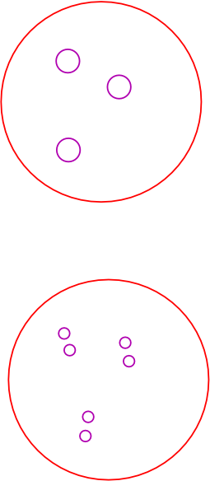
Resolving the hadron…
Ren.Group-DGLAP evolution
(sums large logs in Q²)
Increasing Q²
Phase space density (# partons / area / Q² ) decreases
- the proton becomes more dilute…

Slide 17
BEYOND pQCD IN THE Bj LIMIT
Works great for inclusive, high Q² processes
Higher twists important when Q² ≈ Q_{S}²(x)
Problematic for diffractive/exclusive processes
Formalism not designed to treat shadowing,
multiple scattering, diffraction, energy loss,
impact parameter dependence, thermalization…

Slide 18
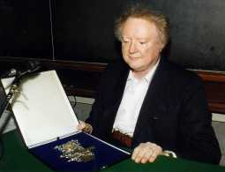
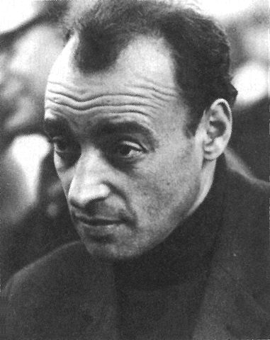
The Regge-Gribov Limit
Physics of strong fields in QCD, multi-particle production,
Novel universal properties of QCD ?

Slide 19
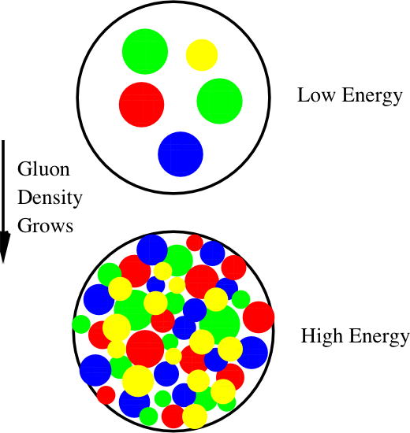
Resolving the hadron…
Ren.Group-BFKL evolution
(sums large logs in x)
Large x
Small x
Gluon density saturates at phase space density f = 1 /α_{S}
- strongest (chromo-) E&M fields in nature…

Slide 20
Bremsstrahlung
-linear QCD evolution
Gluon recombination
and screening
-non-linear QCD evolution
Proton becomes a dense many body system at high energies

Slide 21

Parton Saturation
Gribov,Levin,Ryskin
Mueller,Qiu
Competition between attractive bremsstrahlung
and repulsive recombination and screening effects
Maximum phase space density (f = 1/α_{S}) =>
This relation is saturated for

Slide 22
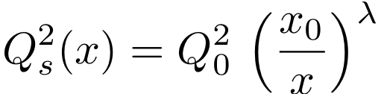
Parton Saturation:Golec-Biernat
--Wusthoff dipole model
γ*
z
q
r⊥
1-z
q
P
Parameters: Q₀ = 1 GeV; λ = 0.3; x₀ = 3* 10⁻⁴ ; σ₀ = 23 mb

Slide 23
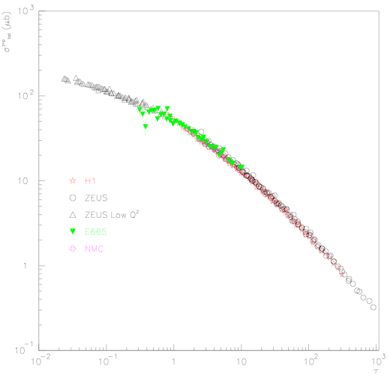
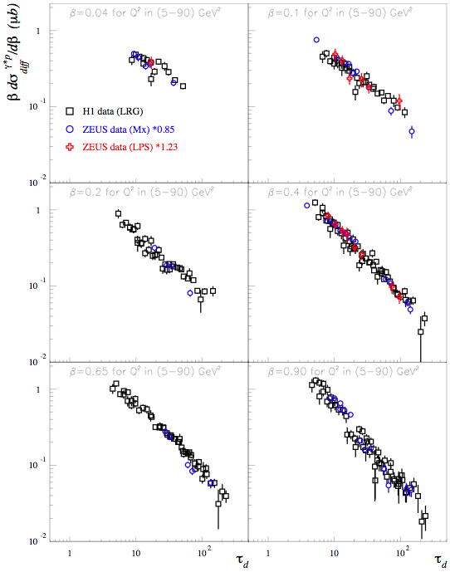
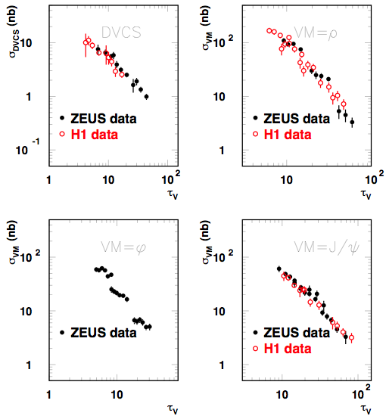
Evidence from HERA for geometrical scaling
Golec-Biernat, Stasto,Kwiecinski
F₂^{D}
τ
F₂
τ = Q² / Q_{S}²
τ_{D}
VM, DVCS
τ_{V}
Marquet, Schoeffel hep-ph/0606079
Scaling seen for
F₂^{D}
and VM,DVCS for same Q_{S} as F₂
Gelis et al., hep-ph/0610435

Slide 24
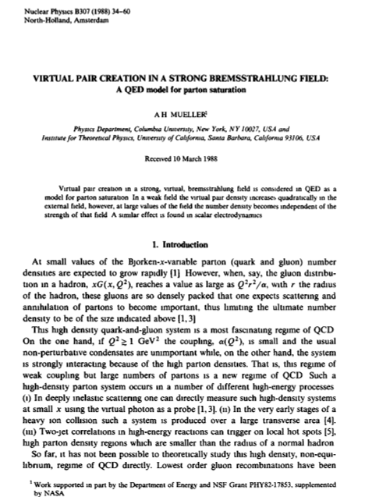
High energy
QCD as a
many body
system

Slide 25
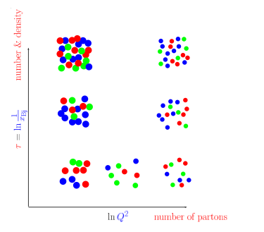
Many-body dynamics of universal gluonic matter
How does this happen ? What are
the right degrees of freedom ?
How do correlation functions of
these evolve ?
Is there a universal fixed point
for the RG evolution of d.o.f
Does the coupling run with Q_{s}² ?
How does saturation transition to
chiral symmetry breaking and
confinement
ln(Λ_{QCD}²)

Slide 26
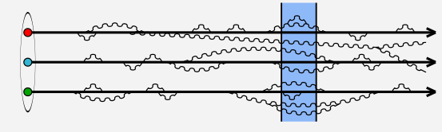
The nuclear wavefunction at high energies
|A> = |qqq…q> + … + |qqq…qgg…g>
At high energies, interaction time scales of fluctuations
are dilated well beyond typical hadronic time scales
Lots of short lived (gluon) fluctuations now seen by probe
-- proton/nucleus -- dense many body system of (primarily) gluons
Fluctuations with lifetimes much longer than interaction
time for the probe function as static color sources for more
short lived fluctuations
Nuclear wave function at high energies is a Color Glass Condensate

Slide 27

The nuclear wavefunction at high energies
|A> = |qqq…q> + … + |qqq…qgg…gg>
Higher Fock components dominate
multiparticle production-
construct Effective Field Theory
Valence modes-are static sources for wee modes
Born--Oppenheimer LC
separation natural for EFT.
RG equations describe
evolution of wavefunction
with energy
Dynamical
Wee modes

Slide 28
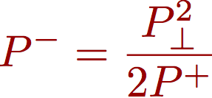


Effective Field Theory on Light Front
Susskind
Bardacki-Halpern
Poincare group on LF
Galilean sub-group
of 2D Quantum Mechanics
isomorphism
Eg., LF dispersion relation
Momentum
Energy
Mass
Large x (P⁺) modes: static LF (color) sources ρª
Small x (k⁺ <<P⁺) modes: dynamical fields
McLerran, RV
CGC: Coarse grained many body EFT on LF
non-pert. gauge invariant “density matrix”
defined at initial scale Λ₀⁺
RG equations describe evolution of W with x
JIMWLK, BK

Slide 29
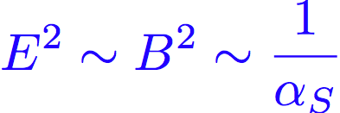
The Color Glass Condensate
McLerran, RV
Jalilian-Marian,Kovner,Weigert
Iancu, Leonidov,McLerran
In the saturation regime:
Strongest fields in nature!
CGC: Classical effective theory of QCD describing
dynamical gluon fields + static color sources in non-linear regime
Novel renormalization group equations (JIMWLK/BK)
describe how the QCD dynamics changes with energy
A universal saturation scale Q_{S} arises naturally in the theory

Slide 30
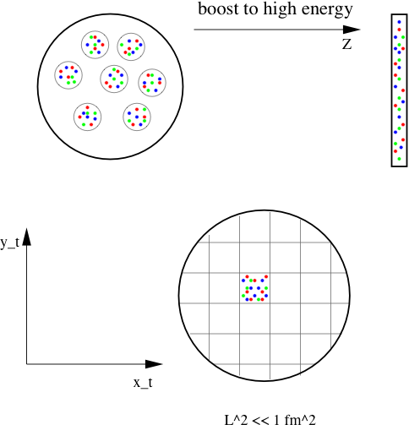
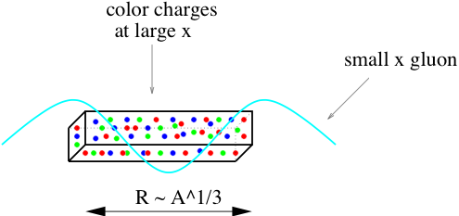
What do sources look like in the IMF ?
Wee partons “see” a large density of color sources
at small transverse resolutions

Slide 31


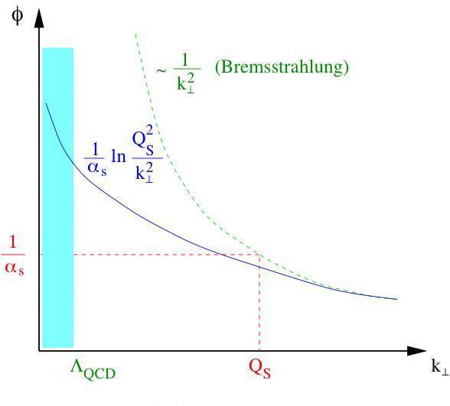
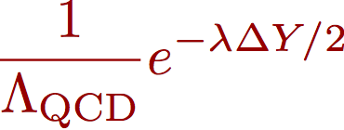
Classical field of a large nucleus
For a large nucleus, A >>1,
“Pomeron” excitations
“Odderon” excitations
McLerran,RV
Kovchegov
Jeon, RV
A_{cl} from
1/Λ_{QCD}
2R / γ
Wee parton
dist. :
determined from RG

Slide 32
Quantum evolution of classical theory: Wilson RG
Fields
Sources
Integrate out
Small fluctuations => Increase color charge of sources
Wilsonian RG equations describe evolution of all
N-point correlation functions with energy
JIMWLK
Jalilian-marian, Iancu, McLerran,Weigert, Leonidov,Kovner

Slide 33

Saturation scale grows with energy
Typical gluon
momenta are large
Typical gluon k_{T} in
hadron/nuclear
wave function
Bulk of high energy cross-sections:
obey dynamics of novel non-linear QCD regime
Can be computed systematically in weak coupling

Slide 34
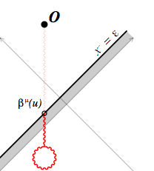
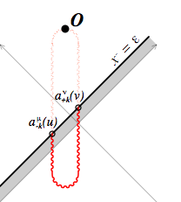



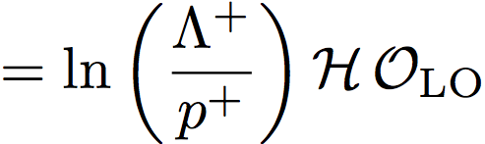
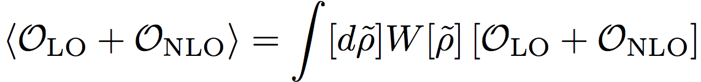
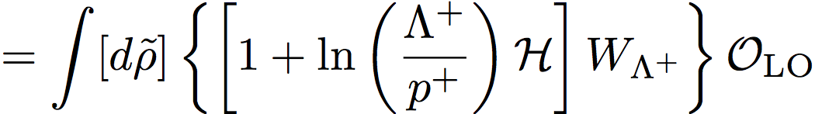
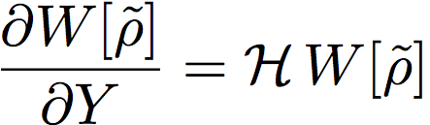

JIMWLK RG evolution for a single nucleus:
(
)
+
(keeping leading log divergences)
LHS independent of
=>
JIMWLK eqn.
Jalilian-Marian,Iancu,McLerran,Weigert,Leonidov,Kovner

Slide 35
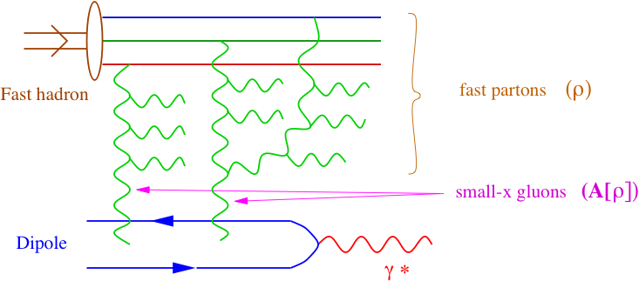
CGC Effective Theory: B-JIMWLK hierarchy of correlators
“time”
“diffusion coefficient”
At high energies, the d.o.f that describe the frozen many-body
gluon configurations are novel objects: dipoles, quadrupoles, …
Universal – appear in a number of processes in p+A and e+A;
how do these evolve with energy ?

Slide 36
Solving the B-JIMWLK hierarchy
JIMWLK includes all multiple scattering and leading log evolution in x
Expectation values of Wilson line correlators at small x
satisfy a Fokker-Planck eqn. in functional space
This translates into a hierarchy of equations for n-point
Wilson line correlators
As is generally the case, Fokker-Planck equations can be
re-expressed as Langevin equations – in this case for Wilson lines
Weigert (2000)
Blaizot,Iancu,Weigert
Rummukainen,Weigert
First numerical solutions exist: I will report on recent developments

Slide 37




B-JIMWLK hierarchy: Langevin realization
Numerical evaluation of Wilson line correlators on 2+1-D lattices:
Langevin eqn:
Gaussian random variable
“square root” of JIMWLK kernel
“drag”
Initial conditions for V’s from the MV model
Daughter dipole prescription for running coupling

Slide 38
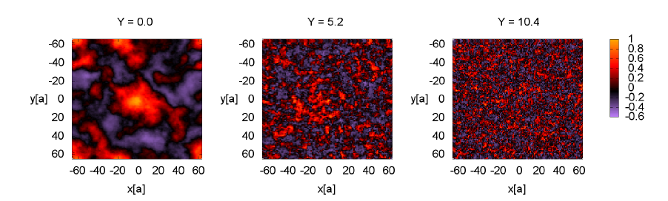
Functional Langevin solutions of JIMWLK hierarchy
Rummukainen,Weigert (2003)
Dumitru,Jalilian-Marian,Lappi,Schenke,RV: arXiv:1108.1764
Multi-parton correlations in nuclear wavefunctions:
Event-by-event rapidity, number and impact parameter fluctuations

Slide 39
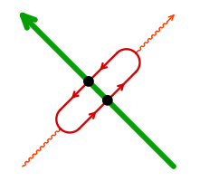


Inclusive DIS: dipole evolution

Slide 40
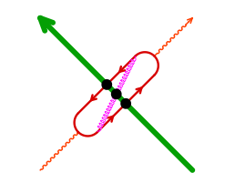
Inclusive DIS: dipole evolution
B-JIMWLK eqn. for dipole correlator
Dipole factorization:
N_{c} ➔ ∞
Resulting closed form eqn. is the Balitsky-Kovchegov eqn.
Widely used in phenomenological applications

Slide 41
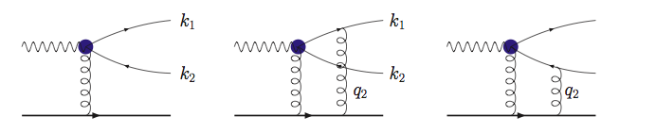


Semi-inclusive DIS: quadrupole evolution
Dominguez,Marquet,Xiao,Yuan (2011)
Cannot be further simplified a priori
even in the large N_{c} limit

Slide 42
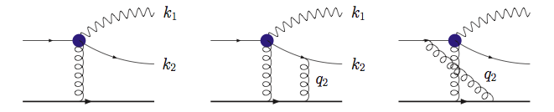
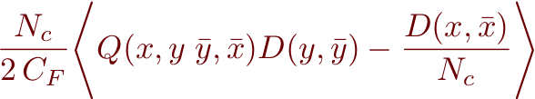
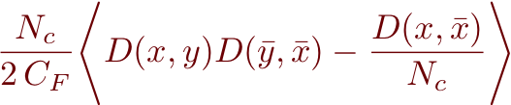
Universality: Di-jets in p/d-A collisions
Jalilian-Marian, Kovchegov (2004)
Marquet (2007)
Dominguez,Marquet,Xiao,Yuan (2011)
Fundamental ingredients are the universal dipoles and quadrupoles
For finite N_{c}, anticipate higher multipole contributions

Slide 43
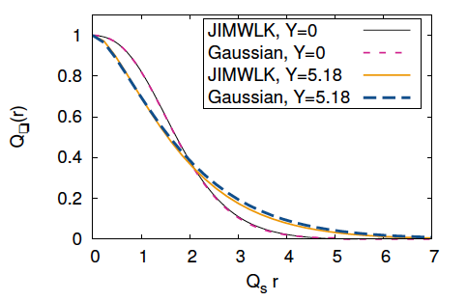
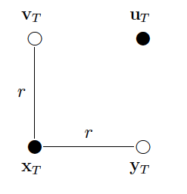
Gaussian approximation to JIMWLK
Dumitru,Jalilian-Marian,Lappi,Schenke,RV

Slide 44
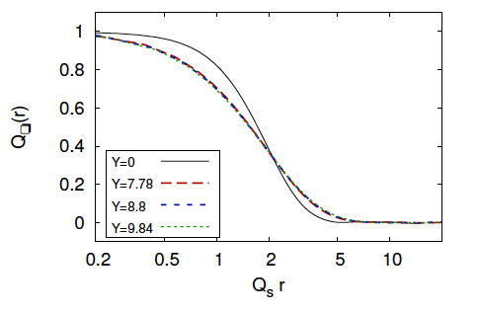

Gaussian approximation to JIMWLK
Dumitru,Jalilian-Marian,Lappi,Schenke,RV
Geometrical scaling
RG evolution of multipole correlators

