Slide 1

EAF: No-one said it was going to be easy
Kevern Cochrane

Slide 2
EAF – time to drop the term?????????????
1972
1982
1992
1995
2001
2006
UNCLOS
UN Convention on the Law of the Sea
UN Fish Stock Agreement
UNICPOLOS
Ecosystem Approach to Fisheries
UNCED
Jakarta Mandate
UN Conference on the Human Environment
UN Conference on Environment and Development
Malawi Principles
WSSD
Rio Declaration
CBD
Agenda 21 (Chapter 17)
FAO
Cancùn Declaration
Code of Conduct for Responsible Fisheries
Reykjavik Declaration

Slide 3
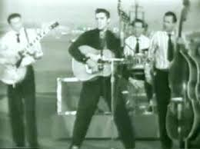
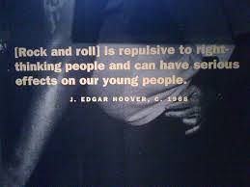


Rock ‘n Roll!
Whatever adults don't understand, because they didn't grow up with it, is the thing they're going to be afraid of and try to legislate out of existence. It happened with videogames, it happened with television, it happened with pinball parlours and rock and roll.
Warren Spector
“Rock & Roll Called ‘Communicable Disease,’
Rock and roll “impels teenagers to wear ‘ducktail’ haircuts, wear zoot suits and carry on boisterously at rock & roll affairs.”

Slide 4
South Africa to go it alone?
NMFS - USA | NOAA's Integrated Ecosystem Assessment Program – ‘EBM provides a bedrock principle for a new National Ocean Policy, established in 2010’
New England Fisheries Management Council | The Scientific and Statistical Committee – ‘considers the larger aspects of the ‘spirit of the act’ (e.g., ecosystem-based fishery management, socio-economic benefits ….’
ICES (Strategic Plan 2014-2018) | The ICES Strategic Plan commits to building a foundation of science around one key challenge; integrated ecosystem understanding….. This will provide the integrated information and advice that decision-makers need.
ICCAT – Sub-Committee on Ecosystems. | ‘… Sub-Committee on Ecosystems …. will serve as the scientific cornerstone in support of an Ecosystem Approach to Fisheries (EAF) in ICCAT. Strategic Plan 2015-2020 - Advance Ecosystem Based Fishery Management Advice
CCAMLR | ‘Being responsible for the conservation of Antarctic marine ecosystems, CCAMLR practises an ecosystem-based management approach.’
Marine Stewardship Council (MSC) | ‘We offer the world’s only wild-capture seafood certification and ecolabelling program that is consistent with .. [FAO] Code of Conduct for Responsible Fishing… {FAO] Guidelines for Ecolabelling’ – requires implementation of EAF
South Africa – FRAP 2015 + SSFP | Both recognize that EAF is central to the fisheries management system.

Slide 5
Driving the need for EAF: population growth

Slide 6
Number of decked fishing vessels in the world fleet
(Garcia and Grainger 2005)

Slide 7
World Capture Fisheries Production 1950-2012

Slide 8
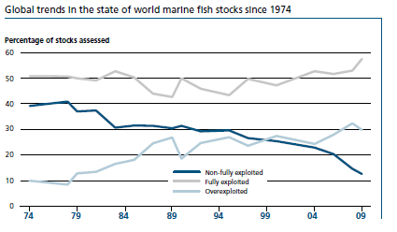
A key driver: estimated status of world stocks (FAO, SOFIA 2012)

Slide 9
Concept development. Why EAF?
Concerns over status of target and associated fish stocks and ecosystems
Increasing awareness of the importance of the interactions among fishery resources and between fishery resources and the ecosystem
Recognition of a wide range of societal interests in marine ecosystems
Advances in science (environmental effects on fishery resources and effects of fishing on non-target species and habitats, food-chain effects and biodiversity)

Slide 10
What is an ecosystem approach (NOAA)?
Ecosystem approaches to management use integrated approaches to study and manage the resources of an entire ecosystem. This approach considers the cumulative impacts from various sources and the balance of conflicting uses. Using an ecosystem approach to manage aquatic resources, including fisheries, includes multiple factors such as pollution, coastal development, harvest pressure, predator/prey and other ecological interactions, and watershed management.

Slide 11
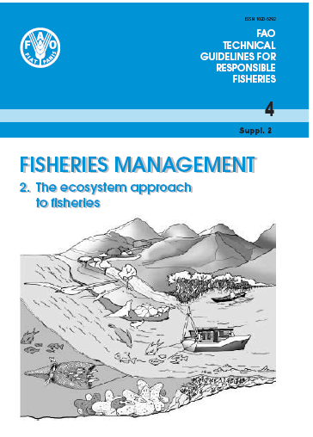
EAF is neither inconsistent with, nor a replacement for, current fisheries management approaches. Rigorously applying [single-species] approaches (with appropriate emphasis on the precautionary approach and rights-based allocation) would begin to help solve some of the current fisheries problems….. Thus, in practice, EAF in the foreseeable future is likely to be developed as an incremental extension of current fisheries management practices. (FAO EAF Guidelines, 2003)

Slide 12
An ecosystem approach is implicit in the South African constitution
24. Environment.-Everyone has the right-
(a) to an environment that is not harmful to their health or well-being; and
(b) to have the environment protected, for the benefit of present and future generations, through reasonable legislative and other measures that-
  (i) prevent pollution and ecological degradation;
  (ii) promote conservation; and
  (iii) secure ecologically sustainable development and use of natural resources
  while promoting justifiable economic and social development.

Slide 13
EAF in South Africa: the real issues
Population of South Africa (mid-year 2015) | 54.96 million
Population growth rate | 1.65% (900 000 per year)
Unemployment rate – 3rd Qtr 2015 | 25.5%
No of people living below the poverty line (R779/ person/month) | 27 million
Annual GDP growth | 1%

Slide 14
The issues: status of the South African Marine Fishery Resources 2014.

Slide 15
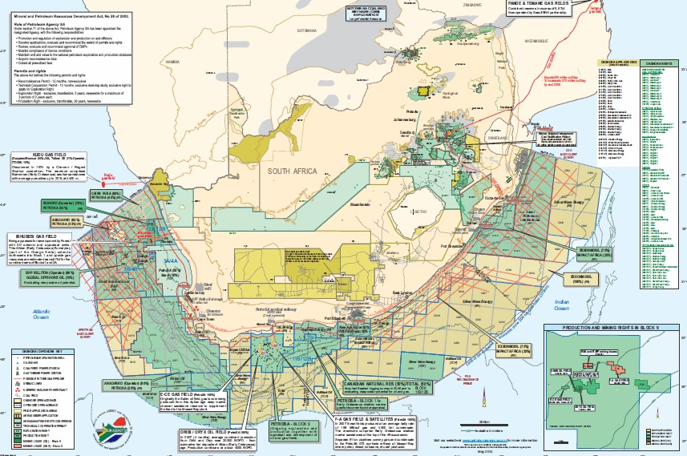
Petroleum Exploration and Production Activities in South Africa (SAOGA).

Slide 16
Some of key issues to be addressed
Optimising the role of fisheries in alleviation of poverty in coastal communities and cities (including implementation of SSFP, FRAP etc);
Recovery of over-exploited and depleted resources (inshore resources in worst state);
Conservation of biodiversity, ensuring health of top predators (sea birds, chondrichthyans, ..);
Coastal zone development: impacts on water quality, inshore habitats, status of estuaries (impact of pollution heavy metals on export dogfish from SA to EU);
Extent and impacts of illegal fishing, particularly on inshore resources;
Maintaining the social and economic contributions, and global competiveness, of commercial fisheries;
Managing the likely growth of coastal and offshore mining, gas and oil extraction to minimise impacts on fisheries;
Serious limitations in science and management capacity for fisheries and ocean governance;
………..

Slide 17
Single-species silos
Demer-sal fishery
Mining, oil, gas
Small pelagic
fishery
Bio-diversity - ecosystem functioning
Mid-water trawl fishery
Coastal zone develop-ment
Inshore line-fishery
Coastal poverty reduction

Slide 18
EAF and EA - Recognising and incorporating the interactions
Demer-sal fishery
Mining, oil, gas
Small pelagic
fishery
Bio-diversity - ecosystem functioning
Mid-water trawl fishery
Coastal zone develop-ment
Inshore line-fishery
Coastal poverty reduction

Slide 19
Conclusions
The controversies and complexities that frustrate managers and scientists are nothing to do with the term EAF;
They are an inevitable result of the near impossible task of trying to use scarce resources in a sustainable and equitable manner in a grossly unequal and complex society;
Quibbling about the term EAF is a wasteful distraction. EAF is underway and here to stay – implemented properly it provides a framework to identify and address the real issues in fisheries across all dimensions;
Addressing the key issues will require the skills and methods of conventional single-species assessment and management but also much more, with additional players and diverse scientific methods both quantitative and non-quantitative;
The fundamental constraint at present is lack of clear leadership from government authorities. Scientists could help to promote and encourage such leadership by speaking with a more consistent and integrated voice rather than adding to the confusion with contradictory and fragmented opinions.

Slide 20
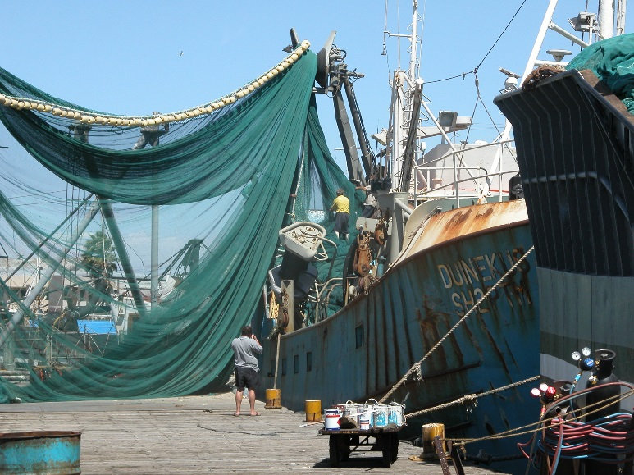

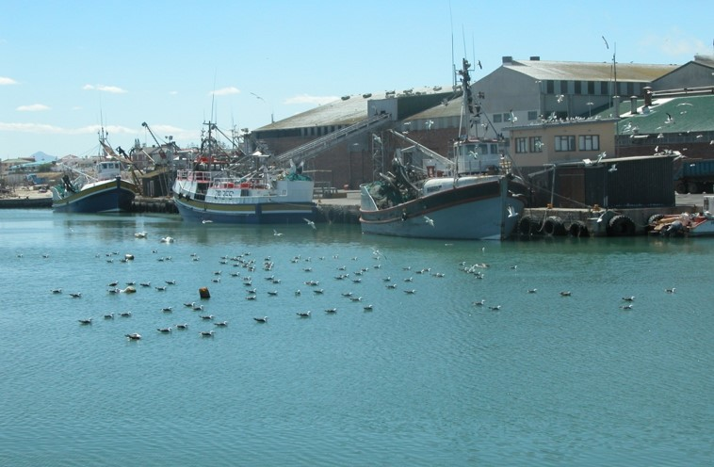



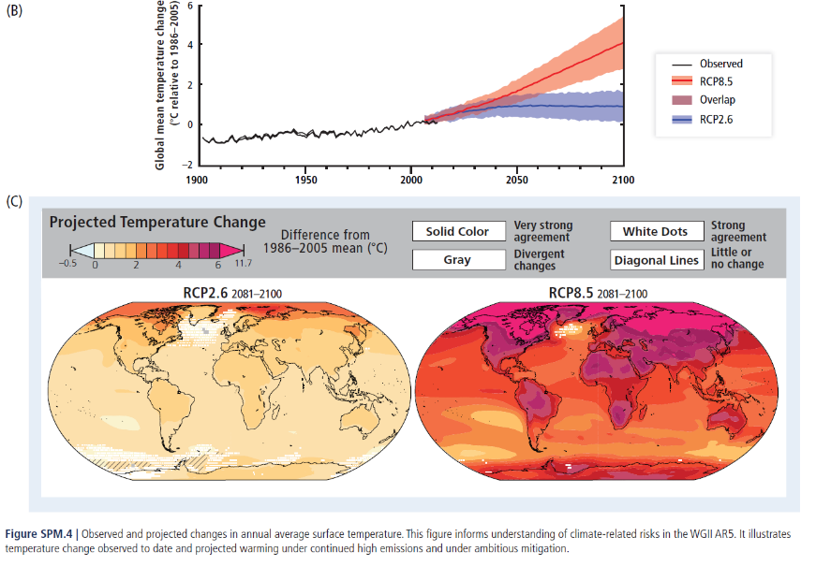
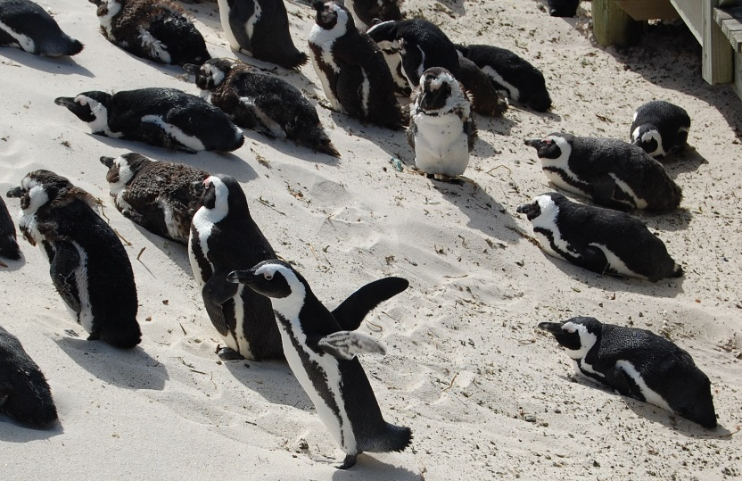
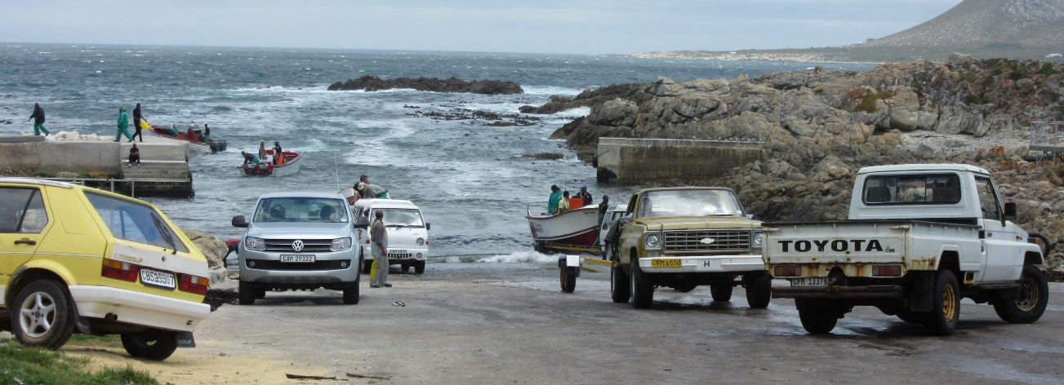

EAF IS HERE TO STAY

