Slide 1
Opportunity based model component of “The economic impact of penguin island closures on the pelagic fishing industry”

Slide 2
Original approach – Whether fishing adjacent to penguin protection areas is more expensive (lower catch rate)
Additional approach: Whether closures reduce the volume of anchovy and related species that are caught
Fishing opportunities limited in time and space:
West coast anchovy recruits move down the coast in pulses.
Periodic weather events disrupt the pattern of aggregation of anchovy.
Following strong upwelling it takes time for phytoplankton growth and secondary zooplankton growth to reach a point where anchovy are able to feed near the surface.
Additional factors are constraints on processing capacity and the need to get product to factories within < 30 hours to maintain quality.
Opportunity based model – review historical fishing records on a set by set basis and determine what would have happened with penguin protection area closures

Slide 3
Categorisation of alternative opportunities: Adj, Adj2, Other Island, Gansbaai, St Helena Bay, Extra Grids
Dassen Island

Slide 4
Robben Island

Slide 5
OBM Approach
For the i-th set a determination is made whether it occurs in an intersecting grid or not.
If the i-th set lies within an intersecting grid, then a random selection is made as to whether it lies inside the penguin closure area or outside the penguin closure area. This is based on the proportion of area for that grid which is inside / outside the penguin protection area.
A search is carried out to determine the existence of viable alternative opportunities, at a given point in the search hierarchy. The search hierarchy is Other Island, Adj, Adj2, Gansbaai, St Helena Bay, Extra. These alternative opportunities are unique to each grid, and may therefore include intersecting grids in the case of the Adj and Adj2 level of the hierarchy.
If a viable opportunity exists at a particular level of the hierarchy, further searches at later levels in the hierarchy are not carried out.
If an alternative opportunity exists which is itself within in an intersecting grid, a random selection process is carried out to determine if that opportunity is viable, i.e. lies outside the penguin protection area. This random selection process is based on the proportion of area for that grid which is inside / outside the penguin protection area.
Opportunities are average standardised catches at a day and grid level.
Finally (a) the replacement opportunity is randomly selected from the finalised set of viable opportunities, (b) the replacement catch is constrained to not exceed the catch that is being replaced, and (c) the replacement catch is corrected for (multiplied by) the boat factor for the vessel in question.

Slide 6
Process
Interim Presentation to PWG
Query “Alternative Opportunities”.
Final Report to PWG: mid –October.
  Feedback
  1. Reduce vessels
  2. Increase survey days
  3. Increase Opportunities
  4. Editorial Minor
  4. Editorial Moderate
  5. GLM Analyses
  7. Revise Economics
  8. Resolve Grids / Duplicates

Slide 7
Results of Resolving Duplicates
More catch on the West Coast
More catch in penguin protection areas
A smaller % of the above is unreplaceable (from 50% to 40%)

Slide 8
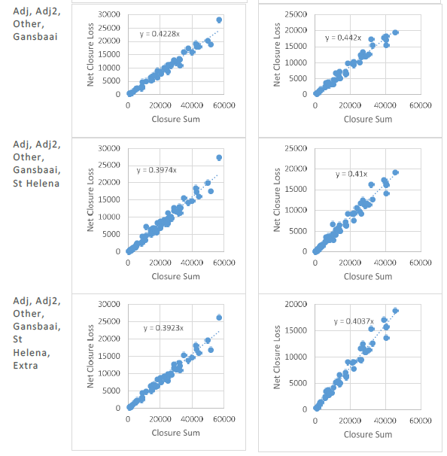
Additional Opportunities

Slide 9
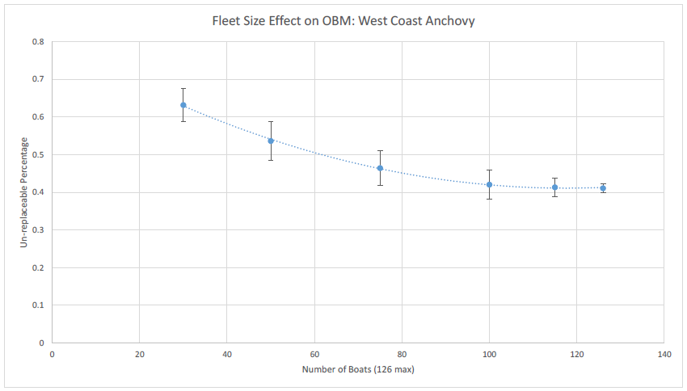
Fleet reduction (% of vessels, 1987 – 2014)

Slide 10
Fleet reduction (% of sets, 1997 – 2007)

Slide 11
Limiting tendency for fleet reduction

Slide 12
Limiting tendency for fleet reduction

