Slide 1
PROGRESS IN THE SIMULATION TESTING OF PENGUIN CLOSURE EFFECT RESPONSE
An Introduction

Slide 2
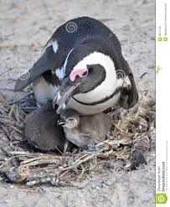
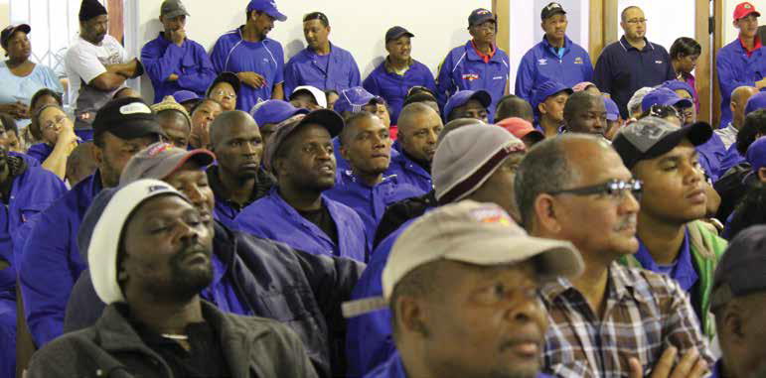
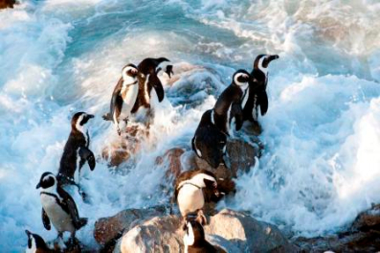
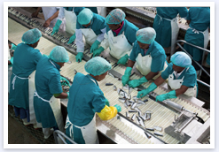
Task Team Members
Mike Bergh
Doug Butterworth
Kevern Cochrane (chair)
Taryn Morris
Richard Sherley
Henning Winker
Thanks to Andrea Ross-Gillespie
The key stakeholders

Slide 3
Mandate of the Task team
To address the recommendations from the 2014 Panel:
  A1. (H). That simulations to evaluate bias in estimation methods be explored, which are conditional of the types of scenarios reflected in MARAM/IWS/DEC14/Peng/A10
  A.2 (H) Various elaborate models have been applied to test the effect of fishing on penguin demographics. More elementary analyses directly aimed at evaluating the questions and statistical power should be applied…

Slide 4
Penguin Response Data Available
Fledgling success
Chick growth rates
Active and potential nests
Foraging path length
Foraging trip direction
Chick condition
To date TT has made use of aggregated data only. See MARAM/IWS/DEC15/PengD/P4 for suggestions on how individual data could be used in the future.

Slide 5
MARAM/IWS/DEC15/PengD/P1. Specifications for operating models to evaluate bias in estimation methods in accordance with recommendation A.1 of the 2014 International Review Panel
Two approaches for operating models:
Sub-regional biomass surrogate approach:
  α_{y} = year effect reflecting the pelagic fish biomass present in the sub-region
  F = penguin response variable
  λ = effect of catches
  δ = effect of closures
Regional biomass approach:
  B_{y} = biomass within the wider region including both islands

Slide 6
Other comments on MARAM/IWS/DEC15/PengD/P1
Considers both closure (δ) and catch (λ) as covariates, instead of one or the other.
Includes an adjustment to the residual error formulation to be able to take small sample size into account (equation (2)).
Approach to incorporate the correlation between catch taken close to islands and local abundance described on pgs 3-4 of the document.
Recommendation from 2014 Panel that autocorrelation in residuals of pseudo-data needed to be taken into account addressed by Eq. (8).

Slide 7
MARAM/IWS/DEC15/PengD/P2. Consolidated analyses produced in implementation of the approaches described in document P1
1: Some initial results for the penguin simulation conditioning process
2: Penguin process vs observation error
3: Generating pseudo data – evaluating correlation for all years in which catch and biomass are available
4: Generating pseudo data – some initial results
5: A problem detected with the biomass surrogate approach
6: Possible further penguin analyses
7: Evaluating “small-sample-size” bias
8: Further runs for simulating pseudo data as recommended in Section 6
9: Testing a simple estimator

Slide 8
MARAM/IWS/DEC15/PengD/P3. Penguin power analysis methodology - draft
Describes extension of the methodology of P1 to generate pseudo-data to allow the estimation power of an island closure experiment to be evaluated.
Addresses proposal for specification of effect size and biological basis for setting a minimum threshold for effect size.
Presents the results of four examples of applying the process.

Slide 9
MARAM/IWS/DEC15/PengD/P4. Simulation testing of penguin closure effect response estimators – where next?
Bias estimates required for use in adjusting estimates of penguin closure response parameters. Document P4 sets out the issues arising in addressing bias estimation in moving forward on basis of P1 (issues reported in P2).
Choices cover e.g. methods of estimation, methods for generating data for simulations and interpretation of the results (particularly where large number of plausible scenarios to consider, each with different estimates of bias).
Addresses:
  1) Options for scenario specification (e.g. response variables, conditioning and estimation models, which fish species to consider, areas for defining catches, etc)
  2) Data to be used
  3) Conditioning issues
  4) Issues related to generating pseudo-data for simulation testing
  5) Procedure for adjusting initial estimates for bias
  6) Aggregating results
TT requests that the Panel considers document point by point, plus any related aspects the Panel may raise, and advise on choices.

