Slide 1
INTERNATIONAL REVIEW PANEL REPORT FOR THE 2015
INTERNATIONAL FISHERIES STOCK ASSESSMENT WORKSHOP
30 November - 4 December 2015, UCT
NON TECHNICAL SUMMARY

Slide 2





The Panel
Alistair Dunn, NIWA, New Zealand
Malcolm Haddon, CSIRO, Australia
Ana Parma Cenpat, Argentina
André Punt, UW, USA
Expertise in quantitative fishery science, stock assessment, ecosystem modelling, and statistical analysis of data

Slide 3
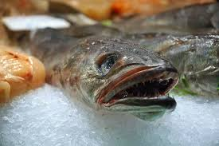
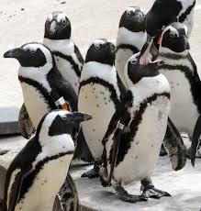


With Special Guest Stars

Slide 4
Focus of the review
African Penguins-I
  Review progress related to the detection of area closure effects on penguins
  Provide guidance on how finalize this process
African Penguins-II
  Review the Opportunity Based Model (OBM)
Hake
  Review progress related to accounting for predation within the hake assessment and provide guidance for next steps
Sardine
  Review progress on the development of a two-stock assessment model for South African sardine

Slide 5
Overall Comments
As in previous reviews, the Panel was highly impressed with the quality of information presented.
The collaboration between university, industry, eNGO, and government researchers was impressive, with all items reviewed involving some form of collaborative work.
There were fewer documents this year, which meant the Panel was able to delve more deeply into key technical aspects.
The Panel would have benefited from “fishery descriptions” to assist new panel members get up to speed.

Slide 6
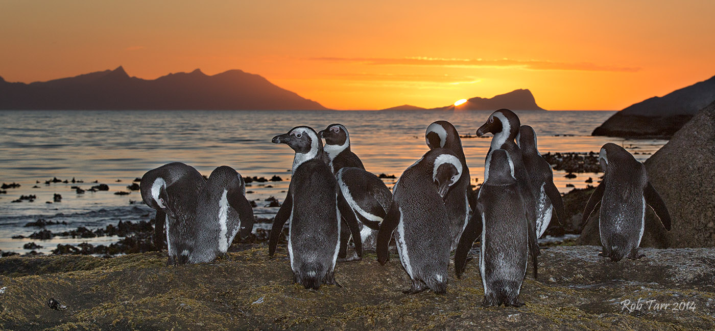
African Penguins
Robben Island

Slide 7
Background
 | Dassen | Robben | St Croix | Bird
2008 | X
2009 | X |  | X
2010 |  |  | X
2011 |  | X | X
2012 |  | X |  | X
2013 |  | X |  | X
2014 | X |  |  | X
2015 | X |  | X
2016 | X |  | X
2017 |  | X | X
2018 |  | X |  | X
2019 |  | X |  | X
2020 | X |  |  | X
2021 | X |  | X
2022 | X |  | X
2023 |  | X | X
2024 |  | X |  | X
2025 |  | X |  | X
2026 | X |  |  | X
2027 | X |  | X
2028 | X |  | X
2029 |  | X | X
2030 |  | X |  | X
2031 |  | X |  | X
2032 | X |  |  | X
Years(T) | 25 | 25 | 25 | 25
Closures | 12 | 12 | 12 | 12
(T from 2009) |  |  | 24 | 24
The objectives from the 2010 Panel report were “to maximize the probability of determining whether pelagic fishing near colonies has an impact on penguins”

Slide 8
Monitoring the penguin populations
Response variables
Fledgling Success
Chick growth rates
Active and potential nests
Forage path length
Forage trip duration
Chick condition
Of these response variables:
Fledgling success is directly related to reproductive rate
The rest are indirect measures

Slide 9
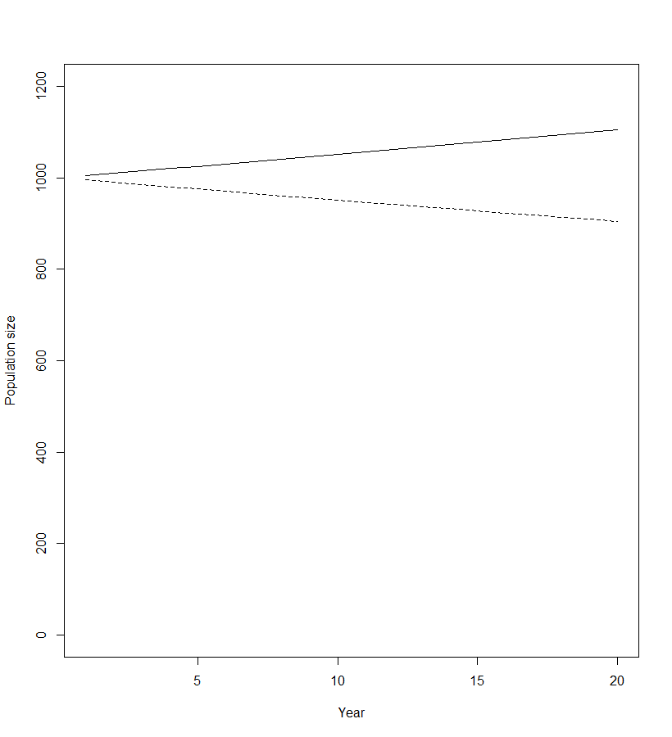
Effect Size
For each response variable being measured, what change in the variable corresponds to an x% change in the reproductive rate for penguins. This is the minimum effect size we are interested in.
We wish to see if the data can detect whether the change in the response variable is at least the minimum effect size. If so, we can conclude there is an (important) fishery effect.
Note: there may be some response variables for which a minimum effect size cannot be determined – such response variables should be ignored for the purposes of this work (but may be important in understanding penguin population dynamics).
Note: the impact on reproductive rate may not be the only or most important factor impact penguins.
A 10% change in (say) fledgling success
corresponds to a 1% in population growth rate

Slide 10
Key note!
Note of the indicators are exact measures of population change because even if fledgling success is increasing, the population may be collapsing because the number of nests is declining faster than the increase in fledgling success
Thus the Panel reiterates its recommendation from last year:
“Develop and implement a comprehensive research program that aims to identify the core reasons for the reduction in penguin population numbers, and identify any potential mitigation measures.”

Slide 11

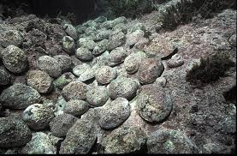
Power
We want “statistical” power

Slide 12
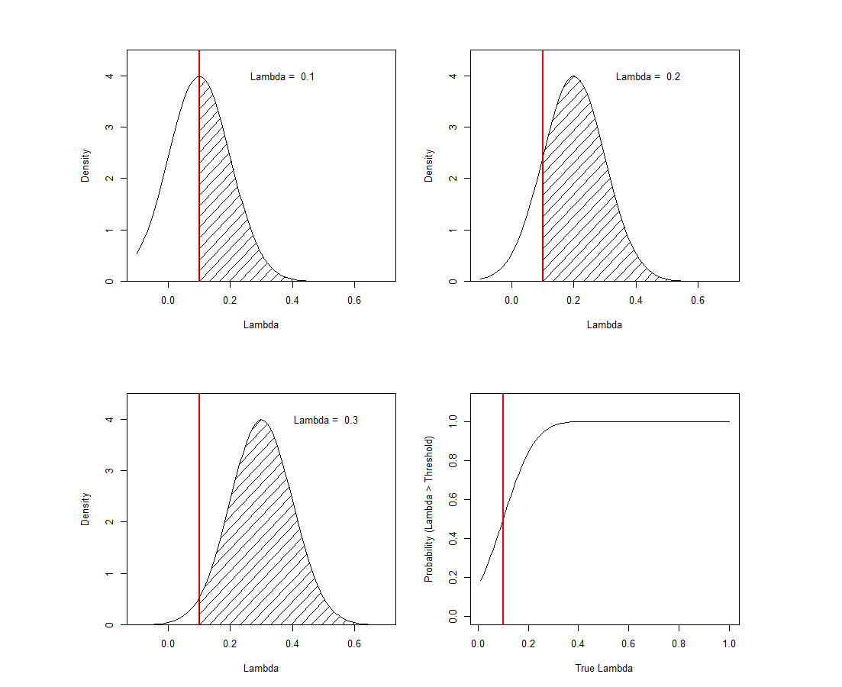
“Illustrative example”
If the threshold is 0.1 and the true λ is 0.1, 0.2,
and 0.3.
If the estimate is the unbiased but variable what estimates could we get?

Slide 13
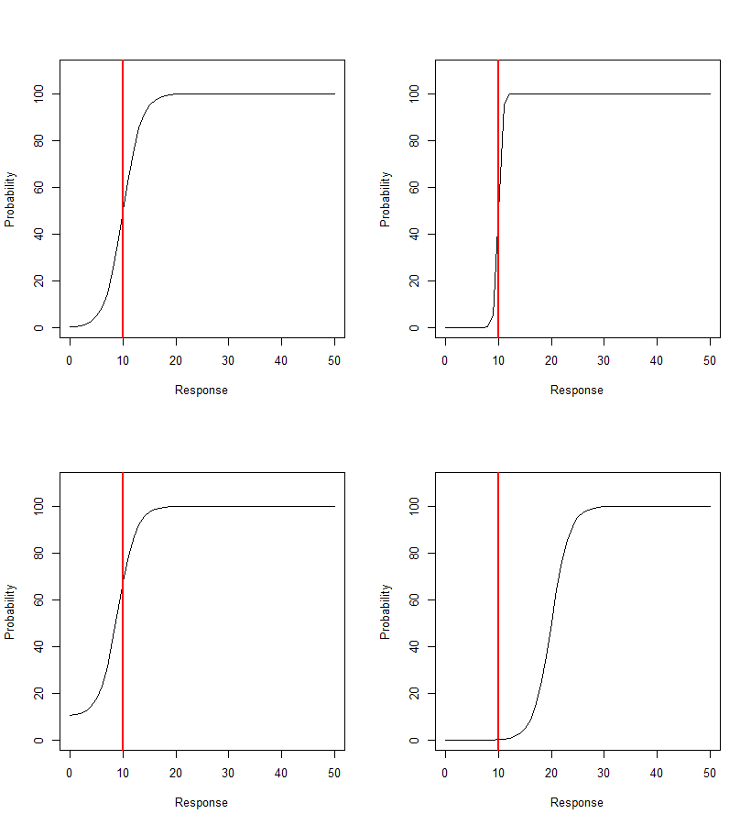
Statistical Power – a primer
Lets say we wish to detect if X > 10%. We can define a function H(Data) such that:
H(Data) = 0 if X ≤ 10%
H(Data) = 1 if X > 10%
But the data are noisy so
H(Data) may indicate 1 even if X ≤ 10% (high Type I error)
H(Data) may indicate 0 even if X > 10% (high Type II error or low “power”)
We need to check for Type I and Type II error

Slide 14
Issues for Penguins
Does fishing impact penguins in a biologically important way (island open vs closed or proportional to the catch)
  If catch, which species and how close to an island to matter??
  Does high catch mean depletion of biomass of presence of prey??
The Panel provided advice on these topics and several (even more) technical issues.

Slide 15
Lost catches (the OBM)
If you can’t fish of Robben Island, where do you go to?
Adjacent blocks
Next to adjacent blocks
Other island
St Helena bay
Given you fish a block what catch-rate do you get?

Slide 16
Panel recommendations
The original analysis made some assumptions that may lead to an over-estimation of the lost catch proportion
  Original 40.5%; revised base case range -3.24% to 23.09%
Refining the revised range will require a more detailed “fleet dynamics model” – developing this model will require additional modelling resources, additional data (e.g. tracks for individual vessels) and “on water” discussions.
Work should be undertaken to “validate” the model (does it really capture what fishers actually do).

Slide 17
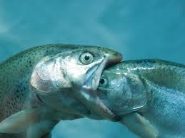

Hake
The current assessment model does not include the impact of changes over of time of hake biomass on predation rates:
M. capensis eats M. capensis
M. capensis eats M. paradoxus
M. paradoxus eats M. paradoxus

Slide 18
Panel Recommendations
Refine the approach used to compute the proportion of each hake species in eaten by each hake species (by prey size class)
Modify the model to allow small M. capensis to avoid M. paradoxus (the gape size for small M. capensis is big enough to consume small M. paradoxus, but they do not overlap spatially)

Slide 19
Sardine
Development of a two-stock model continues
Additional parasite data are available and have been used to refine the parasite loads for south coast fish

Slide 20

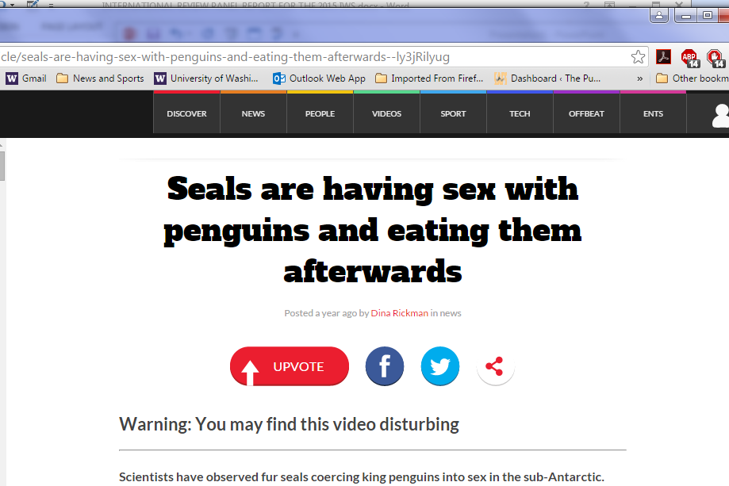
Questions?

Slide 21
Identify and review the response variables.
Select quantitative thresholds for the parameter (λ/ δ) for each response variable.
For each model in the reference set
  For a range (e.g. 3-5) of the parameter
  Condition the operating model
  For a set of simulations
    Simulate future data and add it to the actual data already available
    Compute the probability that λ exceeds the threshold (P_{i})
    If P_{i} larger than a control value (X ~ 0.5), consider the hypothesis that the parameter is larger than the threshold is supported
    Average the P_{i}s
  Plot the results from 3) and 4) vs the values for parameters
If there is “bias”, adjust the control variable or the threshold at step 3), III), b)
  Default P(N > 0.5) over curves
Don’t forget to apply the above algorithm when the value of the parameter is LESS than the threshold.

