Slide 1
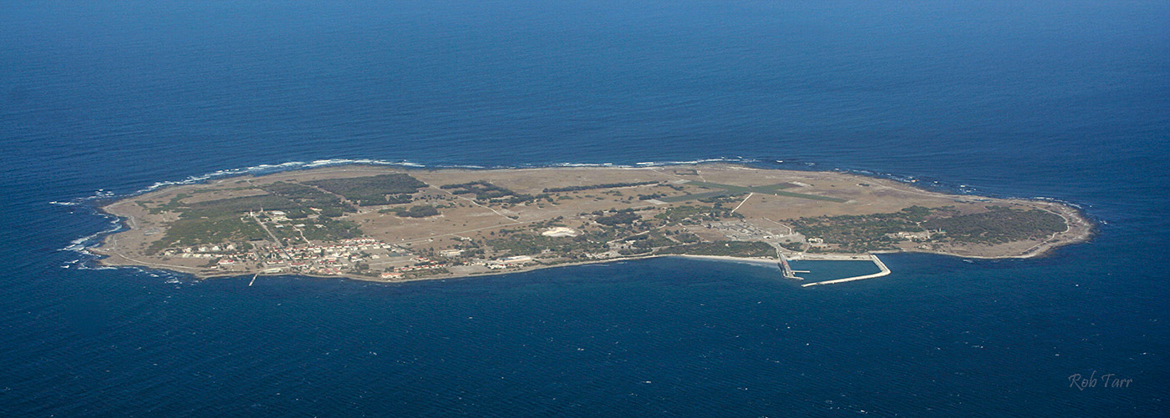
ISLAND CLOSURE FEASIBILITY STUDY
INTERNATIONAL STOCK ASSESSMENT REVIEW WORKSHOP,
CAPE TOWN, 1-5 DECEMBER 2014
Photos courtesy of Rob Tarr

Slide 2
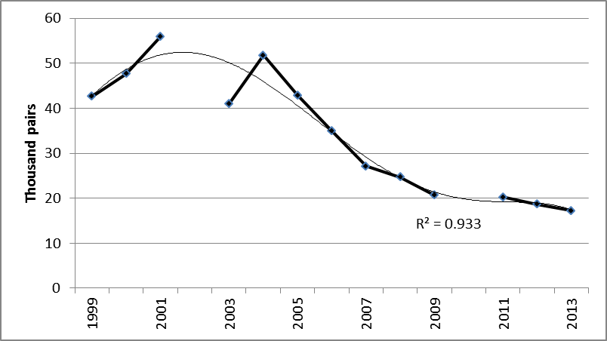
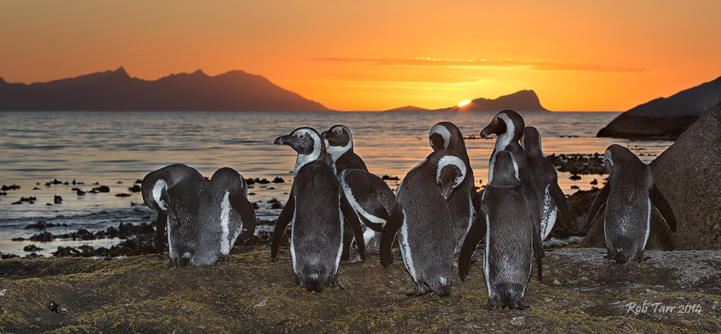
Whole coast
Makhado et al. 2014.
FISHERIES/2014/MAR/SWG-PEL/ICTT/9

Slide 3
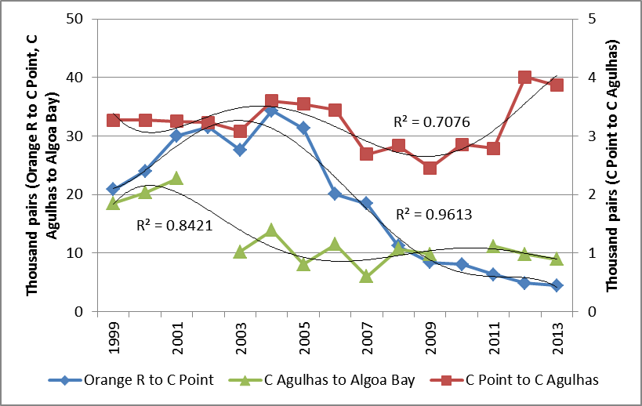
Coast-disaggregated
Makhado et al. 2014.
FISHERIES/2014/MAR/SWG-PEL/ICTT/9

Slide 4
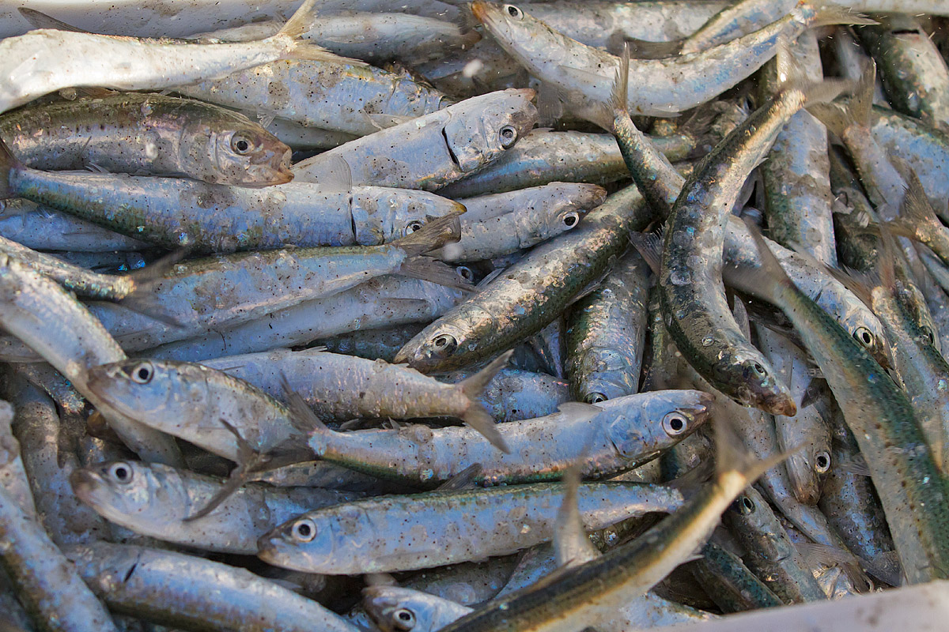
CONCERN:
That fishing around penguin breeding islands is a major contributor to declining penguin populations
ISLAND CLOSURE FEASIBILITY STUDY:
To determine whether an experimental closure programme could provide definitive conclusions regarding the impact of fishing close to penguin breeding islands on penguin
populations within a reasonable timeframe

Slide 5
ISLAND CLOSURES (X = closed) (as agreed at the 2010 stock assessment workshop)
Island | 2008 | 2009 | 2010 | 2011 | 2012 | 2013 | 2014
Dassen (West) | X | X |  |  |  |  | X
Robben (West) |  |  |  | X | X | X
St Croix (South) |  | X | X | X
Bird (South) |  |  |  |  | X | X | X

Slide 6
DIFFERING ANALYTICAL
TECHNIQUES AND
INTERPRETATIONS
=
ALTERNATIVE
CONCLUSIONS
WITHIN DAFF, DECISIONS ON FURTHER ISLAND CLOSURES NEED TO BE MADE BY MID DECEMBER
2014

Slide 7
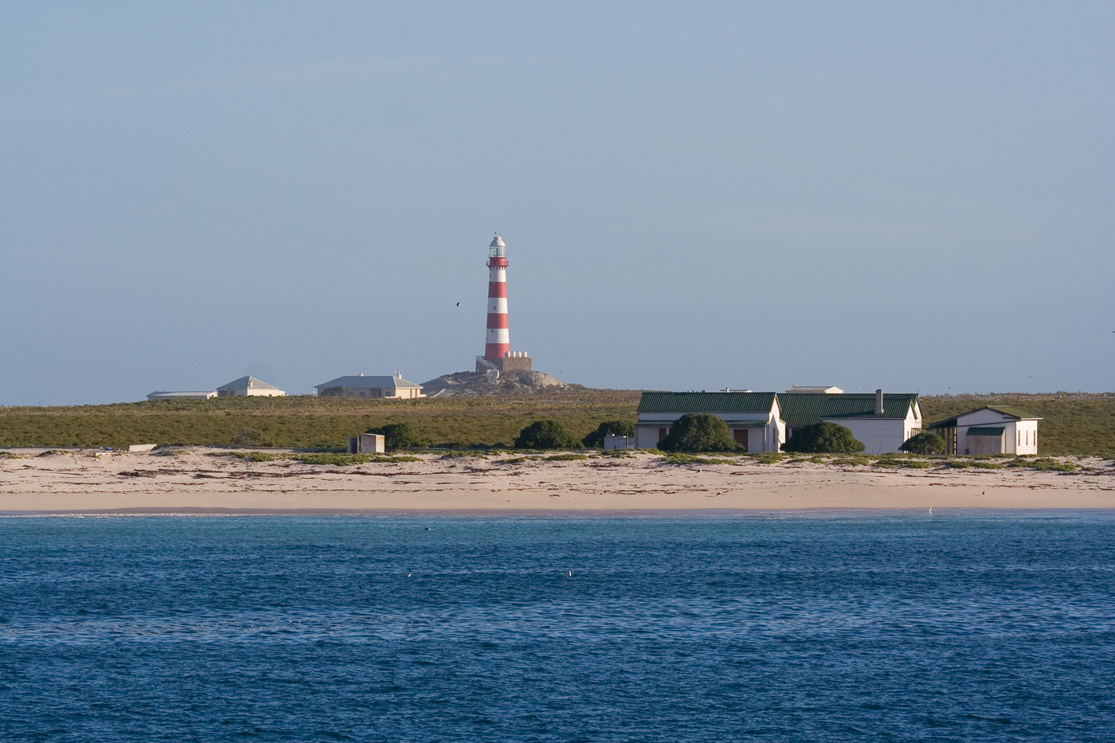
KEY QUESTIONS/ TERMS OF REFERENCE
1. Can the Island Closure Feasibility Study tell us whether an experimental closure programme could yield definitive conclusions regarding the impact of fishing close to penguin breeding islands on penguin populations?
If no:
2. Will further closures assist?
3. If so, what closure regime going forward would provide the answers?
4. What data and analyses would be most appropriate going forward?*
If yes:
5. Can it be used to draw conclusions re responses of penguin populations?
6. If no, what closure regime, data and analyses will assist in moving towards a conclusion?
7. If yes, what conclusions can be drawn from the existing data and analyses regarding the penguin response, and what additional analyses can help in determining the penguin response?*
8. If yes, is it advisable to proceed to a full- scale experiment?
* Further analyses suggested should provide definitive answers in the short term, taking account of the practical constraints of existing capacity, time and data availability

Slide 8
