Slide 1


ECOFISH WP1 WP2 Hake biology workshop
12 – 13 November 2014

Slide 2
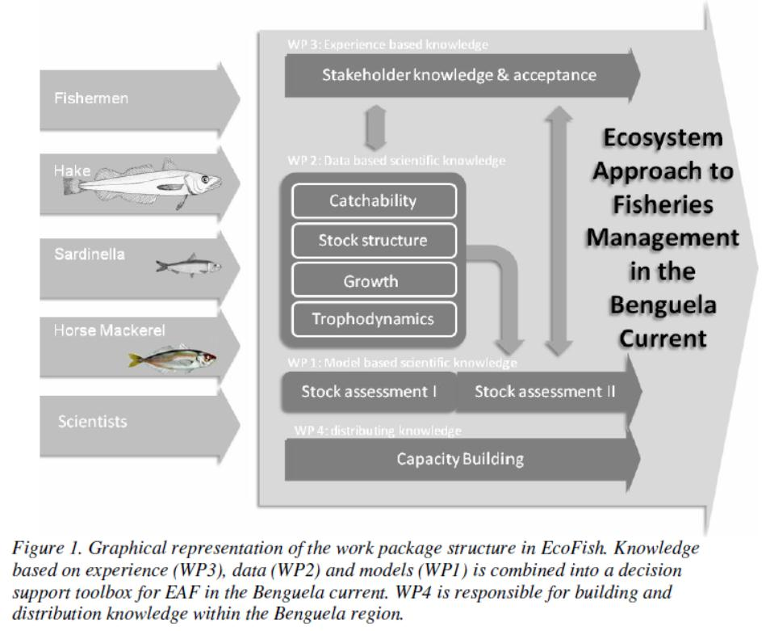

Slide 3
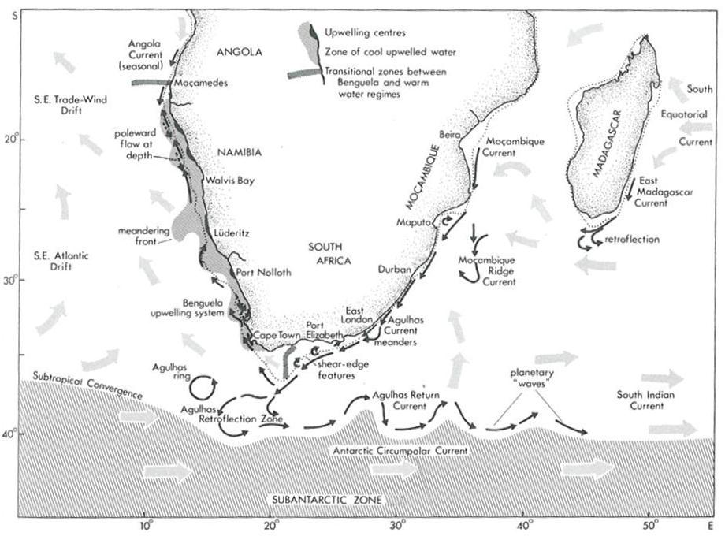

Slide 4
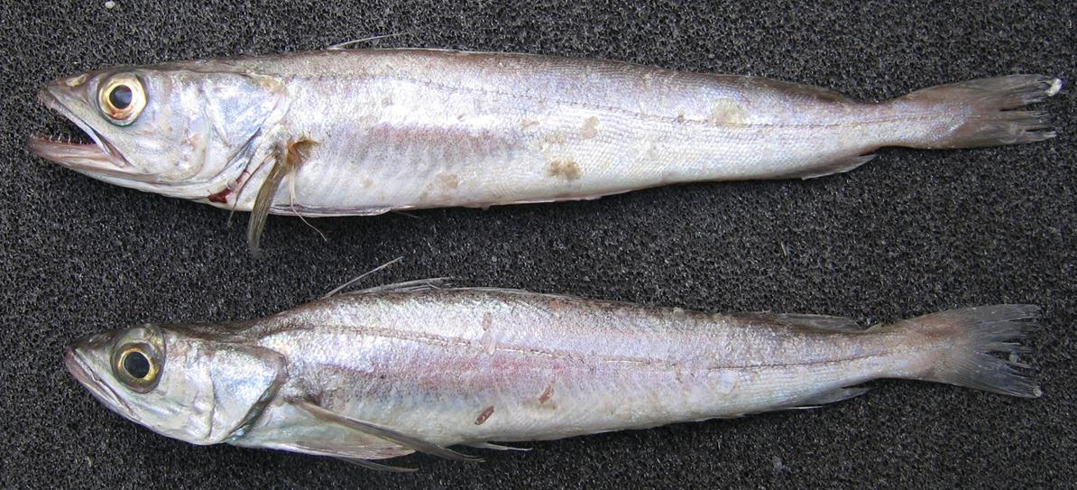
Notes:
Morphologically similar. Commercial catches don’t distinguish between species

Slide 5
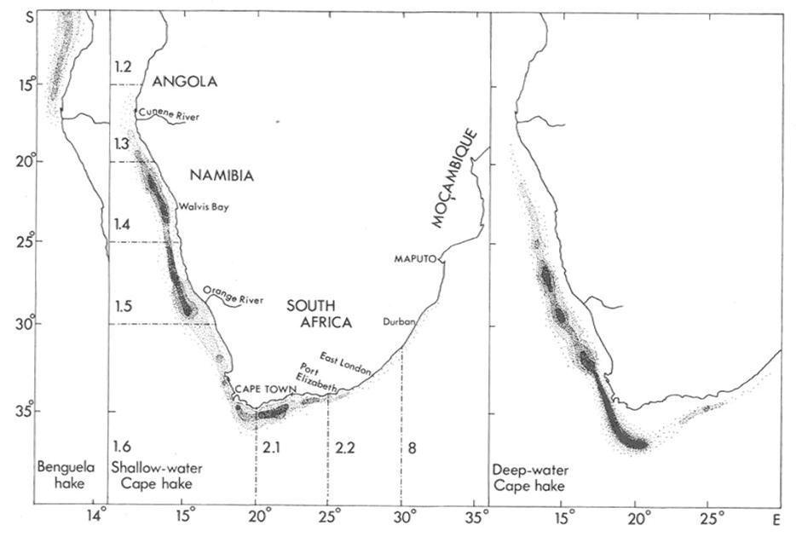
Notes:
HKC: S Angola – N KZN. 30 – 500m. Most of biomass 100 – 300m
HKP: N Namibia – S Mocambique. 110 m – 1000m. Most of biomass 200 - 800m
Both species: inc size with inc depth

Slide 6
DECEMBER 2013 IWS – Recommendation of the International Panel

Slide 7
2014 ECOFISH WP1 – WP2 WORKSHOPS
DATA/INFORMATION REVIEWED
Spatial patterns in survey derived densities/abundances at size/age
  GeoPOP (data from Namibian and SA surveys + BCC “transboundary” surveys
  Transboundary surveys (Nansen – Blue Sea)
  Genetics
  mDNA
  Microsatellites
  Parasites
  Reimer 1993
  Spawning patterns
  GSI
  Spatial patterns in age/growth
  Spatial patterns in commercial CPUE (Namibia)

Slide 8
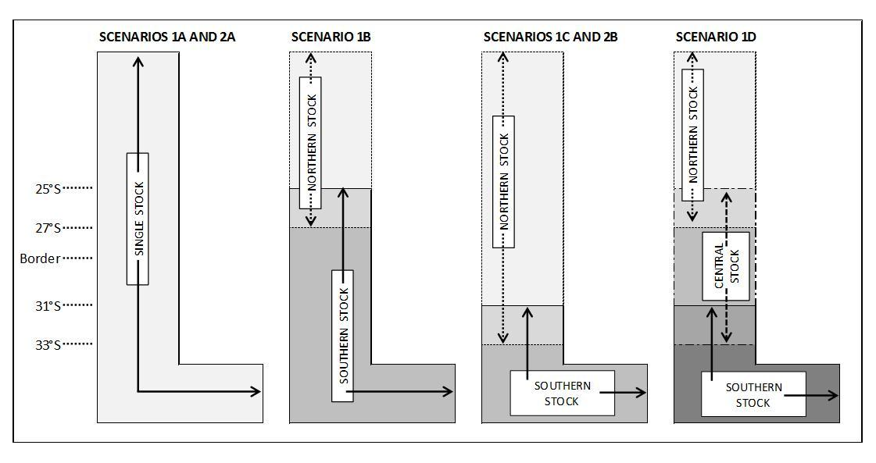
MARCH 2014 ECOFISH WP1 – WP2 WORKSHOP
STOCK STRUCTURE HYPOTHESES

Slide 9
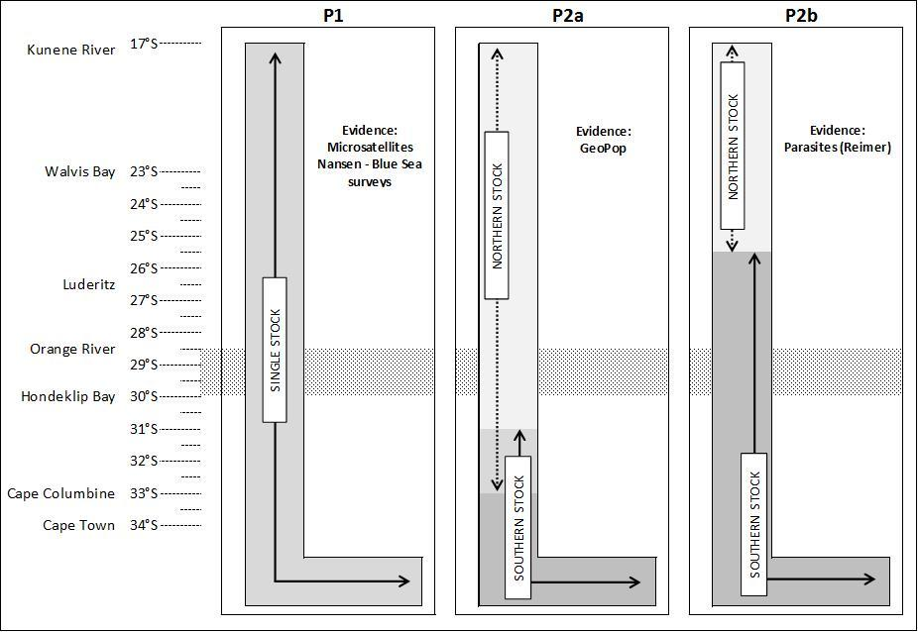
NOVEMBER 2014 ECOFISH WP1 – WP2 WORKSHOP
STOCK STRUCTURE HYPOTHESES Merluccius paradoxus

Slide 10
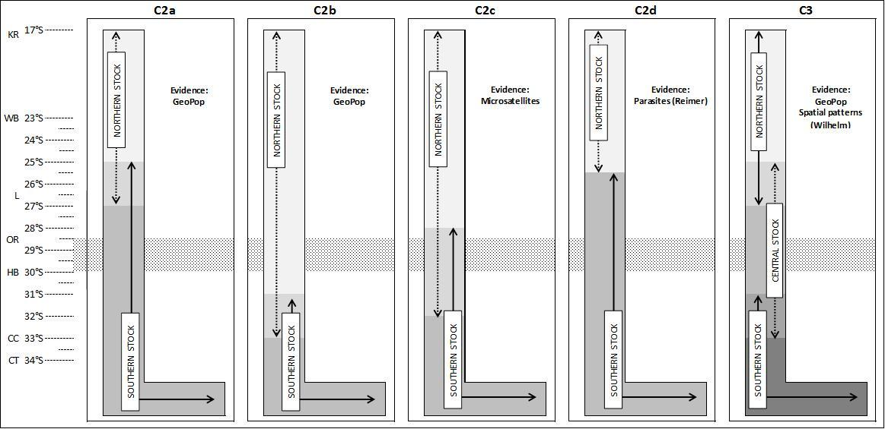
NOVEMBER 2014 ECOFISH WP1 – WP2 WORKSHOP
STOCK STRUCTURE HYPOTHESES Merluccius capensis

Slide 11
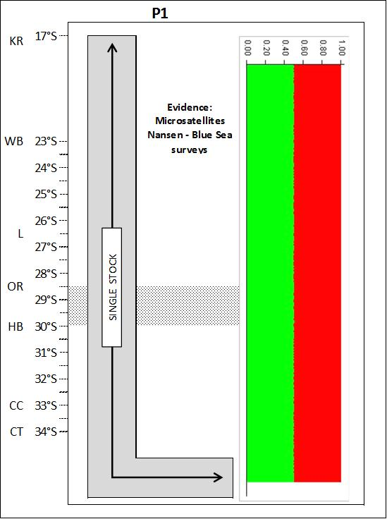
NOVEMBER 2014 ECOFISH WP1 – WP2 WORKSHOP
STOCK STRUCTURE HYPOTHESES Merluccius paradoxus

Slide 12
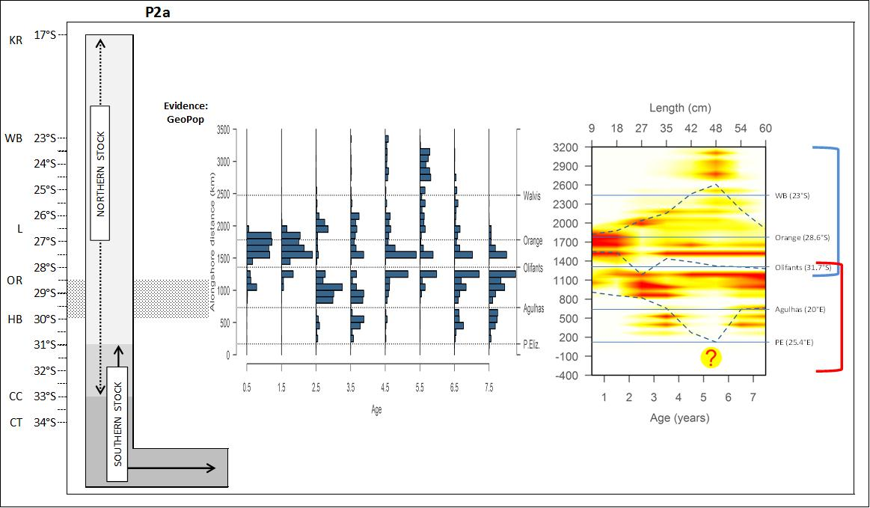
NOVEMBER 2014 ECOFISH WP1 – WP2 WORKSHOP
STOCK STRUCTURE HYPOTHESES Merluccius paradoxus

Slide 13
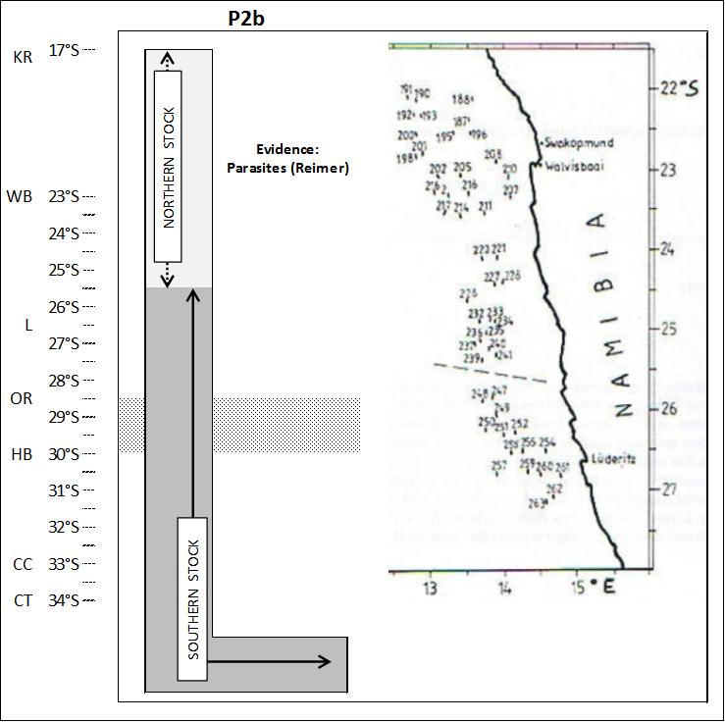
NOVEMBER 2014 ECOFISH WP1 – WP2 WORKSHOP
STOCK STRUCTURE HYPOTHESES Merluccius paradoxus

Slide 14
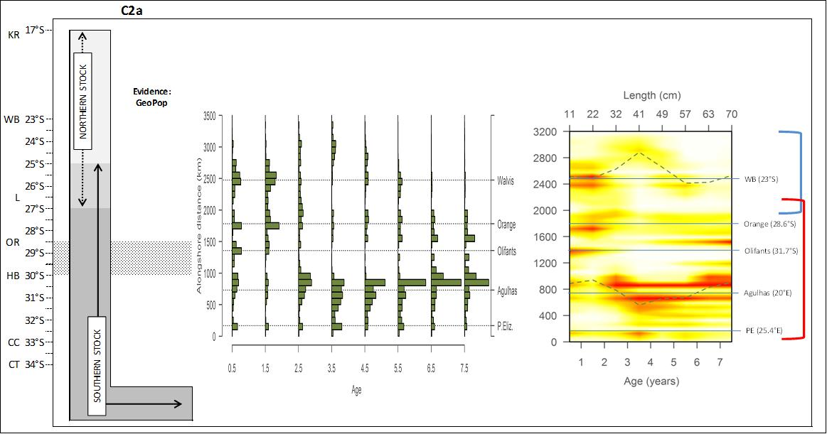
NOVEMBER 2014 ECOFISH WP1 – WP2 WORKSHOP
STOCK STRUCTURE HYPOTHESES Merluccius capensis

Slide 15
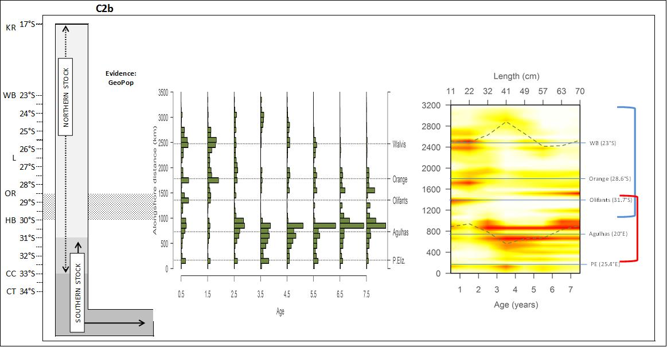
NOVEMBER 2014 ECOFISH WP1 – WP2 WORKSHOP
STOCK STRUCTURE HYPOTHESES Merluccius capensis

Slide 16
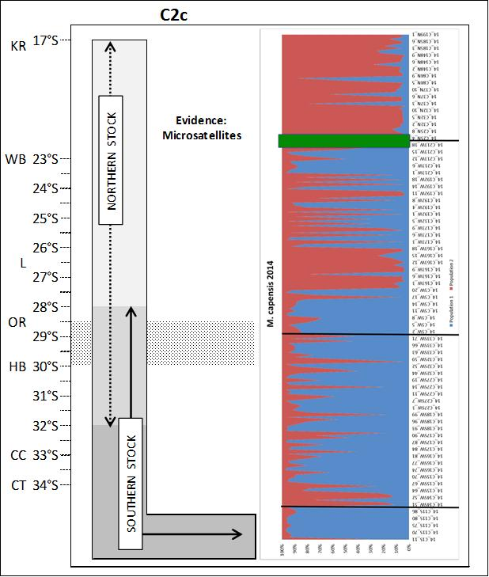
NOVEMBER 2014 ECOFISH WP1 – WP2 WORKSHOP
STOCK STRUCTURE HYPOTHESES Merluccius capensis

Slide 17
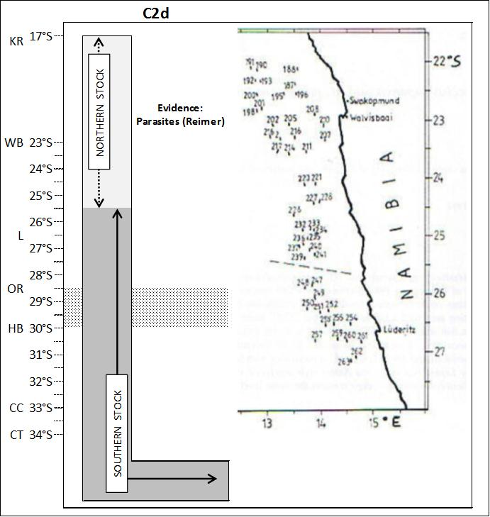
NOVEMBER 2014 ECOFISH WP1 – WP2 WORKSHOP
STOCK STRUCTURE HYPOTHESES Merluccius capensis

Slide 18
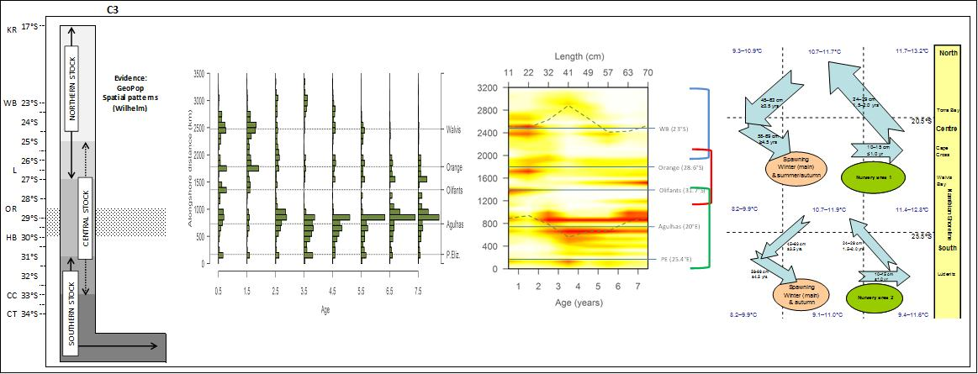
NOVEMBER 2014 ECOFISH WP1 – WP2 WORKSHOP
STOCK STRUCTURE HYPOTHESES Merluccius capensis

